Slide 2



I can smell…
next

Slide 3

I can smell a rose.
back

Slide 4

I can smell freshly baked bread.
back

Slide 5

I can smell stinky socks!
back

Slide 6
What can you smell?

Slide 7

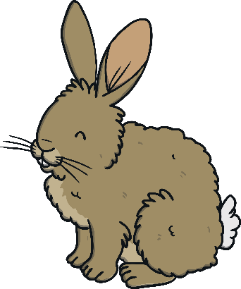

I can see…
next

Slide 8

I can see the moon shining in the night sky.
back

Slide 9

I can see a rabbit hopping around the fields.
back

Slide 10

I can see a boat floating on the water.
back

Slide 11
What can you see?

Slide 12



I can hear…
next

Slide 13

I can hear a bell ringing.
back

Slide 14

I can hear music playing loudly.
back

Slide 15
I can hear fireworks crashing and banging in the sky.
back

Slide 16
What can you hear?

Slide 17



I can touch…
next

Slide 18

I can touch a fluffy, soft cat.
back

Slide 19

I can touch crunchy, cold snow.
back

Slide 20

I can touch crumbling, brown soil.
back

Slide 21
What can you touch?

Slide 22



I can taste…
next

Slide 23

I can taste a delicious ice cream.
back

Slide 24

I can taste a sweet strawberry.
back

Slide 25

I can taste a sour lemon.
back

Slide 26
What can you taste?

Slide 27


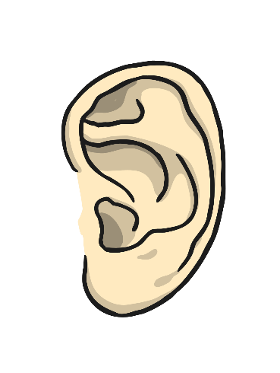


sight
taste
smell
hearing
touch

