Slide 2

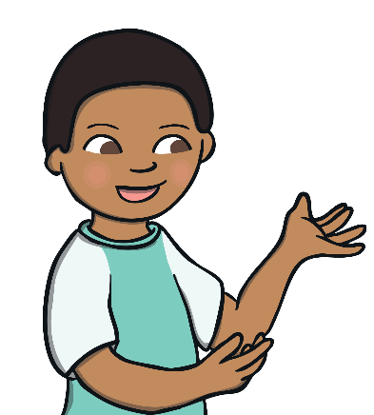
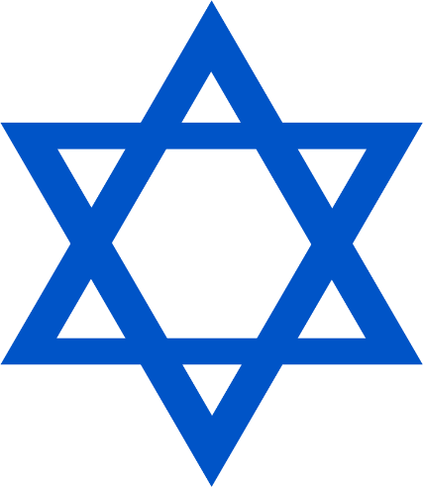
Harvest Festivals
Talk About It
What do you know about Harvest Festivals? Are there any harvest songs you like to sing?
Today, we are going to learn about Sukkot. Sukkot is a Harvest Festival celebrated by people who belong to the Jewish faith. This is the special Jewish sign. It is called a Star of David.

Slide 3

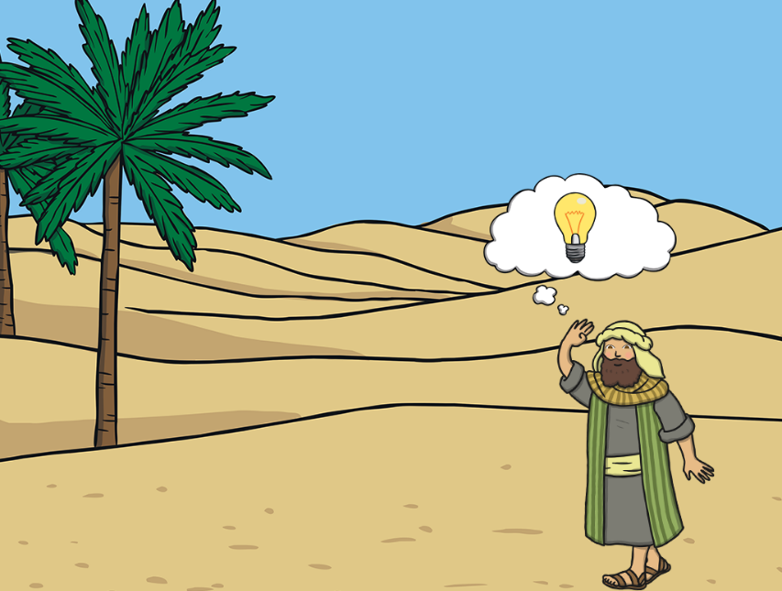
What Is Sukkot?
Jewish people sometimes use a language called Hebrew. Some of their prayers are in Hebrew and their special book, called the Torah,
is written in Hebrew.
‘Sukkah’ is a Hebrew word for a kind of tent. The festival of Sukkot is a time to remember how thousands of years ago the Jewish people wandered the desert, trying to find a place to live. Along the way, they built tents out of palm leaves and branches to live in.
Sukkot is celebrated during the autumn. It lasts for seven days.

Slide 4
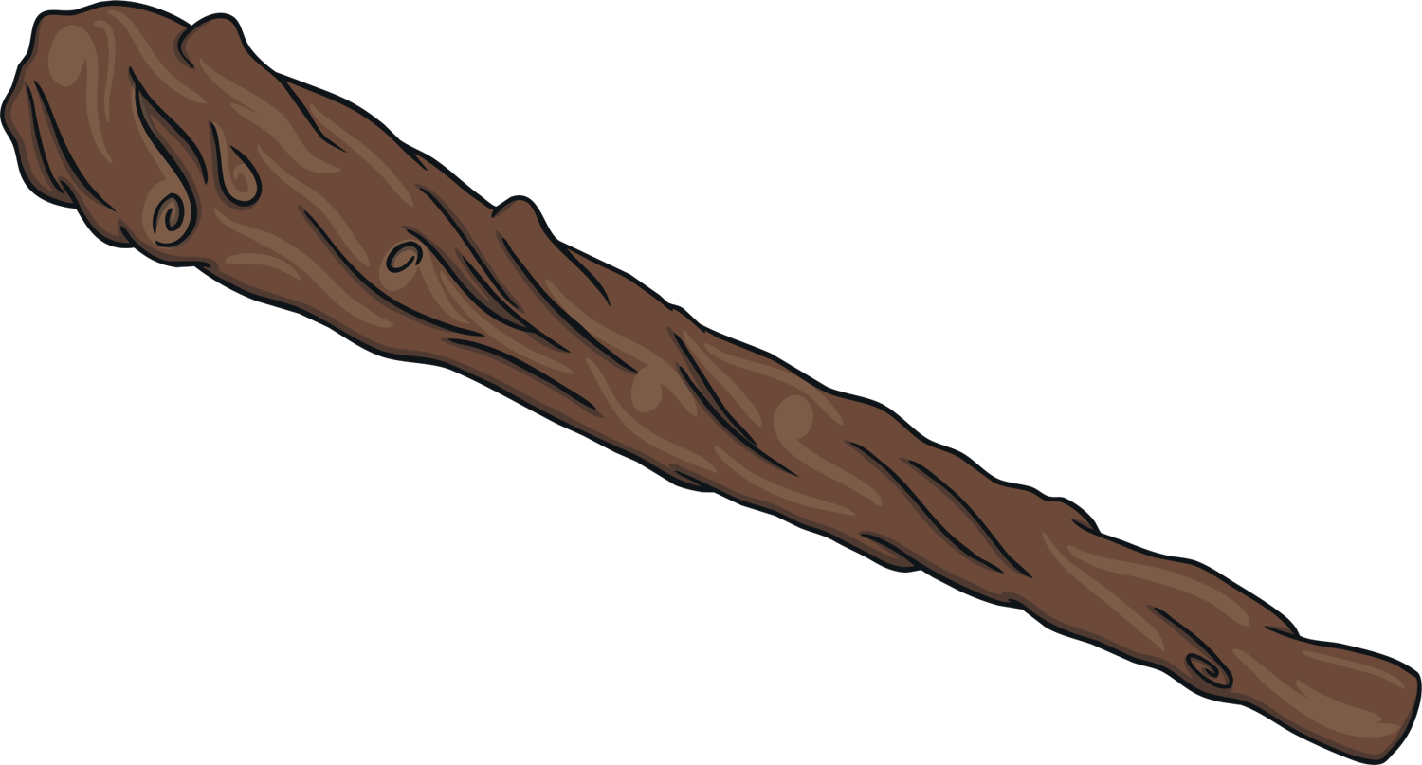
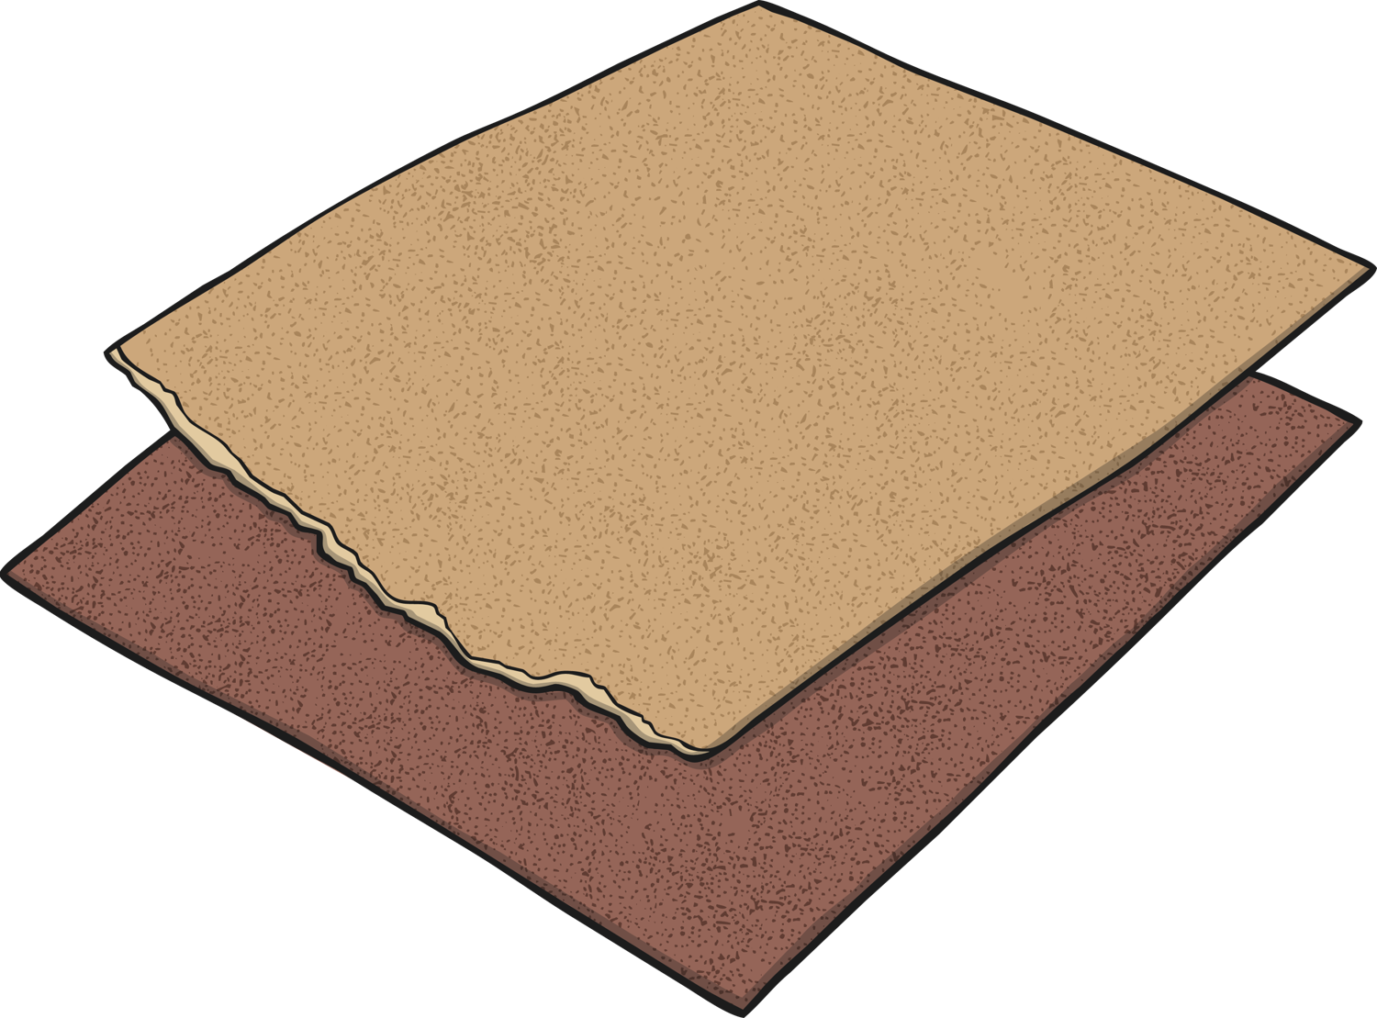
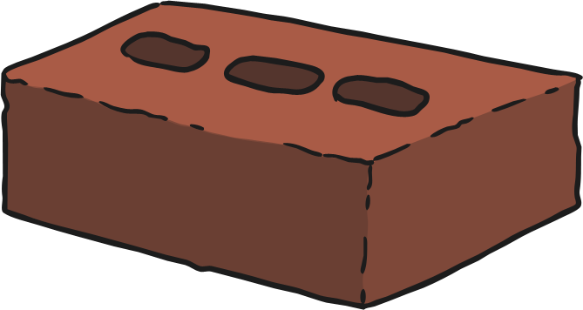
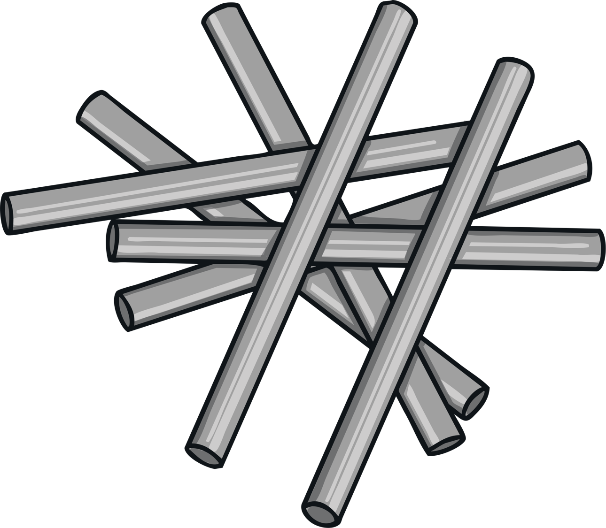
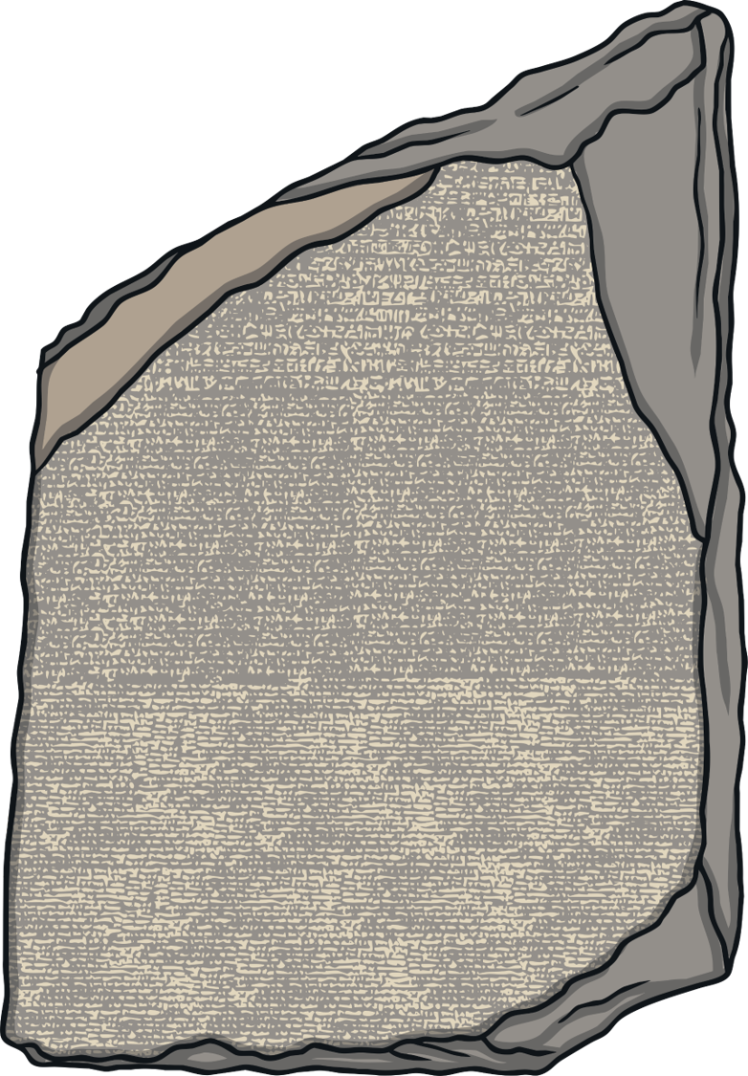
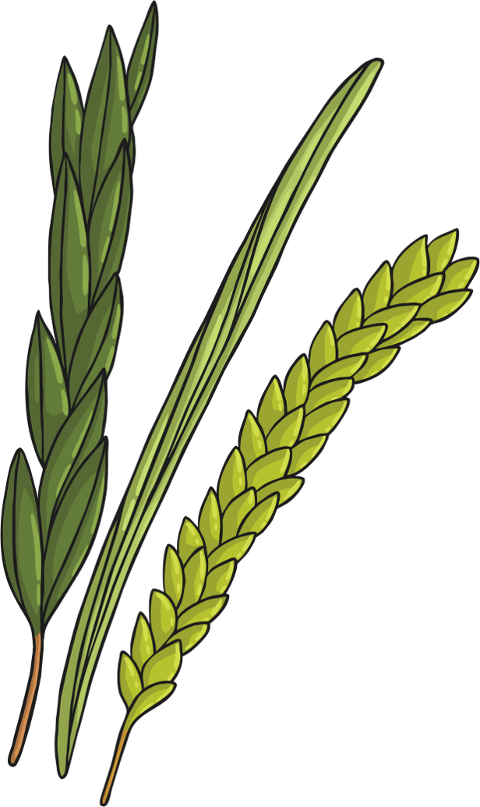
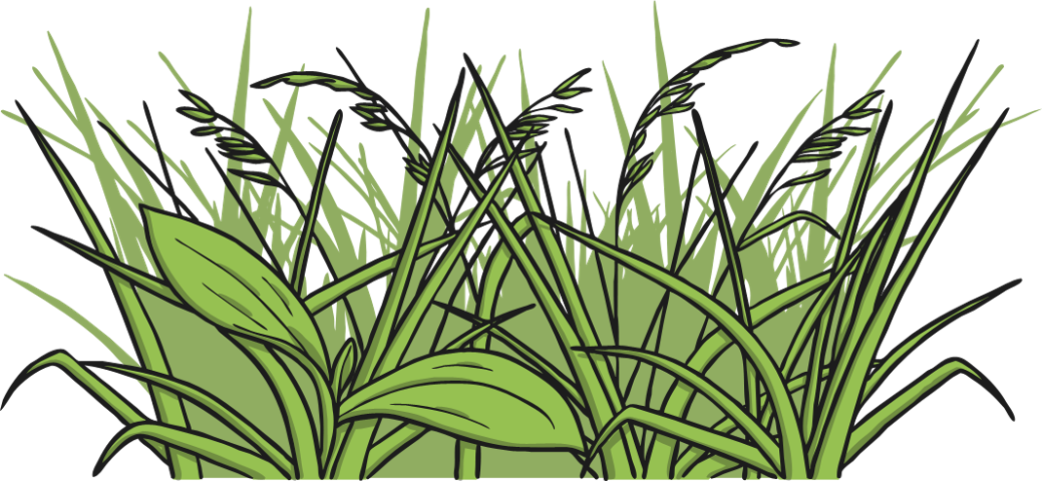
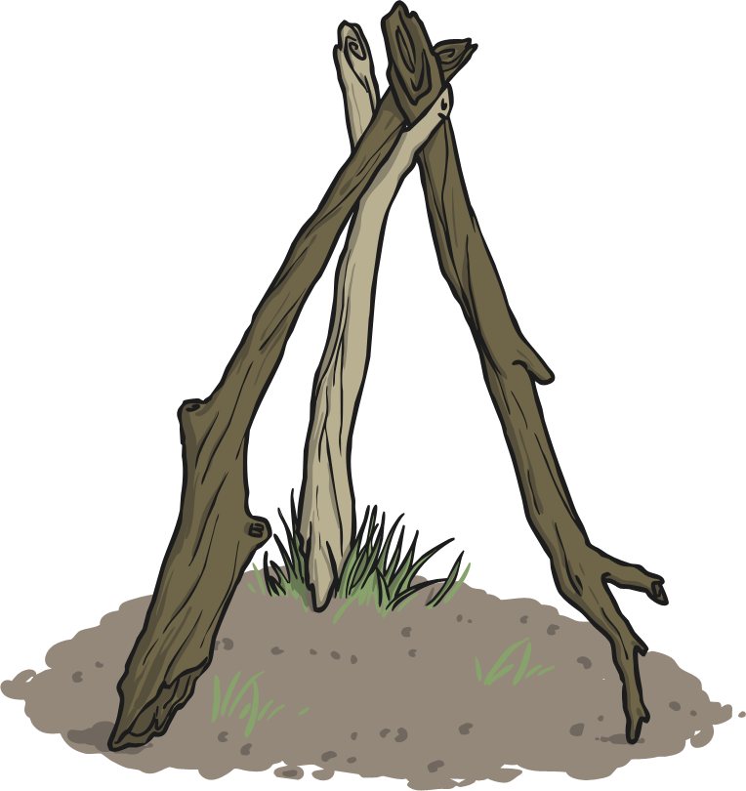
How Is Sukkot Celebrated?
To get ready for Sukkot, people start to build a sukkah.
A sukkah must have at least three walls. These walls can be made out of anything. People often use wood, textiles, brick, metal or stone.
The roof of the sukkah must be something found from the ground,
such as plants, grasses or branches.

Slide 5
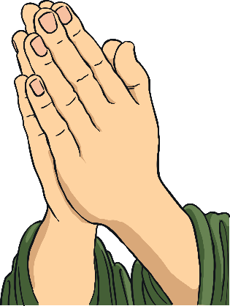
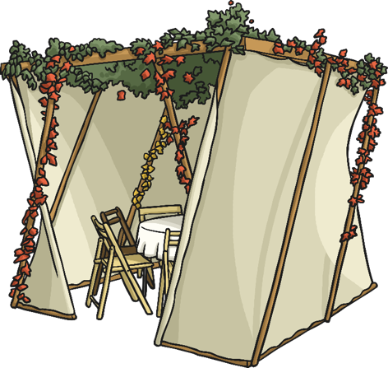
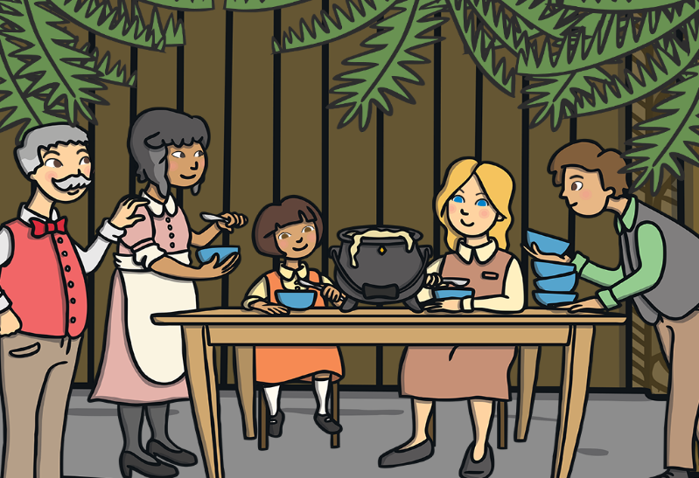
How Is Sukkot Celebrated?
Jewish people spend as much time as possible in their sukkah for the whole week of Sukkot. They eat all their meals in the sukkah and say a prayer to thank God for Sukkot.

Slide 6
The Four Kinds
As part of the Sukkot celebrations, Jews use something called the
Four Kinds..
lulav
palm branch
avarot
willow branch
etrog
a fruit like a lemon
handassim
a flower called myrtle
People take the Four Kinds, say a special prayer over them and wave them right, left, forward, up, down and backward.

Slide 7
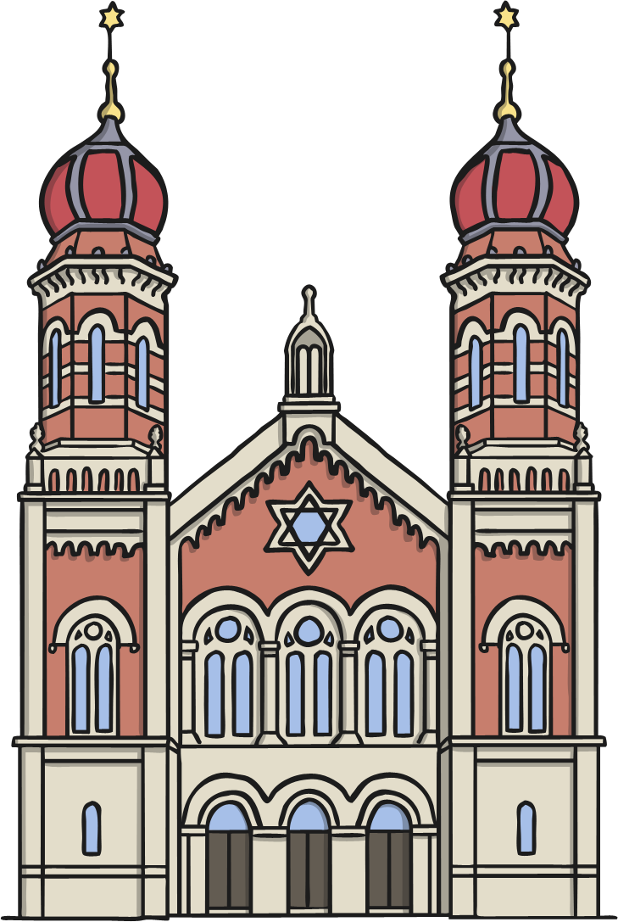
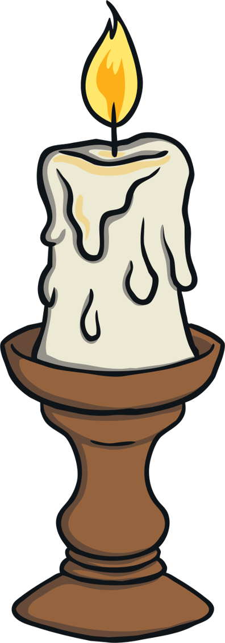
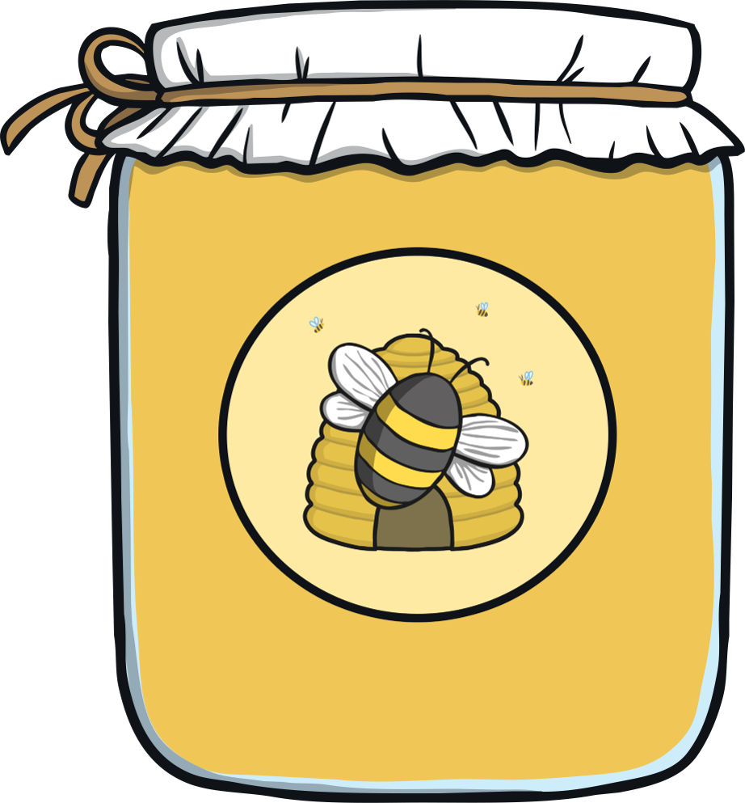
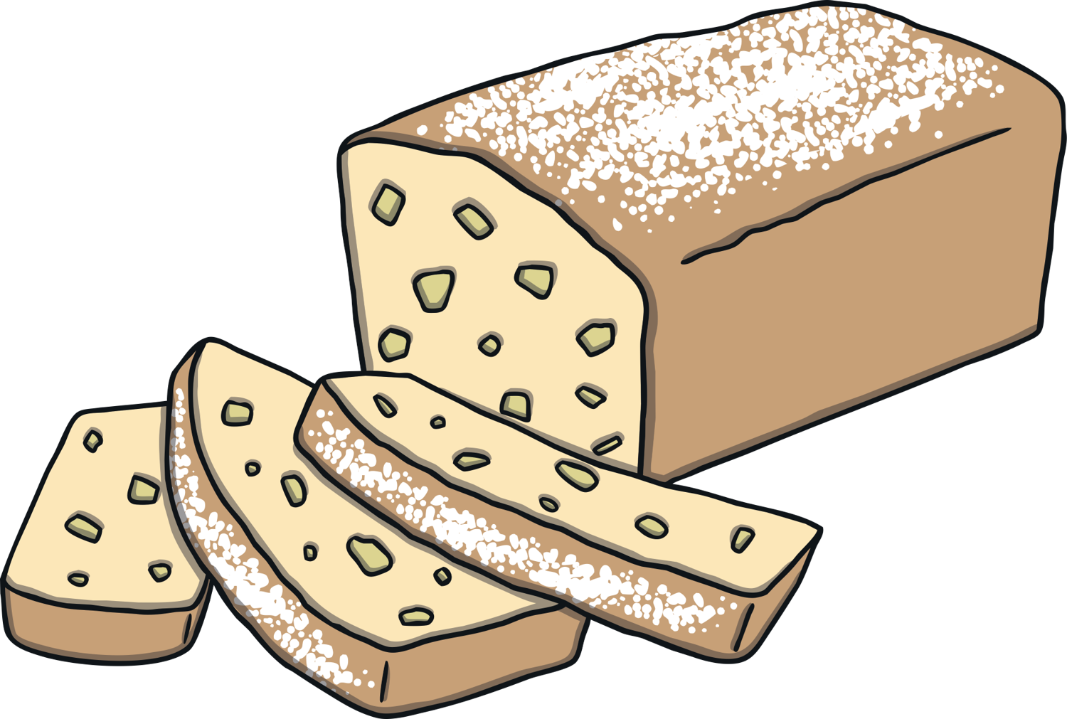
How Is Sukkot Celebrated?
During Sukkot, people don’t go to work or school for two days. They also go to their special place, called a synagogue, where
they worship God.
They light candles and eat special food, including bread dipped in honey.

