Slide 1


Slide 3





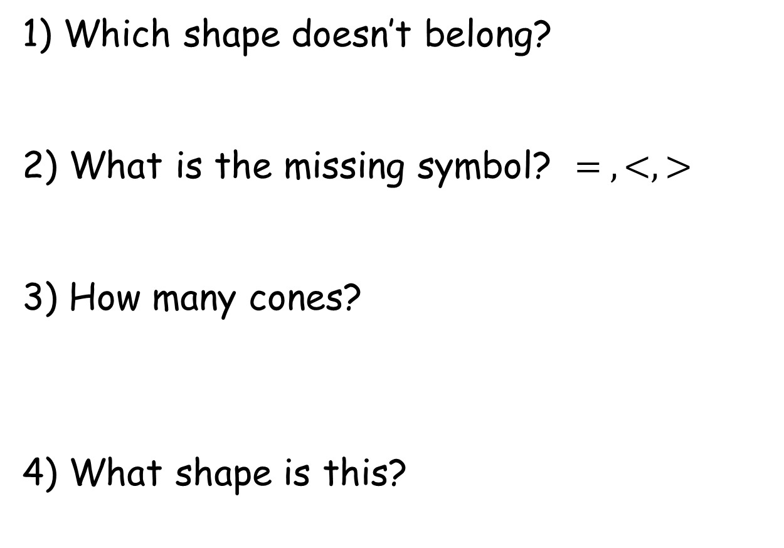
1) Which shape doesn’t belong?
2) What is the missing symbol? $= , <, >$
3) How many cones?
4) What shape is this?

Slide 4

1) Which shape doesn’t belong?
2) What is the missing symbol? $= , <, >$
3) How many cones?
4) What shape is this?
$$>$$
4
sphere

Slide 6
Here are some pictures of 2-D shapes

Slide 7

I can draw pictures using
2-D shapes

Slide 8

These are the names of
2-D shapes
circle
square
rectangle
triangle

Slide 9
Which shapes are squares?

Slide 10
Which shapes are circles?

Slide 11
Which shapes are triangles?

Slide 12
Which shapes are rectangles?

Slide 13

What 2-D shapes are in these pictures?
Have a think

Slide 14
Have a go at the rest of the worksheet

