Slide 1


Slide 3
1) Which shape is a triangle?
2) Which shape is a square?
3) How many sides does a square have?
4) How many circles do you see?

Slide 4
1) Which shape is a triangle?
2) Which shape is a square?
3) How many sides does a square have?
4) How many circles do you see?
4
3

Slide 6
Sorting rules:
What is the same?
What is different?

Slide 7
Sorting rules - Colour

Slide 8

Sorting rules - shape
Have a think
Circles
Squares

Slide 9
Sorting rules - shape
Have a think
Triangles
Rectangles

Slide 10
Have a go at questions 1 and 2 on the worksheet

Slide 11


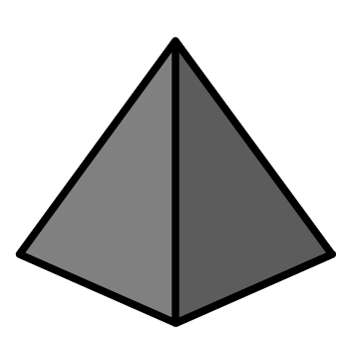


Have a think
2-D shapes
3-D shapes

Slide 12
How have the shapes been sorted?
Have a think
Shapes with 3 sides
Shapes with 4 sides

Slide 13
Have a go at the rest of the worksheet

