Slide 1


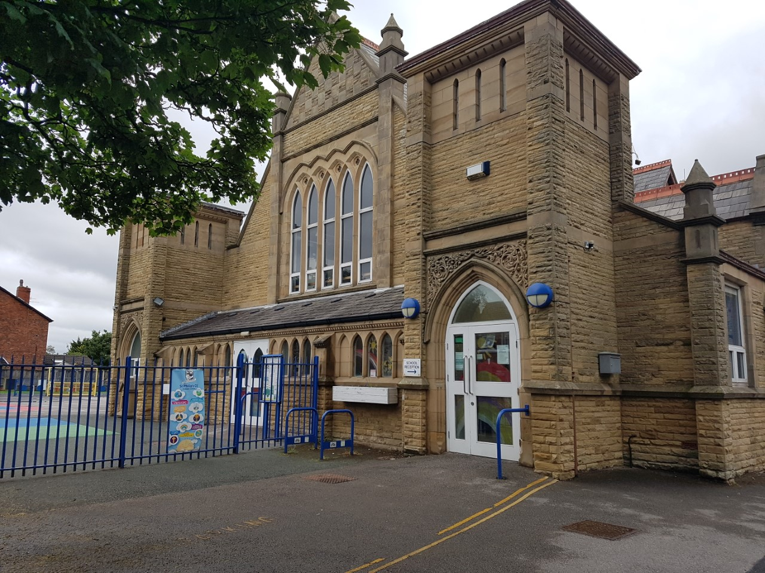
St Philip’s CE Primary School

Slide 2

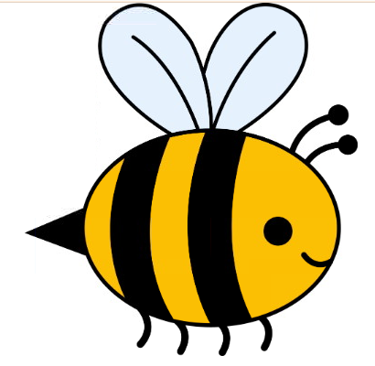

It will be fantastic to see you all back in school and we are so excited. Please read through the slides and discuss the important changes as a family. We want to share these with you to keep us all safe, so we are ready, respectful and responsible learners.
St Philip’s CE Primary School

Slide 3


Try your best to stay apart from others
You have probably heard of ‘social distancing’. Try your best to stay 2m away from other people in your class – even the teachers! Lots of waves and thumbs up and smiles are all great!
Think of it as a protective force-field you have around you, like you are a super hero!

Slide 4



Stay inside your class ‘bubble’ all day
It is important that we do not mix with children and adults who are in other bubbles at the moment. We will have our lunch in our bubble and play outside in our bubble too.
Again we can wave and smile at others from a distance.
This Photo by Unknown Author is licensed under CC BY

Slide 5
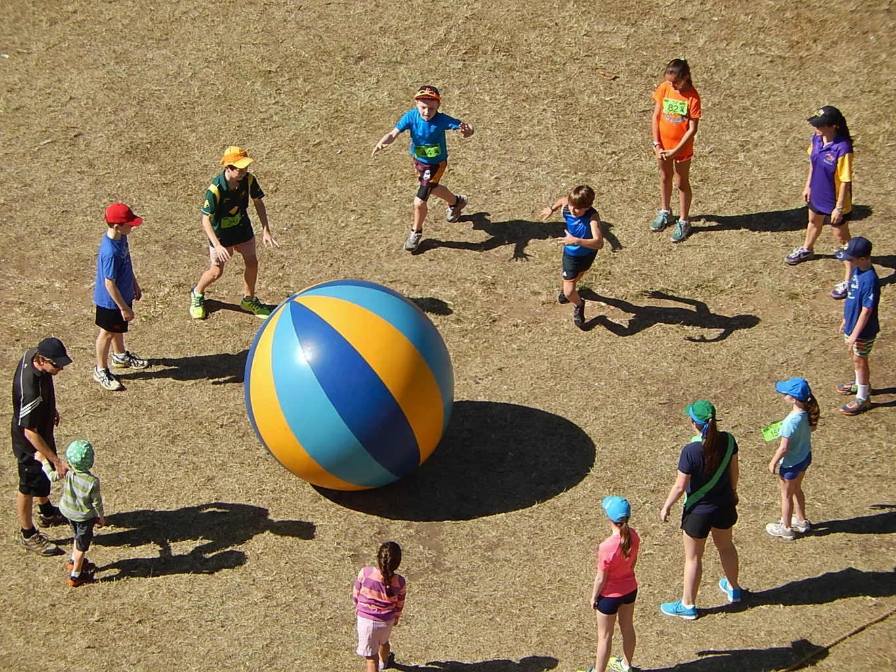
Try hard to keep apart outside too
It is very hard, but when we go outside, please do your best to keep your distance even if you are playing a game.

Slide 6
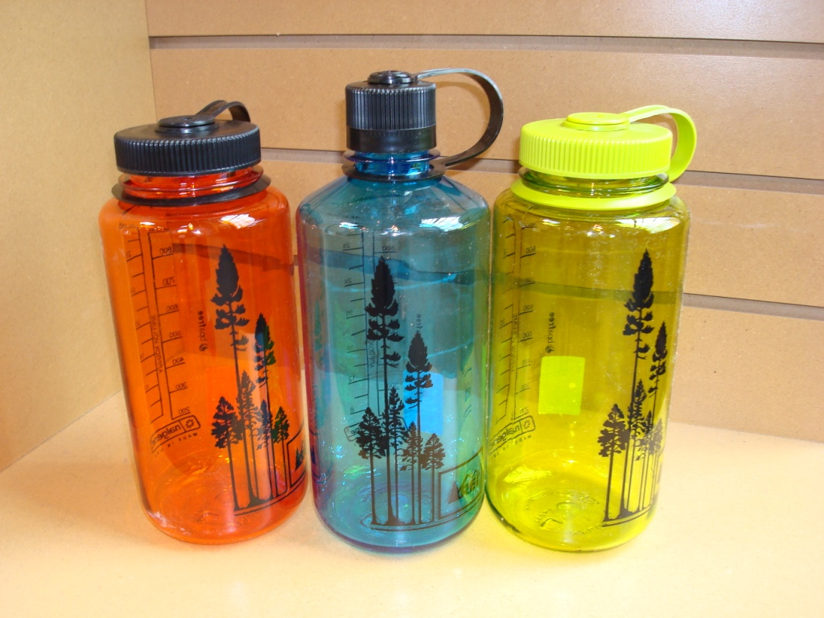

Do not bring things from home or take things home with you.
You will need:
a named water bottle
a coat/sun hat
NO PE KIT, NO BAGS
This Photo by Unknown Author is licensed under CC BY-SA

Slide 7

If you feel unwell tell an adult
DO NOT come to school if you feel unwell
If you feel unwell at school, you must tell an adult quickly.

Slide 8
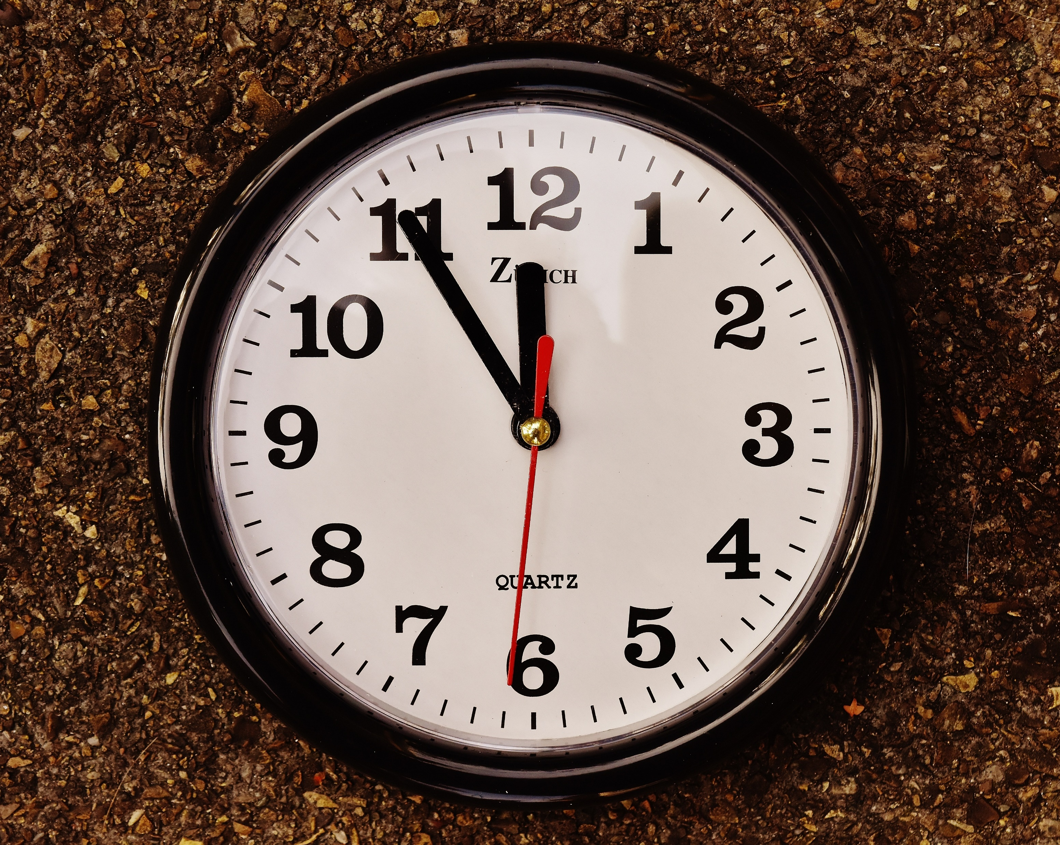

Come to school and leave school at the times you have been given
You will enter and leave by your own ‘bubble’ door.
There will be a one way system to enter and leave school.
Only one adult per child to drop off and collect.
Please be on time and don’t stop to chat to friends in the playground.

Slide 9
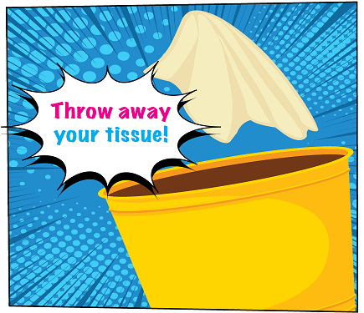

Catch it, kill it, bin it!
If you cough or sneeze try and do it into a tissue and then put the tissue in the bin.
If you have no tissue, cough into your elbow.
THEN WASH YOUR HANDS!

Slide 10
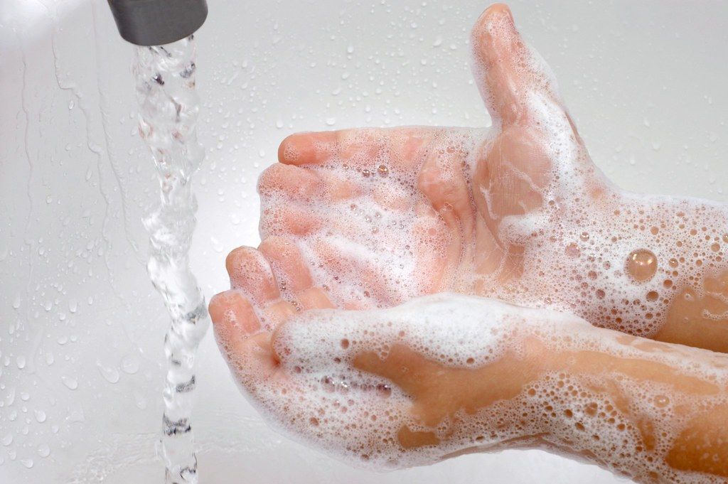
Wash your hands regularly!
We have a cleaning station in all bubbles and you will be hand washing, hand sanitising and cleaning your desks frequently throughout the day.
Hand washing rules:
Make sure your hands are wet and add a small pump of soap. Rub and wash for at least 20 seconds. Dry hands properly and throw paper towels in the bin. If your hands get sore you can bring your own named soap and/or cream.

Slide 11
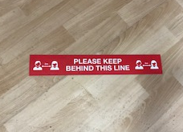
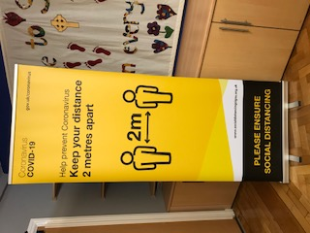
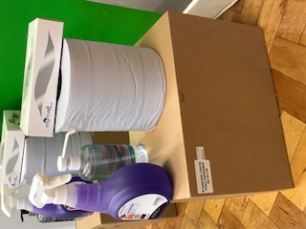
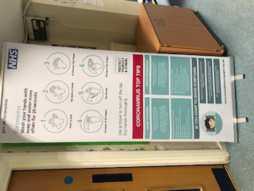

We have been busy making our school a safe place for us all!
Look out for all our new signs and reminders ………
Everyone will get their own work pack with resources inside
Mr Bradley will be busy making us all cleaning stations around school and the cleaning staff are coming in more too

Slide 12

We will still follow our normal St Philip’s Bee Behaviour Standards
Be Ready
Be Respectful
Be Responsible
Fantastic walking
Make sure the adults in your bubble catch you doing the right thing!

Slide 13
Let’s do this together!
If we can follow all these extra rules to keep us safe for the next few weeks, then hopefully our school will be back to normal as soon as possible!
VISION STATEMENT
Happiness, love and security abound
Everyone is special
Every achievement is celebrated
Relationships and teamwork matter
A beacon of light in the community
Christ in everything we do

Slide 14
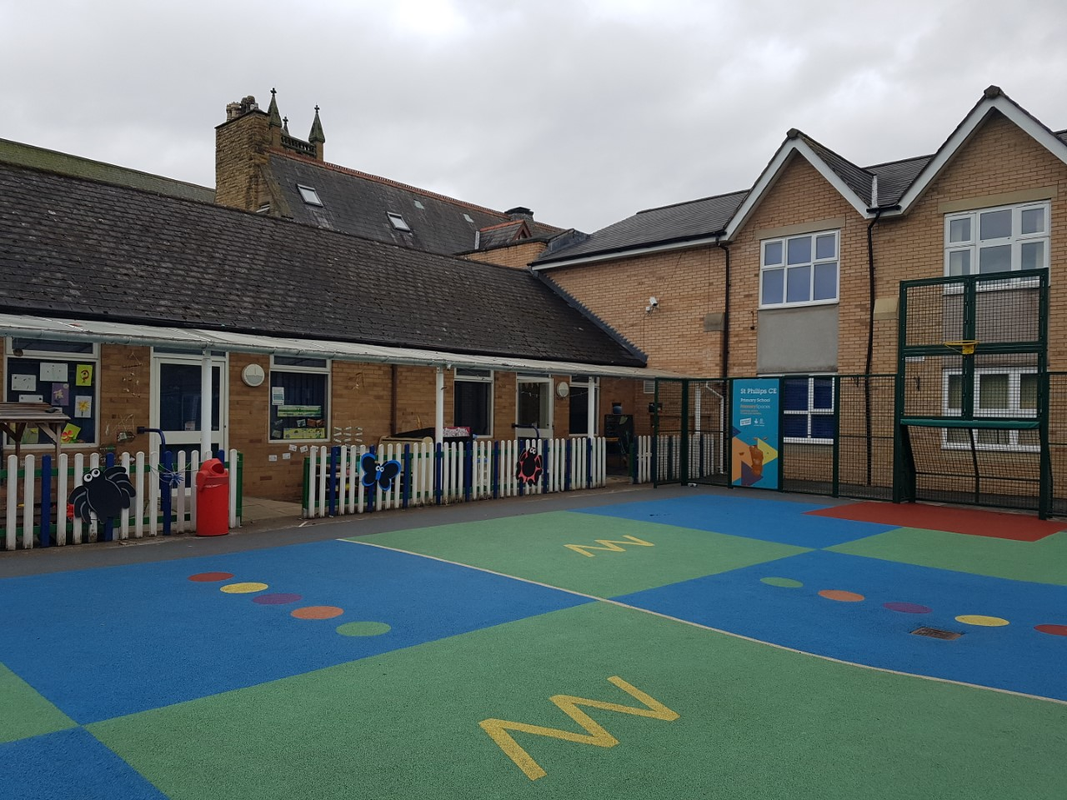
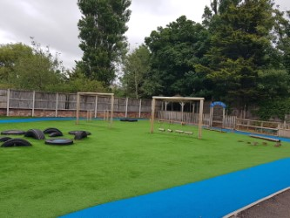
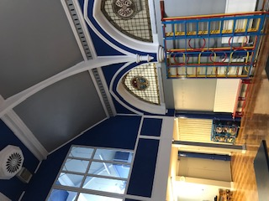
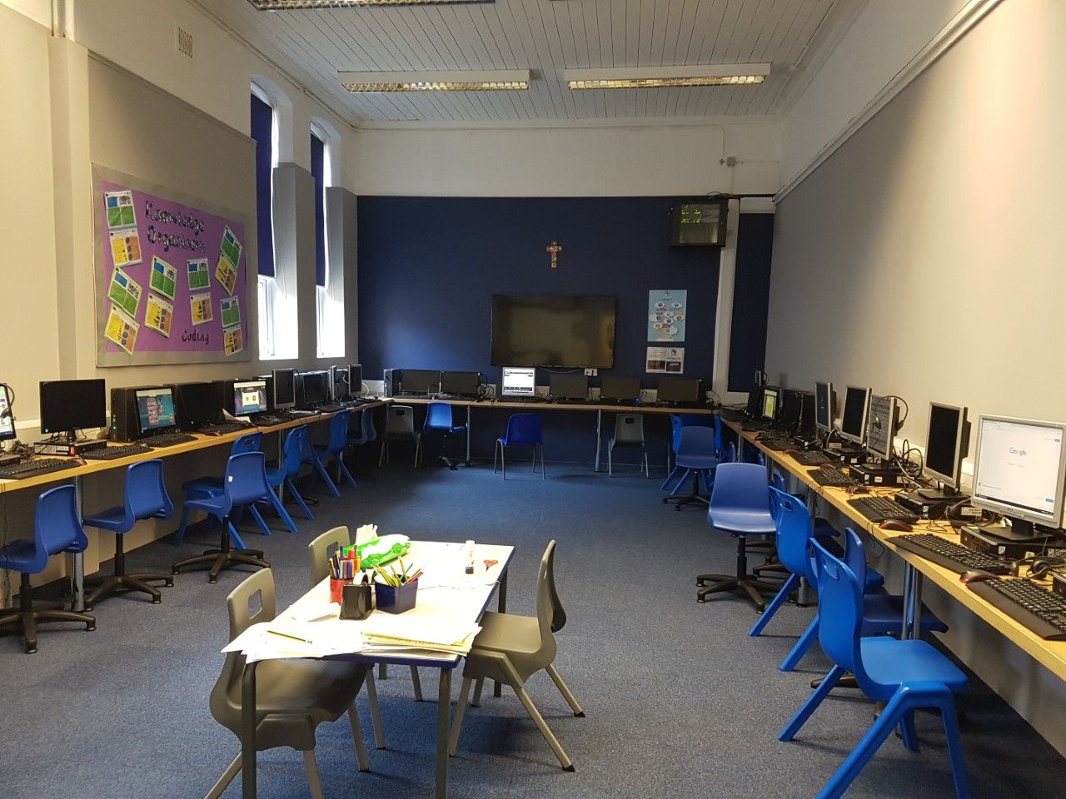
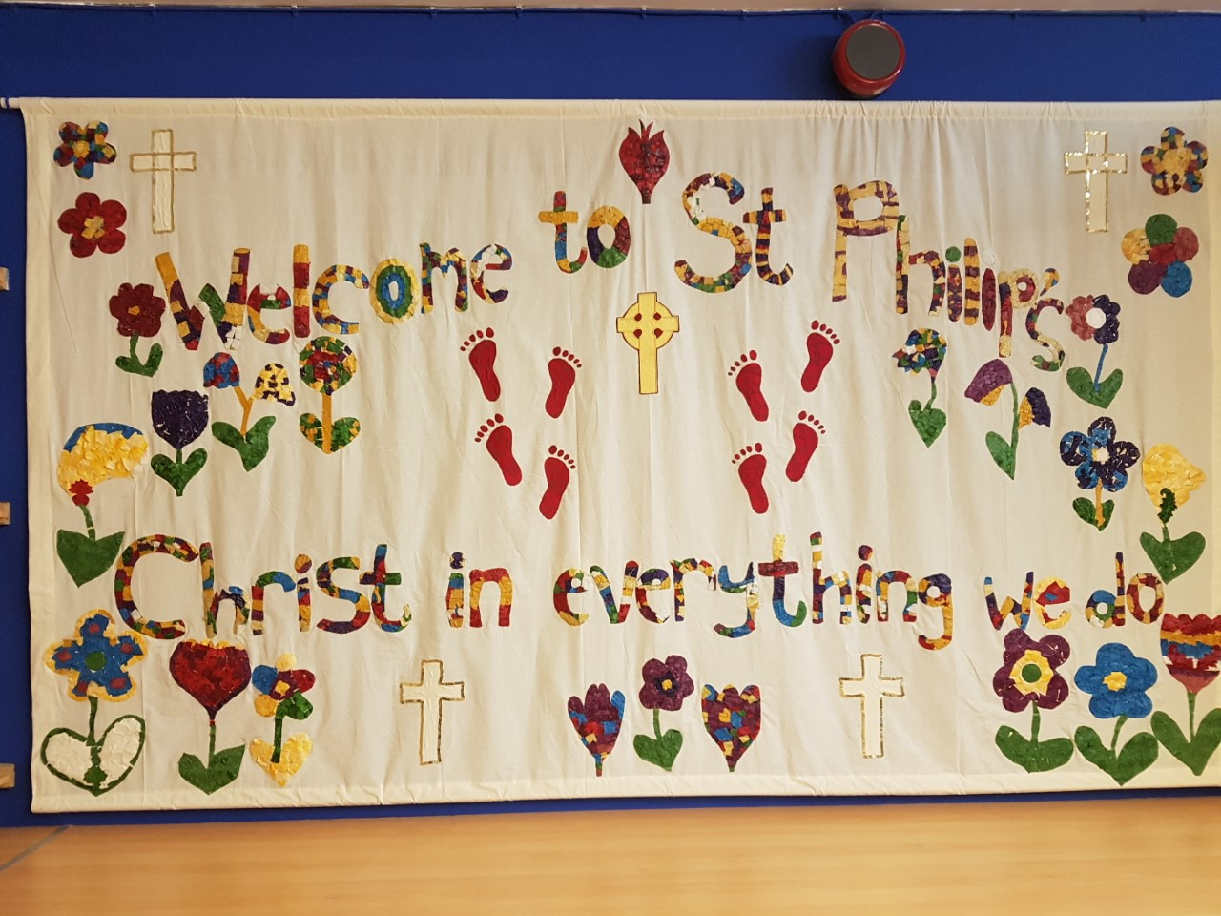
Some reminders of what school looks like.
We’ve had our beautiful hall painted and the playground is empty without you all.
See you soon.
Love from all the staff at your school.

