Slide 1
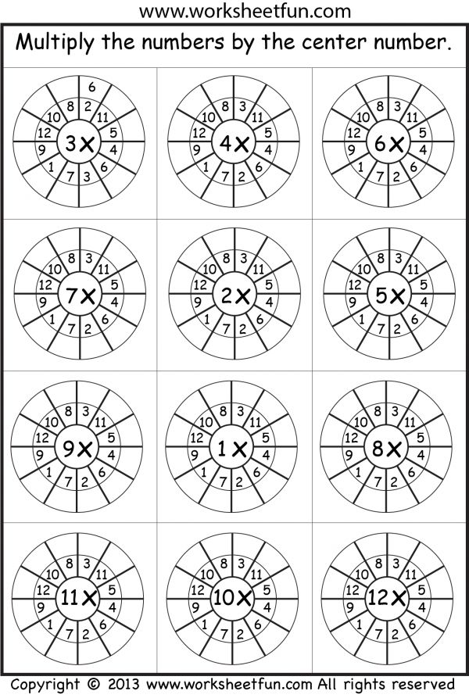
Notes:
Warm up for all- see how they do

Slide 2
07.09.20
L.O.: investigate how to represent numbers in different ways.

Slide 3
Crucial vocabulary this lesson:
Place value
Column
Equal
Hundreds
Tens
Thousands
Tens of thousands
Hundreds of thousands
Greater than
Less than
Integer
10 times greater/smaller

Slide 4
Do now
Using the apparatus on your table, create the number below:
How many different ways can you think of?
568

Slide 5
Do now
Using the apparatus on your table, create the number below:
How many different ways can you think of?
1508

Slide 6
Do now
Using the apparatus on your table, create the number below:
How many different ways can you think of?
10,010

Slide 7

Let’s hear all your methods and see you creations!

Slide 8
Do now
Partition the number below:
What does each digit represent?
12,708

Slide 9
Do now
Using the apparatus on your table, create the number below:
How many different ways can you think of?
35,616

Slide 10
Do now
Partition the number below:
What does each digit represent?
282,408

Slide 11
Do now
Partition the number below:
What does each digit represent?
120,267

Slide 12
Let’s hear all your methods and see you creations!

Slide 13
Over to you…
4,654 | 12,830 | 3,050 | 9,575
15,420 | 6,326 | 2,430 | 1,670
Select your own group
number to make.

Slide 14
Let’s hear all your methods and see you creations!

Slide 15
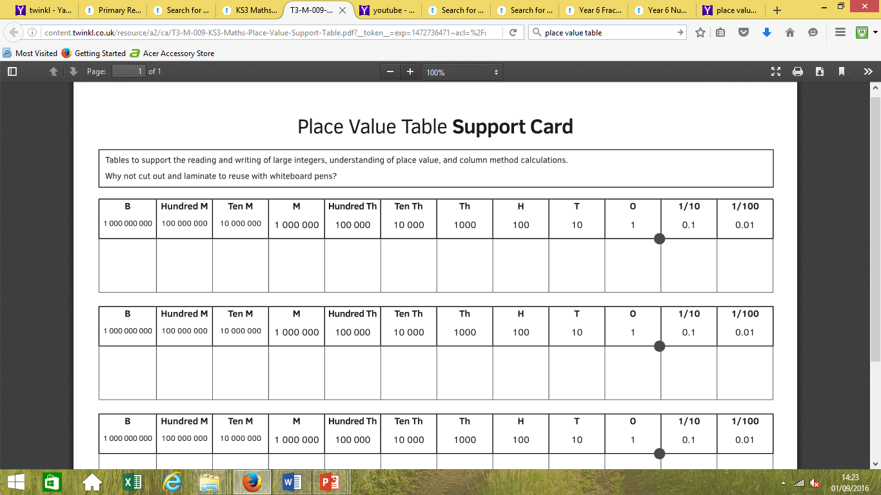
Our number system…
Show me the value using your apparatus…

Slide 16
Our number system…
What do you notice??

Slide 17

I notice that our
number system…

Slide 18
What happens to the columns as you move to the left?
So what happens to the numbers if you move to the right?

Slide 19
When reading numbers, FIRST look at the furthest column on the left in your number.
Then work across to the right as you read your number.

Slide 20
My number…
What do you know about
the place value chart?

Slide 21
Talk Task
Look at the number below: tell me 3
facts about it:
1,203,456
FACT 1: 1,203,456 is a 7 digit number, therefore it has an integer in the millions column.
FACT 2: 1,203,456 has no tens of thousands so instead there is a place holder.
FACT 3: 1,203,456 when rounded to the nearest hundred equals 1,203,500.

Slide 22
Complete your key skills test stage 5.Let’s see what we remember.
Tues
Use your
prompt sheets
15 minutes

Slide 23
08.09.20
L.O: Read and write numbers up to 1,000,000.

Slide 24
Crucial vocabulary this lesson:
Place value
Column
Hundreds
Tens
Thousands
Tens of thousands
Hundreds of thousands
Millions
Greater than
Less than
Integer
10 times greater/smaller

Slide 25
Our number system…

Slide 26
What happens to the columns as you move to the left?
So what happens to the numbers if you move to the right?

Slide 27
Notes:
Prompts for SEN and LA to stick in their books to use.

Slide 28
When reading numbers, FIRST look at the furthest column on the left in your number.
Then work across to the right as you read your number.

Slide 29
My number…
What do you know about
the place value chart?

Slide 30
Talk Task
Look at the number below: tell me 3
facts about it:
1,203,456
FACT 1: 1,203,456 is a 7 digit number, therefore it has an integer in the millions column.
FACT 2: 1,203,456 has no tens of thousands so instead there is a place holder.
FACT 3: 1,203,456 when rounded to the nearest hundred equals 1,203,500.

Slide 31
Over to you…
Look at the number below. WRITE 3 facts about it:
605,380
FACT 1: ____________________________________________.
FACT 2: ____________________________________________.
FACT 3: ____________________________________________.
On your whiteboards

Slide 32


Introduction
Identify the value of the highlighted digit.
1,345,789
543,081
5,116,902
39,597
10,388,264
© Classroom Secrets Limited 2018

Slide 33
Introduction
Identify the value of the highlighted digit.
1,345,789 | 7 hundreds (700)
543,081 | 4 ten thousands (40,000)
5,116,902 | 6 thousands (6,000)
39,597 | 9 tens (90)
10,388,264 | 3 hundred thousands (300,000)
© Classroom Secrets Limited 2018

Slide 34
Match up!
https://classroomsecrets.co.uk/free-year-6-numbers-to-ten-million-iwb-place-value-activity/

Slide 35
576 | Five thousand and five hundred.
807 | Two thousand, nine hundred and sixty.
5,500 | Eight thousand and forty.
3,400 | Seven thousand, seven hundred and thirty.
2,960 | Five hundred and seventy-six.
8,040 | Three thousand and four hundred.
7,730 | Eight hundred and seven.
SEN

Slide 36
1,576 | ______________________________________ _______________________________________ _______________________________________
8,007 | ______________________________________ _______________________________________ _______________________________________
28,570 | ______________________________________ _______________________________________ _______________________________________
14,700 | ______________________________________ _______________________________________ _______________________________________
90,600 | ______________________________________ _______________________________________ _______________________________________
28,900 | ______________________________________ _______________________________________ _______________________________________
57,440 | ______________________________________ _______________________________________ _______________________________________
SEN

Slide 37
1,678,854 | One million, six hundred and seventy-eight, eight hundred and fifty-four. | 340,790 | Three hundred and forty thousand, seven hundred and ninety.
907,093 | Nine hundred thousand and ninety-three. | 239,301 | Two hundred and thirty-nine thousand, three hundred and one.
574,354 | Five hundred and seventy-four thousand, three hundred and fifty-four. | 125,095 | One hundred and twenty-five thousand and ninety-five.
276,094 | Two hundred and seventy-six thousand and ninety-four. | 45,678 | Forty-five thousand, six hundred and seventy- eight.
LA
Notes:
Stick bold column in books and match up with words. CUT INTO STRIPS BEFORE GIVE ACTIVITY!

Slide 38
1,978,054 |  | 367,790
923,793 |  | 1,777,101
1,903,455 |  | 303,003
504,054 |  | 105,005
2,078,401 |  | 5,686,300
1,276,114 |  | 13,008
Your turn: |  | Your turn:
MA
Notes:
To do in books. Ext: using a dice- children create a 7 digit number for their partner to write in their books

Slide 39
1,978,054 |  | Forty-nine thousand and one.
Nine million, three hundred and eighty-one thousand, four hundred and four. |  | 1,777,101
1,903,455 |  | 303,003
Five hundred and forty-thousand, two hundred and two. |  | 105,005
2,078,401 |  | 5,686,300
1,276,114 |  | Six million and thirty-nine thousand, and seventeen.
Your turn (integers first): |  | Your turn (words first):
HA
Notes:
To do in books.

Slide 40
1,978,054 |  | Forty-nine thousand and one.
Nine million, three hundred and eighty-one thousand, four hundred and four. |  | 1,777,101
1,903,455 |  | 303,003
Five hundred and forty-thousand, two hundred and two. |  | 105,005
2,078,401 |  | 5,686,300
1,276,114 |  | Six million and thirty-nine thousand, and seventeen.
Your turn (integers first): |  | Your turn (words first):
HA
Notes:
To do in books.

Slide 41

Odd one out…
Notes:
PLENARY

Slide 42
2,087,350 | 1,056,700 | 1,098,257
80,452 | 1,008,332 | 502,108
The following numbers are the odd
ones out because…
Notes:
No right answer- good for children to explain their ideas and justify using correct terminology.

Slide 43
Do now
Which is greater:
Seventy six thousand, eight
hundred and twenty six or
718626?
Then create one for your partner.

Slide 44
LA
Do now
Which is greater:
Six thousand, eight
hundred and twenty six or
17626?
Then create one for your partner.

Slide 45
SEN
Do now
Which is greater:
Six thousand, eight
hundred and twenty six or
10,726?
Then create one for your partner.

Slide 46
Do now…
X | 6 | 3 | 5 | 12 | 9 | 2 | 7 | 10 | 8 | 11 | 4
3
8
11
6
7
4
9
2
12
10
5

Slide 47
Do now…
X | 6 | 3 | 5 | 12 | 9 | 2 | 7 | 10 | 8 | 11 | 4
3 | 18 | 9 | 15 | 36 | 27 | 6 | 21 | 30 | 24 | 33 | 12
8 | 48 | 24 | 40 | 96 | 72 | 16 | 56 | 80 | 64 | 88 | 32
11 | 66 | 33 | 55 | 132 | 99 | 22 | 77 | 110 | 88 | 121 | 44
6 | 36 | 18 | 30 | 72 | 54 | 12 | 42 | 60 | 48 | 66 | 24
7 | 42 | 21 | 35 | 84 | 63 | 14 | 49 | 70 | 56 | 77 | 28
4 | 24 | 12 | 20 | 48 | 36 | 8 | 28 | 40 | 32 | 44 | 16
9 | 54 | 27 | 45 | 108 | 81 | 18 | 63 | 90 | 72 | 99 | 36
2 | 12 | 6 | 10 | 24 | 18 | 4 | 14 | 20 | 16 | 22 | 8
12 | 72 | 36 | 60 | 144 | 108 | 24 | 84 | 120 | 96 | 121 | 48
10 | 60 | 30 | 50 | 120 | 90 | 20 | 70 | 100 | 80 | 110 | 40
5 | 30 | 15 | 25 | 60 | 45 | 10 | 35 | 50 | 40 | 55 | 20

Slide 48
09.09.20
L.O: Continue to read and write numbers up to 6 digits or more.
L.O: Continue to read, write and order numbers up to 1,000,000.

Slide 49
Crucial vocabulary this lesson:
Place value
Column
Hundreds
Tens
Thousands
Tens of thousands
Hundreds of thousands
Millions
Tens of millions
Greater than
Less than
Integer
10 times greater/smaller

Slide 50
Talk Task
Look at the number below: tell me 3
facts about it:
1,203,456
FACT 1: 1,203,456 is a 7 digit number, therefore it has an integer in the millions column.
FACT 2: 1,203,456 has no tens of thousands so instead there is a place holder.
FACT 3: 1,203,456 when rounded to the nearest hundred equals 1,203,500.

Slide 51
Talk Task
What happens to the value in each
column, as you move to the left?
How do you know?

Slide 52
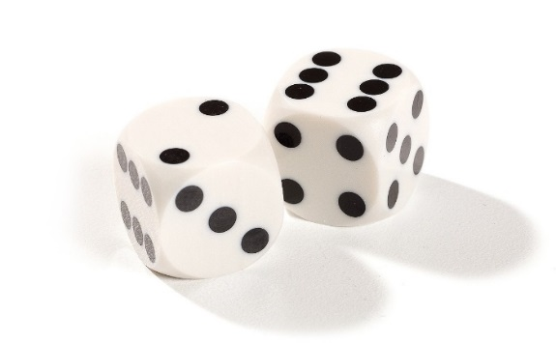
Generate and compare numbers.
Notes:
In partners, children generate a number using a dice for their partner to write. SEN 4/5 digit numbers. MA 6 digit numbers and HA 7 digit.

Slide 54

Write the number I say:

Slide 55
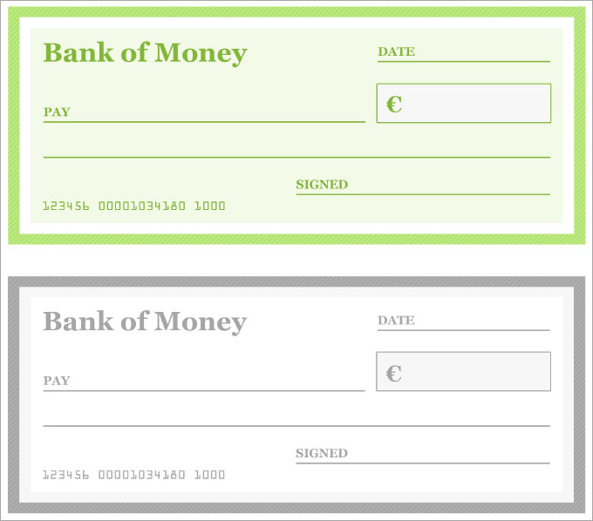
£
£
£
£
£
£
LA
Notes:
For SEN AND LA to stick in their books.

Slide 56
Twelve thousand, four hundred and five. | Seven thousand, three hundred and twenty-four. | Nine thousand, six hundred and seventy-two.
Six thousand and ten. | Sixty-two thousand, three hundred. | Four thousand, three hundred and ninety.
Three thousand, six hundred and twenty. | Five thousand, hundred and forty. | One hundred and eleven thousand, nine hundred and twenty-two.
Two hundred and three thousand. | Seven thousand, three hundred and eighty. | , three hundred and forty thousand.
LA
Notes:
Write on their cheques in their books.

Slide 57
£
£
£
£
£
£
LA
Notes:
For SEN AND LA to stick in their books.

Slide 58
£
£
£
£
£
£
LA
Notes:
For SEN AND LA to stick in their books.

Slide 59
£4,563,544 | £3,456,775 | £6,789,655
£2,231,009 | £6,746,302 | £3,567,654
£9,456,754 | £4,786,544 | £3,456,899
£3,457,786 | £9,234,983 | £10,021,124
M
Notes:
Write on their cheques in their books. Extension: once the children have completed all their cheques confidently, they then write them in order smallest to biggest in their books.

Slide 60
£4,563,544 | £3,456,775 | £6,789,655
£2,231,009 | £6,746,302 | £3,567,654
£9,456,754 | £4,786,544 | £3,456,899
£3,457,786 | £9,234,983 | £10,021,124
M
Notes:
Write on their cheques in their books. Extension: once the children have completed all their cheques confidently, they then write them in order smallest to biggest in their books.

Slide 61
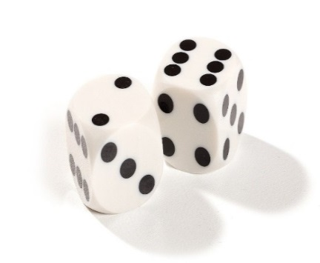
Over to you…
In partners, you are to roll the dice and you are to generate a 7 digit number (so roll the dice 7 times).
Once you have your number, you then need to write it in words accurately in your books.
You then need to order the numbers and record in figures in your table to stick in your books.
I am looking for well presented work.
I am looking for numbers to be written clearly and accurately with no words missing out.
HA

Slide 62
First generated sequence. | Second generated sequence. | Third generated sequence.
First generated sequence ordered smallest to largest. | Second generated sequence ordered largest to smallest. | Third generated sequence ordered smallest to largest.
Notes:
HA to stick in books or draw themselves. Once they have their different sequences, they then order each sequence from smallest to largest.

Slide 63
Plenary
Do now, then explain on your whiteboard:
Show the value of the digit 6 in these numbers?
6787555
95467754
Explain how you know.

Slide 64
Plenary
Put a number in the missing
space below to make the
sentence correct.
4_236460 > 46236460

Slide 65
Order biggest to smallest:
771,134, 773,411,
707,456, 771,456
Then explain in full how
you know you are right.
Notes:
Challenge for LA

Slide 66
Challenge!
Create seven numbers where the digits total 6 and the tens of thousands digit is 2.
What is the largest/smallest number you can make?

