Slide 1
Monday 14th September
LO: To round numbers to 10, 100 and 1000 – Triangles
LO: To round numbers to 10,100, 1000, 10 000

Slide 2


Slide 3
https://vimeo.com/454666928

Slide 4

Our favourite…!
https://www.youtube.com/watch?v=3afU6JQG15I
Sing along !

Slide 5
Crucial vocabulary this lesson…
round/rounding
estimate/estimating
approximate/approximating
to the nearest…/rounding off…
actual
whole numbers
place value
number line

Slide 6

Rounding
Rounding makes it easier to talk about and understand numbers.
We round numbers in order to make numbers simpler to work with, to estimate answers or to explain how near a number is to another number.

Slide 7
Rounding Accurately
We can round numbers to different degrees of accuracy. Sometimes, it is useful to round a number to the nearest 10. Other times we may round a number to the nearest 100, 1000, 10 000, 100 000 or 1 000 000!
In order to round to a given degree of accuracy, we need to
know which digit to consider to tell us whether to round up or
round down.
The rule for identifying the digit to consider is to look
at the digit in the place before the value we are
rounding to.
For example, if we want to round to the nearest 10,
we will look at the number in the ones place.
This is because ones are in the place before tens.

Slide 9
Round 37 to the nearest 10
40
30
40
37
Round 422 to the nearest 10
420
420
430
422

Slide 10


Have a think
Round 1,245 to the nearest 10
1,250
You can’t round this number to the nearest 10 because the ones is a 5
1,240
1,250
1,245

Slide 11
Over to you…
Have a think
Round these numbers to the nearest 100
3,472
100
3,400
3,450
3,500
3,472
4,376
4,400

Slide 12
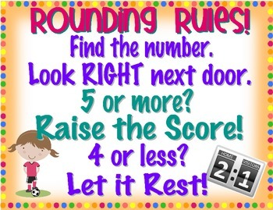

Slide 13
Rounding Accurately
Round 34 233 to the nearest 10.
To do this, we first of all identify the tens numbers either side
of this number.
We then look at the digit in the place before the tens place.
In 34 233, the digit we need to consider is the 3 in the ones place.
We use this digit to decide whether to round up to 240,
or down to 230.
34 230
34 240

Slide 14
Rounding Accurately
Round 34 233 to the nearest 10.
If the digit is a 1, 2, 3 or 4, we round down.
If the digit is a 5, 6, 7, 8 or 9, we round up.
In 34 233, the digit we need to consider is a 3, so we round down.
34 233 rounded to the nearest 10 is 34 230.
34 233
34 230
34 240

Slide 15
Rounding Accurately
Now try this one:
Round 34 233 to the nearest 100.
Identify the hundreds number either side of this number.
Look at the digit in the place before the hundreds place.
In 34 233, this digit is the 3 in the tens place.
Decide whether to round down to 34 200 or up to 34 300.
34 233
34 200
34 300

Slide 16
Rounding Accurately
Did you get it?
Round 34 233 to the nearest 100.
34 233 rounded to the nearest 100 is 23 200.
34 233
34 200
34 300

Slide 17
Over to you….
Hexagons- 5a- 8a sheet- Mrs Cooper & Mrs Day
Squares- 1a-4a sheet- Mrs Lund (out)
Triangles-independent
Ipads- BBC Bitesize link…
Rounding rockets game
https://www.topmarks.co.uk/maths-games/rocket-rounding
https://www.bbc.co.uk/teach/skillswise/rounding-and-estimating/zv8qcqt

Slide 18
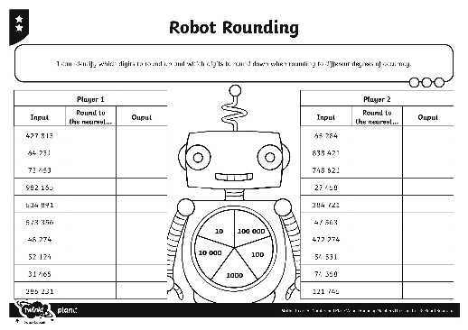
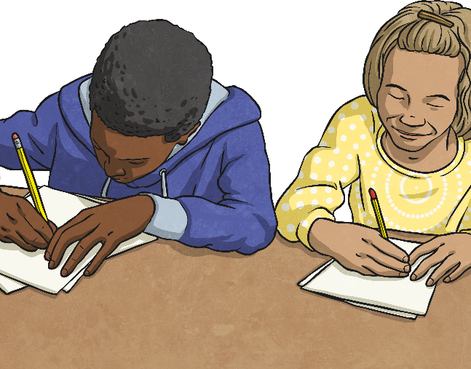
Octagons- Mrs Warham
Robot Rounding Activity
Use the dial on your Robot Rounding Activity Sheet to play a rounding game with your partner.
To use the dial, place a paper clip in the centre of the dial. Place the point of your pencil inside the paper clip, on the exact centre of the dial. Spin the paper clip around the point of your pencil to play!
The aim of the game is to get the most points. You get one point for every number you round correctly.
Look at the first number in the 'Input' column. Spin the robot's dial to find the degree of accuracy. Record this in the 'Round to the Nearest...' column. Then round the number to the required degree of accuracy. Record your answer in the 'Output' column.
Take turns to spin the dial and round each of the numbers in the 'Input' column.

Slide 19
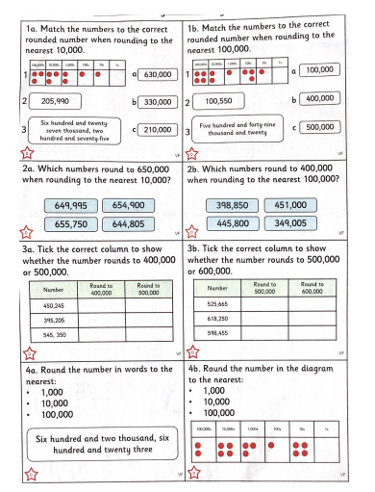

Slide 20
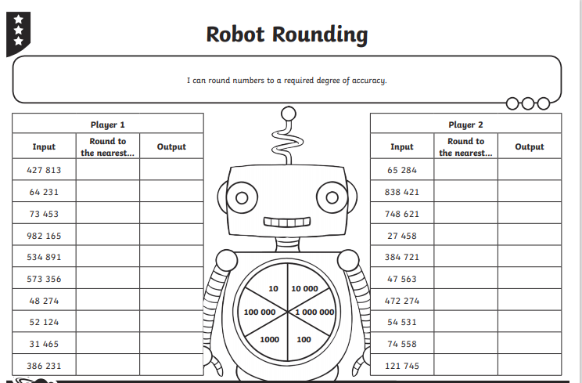
Octagons

Slide 21
Tuesday 15th September
LO: To round numbers to 10, 100 and 1000 – Triangles
LO: To round numbers to 10,100, 1000, 10 000 (problem solving)

Slide 22
Our favourite…!
https://www.youtube.com/watch?v=3afU6JQG15I
Sing along !

Slide 23
Day 2-Crucial vocabulary this lesson…
round/rounding
estimate/estimating
approximate/approximating
to the nearest…/rounding off…
actual
whole numbers
place value
number line
Explain to your partner three of the meanings of these words.

Slide 24
Rounding
Rounding makes it easier to talk about and understand numbers.
We round numbers in order to make numbers simpler to work with, to estimate answers or to explain how near a number is to another number.

Slide 25
Revision
Round 2,855 to the nearest 1,000
3,000
2,000
2,500
3,000
2,855

Slide 26


Robot Rounding
2 485 000
10
100 000
10 000
100
1000
2 485 000
Click the robot to
reveal the answer!

Slide 27
Robot Rounding
800 000
10
100 000
10 000
100
1000
783 924
Click the robot to
reveal the answer!

Slide 28
Robot Rounding
45 630
10
100 000
10 000
100
1000
45 628
Click the robot to
reveal the answer!

Slide 29
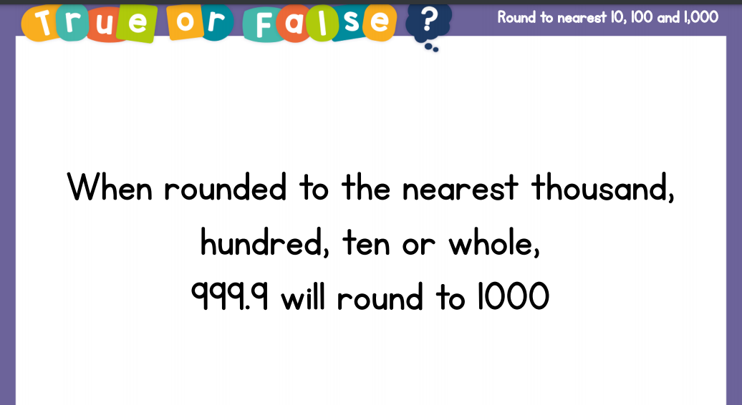
Talk task

Slide 30
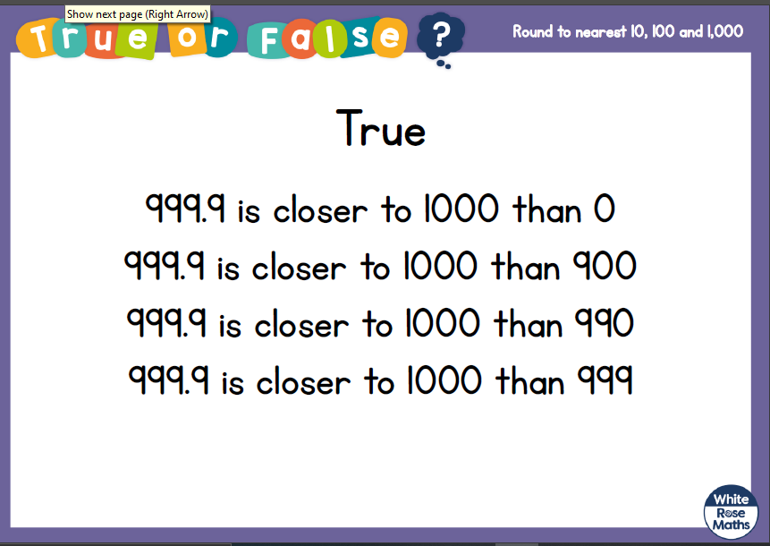

Slide 31


My number is 1,350 when rounded to the nearest 10
Mo
Rosie
Both numbers are whole numbers.
What is the greatest possible difference between the two numbers?
My number is 1,400 when rounded to the nearest 100

Slide 32
Have a think
Which numbers round to 31,000 when rounded to the nearest 1,000?
30,535
29,992
31,000
30,000
31,530
31,350
32,000
31,000

Slide 33
Over to you….
½ Hexagons (out)- Mrs Warham
½ Hexagons- Cinema problem then…
7a-9a Whiterose -Mrs Cooper
Squares - ques 6-9 Whiterose
Octagons- Independent -7a-9a Whiterose
(Extension task- Miss Jones problem)
Triangles (out)- Mrs Lund

Slide 34
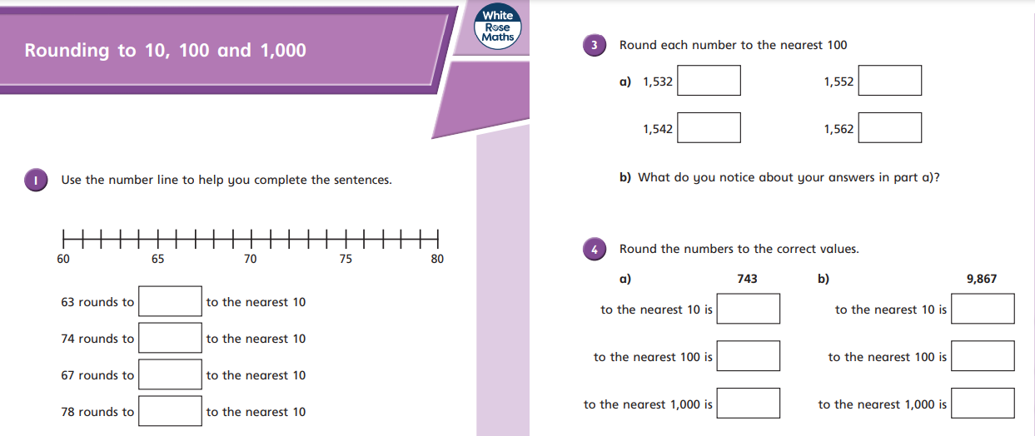
Triangles….

Slide 35
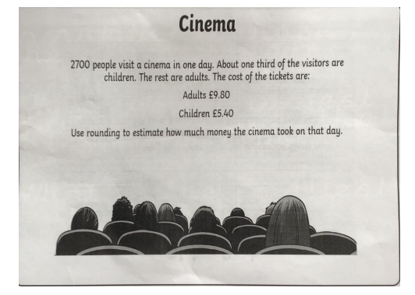

Slide 36
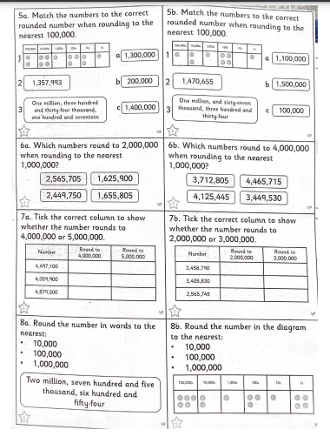

Slide 37
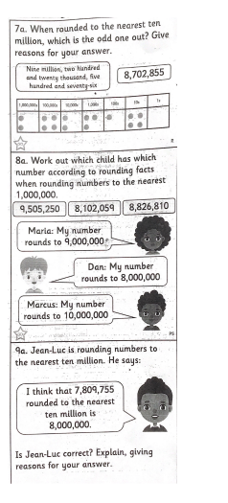

Slide 38
Wednesday 16th September
LO: To round numbers to 10, 100 and 1000 (problem solving) – Triangles
LO: To solve problems involving rounding
LO: To round any number (Squares)

Slide 39
Our favourite…!
https://www.youtube.com/watch?v=3afU6JQG15I
Sing along !

Slide 40
Crucial vocabulary this lesson…
round/rounding
estimate/estimating
approximate/approximating
to the nearest…/rounding off…
actual
whole numbers
place value
number line

Slide 41
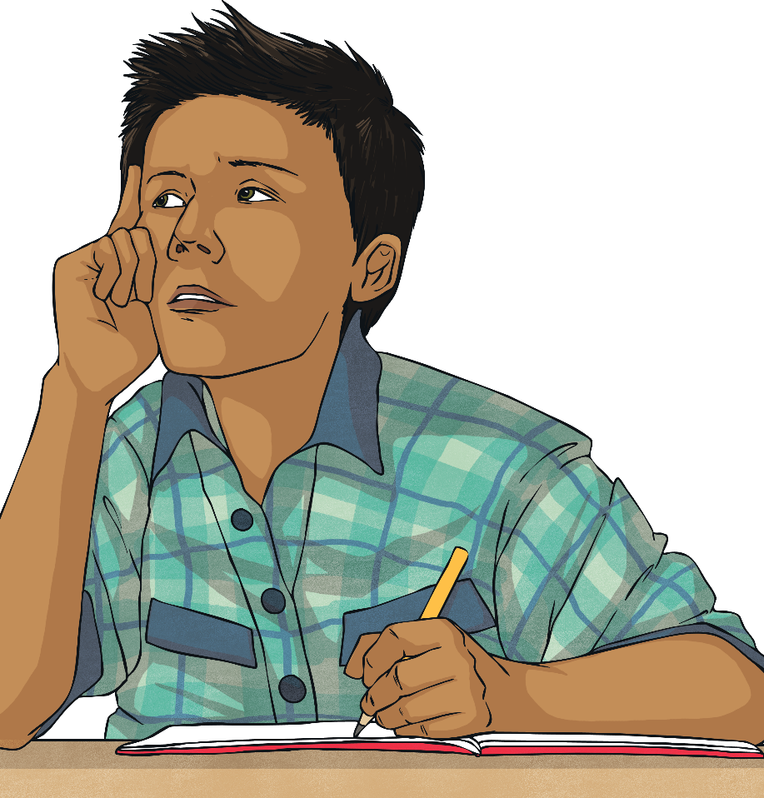
Rounding Reminders
What are your top tips for
rounding numbers?
Think about how to decide which digit to consider and how to decide whether to round up or down.
Write your rounding reminders down so that you remember what to do!

Slide 42

I’m thinking of an integer that is 23,100 when rounded to the nearest 100
What is the smallest number Jack could be thinking of?
23,050
23,050
23,070
23,090
23,110
23,130
23,150
23,060
23,080
23,100
23,120
23,140
What is the greatest number Jack could be thinking of?
23,149
Have a think

Slide 43
Talk task
Whitney rounded 2,215,678 to the nearest million and wrote 2,215,000
Can you explain to Whitney what mistake she has made?

Slide 44
15,987 15,813 15,101 16,101
Tommy says, “My number rounds to 16,000 to the nearest 1,000”
Alex says, “My number has one hundred.”
Jack says, “ My number is 15,990 when rounded to the nearest 10”
Dora says, “My number is 15,000 when rounded to the nearest 1,000”
Can you work out which child has which card?

Slide 45
Weds- Over to you….
Hexagons(out)- Mrs Warham & Mrs Lund -
Problem solving
Squares- Independent -Whiterose sheet
Octagons- Mrs Day – Problem solving
Triangles- Mrs Cooper
Whiterose questions 6-9

Slide 46
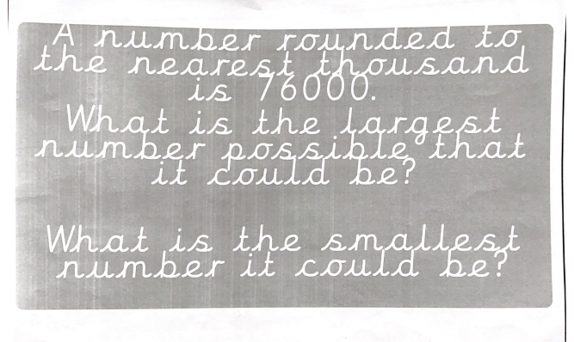
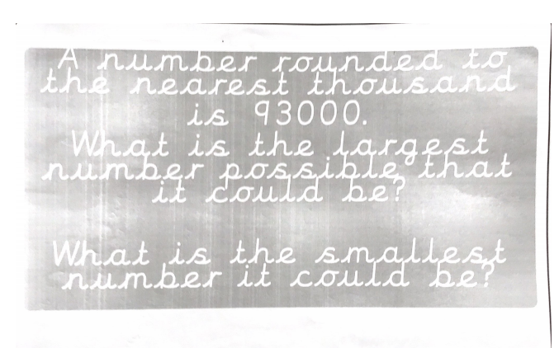

Slide 47
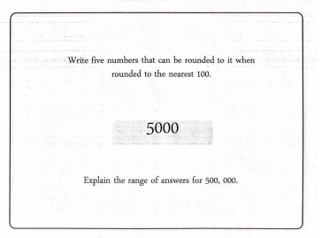

Slide 48
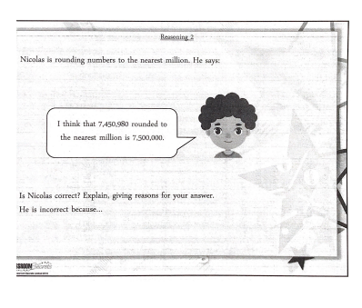

Slide 49
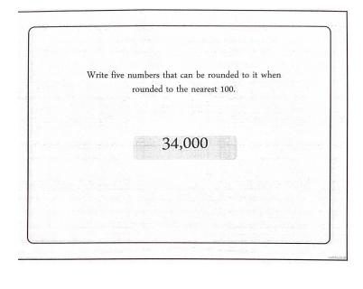

Slide 50
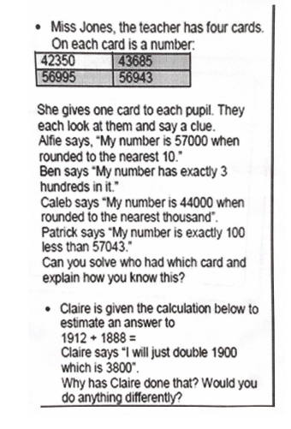

Slide 51
Recap time…useful websites
https://vimeo.com/454666928
https://www.bbc.co.uk/teach/skillswise/rounding-and-estimating/zv8qcqt
https://www.youtube.com/watch?v=n1VBMphaRPo

Slide 52
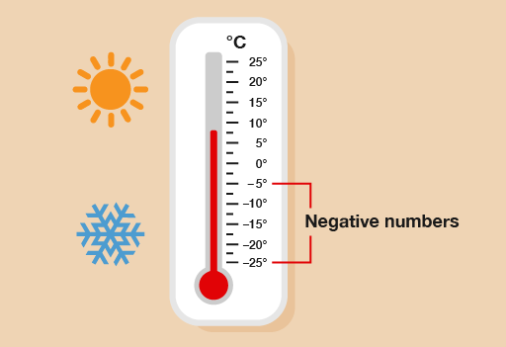
Thursday 17th September
LO: To understand and use negative numbers

Slide 53
Revision- Watch the clip!
https://www.bbc.co.uk/bitesize/topics/znwj6sg/articles/zxthnbk

Slide 54
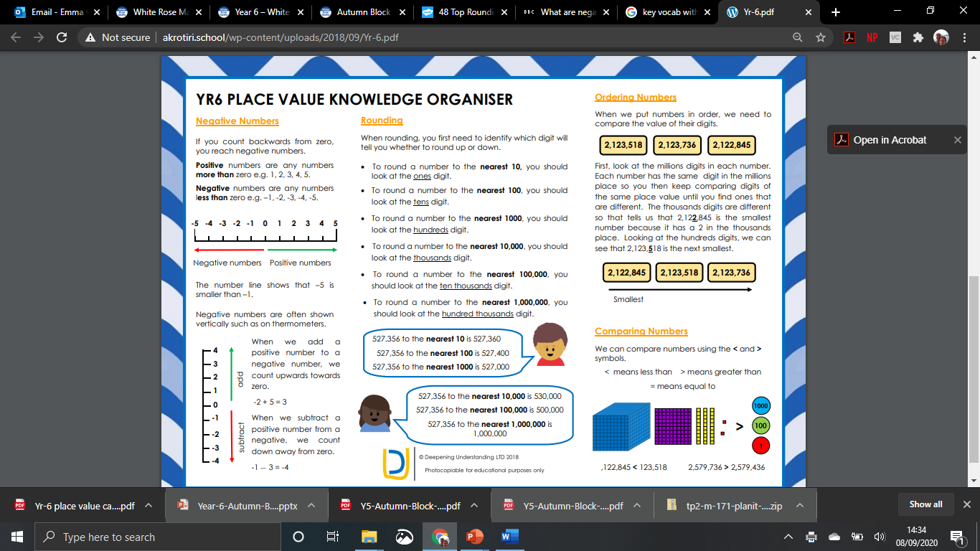
Stick
in
books…

Slide 55


https://www.bbc.co.uk/bitesize/topics/znwj6sg/articles/zxthnbk
A
B
C
D
E
-5 |  |  |  |  |  |  |  |  |  | 5
Revision
© Classroom Secrets Limited 2018

Slide 56
Introduction
What number does each arrow point to?
A
B
C
D
E
-5 | -4 |  |  | -1 | 0 |  | 2 |  | 4 | 5
© Classroom Secrets Limited 2018

Slide 57
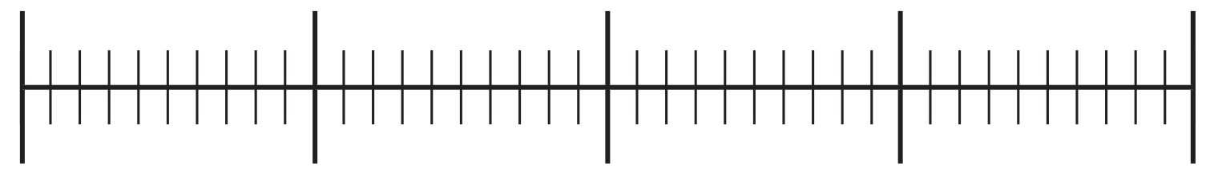
Varied Fluency 1
Put the numbers below in the correct place
on the number line.
10
-13
2
-7
18
-20
20
© Classroom Secrets Limited 2018

Slide 58
Varied Fluency 1
Put the numbers below in the correct place
on the number line.
10
-13
2
-7
18
10
-13
-7
2
18
-20
20
© Classroom Secrets Limited 2018

Slide 59
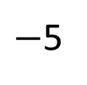
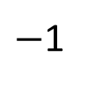
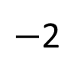
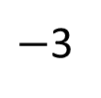
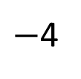
Have a think
The number line looks correct to me!
$−$1
$−$2
$−$3
$−$4
$−$5
0
1
2
3
4
5

Slide 60
Varied Fluency 2
If the temperature in London is 23°C and the temperature in Greenland is -12°C, the difference between the two temperatures is 35°C.
True or False?
Talk task…
© Classroom Secrets Limited 2018

Slide 61
Varied Fluency 2
If the temperature in London is 23°C and the temperature in Greenland is -12°C, the difference between the two temperatures is 35°C.
True or False?
True
© Classroom Secrets Limited 2018

Slide 62
Varied Fluency 3
Circle the smallest number in each set below.
a
-19 2 -3 0 -21 4
b
16 -17 1 0 4 -9
c
-11 3 -6 12 -8 2
© Classroom Secrets Limited 2018

Slide 63
Varied Fluency 3
Circle the smallest number in each set below.
a
-19 2 -3 0 -21 4
b
16 -17 1 0 4 -9
c
-11 3 -6 12 -8 2
© Classroom Secrets Limited 2018

Slide 64
Varied Fluency 4
Find the difference between the largest and smallest
number in each row.
a
-36 5 -1 0 -8 19
b
25 -1 7 4 -17 -9
c
-16 3 1 19 -5 23
© Classroom Secrets Limited 2018

Slide 65
Varied Fluency 4
Find the difference between the largest and smallest
number in each row.
55
42
39
a
-36 5 -1 0 -8 19
b
25 -1 7 4 -17 -9
c
-16 3 1 19 -5 23
© Classroom Secrets Limited 2018

Slide 66
Reasoning 1
Which is the odd one out? Explain why.
a
the difference between 3 and -4
b
9 more than -2
c
the difference between -5 and 2
d
10 more than -4
© Classroom Secrets Limited 2018

Slide 67
Reasoning 1
Which is the odd one out? Explain why.
The odd one out is ‘d’ because the answer is 6, the other answers are 7.
a
the difference between 3 and -4
b
9 more than -2
c
the difference between -5 and 2
d
10 more than -4
© Classroom Secrets Limited 2018

Slide 68
Friday 18th September
LO: To understand and use negative numbers (problem solving)

Slide 70
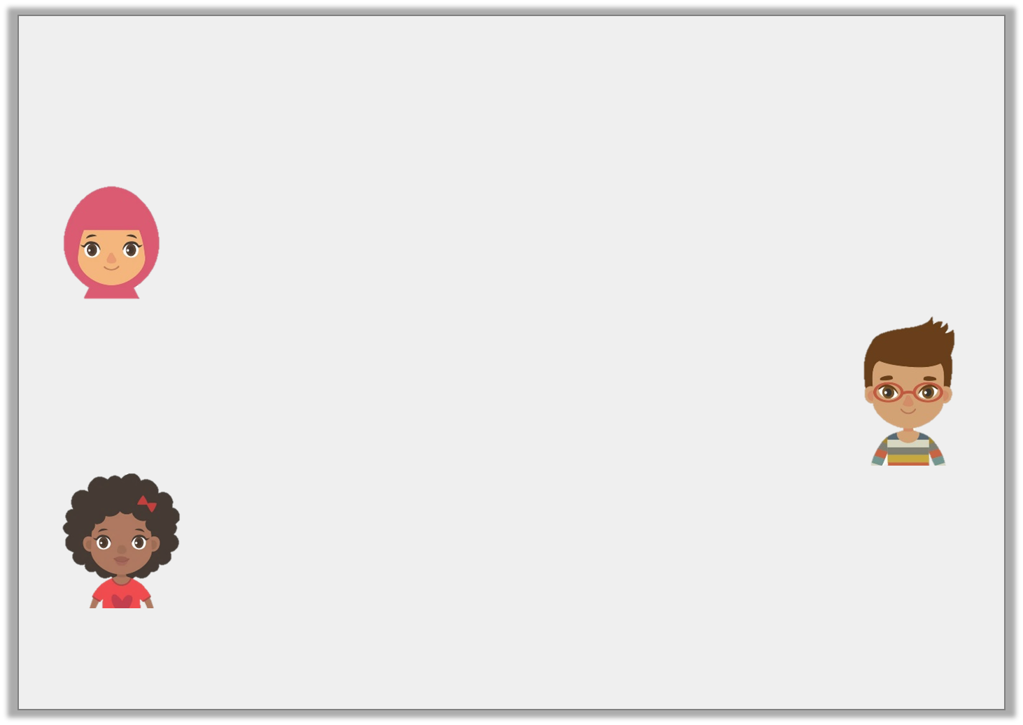
Problem Solving 1
Work out the answers to the children’s questions, then order them from smallest to largest.
What is the difference between 21°C and -32°C?
Hafsa
Which number is halfway between -6 and 48?
Josh
What is 27 greater than
-28?
Isabel
© Classroom Secrets Limited 2018

Slide 71
Problem Solving 1
Work out the answers to the children’s questions, then order them from smallest to largest.
Order: -1, 21, 53
What is the difference between 21°C and -32°C?
53
Hafsa
Which number is halfway between -6 and 48?
21
Josh
What is 27 greater than
-28?
-1
Isabel
© Classroom Secrets Limited 2018

Slide 72
Talk task
Problem Solving 2
Ben had £23 in his bank account. On Monday, he paid his phone bill and bought a t-shirt. His account is now overdrawn by £42. If the phone bill was £39, how much was Ben’s t-shirt?
© Classroom Secrets Limited 2018

Slide 73
Problem Solving 2
Ben had £23 in his bank account. On Monday, he paid his phone bill and bought a t-shirt. His account is now overdrawn by £42. If the phone bill was £39, how much was Ben’s t-shirt?
-42 + 39 = -3
The difference between -3 and 23 is 26.
£26
© Classroom Secrets Limited 2018

Slide 75
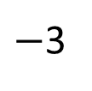
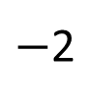
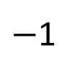
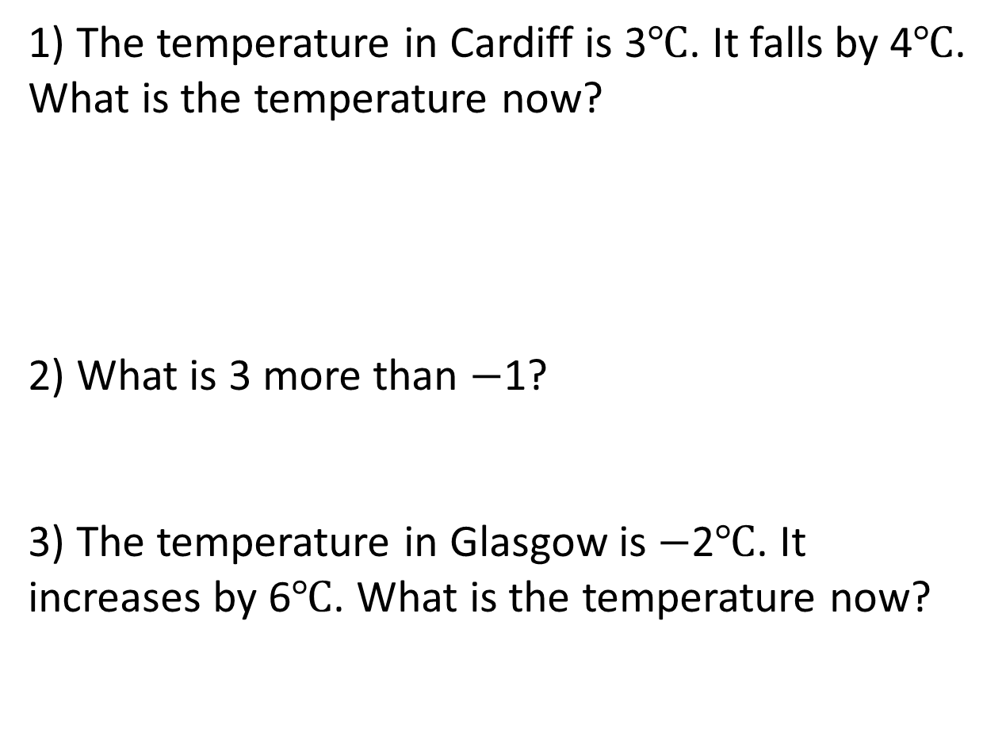
1) The temperature in Cardiff is 3$℃$. It falls by 4$℃$. What is the temperature now?
2) What is 3 more than $−$1?
3) The temperature in Glasgow is $−$2$℃$. It increases by 6$℃$. What is the temperature now?
$−$3
$−$2
$−$1
0
1
2
3

Slide 76
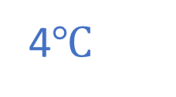
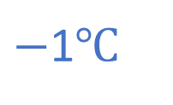
1) The temperature in Cardiff is 3$℃$. It falls by 4$℃$. What is the temperature now?
2) What is 3 more than $−$1?
3) The temperature in Glasgow is $−$2$℃$. It increases by 6$℃$. What is the temperature now?
$−$1$℃$
$−$3
$−$2
$−$1
0
1
2
3
2
4$℃$

Slide 77


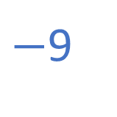



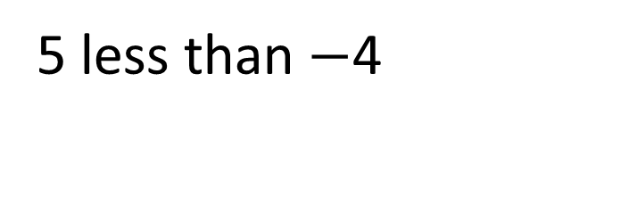
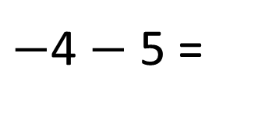

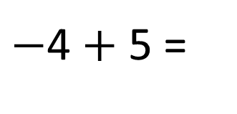


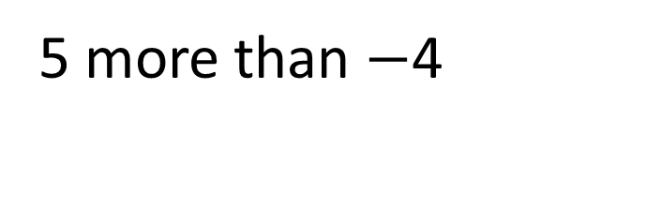


Have a think
$−$4 $+$ 5 =
1
$−$4 $−$ 5 =
$−$9
5 more than $−$4
5 less than $−$4
$−$10
$−$9
$−$8
$−$7
$−$6
$−$5
$−$4
$−$3
$−$2
$−$1
0
1
2
3
4
5
6
7
8
9
10
What’s the same and what’s different?

Slide 78
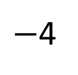
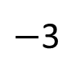
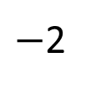
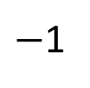
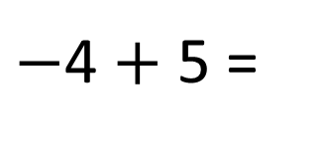
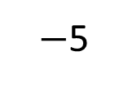
$−$4 $+$ 5 =
1
4
1
$−$5
$−$4
$−$3
$−$2
$−$1
0
1
2
3
4
5
4
1

Slide 79
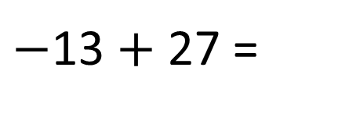
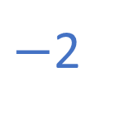
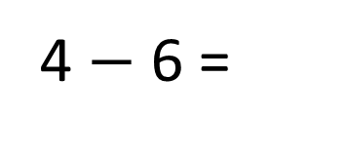
$−$4 $+$ 5 =
1
4
1
$−$5
$−$4
$−$3
$−$2
$−$1
0
1
2
3
4
5
2
4
4 $−$ 6 =
14
$−$2
$−$13 $+$ 27 =
4
2
13
14

Slide 80

Negative Numbers
Diving
Match the answer to these statements to the correct place on the number line.
What is 12 less than 5? | -10 +14 = | What is 17 taken from 7? | Add 9 to -8 = | 2 - 11 =
-7
4
-10
1
-9
-10 -9 -8 -7 -6 -5 -4 -3 -2 -1 0 1 2 3 4 5 6 7 8 9 10

Slide 81
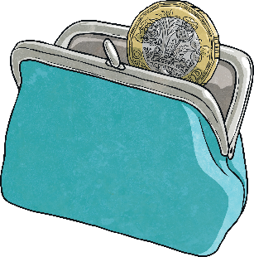
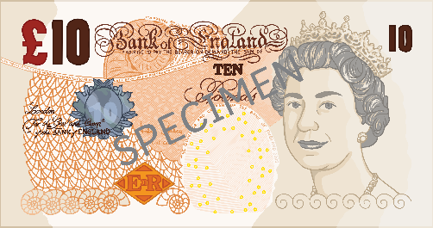
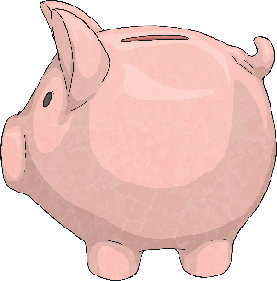
Negative Numbers
Diving
I have -£26 in my bank account. I put £35 into my account. What is my new balance?
My bank account has £9 in it. I spend £19. What is my new bank account balance?
I spend £45 on a new game. The balance in my bank account is now -£12. How much money did I have in my account before I bought the game?
£9
-£10
£33

Slide 82
Negative Numbers
Diving
This table shows how the temperature changed on four different streets around the world. Complete the table to show how the temperatures changed over three months.
Town | October | Temperature change | November | Temperature Change | December
Study Street | 13°C | -10°C |  | -7°C
Reasoning Road | -1°C | +5°C |  | -6°C
Problem-Solving Place | -5.5°C |  | 7.5°C |  | -11.5°C
3°C
-4°C
4°C
-2°C
+12°C
-19°C

Slide 83
Negative Numbers
Deeper
Miriam has found the minimum and maximum average temperatures for four countries around the world. She has calculated the temperature range for each country.
Can you identify her mistakes and correct them?
Country | Average Minimum Temperature | Average Maximum Temperature | Average Temperature Range
Canada | -29°C | 15°C
China | -12°C | 21°C
Sweden | -16.6°C | 17.9°C
44°C
43°C
Correct
33°C
34.5°C
33.5°C

Slide 84



Negative Numbers
Deeper
Country | Average Minimum Temperature | Average Maximum Temperature | Average Temperature Range
Canada | -29°C | 15°C | 44°C
China | -12°C | 21°C | 33°C
Sweden | -16.6°C | 17.9°C | 34.5°C
Using the table, explain whether the following statements are true or false.
If you order the countries by their average minimum temperature, from coldest to warmest, they would be: Canada, Sweden and China.
The difference in temperature between the coldest average minimum temperature and the hottest average maximum temperature is less than 40°C.
True. From the coldest to warmest temperature, the order would be: Canada (-28.7°C), Sweden (-16.6°C) and China (-11.7°C).
False. The difference between -29°C and 21°C is 50°C. This is greater
than 40°C.

Slide 85

Negative Numbers
Deepest
An explorer was investigating a deep crater.
On day one, she travelled -5.6m down the crater. On day two, she travelled a further -4.8m down the crater. On day three, she travelled 6.8m back up the crater to collect some more supplies. On day four, she travelled another -9.7m back down the crater. On day five, she travelled all the way back up to the top of the crater to return to the surface.
How far did she need to travel on day five to return to the surface?
13.3m

