Slide 1
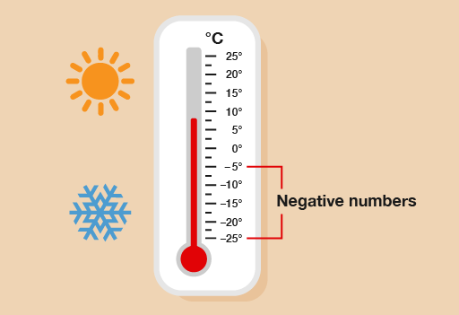
Week 3
Monday 21st September
LO: To order and compare positive and negative numbers

Slide 2
Let’s count!
Count in 2’s backwards from 12.
Count backwards in 5’s from 30.
Count backwards in 10’s from 50.

Slide 3
Revision- Watch the clip!
https://www.bbc.co.uk/bitesize/topics/znwj6sg/articles/zxthnbk

Slide 4
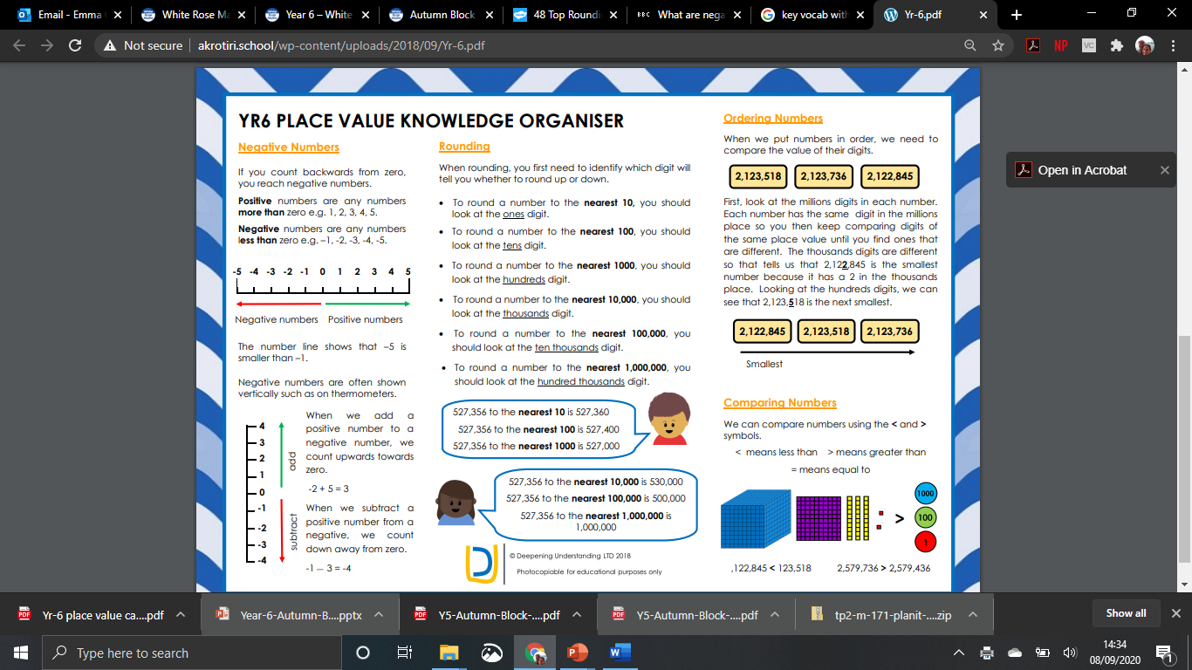
Stick
in
books…

Slide 5
Key vocabulary:
greater than
fewer than
minus
positive numbers
negative numbers
difference between

Slide 6


https://www.bbc.co.uk/bitesize/topics/znwj6sg/articles/zxthnbk
A
B
C
D
E
-5 |  |  |  |  |  |  |  |  |  | 5
Revision
© Classroom Secrets Limited 2018

Slide 7
Introduction
What number does each arrow point to?
A
B
C
D
E
-5 | -4 |  |  | -1 | 0 |  | 2 |  | 4 | 5
© Classroom Secrets Limited 2018

Slide 8
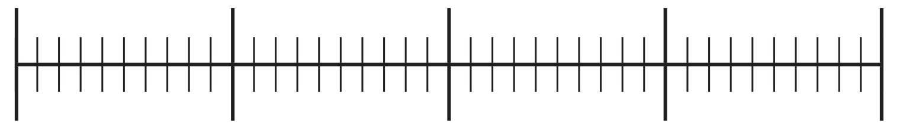
Varied Fluency 1
Put the numbers below in the correct place
on the number line.
10
-13
2
-7
18
-20
20
© Classroom Secrets Limited 2018

Slide 9
Varied Fluency 1
Put the numbers below in the correct place
on the number line.
10
-13
2
-7
18
10
-13
-7
2
18
-20
20
© Classroom Secrets Limited 2018

Slide 10


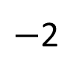
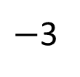
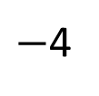
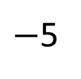
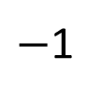
Talk about it!
Have a think
The number line looks correct to me!
$−$1
$−$2
$−$3
$−$4
$−$5
0
1
2
3
4
5

Slide 11
Can you order this set of numbers starting with the coldest?
20
- 20
- 2
5
- 15
10

Slide 12
Negative Numbers
6
5
4
Getting warmer
3
The temperature
scale is often seen vertically.
2
1
Water freezing
0
- 1
As the temperature goes below freezing we use negative numbers.
- 2
Getting colder
- 3
- 4
- 5
- 6

Slide 13
Varied Fluency 2
If the temperature in London is 23°C and the temperature in Greenland is -12°C, the difference between the two temperatures is 35°C.
True or False?
Talk task…
© Classroom Secrets Limited 2018

Slide 14
Varied Fluency 2
If the temperature in London is 23°C and the temperature in Greenland is -12°C, the difference between the two temperatures is 35°C.
True or False?
True
© Classroom Secrets Limited 2018

Slide 15
Over to you….
https://vimeo.com/454667428
Mrs Day Triangles (Out) Work through video. Then ordering negative numbers
Sheet independently .
Squares- Mrs Lund Whiterose sheet
Hexagons-Independent- slide 18
Octagons- Mrs Warham

Slide 16
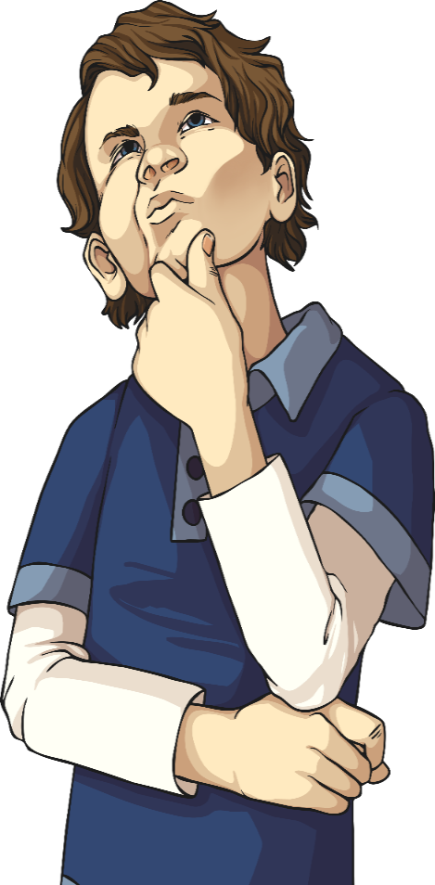
Triangles
Order the following numbers from smallest to largest:
34, -23, 14, -12, 41, -2, -24, 13
9⁰C, -7⁰C, -9⁰C, 3⁰C, -5⁰C, 0⁰C, -12⁰C
45, 67, -23, 28, -12, 78, -59, -1

Slide 17
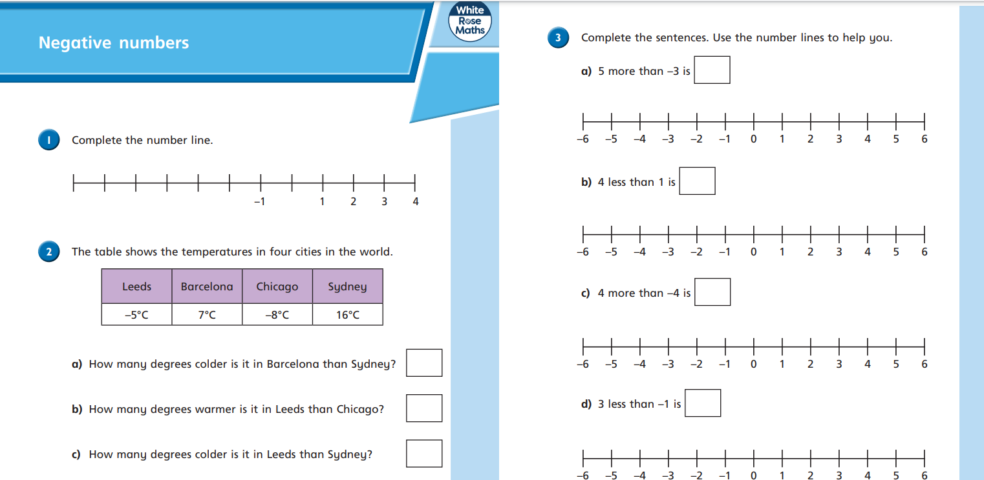
Squares- Mrs Lund Whiterose sheet

Slide 18
Hexagons: Over to you…
Order smallest to biggest:
-56, -87, 42, 5, -21
55, -68, -94, 4
-100 60, -77, 36, -46
59, -82, -5, 7, -10
-45, 52, 31, 6, -93
Compare:
6. 34 < or > -17
7. -45 < or > 5
8. 65 < or > -3
9. -37 < or > 20
10. 18 < or > -3
Compare:
1. 64 < or > -87
2. -85 < or > 95
3. 75 < or > -13
4. -67 < or > 20
5. 108 < or > -93
Spot the mistake:
6. -5, 5, 15, 25, 30
7. -18, -12, -6, 6
8. -9, -6, -3, 3, 6,
9. 30, 15, 0, -15, -20
10. -65, -25, -25, -65

Slide 19
Order smallest to biggest:
-56, -87, 42, 5, -21
55, -68, -94, 4
-100 60, -77, 36, -46
59, -82, -5, 7, -10
-45, 52, 31, 6, -93
Compare:
6. 34 < or > -17
7. -45 < or > 5
8. 65 < or > -3
9. -37 < or > 20
10. 18 < or > -3
Order smallest to biggest:
-56, -87, 42, 5, -21
55, -68, -94, 4
-100 60, -77, 36, -46
59, -82, -5, 7, -10
-45, 52, 31, 6, -93
Compare:
6. 34 < or > -17
7. -45 < or > 5
8. 65 < or > -3
9. -37 < or > 20
10. 18 < or > -3
Order smallest to biggest:
-56, -87, 42, 5, -21
55, -68, -94, 4
-100 60, -77, 36, -46
59, -82, -5, 7, -10
-45, 52, 31, 6, -93
Compare:
6. 34 < or > -17
7. -45 < or > 5
8. 65 < or > -3
9. -37 < or > 20
10. 18 < or > -3
To print

Slide 20
22.09.20
L.O. To find the difference between positive and negative numbers.

Slide 21
Warm up! True or false?
When I count backwards in 1000s from
10,034, I will say 6340.

Slide 22
Key vocabulary:
greater than
fewer than
minus
positive numbers
negative numbers
difference between

Slide 23
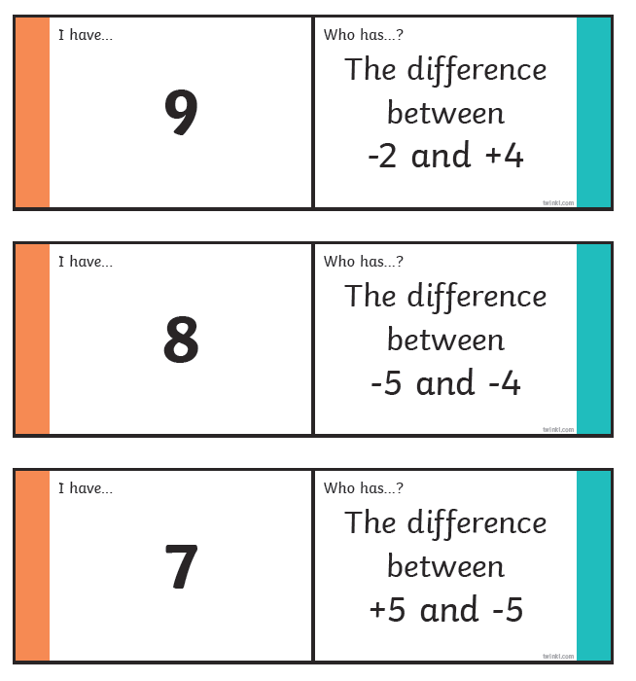
Triangles in input

Slide 24
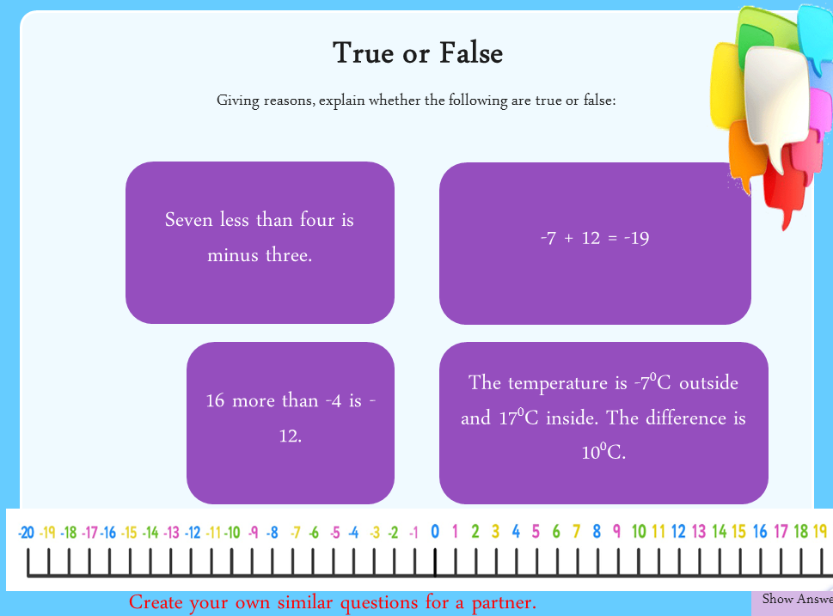

Slide 25

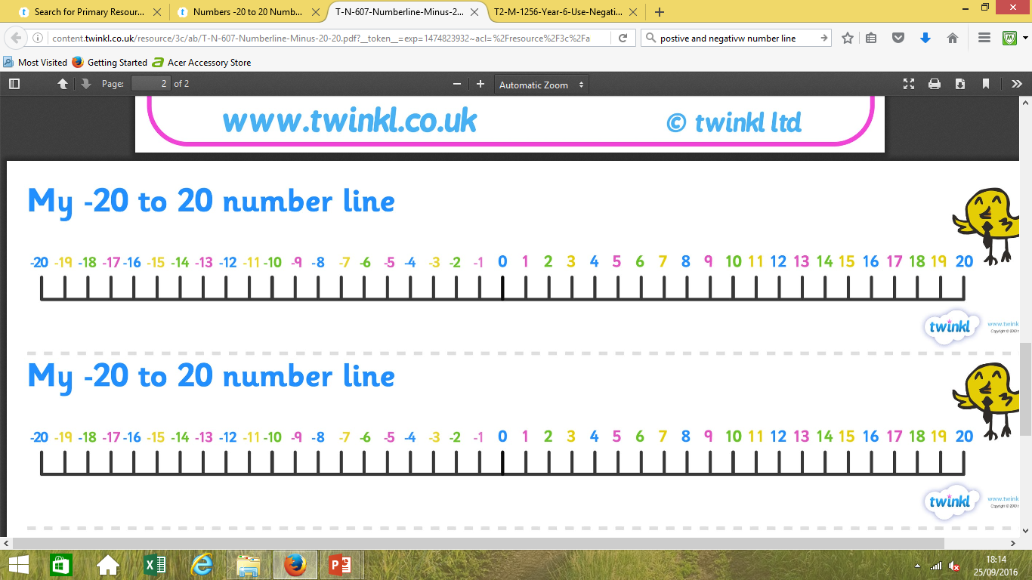
True or False
Giving reasons, explain whether the following are true or false:
Seven less than four is minus three.
False - the answer is 5. The answer goes through 0, so +7 to 0, and +5 more to 5.
True
-7 + 12 = -19
False - the answer is 12. The answer goes through 0, so +4 to 0, and +12 more to 12.
False - the answer is 24⁰C. The answer goes through 0, so -7 to 0 is 7, and 0 to 17 is 17. 7 + 17 = 24.
16 more than -4 is -12.
The temperature is -7⁰C outside and 17⁰C inside. The difference is 10⁰C.
Hide
Answers
Create your own similar questions for a partner.
Show Answers

Slide 26
True or false?
-34
<
-60
I know that -34 is _______than -60 because___________________________________________________.

Slide 27
Difference between:
-2 and 15

Slide 28
Difference between:
-18 and 22

Slide 29
Difference between:
-27 and 38

Slide 30
Reasoning 1
Which is the odd one out? Explain why.
Talk about it!
a
the difference between 3 and -4
b
9 more than -2
c
the difference between -5 and 2
d
10 more than -4
© Classroom Secrets Limited 2018

Slide 31
Reasoning 1
Which is the odd one out? Explain why.
The odd one out is ‘d’ because the answer is 6, the other answers are 7.
a
the difference between 3 and -4
b
9 more than -2
c
the difference between -5 and 2
d
10 more than -4
© Classroom Secrets Limited 2018

Slide 32
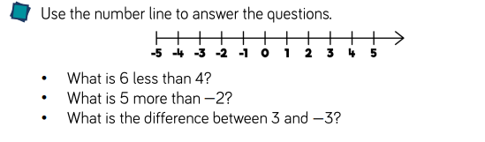

Slide 33
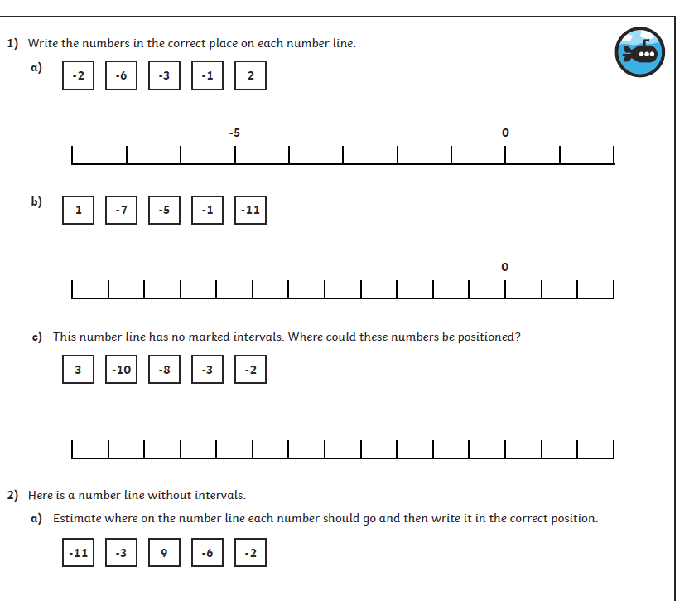
Tues- Over to you….
Triangles- Negative number line worksheet
Revise using IPADs then complete independently.
https://www.theschoolrun.com/what-are-negative-numbers
Squares-Mrs Cooper
Hexagons- Mrs Warham/Mrs Lund- Negative number differences- temp
Octagons- independent- temp sheet

Slide 34
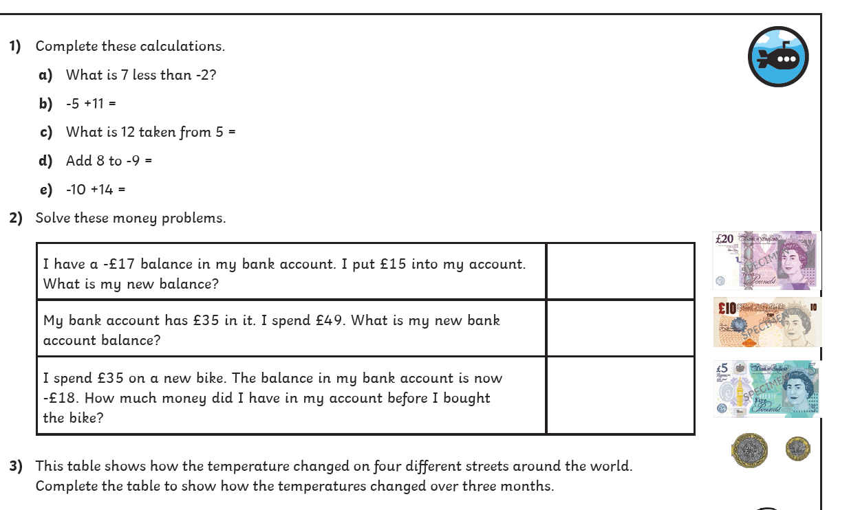
Hexagons- Mrs Warham/Mrs Lund- Negative number differences- temp

Slide 35
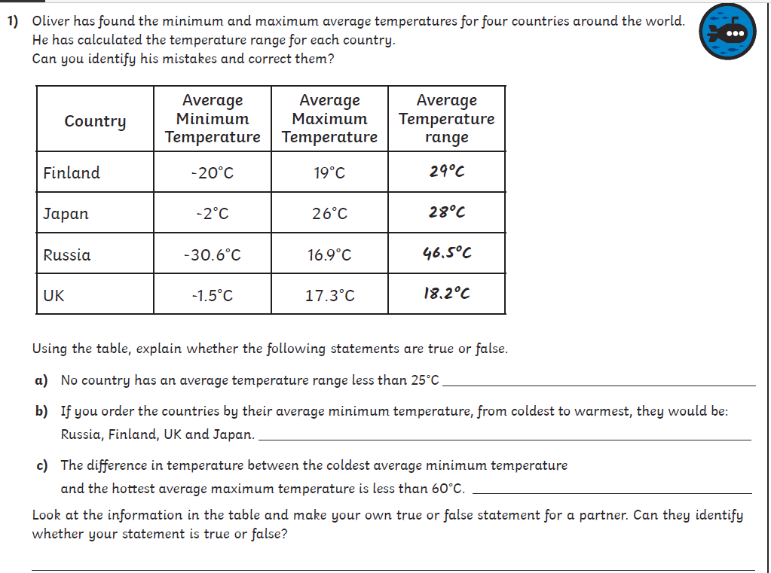
Octagons

Slide 36
Find the difference:
-15 and 8
4 and -2
20 and -3
-9 and 32
16 and -4
32 and -5
-18 and 4
-12 and 23
-4 and 37
56 and – 12
9 and – 27
-65 and 33
Squares

Slide 37
Week 3
Tuesday 22nd September
LO: To understand and use negative numbers (problem solving)

Slide 38
Let’s count! True or False?
When I count backwards in 50s
from 10 I will say -150.
Explain how you know.

Slide 39
Varied Fluency 4
Complete the part-whole model.
49
-91
© Classroom Secrets Limited 2018

Slide 40
Varied Fluency 4
Complete the part-whole model.
49
-140
-91
© Classroom Secrets Limited 2018

Slide 41
True or false?
4 less than -5 is -9

Slide 42
True or false?
8 more than -7 is -15

Slide 43

Talk about it….

Slide 44
True or false?
-34
<
-60
I know that -34 is _______than -60 because___________________________________________________.

Slide 45
Varied Fluency 2
On the surface of Jupiter, the temperature can be as low
as -160°C. At the top of Jupiter’s atmosphere, the temperature can increase by 885°C.
What is the temperature at the top of Jupiter’s atmosphere?
© Classroom Secrets Limited 2018

Slide 46
Varied Fluency 2
On the surface of Jupiter, the temperature can be as low
as -160°C. At the top of Jupiter’s atmosphere, the temperature can increase by 885°C.
What is the temperature at the top of Jupiter’s atmosphere?
-160 + 885 = 725°C
© Classroom Secrets Limited 2018

Slide 47
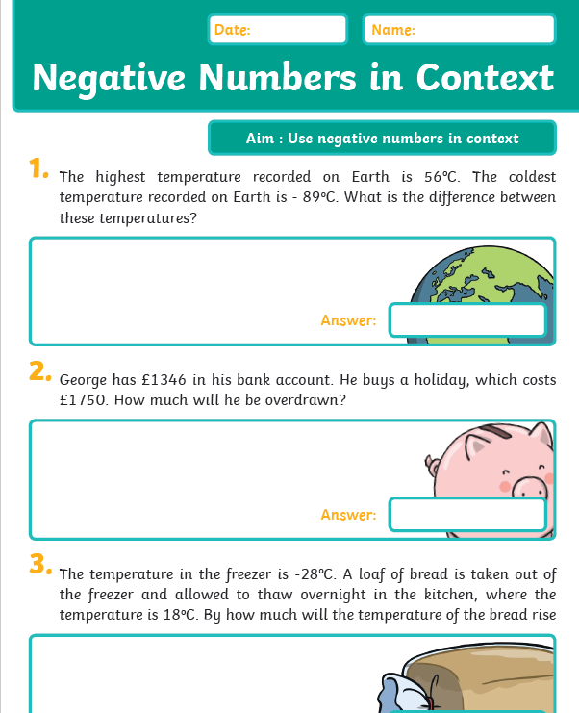
Weds - Over to you….
Triangles- Negative number problems – Mrs Lund
Squares/Hexagons-Mrs Cooper-
Hexagons - Mrs Warham (grp) Rest in class
Problem solving- slides
Octagons-Mrs Day (out room)

Slide 48
Squares/Hex

Slide 49
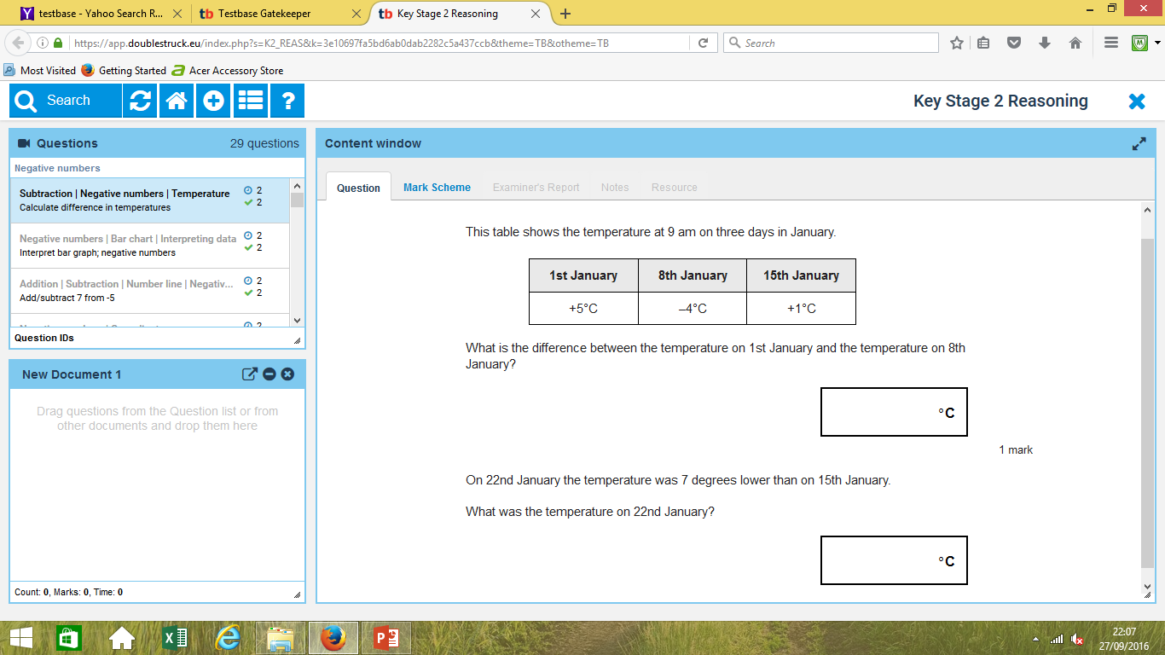
Squares/Hex

Slide 50
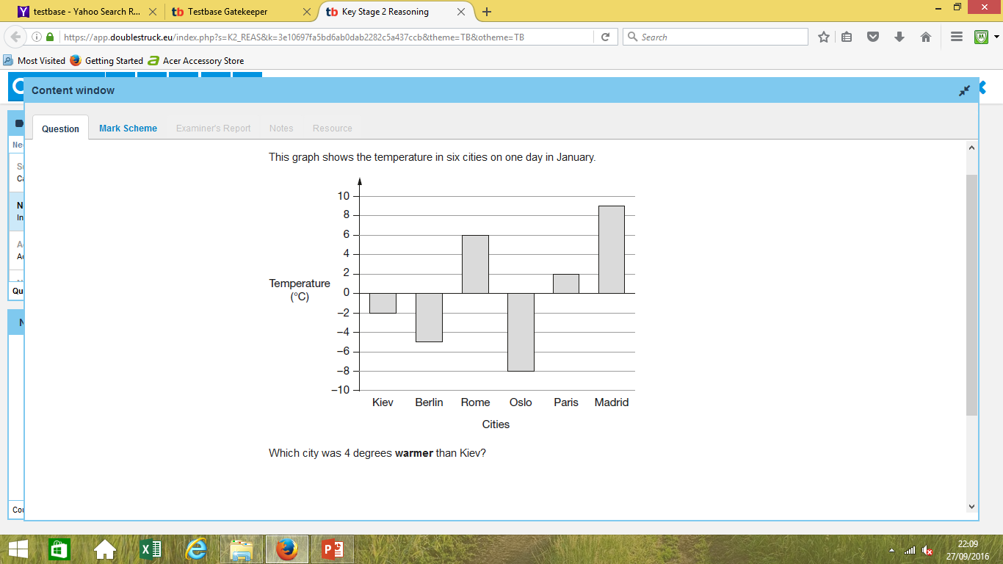
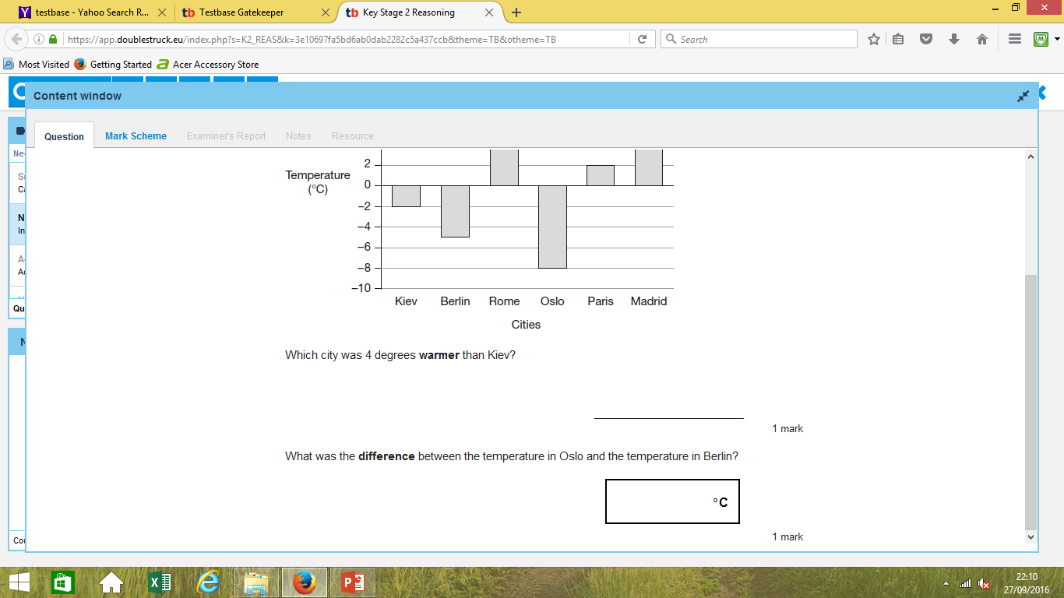
Squares/Hex

Slide 51
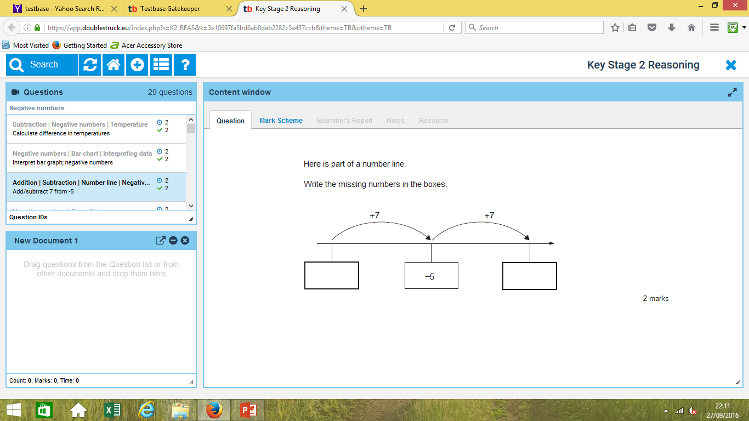

Slide 52
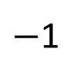
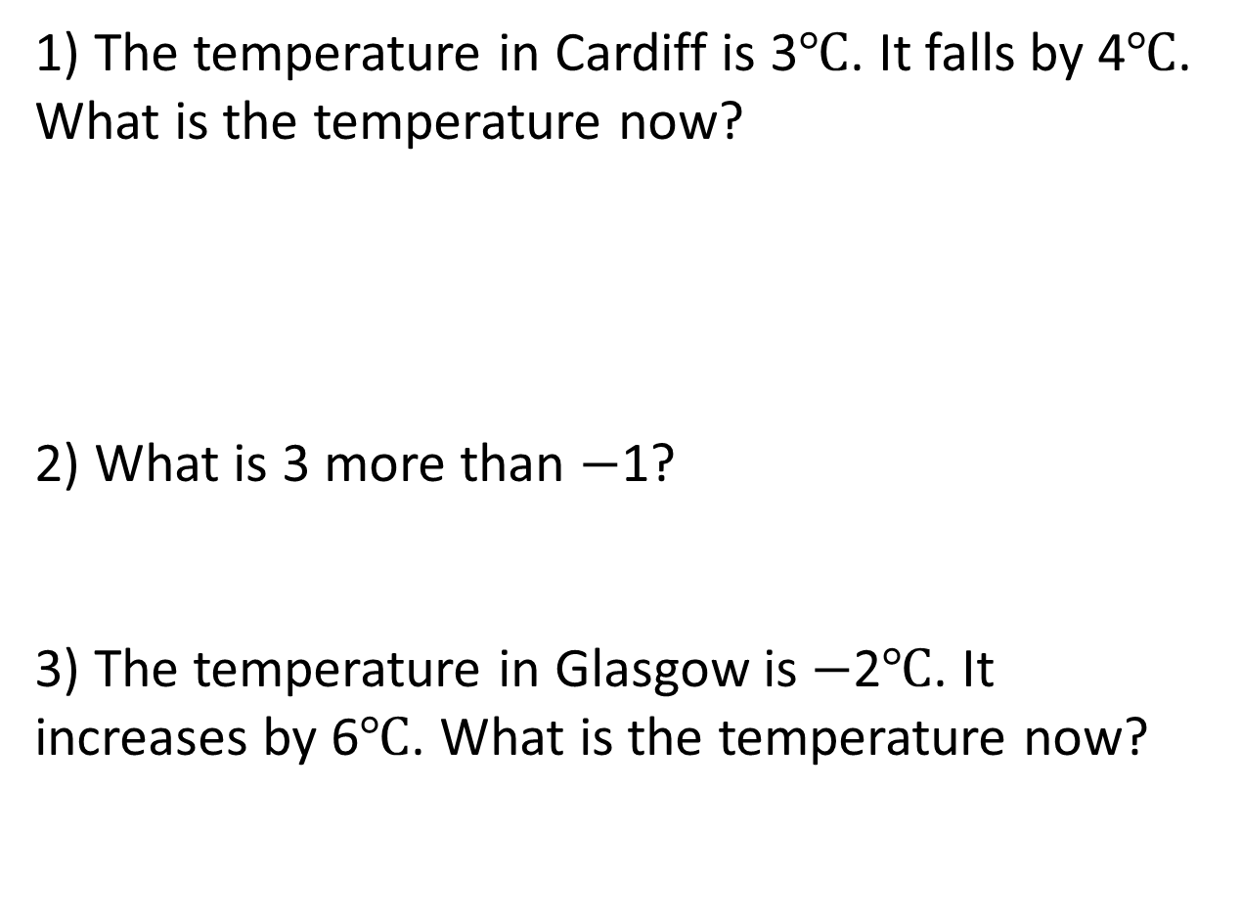
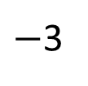
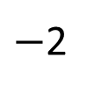
Triangles
1) The temperature in Cardiff is 3$℃$. It falls by 4$℃$. What is the temperature now?
2) What is 3 more than $−$1?
3) The temperature in Glasgow is $−$2$℃$. It increases by 6$℃$. What is the temperature now?
$−$3
$−$2
$−$1
0
1
2
3

Slide 53
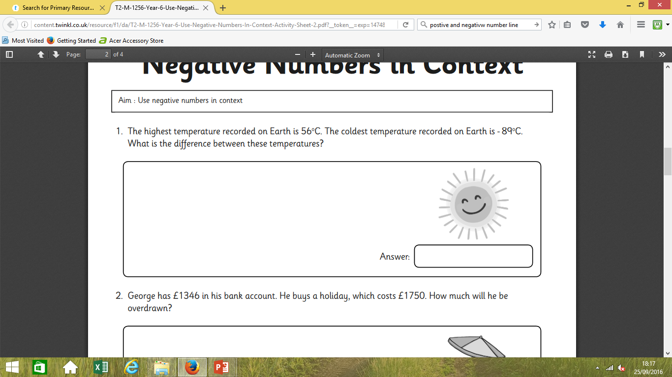
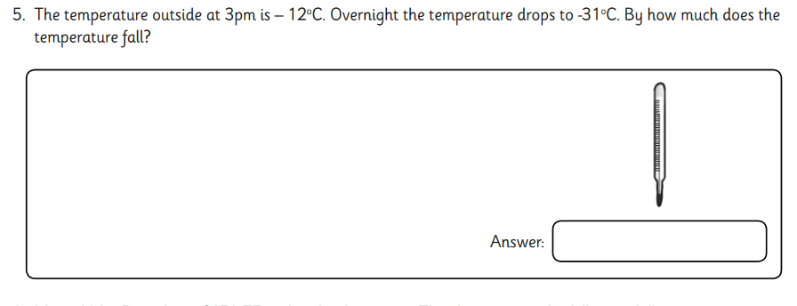
Triangles

Slide 54
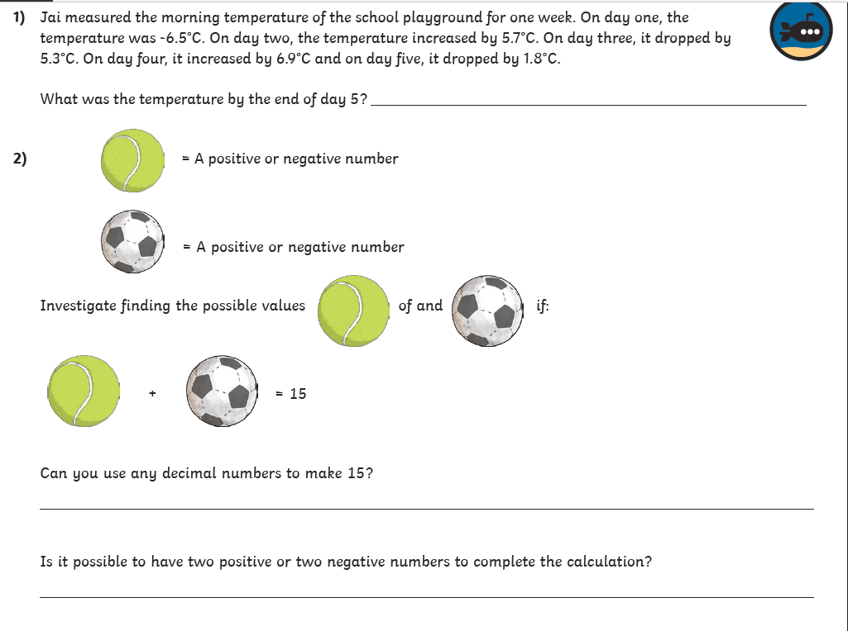
Octagons- problem solving Mrs Day

Slide 55

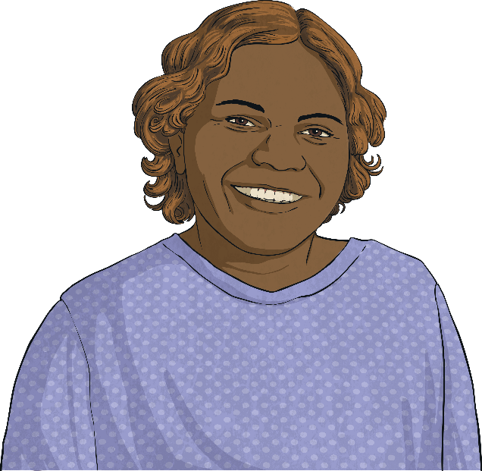
Negative Numbers
Deepest
An explorer was investigating a deep crater.
On day one, she travelled -5.6m down the crater. On day two, she travelled a further -4.8m down the crater. On day three, she travelled 6.8m back up the crater to collect some more supplies. On day four, she travelled another -9.7m back down the crater. On day five, she travelled all the way back up to the top of the crater to return to the surface.
How far did she need to travel on day five to return to the surface?
13.3m
Octagons

Slide 56
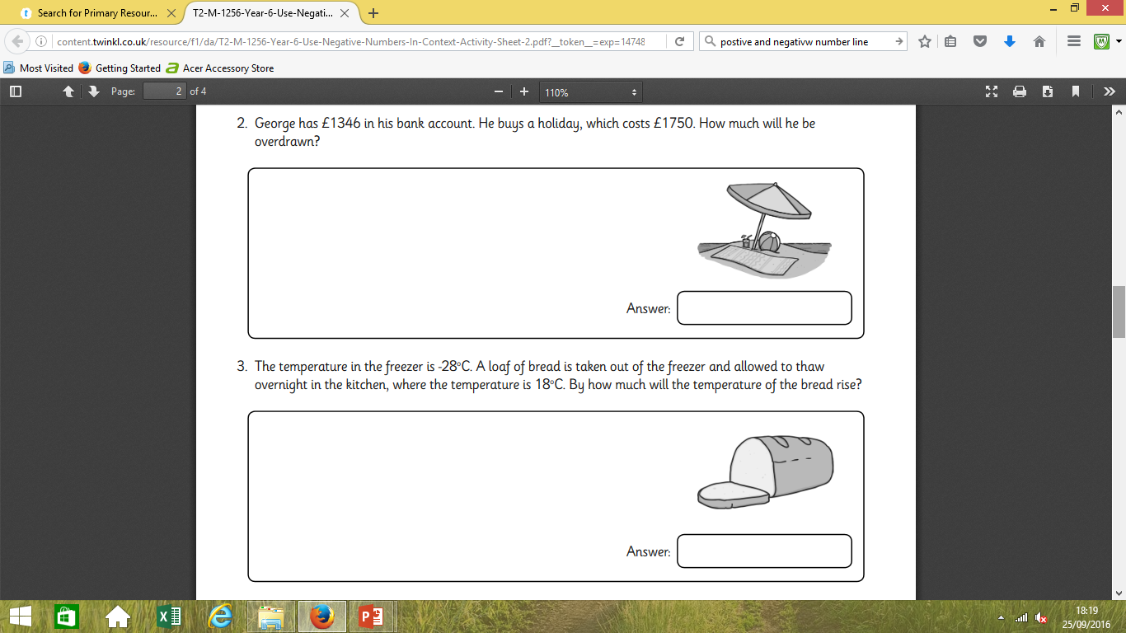

Slide 58
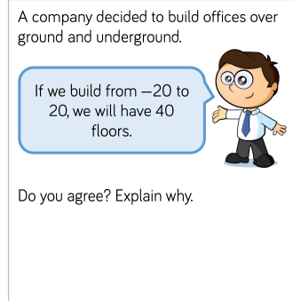

Slide 59
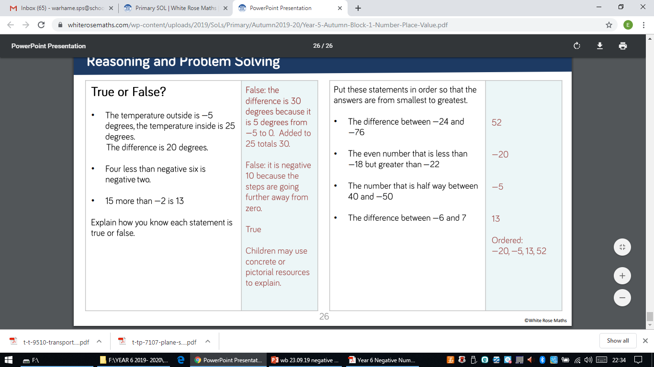

Slide 61
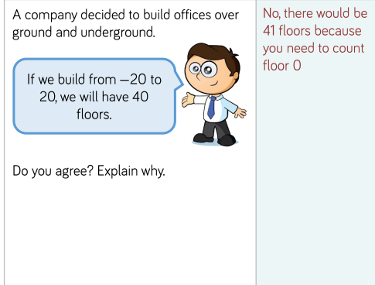

Slide 63
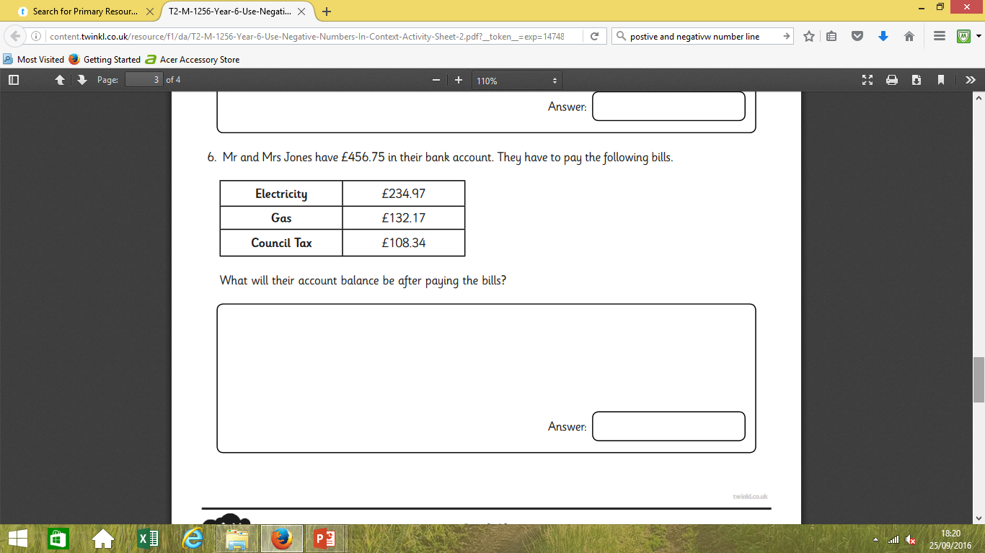

Slide 64
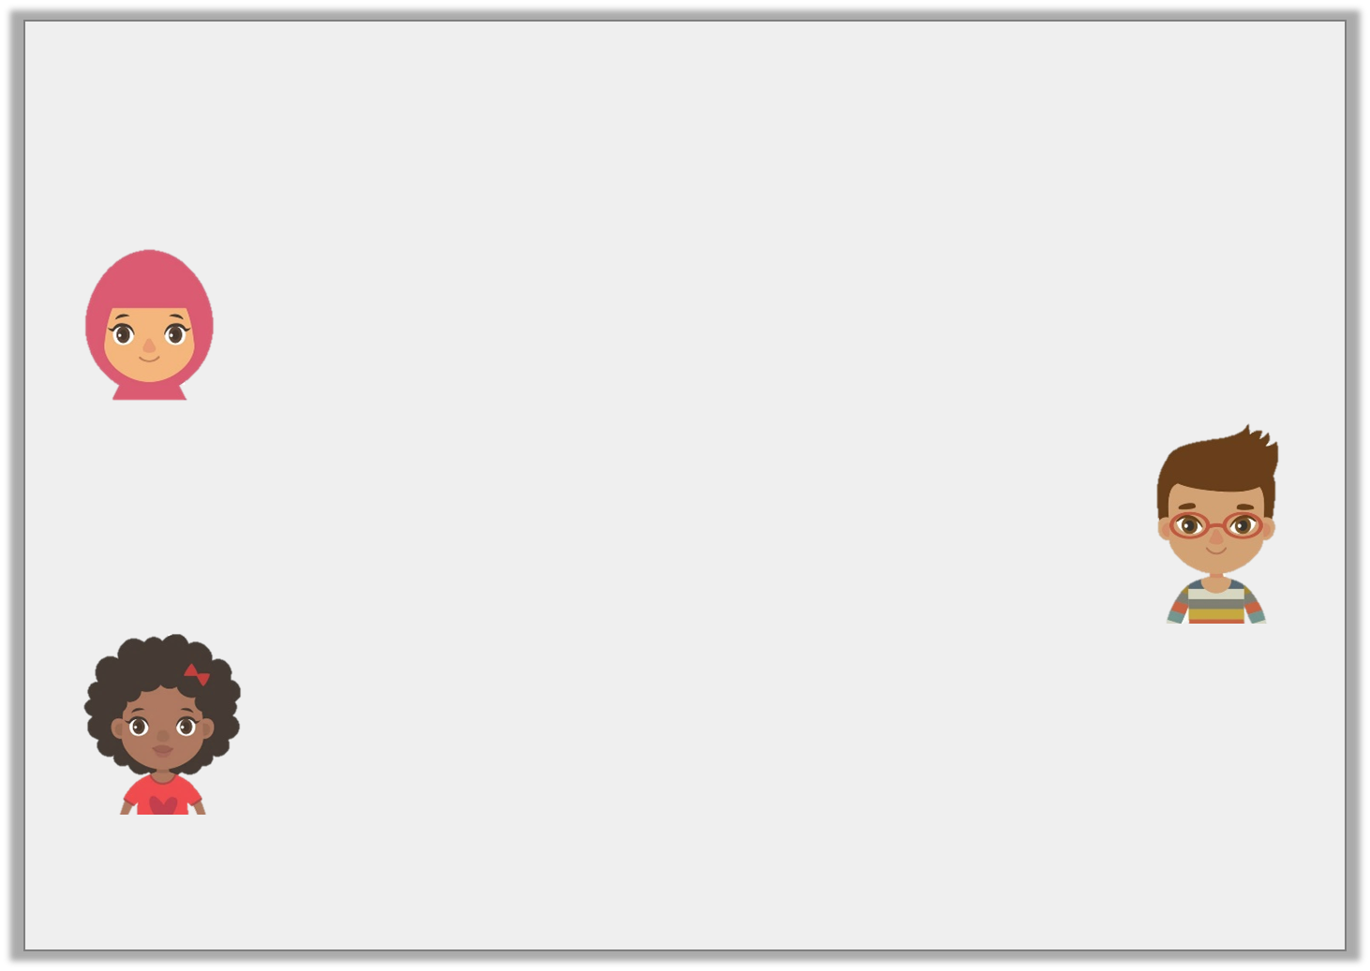
Problem Solving 1
Work out the answers to the children’s questions, then order them from smallest to largest.
What is the difference between 21°C and -32°C?
Hafsa
Which number is halfway between -6 and 48?
Josh
What is 27 greater than
-28?
Isabel
© Classroom Secrets Limited 2018

Slide 65
Problem Solving 1
Work out the answers to the children’s questions, then order them from smallest to largest.
Order: -1, 21, 53
What is the difference between 21°C and -32°C?
53
Hafsa
Which number is halfway between -6 and 48?
21
Josh
What is 27 greater than
-28?
-1
Isabel
© Classroom Secrets Limited 2018

Slide 66
Talk task
Problem Solving 2
Ben had £23 in his bank account. On Monday, he paid his phone bill and bought a t-shirt. His account is now overdrawn by £42. If the phone bill was £39, how much was Ben’s t-shirt?
© Classroom Secrets Limited 2018

Slide 67
Problem Solving 2
Ben had £23 in his bank account. On Monday, he paid his phone bill and bought a t-shirt. His account is now overdrawn by £42. If the phone bill was £39, how much was Ben’s t-shirt?
-42 + 39 = -3
The difference between -3 and 23 is 26.
£26
© Classroom Secrets Limited 2018

Slide 68
Negative Numbers
Diving
Match the answer to these statements to the correct place on the number line.
What is 12 less than 5? | -10 +14 = | What is 17 taken from 7? | Add 9 to -8 = | 2 - 11 =
-7
4
-10
1
-9
-10 -9 -8 -7 -6 -5 -4 -3 -2 -1 0 1 2 3 4 5 6 7 8 9 10

Slide 69
Negative Numbers
Diving
This table shows how the temperature changed on four different streets around the world. Complete the table to show how the temperatures changed over three months.
Town | October | Temperature change | November | Temperature Change | December
Study Street | 13°C | -10°C |  | -7°C
Reasoning Road | -1°C | +5°C |  | -6°C
Problem-Solving Place | -5.5°C |  | 7.5°C |  | -11.5°C
3°C
-4°C
4°C
-2°C
+12°C
-19°C

Slide 70
Negative Numbers
Deeper
Miriam has found the minimum and maximum average temperatures for four countries around the world. She has calculated the temperature range for each country.
Can you identify her mistakes and correct them?
Country | Average Minimum Temperature | Average Maximum Temperature | Average Temperature Range
Canada | -29°C | 15°C
China | -12°C | 21°C
Sweden | -16.6°C | 17.9°C
44°C
43°C
Correct
33°C
34.5°C
33.5°C

Slide 71
Varied Fluency 1
Complete the number line.
-56
-52
-51
© Classroom Secrets Limited 2018

Slide 72
Varied Fluency 1
Complete the number line.
-56
-52
-51
-55
-54
-53
-50
-49
-48
© Classroom Secrets Limited 2018

Slide 73
Talk task
Spot the mistake:
-80, -60, -30, -20
What is wrong with
this sequence of
numbers?
Spot the mistake:
60, 45, 30, 15, 0, -5
What is wrong with
this sequence of
numbers?

Slide 74
Varied Fluency 3
Fill in the blanks to make the statements correct.
12 | – | 56 | > |  | – | 50
 | – | 43 | < | 41 | – | 89
© Classroom Secrets Limited 2018

Slide 75
Varied Fluency 3
Fill in the blanks to make the statements correct.
any number < 6
any number > -5
12 | – | 56 | > |  | – | 50
 | – | 43 | < | 41 | – | 89
© Classroom Secrets Limited 2018

Slide 76
True or false?
-54
<
-20
I know that -54 is ________than -20 because___________________________________________________.

Slide 77
Reasoning 2
Which is the odd one out?
Explain why.
A | 50 | – | 75 | = | 0 | – | 25
B | 30 | – | 80 | = | 40 | – | 90
C | 35 | – | 60 | = | 63 | – | 88
© Classroom Secrets Limited 2018

Slide 78
Reasoning 2
Which is the odd one out?
Explain why.
B is the odd one out because…
A | 50 | – | 75 | = | 0 | – | 25
B | 30 | – | 80 | = | 40 | – | 90
C | 35 | – | 60 | = | 63 | – | 88
© Classroom Secrets Limited 2018

Slide 79
Reasoning 2
Which is the odd one out?
Explain why.
B is the odd one out because A and C both equal -25 whereas B equals -50.
A | 50 | – | 75 | = | 0 | – | 25
B | 30 | – | 80 | = | 40 | – | 90
C | 35 | – | 60 | = | 63 | – | 88
© Classroom Secrets Limited 2018

Slide 80


