Slide 1
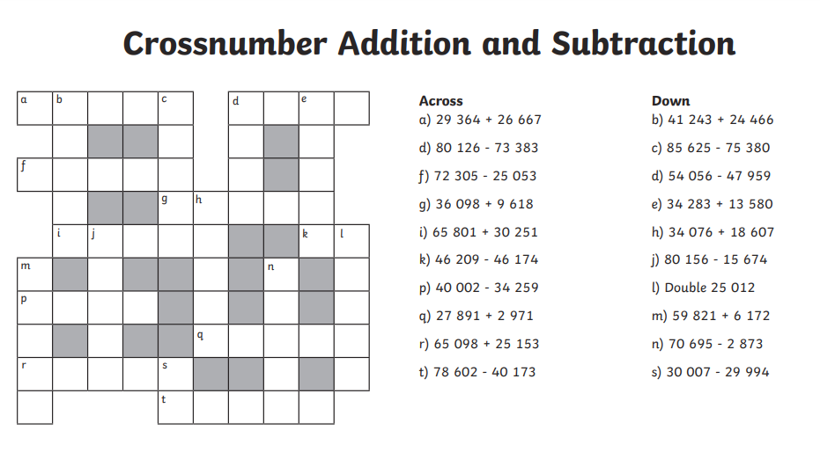
Extension task

Slide 2
Extension task

Slide 3
Do now:
x | 8 | 5 | 4 | 7 | 6 | 10 | 9 | 3 | 12 | 11
3
5
11
7
12
6
9
4
8
10

Slide 4
Do now:
x | 8 | 5 | 4 | 7 | 6 | 10 | 9 | 3 | 12 | 11
3
5
11
7
12
6
9
4
8
10

Slide 5
Do now:
x | 8 | 5 | 4 | 7 | 6 | 10 | 9 | 3 | 12 | 11
3 | 24 | 15 | 12 | 21 | 18 | 30 | 27 | 9 | 36 | 33
5 | 40 | 25 | 20 | 35 | 30 | 50 | 45 | 15 | 60 | 55
11 | 88 | 55 | 44 | 77 | 66 | 110 | 99 | 33 | 132 | 121
7 | 56 | 35 | 28 | 49 | 44 | 70 | 63 | 21 | 84 | 77
12 | 96 | 60 | 48 | 84 | 72 | 120 | 108 | 36 | 144 | 132
6 | 48 | 30 | 24 | 42 | 36 | 60 | 54 | 18 | 72 | 66
9 | 72 | 45 | 36 | 63 | 54 | 90 | 81 | 27 | 108 | 99
4 | 32 | 20 | 16 | 28 | 24 | 40 | 36 | 12 | 48 | 44
8 | 64 | 40 | 42 | 56 | 48 | 80 | 72 | 24 | 96 | 88
10 | 80 | 50 | 40 | 70 | 60 | 100 | 90 | 30 | 120 | 110

Slide 6
24/9/20
LO: To add whole numbers with more than 4 digits (column method)
Revision!

Slide 7
how many
altogether
total
What knowledge do we have
already about addition?
plus
increase
join
sum
combined

Slide 8
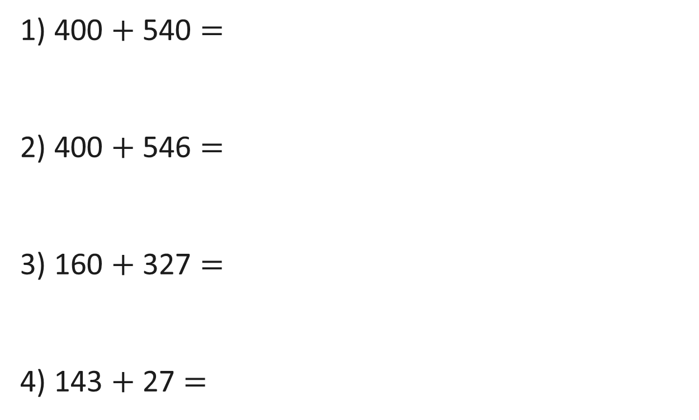
1) 400 $+$ 540 $=$
2) 400 $+$ 546 $=$
3) 160 $+$ 327 $=$
4) 143 $+$ 27 $=$
WARM UP TASK!

Slide 9

940
1) 400 $+$ 540 $=$
2) 400 $+$ 546 $=$
3) 160 $+$ 327 $=$
4) 143 $+$ 27 $=$
946
487
170

Slide 10
Crucial vocabulary:
place value
columns
exchange
calculation symbol
inverse
equation
integer
addition

Slide 11


Dexter scores 12,304 points in a game.
Rosie scores 1,263 points.
How much do they score altogether?

Slide 12





Dexter scores 12,304 Rosie scores 1,263
TTh | Th | H | T | O
TTh | Th | H | T | O
1 | 2 | 3 | 0 | 4
 | 1 | 2 | 6 | 3
1
3
5
6
7
1
3
5
6
7

Slide 13



Have a think
Dexter scores 12,304 points in a game.
Rosie scores 1,263 points.
How much do they score altogether?
13,567
Mo scores 12,304 points in a game.
Eva scores 1,268 points.
How much do they score altogether?

Slide 14

Mo scores 12,304 Eva scores 1,268
TTh | Th | H | T | O
TTh | Th | H | T | O
1 | 2 | 3 | 0 | 4
 | 1 | 2 | 6 | 8
1
3
5
7
12
2
1
1
3
5
7
12
2

Slide 15
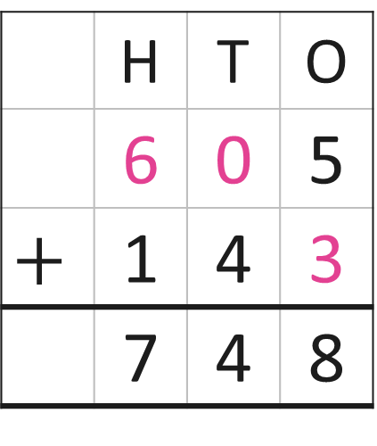
 | Hundreds | Tens | Ones
 | H | T | O
 | 6 | 0 | 5
$$+$$ | 1 | 4 | 3
 | 7 | 4 | 8
7
4
8

Slide 16
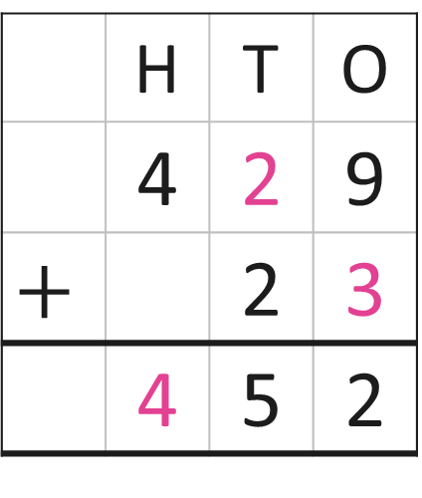
 | Hundreds | Tens | Ones
 | H | T | O
 | 4 | 2 | 9
$$+$$ |  | 2 | 3
 | 4 | 5 | 2
1
5
2

Slide 17



Have a think
6
4
7
$+$ 463 $=$ 1,000
The missing number is 647
600 $+$ 400 $=$ 1,000

Slide 18
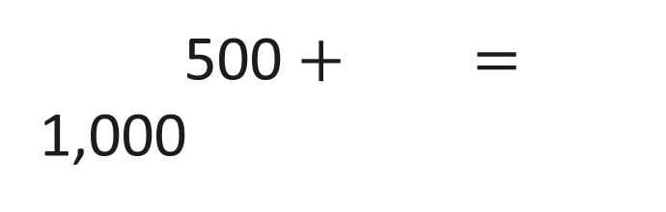
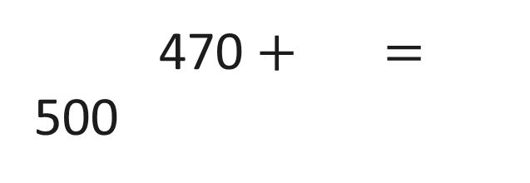
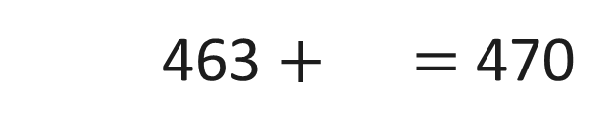
537
$+$ 463 $=$ 1,000
7
463 $+$ $=$ 470
30
470 $+$ $=$ 500
500
500 $+$ $=$ 1,000

Slide 19
935,079 + 679,708

Slide 20
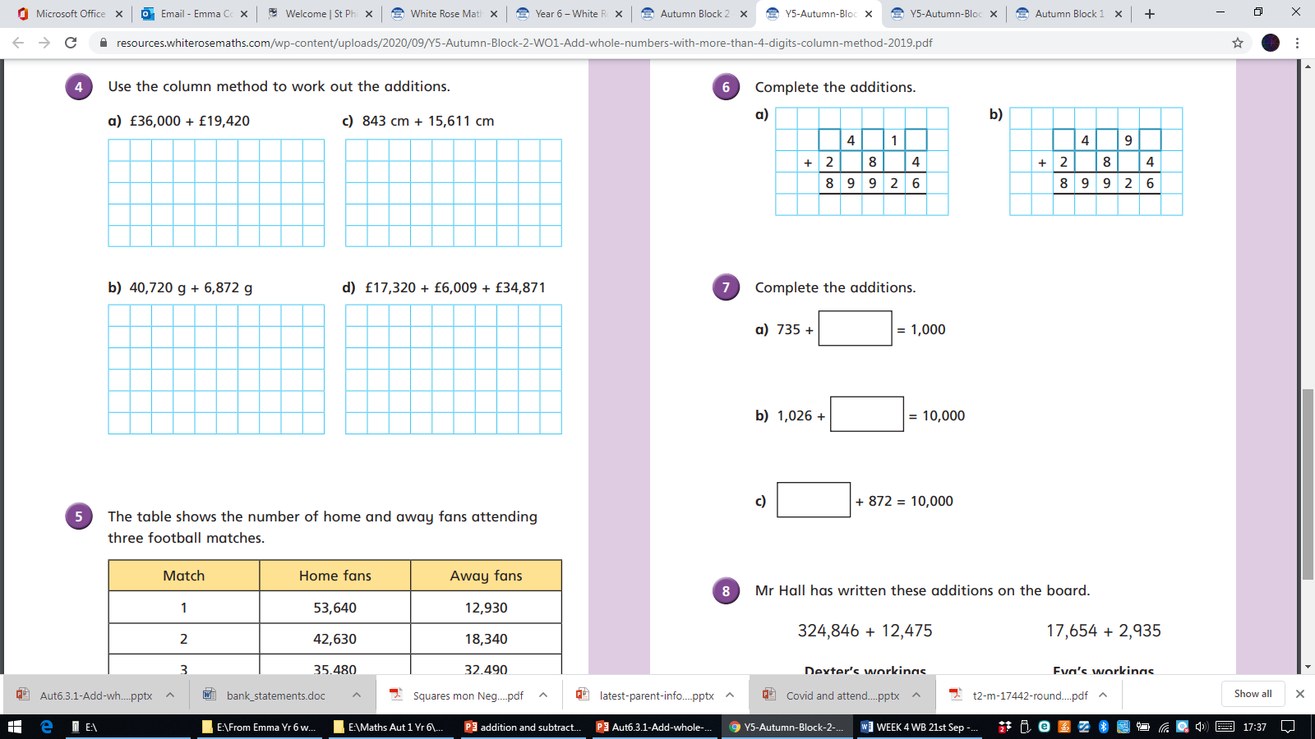
Squares ques 4/5 Hexagons 5,6,7

Slide 21
Triangles- Mrs Day out
Practice time! https://www.topmarks.co.uk/maths-games/daily10
Choose addition- level 3 and then select your time intervals. Record the answers on your board
Adding cube- roll the dice and add the numbers. Do the sums in your book- remember to set out clearly.

Slide 22
Octagons 6, 7 and 8

Slide 23
Octagons - Select two numbers to add.
Line up the columns!
47,854 | 72,345 | 56,789 | 94,533 | 43,445 | 21,245
686,543 | 34,256 | 76,544 | 4,5967 | 88,644 | 34,678
56073 | 45,567 | 67897 | 3,332 | 34,332 | 28,309
792655 | 226679 | 56,907 | 56,480 | 33546 | 214,576
181,589 | 549255 | 32,322 | 87645 | 467,876 | 126,211
15687 | 177,654 | 16,432 | 986,875 | 246,765 | 63377

Slide 24
25.9.20
L.O. To solve addition and subtraction problems . (Octagons) Mrs Warham
L.O. To continue to add 5 digit numbers or more using the written column method.

Slide 25
10 a day!
1. Half 60 then half it again.
2. Take 52 from 400.
3. What is 10 less than 1002?
4. Subtract 17 from 60.
5. Add 1.7 to 4.8.
6. What is 67 more than 34?
7. How many faces does a triangular prism have?
8. Add together 15 and 25 and 35.
9. What is 5oC more than -1oC?
10. I subtracted 7 then multiplied by 4, my answer was 24. What number did I start with?

Slide 26
how many
altogether
total
What knowledge do we have
already about addition?
plus
increase
join
sum
combined

Slide 27
9,035,039 + 79,786

Slide 28
£35.039 + £7.86

Slide 29
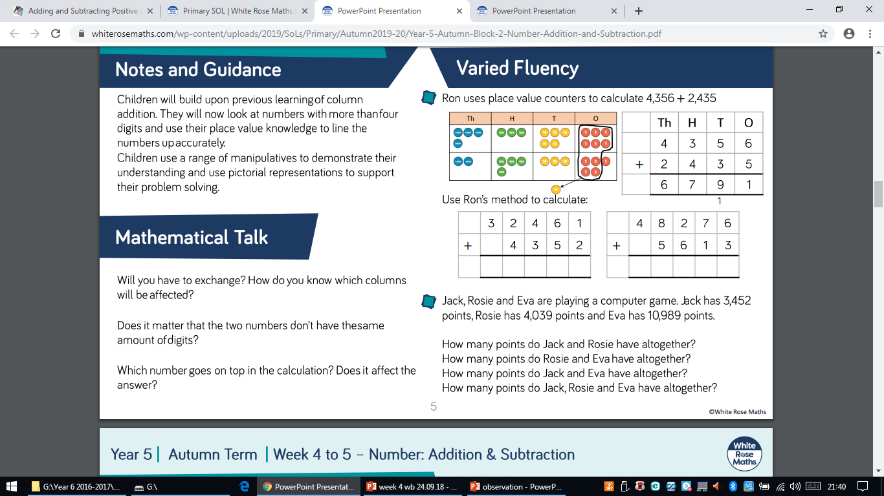
68.58 + 357.073

Slide 30
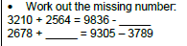

Slide 31
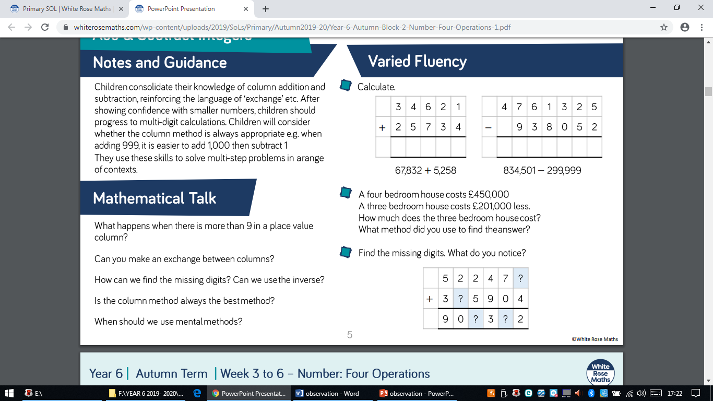

Slide 32
Over to you
Octagons- Mrs Warham
Squares-Mrs Lund out
Hexagons- Class
Triangles-Class

Slide 33
Squares
4.5g + 57.56g =
23.65m + 64.88m =
593.85m + 79.7m =
67.54cm + 35.84cm =
3.86cm + 49.28cm =
45.1kg + 196.3kg =
25.8kg + 6.48kg =
£7.85 + £72.82 =
£96.7 + £68.5 =
£96.32 + £87.5 =
£25.67 + £68.57 =
£29.40 + £3.86 =
4.5g + 57.56g =
23.65m + 64.88m =
593.85m + 79.7m =
67.54cm + 35.84cm =
3.86cm + 49.28cm =
45.1kg + 196.3kg =
25.8kg + 6.48kg =
£7.85 + £72.82 =
£96.7 + £68.5 =
£96.32 + £87.5 =
£25.67 + £68.57 =
£29.40 + £3.86 =

Slide 34
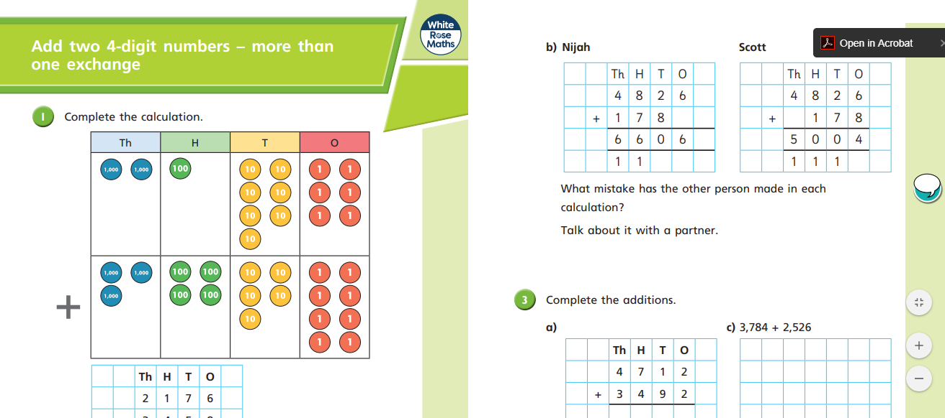
Triangles- IPAD revision and White rose video
https://vimeo.com/458471350

Slide 35
Hexagons- Roll the dice find two numbers to add.
Line up the columns!
£47.854 | £873.45 | £567.89 | £345.33 | £334.45 | £2124.50
£665.43 | £342.56 | £765.44 | £245.67 | £886.44 | £3467.80
£5673 | £455.67 | £7897 | £233.32 | £4433.2 | £783.09
£776.55 | £6679 | £689.07 | £564.80 | £3346 | £1245.76
£115.89 | £4225.50 | £4323.22 | £7645 | £4678.76 | £2362.11
£5687 | £776.54 | £364.32 | £698.75 | £46.65 | £33.77

Slide 36
Hexagons- Roll the dice find two numbers to add.
Line up the columns carefully in your book!
£47.854 | £873.45 | £567.89 | £345.33 | £334.45 | £2124.50
£665.43 | £342.56 | £765.44 | £245.67 | £886.44 | £3467.80
£5673 | £455.67 | £7897 | £233.32 | £4433.2 | £783.09
£776.55 | £6679 | £689.07 | £564.80 | £3346 | £1245.76
£115.89 | £4225.50 | £4323.22 | £7645 | £4678.76 | £2362.11
£5687 | £776.54 | £364.32 | £698.75 | £46.65 | £33.77

Slide 37
Extension tasks….

Slide 38
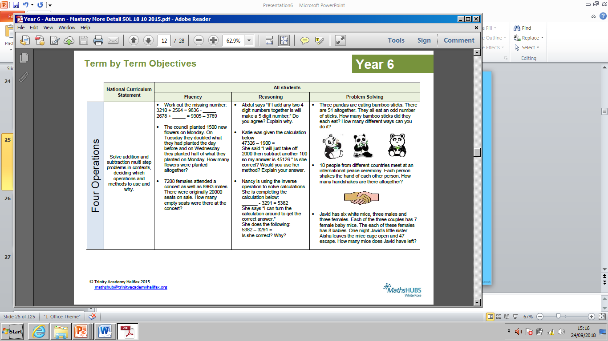

Slide 39
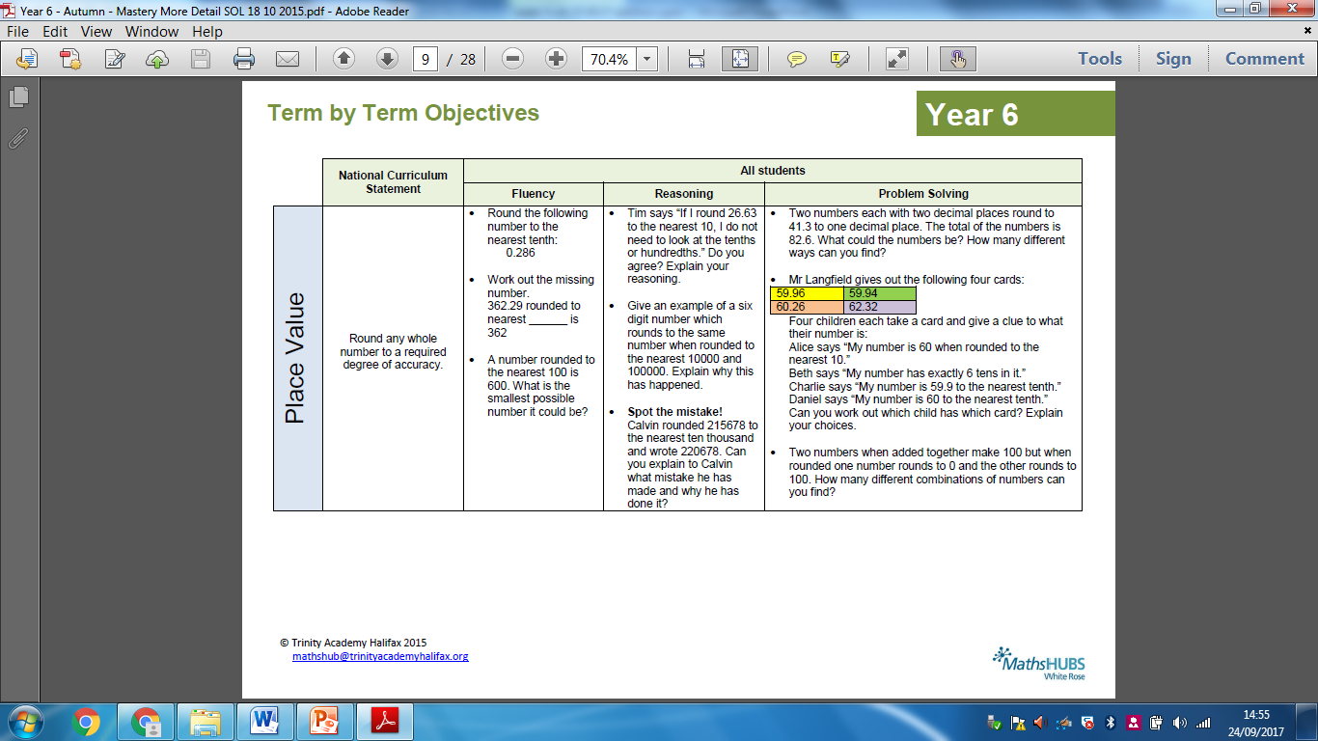
Do now:

