Slide 1

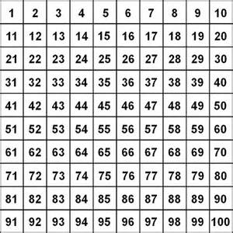
Do now…
Circle all the prime numbers.
I agree because…
I know that I am right
because…
Let me show
you…

Slide 2
Define what a prime number is.
Notes:
Numbers 1-50 SEN and MA. Numbers 51-100 MA and HA

Slide 3
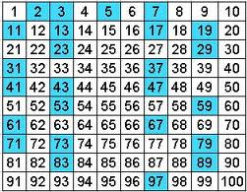
And the prime numbers are…

Slide 4
Crucial vocabulary:
Factor
Multiple
Prime number
Multiply
Divided
Even number
Common
Common multiple
Common factor
Prime Factor

Slide 5
12.10.20
L.O: understand and identify common factors of numbers.

Slide 6
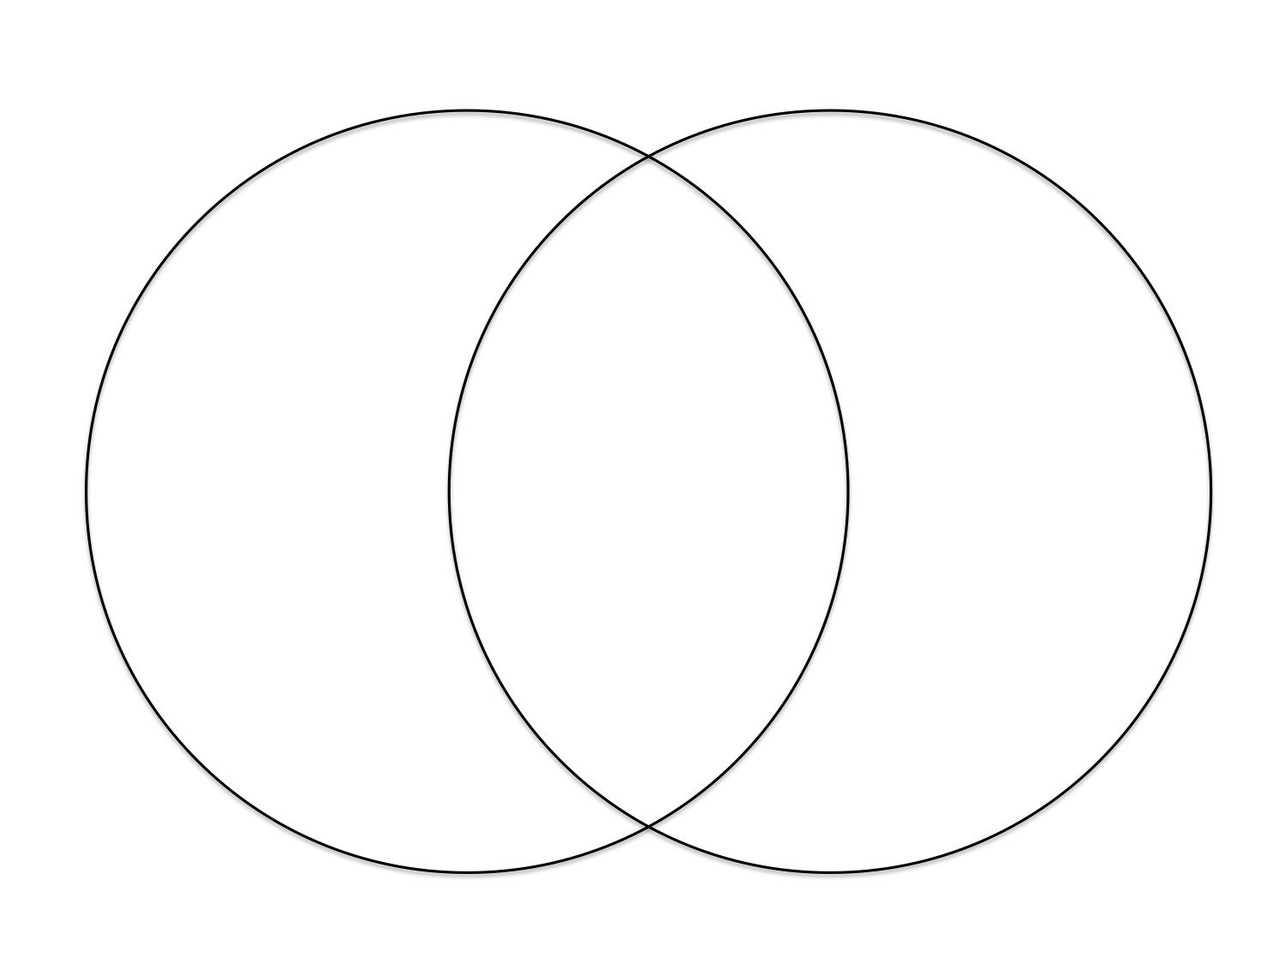
Factors of 18:
Common
factors:
Factors of 63:
1, 18
1, 63
2, 9
9, 3
3, 21
3, 6
7, 9
9 and 3 are common factors because…

Slide 7
Factors of 24:
Factors of 80:
1,24
2,12
3,6
4,8
Common factors:
1,80
2,40
4, 20
5, 16
8,10
2, 4
8
The common factors are:

Slide 8
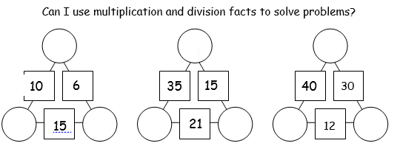
Finding the common factors:

Slide 9

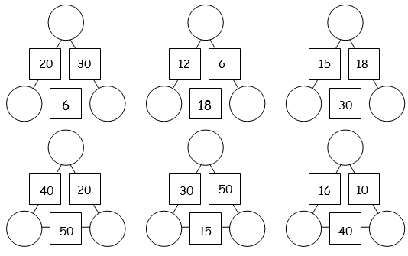
Talking task…
I know that I am right
because…
If… then…

Slide 10
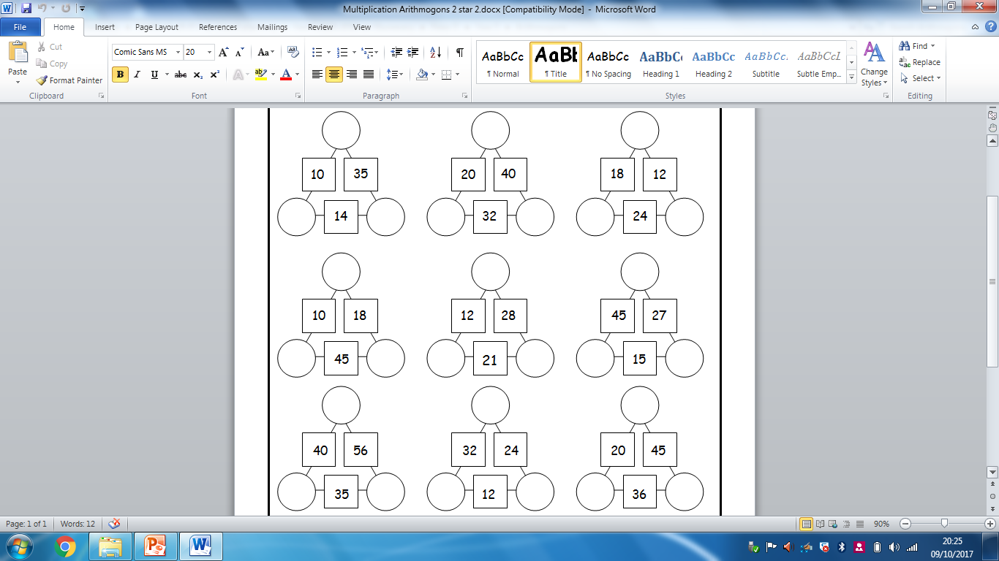
Notes:
Print and stick one copy in books to complete. Then go through and peer mark.

Slide 11
Multiplication Arithmogons
5 is a common factor of 20 and 45 because:
5 X 9 = 45
5 X 4 = 20
5 is a factor for both numbers.
9 is a common factor of 36 and 45 because:
5 X 9 = 45
4 X 9 = 36
9 is a factor for both numbers.
5
20
45
4
36
9

Slide 12
Multiplication Arithmogons
______is a common factor of _____ and ____ because:
_____ is a factor for both numbers.
7
21
35
3
15
5

Slide 13
Multiplication Arithmogons
8
4
5
6
7
8
Find the numbers that these numbers
are common factors of…

Slide 14
Multiplication Arithmogons
8
4
40
48
28
32
5
30
6
7
56
8

Slide 15
Multiplication Arithmogons
______is a common factor of _____ and ____ because:
_____ is a factor for both numbers.
20
35

Slide 16
Activities
Triangles: Mrs Day –Smiley page 1 and using times table grids.
Squares- in class – page 2 independent
Hexagons: 2 star and ext 2 star page 2. Half in class and half with Mrs Lund
Octagons: page 3 and ext- electric page – out with Mrs Warham

Slide 17
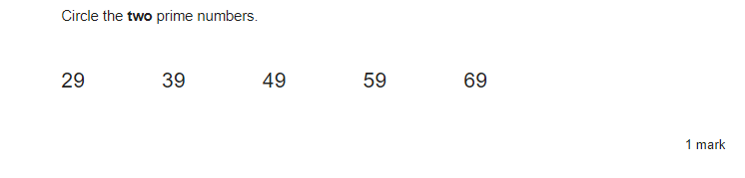
Do Now:

Slide 18
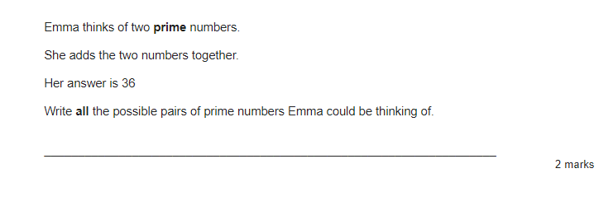

Slide 19
13.10.20
L.O: understand and identify common multiples and prime factors of numbers.

Slide 20
Crucial vocabulary:
Factor
Multiple
Prime number
Multiply
Divided
Even number
Common
Common multiple
Common factor
Prime Factor

Slide 21
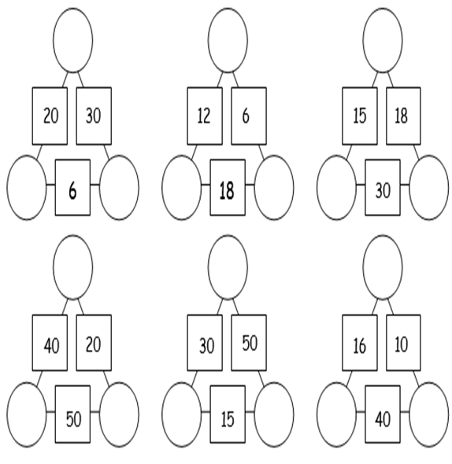
On white boards!
Let’s hear you use the key vocabulary:
Common factor with your partner!

Slide 22
A common
factor is…

Slide 23
Multiples of 20:
Multiples of 5:
Common factors:
The common multiples are:

Slide 24
Prime Factors:
Develop thinking:
Prime factors are the prime numbers which multiply together to make a number.

Slide 25
Factor Tree
48
8
6
4
2
3
2
2
2
Photo courtesy of (@flickr.com) - granted under creative commons licence – attribution

Slide 26
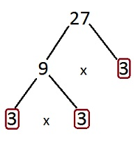
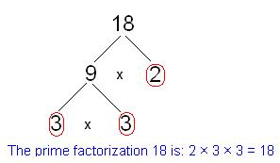
3 x 3 x 2 = 18
3 x 3 x 3 = 27

Slide 27
20

Slide 28
20

Slide 29
12

Slide 30
12

Slide 31
32

Slide 32
32

Slide 33
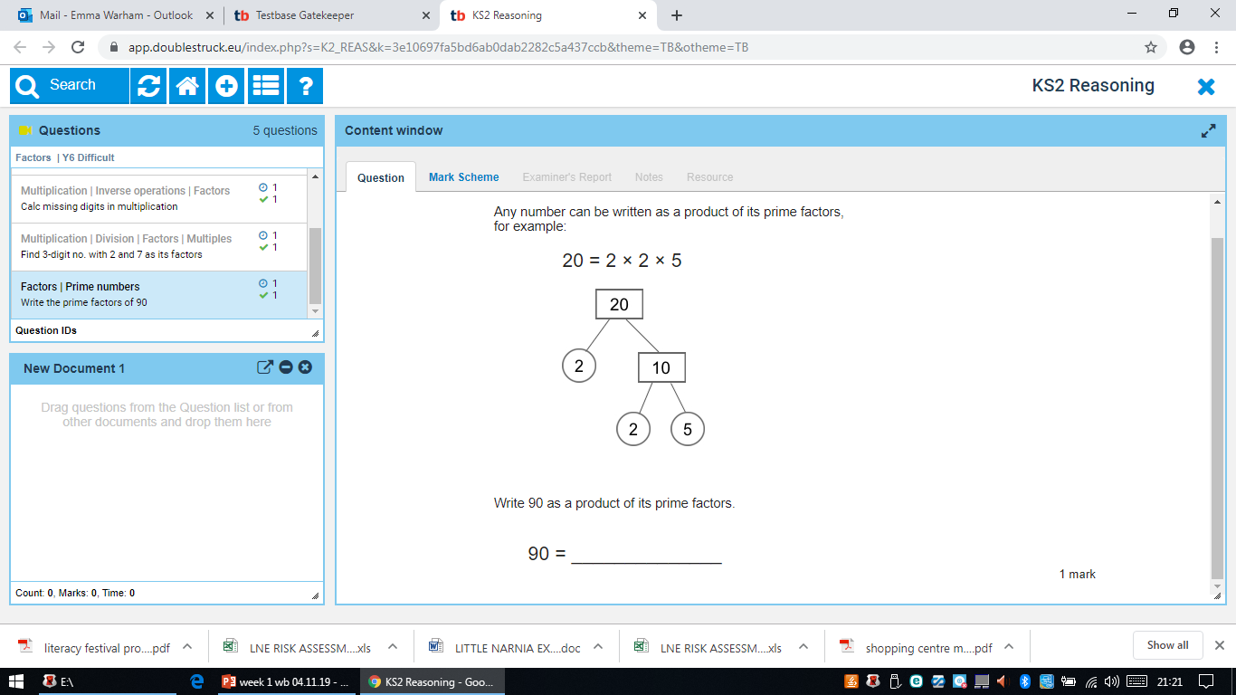
Complete on sheet and stick in your books.

Slide 35
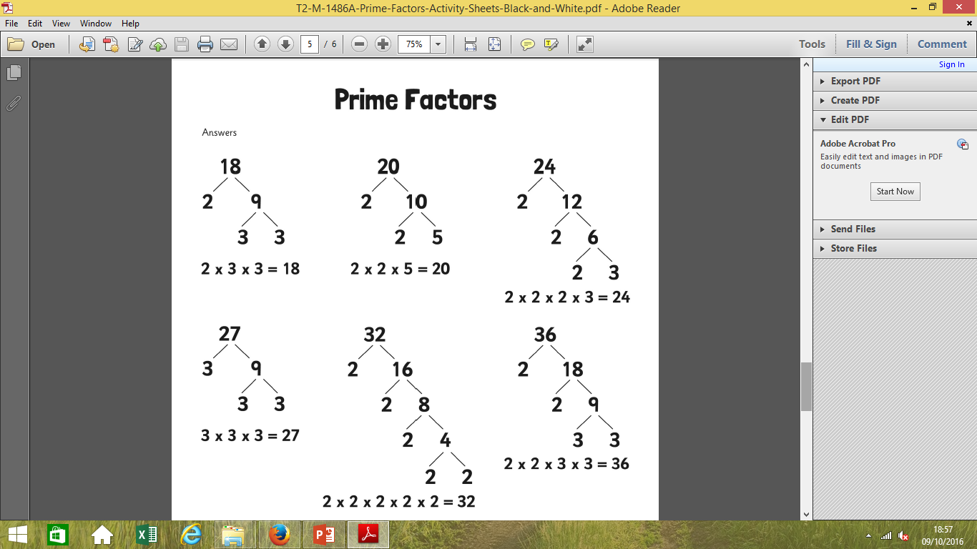
Help sheet stick in books

Slide 37
Triangles warm up
Ways of making factors of:
15
5 groups of 3
= 5 x 3
5 AND 3 are FACTORS
OR:
3 groups of 5
What other factors
of 15 are there?

Slide 38
Triangles: work with Mrs Cooper
Use each of the factor tree templates to solve the each of the Prime factors of the numbers below:
20
Write the factors of 20 first.
Pick two factors that go together and put them in a factor tree for number 20.
Factors of 20:
18
Factors of 18:
30
Factors of 30:

Slide 39
Triangles: work with Mrs Cooper
32
Factors of 32:
16
Factors of 16:

Slide 40
In pairs, find the factors of the numbers below. Select 2 factors together and then begin your prime factor tree.
Factors:
Prime Factors:
Factors:
Prime Factors:
45
48
36
Factors:
Prime Factors:
88
Factors:
Prime Factors:
72
52
Factors:
Prime Factors:
Factors:
Prime Factors:
Squares: Work with Mrs Lund

Slide 41
In pairs, find the factors of the numbers below. Select 2 factors together and then begin your prime factor tree.
96
Factors:
Prime Factors:
81
Factors:
Prime Factors:
70
Factors:
Prime Factors:
Squares: Work with Mrs Lund

Slide 42
Hexagons: half in class, half with Mrs Warham
In pairs, find the factors of the numbers below. Select 2 factors together and then begin your prime factor tree.
111
96
Factors:
Prime Factors:
Factors:
Prime Factors:
81
99
Factors:
Prime Factors:
Factors:
Prime Factors:
70
84
Factors:
Prime Factors:
Factors:
Prime Factors:

Slide 43
Hexagons: half in class, half with Mrs Warham
In pairs, find the factors of the numbers below. Select 2 factors together and then begin your prime factor tree.
116
126
Factors:
Prime Factors:
Factors:
Prime Factors:

Slide 44
Octagons- independent
In pairs, find the factors of the numbers below. Select 2 factors together and then begin your prime factor tree.
111
96
Factors:
Prime Factors:
Factors:
Prime Factors:
81
99
Factors:
Prime Factors:
Factors:
Prime Factors:
70
84
Factors:
Prime Factors:
Factors:
Prime Factors:

Slide 45
Octagons- independent
In pairs, find the factors of the numbers below. Select 2 factors together and then begin your prime factor tree.
126
116
Factors:
Prime Factors:
Factors:
Prime Factors:
133
147
Factors:
Prime Factors:
Factors:
Prime Factors:

Slide 46
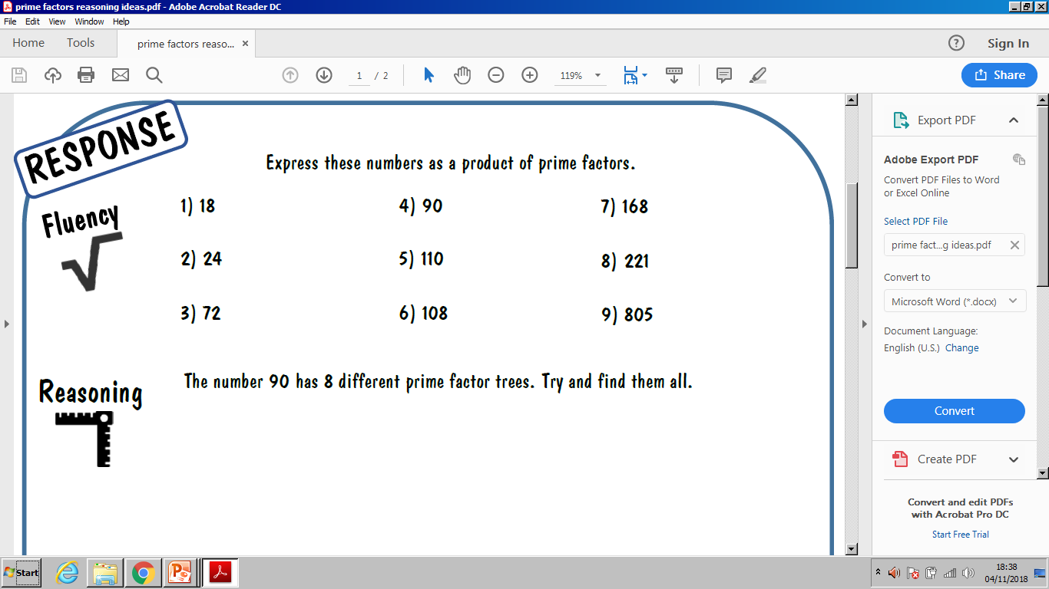
Octagons- independent

Slide 47
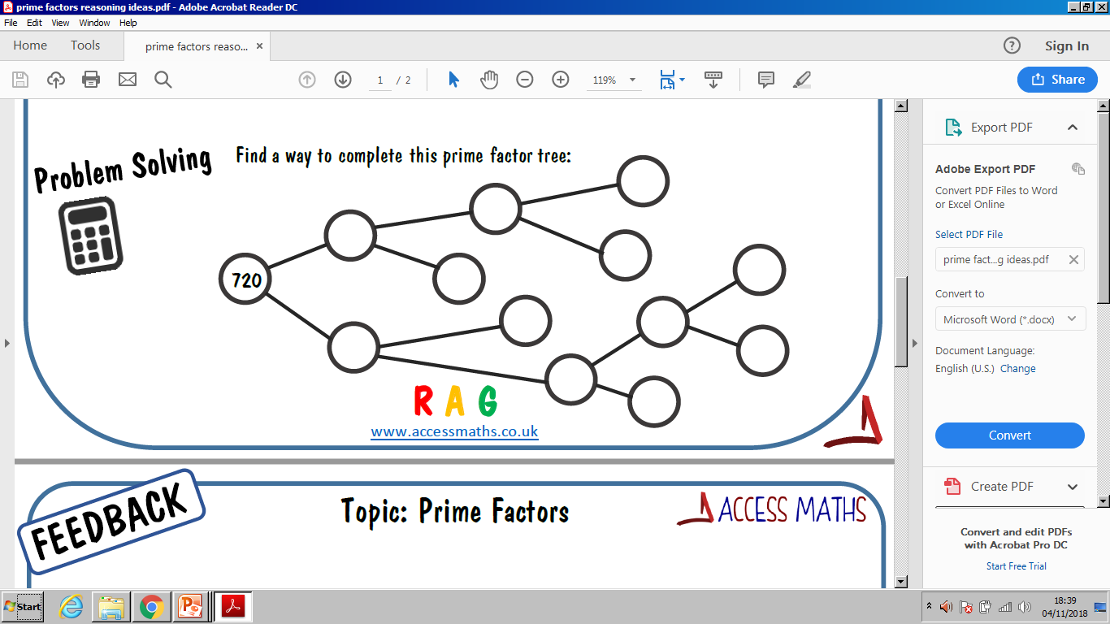
Octagons- independent

Slide 48
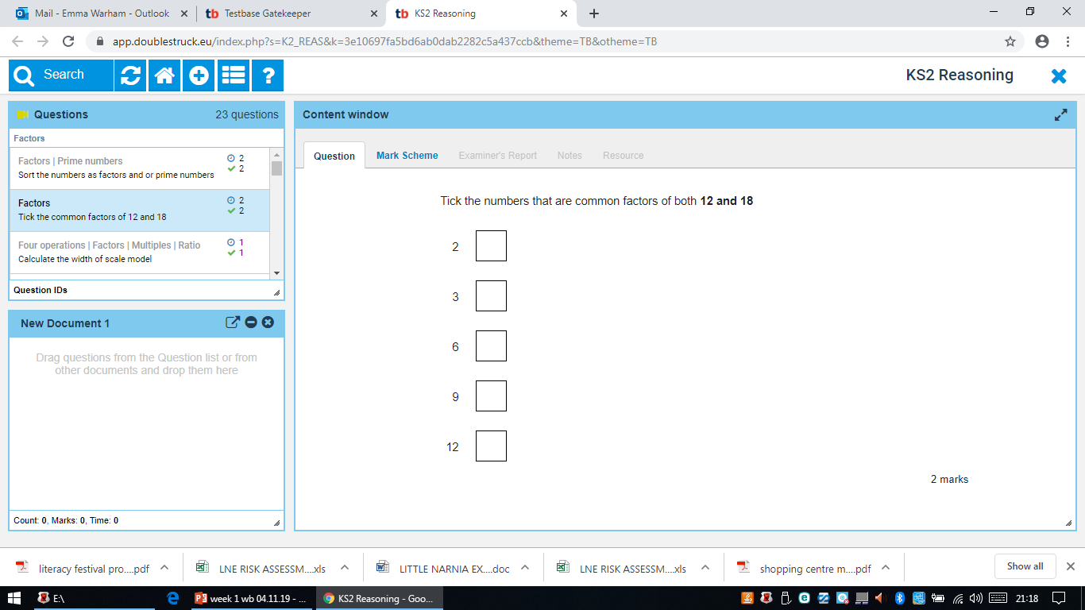
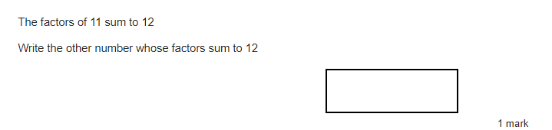
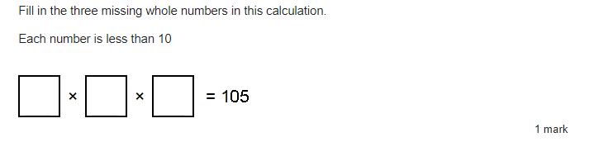
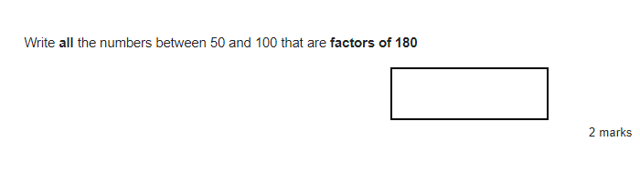
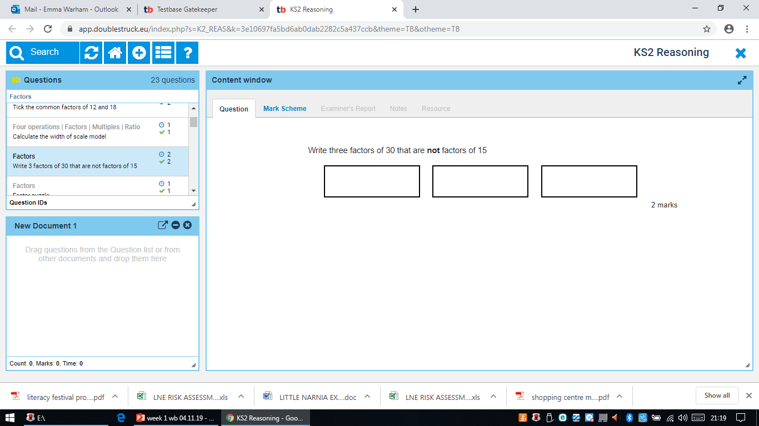
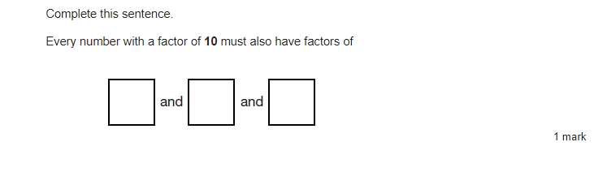
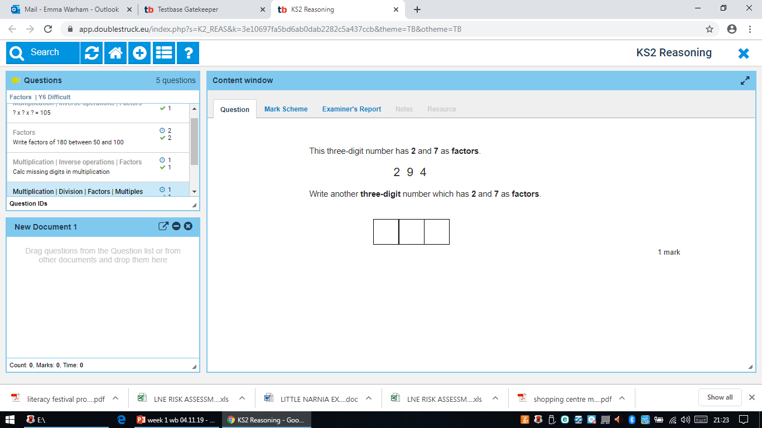
Extension:

Slide 49
14.10.20
L.O: multiply up to 3 digit numbers by 2 digit numbers using the written column method.

Slide 50
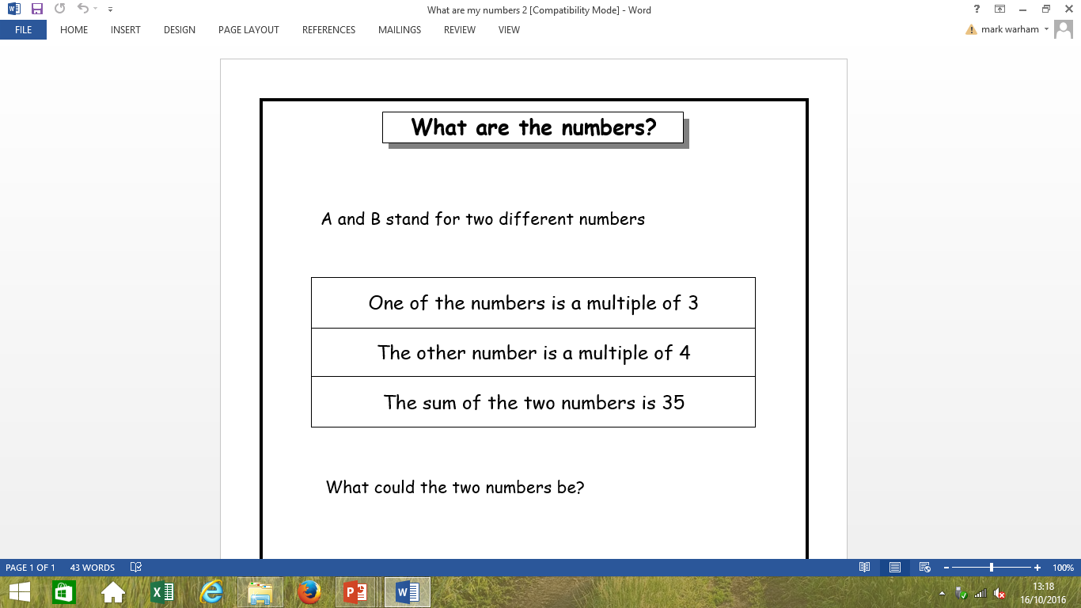
Do now:

Slide 51
Crucial Vocabulary:
X
Multiply
Product
Multiplication
Times
Repeated addition
Groups of

Slide 52

True or False?!
The prime factors of 21 are:
2, 7 and 3.
In partners, write your own
True or False statement.

Slide 53
Work out on your whiteboards:
67 x 48 =
135 x 79 =

Slide 54
Grid multiplication:
950
25 x 38 =
As we know, when we multiply using the gird we separate the numbers into tens and units.
X |  | T | U
 |  | 20 | 5
T | 30
U | 8
Finally, we add each row together to get our total that we have multiplied.
600 + 150 = 750
160+40= 200
750+ 200 = 950
Then we begin to multiply the tens by the tens.
The units by the tens.
Then the units by the units.
600
150
160
40

Slide 55
Now let’s transform the grid into the column method…
25 x 38 =
25 x 38 =
X |  | T | U
 |  | 20 | 5
T | 30
U | 8
T U
2 5
X 3 8
So far- what is similar?

Slide 56
Now that we have partitioned the tens and units into columns- what do you think we do next?
25 x 38 =
25 x 38 =
X |  | T | U
 |  | 20 | 5
T | 30
U | 8 |  | 40
T U
2 5
X 3 8
0
We carry over the 4 tens into the tens column (like when you use the column method for addition).
4
We multiply the units by the units.

Slide 57
Now we need to multiply the tens by the units.
25 x 38 =
25 x 38 =
X |  | T | U
 |  | 20 | 5
T | 30
U | 8 | 160 | 40
T U
2 5
X 3 8
20 0
The 2 is NOT worth 2. It is worth 2 TENS (20).
So 20 x 8 = 160.
160 + 40 = 200
4
What do you now notice?

Slide 58
Now we need to multiply the units by the tens.
25 x 38 =
25 x 38 =
X |  | T | U
 |  | 20 | 5
T | 30 |  | 150
U | 8 | 160 | 40
H T U
2 5
X 3 8
20 0
5 0
Because we are now multiplying in the tens column – our answer MUST be in the tens column.
We need a place holder in the units column.
5 x 30 = 150
4
The 1 hundred MUST be carried over
to the hundreds column
1

Slide 59
Finally, we multiply the tens by the tens.
25 x 38 =
25 x 38 =
X |  | T | U
 |  | 20 | 5
T | 30 | 600 | 150
U | 8 | 160 | 40
H T U
2 5
X 3 8
20 0
7 5 0
Now we need to multiply
20 x 30.
600 + 150 = 750
4
1

Slide 60
Just like the grid, we now add to make the total:
950
950
25 x 38 =
25 x 38 =
X |  | T | U
 |  | 20 | 5
T | 30 | 600 | 150
U | 8 | 160 | 40
H T U
2 5
X 3 8
20 0
750
9 5 0
Add the total for each row.
750 + 200 = 950
+
4
1

Slide 61
Let’s try one together:
54 x 93 =
First- how do we set it out?

Slide 62
How about another one?
82 x 75 =
THINK- how do we set it out?

Slide 63
Now here is a slightly trickier one:
342 x 65 =
THINK- how do we set it out?

Slide 64
Let’s try one together:
54 x 93 =
First- how do we set it out?

Slide 65
How about another one?
82 x 75 =
THINK- how do we set it out?

Slide 66
Now here is a slightly trickier one:
804 x 45 =
THINK- how do we set it out?

Slide 67
Now here is a slightly trickier one:
567 x 87 =
THINK- how do we set it out?

Slide 68
Triangles- work with Mrs Day 2 digit by 2 digit sheets
Squares- work with Mrs Cooper- 2 digit by 2 digit- Bronze
Hexagons- half with Mrs Lund and Half with Mrs Warham - Silver
Octagons- independent- Gold

Slide 69

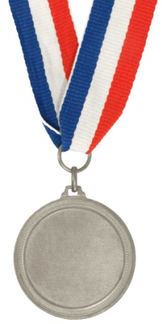

Bronze | Silver | Gold
54 x 28 = 87 x 45 = 33 x 65 = 34 x 24 = 42 x 55 = 73 x 64 = 42 x 66 = 23 x 25 = 43 x 28 = 25 x 46 = | 84 x 98 = 77 x 65 = 133 x 65 = 94 x 74 = 402 x 85 = 273 x 64 = 22 x 166 = 27 x 85 = 43 x 282 = 253 x 46 = | 524 x 98 = 872 x 85 = 363 x 95 = 734 x 54 = 482 x 85 = 739 x 67 = 842 x 69 = 273 x 28 = 493 x 260 = 275 x 888 =

Slide 70
Do now:
1. How many fours are in 120?
2. What is one third of 75?
3. What is 65 takeaway 22, add 9?
4. What is 7 more than 998?
5. Divide 72 by 9.
6. Which fraction is the same as 0.2: 1/2, 1/3 or 1/5?
7. How many centimetres are in 45millimetres?
8. What is the sum of 78 and 23?
9. Liam spent £1.90. How much change did he get from £3.00?
10. Multiply 7 by 4, then add 40.

Slide 71
Prove it!
2369.218 – 1123.364 = 1245.854

Slide 72
16.10.20
L.O: multiply up to 3 digit numbers by 2 digit numbers using the written column method.

Slide 73
Crucial Vocabulary:
Place holder
Multiplication
Place value column
Hundreds, tens and ones
Addition
Total
Partition

Slide 74
Crucial Vocabulary:
x
Multiply
Product
Multiplication
Times
Repeated addition
Groups of

Slide 75
Let’s try one together:
286 x 55 =
First- how do we set it out?

Slide 76
Talk Task
With your partner, come up with rules that you need to follow in order to work out long multiplication CORRECTLY:

Slide 77
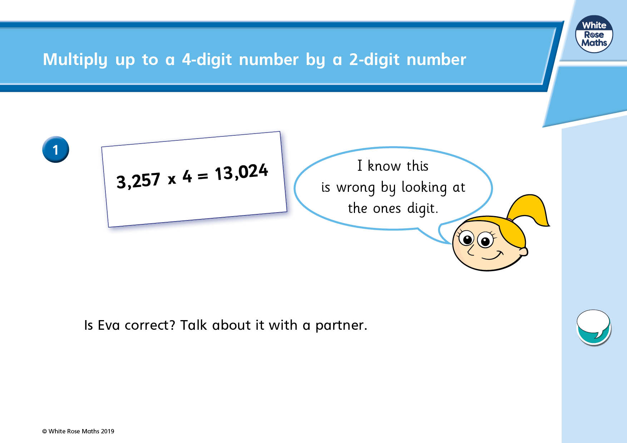

Slide 78
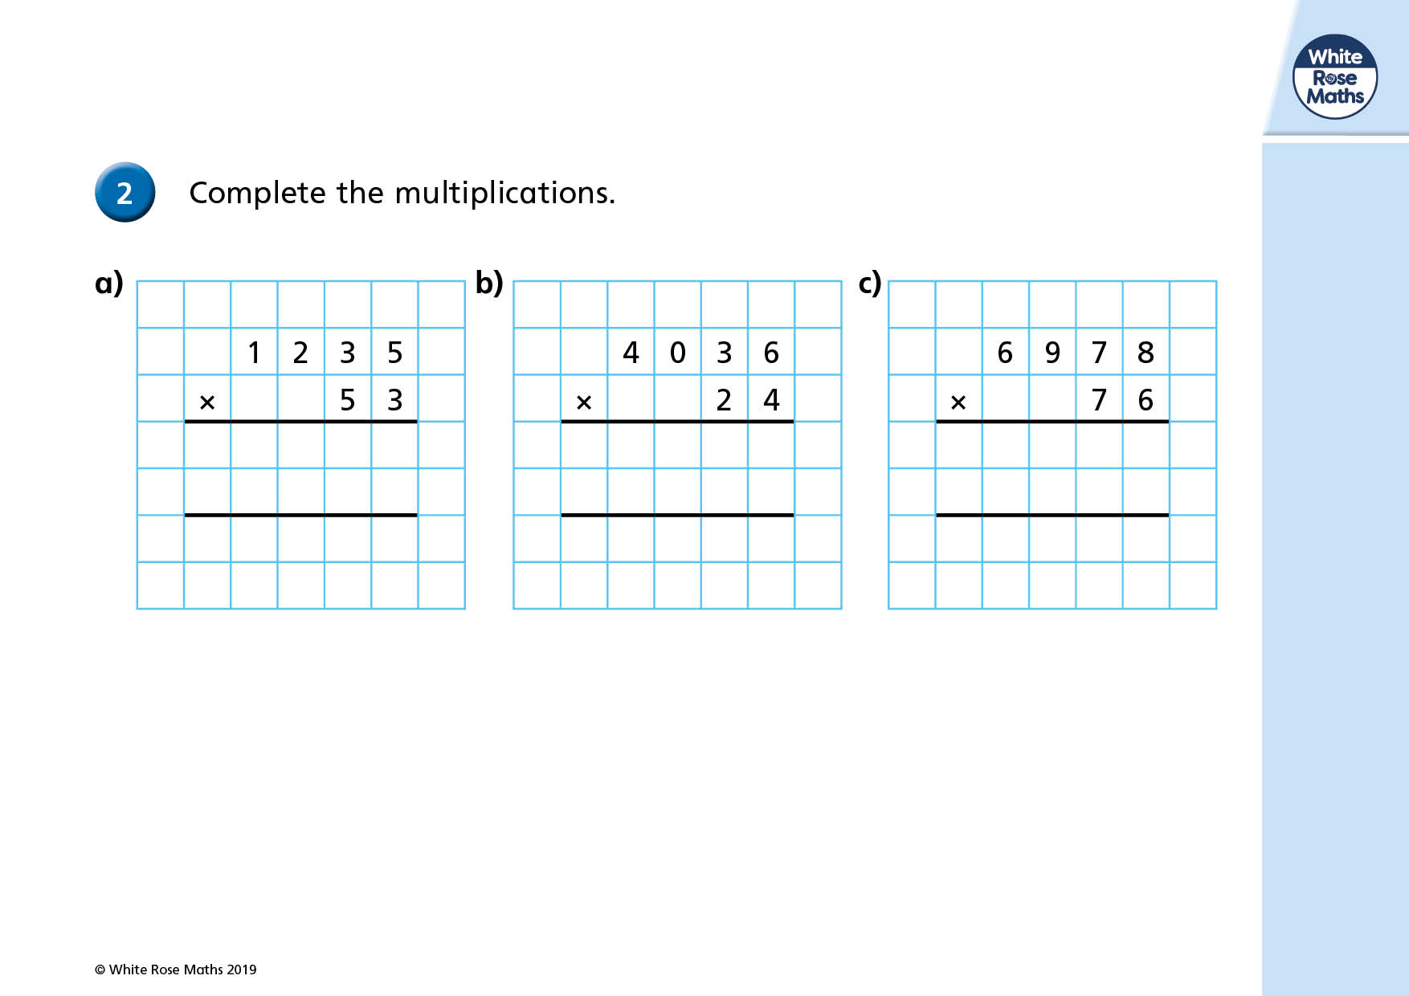

Slide 79
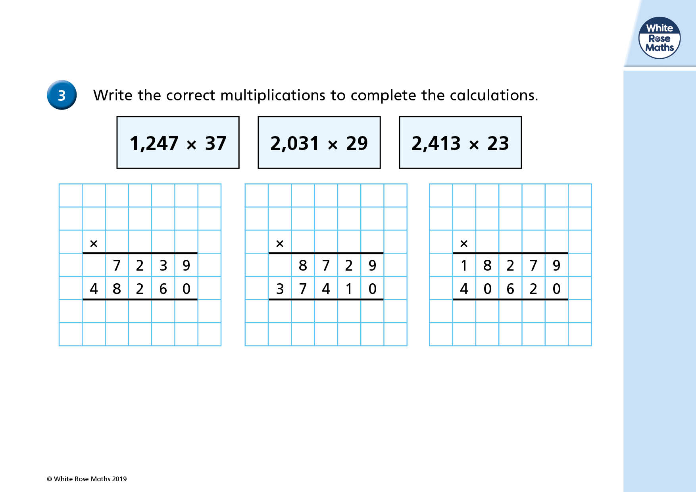

Slide 80
The student becomes the teacher!
785 x 68=
53,380
568 x 42=
23,856
Magnificent multipliers!
Who is up for the challenge?

Slide 81
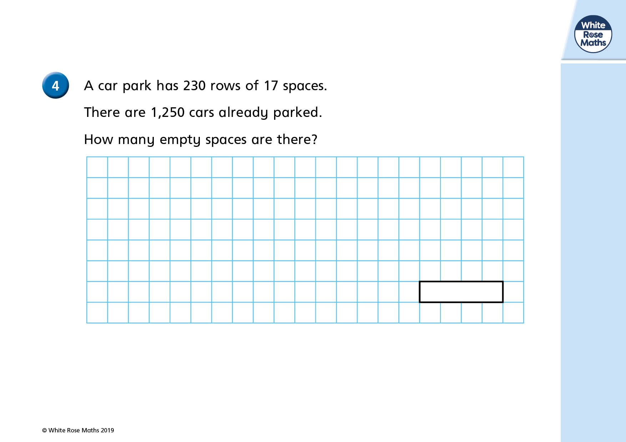

Slide 82
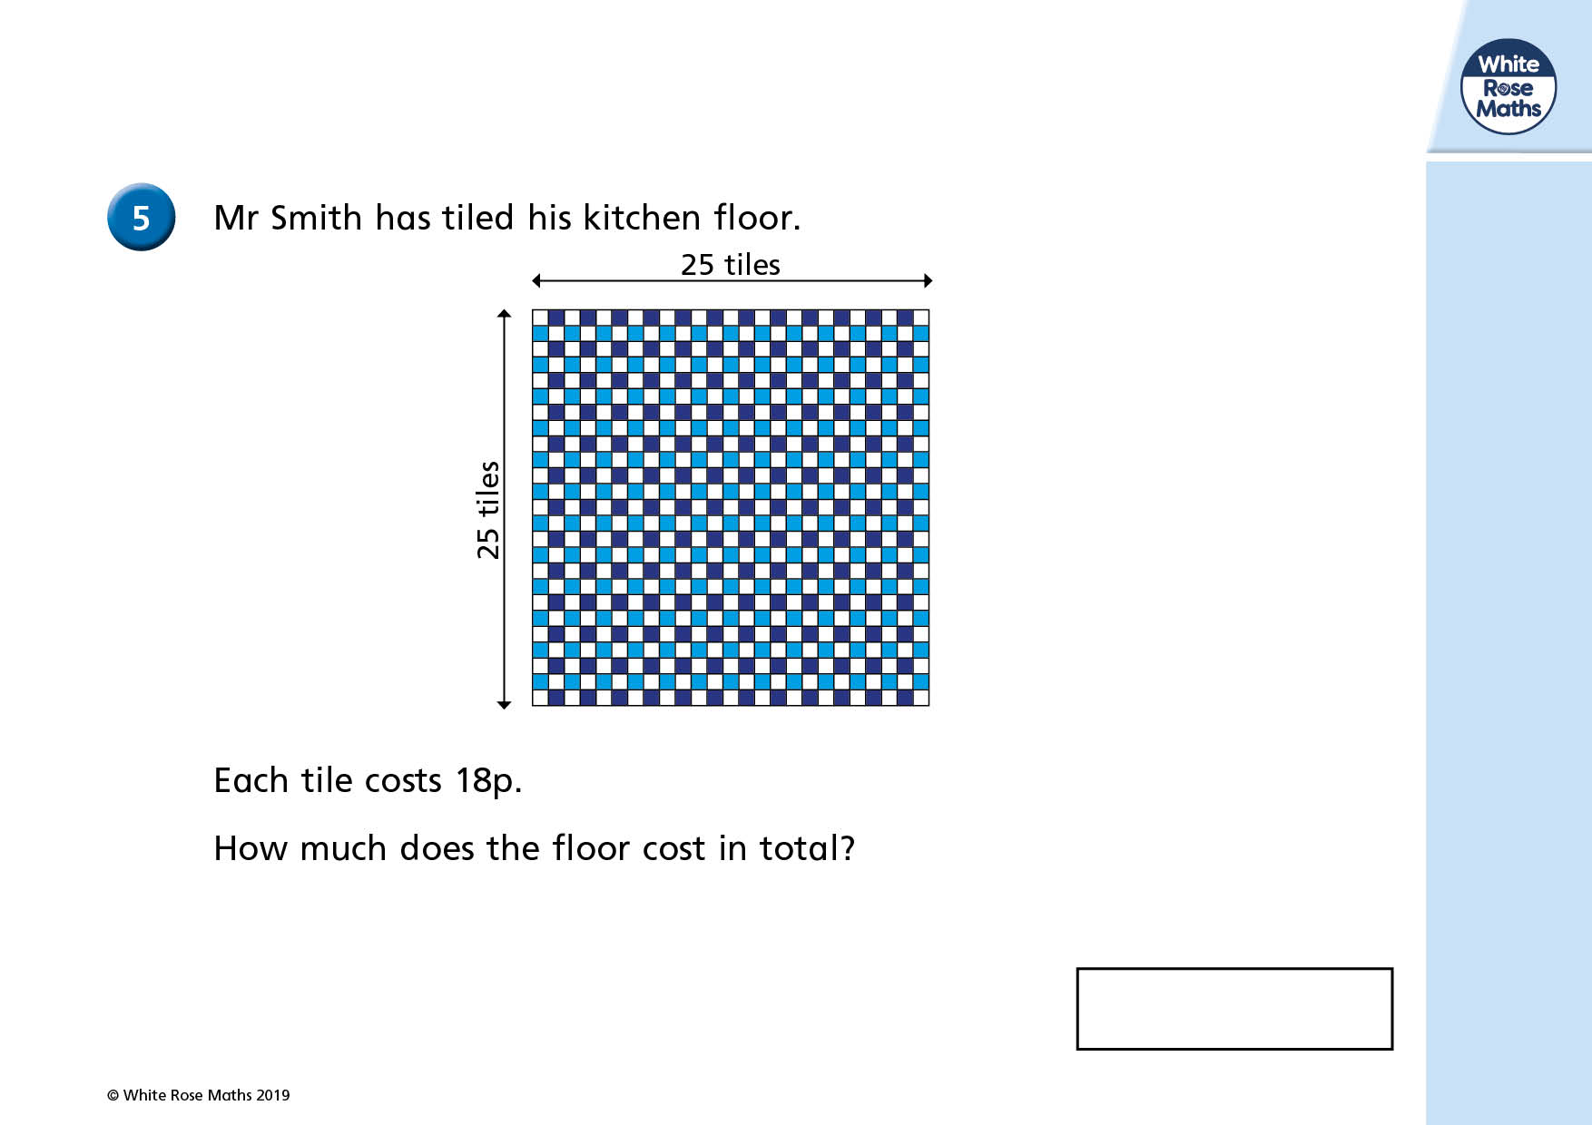

Slide 83
Over to you…
Your task this lesson is to practise the written column method for multiplication. You are to ENSURE YOU CHECK your work and feel confident with this method.
Each group will have a set of calculations to complete.
Triangles- Mrs Cooper
Squares- Mrs Lund
Hexagons- Independent
Octagons- Mrs Warham

Slide 84
Triangles
33 x 56 =
57 x 84 =
25 x 62 =
82 x 43 =
66 x 33 =
75 x 37 =
92 x 35 =
98 x 22 =
79 x 88 =
69 x 89 =
Triangles
33 x 56 =
57 x 84 =
25 x 62 =
82 x 43 =
66 x 33 =
75 x 37 =
92 x 35 =
98 x 22 =
79 x 88 =
69 x 89 =
Triangles
33 x 56 =
57 x 84 =
25 x 62 =
82 x 43 =
66 x 33 =
75 x 37 =
92 x 35 =
98 x 22 =
79 x 88 =
69 x 89 =
Triangles
33 x 56 =
57 x 84 =
25 x 62 =
82 x 43 =
66 x 33 =
75 x 37 =
92 x 35 =
98 x 22 =
79 x 88 =
69 x 89 =

Slide 85
Squares and Hexagons
65 x 34 =
73 x 57 =
98 x 86 =
59 x 87 =
47 x 86 =
76 x 49 =
98 x 67 =
154 x 66 =
176 x 94 =
342 x 55 =
256 x 32 =
423 x 45 =
293 x 53 =
542 x 64 =
257 x 43 =
Squares and Hexagons
65 x 34 =
73 x 57 =
98 x 86 =
59 x 87 =
47 x 86 =
76 x 49 =
98 x 67 =
154 x 66 =
176 x 94 =
342 x 55 =
256 x 32 =
423 x 45 =
293 x 53 =
542 x 64 =
257 x 43 =
Squares and Hexagons
65 x 34 =
73 x 57 =
98 x 86 =
59 x 87 =
47 x 86 =
76 x 49 =
98 x 67 =
154 x 66 =
176 x 94 =
342 x 55 =
256 x 32 =
423 x 45 =
293 x 53 =
542 x 64 =
257 x 43 =
Squares and Hexagons
65 x 34 =
73 x 57 =
98 x 86 =
59 x 87 =
47 x 86 =
76 x 49 =
98 x 67 =
154 x 66 =
176 x 94 =
342 x 55 =
256 x 32 =
423 x 45 =
293 x 53 =
542 x 64 =
257 x 43 =
Squares and Hexagons
65 x 34 =
73 x 57 =
98 x 86 =
59 x 87 =
47 x 86 =
76 x 49 =
98 x 67 =
154 x 66 =
176 x 94 =
342 x 55 =
256 x 32 =
423 x 45 =
293 x 53 =
542 x 64 =
257 x 43 =

Slide 86
Octagons:
385 x 94 =
903 x 67 =
898 x 186 =
759 x 287 =
2347 x 186 =
376 x 249 =
2198 x 267 =
154 x 66 =
7176 x 94 =
9342 x 55 =
8256 x 32 =
9423 x 45 =
2293 x 53 =
2542 x 64 =
1257 x 43 =
Octagons:
385 x 94 =
903 x 67 =
898 x 186 =
759 x 287 =
2347 x 186 =
376 x 249 =
2198 x 267 =
154 x 66 =
7176 x 94 =
9342 x 55 =
8256 x 32 =
9423 x 45 =
2293 x 53 =
2542 x 64 =
1257 x 43 =
Octagons:
385 x 94 =
903 x 67 =
898 x 186 =
759 x 287 =
2347 x 186 =
376 x 249 =
2198 x 267 =
154 x 66 =
7176 x 94 =
9342 x 55 =
8256 x 32 =
9423 x 45 =
2293 x 53 =
2542 x 64 =
1257 x 43 =
Octagons:
385 x 94 =
903 x 67 =
898 x 186 =
759 x 287 =
2347 x 186 =
376 x 249 =
2198 x 267 =
154 x 66 =
7176 x 94 =
9342 x 55 =
8256 x 32 =
9423 x 45 =
2293 x 53 =
2542 x 64 =
1257 x 43 =
Octagons:
385 x 94 =
903 x 67 =
898 x 186 =
759 x 287 =
2347 x 186 =
376 x 249 =
2198 x 267 =
154 x 66 =
7176 x 94 =
9342 x 55 =
8256 x 32 =
9423 x 45 =
2293 x 53 =
2542 x 64 =
1257 x 43 =

Slide 87
Odd one out
234
X 56
234
X 56
234
X 56

Slide 88
Odd one out
283
X 66
283
X 66
283
X 66

