Slide 1
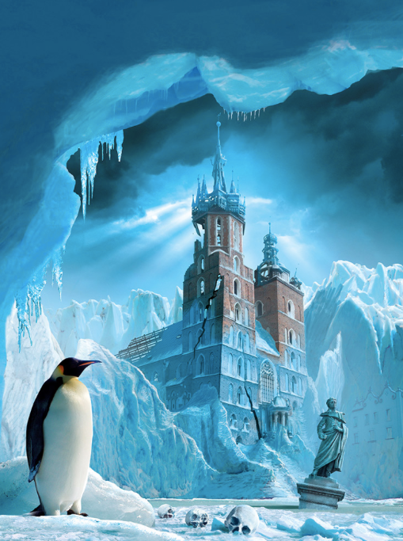
100 word challenge

Slide 2
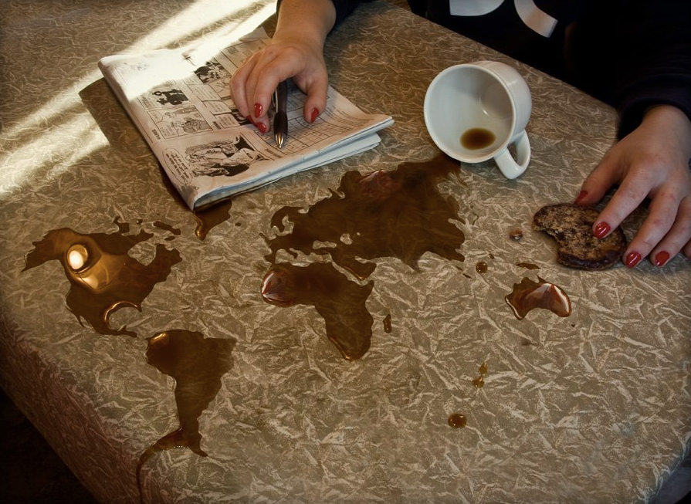
100 word challenge

Slide 3
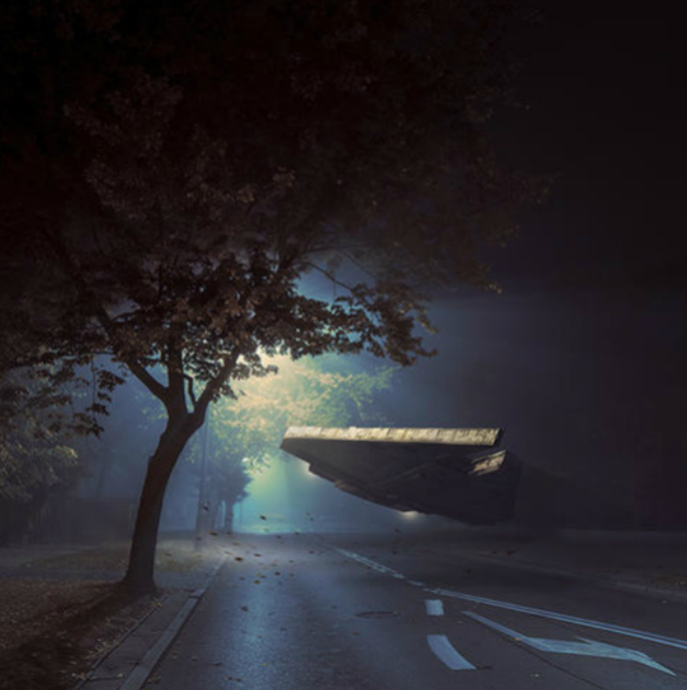
100 word challenge…
It was the middle of the night when they came.
A typical autumn evening, there was a scattering of fallen, auburn leaves on the highway. Light leaked from a flickering streetlamp, which buzzed faintly as the light bulb struggled.
The wind moaned quietly, and the leaves crackled as they rose and fell, dancing as if controlled by an unseen puppet master.
A humming noise was the first sign of their arrival. In the distance at first, then filling the street as it came closer. It hovered several feet from the road, tilting slightly from side to side as if surveying the land around.
A little girl gasped as she watched from her bedroom window…

Slide 4
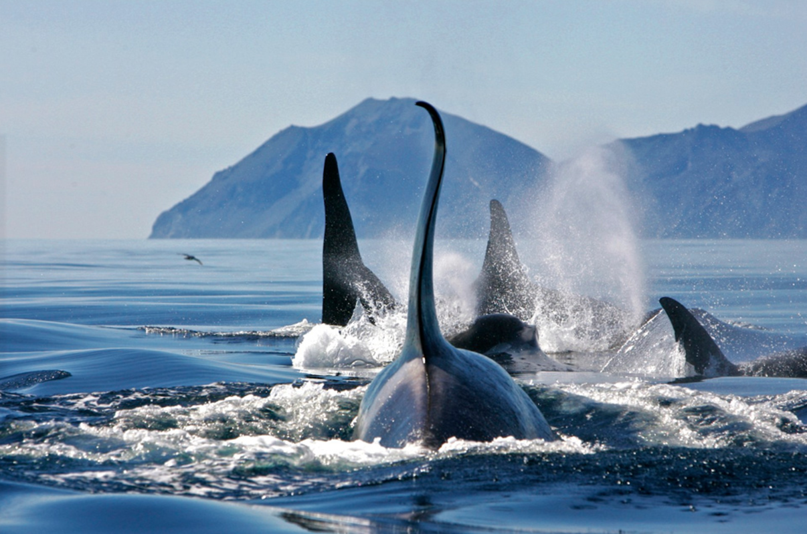
The pod travelled everywhere together. Moving as one through the ice-cold, northern waters, they began to stalk their prey…
100 word challenge…

Slide 5
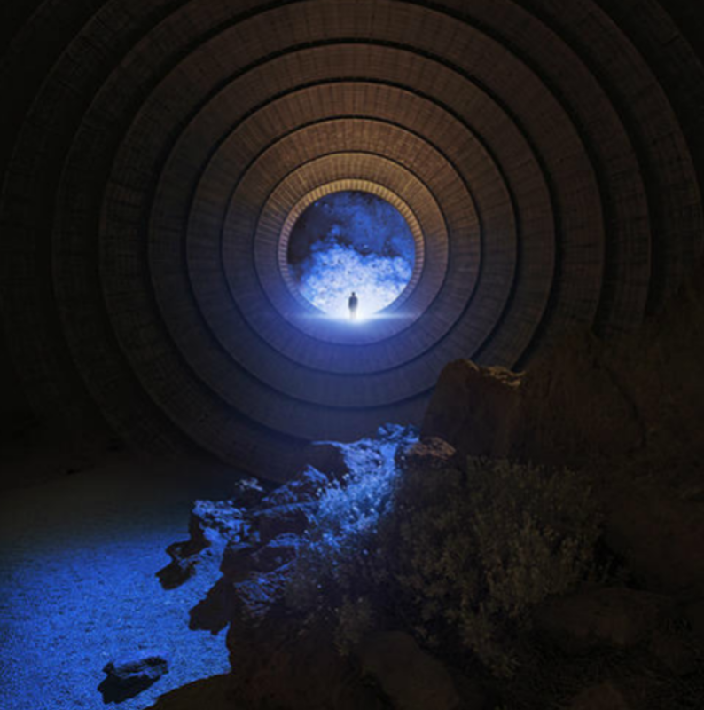
FBI Case 3478
Location: Area 51
Time: 0100 hours
Status: Highly Classified
Risk: Extremely Dangerous, Code Red.
INTEL
Description by eyewitness: “It just seemed to come out of nowhere. It was travelling really quickly, and there was a bright blue light at the front of it as it flew. As it got closer, I hid behind some rocks. A few minutes later, the thing landed smoothly on the ground, and this ‘door thing’ opened. Before I blacked out, I saw a figure standing there looking at me. That’s all I can remember.”
Task: Can you report on the mysterious sighting by writing a report for the FBI?

Slide 6
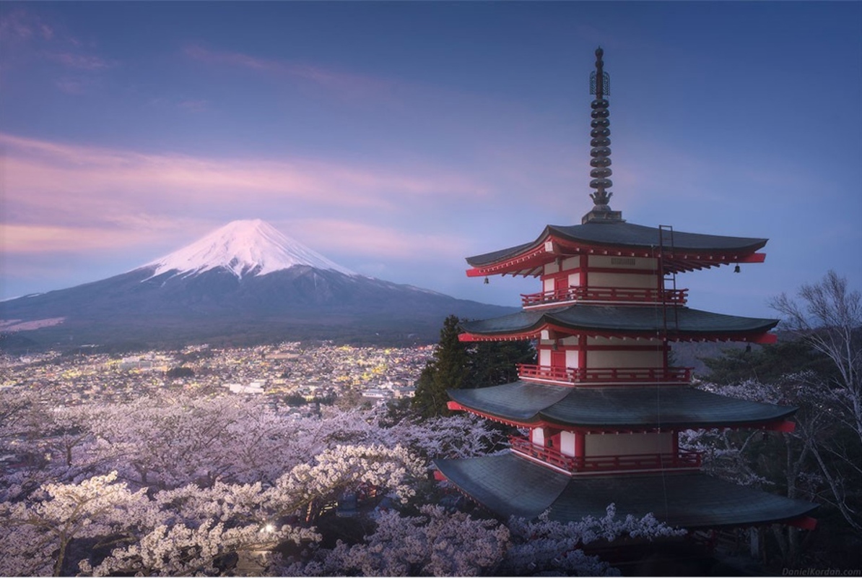
100 word challenge
The monastery was his home. It had been for most of his life.
As he drew back the shutter and gazed out, as he did every morning when the sun rose in the East, the view astounded him. He thought to himself that this must surely be the most beautiful place on earth…
Can you continue the description of what he saw?

Slide 7
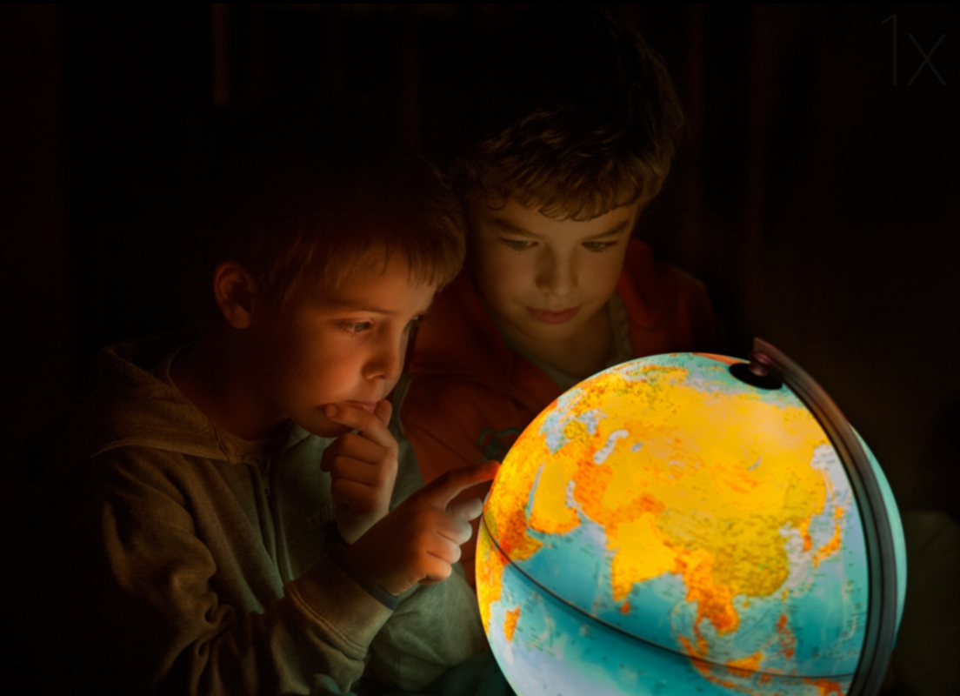
100 word challenge
“Hmmm. Where shall we go this time?” Jeremy asked his brother.
“How about there!?” replied Max excitedly. “We’ve always talked about going there!”
The brothers both put their fingers on the part of the world they had chosen, and waited for the magic to happen.
“I wonder if it will be as fun as our last trip,” mused Jeremy, as the globe began to glow…

Slide 8
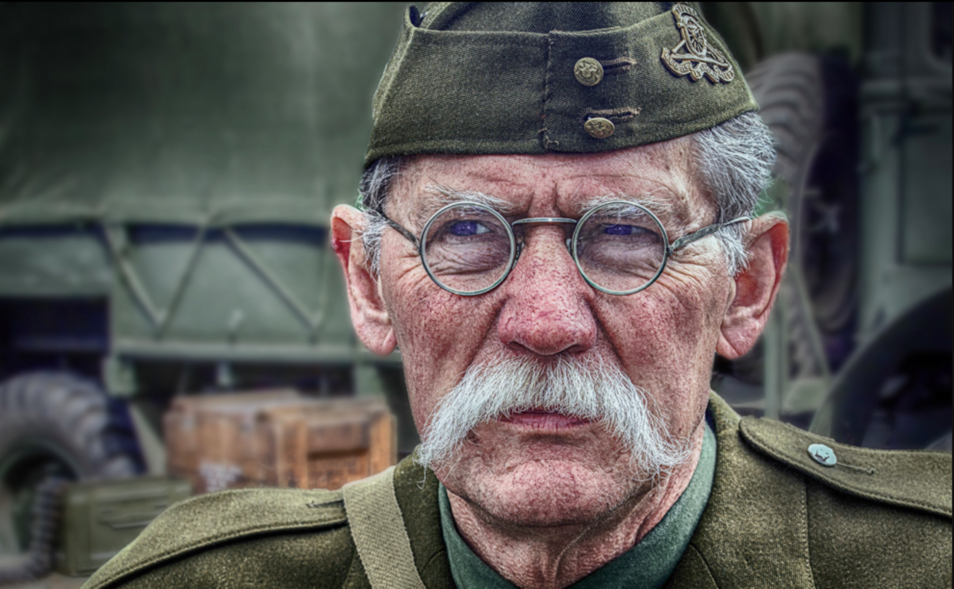
100 word challenge
George had not worn his uniform for many years. Now that he finally did, the memories all came flooding back to him…

