Slide 1
100 word challenge…
Select the image on slide 2 or 3 to write your 100 word challenge. Get your minds all warmed up and remember all those key techniques you know how to use:
Figurative language
Body language
Complex sentences
Powerful vocabulary
Suspense

Slide 2
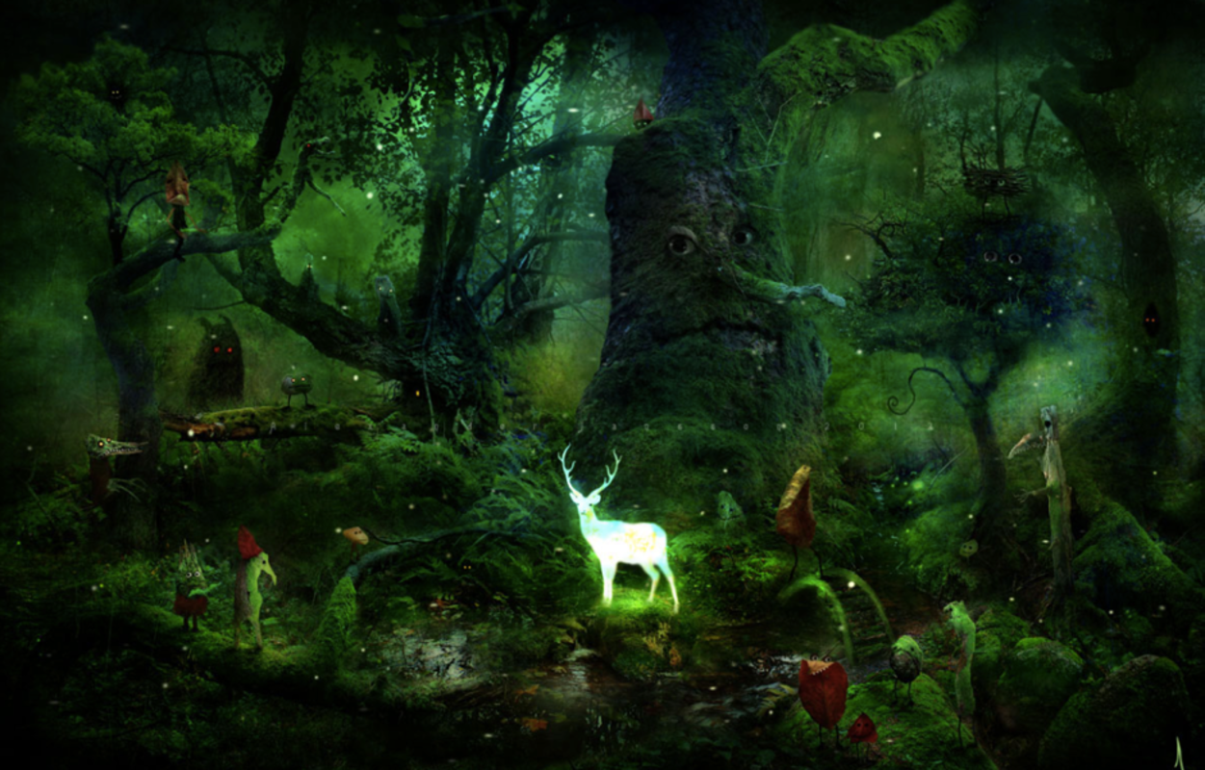
Eyes. Wherever you went in Watchwood Forest there were eyes.
It was home to the most beautiful and mysterious creatures in the entire realm, yet very few human eyes had ever seen it.
One day, at the time of year where it stays sunny and warm well into the evening, a little girl called Rose decided she would explore Watchwood Forest. Rose had been told by her parents and by numerous other bossy grown-ups that she was never to go into the Forest.
Now, to you and me (as the kind of people that always follow the rules), it might seem a little careless and a bit reckless and maybe even a bit foolish for Rose to find herself in such a place, especially after been told such a thing! However, Rose was not that sort of girl. In her mind, rules were there to be broken…
Can you continue Rose’s story?

Slide 3
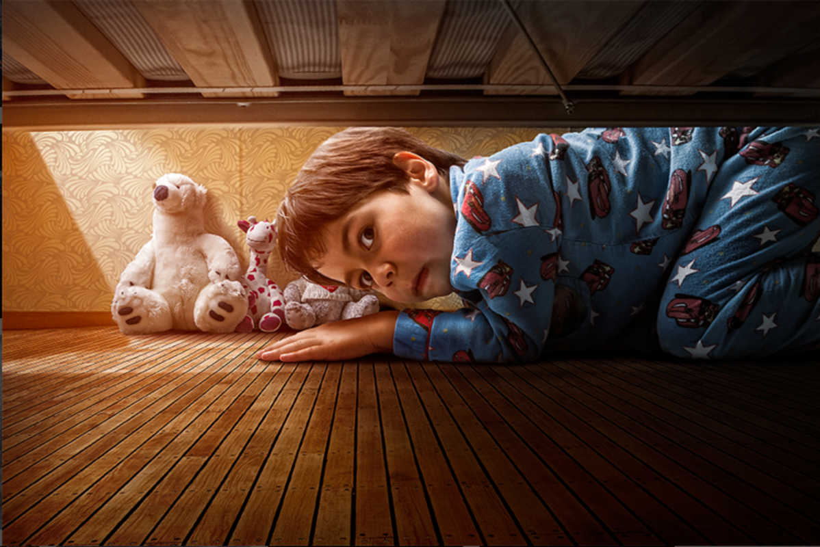
The scuttling noise had disturbed Michael, and he’d shot bolt upright in bed. After taking a deep breath, he flung himself onto the smooth wooden boards of his bedroom floor and took a peek…

Slide 4
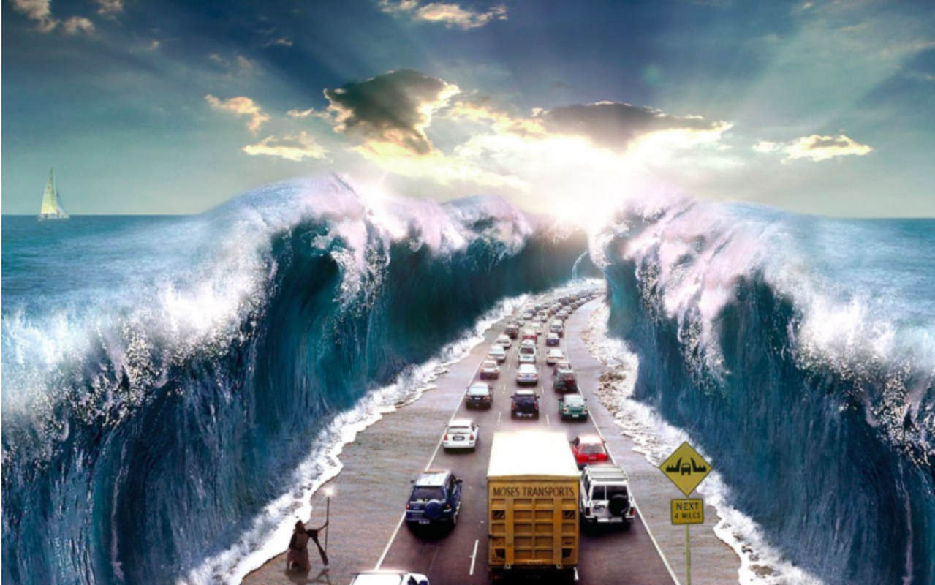
100 word challenge
It was that time again… Our annual surfing trip to Devon. While my parents packed up the suitcases and loaded up the car for the long journey ahead, we chatted excitedly about what an incredible holiday this was going to be!
Not too long into the journey, the beautifully clear, blue sky became dark and ominous. All of a sudden, crashing towards the long line of traffic, was a colossal wave – not the kind you’d want to catch on a board either…
Desperately, people raced wildly out of their cars, running, screaming and panicking yet as I looked to my left, I saw a man…

Slide 5
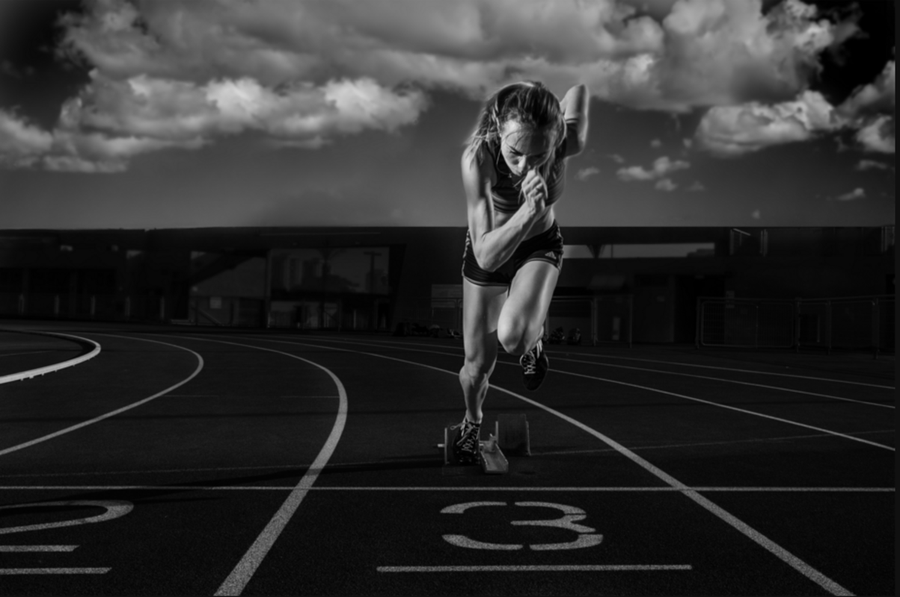
100 word challenge
Like a venomous snake coiled before making a deadly strike, they waited…
Bang! The gunshot echoed around the stadium, and the athletes sprang out of the starting blocks. Within moments, they were tearing up the track with ferocious speed.
She could hear the pounding footsteps of the athletes around her, and out of the corner of each eye she caught a glimpse of their presence beside her.
She streamlined her thoughts, channelled her energy, and focused on the one thing that meant more to her than anything: winning the gold medal…

Slide 6
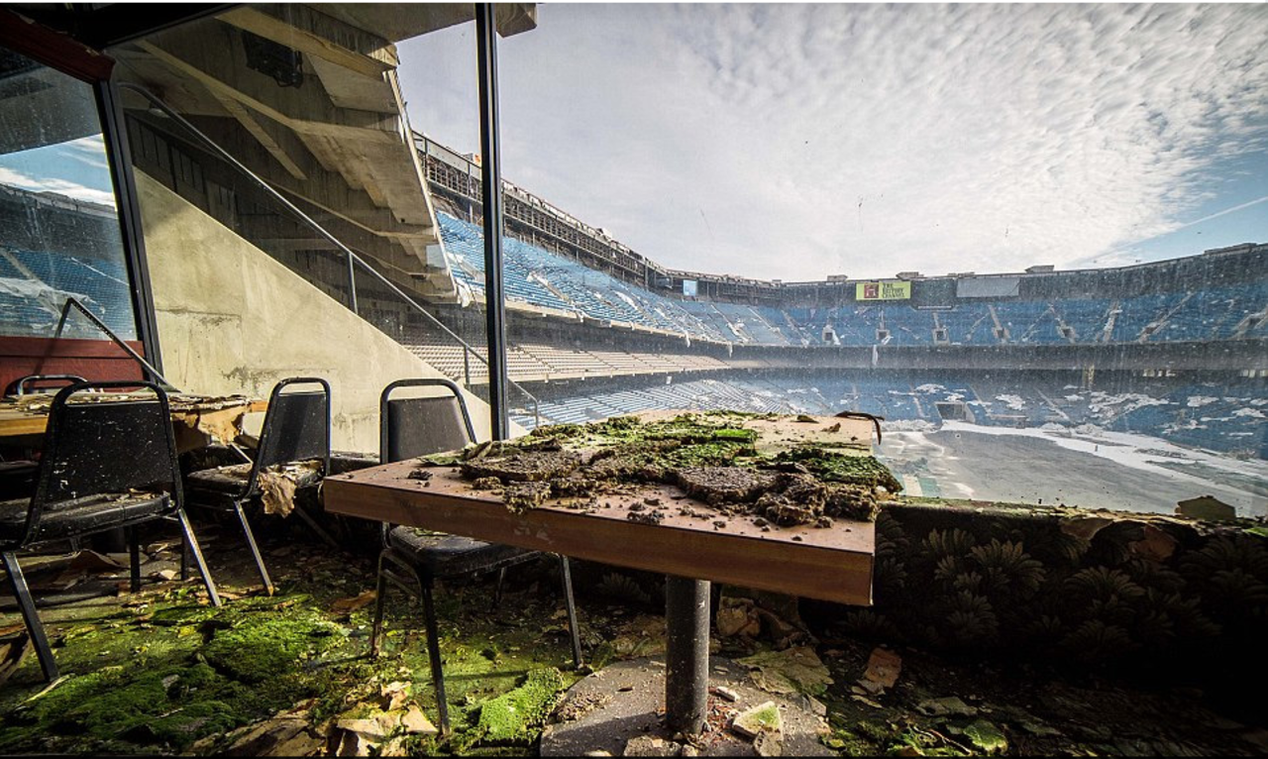
100 word challenge
This place had once been filled with noise, thousands upon thousands of excited fans cheering as they applauded ‘the beautiful game’ being played in front of them.
Now, all that remained were memories. Would this place ever be restored to its former glory?

Slide 7
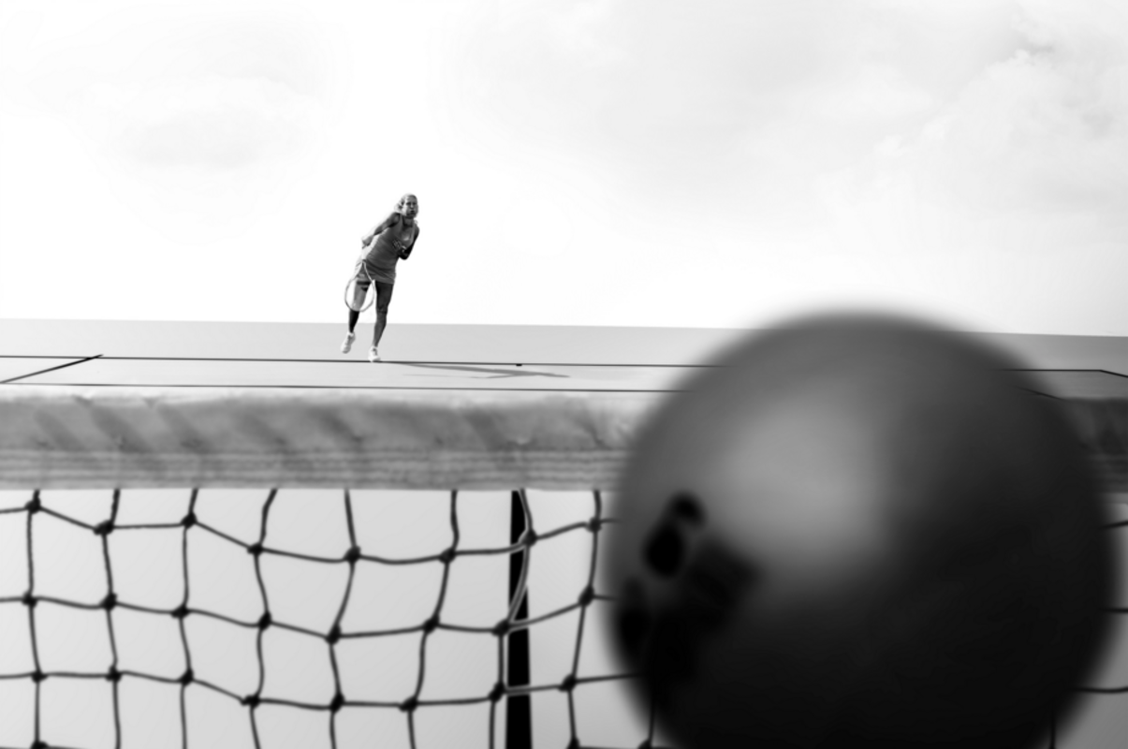
100 word challenge
She gripped me tightly in her fingers. I could tell exactly what was about to happen…
Without warning, I felt myself being flung high into the air. For a moment it felt like I was flying as the wind rushed past me. I could see myself glowing a gloriously bright shade of yellow in the glistening sunshine as it poured down upon the court.
As I reached the pinnacle of my flight, I glanced down and saw her reaching up towards me with her racquet.
Then, it happened...
Everything blurred; my whole world went out of shape for an instant. I was hit by a wall of confusion and I felt totally disorientated. It wasn’t until I sailed over the top of the net that I came to my senses and realised what had happened...

Slide 8
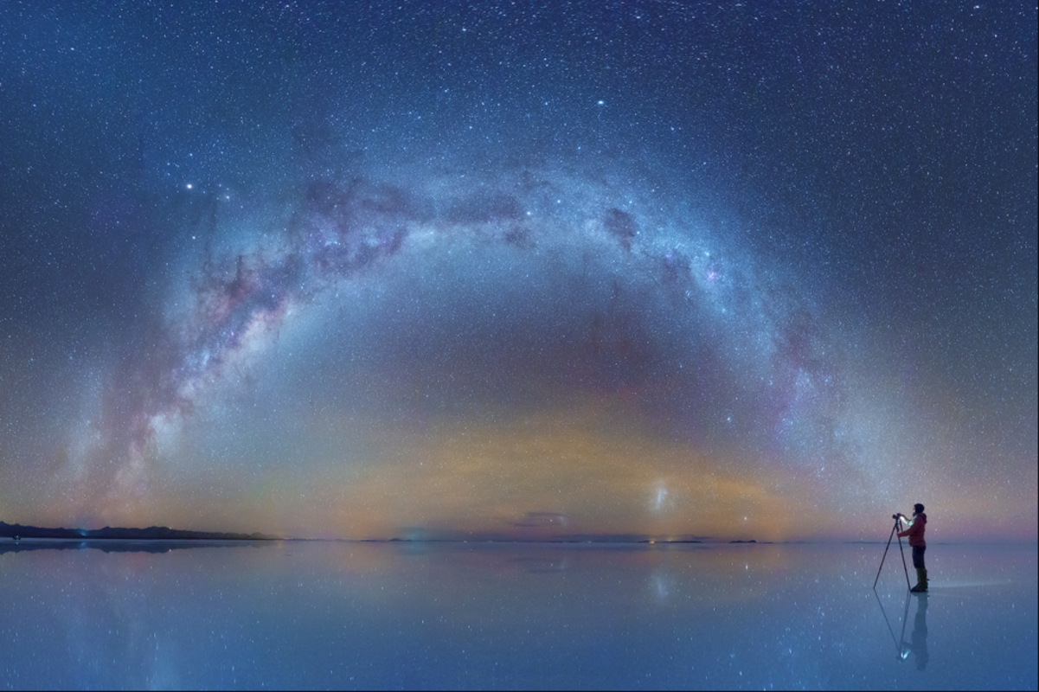
100 word challenge
As an astronomer, Peter believed he had the best job in the world! Ever since he was a boy, Peter had been fascinated with stars, planets, moons, comets and galaxies. Any celestial object that he witnessed had Peter enraptured.
As he stood alone on the frozen surface of the lake, wrapped up well against the bitterly cold wind, Peter glimpsed something extraordinary through his telescope. It was in moments like this that Peter truly felt alive...

Slide 9
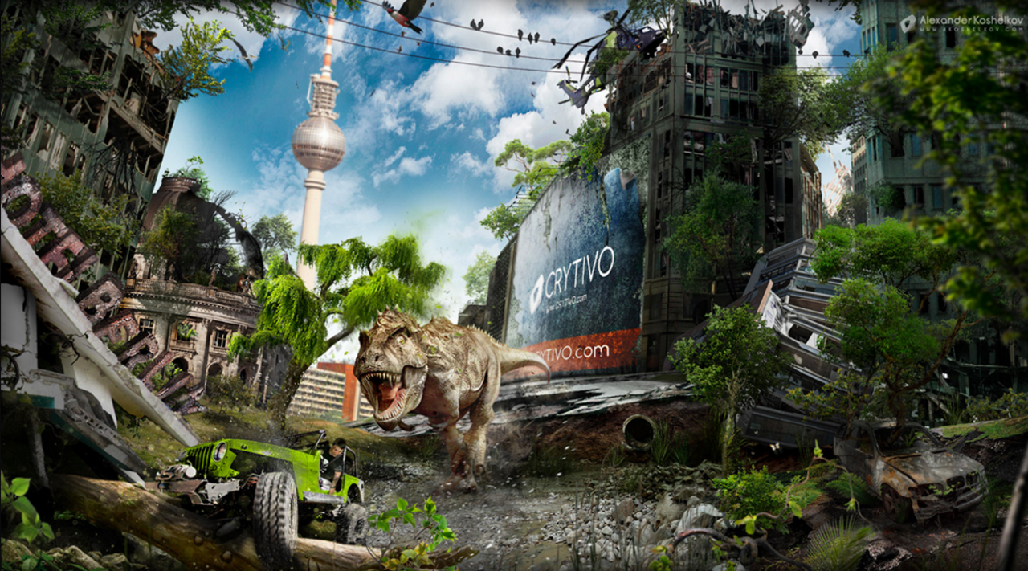
The engine screamed as the wheels spun round. His heart pounded. Tim knew that he only had seconds to act.
There was a long, moss-covered log wedged underneath the jeep, preventing it from moving. The wheels continued to spin pointlessly, smoke starting to billow out from underneath the bonnet.
A terrifying roar filled his ears, and he knew the monster was right behind him. He could feel the ground shake beneath him as its gigantic feet collided with the ground. He knew what would happen if it caught him, and muttered a prayer beneath his breath.
Tim suddenly found himself lunging forward. He realised that the wheels must finally have found some traction, and he breathed out with relief as he sped off onto the path once again; the wheels of the jeep content to be chewing up the firm gravel once again.
The chase was back on, and the T-Rex let out another blood-chilling roar, determined not to let its prey escape…

Slide 10
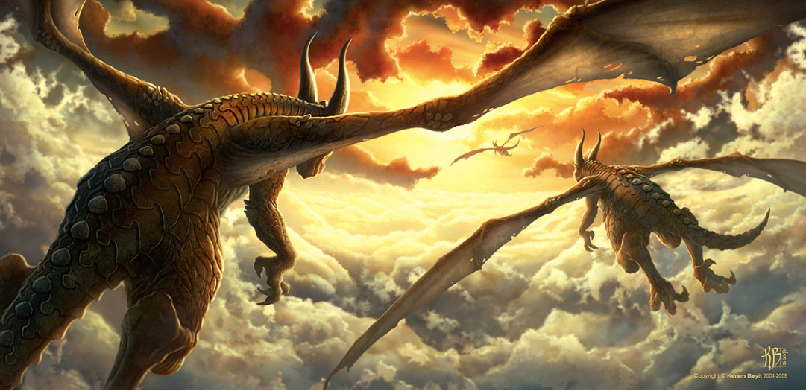
A simile is a way of describing something by comparing it to something else, often using the word “like” or “as.”
Can you think of your own similes to use in your writing?
You could experiment using metaphors, or even personification to make your writing really exciting to read!
Up-level:
The dragon flew through the sky. The sun was shining in the sky.
There were big clouds.

Slide 11
As an astronomer, Peter believed he had the best job in the world! Ever since he was a boy, Peter had been fascinated with stars, planets, moons, comets and galaxies. Any celestial object that he witnessed had Peter enraptured.
As he stood alone on the frozen surface of the lake, wrapped up well against the bitterly cold wind, Peter glimpsed something extraordinary through his telescope. It was in moments like this that Peter truly felt alive...

Slide 12
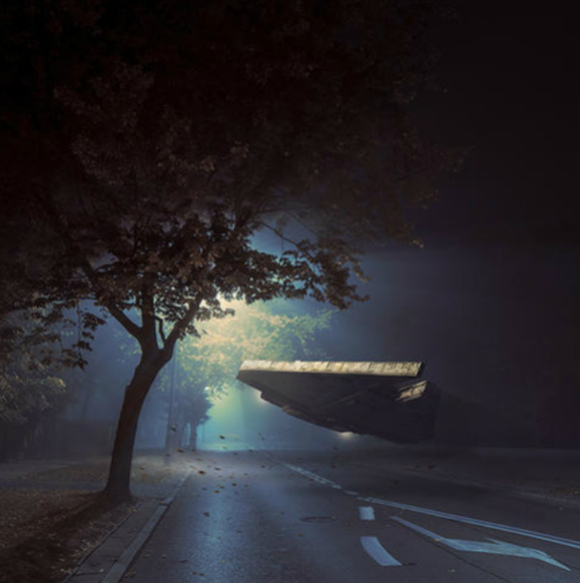
It was the middle of the night when they came.
A typical autumn evening, there was a scattering of fallen, auburn leaves on the highway. Light leaked from a flickering streetlamp, which buzzed faintly as the light bulb struggled.
The wind moaned quietly, and the leaves crackled as they rose and fell, dancing as if controlled by an unseen puppet master.
A humming noise was the first sign of their arrival. In the distance at first, then filling the street as it came closer. It hovered several feet from the road, tilting slightly from side to side as if surveying the land around.
A little girl gasped as she watched from her bedroom window…

Slide 13
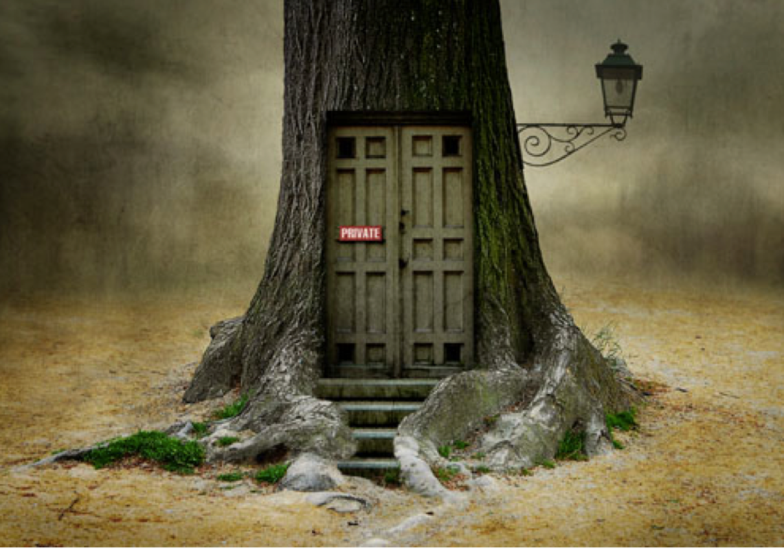
The creaky, old doors had not been opened for years. The beast had always lived inside, but nobody dared to visit. Noises that echoed from the gaps in the door had haunted those who heard them. Nobody knew what the narrow, mossy steps led to. Nobody knew what was lurking within.
One day, the heavy, wooden doors slowly began to open with a groan…
Can you continue the story of the mysterious door?

Slide 14
Eyes. Wherever you went in Watchwood Forest there were eyes.
It was home to the most beautiful and mysterious creatures in the entire realm, yet very few human eyes had ever seen it.
One day, at the time of year where it stays sunny and warm well into the evening, a little girl called Rose decided she would explore Watchwood Forest. Rose had been told by her parents and by numerous other bossy grown-ups that she was never to go into the Forest.
Now, to you and me (as the kind of people that always follow the rules), it might seem a little careless and a bit reckless and maybe even a bit foolish for Rose to find herself in such a place, especially after been told such a thing! However, Rose was not that sort of girl. In her mind, rules were there to be broken…
Can you continue Rose’s story?

Slide 15
A simile is a way of describing something by comparing it to something else, often using the word “like” or “as.”
Can you think of your own similes to use in your writing?
You could experiment using metaphors, or even personification to make your writing really exciting to read!
Up-level:
The dragon flew through the sky. The sun was shining in the sky.
There were big clouds.

