Slide 1

Lesson 4-
L.O. To understand how Christian’s life journeys can be different.

Slide 2
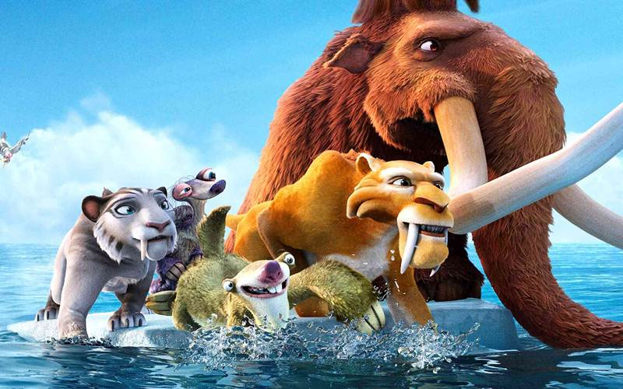
https://www.youtube.com/watch?v=Ydi84qnYp8c
We all have a destination…
experiences on way will
all be different!

Slide 3
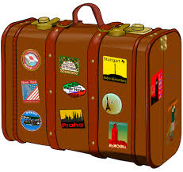
A journey usually involves luggage of some kind…

Slide 4

You have a rucksack to carry on your life journey…
Imagine…

Slide 5
What supplies will you need to pack/collect along the way to help you travel on your journey?

Slide 6
How about…?
Compassion? Love? Courage?
Wisdom? Friendship?
Responsibility?

Slide 7
Think about….
Consider the journey of a Christian. What might they need to help them?

Slide 8

Recap….
Is choosing to journey through life as a Christian an easy option?
Why? Why not?

Slide 9
Do all Christians live the same life journey?
What about Christians in other countries?

Slide 10
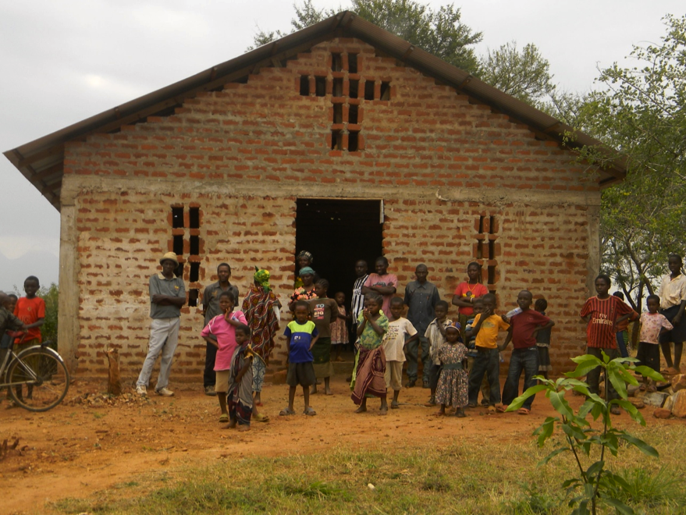

Slide 11
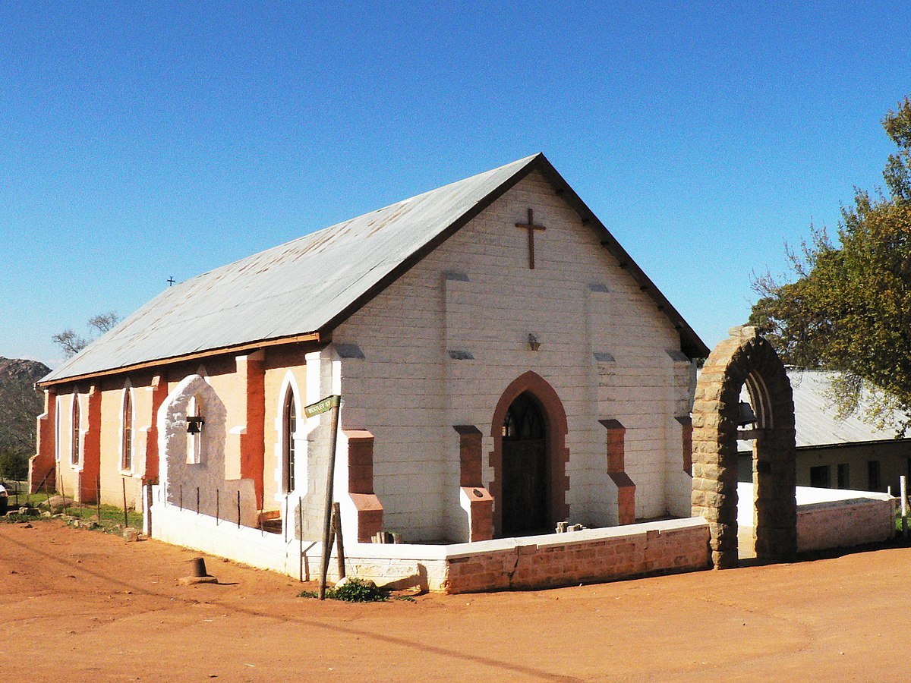

Slide 12
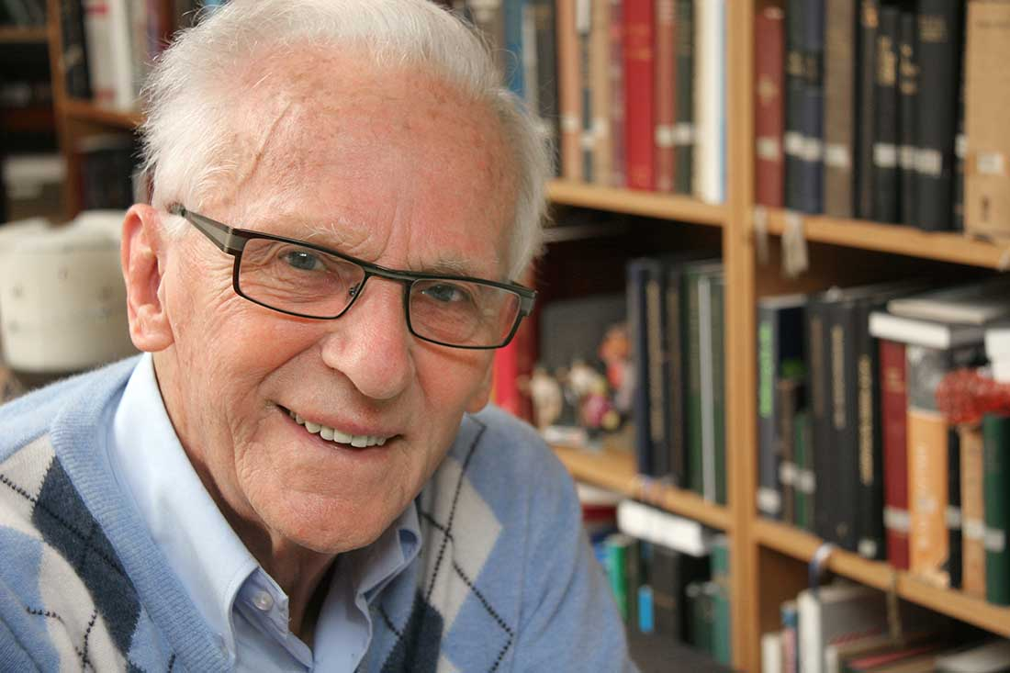
https://www.elim.org.uk/Articles/522556/How_do_you.aspx
Who is this man?
Open Doors first began in 1955 when God called a young Dutchman to take Bibles behind the Iron Curtain for people who were desperate for the Word of God. Brother Andrew became known the world over as ‘God’s Smuggler’.

Slide 13
Persecuted Christians
There are between 50,000 and 70,000 Christians being held in labour camps in North Korea, simply for daring to believe in Jesus.
Hea Woo is a Christian who was imprisoned in North Korea. When she arrived at the prison camp where she was held, there was a sign saying ‘Do not try to escape, you shall be killed’. She says, “The guards were merciless. They kicked me and beat me with sticks. Christians are sometimes killed or locked up for the rest of their lives in concentration camps.
https://www.opendoorsuk.org/persecution/world-watch-list/

Slide 14
And yet, even in these labour camps that are like hell on earth, God is at work. Hea Woo says, “God helped me to survive. Even more: He gave me a desire to evangelise among the other prisoners! He showed me whom I should approach. God used me to lead five people to faith. We met together out of the view of the guards. Often that was in the toilet. There we held a short service. I taught them Bible verses and some songs, which we sang almost inaudibly.”

Slide 15
Iran:
Imagine a young boy called Hami*. His parents are Christians, but in secret. That’s because in Iran, becoming a Christian or sharing the gospel is dangerous - you could end up in prison. They go to a small house church that meets at Pastor Milad’s* house, but that means Pastor Milad is taking a risk. https://www.opendoorsuk.org/resources/children-at-home/

Slide 16
Class - What are the similarities and differences of Christians’ life journeys?
Similarities | Differences
https://www.youtube.com/watch?v=u4qbmPpfG6s

Slide 17
Class discussion: What are the similarities and differences of Christians’ life journeys?
Similarities | Differences
All Christians trust in God All Christians want to have fellowship Christians will trust in God through all things All Christians believe in God and Jesus and will follow the Bible’s teachings They all pray to God Christians get married in a church | Some Christians go on pilgrimages and some don’t. Not all Christians around the world are allowed or able to go to Church. Christians can be persecuted for their faith Not all Christians are free to express their faith. Christians can be baptised, christened or confirmed.

Slide 18
Write an informal letter of encouragement to ‘Hami’. Think carefully about what you would say to him- how would you encourage him? What do you think about his life and having to worship in secret? Could you share a Bible verse?

Slide 19
Success criteria:
LO: To write an informal letter of encouragement to ‘Hami- using a variety of sentence starts and informal language (link to letter writing- English)
Baseline = Use two different sentence starts, some informal language, basic punctuation
Good/very good = Use four different sentence starts, variety of informal language and a Bible verse, some varied punctuation
Excellent = Use a wide variety of different sentence starts, a wide variety of informal language, different Bible verses to encourage Hami ,varied punctuation
Check your punctuation carefully! Can you use commas for complex sentences? Can you use a colon?

Slide 20
6 ways to
start a sentence…

Slide 21
Start with a verb…
Stressing about my workload, I feel it is too much.

Slide 22
Start with
an emotion word…
ed
3ed
Stressed, fatigued, and overworked, I feel I am being unfairly treated.

Slide 23
Start with
a conjunction…
Although I am your favourite colour, I need a well earned rest!

Slide 24
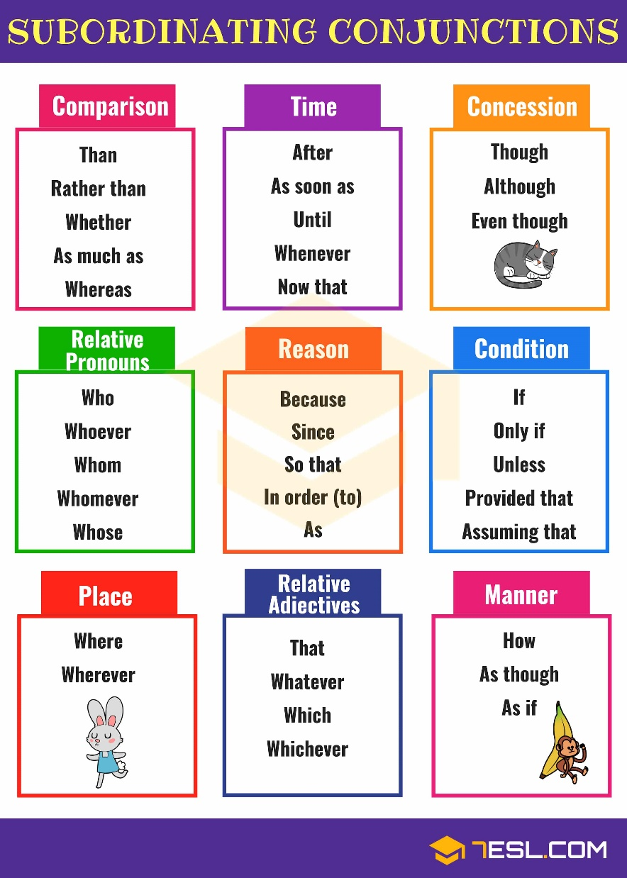

Slide 25
Start with an adverb …
Miserably, I watch while you use yellow crayon to colour the sun.

Slide 26
Start with a simile …
As unclothed as a newborn baby, I sit embarrassed in the crayon box.

Slide 27
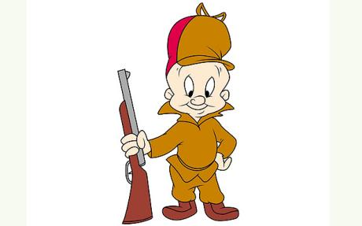
Start with a
coordinating conjunction…
If you used me more often, it would make me happier.
WABBITS

Slide 28
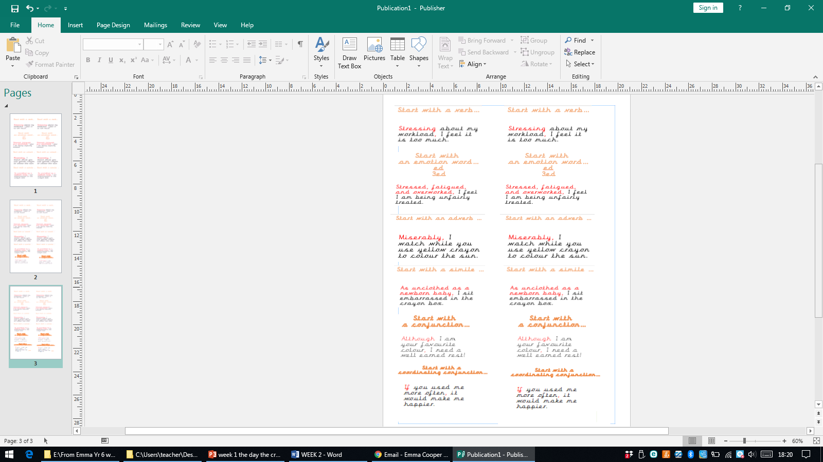

Slide 29
ART TASK- The Secret Church Experience:
Sssh! Don’t tell anyone but in some countries, there are SECRET Christians. They hide their Bibles and gather secretly so that they won’t get into trouble.
Make your own secret house church
Your mission is to make a mini secret house church to help you pray for Christians in North Korea complete with toy figures and miniature pictures and Bibles!

Slide 30
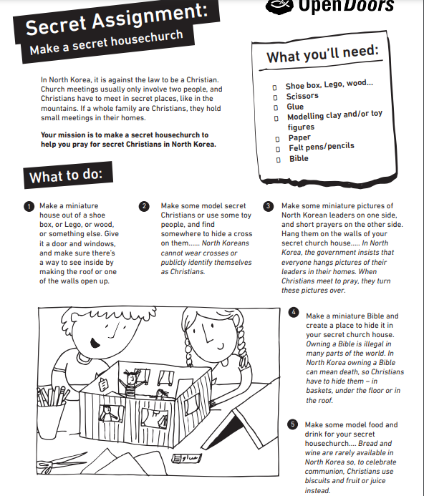
Over to
you….

Slide 31
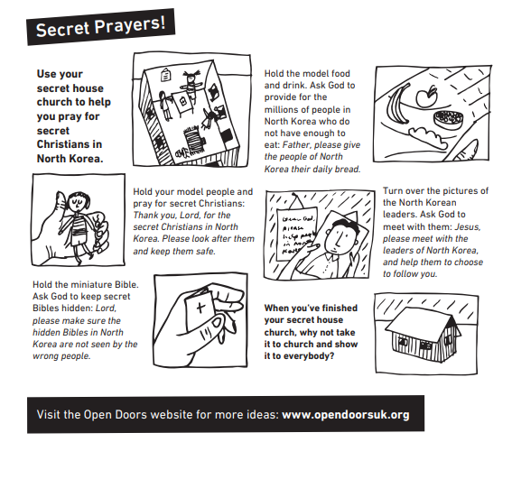

Slide 32
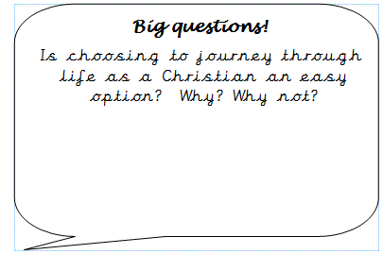

Slide 33

Over to you…
https://www.opendoorsuk.org/act/letter/
https://www.opendoorsuk.org/act/letter/colombia-childrens-campaign/
Could you send a card or postcard with a drawing and short message? Write in simple English, or use the suggested Spanish phrases .
PSCHE/Worship time

Slide 34
Important guidelines
Keep your message short and positive and print clearly, whether in Spanish or English.
Include an encouraging verse from the Bible (you can find Spanish translations at biblegateway.com)
Show sensitivity. Please don’t dwell on the difficulties of their situation or share about the blessings of your own life.
Please don’t mention Open Doors anywhere – and don’t include your surname or address.

Slide 35
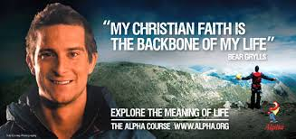
Lesson 5
L.O. To compare the impact of faith on a believer’s life journey in comparison to a person of no faith
https://www.youtube.com/watch?v=qfiQoHyJC10

Slide 36
How would a Christian’s life journey, differ to a person who does not have a faith?
Would they celebrate the same things?
How could their journeys be different?
Paired tasks…
complete the chart.

Slide 37
Person who has a faith | Person who doesn’t have a faith
Think differently about festivals. Christians would celebrate Christmas and Easter.
They would attend their holy place of worship. Example: Jewish people would go to a synagogue and Christians would go to church.
People who have a faith would pray
People who have a faith may fast or eat different food.

Slide 38
Person who has a faith | Person who doesn’t have a faith
Think differently about festivals. Christians would celebrate Christmas and Easter.
They would attend their holy place of worship. Example: Jewish people would go to a synagogue and Christians would go to church.

Slide 39
Person who has a faith | Person who doesn’t have a faith
Think differently about festivals. Christians would celebrate Christmas and Easter.
They would attend their holy place of worship. Example: Jewish people would go to a synagogue and Christians would go to church.

Slide 40
Person who has a faith | Person who doesn’t have a faith
Read their holy scripture: Bible, Torah etc to learn teachings and gain wisdom. | Wouldn’t attend their holy place of worship.
Trust in God when they have hard times. | Won’t pray to God.
Pray to God to give thanks, pray for help and support. | Not worship and listen to different music.
Love God and each other. | Won’t read holy scriptures.
Religious values | Still have values in life that may be similar to religious ones.

Slide 41
A person who does not have a faith won’t attend a place of worship each week; however, ___________________
________________________________________________.
A person of faith _____________
___________________, on the other hand, ________________________________
________________________________________.

Slide 42
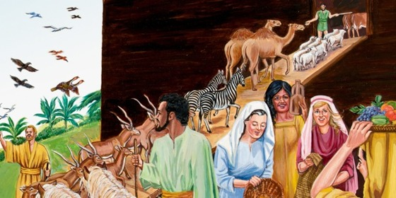
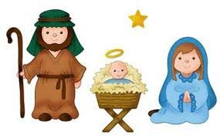
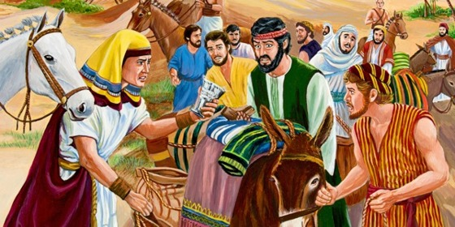
Investigate Bible characters who lived by Faith
Abraham and Sarah
David

Slide 43
Think of Bible characters who put their faith into action- complete the chart
Bible character | Event | What does it tell us about their beliefs?
e.g. Mary | Gave birth to Jesus | Trusted God, even when didn’t know what would happen and how Joseph would feel.
Noah | Built the Ark | Trusted God and believed what he had told him- even when people laughed at him

Slide 44
Red, Yellow and Orange group think of your own characters and events.
Bible character | Event | What does it tell us about their beliefs?
e.g. Mary | Gave birth to Jesus | Trusted God, even when didn’t know what would happen and how Joseph would feel.
Noah | Built the Ark | Trusted God and believed what he had told him- even when people laughed at him
Blue group- use the sheet- I have given you the characters- what event happened to them ? What does it tell us about them?

Slide 45
Lesson 6
L.O.To understand why people go on pilgrimage.

Slide 46
Think about it….
Are there any places in the world that you would love to visit? Take a moment to think about why.
Perhaps you chose somewhere that is associated with someone special – for example, the town or country your grandparents were born, or where a hero of yours lives. Perhaps you chose a place you have heard a lot about and would love to see for yourself.

Slide 47
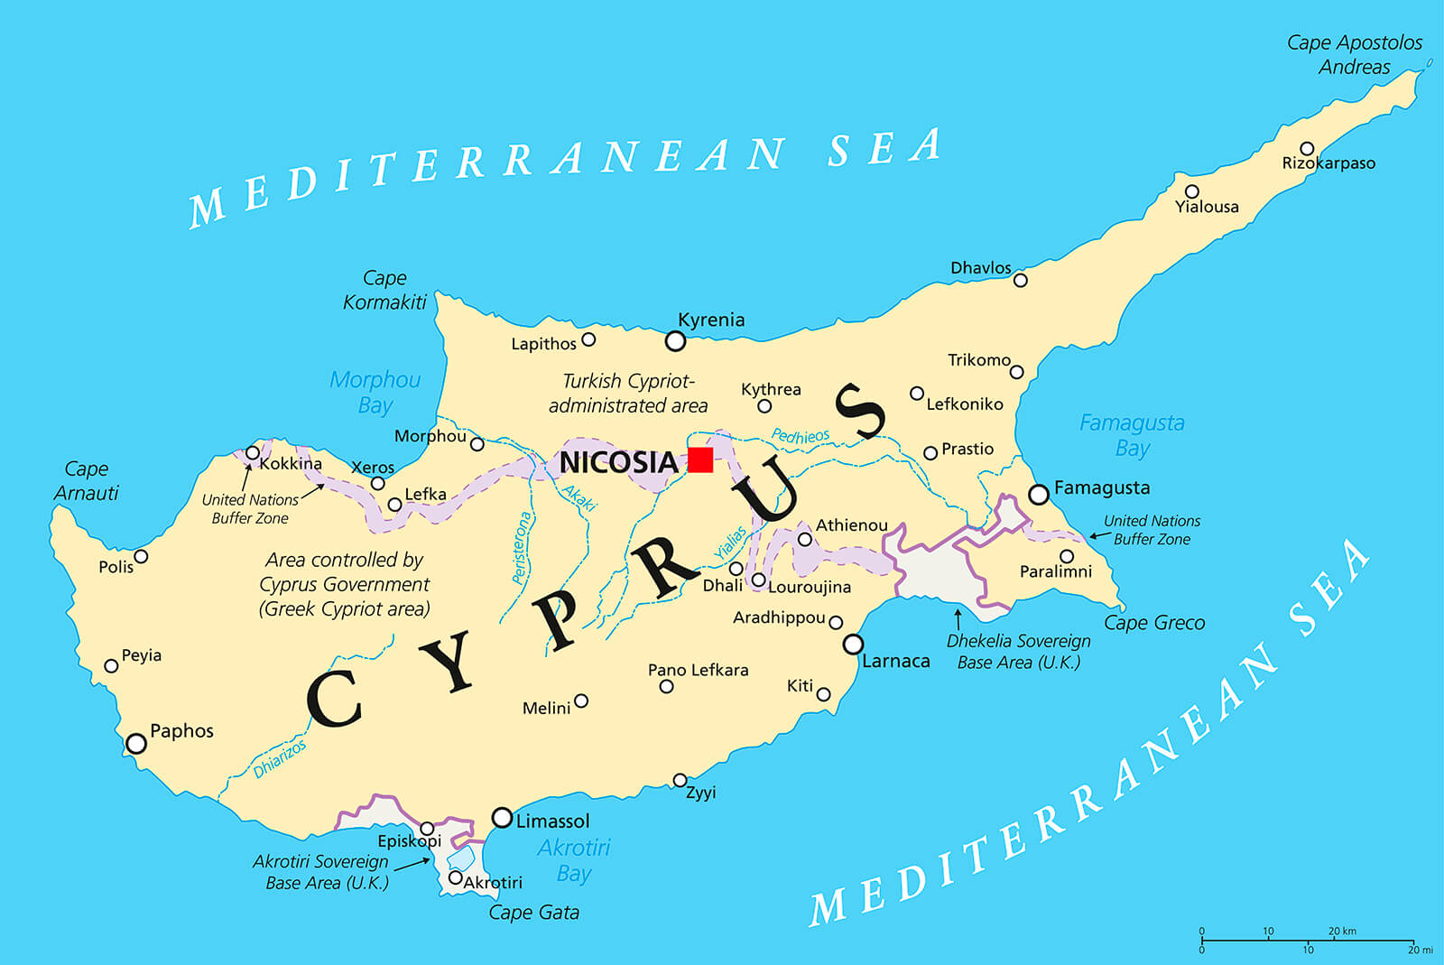
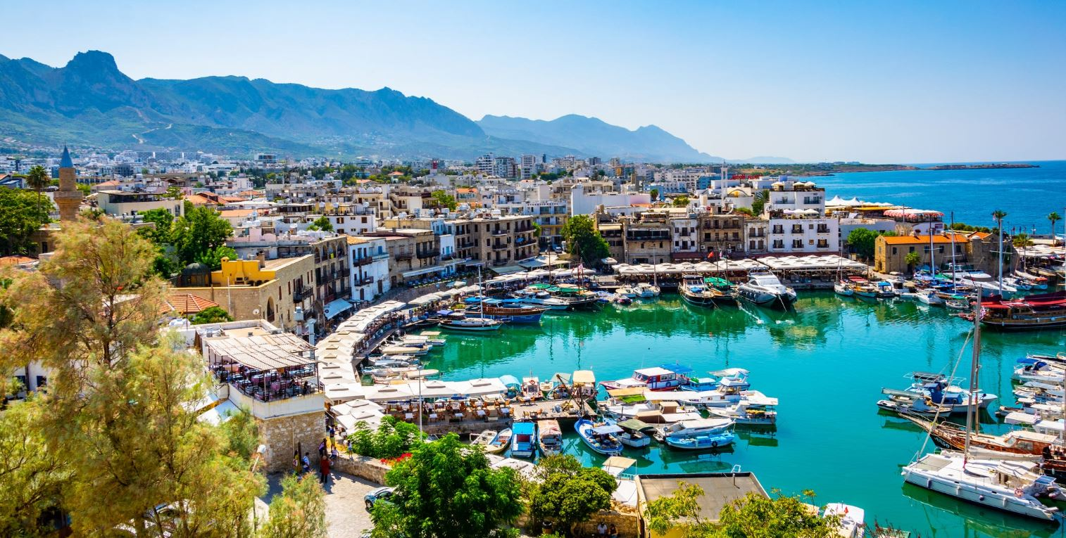

Slide 48
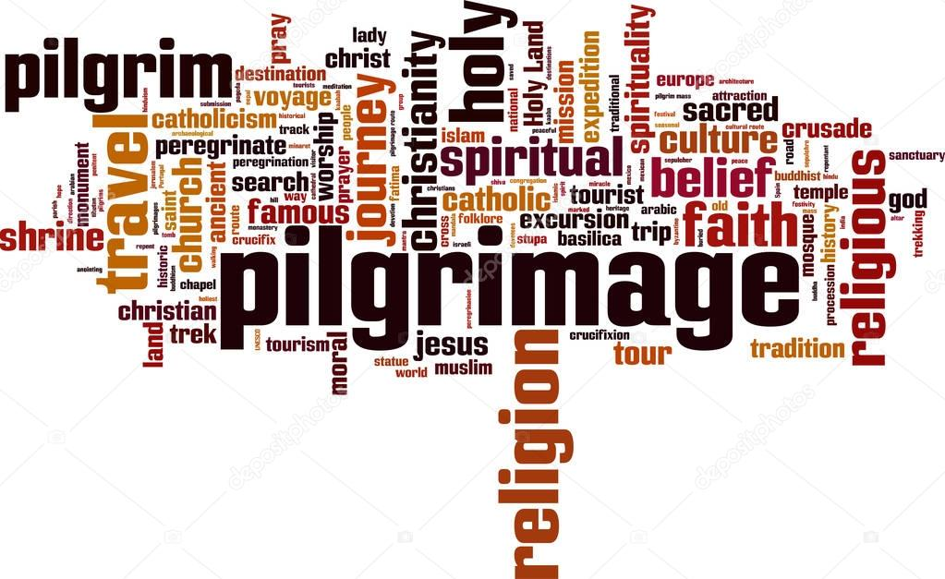

Slide 49
We are learning about pilgrimages and special journeys
We all take journeys everyday. Sometimes we go on a special journey:
When we go on a special holiday
To visit relatives who live far away
To see a baby that has been born
When we move house
To visit somewhere that is special to your family
Have you ever been on a memorable journey? Where were you going?
How did you feel?

Slide 50
In every religion there are special places to which people travel; usually because something important happened there.
These journeys are called…
PILGRIMAGES
There are many reasons why people go on pilgrimages:
To renew their faith – or their belief in their god
To feel part of a larger group or family
Because it is commanded in the scriptures or holy writings
To bring something back (an actual souvenir, or something spiritual)

Slide 51
Here are some examples of special journeys.
A widow visiting a war grave in France.
An Arsenal fan travelling to Leeds for a match.
A pilgrim travelling to Canterbury Cathedral to visit the shrine of Archbishop Thomas a Becket.
What are the reasons for each journey?

Slide 52
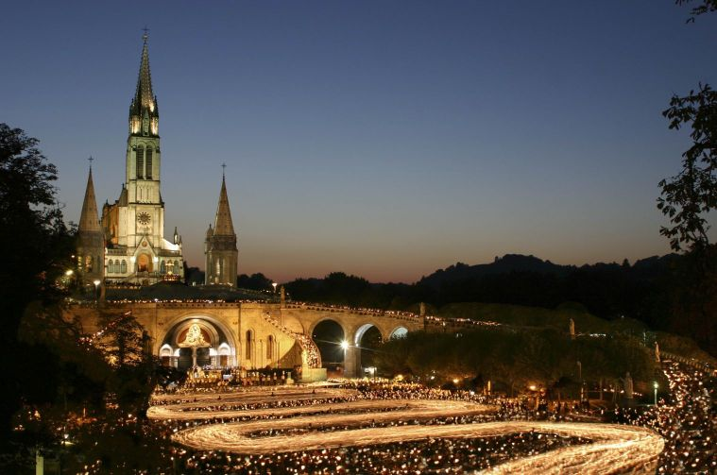
Some Christians go to Lourdes, in France.
Why do they go?
What do they do there?

Slide 53
Why do you think Christians would decide to go on a pilgrimage to the Holy Land – the land where Jesus was born and lived?
What do you think they would hope to see and do when they were there?
Watch the film and discover two people’s experiences of a pilgrimage to the Holy Land.

Slide 54
https://request.org.uk/life/spirituality/pilgrimage/

Slide 55
When Christians go on pilgrimage they travel somewhere that is special to their faith. It might be to places written about in the Bible, such as where Jesus and the early Christians lived. It may be a place where a miracle once happened or a saint is buried. Often the journey itself matters as much as being at the special place, because it gives the ‘pilgrim’ – the person on the journey – time to pray and think.

Slide 56
Pilgrimage is an important part of spiritual life for many Christians. By taking the time to go on pilgrimage, people can leave behind everyday concerns from back home and spend time in the presence of God as they travel to a place with special meaning. People have always gone on pilgrimage for many reasons – perhaps to say sorry to God for something they had done wrong (penance), or because they were ill and wanted God to heal them.
They might be looking for an answer to a problem or difficulty, or they might be looking for peace or healing. Over the years, places have become special for different reasons, and Christians decide to visit them to become closer to God in these special places.

Slide 57
Pilgrimage

Slide 58
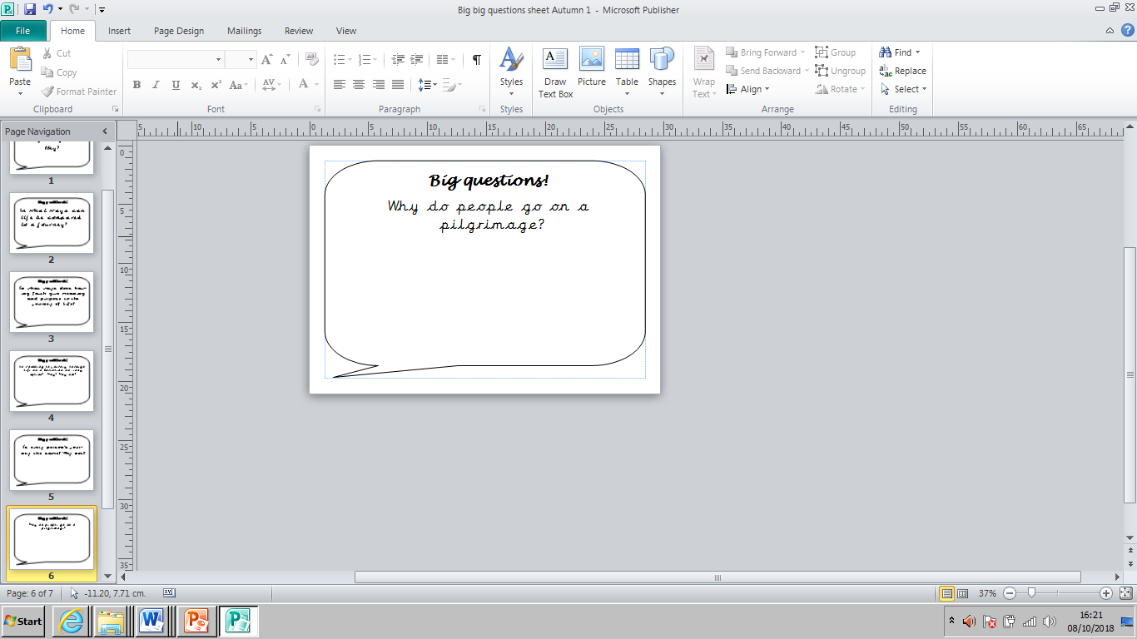

Slide 60
Hindu Pilgrimage
https://www.bbc.com/teach/class-clips-video/a-hindu-pilgrimage/z4ghf4j

