Slide 1
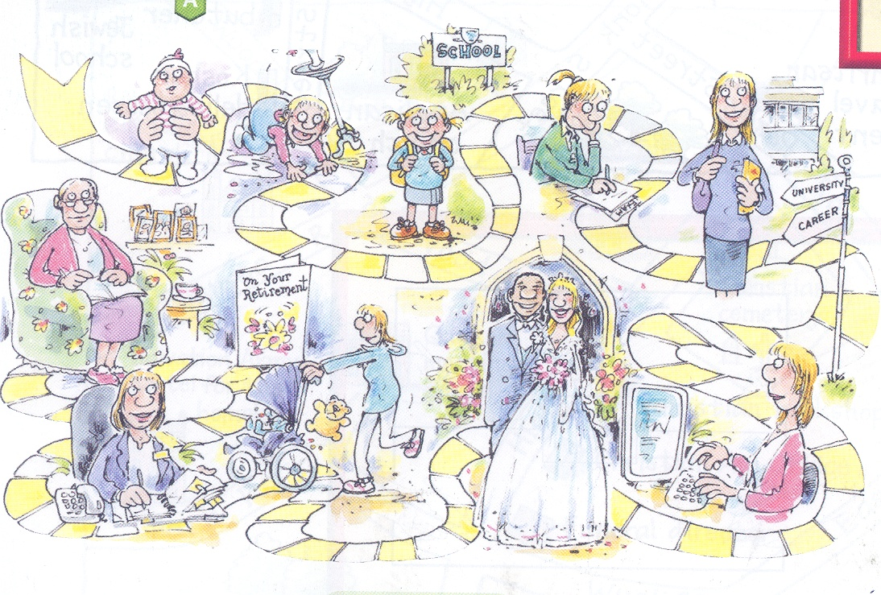


Before we begin…
On your whiteboards write down what you think this picture shows.
3 minutes

Slide 2
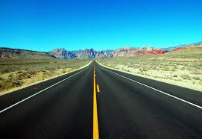
The Journey of
Life
‘’Life is a journey and only you hold the map.’’
‘’Life is a journey not a destination.’’

Slide 3
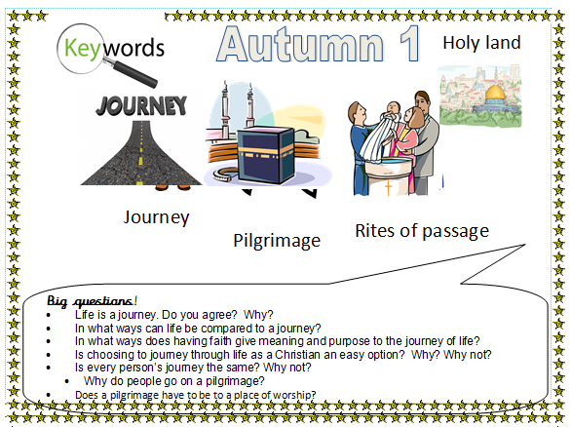

Slide 4

L.O. To understand how life can be compared to a journey and explore my life journey so far.

Slide 5
What is a journey?

Slide 6

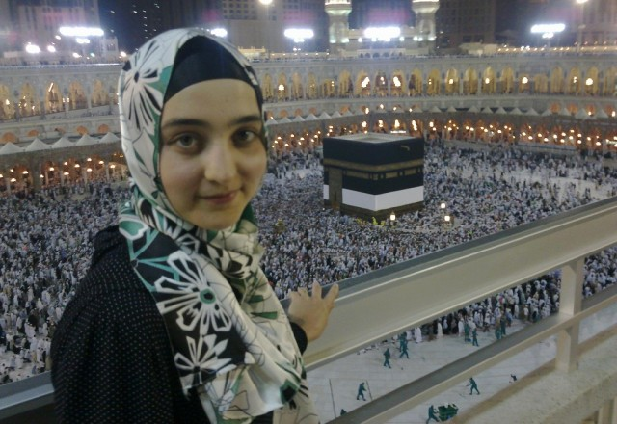
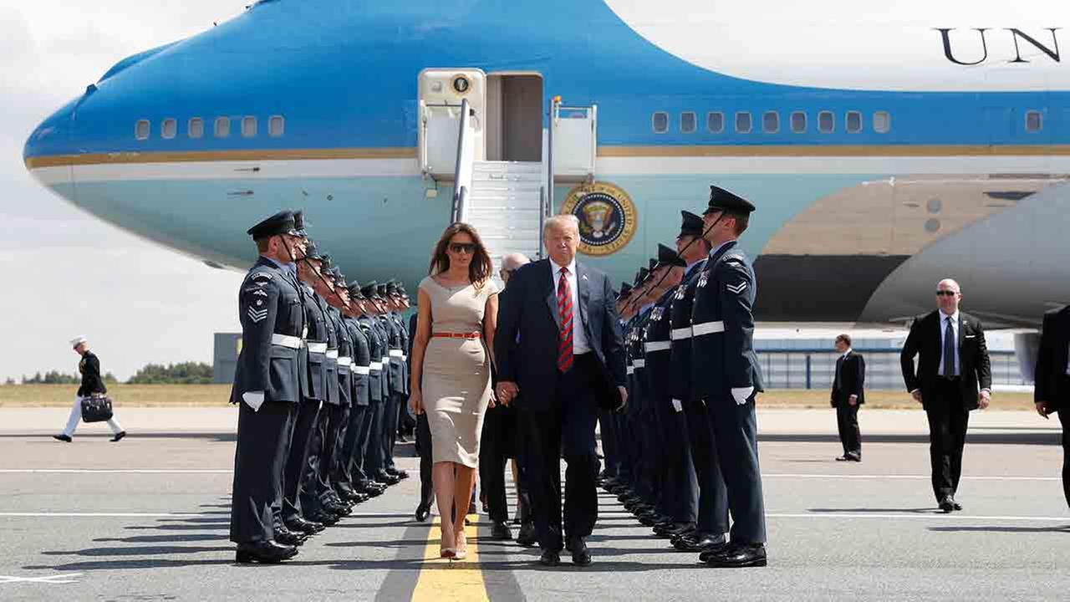
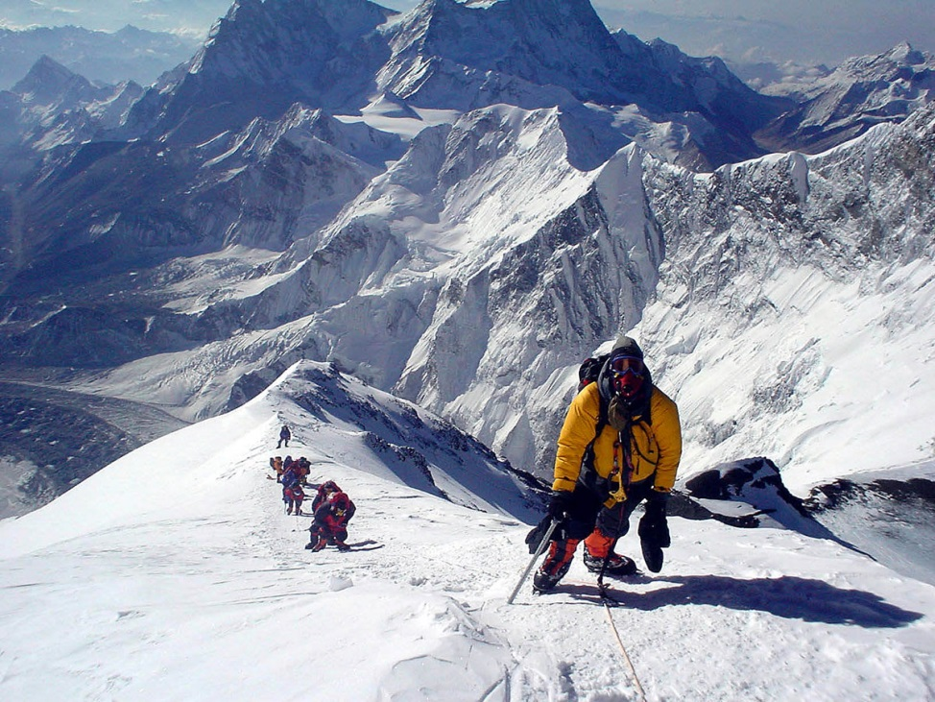
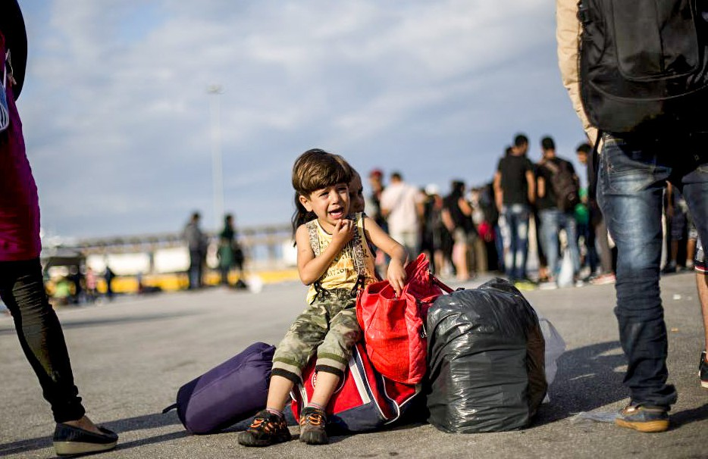

Slide 7
What does it mean
to go on a journey?

Slide 8
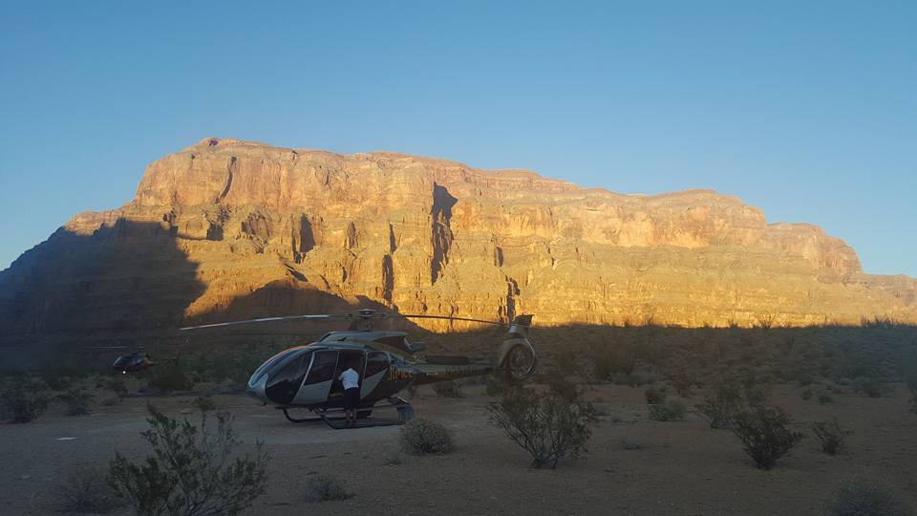
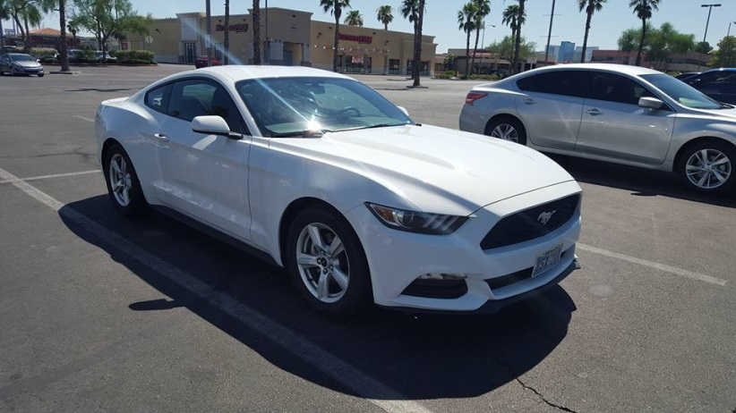
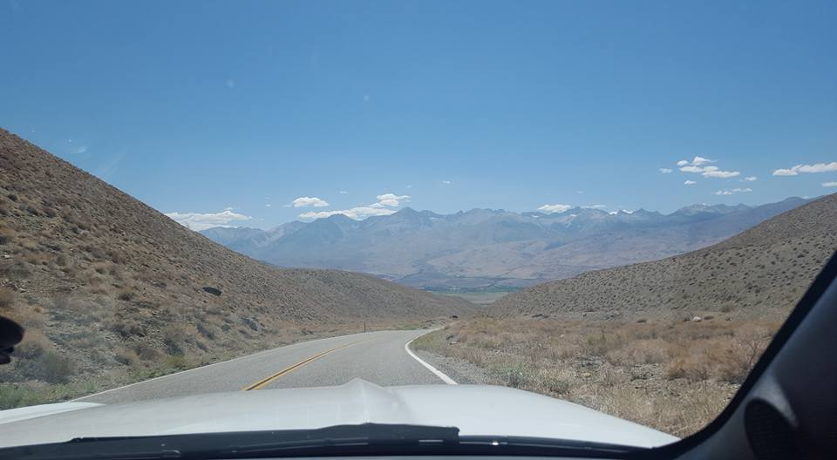
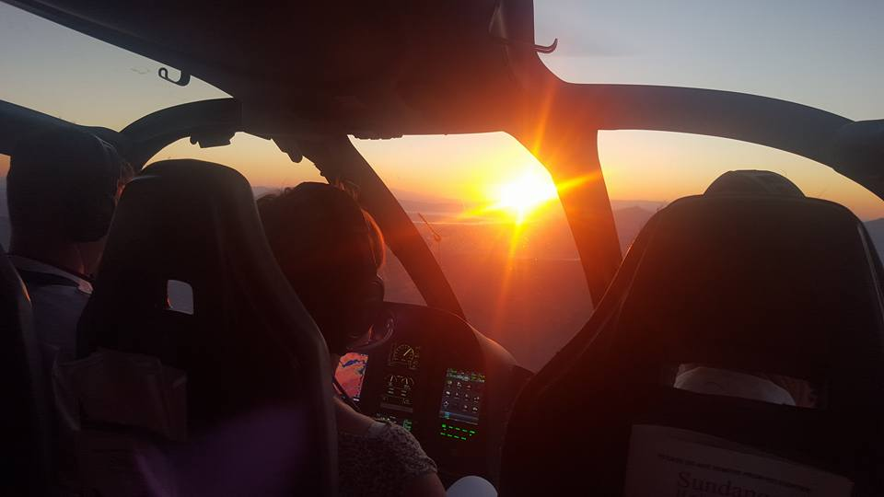
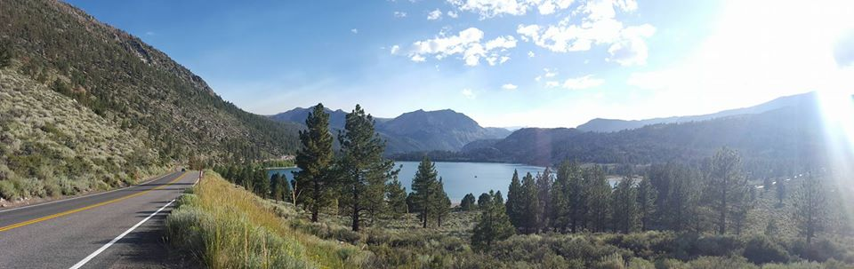
Journeys can be short or long, exciting or routine, a mystery or clearly planned.

Slide 9

What journeys have
you been on?
Talk about…
What happened? Where did you go?
For what reason did you travel?

Slide 10

Do you agree?

Slide 11
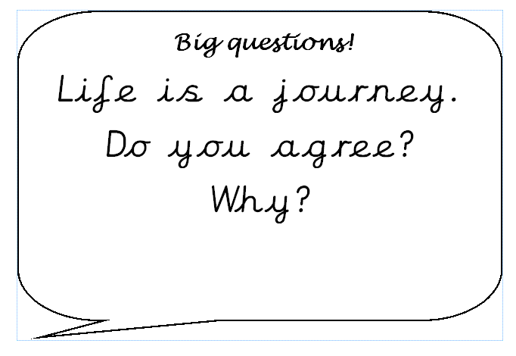
In what ways can life be
compared to a journey?

Slide 12


So, what is the ‘Journey of Life’…?
http://youtu.be/jYOsWWKHZVw

Slide 13
What are the similarities and differences of life and a journey?
Similarities | Differences

Slide 14
The journey of life shows your path through life. You start your journey when you are born, travel through life achieving religious (christening, marriage) and secular (first day at school) milestones and achievements. You end your journey when you die.
OR DO YOU?!

Slide 15
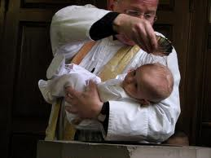
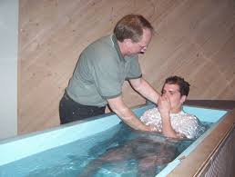
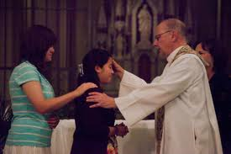
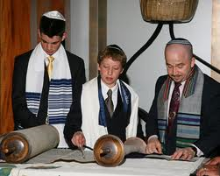
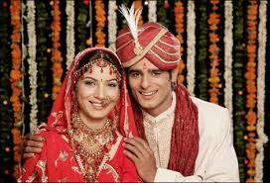
Religious milestones and achievements:

Slide 16
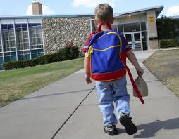
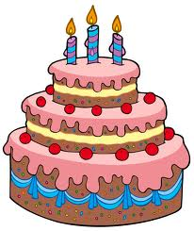

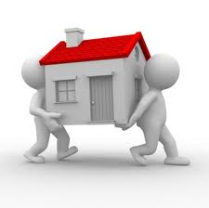
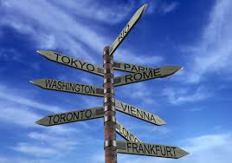
Secular milestones and
achievements:

Slide 17
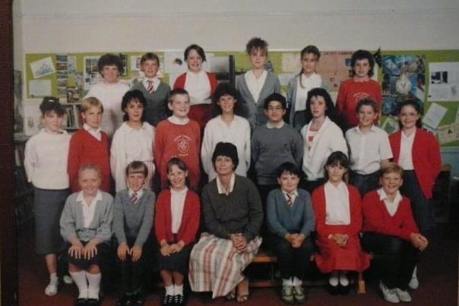
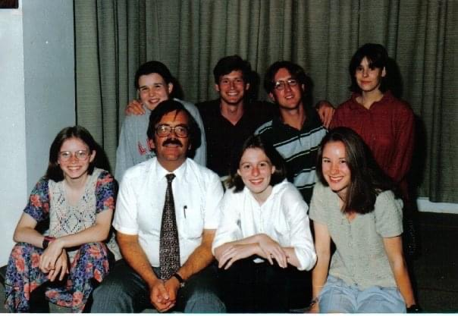
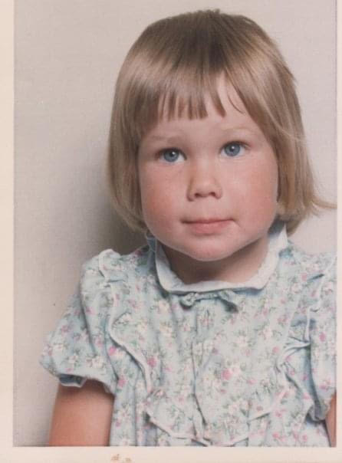
My life…
My journey…

Slide 18
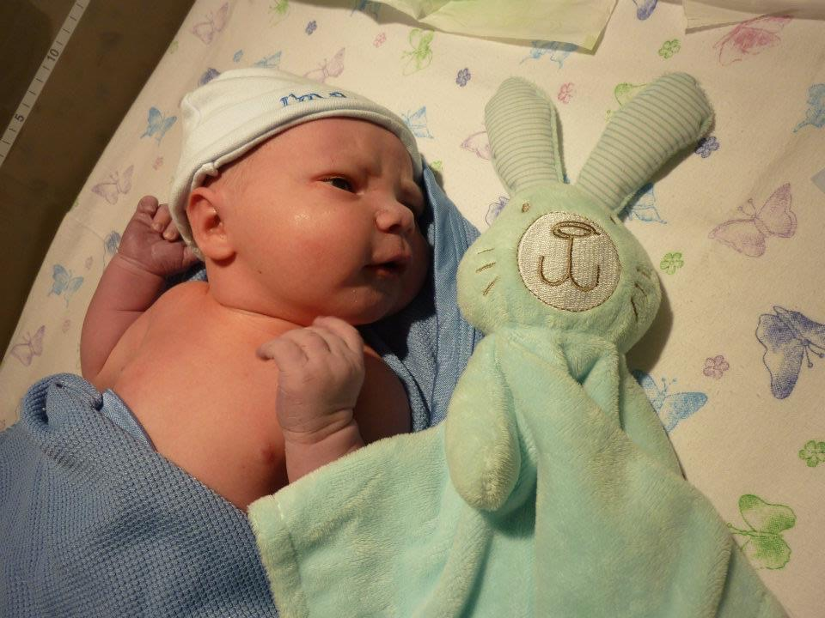
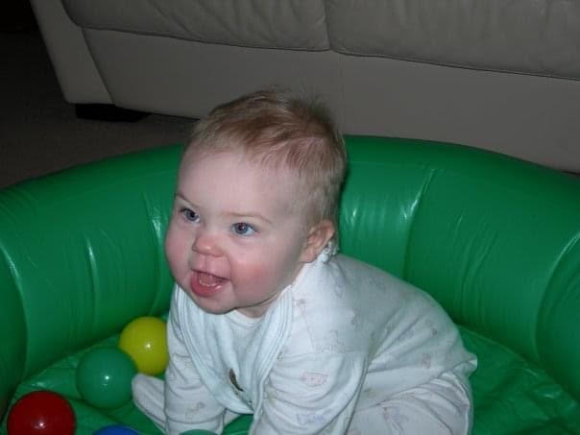
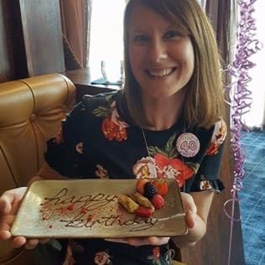
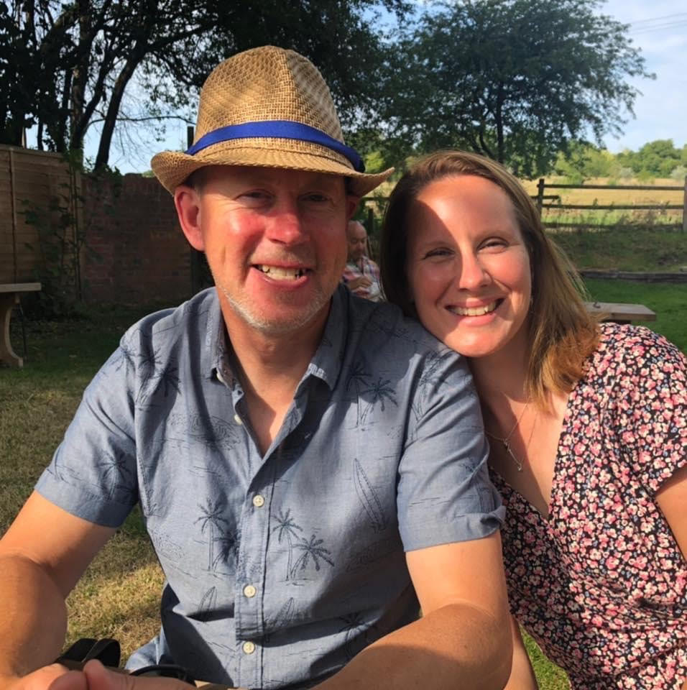
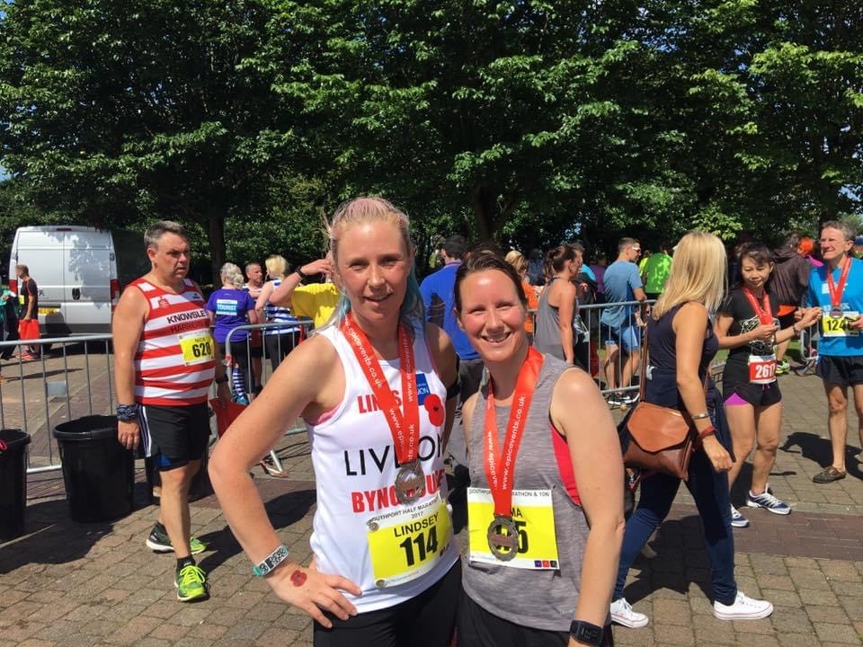
My life…
My journey…

Slide 19

Religious
Journey of Life
Secular
Achievement
Milestone

Slide 20
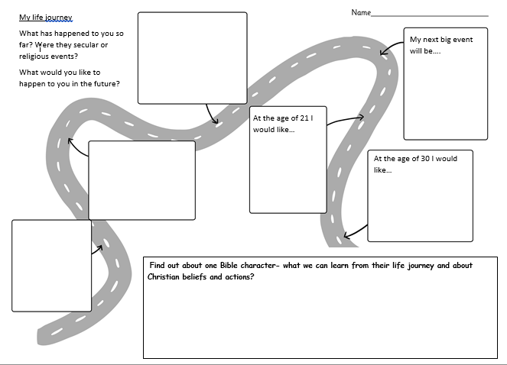
TASK
Who or what has influenced you. For example, did you have a choice of which school to attend?

Slide 21

What about your future journey?
Think about your predictions, hopes and dreams for your future.
Explain your choices.

Slide 22
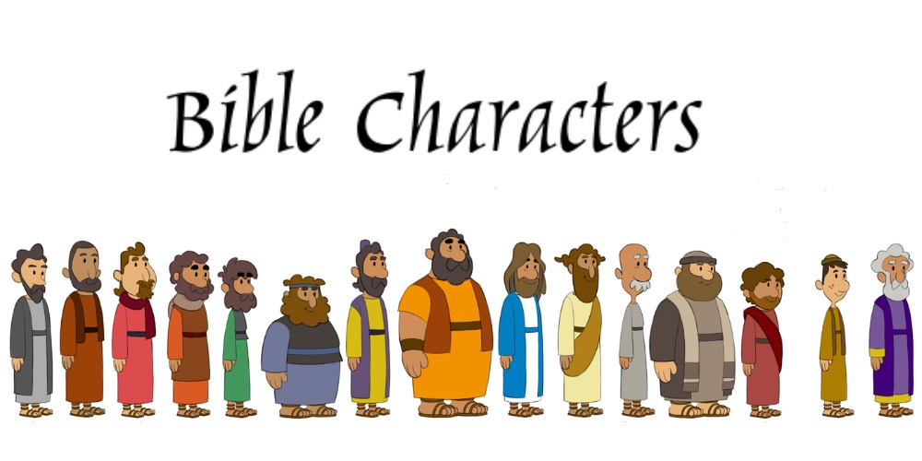
Moses
Joseph
Esther
Explore the life journey of …
Noah
_{Daniel}
Abraham
Ruth

Slide 23
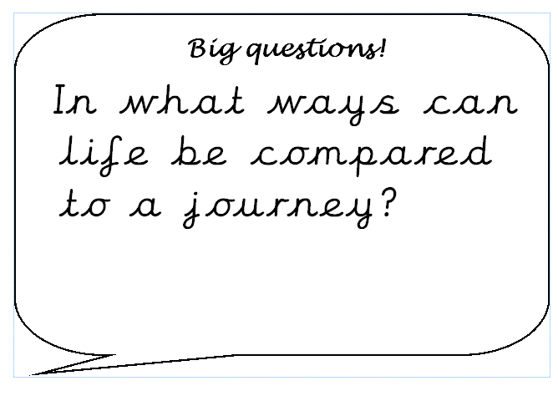

Slide 24
Journeys that Jesus travelled:
Jerusalem as a boy for Passover (Luke 2:41-52)
For his Baptism in the River Jordan (Mark 1:9-11)
to Cana for a wedding (John 2:1-12)
He teaches in Galilee, visits Capernaum (Luke 5:27-28) Jerusalem (John 5:27-28), Bethany (Luke 18:35-43), Nazareth (Luke 18:41-56), Jericho (Luke 18:35-19:10) and finally Jerusalem (crucifixion)
Where did the miracles take place?

