Slide 1

English-
Can I build another me?

Slide 2
Friday 4th September
LO: To use a variety of sentences
starters to describe me
What does ‘unique’ mean?

Slide 3
Read story….

Slide 4
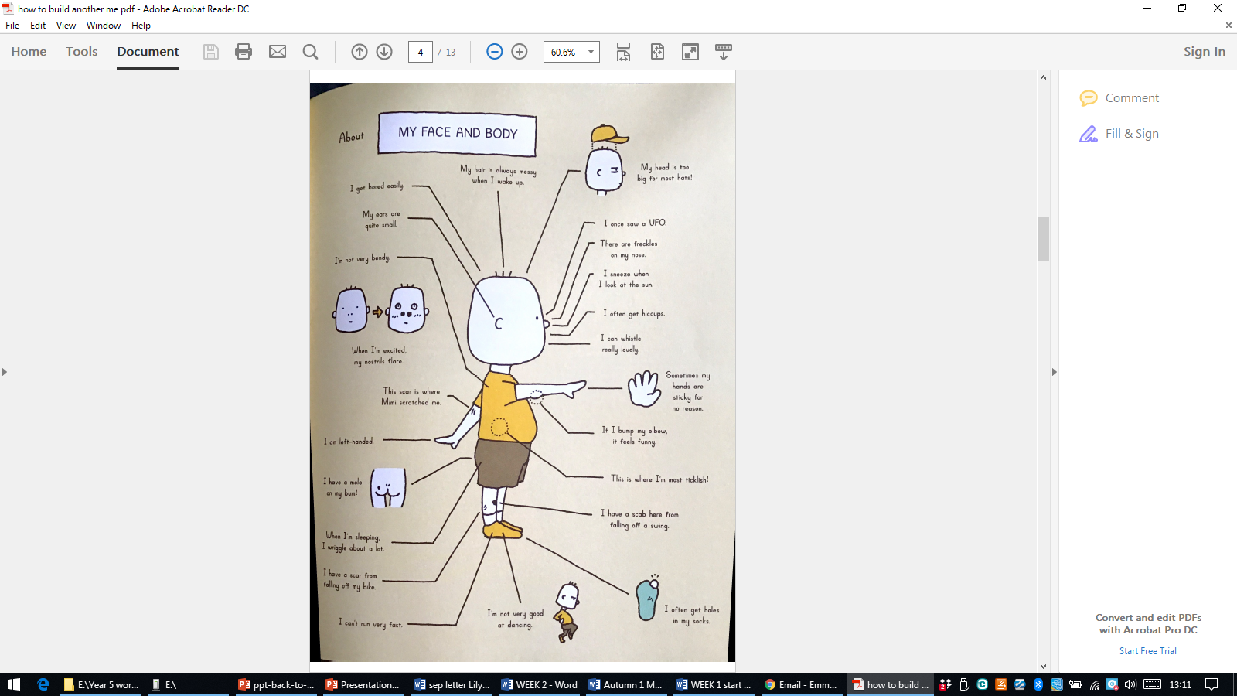
Circle time- who can share a story about their eyes? Feet? Hands?
What makes you unique?

Slide 5
Read story….

Slide 6
Activity 1- Draw a side of view of yourself in the box…
2) Cut out the box and stick in the middle of the page
3) Around the box label all about you! Write on the lines!

Slide 7
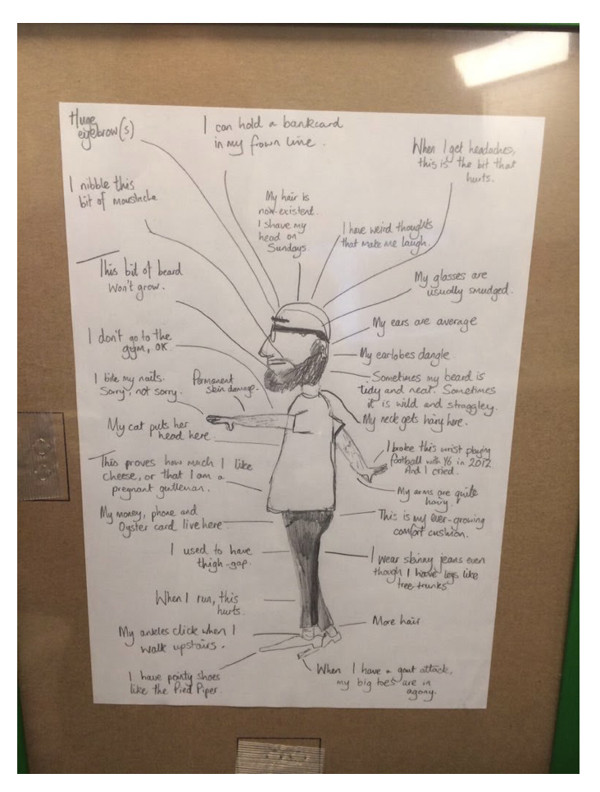

Slide 8
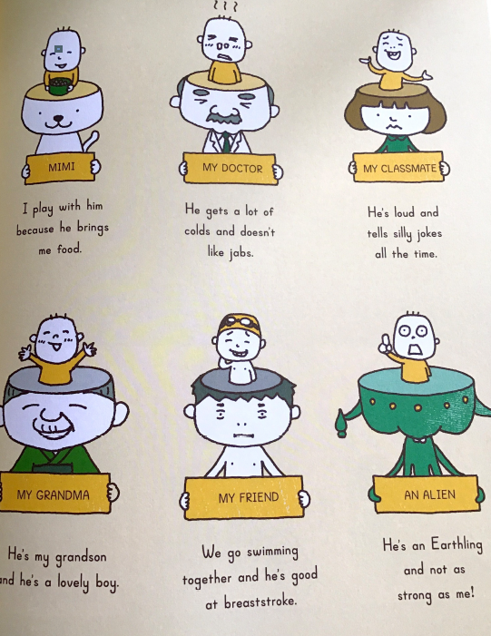
Extension task- what do others say about you?

