Slide 1
Tuesday 8th September
SPAG- L.O. To understand and use apostrophes for contractions.

Slide 2
Apostrophes can be used to show missing letters.
When you use an apostrophe, you ‘OMIT’
(replace) a letter so it is called:
Omission.
I can not come to the party.
I can’t come to the party.
Can not becomes can’t.
The apostrophe shows that there are letters missing. It goes where the missing letter is supposed to go.

Slide 3
More examples of apostrophes for contraction/omission.
Jack would not play with his baby brother.
Jack wouldn’t play with his baby brother.
Claire did not want to eat the unhealthy chocolate cake.
Claire didn’t want to eat the unhealthy chocolate cake.

Slide 4
What do these words become when you shorten them?
have not
they will
shall not
I have
you are
haven’t
they’ll
shan’t
I’ve
you’re

Slide 5
Make sure the apostrophe is in the correct place.
Check these for accuracy;
did’nt
we’ll
should’nt
didn’t
we’ll (correct)
shouldn’t

Slide 6
hasn’t
isn’t
doesn’t
…are short for has NOT, is NOT, does NOT.
I’ll
He’ll
They’ll
…are short for I WILL, he WILL and they WILL.
They have two letters missing

Slide 7
Apostrophes
Correct the mistakes
im called Jo
doesnt he want to get his money?
ill go on Saturday
theyll be in trouble
hell get told off if he isnt careful

Slide 8
Its and it’s
So many people get this wrong!!!
The apostrophe is only used to show ‘it is’.
It’s sunny today.
It’s very kind of you to give me your last sweet.
“It’s full of wonderful things,” exclaimed Howard Carter after discovering Tutankhamun’s tomb.

Slide 9
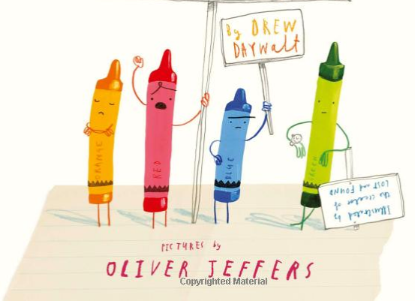
Tuesday 8th September
LO: To identify the mood of informal writing
https://www.youtube.com/watch?v=ZttMDho5HMw

Slide 11
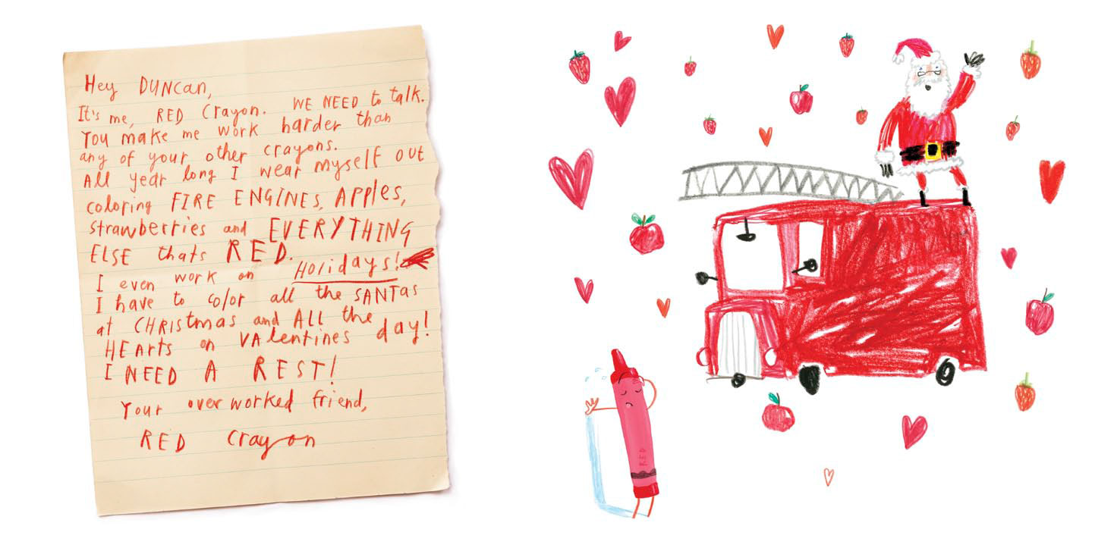

Slide 12
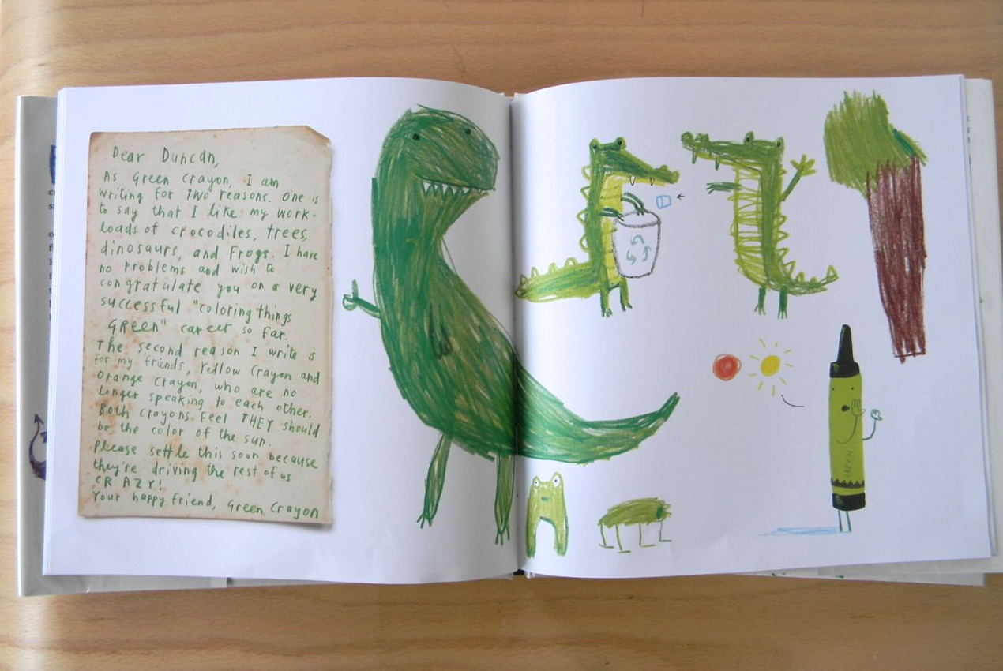

Slide 13
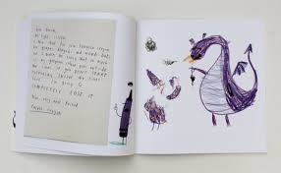

Slide 14
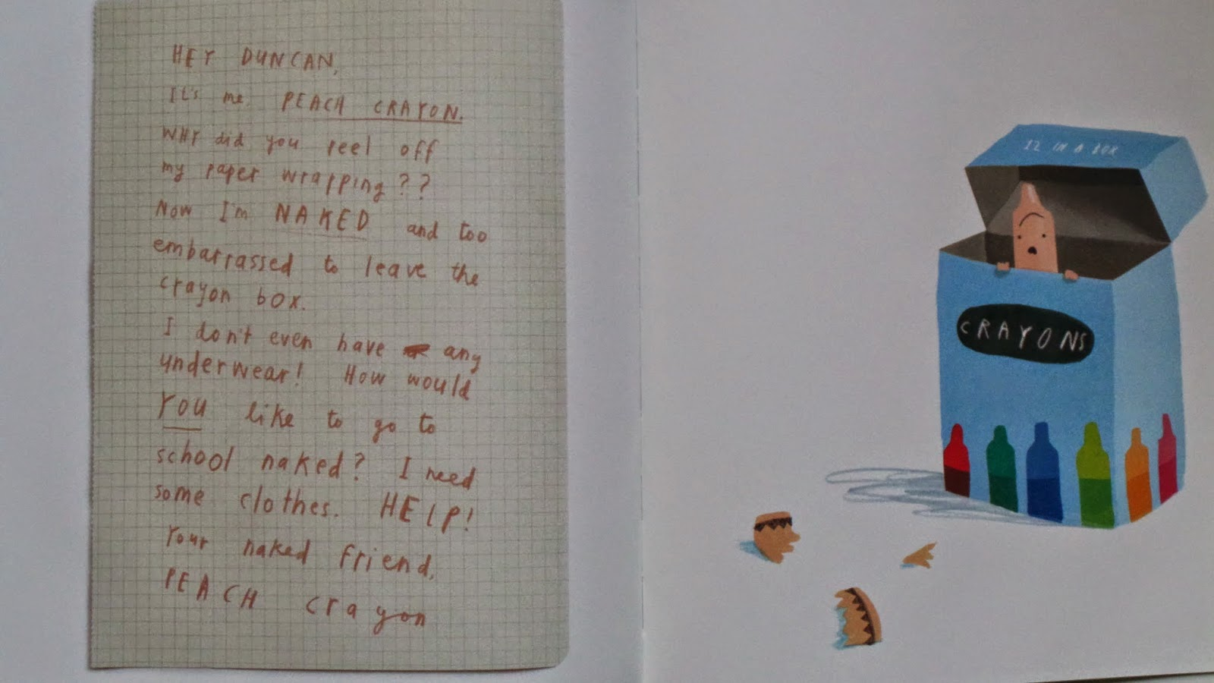

Slide 15
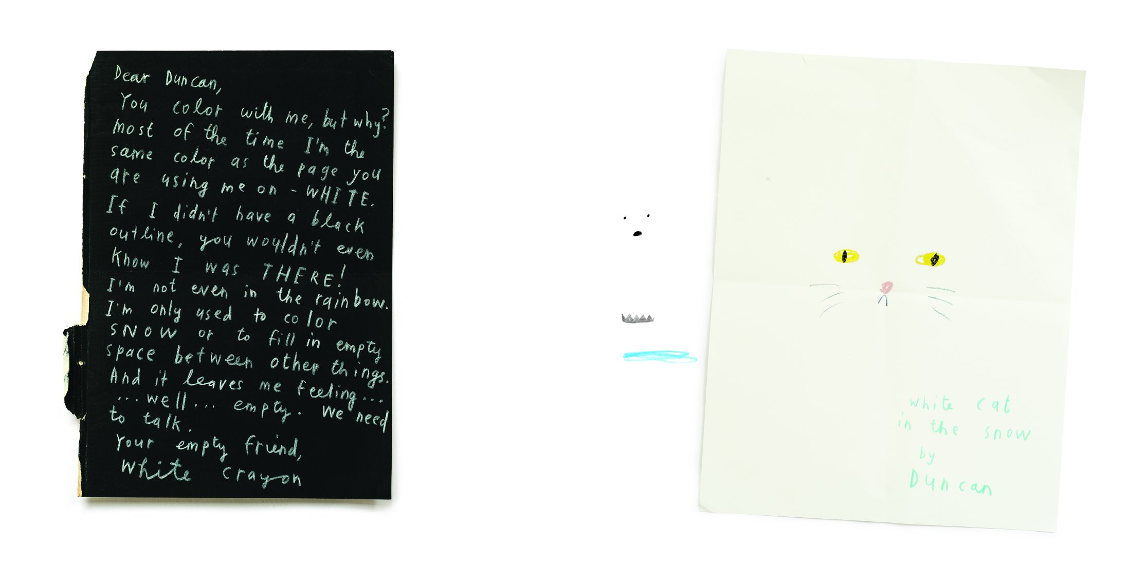

Slide 16
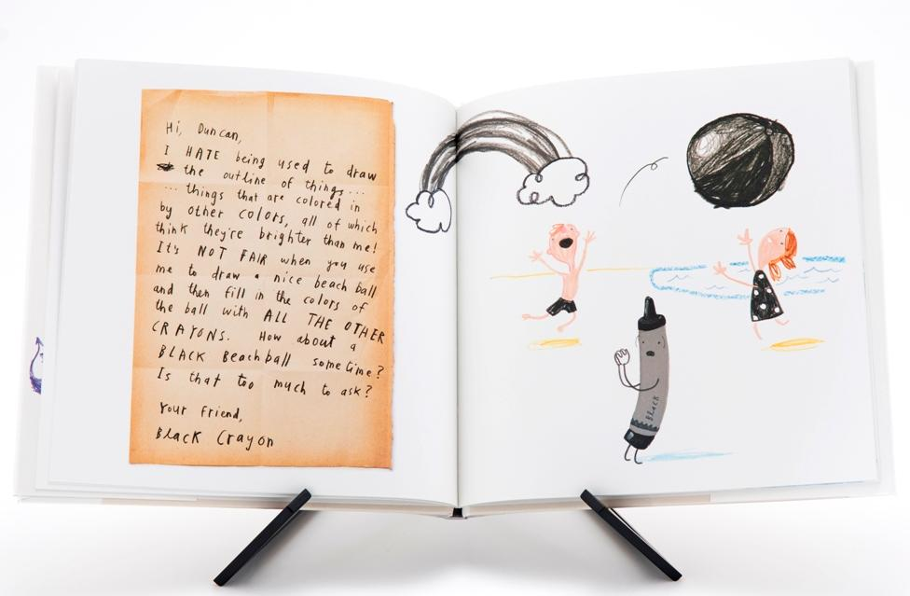

Slide 17
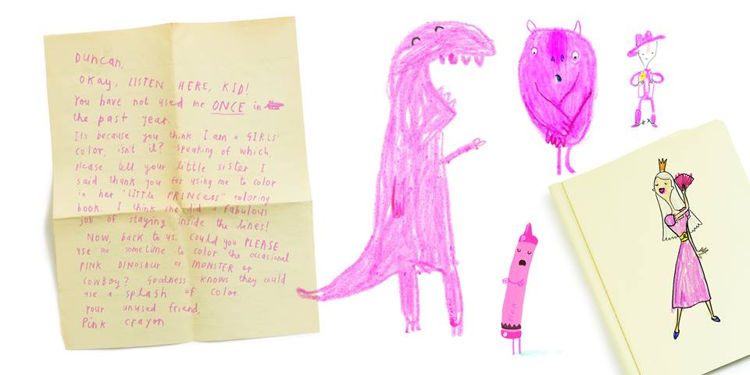

Slide 18
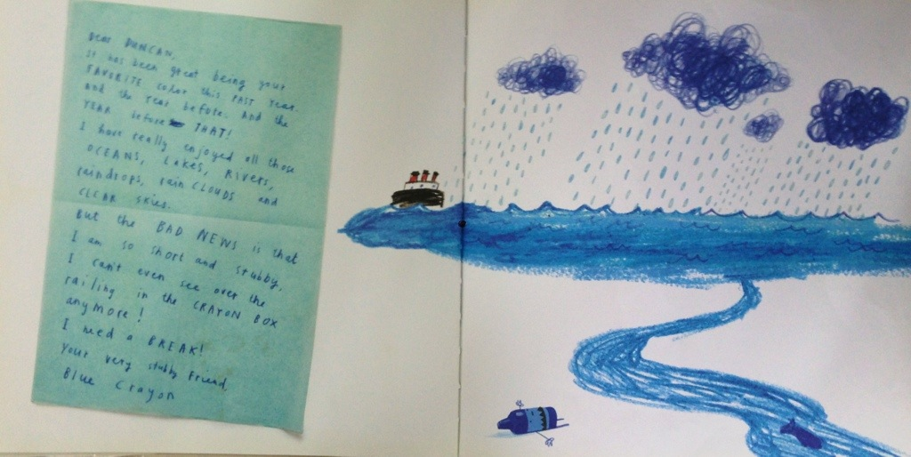
How does the crayon
feel in this letter?
How do you know?

Slide 19
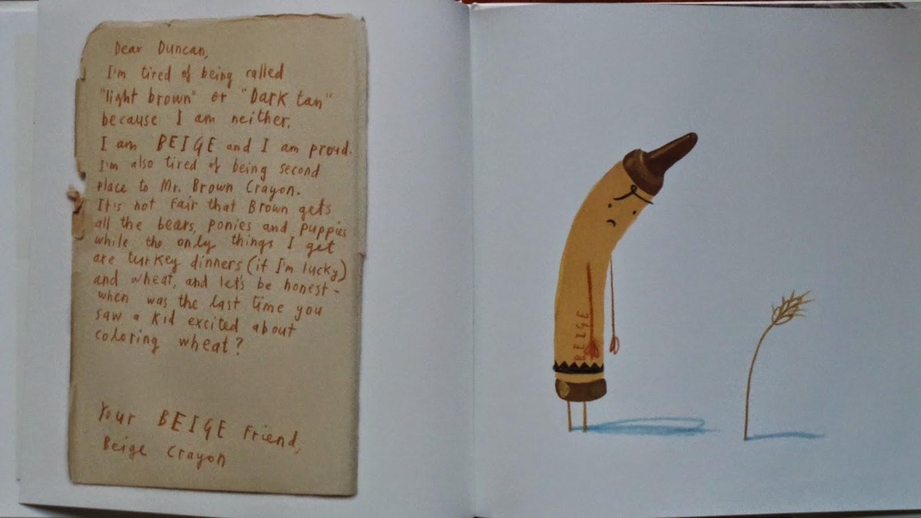
How does the crayon
feel in this letter?
How do you know?

Slide 20
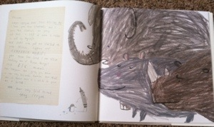

Slide 21
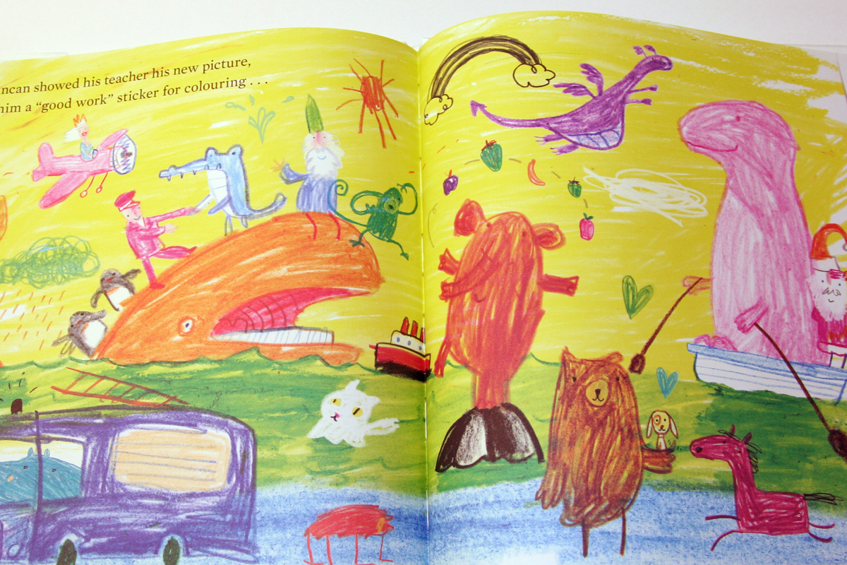

Slide 23
Coloured crayon: __________________
How does the crayon feel in this letter?___________________________________________________________________________________________________
How do you know?
____________________________________________________________________________________________________________________________________________________________
Over to you…look at the letters again.
Pick out language to show the
mood of the crayon. Complete the questions in your book

Slide 24
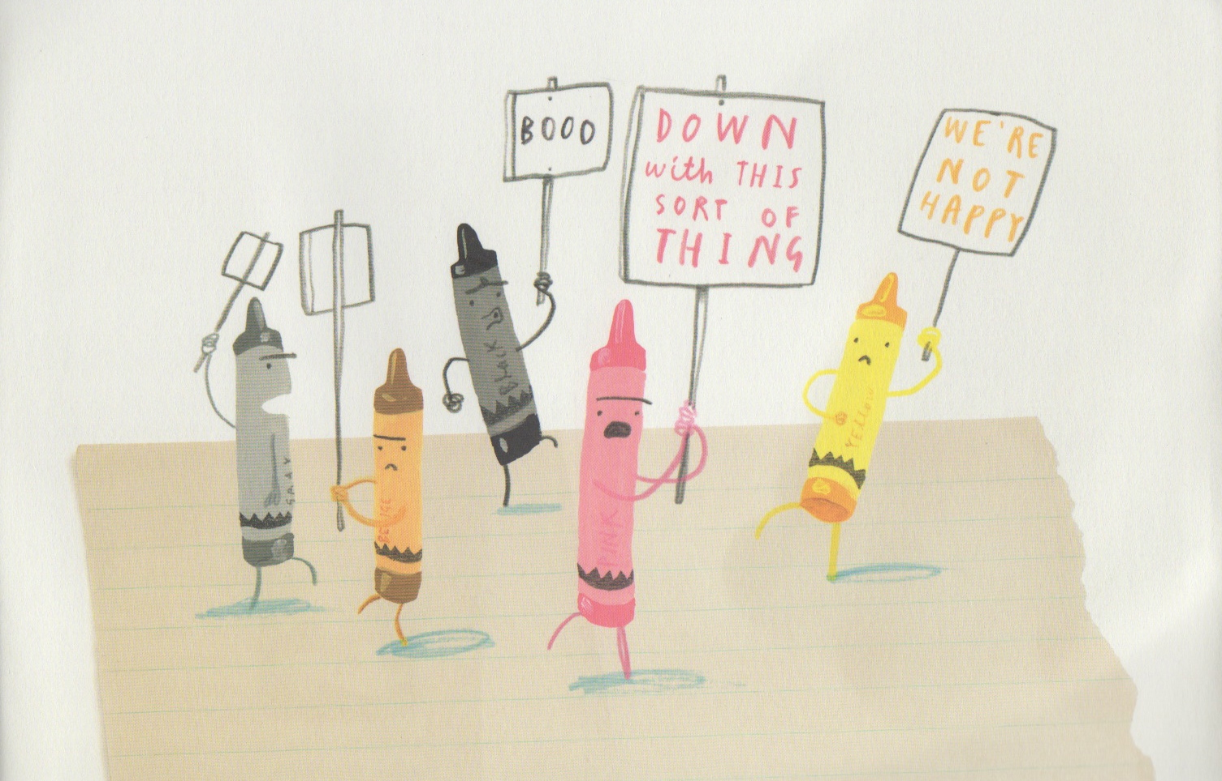

Slide 25
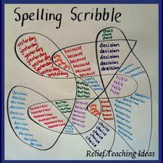
Wednesday 9th September 2019
Spellings LO: Suffixes ‘ial’ ‘cial’ ‘tial’

Slide 26
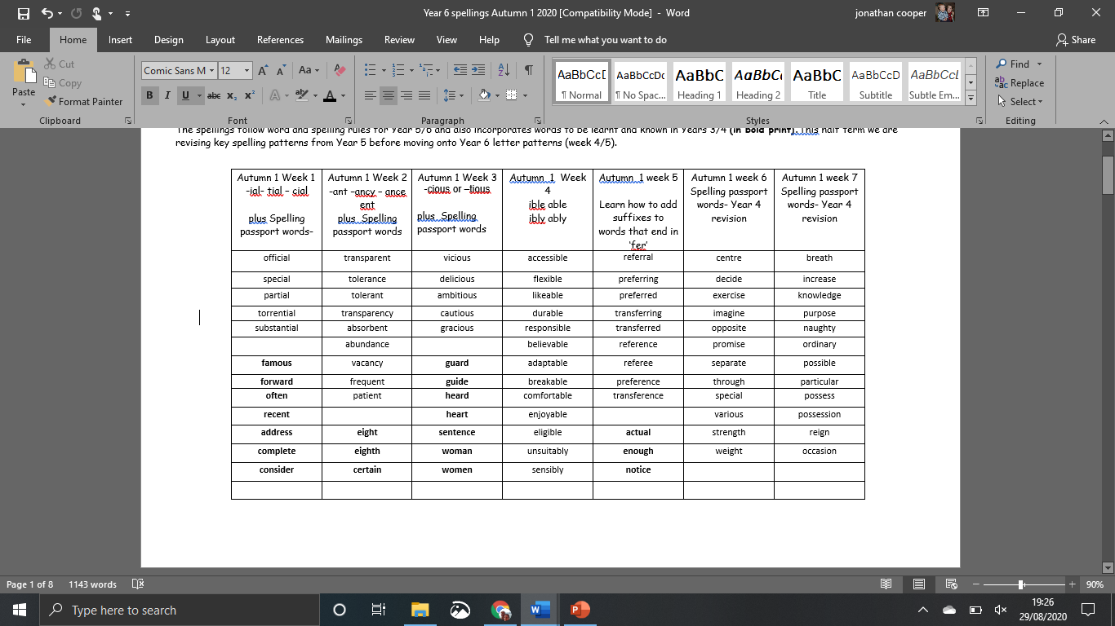
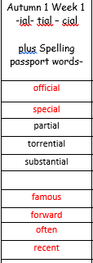
Spellings

Slide 27
LO: To vary sentence starts (writing from a crayon- Shared write)

Slide 28
What does
informal mean?

Slide 29
How do these letters begin and end?
Examples:
Hey listen here kid,
We need a chat!

Slide 32

Over to you…
You are to practise creating your very own informal openings and endings to the letters written by the crayons.
Refer to your table for ideas.
How have you addressed Duncan?
How have you signed your letter?

Slide 33
Informal phrases and features
What ideas did you think of?

Slide 34
6 ways to
start a sentence…

Slide 35
Start with a verb…
Stressing about my workload, I feel it is too much.

Slide 36
Start with
an emotion word…
ed
3ed
Stressed, fatigued, and overworked, I feel I am being unfairly treated.

Slide 37
Start with
a conjunction…
Although I am your favourite colour, I need a well earned rest!

Slide 38
Start with an adverb …
Miserably, I watch while you use yellow crayon to colour the sun.

Slide 39
Start with a simile …
As unclothed as a newborn baby, I sit embarrassed in the crayon box.

Slide 40
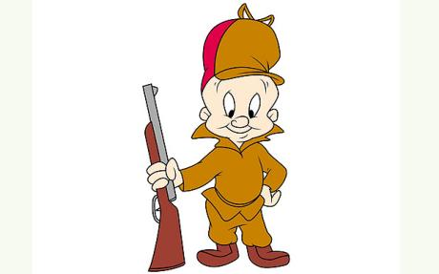
Start with a
coordinating conjunction…
If you used me more often, it would make me happier.
WABBITS

Slide 41

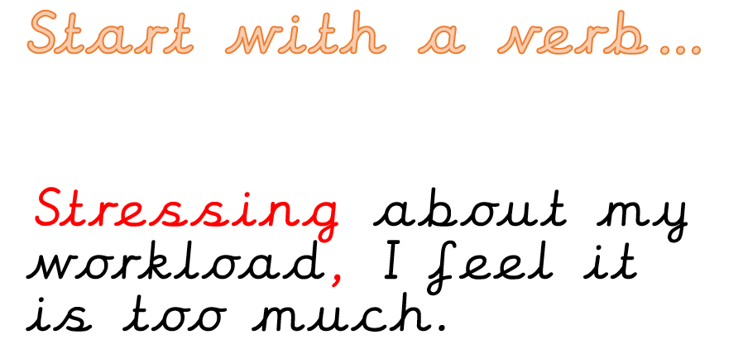
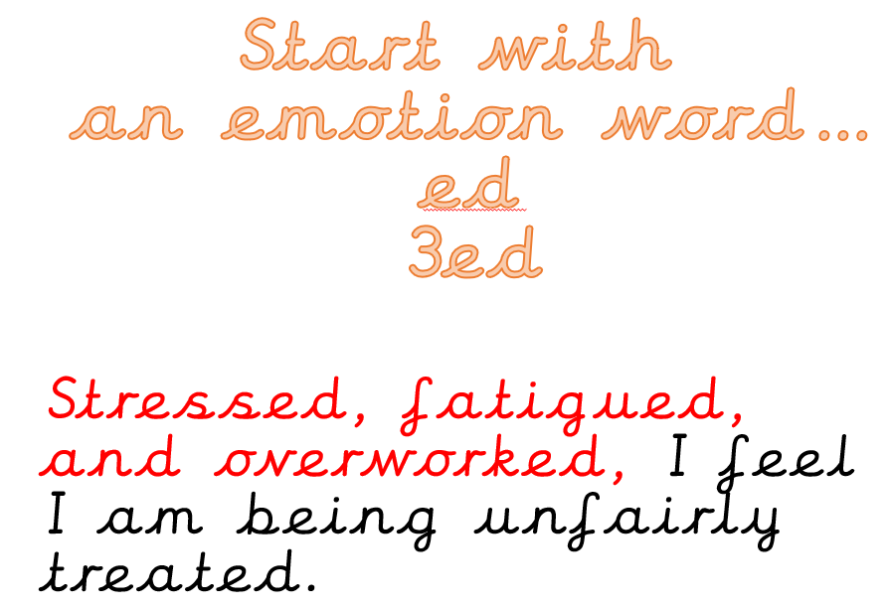
Over to you….paired work
Use the 6 sentence starts to write some sentences which the crayons might use… write them in your books!
Write your own example next to it.
Write your own example next to it.

Slide 42
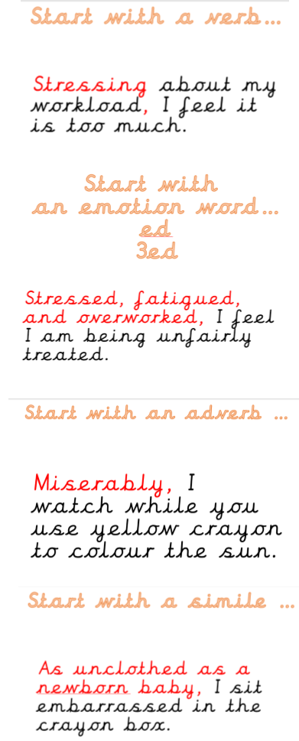
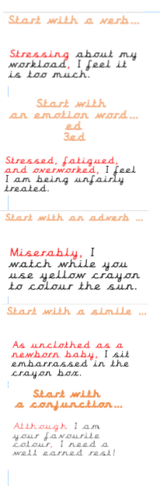
Blue group
Orange group

Slide 43
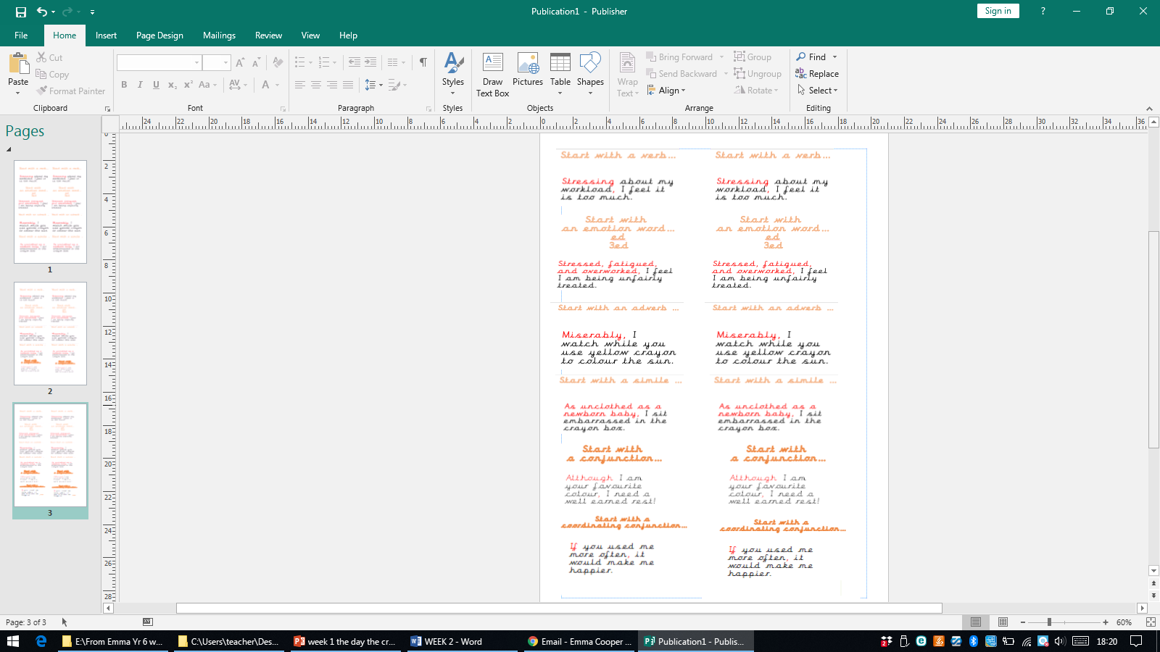
Red group

Slide 44
Thursday 8th September
SPAG- L.O. To use apostrophes for contractions.

Slide 45
Apostrophes can be used to show missing letters.
When you use an apostrophe, you ‘OMIT’
(replace) a letter so it is called:
Omission.
I can not come to the party.
I can’t come to the party.
Can not becomes can’t.
The apostrophe shows that there are letters missing. It goes where the missing letter is supposed to go.

Slide 46
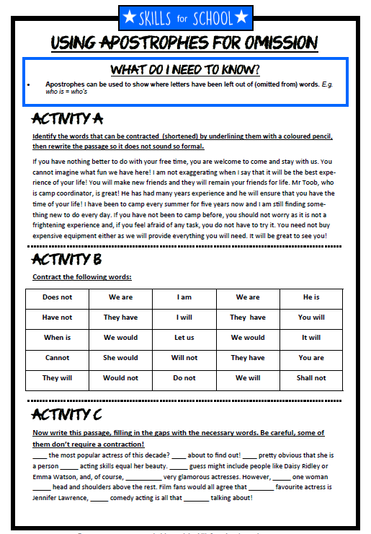
Over to you….
Yellow and Red
Blue group
Orange group

Slide 47
LO: To vary sentence starts to include in an informal letter to Mrs Cooper (paired write)

Slide 48
Revision!
What does
informal mean?

Slide 49
6 ways to
start a sentence…

Slide 50


Slow writing

Slide 51


Sentence 1:
Must start with an adverb followed by an ‘ing’ verb.

Slide 52
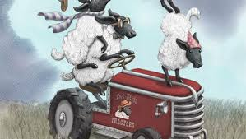
Sentence 2:
Must begin with ‘ed’ and the power of three.
EMOTION WORDS

Slide 53
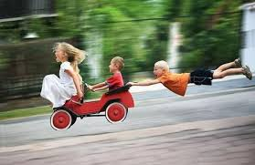
Sentence 3:
Must begin with a simile.

Slide 54
Start with a verb…
Stressing about my workload, I feel it is too much.

Slide 55
Start with
an emotion word…
ed
3ed
Stressed, fatigued, and overworked, I feel I am being unfairly treated.

Slide 56
Start with
a conjunction…
Although I am your favourite colour, I need a well earned rest!

Slide 57
Start with an adverb …
Miserably, I watch while you use yellow crayon to colour the sun.

Slide 58
Start with a simile …
As unclothed as a newborn baby, I sit embarrassed in the crayon box.

Slide 59
Start with a
coordinating conjunction…
If you used me more often, it would make me happier.
WABBITS

Slide 60
Dear Year 6,
Right- we have a problem! I’m utterly fed up with our current situation. As you know, we teachers have a lot of children to care for and educate over the years (29 actually!) and I think it’s time you all pulled your weight! Since I have been teaching in this class, I have been worried. Stressing about your behaviour, I am frustrated and anxious. Because of you, all my hair is turning grey!
Like a whirlwind, you tear around this classroom wreaking havoc each morning. I’ve had enough. Is it too much to ask for you all to ensure our classroom is kept tidy ?! I am also wanting you all to be aware that I will no longer write PINK feedback in your books, if you continue to disregard my comments. How would you feel if you worked hard on your piece of work only for me to ignore it? Therefore, I think it has gotten to the point where you as Year 6 pupils can decide whether to put 100% effort into your learning or not!
In front of you, I smile but I collapse in my chair at the end of the day! I work hard to plan your lessons and this is how you repay me! Frustrated, exasperated, irritated and miserable, I hate shouting but I’ve just about had it!
Tired, annoyed and overwhelmed with exhaustion, I have had enough! Although I love teaching, I’m done! I feel disappointed and upset. If people keep ignoring me, if you keep talking while I’m talking, if you don’t stop daydreaming, then I will quit! I hope you take my thoughts seriously and I look forward to your response.
Your fed-up teacher,
Mrs Cooper
Spot the different sentence starts!

Slide 61
Over to you….paired work
Use the 6 sentence starts to write sentences which
you could use in letter back to me (your
stressed out teacher!)
Remember! Keep the tone informal!

Slide 62
Ed words | Ing verbs
Adverbs (ly) | conjunctions

Slide 63
simile | Ing verbs
Adverbs (ly) | Coordinating conjunctions

Slide 64
Friday 11th September 2019
LO: To vary sentence starts to write an informal letter to Mrs Cooper (paired write)

Slide 65
Dear Year 6,
Right- we have a problem! I’m utterly fed up with our current situation. As you know, we teachers have a lot of children to care for and educate over the years (29 actually!) and I think it’s time you all pulled your weight! Since I have been teaching in this class, I have been worried. Stressing about your behaviour, I am frustrated and anxious. Because of you, all my hair is turning grey!
Like a whirlwind, you tear around this classroom wreaking havoc each morning. I’ve had enough. Is it too much to ask for you all to ensure our classroom is kept tidy ?! I am also wanting you all to be aware that I will no longer write PINK feedback in your books, if you continue to disregard my comments. How would you feel if you worked hard on your piece of work only for me to ignore it? Therefore, I think it has gotten to the point where you as Year 6 pupils can decide whether to put 100% effort into your learning or not!
In front of you, I smile but I collapse in my chair at the end of the day! I work hard to plan your lessons and this is how you repay me! Frustrated, exasperated, irritated and miserable, I hate shouting but I’ve just about had it!
Tired, annoyed and overwhelmed with exhaustion, I have had enough! Although I love teaching, I’m done! I feel disappointed and upset. If people keep ignoring me, if you keep talking while I’m talking, if you don’t stop daydreaming, then I will quit! I hope you take my thoughts seriously and I look forward to your response.
Your fed-up teacher,
Mrs Cooper

Slide 66
An informal letter should be…
Lively and informal as though you are chatting
You could include rhetorical questions
Use contractions for words
Phrases or expressions: ‘you’ll never believe it..’ ‘it was the craziest thing I’d seen..’
Sign off with ‘best wishes’ or ‘Regards’ or ‘love’
You may need an after thought known as a ‘P.S.’

Slide 67
6 ways to
start a sentence…

Slide 68
Start with a verb…
________ing about my workload, I feel it is too much.

Slide 69
Start with
an emotion word…
ed
3ed
________ed, _______ed and _______ed,__________________________________________.

Slide 70
Start with
a conjunction…
Although_________________,_______________________________.

Slide 71
Start with an adverb …
________ly,_________________________________________.

Slide 72
Start with a simile …
As __________________ as a _________________________, ________
__________________________.

Slide 73
Start with a
complex conjunction…
If you used me more often, it would make me happier.
WABBITS

Slide 74
ed opener | Word bank | Exhausted, __________ed and ____________, | Your choice | Who, which, where | Semi colon
ing_______ly, | simile | Expanded noun phrase | Ed power of three | upset | Subordinating conjunction
Mag pie | angry | preposition | Mag pie | overjoyed | Your choice
ly, ing opener | Who, which, where | Ing verb | conjunction | Your choice | Despite,
brackets | simile | conjunction | Word bank | Terrified, overwhelmed with ______and __________, | ing opener
Mag pie | Semi colon | Expanded noun phrase | simile, | although | Your choice

Slide 75
Monday 1th September 2019
L.O: create a shared write for a formal letter.

Slide 76
So what is formal language?

Slide 77

Choose a letter…

Slide 78
Informal
Formal

Slide 79
6 ways to
start a sentence…

Slide 80
Start with a verb…
Contemplating about my workload, I wish to express my dissatisfaction.

Slide 81
Start with
an emotion word…
ed
3ed
Underappreciated, fatigued, and overworked, I did not envisage this volume of work as part of my job when I started.

Slide 82
Start with
a conjunction…
Despite the fact that I am your favourite colour, I can assure you that I am in need of some respite.

Slide 83
Start with a WABBIT …
Whilst I am aware that I am not the only colour that is popular, I cannot stress enough the importance of me receiving time off.
WABBITS

Slide 84
Start with a
coordinating conjunction…
If one were to consider my request, it would make improve my wellbeing.
WABBITS

Slide 85

WAGOLL
The Crayon Box
Duncan’s Room
Southport
Merseyside
Monday 17th September 2018
Master Duncan Jones
15 Privet Drive
Southport
Merseyside
PR8 6SS
Dear Master Duncan,
It is with regret that I write this letter of complaint; however, I cannot continue to carry out my vital role to the best of my ability if certain demands continue.
As you are aware, I am your favourite and most trusted crayon and I am proud to carry out the work that you demand of me. Although I understand that you enjoy colouring and need my utmost attention in all your drawings, I am now in need of some respite. Stressed, tired, and overworked, I feel I am being unfairly treated. Many of my colleagues receive a rest between jobs, yet I am expected to work constantly with no well-earned rest.
Unfortunately, if you do not provide me with some well eared time off, then I will be forced to retire.
I trust you understand my concerns,
Yours sincerely,
Red Crayon.

Slide 86
Magpie
Recently, Yellow Crayon and I have been discussing who the rightful colour of the sun is.
Over the past two weeks, you have been using me to a noticeable extent.
Sadly, I can no longer continue operating for you, unless you reduce my workload. I believe there are a number of ways to rectify this problem, such as…

Slide 87
Magpie
This is due to you selecting my colour far too often.
Due to this, I feel exhausted and overworked.

Slide 88
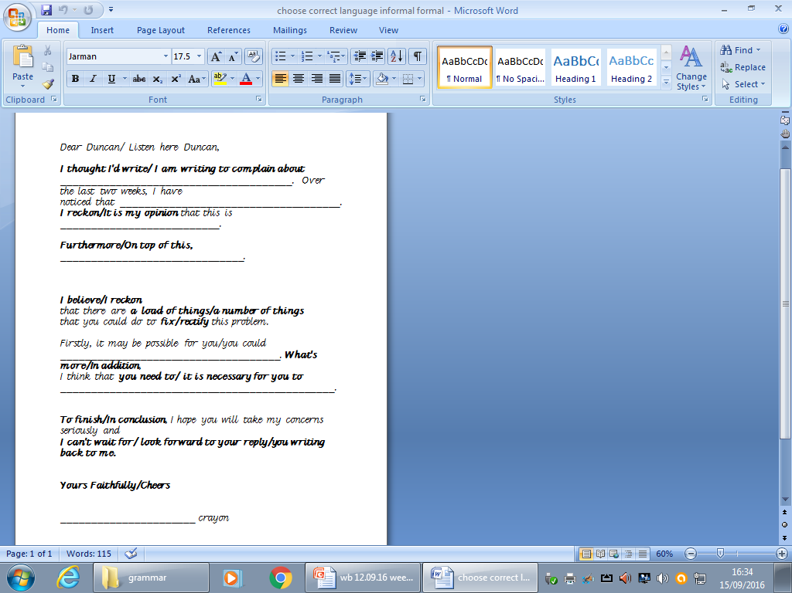

Slide 89

What makes a great letter??

Slide 90
Over to you…
Choose a letter written by a crayon and rewrite it FORMALLY.

Slide 91
Tuesday 19th September 2018
L.O. understand and use subjunctive form.
L.O. finish, edit and up-level a formal letter

Slide 92
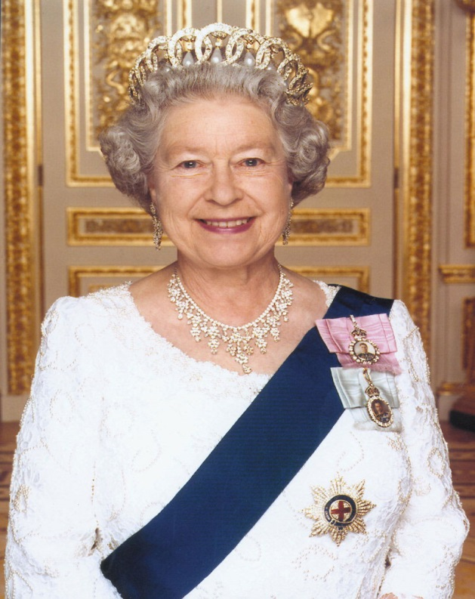
When looking for the subjunctive, speak like the Queen!

Slide 93

They can be used for:
Showing conditions that are not true.
Making a command more formal.
Making a request/wish more formal.
Let’s see examples of them!

Slide 94

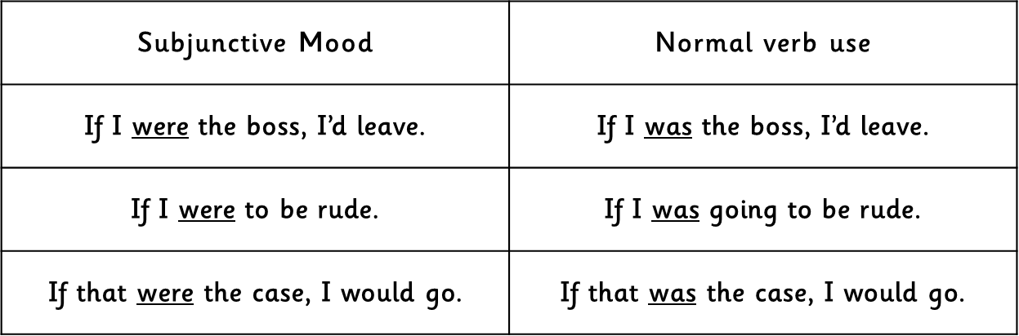


This can be done by changing the verb ‘was’ to ‘were’ to sound more formal.

Slide 95

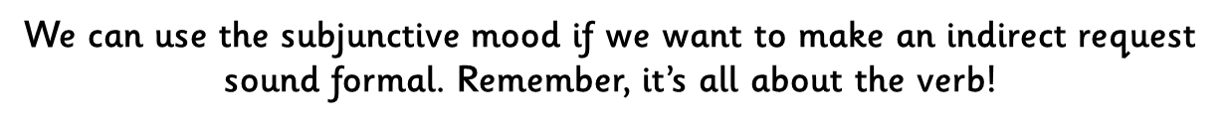
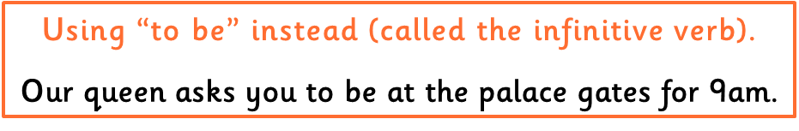

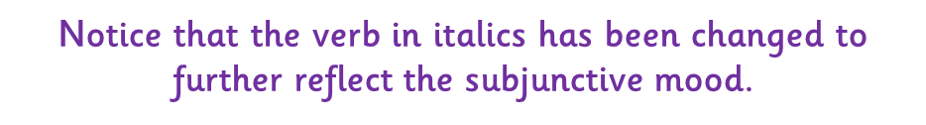

Slide 96
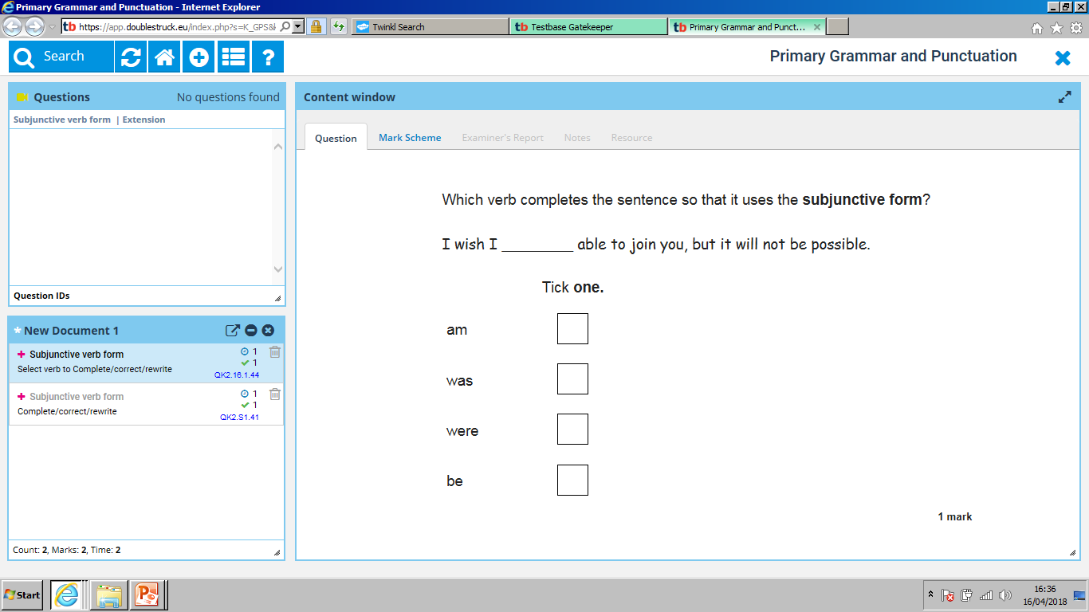

Slide 97
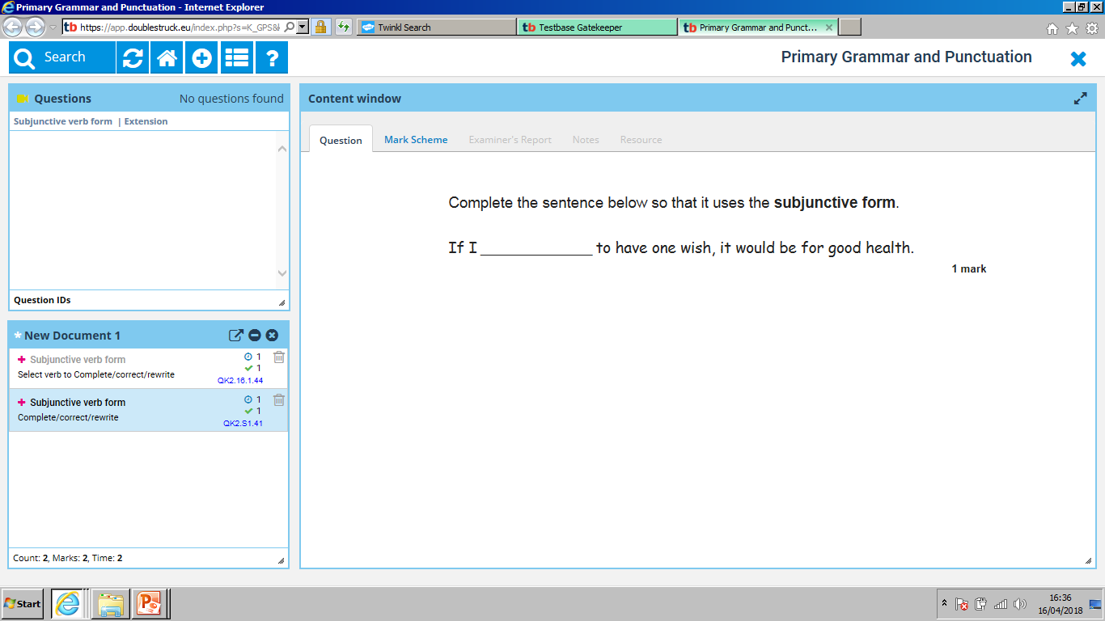

Slide 98
Up-level
I will end up in blue crayons state- short and stubby.
Yours sincerely, Red crayon.
It break my heart
I just hope

Slide 99
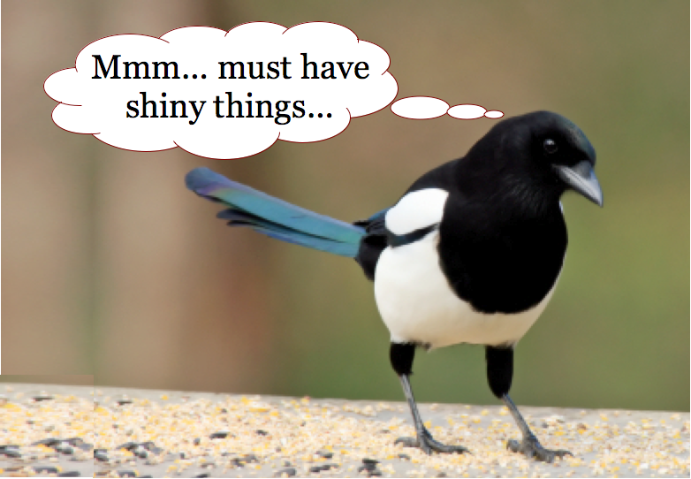
Magpie time!

Slide 100
Magpie
Recently, Yellow Crayon and I have been discussing who the rightful colour of the sun is.
Over the past two weeks, you have been using one to a noticeable extent.
Sadly, one can no longer continue operating for you, unless you reduce my workload. One believes there are a number of ways to rectify this problem, such as…

Slide 101
Magpie
This is due to you selecting one to colour far too often.
Due to this, one feels exhausted and overworked.

Slide 103

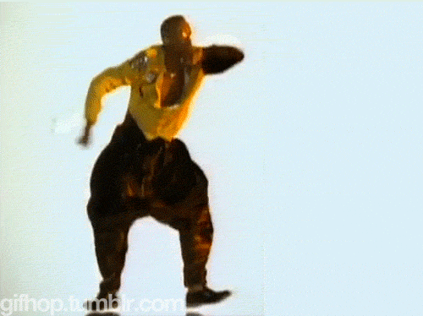
WABOLL TIME

Slide 104
WABOLL
Dear Duncan,
I am writing to inform you that I am unhappy with my workload. You work me too hard. I need a well earned break.
I think you should consider giving me a holiday. How about colouring strawberries green once in a while. Stressed, tired I feel I am overworked.
I hope you take my request seriously.
Your sincery, red crayon.

Slide 105
WAGOLL

Slide 106
Magpie time!

Slide 107
The Crayon Box
Duncan’s Room
Southport
Merseyside
Monday 17th September 2018
Dear Master Duncan,
It is with great regret and concern that I am writing to you today to complain about the well-being of both my colleagues: Yellow and Orange Crayon. If you would be so kind as to consider my requests and reply as soon as possible, one would greatly appreciate it.
It greatly concerns me that a dispute between two colleagues has been on-going for a fortnight. Over the past two weeks, the two named colleagues have had a large disagreement and have been arguing to a noticeable extent. It has therefore fallen upon oneself to inform you on the matter. One trusts you will understand one’s requests and resolve the situation.
The main part of the problem is due to Yellow and Orange Crayon thinking they are both the colour of the sun. This is causing quite a disruption amongst the Crayon Box and our well-being is starting to be affected.
Troubled, vexed and frustrated, The Crayon Box and I request that you resolve this matter swiftly so it does not interrupt our important workload.
One trusts that you understand these concerns.
Yours sincerely,
Green Crayon.
Shared writing

Slide 108
Wednesday 19th September
L.O: start complex sentences in various ways.

Slide 109
Ed words | Ing verbs
Adverbs (ly) | conjunctions

Slide 110
Slow writing

Slide 111
Sentence 1:
Must start with an adverb followed by an ‘ing’ verb.

Slide 112
Sentence 2:
Must begin with ‘ed’ and the power of three.
EMOTION WORDS

Slide 113
Sentence 3:
Must begin with a simile.

Slide 114
6 ways to
start a sentence…
Over to you!

Slide 115
Start with a verb…
________ing about my workload, I feel it is too much.

Slide 116
Start with
an emotion word…
ed
3ed
________ed, _______ed and _______ed,__________________________________________.

Slide 117
Start with
a conjunction…
Although_________________,_______________________________.

Slide 118
Start with an adverb …
________ly,_________________________________________.

Slide 119
Start with a simile …
As __________________ as a _________________________, ________
__________________________.

Slide 120
Start with a
complex conjunction…
If you used me more often, it would make me happier.
WABBITS

Slide 121
Magpie time!

Slide 122
ed opener | Word bank | Exhausted, __________ed and ____________, | Your choice | Who, which, where | Semi colon
ing_______ly, | simile | Expanded noun phrase | Ed power of three | upset | Subordinating conjunction
Mag pie | angry | preposition | Mag pie | overjoyed | Your choice
ly, ing opener | Who, which, where | Ing verb | conjunction | Your choice | Despite,
brackets | simile | conjunction | Word bank | Terrified, overwhelmed with ______and __________, | ing opener
Mag pie | Semi colon | Expanded noun phrase | simile, | although | Your choice

Slide 123
Thursday 20th September 2018
L.O: express mood in our writing.

Slide 124
Tag Question
A tag question is a small question at the end of a sentence. They normally ask for confirmation of what was being said.
A tag question is different than the Yes/No or Direct Address because it comes at the end of the sentence. A tag question is separated from the rest of the sentence using a comma.
You don’t speak French, do you?
Kelly is not moving, is she?

Slide 125
Practice
Where would you put the comma in this sentence?
Yes I am in Mrs. Ray's class.
Yes, I am in Mrs. Ray's class.
You are going on vacation aren’t you?
You are going on vacation, aren’t you?
Samantha please stay in your seat.
Samantha, please stay in your seat.
No I have not seen your backpack.
No, I have not seen your backpack.
It will not rain today will it?
It will not rain today, will it?
Jerry can you bring pie to the party?
Jerry, can you bring pie to the party?

Slide 126

The day the teacher quit
Why would the teacher quit?
The Day
The
Teacher
Quit

Slide 127
Phrases you say when you are disappointed
On your whiteboards, write phrases you say when you are disappointed.

Slide 128
Phrases teachers say when they are disappointed

Slide 129
Phrases said would say when disappointed
Phrases said would say when disappointed

Slide 130
What would make me quit?

Slide 131
What would I say to express my mood?

Slide 132
Start with
an emotion word…
ed
3ed
Frustrated, infuriated and overwhelmed, I watched in horror as my class destroyed the classroom.

Slide 133
Start with
a conjunction…
Although this may not seem important to you, believe me it is!

Slide 134
Start with an adverb …
Frantically, my class tided their tables.

Slide 135
If…if…if…then…
If you continue to frustrate me, if you continue to disobey me, if you give up completely, then I will quit!
Your go…

Slide 136
WAGOLL

Slide 137
Friday 21st September 2018
L.O: express mood in our writing and create a shared write.

Slide 138
Features of informal writing

Slide 139
6 ways to
start a sentence…

Slide 140
Start with a simile | If…if…if…, then________. | Start with ‘ed power of 3’ | Start with a conjunction | Start with an ing verb | Start with an ly adverb
Start with ‘ed power of 3’ | Start with a subordinating conjunction | Start with an ing verb | Your choice | If…if…if…, then________. | Start with a simile
Start with an ing verb | Your choice | Start with an ly adverb | Start with a simile | Start with an ly adverb | Start with ‘ed power of 3’
Start with an ly adverb | Start with ‘ed power of 3’ | If…if…if…, then________. | Start with an ing verb | Start with a Subordinating conjunction | If…if…if…, then________.
If…if…if…, then________. | Start with a simile | Start with a subordinating conjunction | Start with an ly adverb | Start with ‘ed power of 3’ | Start with an ly adverb
Start with a subordinating conjunction | Start with an ing verb | Start with ‘ed power of 3’ | If…if…if…, then________. | Start with an ing verb | Start with a simile

Slide 141
Monday 24th September
L.O. plan an informal letter.

Slide 142
Ed words | Ing verbs
Adverbs (ly) | Conjunctions
Frustrated baffled
Stressed
Exhausted shattered
Exasperated perplexed
Overwhelmed
worried irritated
Contemplating
Stressing ignoring
Marking wreaking
Writing confusing
Waiting
talking
Angrily
Anxiously
Utterly
Stealthily
Chaotically
When
As
Because
Before
If
Though
Since

Slide 143
Slow writing

Slide 144
Sentence 1:
Must start with an adverb followed by an ‘ing’ verb.

Slide 145
Sentence 2:
Must begin with ‘ed’ and the power of three.
EMOTION WORDS

Slide 146
Sentence 3:
Must begin with a simile.

Slide 147
Start with a verb…
Driving me up the wall, you always fiddle with your pencils.

Slide 148
Start with
an emotion word…
ed
3ed
Frustrated, infuriated and overwhelmed, I watched in horror as my class destroyed the classroom.

Slide 149
Start with
a conjunction…
Although this may not seem important to you, believe me it is!

Slide 150
Start with a simile …
Like a whirlwind, you tear around this classroom wreaking havoc.

Slide 151
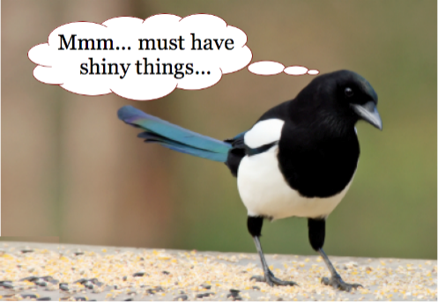
Magpie time!
Although I love teaching, I’m done.
Stop it now!
If you don’t stop…
Anxiously shouting, I tell you off while you giggle.
Annoyed, exhausted and stressed, I wait for you to be quiet. .
Put your rulers down!
Have I done something wrong?
I’m not putting up with this!
I have said this too many times-stop fiddling!
Tired, angry and overwhelmed with exhaustion, I have had enough!
I feel frustrated, angry and mad.
Because of you, all my hair is turning grey.

Slide 152
Magpie time!
I work hard all weekend to plan your lessons and this is how you repay me.
Since I started teaching this class, I have been worried.
Annoyed, stressed and angry, I am quitting because the children are being naughty.
Angrily, I shout because everyone is fidgety.
Because my class fiddle, I get stressed.
Stressing about the children’s behaviour, I am overworked and stressed.
Nervously, I shout at the class because everyone is talking.

Slide 153
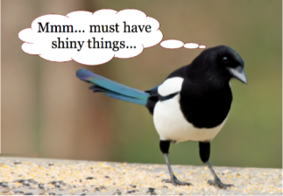
Magpie time-If, if, if, clauses!
If everyone doesn’t stop talking
if nobody stops fiddling
if people don’t stop daydreaming
If you don’t stop talking
if you don’t stop laughing
if you keep fidgeting
if no one listens
if you keep talking while I’m talking
if I have to keep shouting
if you keep ignoring me
if you keep messing with stationery
Pick three!

Slide 154
If…if…if…then…
If you continue to frustrate me, if you continue to disobey me, if you give up completely, then I will quit!
Your go…

Slide 155
Dear 6W,
Right- we have a problem! I’m utterly fed up I am with our current situation. As you know, we teachers have lot of children to care for and educate over the years (30 actually) and I think it’s time you all pulled your weight! Since I have been teaching in this class, I have been worried. Stressing about your behaviour, I am frustrated and anxious. Because of you, all my hair is turning grey. Grrr!
Like a whirlwind, you tear around this classroom wreaking havoc each morning; I’ve had enough. Is it too much to ask for you all to ensure our classroom is kept tidy?! I am also wanting you all to be aware that I will no longer write PINK feedback in your books, if you continue to disregard my comments. How would you feel if you worked hard on your piece of work only for me to ignore it?! Therefore, I think it has gotten to the point where you as Year 6 pupils can decide whether to put 100% effort into your learning, after all isn’t that why we created our class rules??
In front of you, I smile but I collapse in my chair at the end of the day. I work hard to plan your lessons and this is how you repay me! Frustrated and exasperated, irritated and miserable, I hate shouting but I’ve just about had it!
Tired, annoyed and overwhelmed with exhaustion, I have had enough! Although I love teaching, I’m done. I feel disappointed and upset. If people keep ignoring me, if you keep talking while I’m talking, if you don’t stop daydreaming, then I will quit! I hope you take my thoughts seriously and I look forward to your response.
Your turning grey teacher,
Mrs Warham.

Slide 156
Dear _________,
Right- we have a problem! I’m _________________________ with our current situation. As you know, ___________________________________________________________. Stressing about your behaviour,____________________________________________. Because____________________________________,________________________________________.
Like a__________________________, you _____________________________________________. ________________ed, ______________ed and ____________________ed, __________________________________________.
Although_________________________________,____________________________________________________________.
If_____________________________________, if______________________________________, if________________________________, then________________________________! I hope you take my thoughts seriously and I look forward to your response.
Your ____________ teacher,
Mrs Warham.

Slide 157
Tuesday 25th September 2018
L.O: Write an informal letter.

Slide 159
Start with
an emotion word…
ed
3ed
Frustrated, infuriated and overwhelmed, I watched in horror as my class destroyed the classroom.

Slide 160
Start with
a conjunction…
Although this may not seem important to you, believe me it is!

Slide 161
Start with a simile …
Like a whirlwind, you tear around this classroom wreaking havoc.

Slide 162
Dear _________,
Right- we have a problem! I’m _________________________ with our current situation. As you know, ___________________________________________________________. Stressing about your behaviour,____________________________________________. Because____________________________________,________________________________________.
Like a__________________________, you _____________________________________________. ________________ed, ______________ed and ____________________ed, __________________________________________.
Although_________________________________,____________________________________________________________.
If_____________________________________, if______________________________________, if________________________________, then________________________________! I hope you take my thoughts seriously and I look forward to your response.
Your ____________ teacher,
Mrs Warham.
Dear _________,
Right- we have a problem! I’m _________________________ with our current situation. As you know, ___________________________________________________________. Stressing about your behaviour,____________________________________________. Because____________________________________,________________________________________.
Like a__________________________, you _____________________________________________. ________________ed, ______________ed and ____________________ed, __________________________________________.
Although_________________________________,____________________________________________________________.
If_____________________________________, if______________________________________, if________________________________, then________________________________! I hope you take my thoughts seriously and I look forward to your response.
Your ____________ teacher,
Mrs Warham.

Slide 163
Dear _________,
Right- we have a problem! I’m _________________________ with our current situation. As you know, ___________________________________________________________. Stressing about your behaviour,____________________________________________. Because____________________________________,________________________________________.
Like a__________________________, you _____________________________________________. ________________ed, ______________ed and ____________________ed, __________________________________________.
Although_________________________________,____________________________________________________________.
If_____________________________________, if______________________________________, if________________________________, then________________________________! I hope you take my thoughts seriously and I look forward to your response.
Your ____________ teacher,
Mrs Warham.

Slide 164
WAGOLL

Slide 165
Over to you…

Slide 166
Friday 22nd September 2017
WALT: edit and up-level our work.

