Slide 1
Monday 7th September
LO: To identify features
of an effective informal letter
https://www.youtube.com/watch?v=P3k148sIiSk

Slide 2
What does informal mean?
What does formal mean?
Think about…
https://www.bbc.co.uk/bitesize/articles/zmnvgwx

Slide 3

What makes a good letter?

Slide 4
Over to you….
I have written you a letter.
Read through it with your partner and highlight all the good bits using pink!

Slide 5
Over to you...
Write your own letter back to me!
One copy will go in the Y6 time capsule!

Slide 6
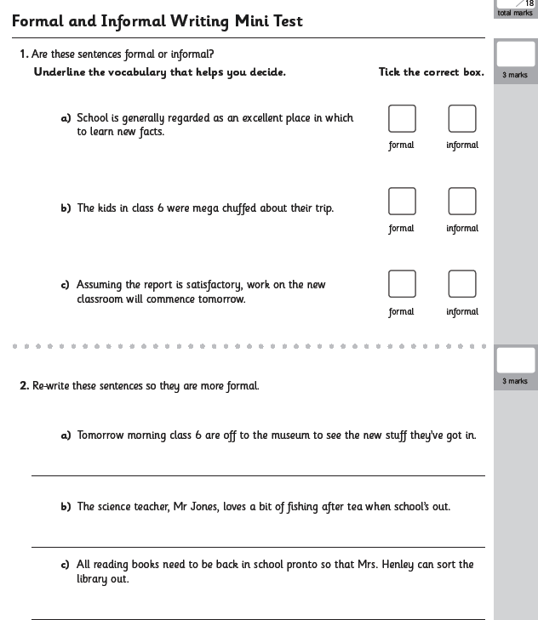
Day 2 LO: To identify formal/informal language
Tuesday 8th September
SPAG activity….

Slide 7

Tuesday 8th September
LO: To identify features of informal writing

