Slide 1
Need ICT lesson this week to research!

Slide 2
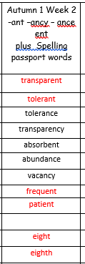
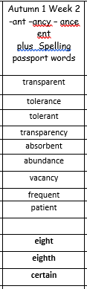
Spelling Week 2
LO: -ant, ancy, ance- ent words

Slide 3
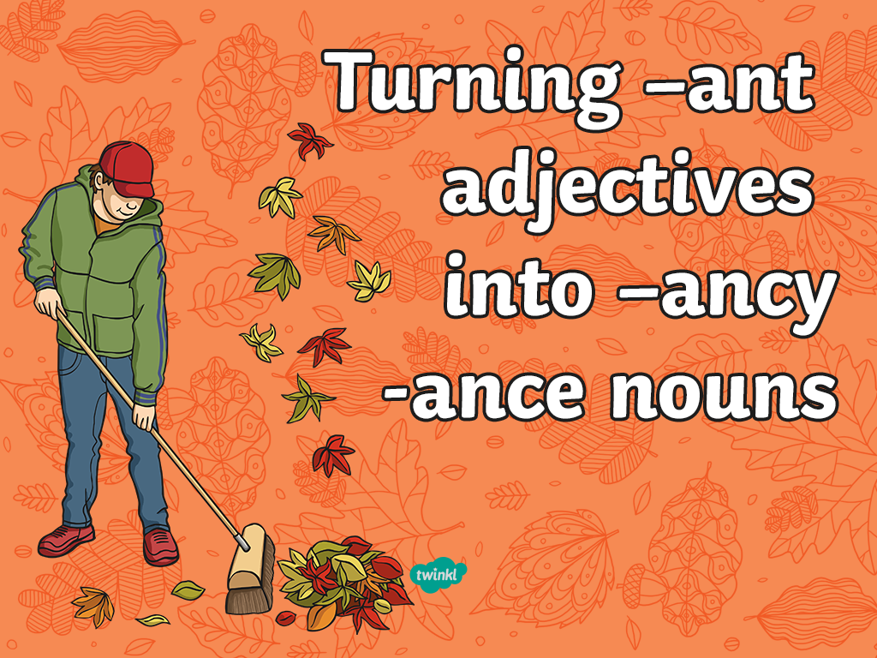
Please create your title slide, main slide
and end slide backgrounds in Photoshop
using the PowerPoint Actions (Z:\#Action Templates\#Actions\PowerPoint)
Save out as jpegs and add your backgrounds to the appropriate Master Slides by going to View, Slide Master.

Slide 4

Many adjectives in the English language end in the same sound made with either –ant or –ent.
It is often tricky to decide which ending to use when you are spelling them…
e.g. is it observant or observent?

Slide 5
A good rule to follow is if the root word can be given an –ation ending then it will usually end in –ant.
observation
observant
Working with a partner, can you write a sentence about the long-eared owl that contains the adjective ‘observant’?

Slide 6

So if the root word can be given an –ation ending, then it will usually end in –ant (and not –ent).
Here are some more example words that follow the same rule:
toleration
tolerant
hesitation
hesitant

Slide 7

Monday 14th September
L.O: To identify and use formal language.

Slide 8
Magpie
Recently, Yellow Crayon and I have been discussing who the rightful colour of the sun is.
Over the past two weeks, you have been using me to a noticeable extent.
Sadly, I can no longer continue operating for you, unless you reduce my workload. I believe there are a number of ways to rectify this problem, such as…

Slide 9
Formal or informal?
Sort it out!

Slide 10
One wishes to express . . .
It bothers me that . .
As I see it . . .
It was out of the blue. . .
One appreciates that . . .
It is for this reason that . . .
Notes:
These phrases should be cut out already in file. Children list whether they think they are formal or informal.

Slide 11
Please accept my . . .
I can assure you. . .
Whilst I am aware. . .
I get that . .
After much consideration,
Listen up.

Slide 12
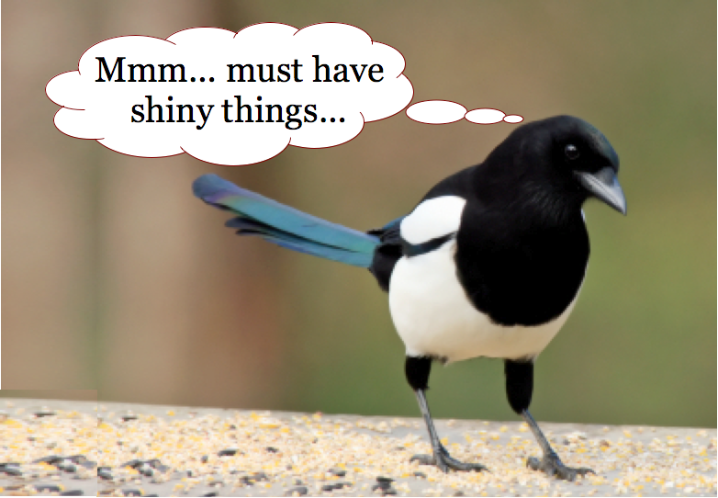
Magpie words and phrases

Slide 13
Type of formal letter | Magpied phrase and vocabulary
Notes:
Slide 13 and 14 is double sided. In partners or individual- children fill in based on examples they look at

Slide 14
Type of formal letter | Magpied phrase and vocabulary

Slide 15
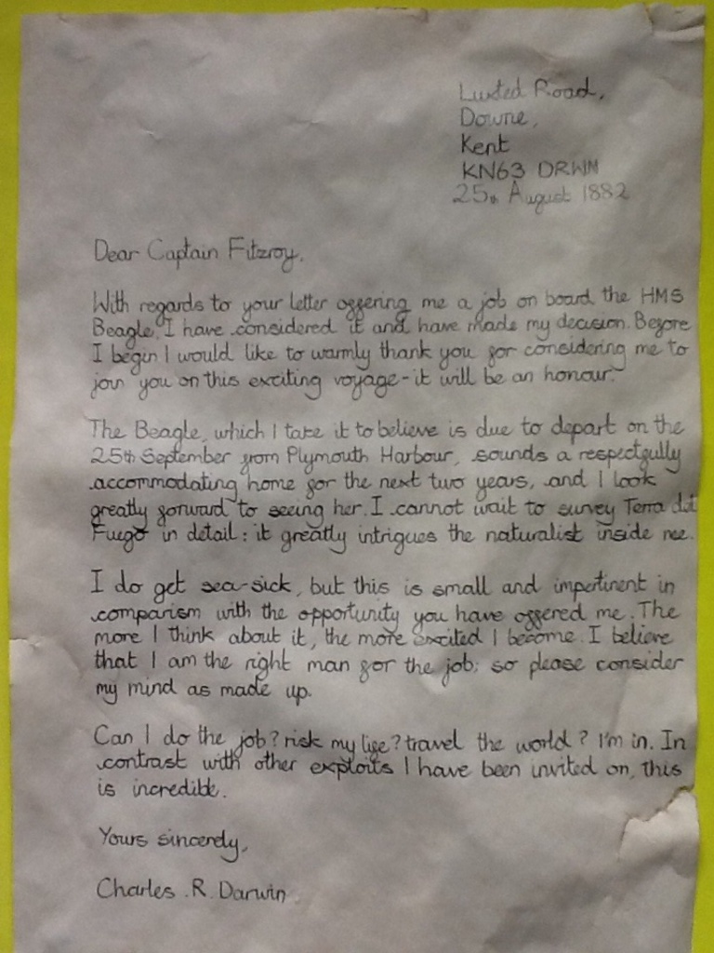
Notes:
One example to go through on board and look for formal features.

Slide 16
So what is formal language?
Notes:
Plenary

Slide 17
Formal language is used for writing official or business letters.
It is precise, correct and impersonal.
Specific phrases are used.
“I am writing to express my dissatisfaction with…”
“I trust that this matter will receive your prompt attention…” instead of: “I hope you’ll deal with this quickly.”
Slang and contractions are never used in formal writing.
Notes:
Add to working wall

Slide 18
Tuesday 16th September
L.O. To understand and use subjunctive form.

Slide 19
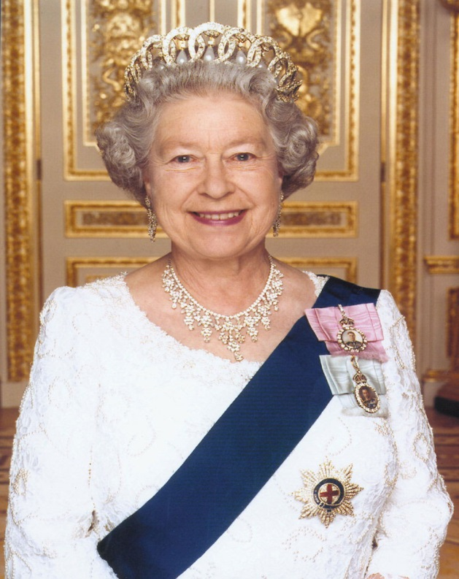
When looking for the subjunctive, speak like the Queen!

Slide 20


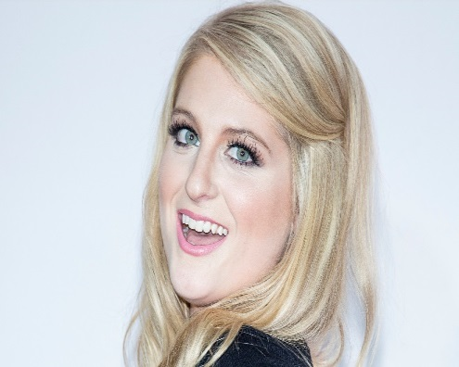
It’s all about that verb… ‘bout that verb...no treble!
Subjunctives make
the language
more formal

Slide 21

They can be used for:
Showing conditions that are not true.
Making a command more formal.
Making a request/wish more formal.
Let’s see examples of them!

Slide 22

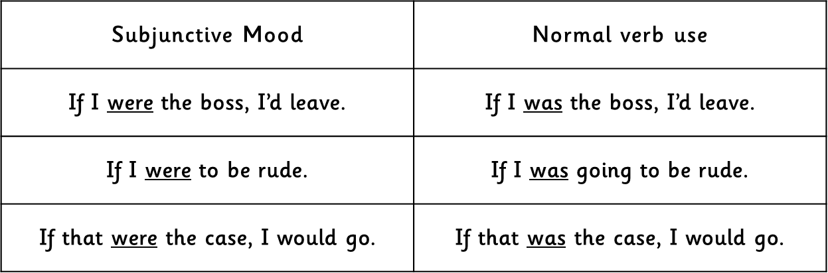


This can be done by changing the verb ‘was’ to ‘were’ to sound more formal.

Slide 23

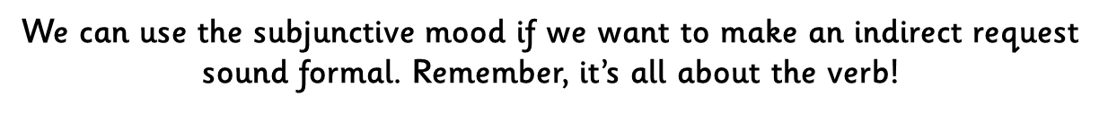
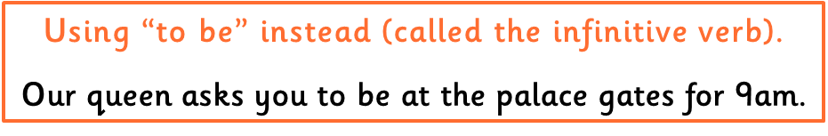

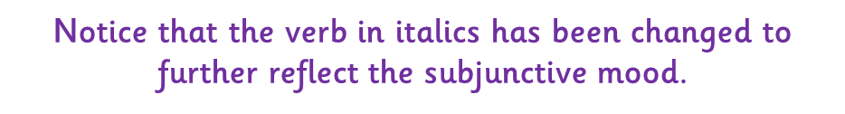

Slide 24
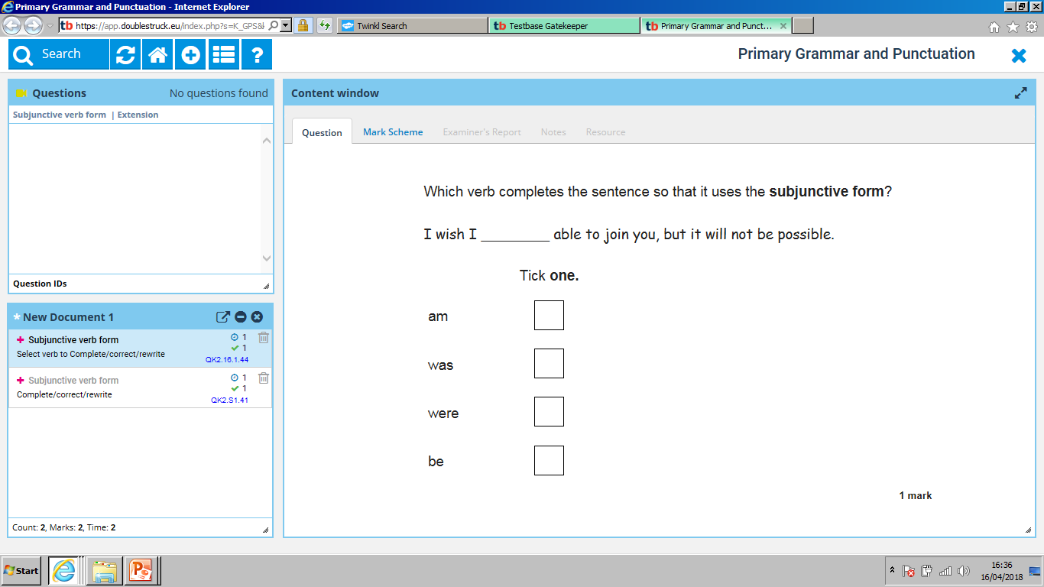

Slide 25
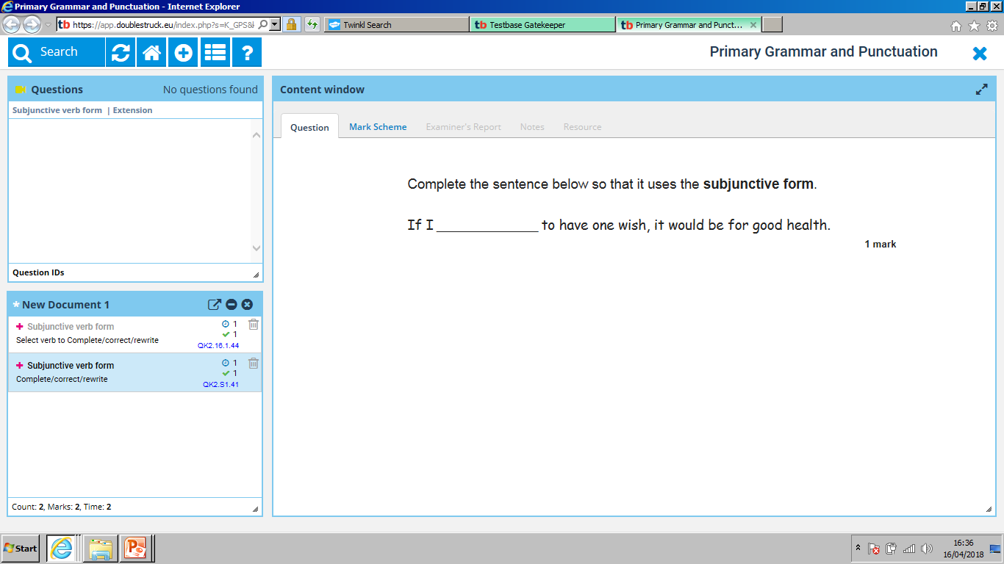

Slide 26
Tuesday 15th September
L.O: create a shared write for a formal letter.

Slide 27

Choose a letter…
Notes:
Put laminated and photocopies on tables for children to refer to

Slide 28
Informal
Formal
Notes:
As a class- add formal phrases they know of and informal phrases they know of

Slide 29
Start with a verb…
Contemplating about my workload, I wish to express my dissatisfaction.
Notes:
Why is this formal?

Slide 30
Start with
an emotion word…
ed
3ed
Underappreciated, fatigued, and overworked, I did not envisage this volume of work as part of my job when I started.

Slide 31
Start with
a conjunction…
Despite the fact that I am your favourite colour, I can assure you that I am in need of some respite.

Slide 32

Start with a WABBIT …
Whilst I am aware that I am not the only colour that is popular, I cannot stress enough the importance of me receiving time off.
WABBITS

Slide 33
Start with a
coordinating conjunction…
If one were to consider my request, it would make improve my wellbeing.
WABBITS
Notes:
How is this written in subjunctive mood?

Slide 34

WAGOLL
The Crayon Box
Duncan’s Room
Southport
Merseyside
Monday 17th September 2018
Master Duncan Jones
15 Privet Drive
Southport
Merseyside
PR8 6SS
Dear Master Duncan,
It is with regret that I write this letter of complaint; however, I cannot continue to carry out my vital role to the best of my ability if certain demands continue.
As you are aware, I am your favourite and most trusted crayon and I am proud to carry out the work that you demand of me. Although I understand that you enjoy colouring and need my utmost attention in all your drawings, I am now in need of some respite. Stressed, tired, and overworked, I feel I am being unfairly treated. Many of my colleagues receive a rest between jobs, yet I am expected to work constantly with no well-earned rest.
Unfortunately, if you do not provide me with some well eared time off, then I will be forced to retire.
I trust you understand my concerns,
Yours sincerely,
Red Crayon.
Notes:
WAGOLL of shared write. Children branch off into groups with Tas/teachers to write their group letter.

Slide 35
WAGOLL
The Crayon Box
Duncan’s Room
Southport
Merseyside
Monday 17th September 2018
Master Duncan Jones
15 Privet Drive
Southport
Merseyside
PR8 6SS
Dear Master Duncan,
It is with regret that I write this letter of complaint; however, I cannot continue to carry out my vital role to the best of my ability if certain demands continue.
As you are aware, I am your favourite and most trusted crayon and I am proud to carry out the work that you demand of me. Although I understand that you enjoy colouring and need my utmost attention in all your drawings, I am now in need of some respite. Stressed, tired, and overworked, I feel I am being unfairly treated. Many of my colleagues receive a rest between jobs, yet I am expected to work constantly with no well-earned rest.
Unfortunately, if you do not provide me with some well eared time off, then I will be forced to retire.
I trust you understand my concerns,
Yours sincerely,
Red Crayon.
Notes:
WAGOLL of shared write. Children branch off into groups with Tas/teachers to write their group letter.

Slide 36
Magpie
Recently, Yellow Crayon and I have been discussing who the rightful colour of the sun is.
Over the past two weeks, you have been using me to a noticeable extent.
Sadly, I can no longer continue operating for you, unless you reduce my workload. I believe there are a number of ways to rectify this problem, such as…
Notes:
What is formal?

Slide 37
Magpie
This is due to you selecting my colour far too often.
Due to this, I feel exhausted and overworked.

Slide 38
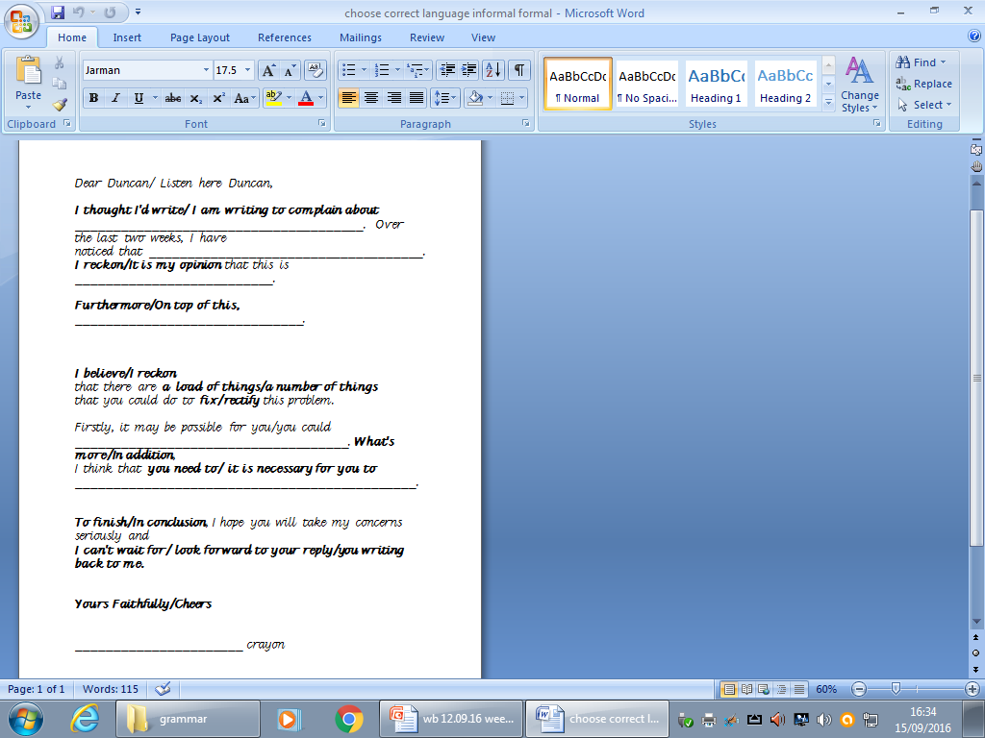
Notes:
SEN to use and write independently.

Slide 39

What makes a great letter??

Slide 40
Over to you…
Choose a letter written by a crayon and rewrite it FORMALLY.

Slide 41
Wednesday 16th September

Slide 42
Spelling Week 2
LO: -ant, ancy, ance- ent words

Slide 43
Wednesday 16th September
L.O. finish, edit and up-level a formal letter

Slide 44
Up-level
I will end up in blue crayons state- short and stubby.
Yours sincerely, Red crayon.
It break my heart
I just hope

Slide 45
Magpie time!
Notes:
Slide 35-40 SPAG warm up

Slide 46
Magpie
Recently, Yellow Crayon and I have been discussing who the rightful colour of the sun is.
Over the past two weeks, you have been using one to a noticeable extent.
Sadly, one can no longer continue operating for you, unless you reduce my workload. One believes there are a number of ways to rectify this problem, such as…

Slide 47
Magpie
This is due to you selecting one to colour far too often.
Due to this, one feels exhausted and overworked.

Slide 48
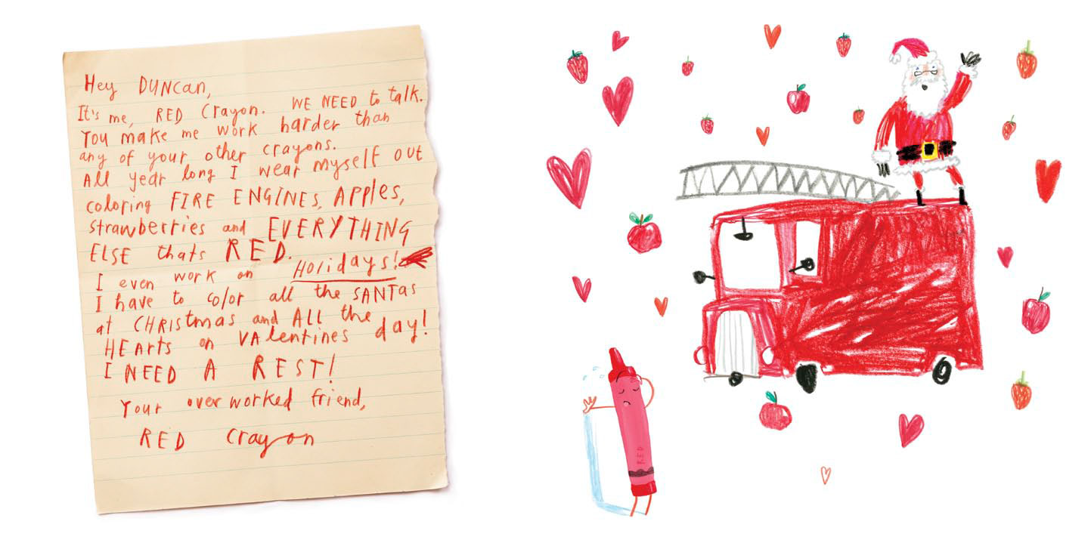

Slide 49

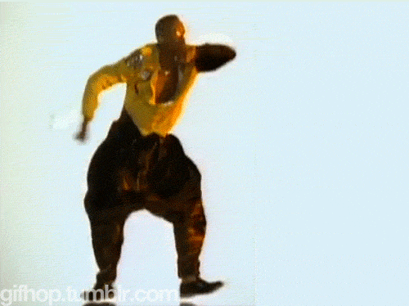
WABOLL TIME

Slide 50
WABOLL
Dear Duncan,
I am writing to inform you that I am unhappy with my workload. You work me too hard. I need a well earned break.
I think you should consider giving me a holiday. How about colouring strawberries green once in a while. Stressed, tired I feel I am overworked.
I hope you take my request seriously.
Your sincery, red crayon.
Notes:
How can we edit and improve this letter? What about our own?

Slide 51
WAGOLL
Dear Sir Duncan,
It is with great regret and concern that one feels the need to write to convey one’s thoughts regarding the recent workload assigned to oneself and the other crayons. It is clearly apparent that you consider one to be one of your favourite coloured crayons and therefore is selected to be used more frequently than others in the crayon box. Over the past two weeks, you have been using one to a noticeable extent. It has therefore fallen upon oneself to express the sheer frustration and exhaustion on the matter and the wish to inform you that believe I, Red Crayon, is in need of a much earned respite.
Furthermore, one’s wellbeing is of great concern and if not considered, may be forced to resign from working in the crayon box. Stressed, tired, and overworked, collectively my colleagues and I feel unfairly treated. One understands that the colour red is an extremely common and popular colour for various objects you create. Therefore I wish to suggest an alternative to your current selection of colours. It is apparent that Beige and Peach Crayons are desperate to be used more frequently than in the given months. It is with regret that one can no longer continue operating for you, unless you reduce the workload. There are a number of ways to rectify this problem, such as considering a Peach fire engine every so often rather than red. In addition, one requests an acceptable amount of paid leave. Currently, you may not be aware of the fact that one has been subject to working not only Christmas days but also Valentines Day. Although one understands that you have a colour preference and I am your favourite colour, I need a well-earned rest.
In conclusion, one hopes you take the specified concerns into account and seriously consider changing the workload and consequently one can have a lasting impact on your colouring experiences. I look forward to your reply.
Yours sincerely,
Red Crayon.
Notes:
Show WAGOLL. Children edit and improve their letters. Using last lesson’s template, they rewrite their letters- adding in more of their own ideas. SEN: if completed their template – practise 6 ways to start a sentence using sentence slides 58- 61

Slide 52
The Crayon Box
Duncan’s Room
Southport
Merseyside
Monday 17th September 2018
Dear Master Duncan,
It is with great regret and concern that I am writing to you today to complain about the well-being of both my colleagues: Yellow and Orange Crayon. If you would be so kind as to consider my requests and reply as soon as possible, one would greatly appreciate it.
It greatly concerns me that a dispute between two colleagues has been on-going for a fortnight. Over the past two weeks, the two named colleagues have had a large disagreement and have been arguing to a noticeable extent. It has therefore fallen upon oneself to inform you on the matter. One trusts you will understand one’s requests and resolve the situation.
The main part of the problem is due to Yellow and Orange Crayon thinking they are both the colour of the sun. This is causing quite a disruption amongst the Crayon Box and our well-being is starting to be affected.
Troubled, vexed and frustrated, The Crayon Box and I request that you resolve this matter swiftly so it does not interrupt our important workload.
One trusts that you understand these concerns.
Yours sincerely,
Green Crayon.
Shared writing WAGOLL

Slide 53
WAGOLL
Dear Sir,
I am writing to convey my thoughts regarding the recent workload assigned to myself and the other crayons. It is clearly apparent that you consider myself to be one of your favourite coloured crayons and I am therefore selected to be used more frequently than others in the crayon box. Over the past two weeks, you have been using me to a noticeable extent. It has therefore fallen upon myself to express my sheer frustration and exhaustion on the matter and wish to inform you that I believe I am in need of a much earned respite.
Furthermore, I am concerned that if my wellbeing is not considered I may be forced to resign from working in the crayon box. Stressed, tired, and overworked, I feel I am being unfairly treated. I understand that the colour red is an extremely common and popular colour for various objects you create. Therefore I wish to suggest an alternative to your current selection of colours. I understand that Beige and Peach Crayons are desperate to be used more frequently than in the given months. Sadly, I can no longer continue operating for you, unless you reduce my workload. I believe there are a number of ways to rectify this problem, such as: could you consider a Peach fire engine every so often rather than red? In addition, I wish to also request an acceptable amount of holiday time off. Currently, you may not be aware of the fact that I have been subject to working not only Christmas days but also Valentines Day. Although I am your favourite colour, I need a well earned rest!
In conclusion, I hope you take my concerns into account and seriously consider changing my workload so I can have a lasting impact on your colouring experiences. I look forward to your reply.
Yours faithfully,
Red Crayon.

Slide 54
Introduction:
I am writing to convey my thoughts regarding the recent workload assigned to myself and the other crayons. It is clearly apparent that you consider myself to be one of your favourite coloured crayons and I am therefore selected to be used more frequently than others in the crayon box. Over the past two weeks, you have been using me to a noticeable extent. It has therefore fallen upon myself to express my sheer frustration and exhaustion on the matter and wish to inform you that I believe I am in need of a much earned respite.

Slide 55
Reasons for how crayon feels:
Furthermore, I am concerned that if my wellbeing is not considered I may be forced to resign from working in the crayon box. Stressed, tired, and overworked, I feel I am being unfairly treated. I understand that the colour red is an extremely common and popular colour for various objects you create. Therefore I wish to suggest an alternative to your current selection of colours. I understand that Beige and Peach Crayons are desperate to be used more frequently than in the given months.
Sadly, I can no longer continue operating for you, unless you reduce my workload. I believe there are a number of ways to rectify this problem, such as: could you consider a Peach fire engine every so often rather than red? In addition, I wish to also request an acceptable amount of holiday time off. Currently, you may not be aware of the fact that I have been subject to working not only Christmas days but also Valentines Day. Although I am your favourite colour, I need a well earned rest!

Slide 56
Conclusion:
In conclusion, I hope you take my concerns into account and seriously consider changing my workload so I can have a lasting impact on your colouring experiences. I look forward to your reply.
Yours sincerely,
Red Crayon.

Slide 57
Magpie time!

Slide 58
Slide 58- 61 are SEN resources.
Print A5 and stick in books. Children create their own sentences.

Slide 59
Start with a verb…
____________ing about my workload, I feel ____________________________.

Slide 60
Start with an adverb …
Miserably, I watch while you use yellow crayon to colour the sun.

Slide 61
Start with an adverb …
__________________ly, I watch while you use yellow crayon to colour the sun.
Over to you…

Slide 62
Start with a
coordinating conjunction…
If you used me more often, it would make me happier.
WABBITS

Slide 63
Thursday 17th September
L.O: To use apostrophes for contraction correctly

Slide 64
Apostrophes can be used to show missing letters.
When you use an apostrophe, you ‘OMIT’
(replace) a letter so it is called:
Omission.
I can not come to the party.
I can’t come to the party.
Can not becomes can’t.
The apostrophe shows that there are letters missing. It goes where the missing letter is supposed to go.

Slide 65
More examples of apostrophes for contraction/omission.
Jack would not play with his baby brother.
Jack wouldn’t play with his baby brother.
Claire did not want to eat the unhealthy chocolate cake.
Claire didn’t want to eat the unhealthy chocolate cake.

Slide 66
What do these words become when you shorten them?
have not
they will
shall not
I have
you are
haven’t
they’ll
shan’t
I’ve
you’re

Slide 67
Make sure the apostrophe is in the correct place.
Check these for accuracy;
did’nt
we’ll
should’nt
didn’t
we’ll (correct)
shouldn’t

Slide 68
hasn’t
isn’t
doesn’t
…are short for has NOT, is NOT, does NOT.
I’ll
He’ll
They’ll
…are short for I WILL, he WILL and they WILL.
They have two letters missing

Slide 69
Its and it’s
So many people get this wrong!!!
The apostrophe is only used to show ‘it is’.
It’s sunny today.
It’s very kind of you to give me your last sweet.
“It’s full of wonderful things,” exclaimed Howard Carter after discovering Tutankhamun’s tomb.

Slide 70
Thursday 17th September
L.O: practise using complex sentences in context.

Slide 71
Up-level
I will end up in blue crayons state- short and stubby.
Yours sincerely, Red crayon.
It break my heart
I just hope

Slide 72
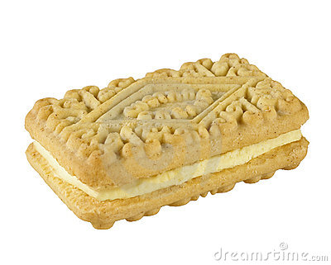
A compound sentence:
The teacher drank her coffee. She sat at her desk.
The teacher drank her coffee and she sat at her desk.
The teacher drank her coffee then sat at her desk.

Slide 73
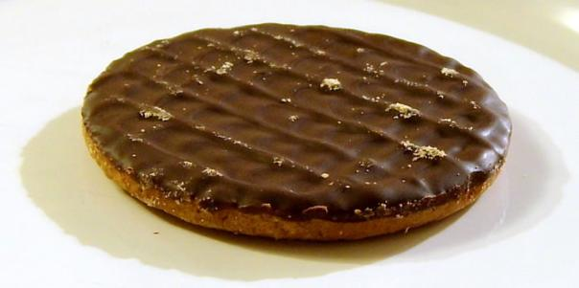
The chocolate biscuit…
A complex sentence
made up of two clauses-one main clause
(which could be a sentence by itself), and one
subordinate clause, which does not make sense by itself.
the subordinate clause is often joined to the rest of the sentence with one of these connectives:
although
after
as
when
whenever
while
until
unless
because
before
if
since
Notes:
Remind children 6 ways to start a sentence is based on complex sentences. What are they? Add to working wall

Slide 74
Remember:
A complex sentence is made up of a main clause, with a subordinate clause added to it.
although
as
after
when
whenever
while
unless
until
because
before
if
since
Example:
Whenever we talk when the teacher is talking, we are told off.
If we misbehave in class, we get into trouble.
A compound sentence is 2 simple sentences joined together by a connective.
and
then
but
or
yet
so
Example:
I was talking so I was told off.
I knew I might get into trouble but I still carried on talking.

Slide 75
Read through the Plastic Pollution reading comprehension
Notes:
Chn read through and highlight key facts.

Slide 76
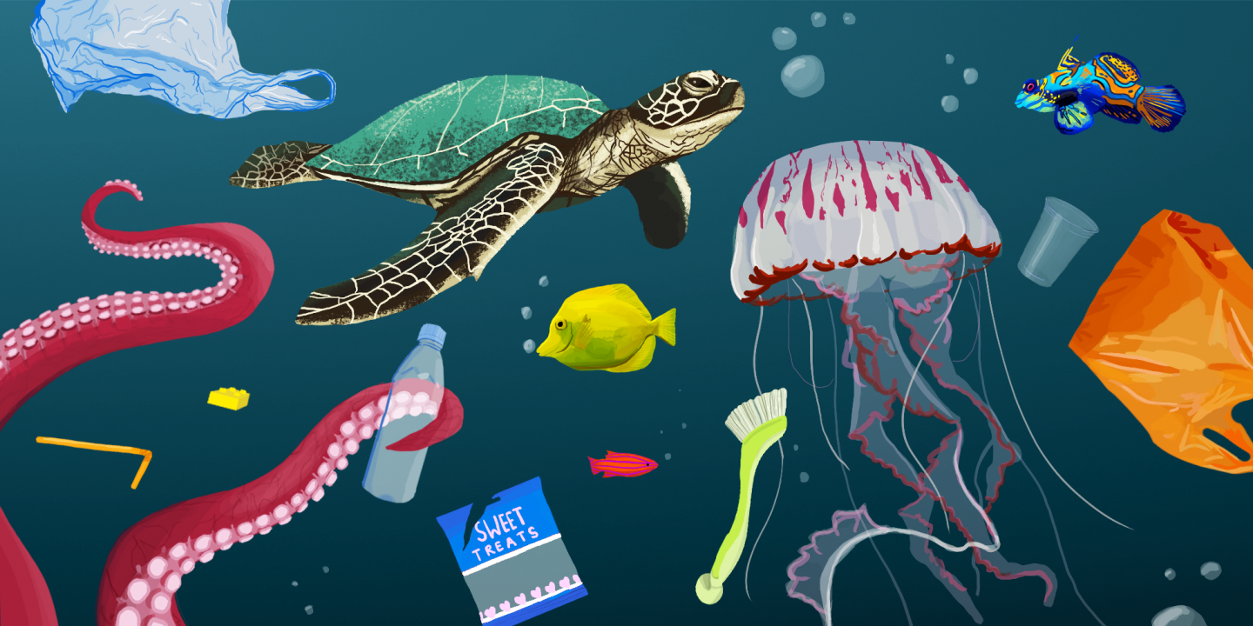
Your writing task over the next week…
Over the next week, you are going to be writing a formal letter to your local supermarket.
The context and reason for writing is to formally request for more I information about what your local supermarket is doing to support the plastic pollution crisis that is evidently affecting our environment.

Slide 77

First of all, let’s practise some sentences that will help us write our letters! Remember, we are writing formally.

Slide 78
Start with
a conjunction…
Despite_________________,_______________________________.
Despite concerning statistics highlighting the devasting impact
single use plastic waste has on our oceans, not all companies are
taking action to make a difference.
Notes:
Slide 74-78 show children how their sentences can link to our new context f plastic pollution in formal tones.

Slide 79
Start with an adverb …
________ly,_________________________________________.
Clearly, the media has recently over the last year indicated
the pressing need for our generation to make a change with
the over use of plastic waste.
Notes:
Slide 74-85 go through during input. Children practise the different sentences as a class. HA independently.

Slide 80
Start with a
complex conjunction…
If more were to be done in the retail business about single use plastic, this would have a positive impact to our planet.
WABBITS

Slide 81
If…if…if…then…
If businesses continue to ignore the facts, if companies choose to not take action, if you choose to do nothing, then it will be too late.
Your go…

Slide 82
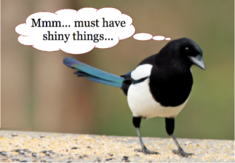
Magpie time-If, if, if, clauses!
If no ones take action,
If companies do not change their ways,
If businesses continue to ignore the facts,
If people do nothing,
If you choose to do nothing,
If current statistics are ignored,
Pick three!
Notes:
Children pick 3 if statements to create their own if…if…if then sentences in books. SEN to do with TA.

Slide 83
Magpie time-If, if, if, clauses!
If people start to take action,
If companies start to make a change and make a difference,
If businesses continue to set the example,
If people collaboratively work together,
If people are made aware,
If current statistics are heard,
Pick three!

Slide 84
The more, the more
The more that organisations begin to make changes and aid reducing their use of single plastic waste, the more chance a world has of being saved.
The more _________________________________the more________________________________.
Notes:
Children practise in their books. SEN printed on A5 – stick in books and fill in with TA.

Slide 85
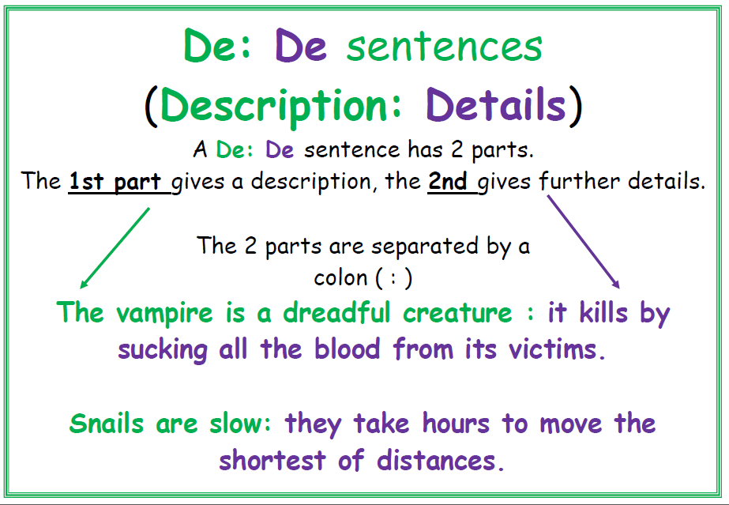

Slide 86
I was exhausted:________________________________
__________________________________.
Snails are slow:__________________________________
________________________________.

Slide 87
Description : Detail
Plastic usage is a devasting problem: each year, 400 million tonnes of plastic is produced and 40% of that is single-use - plastic we'll only use once before it's binned.

Slide 88
Description : Detail
Our planet is in crisis: each year, 400 million tonnes of plastic is produced and 40% of that is single-use - plastic we'll only use once before it's binned.

Slide 89
Your turn…
Oceans are : ___________________________________________________.
Deforestation is a huge problem: _______________________________________-_________________.
There has been considerable debate about whether ______________________________________________.

Slide 90
The more______ ______________ the more ______ ____________________ | The more______ ______________ the more ______ ____________________ | The more______ ______________ the more ______ ____________________ | The more______ ______________ the more ______ ____________________ | The more______ ______________ the more ______ ____________________
adverb (ly word) | adverb (ly word) | adverb (ly word) | adverb (ly word) | adverb (ly word)
Although _____ _______,_____ ____________. | Although _____ _______,_____ ____________. | Although _____ _______,_____ ____________. | Although _____ _______,_____ ____________. | Although _____ _______,_____ ____________.
DE:DE sentence | DE:DE sentence | DE:DE sentence | DE:DE sentence | DE:DE sentence
Despite _____ _______,_____ ____________. | Despite _____ _______,_____ ____________. | Despite _____ _______,_____ ____________. | Despite _____ _______,_____ ____________. | Despite _____ _______,_____ ____________.
If________, if ___ ___________, if ___ ________, then _________________ | If________, if ___ ___________, if ___ ________, then _________________ | If________, if ___ ___________, if ___ ________, then _________________ | If________, if ___ ___________, if ___ ________, then _________________ | If________, if ___ ___________, if ___ ________, then _________________
The more______ ______________ the more ______ ____________________
adverb (ly word)
Although _____ _______,_____ ____________.
DE:DE sentence
Despite _____ _______,_____ ____________.
If________, if ___ ___________, if ___ ________, then _________________
Notes:
Cut strips. Children stick in sentence strips in their books and write their own sentences that they could use in their letters next week. SEN – guided with TA.

Slide 91
Magpie time!

Slide 92

Friday 18th September
L.O. structure facts and ideas to help plan a formal letter.

Slide 93

sentences
Notes:
Edit and respond to marking from last lesson.

Slide 94

Notes:
Read through WAGOLL. Highlight features and discuss as a class.

Slide 95

What makes a strong formal letter?
Refer to the formal and informal table
And highlight the features you need to use.
Notes:
Formal and informal table should be in the blue file- photocopy for children to use and refer to for formal features.

Slide 96
Think about the supermarket you want to write to.
Why do you want to write to them?
What do you know from your research that they are already doing to reduce plastic packaging?
What more information would you like to know from them?

Slide 97
Address of local supermarkets
Tesco | the general manager
ASDA | the general manager
Aldi | the general manager
Sainsburys | the general manager
Morrisons | the general manager
Tesco Extra Town Lane Kew Southport PR8 5JH | Asda Southport Superstore Central 12 Shopping Park Derby Road Southport PR9 0TY | ALDI - Unit 8 Meol Cop Centre Southport PR9 7RG | Lord Street St George's Place Southport PR9 0AF | Morrisons Winter Gardens Southport PR8 1N
Notes:
Children select who they are going to write to

