Slide 1

Monday 21st September

Slide 2
ambitious
cautious
fictitious
infectious
nutritious
contentious
superstitious
pretentious
anxious
obnoxious
How has the /shuhs/sound been made in these words?
They all have ‘tious’ or ‘ious’ endings.

Slide 3
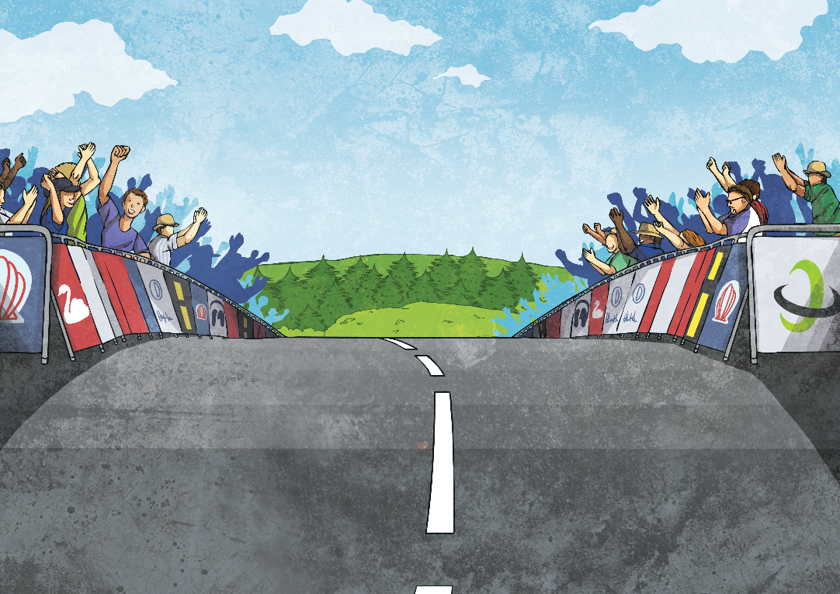
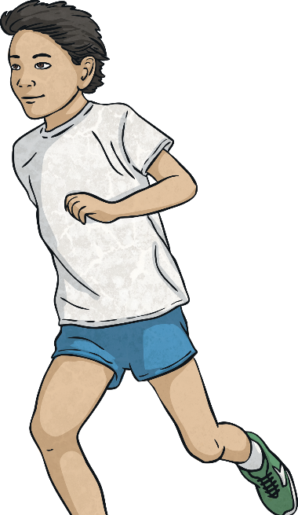

Which ‘tious’ or ‘ious’ word do you think fits in this sentence?
ambitious.
Adam spends a lot of time running races; he is very

Slide 4

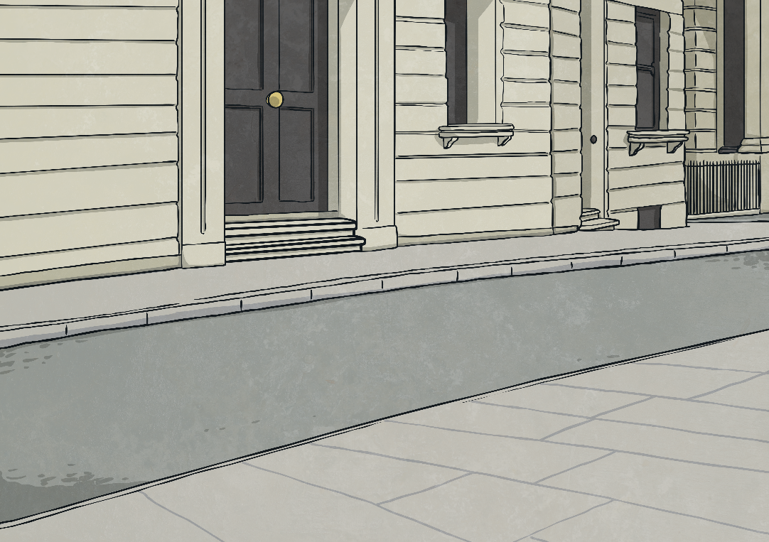
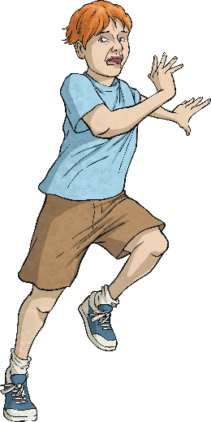
Which ‘tious’ or ‘ious’ word do you think fits in this sentence?
Some people are
superstitious
and will not walk under a ladder.

Slide 5
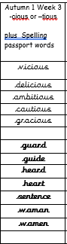
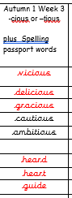
Spellings
LO: -cious–tious words

Slide 6
Monday 21st September
L.O. To complete a plan for a formal letter.

Slide 7
OUR PURPOSE:
WHAT: We are learning how to write formal letters.
WHY: we are going to be writing formal letters to local supermarket, asking them to explain what they are doing about the current single use of plastic problem our world is facing.
WHO: our audience is for the head of local supermarkets

Slide 8


Slide 9
Success Criteria:

Slide 10
Tuesday 22nd September
L.O. To write a formal letter

Slide 11
SPAG
LO: To use De:De sentences
LO: To accurately use commas for lists in my writing (Blue group)

Slide 12
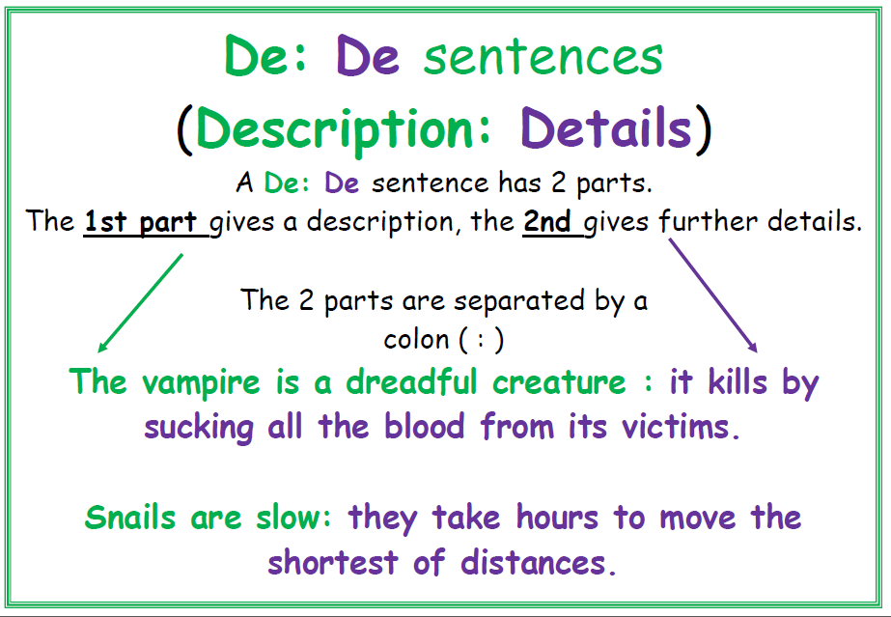

Slide 13
I was exhausted:________________________________
__________________________________.
Snails are slow:__________________________________
________________________________.

Slide 14
Description : Detail
Plastic usage is a devasting problem: each year, 400 million tonnes of plastic is produced and 40% of that is single-use plastic we'll only use once before it's binned.

Slide 15
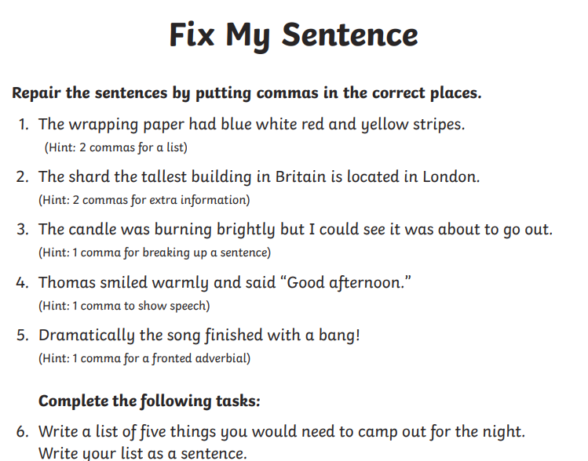
SPAG FOR BLUE GROUP commas pp
Thursday work

Slide 16
SPAG FOR BLUE GROUP commas pp

Slide 17
Description : Detail
Our planet is in crisis: each year, 400 million tonnes of plastic is produced and 40% of that is single-use - plastic we'll only use once before it's binned.

Slide 18
Your turn…
Oceans are____________:________________________________________________.
Plastic is a huge problem: ________________
______________________________________________________________________.

Slide 20
Introduction: explain purpose of writing and the problem.
On behalf of my primary school, I am writing to you today regarding the recent topic that is evidently affecting not just our country but indeed our planet: plastic pollution. As I am sure you are already aware of the catastrophic damage being had and the implications this is having on our environment, not to mention the threat plastic is posing to our marine life in our vast oceans. In Year 6, we have been discussing and researching the damage that has been caused globally and would like to express our concerns on this matter and hear how your company: ‘Tesco’ are making a change for the better.

Slide 21
Main body: why is it a problem?
Plastic pollution is a serious problem and one that if left unattended to and ignored, will leave future generations at a loss. Each year, approximately 100 million marine animals are killed, due to plastic debris in our oceans. Of which, each microscopic piece of plastic that has ever entered our oceans is still there. At St Philip’s CE Primary School, we believe that this needs to change. If more were to be done in the retail business about single use plastic, this would have a positive impact to our planet.

Slide 22
Main body: what/is your supermarket already doing things?
The recycling of plastic has proven almost impossible as most plastic materials are not biodegradable thus will not break down and decompose like other materials. In the media, we have learnt that Tesco is one of the supermarkets that are actively trying to start to make changed in your industry. The use of carrier bags have significantly reduced due to there now being a cost of at least 5pence per bag. Yet, despite extending the 5p charge on single-use plastic bags, major retailers in England still sold 2.1 billion in the last financial year. As you are very much aware, Tesco holds a powerful position being one of the largest UK supermarkets. Therefore, by making changes to single plastic items, your company could make major positive changes in contributing to the reduction of plastic waste.

Slide 23
conclusion
Despite concerning statistics highlighting the devasting impact single use plastic waste has on our oceans, not all companies are acting to make a difference. The more that single packaging is discouraged in supermarkets, the more we are helping save our planet. If businesses continue to listen to the facts, if companies choose to act, if you choose to make a difference, then we may have a chance of saving our world. We hope, therefore, that you will be able to enlighten us on what other ideas you have on helping reduce the amount of single use plastic in your company. I understand that other supermarkets such as Waitrose are encouraging customers to shop using their own reusable packaging. Is this something that you would also consider? I trust this matter will receive your prompt attention.

Slide 24
I look forward to your reply.
Yours faithfully,
Year 6 pupil at St Philip’s CE Primary School.

Slide 25
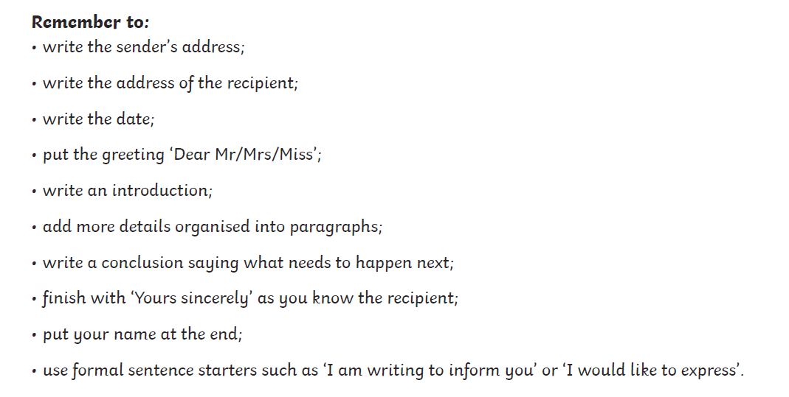

Slide 26

Complex sentences
WABBITS
FORMAL LANGUAGE
TOPIC RELATED VOCABULARY
NON BIODEGRADABLE CATASROPHIC MICROSCOPIC
POLLUTION DECOMPOSE EXPONENTIALLY
SINGLE-USE
DURABLE LANDFILL MARINE LIFE

Slide 27
Complex sentences
WABBITS
FORMAL LANGUAGE
TOPIC RELATED VOCABULARY
NATURAL BUSINESS VARIOUS PARTICULAR
APPRECEIATE ENVIRONMENT OPPORTUNITY
NECESSARY IMMEDIATE SUFFICIENT

Slide 28
What are we looking for?

Slide 29

Wednesday 23rd September
L.O. To edit and complete writing a formal letter

Slide 30
Spellings
LO: -cious
–tious words

Slide 31
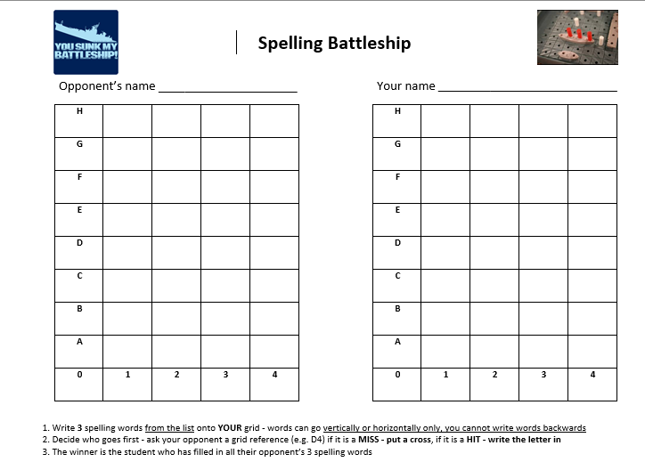
Spelling practice- Battleships!

Slide 32
OUR PURPOSE:
WHAT: We are learning how to write formal letters.
WHY: we are going to be writing formal letters to local supermarket, asking them to explain what they are doing about the current single use of plastic problem our world is facing.
WHO: our audience is for the head of local supermarkets

Slide 33
Tesco | the general manager
ASDA | the general manager
Aldi | the general manager
Sainsburys | the general manager
Morrisons | the general manager
Tesco Extra Town Lane Kew Southport PR8 5JH | Asda Southport Superstore Central 12 Shopping Park Derby Road Southport PR9 0TY | ALDI - Unit 8 Meol Cop Centre Southport PR9 7RG | Sainburys Lord Street St George's Place Southport PR9 0AF | Morrisons Winter Gardens Southport PR8 1N

Slide 35
Introduction: explain purpose of writing and the problem.
On behalf of my primary school, I am writing to you today regarding the recent topic that is evidently affecting not just our country but indeed our planet: plastic pollution. As I am sure you are already aware of the catastrophic damage being had and the implications this is having on our environment, not to mention the threat plastic is posing to our marine life in our vast oceans. In Year 6, we have been discussing and researching the damage that has been caused globally and would like to express our concerns on this matter and hear how your company: ‘Tesco’ are making a change for the better.

Slide 36
Main body: why is it a problem?
Plastic pollution is a serious problem and one that if left unattended to and ignored, will leave future generations at a loss. Each year, approximately 100 million marine animals are killed, due to plastic debris in our oceans. Of which, each microscopic piece of plastic that has ever entered our oceans is still there. At St Philip’s CE Primary School, we believe that this needs to change. If more were to be done in the retail business about single use plastic, this would have a positive impact to our planet.

Slide 37
Main body: what/is your supermarket already doing things?
The recycling of plastic has proven almost impossible as most plastic materials are not biodegradable thus will not break down and decompose like other materials. In the media, we have learnt that Tesco is one of the supermarkets that are actively trying to start to make changed in your industry. The use of carrier bags have significantly reduced due to there now being a cost of at least 5pence per bag. Yet, despite extending the 5p charge on single-use plastic bags, major retailers in England still sold 2.1 billion in the last financial year. As you are very much aware, Tesco holds a powerful position being one of the largest UK supermarkets. Therefore, by making changes to single plastic items, your company could make major positive changes in contributing to the reduction of plastic waste.

Slide 38
conclusion
Despite concerning statistics highlighting the devasting impact single use plastic waste has on our oceans, not all companies are acting to make a difference. The more that single packaging is discouraged in supermarkets, the more we are helping save our planet. If businesses continue to listen to the facts, if companies choose to act, if you choose to make a difference, then we may have a chance of saving our world. We hope, therefore, that you will be able to enlighten us on what other ideas you have on helping reduce the amount of single use plastic in your company. I understand that other supermarkets such as Waitrose are encouraging customers to shop using their own reusable packaging. Is this something that you would also consider? I trust this matter will receive your prompt attention.

Slide 39
I look forward to your reply.
Yours faithfully,
Year 6 pupil at St Philip’s CE Primary School.

Slide 41
Complex sentences
WABBITS
FORMAL LANGUAGE
TOPIC RELATED VOCABULARY
NON BIODEGRADABLE CATASROPHIC MICROSCOPIC
POLLUTION DECOMPOSE EXPONENTIALLY
SINGLE-USE
DURABLE LANDFILL MARINE LIFE

Slide 42
Complex sentences
WABBITS
FORMAL LANGUAGE
TOPIC RELATED VOCABULARY
NATURAL BUSINESS VARIOUS PARTICULAR
APPRECEIATE ENVIRONMENT OPPORTUNITY
NECESSARY IMMEDIATE SUFFICIENT

Slide 43
What are we looking for?

Slide 44
Thursday 24th September
L.O. identify figurative language examples in a poem

Slide 45
SPAG-LO: To identify main and subordinate clauses

Slide 46
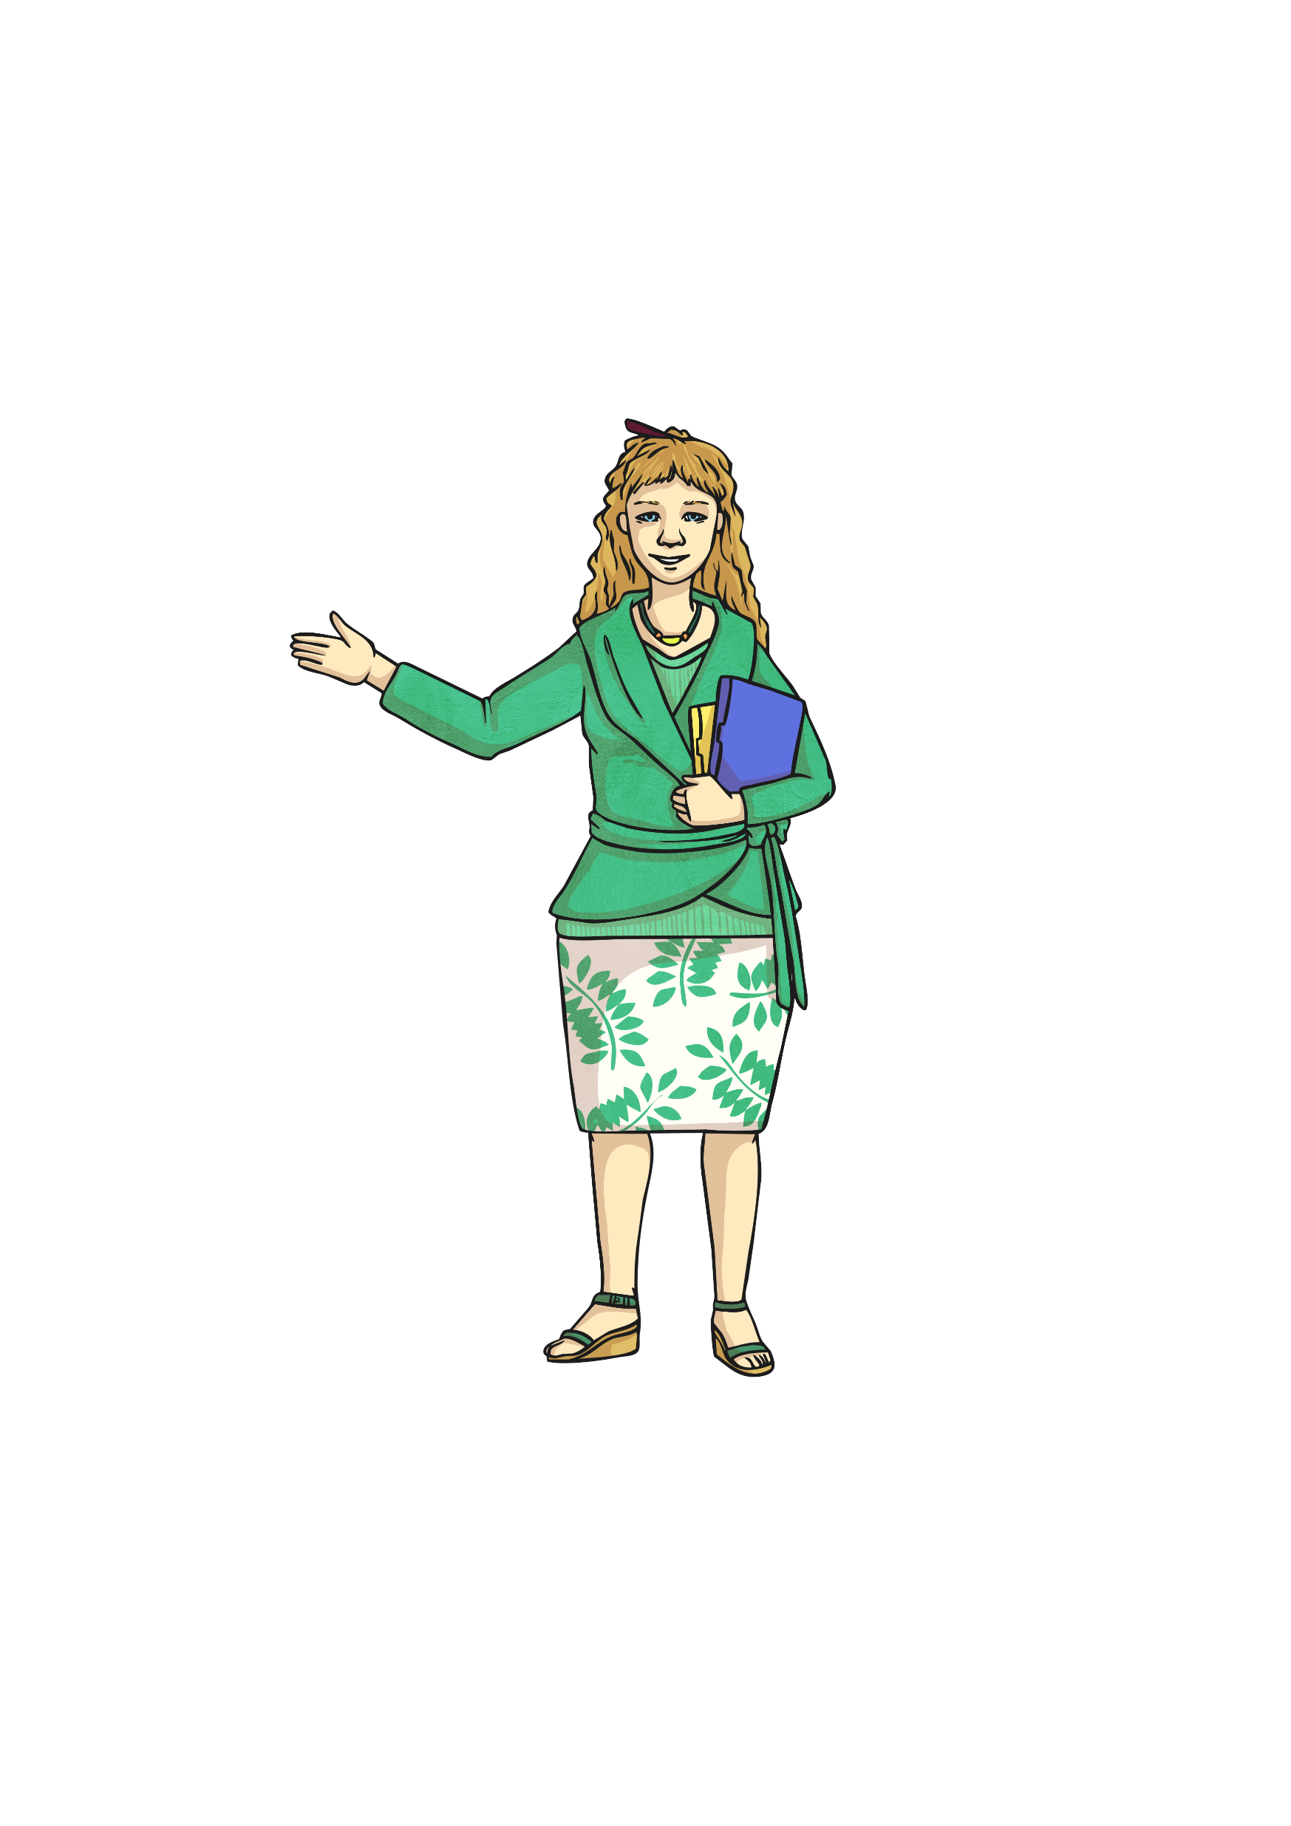
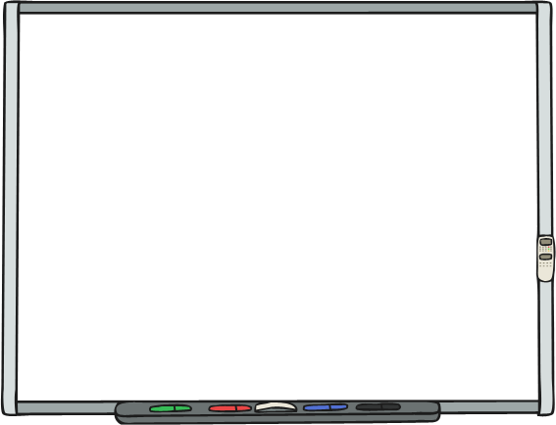
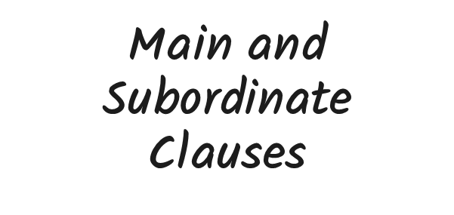
Year 6 Grammar Revision

Slide 47
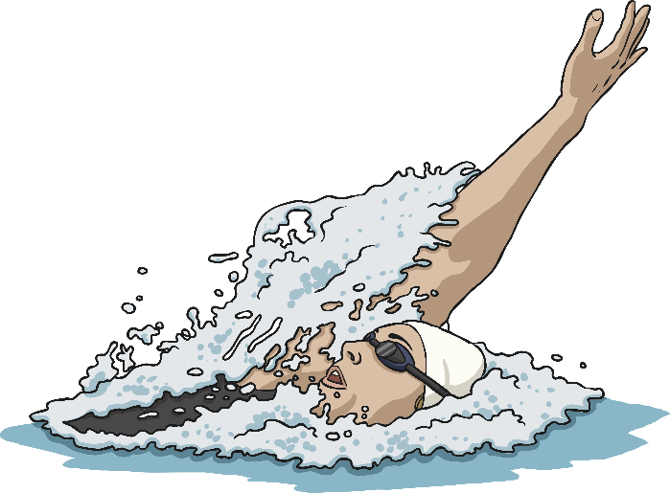
Main Clauses: The Rules
A main clause is a group of words that contains a verb and a subject which makes complete sense on its own. Main clauses could also be called simple sentences.
Can you spot the verbs and subjects in these main clauses?
Karina swam fifty lengths.
Karina swam fifty lengths.
The classroom was empty.
The classroom was empty.
The family were trekking.
The family were trekking.

Slide 48

Subordinate Clauses: The Rules
A subordinate clause is a group of words that is dependant on the main clause because it doesn’t make sense on its own. When main clauses and subordinate clauses are used together to form a sentence, it is called a complex sentence.
Can you spot the main clauses and subordinate clauses?
The girls fed the ducks
before they walked around the lake.
The girls fed the ducks
before they walked around the lake.
The windmill sails turned quickly
because it is very windy today.
The windmill sails turned quickly
because it is very windy today.

Slide 49

Subordinate Clauses: The Rules
Subordinate clauses can often start with a subordinating conjunction.
after
though
because
so that
before
until
while
provided
if
since
once
even
though
whether
unless
although
when
as

Slide 50
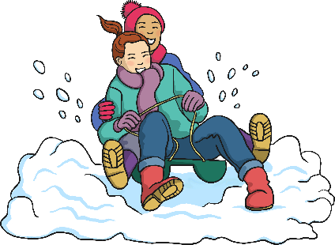
Subordinate Clauses: The Rules
Where in a sentence?
In the sentences we’ve looked at so far, the subordinate clauses have
been after the main clause e.g.
The snow was thick on the ground
because it had snowed heavily.
The children laughed happily as snowballs flew.
The snow was thick on the ground
because it had snowed heavily.
The children laughed happily as snowballs flew.
Subordinate clauses don’t always have to be after the main clause.

Slide 51
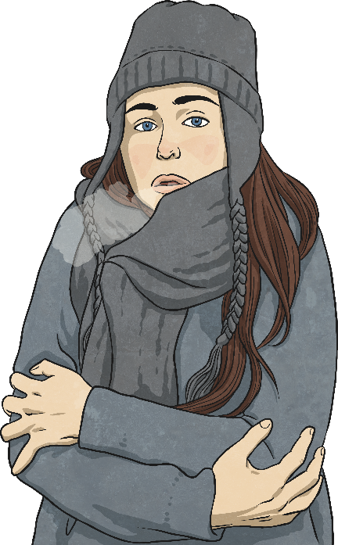
Subordinate Clauses: The Rules
Where in a sentence?
Look at these sentences where the subordinate clause comes before the main clause...
Although she hated them,
Jenny ate the sprouts.
Before the campfire was lit,
the children were shivering in the cold.
Although she hated them,
Jenny ate the sprouts.
Before the campfire was lit,
the children were shivering in the cold.
When we use a subordinate clause at the beginning of a sentence,
we must add a comma before the main clause.

Slide 52
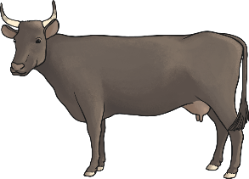
Subordinate Clauses: The Rules
Fronted Adverbials
Subordinate clauses used at the beginning of a sentence can also be called fronted adverbials. Fronted adverbials can start in many ways including with subordinating conjunctions, prepositions, -ing verbs or -ed verbs.
As the sun shone, the cows ate the grass.
Out in the field grazing, they mooed happily.
Lying down in the sun, the cows began to snooze.
Summoned by the farmer, Daisy walked towards the milking shed.
As the sun shone, the cows ate the grass.
Out in the field grazing, they mooed happily.
Lying down in the sun, the cows began to snooze.
Summoned by the farmer, Daisy walked towards the milking shed.
The fronted adverbial subordinate clause will always need to be followed
by a comma to separate it from the main clause.

Slide 53

Quiz! Part 1
Put a tick in the correct column to show whether each group of highlighted words is a main clause or a subordinate clause.
 | Main Clause | Subordinate Clause
If it starts to rain, you can wear your new wellington boots.
Neil gasped for breath before setting off again.
The koala, which is native to Australia, is a mammal.

Slide 54
Quiz! Part 2
Rewrite this sentence with the subordinate clause used as a fronted adverbial. Add a comma if necessary.
David didn’t wear a coat
even though it was cold outside.
Even though it was cold outside,
David didn’t wear a coat.

Slide 55
Quiz! Part 3
Underline the main clauses in the following sentences.
Running late for work, Mum frantically searched for her keys.
The setting sun, which looked beautiful, glistened in the sky.
The gerbil bit my finger before running back to its cage.

Slide 56
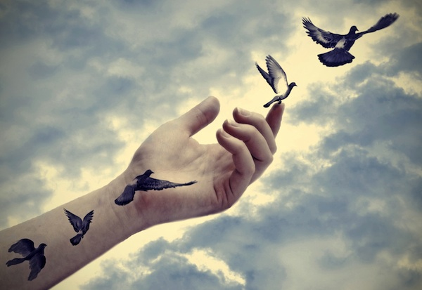
Imagine

Slide 57
Match them up
Alliteration | Squelch
Metaphor | Stating that something is like another thing, using ‘like’ or ‘as…as’
Simile | His eyes were like deep pools
Onomatopoeia | The snake slyly slithered
A word that sounds like its meaning | She had hair of straw
Stating that something IS something else | Repetition of a particular sound
Notes:
Cut up and get children in partners to match up

Slide 58
Likes, Dislikes, Puzzles, Patterns
Imagine

Slide 59
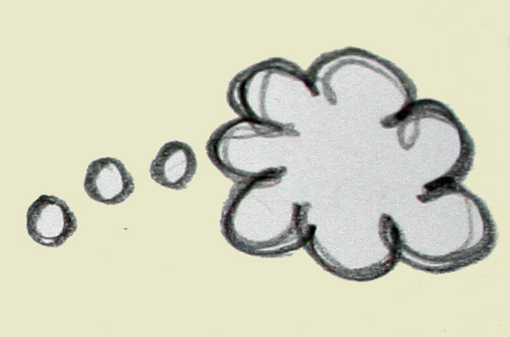
Imagine by Pie Corbett

Slide 60
Imagine -
Imagine -
an angry ant as it ambles along,
a terrified tarantula tickling a trout,
and a curious computer
calling cautiously to the King.
Imagine -
silence closing its lips
and vowing never to speak again,
the humming bird’s wings flickering,
the sea turning over the beach,
scraping the pebbles,
while the weary lorries trundle by.
Notes:
Read through each stanza as a class

Slide 61
Imagine -
smooth pebbles from the summer beach,
the stickiness of honey on a fingertip,
and the heat from a mug of tea,
clutched by hands as if in prayer.
Imagine -
silence trapped
in the candle flame’s dance,
a hyena’s cackle
as it paces its deserted lands,
and the Titanic’s last scream.

Slide 62
Imagine -
the coldness of frost
as it freckles the window pane,
the sharpness of a saw
as it crunches through wood,
and the sadness of a tear
as it trickles down the clown’s cheek.
Imagine -
the Moon’s cold gleam
and trap it in a box,
the joy of the merry-go-round
as it spins like a crazy wheel,
and the force of a rainbow
as it stuns the sky.

Slide 63
Likes
Dislikes
Puzzles
Patterns
Notes:
Complete as a class and then type up and print to go in books

Slide 64
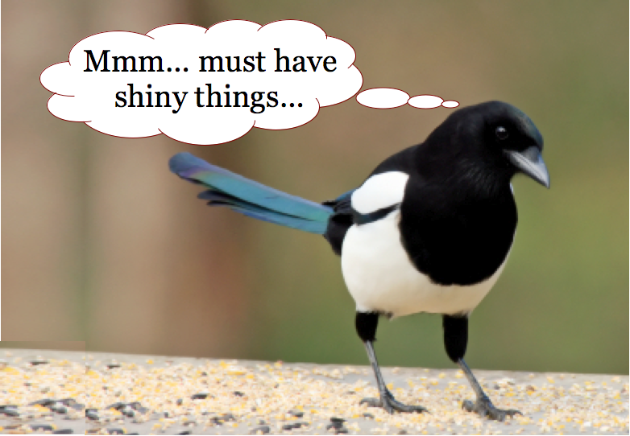
Magpie any examples of the following from ‘Imagine’:
Alliteration:
Personification:
Metaphor:
Simile:
Notes:
Each table has a couple of stanzas to magpie from – every ten mins swap stanzas with another couple to magpie from

Slide 65
Alliteration
Personification
Simile
Metaphor
Notes:
Children complete table in pairs on A4. Take photos to go in book

Slide 66
Our class ideas…
Alliteration
Personification
Curious computer calling cautiously Terrified tarantula tickling a trout Angry ant as it ambles along | Silence closing its lips The Titanic’s last scream Computer calling cautiously Weary lorries trundle by Candle flames dance The joy of a merry-go-round The sharpness of a saw as it crunches through wood The sadness of a tear
As it spins like a crazy wheel Clutched by hands as if in prayer | The force of a rainbow as it stuns the sky Trap moon’s cold gleam in a box Silence trapped
Simile
Metaphor
Notes:
As a class children complete the table with magpie ideas- type up and put in books

Slide 67
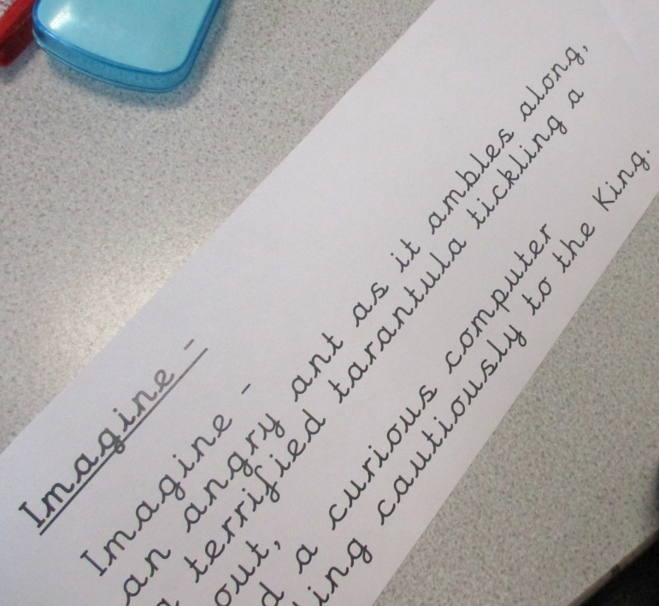
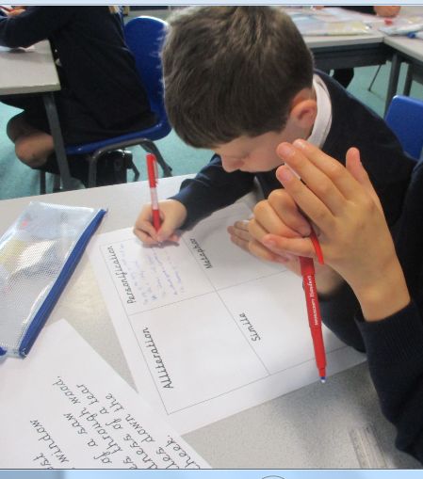
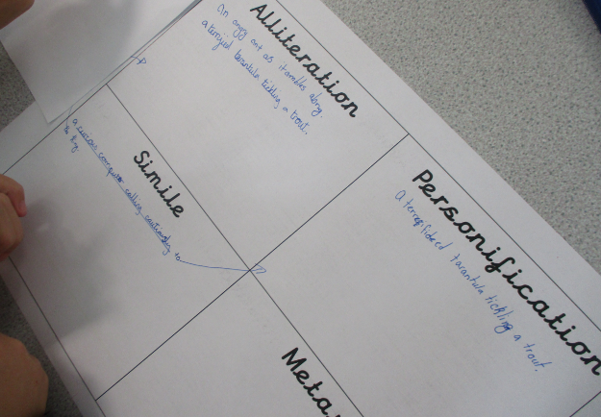
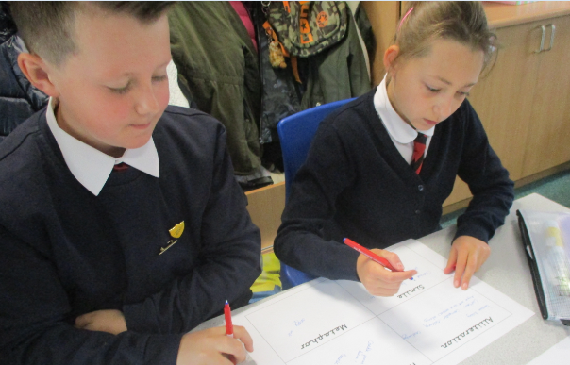
L.O. identify figurative language examples in a poem.
This lesson identified features of figurative language from the poem ‘Imagine’.

Slide 68
Friday 25th September
L.O: create images with our writing.

Slide 69
Imagine

Slide 70
Listen to what the poet, Pie Corbett, has to say about his poem…
http://www.school-portal.co.uk/GroupDownloadFile.asp?GroupId=733796&ResourceID=2232234
http://www.school-portal.co.uk/GroupDownloadFile.asp?GroupId=733796&ResourceID=2232234

Slide 71
Curious computer calling cautiously Terrified tarantula tickling a trout Angry ant as it ambles along | Silence closing its lips The Titanic’s last scream Computer calling cautiously Weary lorries trundle by Candle flames dance
As it spins like a crazy wheel Clutched by hands as if in prayer | The force of a rainbow as it stuns the sky Trap moon’s cold gleam in a box
Alliteration
Personification
Simile
Metaphor

Slide 72

What is the most powerful image?
Notes:
Discuss following questions in partners and feedback as a class

Slide 73
What is your favourite image?
Why?

Slide 74
a
Are any of the images strange?
Why?

Slide 75
Are any of the images hard to imagine?
Why?

Slide 76
Look at the images on your table.
Select one that you like

Slide 77
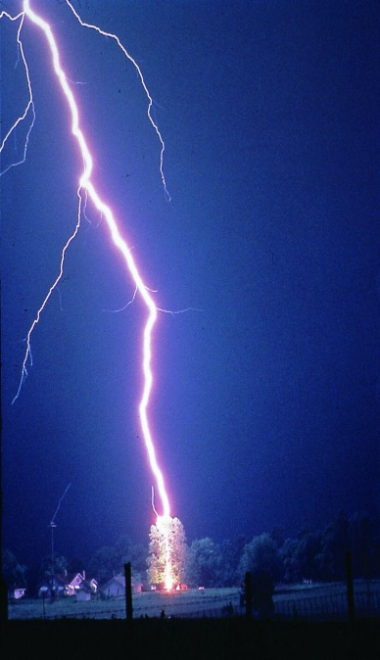
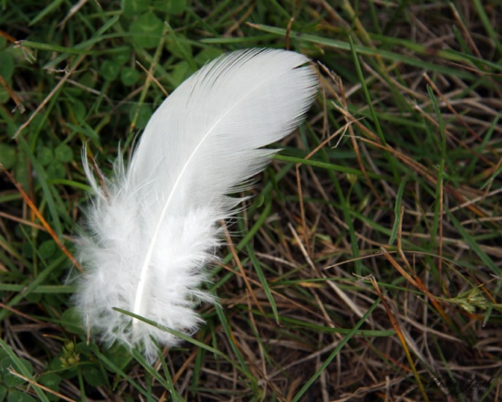

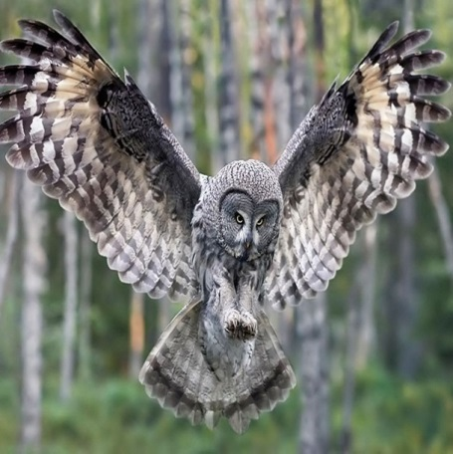
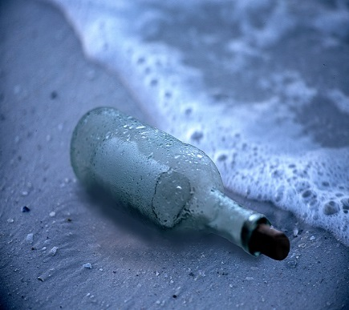
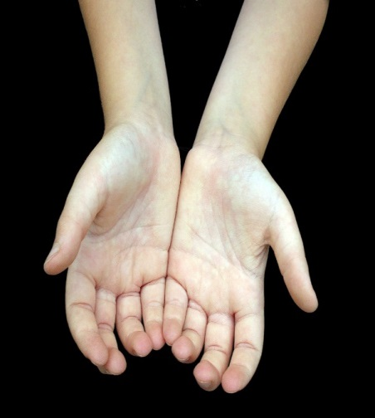
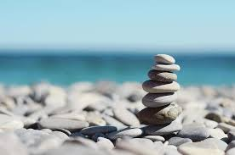
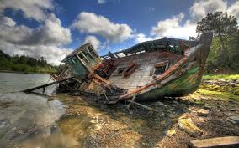
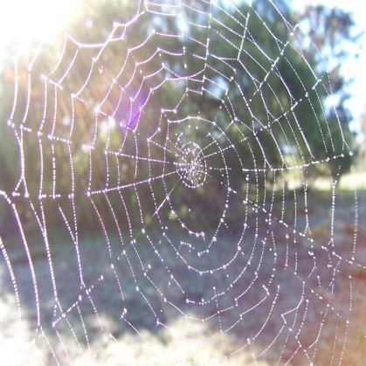
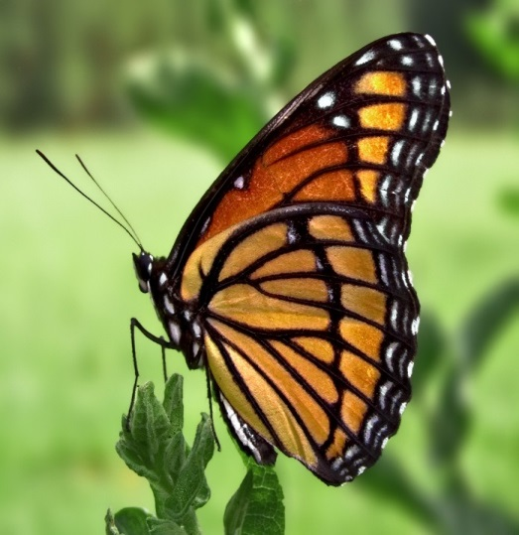
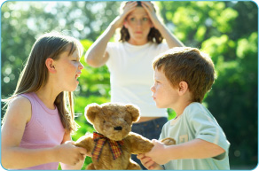
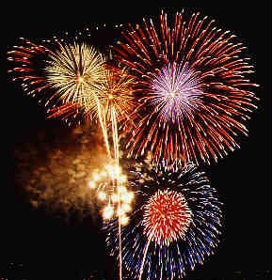

Slide 78
Look at your chosen image closely. Try to spot something in the image that someone else might not have noticed.

Slide 79
Your task…
Use your chosen image to think of examples of:
    Alliteration
    Simile
    Metaphor
    Personification
Remember: The images you choose to create can be as unusual as you like…just make sure they are interesting for your reader!

Slide 80
Image: white, fluffy bird’s feather.
Alliterated phrase: fluttering, fragile, fluffy feather
Simile: as delicate as a single snowflake falling from the sky
Metaphor: laying delicately on the spaghetti-ridden grass
Personification: remaining hopeful to be plucked
Notes:
Model to class and use to scaffold LA and SEN with TA or teacher

Slide 81
Image: _________________________________________
Alliterated phrase: fluttering, fragile, fluffy feather
Simile: as _____________________ as a _______
_____________________________________________________.
Metaphor: it is a __________________________
Personification: laughing, laying, smiling, waving, standing
Notes:
SEN to have a go themselves using template to go in books – LA guided with TA

Slide 82
Notes:
Images to choose from for ideas.

