Slide 1
L.O. understand the different types of subordinate clauses including relative clauses.

Slide 2
Subordinate Clauses: The Tricky Bits
Subordinate clauses can also split the main clause. This is also called an embedded clause or a relative clause.
Look at these examples...
The Eiffel Tower, which is in Paris, is one of the
busiest tourist attractions in the world.
The Eiffel Tower, which is in Paris, is one of the
busiest tourist attractions in the world.
Which is a relative pronoun so this subordinate clause can also be called a relative clause.
It contains extra information so needs marking with commas.
Billy, gasping for air, tried to run from the charging bull.
Billy, gasping for air, tried to run from the charging bull.
This subordinate clause could also be called an embedded clause. Embedded means ‘in the middle of’ as it is in the middle of the main clause. It also contains extra information so needs marking with commas.

Slide 3
Use the following relation pronouns to create a relative clause:
who which that whose
The penguin, _________________________, appeared to be swimming happily.
The dog, that _________________, famished after his adventurous walk.
The boy, whose bike _________, was red and black.

Slide 4
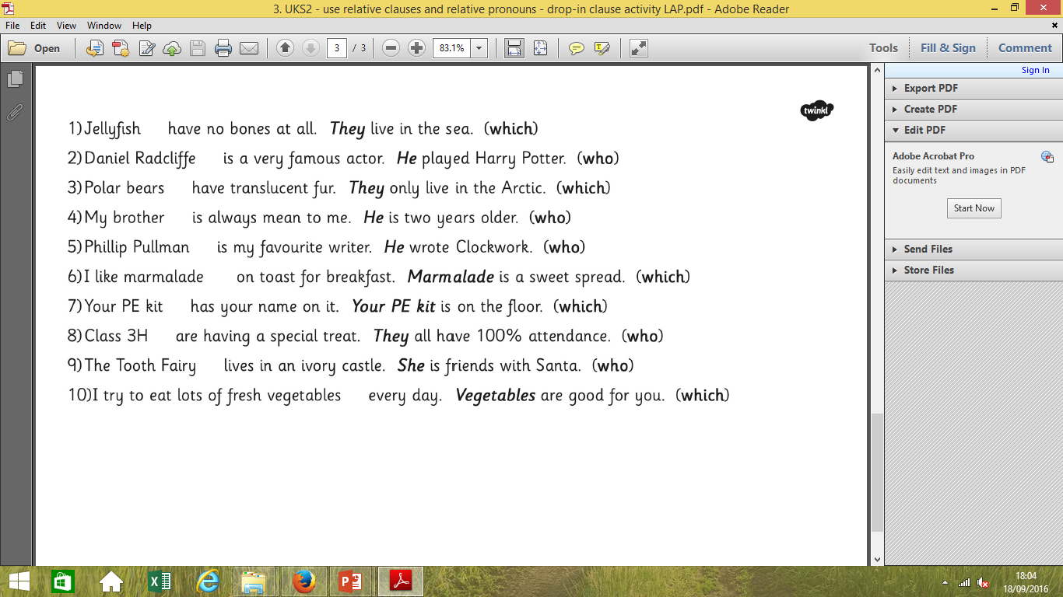
Write all the information into complex sentences using relative clauses.

Slide 5
L.O. use relative clauses accurately.

Slide 6


