Slide 2
Thursday 8th October
L.O: Gather and collect ideas to use in a poem.

Slide 3
Metaphor
x
Figurative – using or containing a non-literal sense of a word or words.
Metaphor is the device that compares something directly with something else in order to create a .
figurative
resemblance
x
Resemblance – similar in appearance or quality to somebody or something else.

Slide 4
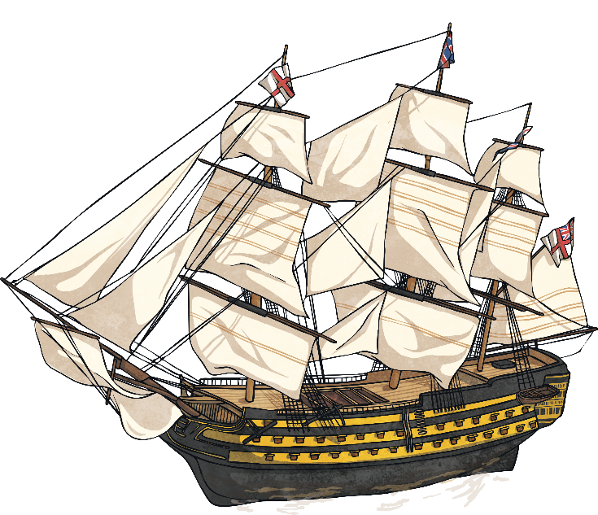
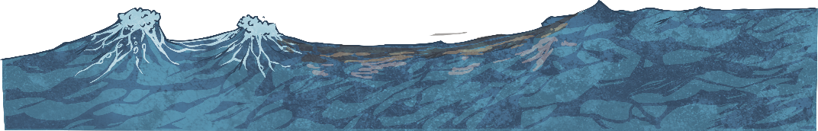
What Is It?
“The moon was a ghostly galleon, tossed upon cloudy seas.”
‘The Highwayman’, Alfred Noyes.
ghostly galleon
x
Image – a picture of something.
We know that a ship can’t be a ghost, but using this metaphor forms the eerie that Alfred Noyes wanted to create for the reader.
image

Slide 5
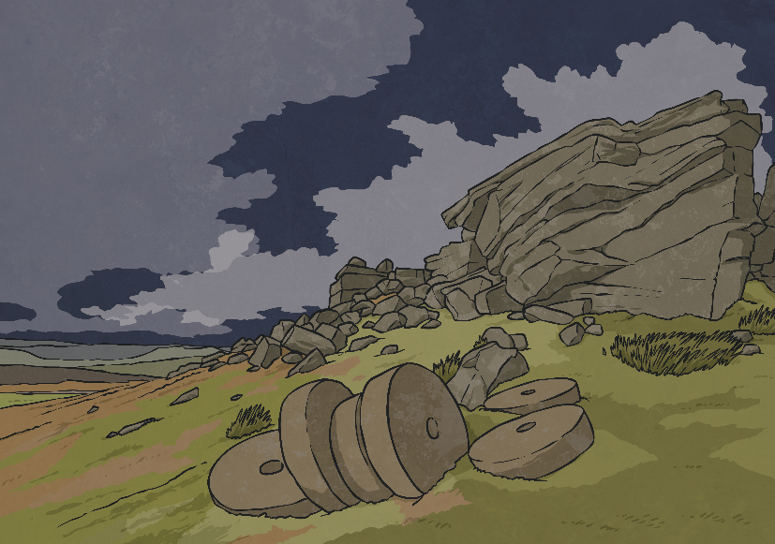
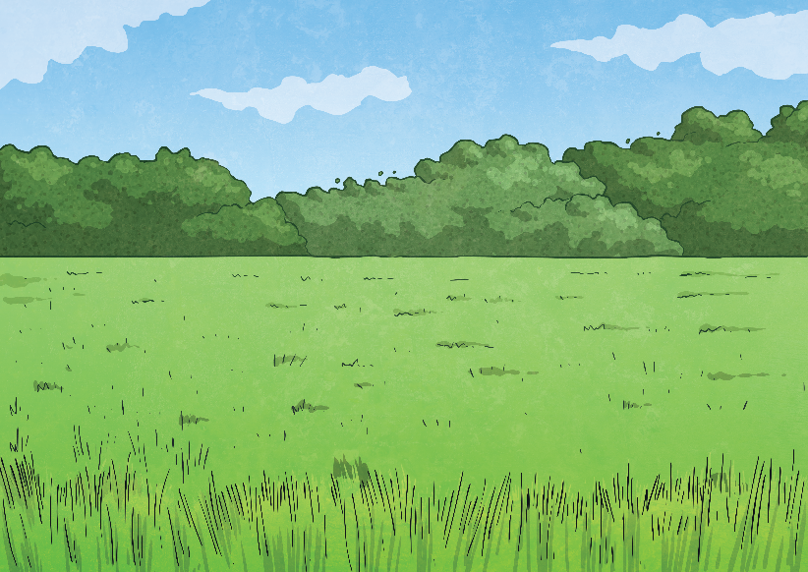
Why Use It?
economically
powerfully
Using metaphors enables the writer to and add
description to something.
specific
x
x
Powerfully – able to produce a strong effect on people’s ideas or emotions.
Economically – efficiently, briefly or carefully.
x
Specific – exact and detailed.
What image does this extract from The Highwayman create for you: A or B? Tell me why.
“The road was a ribbon of moonlight over the purple moor,”
A
B

Slide 6
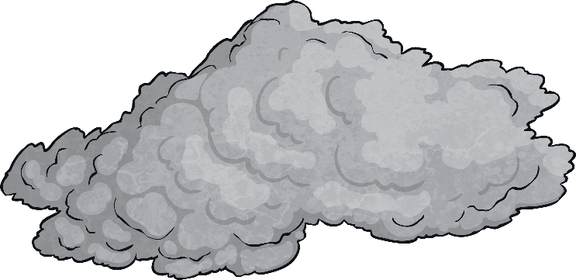
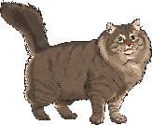
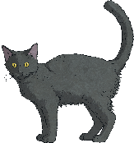


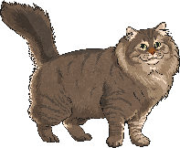
How to Identify a Metaphor
Metaphors are easy to spot because the
between the descriptions of one thing to another do not contain ‘like’ or ‘as’. Figurative sentences containing ‘like’ or ‘as’ are usually similes.
comparisons
x
Comparisons – presenting two or more things to discover similarities and differences between them.
‘It was raining cats and dogs’
and not
‘It was raining like cats and dogs’.

Slide 7
Getting You Started
Here are some examples of metaphors to include in your writing:
This lesson is a recipe for disaster.
He showered her with gifts.
I have butter fingers.
She pulled the wool over my eyes.
You are my sunshine.
A blanket of snow fell.
They hatched a plan.
My name is mud.

Slide 8
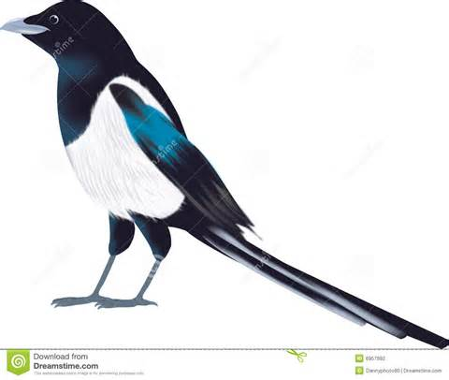
Magpie time!
Refer to the poem!

Slide 9
Metaphors The crystal blue sky is covered in a soft blanket of clouds the panther’s teeth are sharp daggers The ocean of trees are beneath me The canopy layer is a green umbrella-like skin | Similes The canopy shields the rainforest like an umbrella Rainforests are like layers of a sandwich The trees are like the people reaching up to the sky
Personification The sun smiles down on the green paradise Millions of leaves snuggle in a vast infinite mosaic of green The canopy shields the rainforest like an umbrella Down below, crouching in the dark, the plants prey The emergents dashed for the light | Alliteration

Slide 10
Do you like any of these similes? Can you do better?
The iguana’s tail is like a green whip.
The anaconda’s jaws opened as wide as a cave.
The ocelot was as fast as a lightning bolt.
The howler monkey is as loud as a chain saw.
The vines were like ropes to swing on.
The eel looked like a skipping rope.
The sloth was like a slow baby.

Slide 11
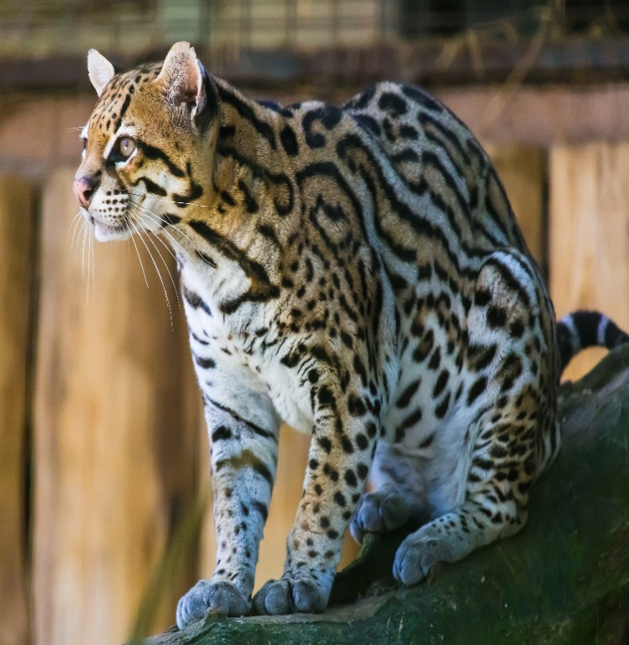
EXTEND THE SIMILE
The ocelot was as fast as a lightning bolt…

Slide 12
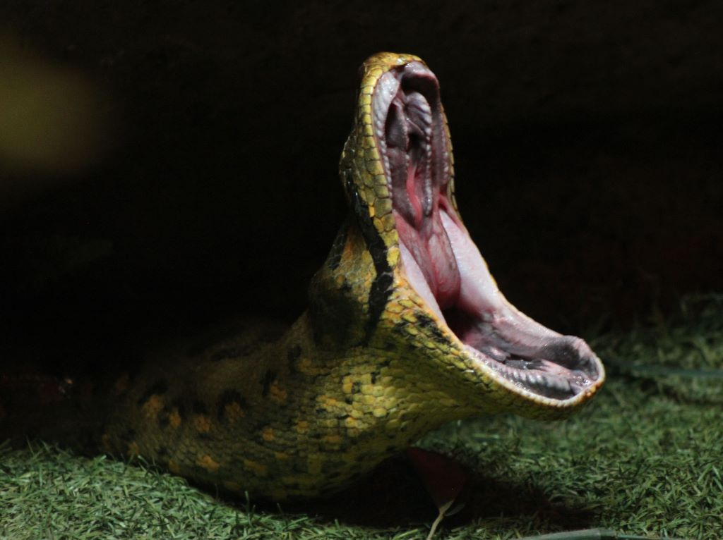
EXTEND THE SIMILE
The anaconda’s jaws opened as wide as a cave…

Slide 13
Examples
the sun smiles down on a green paradise
clouds pour hot rains onto its inhabitant below.
a rainbow of glamorous birds glide through the sweltering, incessant heat, like kites, full of pride.
The crystal blue sky is covered in a soft blanket of clouds.
Millions of leaves snuggle in a vast, infinite mosaic of green
The trees are like people reaching up to the sky.
Down below, crouching in the dark, blooming in the sun, the plants pray. They smile at the sun, whilst praying for blessings and hoping for rain.
Thunderstorms appear and are like fireworks rattling the sky
The canopy shields the rainforest,
like an umbrella
The ocean of trees is beneath me

Slide 14
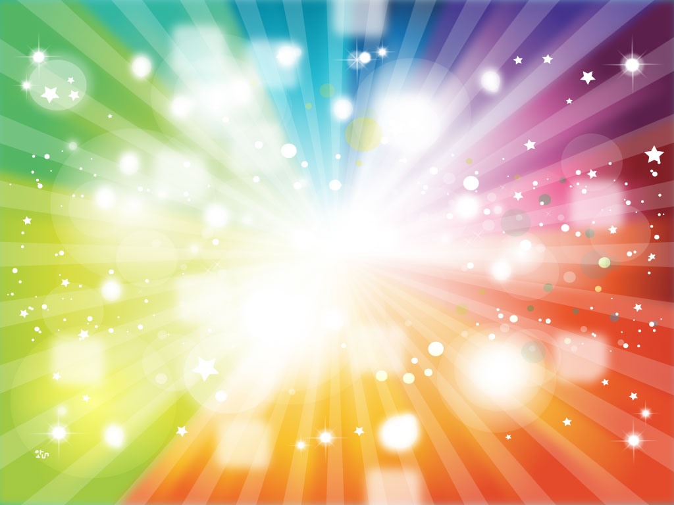

Slow writing

Slide 15

Line 1:
Use personification.

Slide 16
Line 2:
Use alliteration.

Slide 17
Line 3:
Use a metaphor.

Slide 18
Line 4:
Use an extended simile.

Slide 19
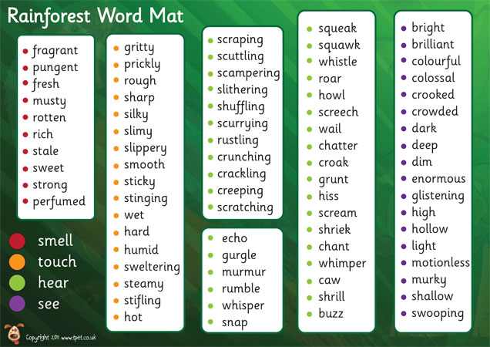
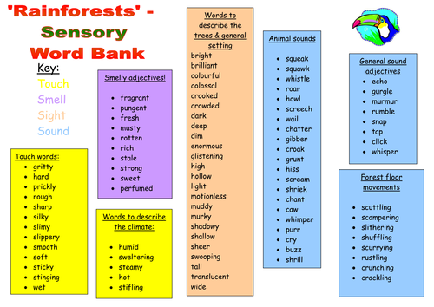

Slide 20
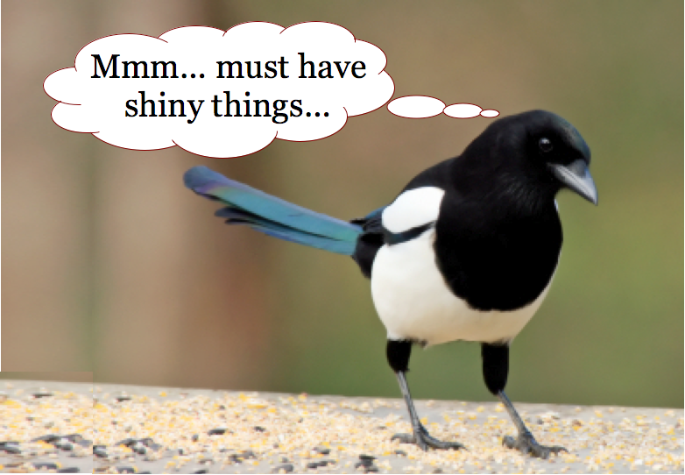
Imagine-
A venomous snake slyly smiling,
as it stalked its prey,
the protective piranhas patrolling patiently
in the turquoise sky.
Imagine-
The overgrown emerald trees,
were bodyguards protecting the rainforest,
and a panther as strong as two lions.
Imagine-
The Amazon River rapidly racing,
down the flowing stream,
and a sloth as slow as a leaf,
falling off a tree.
Imagine-
Mountains of leaves,
on the forest floor,
a pitch black panther
sneaking passed the lazy lion.
MAGPIE TIME

Slide 21
Imagine-
A patient panther pouncing,
On its poor petrified prey,
The tiny shark-like piranhas,
Roaming their fresh waters.
Imagine-
A kaleidoscope of colours,
From a humming bird’s wings,
The constant hiss from a snake,
And trap it in a box.
Imagine-
An army of towering trees,
Standing to attention,
________________________,
______________________
MAGPIE TIME

Slide 22
Your task:
In groups of three, you are to combine your ideas to create 2 stanzas.
Each stanza MUST have 2 different ideas/images over 2-3 lines.
Each stanza MUST begin with ‘Imagine-’.
Your poem must be on
the rainforest.
Use your magpie books.

Slide 25
Magpie
Imagine-
a colourful vibrant macaw stretching its wings
and soaring through the canopy,
protective piranhas patrolling patiently
in the murky, muddy water,
and a panther as strong as two lions,
prowling on its prey.
Imagine-
an army of towering trees
standing to attention,
a constant hiss from a harassed snake
wanting some prey,
and a constant hum from a hummingbird's wings
hovering over the rainforest.

Slide 26
Magpie
Imagine-
a venomous snake slyly smiling
as it stalks its prey,
a panther as strong as two lions,
and an orangutan swimming from tree to tree
shouting to the others to join him.

Slide 27
Magpie
Imagine-
a shard of light
shining through the emerald coral-like trees,
a sly, black panther
prowling through the neon leaves of the large plants,
and a green vine snake unknotting itself
from the rough, brown tree,
as it opens its shark-like mouth
ready to pounce on its prey.

Slide 28
Magpie
Imagine-
a million leaves
snuggled in a vast infinite mosaic of green,
the colourful king macaws
stealthily soaring through the canopy,
and a river as curvy as an anaconda
lurking in the murky water.
.

Slide 29
MAGPIE TIME
Imagine-
The holy aroma,
Of the wild rainforests,
And the speed of a cheetah,
Racing as fast as a formula 1 car
Imagine-
Overgrown emerald leaves,
Like bodyguards standing triumphantly,
The venomous snake smiling slyly,
At its prey below.
Imagine-
The protective piranhas,
Patrolling the turquoise water,
The winding Amazon River
Like cooked spaghetti.

Slide 30
Imagine-
The sensational Santa-Domingo sun,
Squinting the birds’ eyes,
A poor, petrified panther pacing patiently,
Towards its deserted lands.
Imagine-
Piranhas were like mini sharks roaming the rivers,
Waiting for its next victim,
The brigade of trees,
As hollow as pieces of broccoli.
Imagine-
An emerald boa,
Curled up on a branch like cooked spaghetti on a fork,
The sun shooting its beaming light,
Like _____________________.
MAGPIE TIME

Slide 31
Friday 9th October
L.O: write the first part of a poem about the rainforest.

Slide 32
Celebrate
Imagine-
a scaly, emerald green snake
wrapping around a branch like spaghetti on a fork,
the leaves being lazy sunbathers
soaking and relaxing in the light
and the protective piranhas patrolling patiently
waiting for their prey
Imagine-
Tall trees standing to attention
Guarding the temple of light,
The black, silky panther lurked in the trees
Camouflaging in the shadows
And a colourful vibrant parrot
Gliding through the sky like a jet in the air showing off.

Slide 33
Celebrate
Imagine
an ocean of emerald trees
guarding the wonder and life beneath
a winding world of wonder
waiting to be explored
and a slithering river
full of mystical marine creatures gushing through water

Slide 34
Imagine-
A venomous snake slyly smiling,
as it stalked its prey,
the protective piranhas patrolling patiently
in the turquoise sky.
Imagine-
The overgrown emerald trees,
were bodyguards protecting the rainforest,
and a panther as strong as two lions.
Imagine-
The Amazon River rapidly racing,
down the flowing stream,
and a sloth as slow as a leaf,
falling off a tree.
Imagine-
Mountains of leaves,
on the forest floor,
a pitch black panther
sneaking passed the lazy lion.
MAGPIE TIME

Slide 35
Imagine-
The holy aroma,
Of the wild rainforests,
And the speed of a cheetah,
Racing as fast as a formula 1 car
Imagine-
Overgrown emerald leaves,
Like bodyguards standing triumphantly,
The venomous snake smiling slyly,
At its prey below.
Imagine-
The protective piranhas,
Patrolling the turquoise water,
The winding Amazon River
Like cooked spaghetti.
MAGPIE TIME

Slide 36
Imagine-
A patient panther pouncing,
On its poor petrified prey,
The tiny shark-like piranhas,
Roaming their fresh waters.
Imagine-
A kaleidoscope of colours,
From a humming bird’s wings,
The constant hiss from a snake,
And trap it in a box.
Imagine-
An army of towering trees,
Standing to attention,
________________________,
______________________
MAGPIE TIME

Slide 37
Imagine-
The sensational Santa-Domingo sun,
Squinting the birds’ eyes,
A poor, petrified panther pacing patiently,
Towards its deserted lands.
Imagine-
Piranhas were like mini sharks roaming the rivers,
Waiting for its next victim,
The brigade of trees,
As hollow as pieces of broccoli.
Imagine-
An emerald boa,
Curled up on a branch like cooked spaghetti on a fork,
The sun shooting its beaming light,
Like _____________________.
MAGPIE TIME

Slide 38

So now you should all be an EXPERT at using figurative language!
Features you are going to use in your poem:
How many ideas per stanza?
How many lines per stanza?

Slide 39
EXTEND THE SIMILE
The anaconda’s jaws opened as wide as a cave…

Slide 40
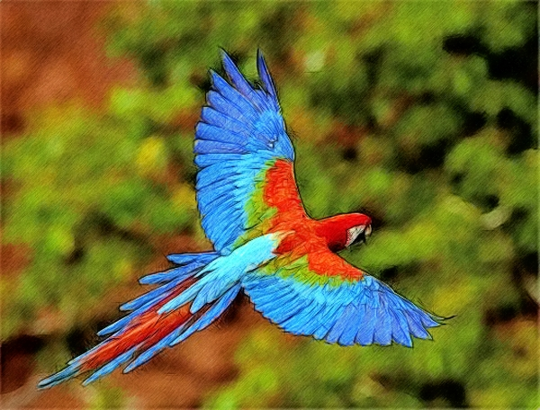
Up-level THE SIMILE
The macaw was as bright as the sun.

Slide 41
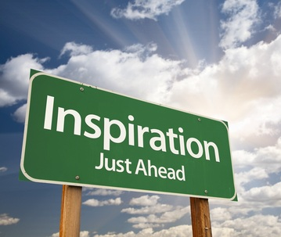
Some inspiration…

Slide 43
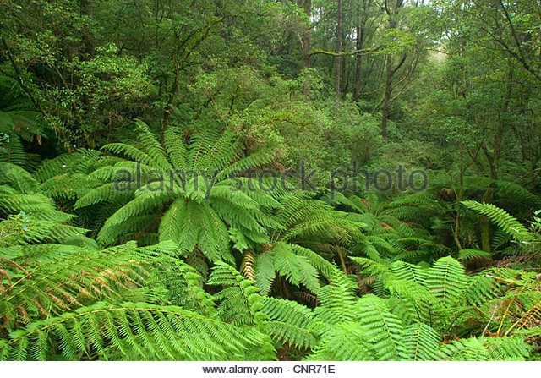

Slide 44
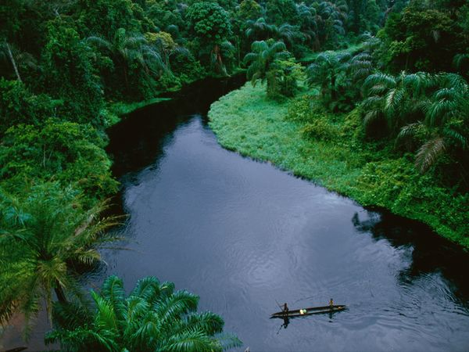

Slide 45
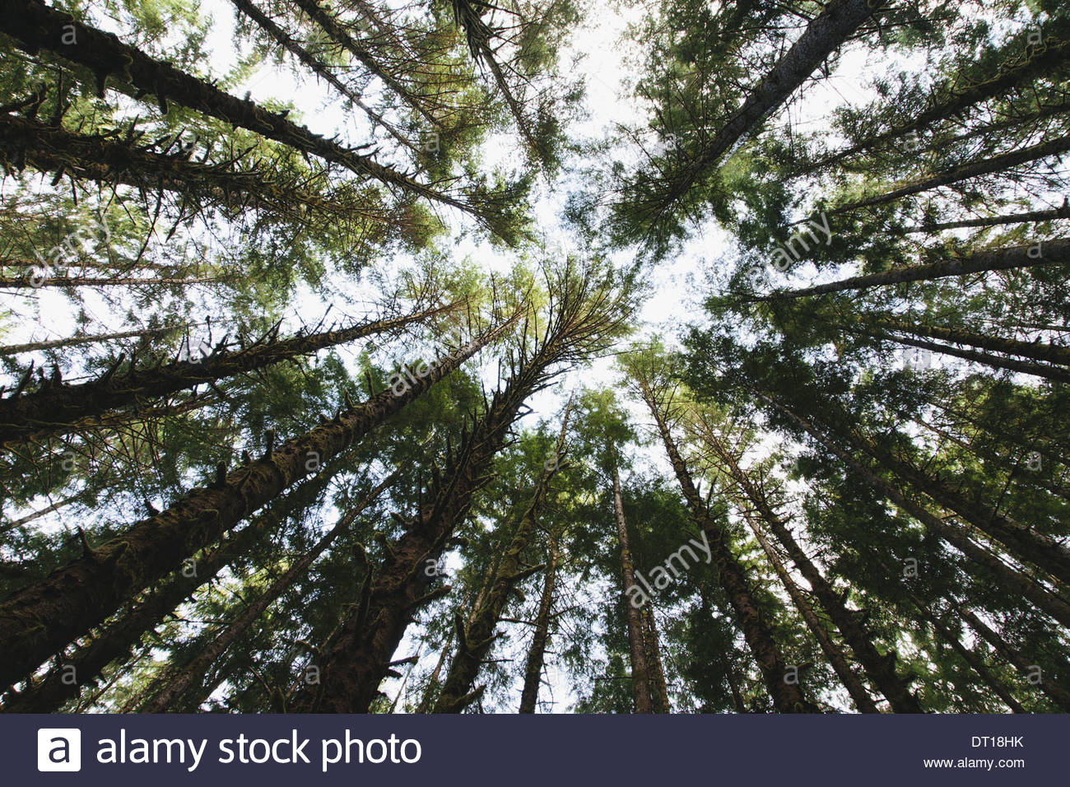

Slide 46
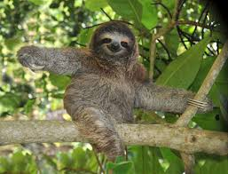

Slide 47


