Slide 1
Tuesday 29th September
L.O: create images with our writing.

Slide 2
Imagine

Slide 3
Imagine -
Imagine -
an angry ant as it ambles along,
a terrified tarantula tickling a trout,
and a curious computer
calling cautiously to the King.
Imagine -
silence closing its lips
and vowing never to speak again,
the humming bird’s wings flickering,
the sea turning over the beach,
scraping the pebbles,
while the weary lorries trundle by.

Slide 4
Imagine -
smooth pebbles from the summer beach,
the stickiness of honey on a fingertip,
and the heat from a mug of tea,
clutched by hands as if in prayer.
Imagine -
silence trapped
in the candle flame’s dance,
a hyena’s cackle
as it paces its deserted lands,
and the Titanic’s last scream.

Slide 5
Imagine -
the coldness of frost
as it freckles the window pane,
the sharpness of a saw
as it crunches through wood,
and the sadness of a tear
as it trickles down the clown’s cheek.
Imagine -
the Moon’s cold gleam
and trap it in a box,
the joy of the merry-go-round
as it spins like a crazy wheel,
and the force of a rainbow
as it stuns the sky.

Slide 6
Likes
Dislikes
The poem doesn’t rhyme
The image of silence trapped in the candle flame’s dance
Powerful and vivid images
A hyena’s cackle
Description using figurative language
Repetition of ‘Imagine’ to make the reader picture the images
It didn’t rhyme
It is confusing as all the images are not linked
There are too many images in one stanza
Repetition – some of us didn’t like
Puzzles
Patterns
Repetition of Imagine to make the reader think of the images
Some images didn’t make sense like a tarantula tickling a trout
The tear of a clown – when clowns are supposed to be happy

Slide 7
Curious computer calling cautiously Terrified tarantula tickling a trout Angry ant as it ambles along | Silence closing its lips The Titanic’s last scream Computer calling cautiously Weary lorries trundle by Candle flames dance
As it spins like a crazy wheel Clutched by hands as if in prayer | The force of a rainbow as it stuns the sky Trap moon’s cold gleam in a box
Alliteration
Personification
Simile
Metaphor

Slide 8

What is the most powerful image?
Notes:
Discuss following questions in partners and feedback as a class

Slide 9
What is your favourite image?
Why?

Slide 10
Are any of the images strange?
Why?

Slide 11
Are any of the images hard to imagine?
Why?

Slide 12
Look at the images on your table.
Select one that you like

Slide 13
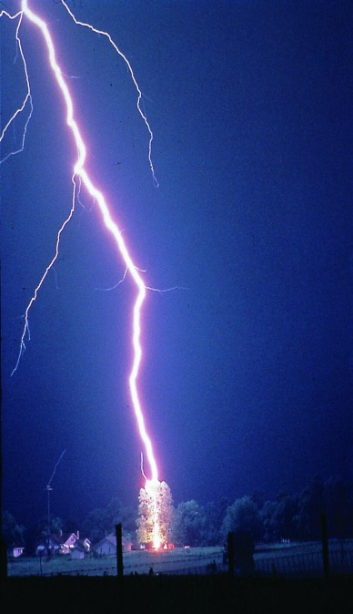
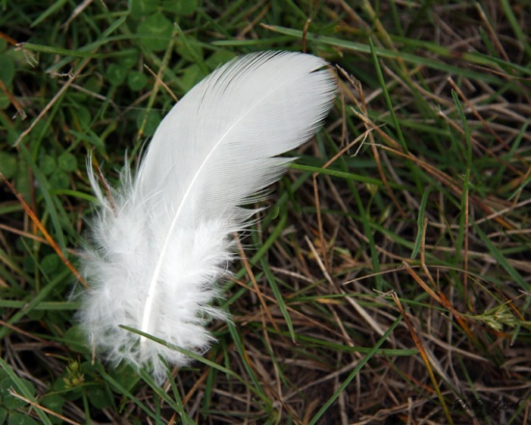
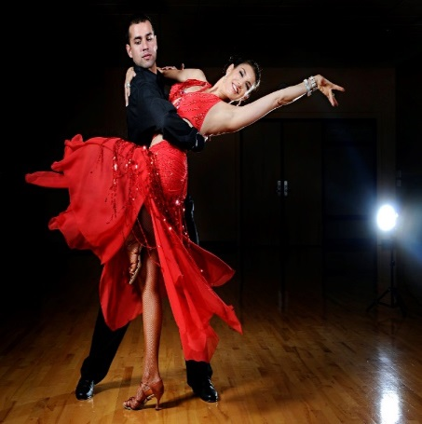
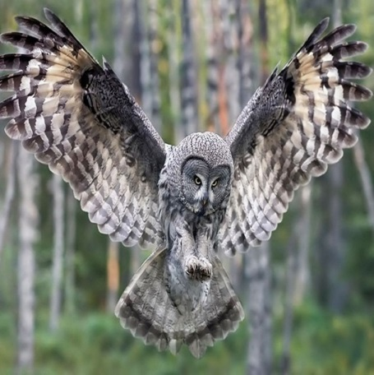
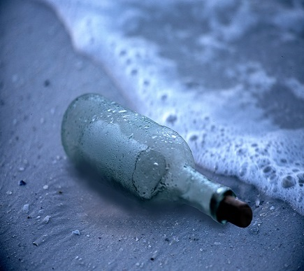
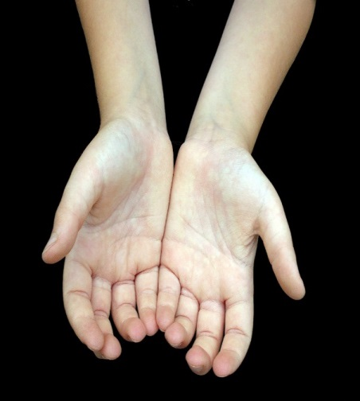
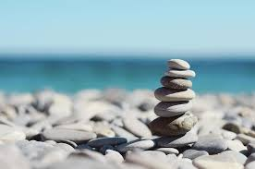
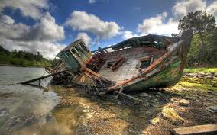
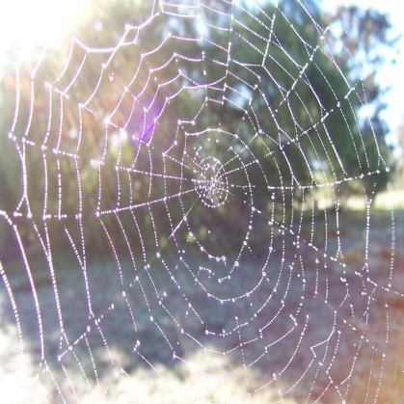
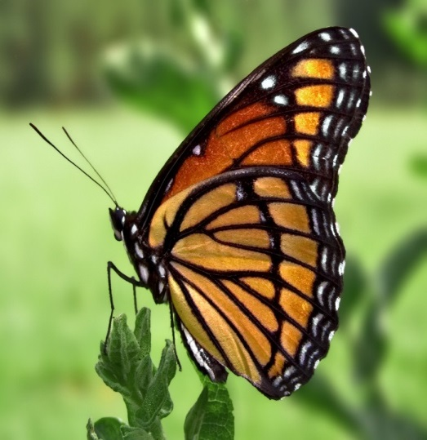
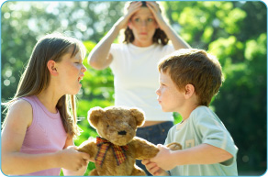
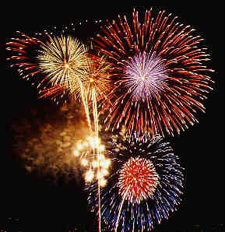

Slide 14
Look at your chosen image closely. Try to spot something in the image that someone else might not have noticed.

Slide 15
Your task…
Use your chosen image to think of examples of:
    Alliteration
    Simile
    Metaphor
    Personification
Remember: The images you choose to create can be as unusual as you like…just make sure they are interesting for your reader!

Slide 16
Image: white, fluffy bird’s feather.
Alliterated phrase: fluttering, fragile, fluffy feather
Simile: as delicate as a single snowflake falling from the sky
Metaphor: laying delicately on the spaghetti-ridden grass
Personification: remaining hopeful to be plucked
Notes:
Model to class and use to scaffold LA and SEN with TA or teacher

Slide 17
Image: _________________________________________
Alliterated phrase: fluttering, fragile, fluffy feather
Simile: as _____________________ as a _______
_____________________________________________________.
Metaphor: it is a __________________________
Personification: laughing, laying, smiling, waving, standing
Notes:
SEN to have a go themselves using template to go in books – LA guided with TA

Slide 18
Image: a lightning bolt in the night sky
Alliterated phrase:
Lively, lengthy lightning, lighting up the luminous sky.
Simile:
Swimming across the sky like a luminous fish in the ocean night water.
Metaphor:
Personification:
Licking its nearest tree target
Notes:
SEN to have a go themselves using template to go in books – LA guided with TA

Slide 19
Image:
Alliterated phrase:
Simile:
Metaphor:
Personification:
Notes:
SEN to have a go themselves using template to go in books – LA guided with TA

Slide 20
Notes:
Images to choose from for ideas.

Slide 21

Magpie time
the lightning was a candle in the sky- flickering and crackling its light.
ferocious fireworks fired frantic colours.
like sugar in water, the fireworks dissolved into the night.
the firework display was a colourful canopy above the crowd of people.
the feather danced up and down like a flamingo dancer.
the feather waved goodbye as it drifted up in the sky
the fireworks were like flaming arrows coming from nowhere
the boat screamed in absolute pain
the boat boldly bashed onto the sandy shore
lightning loudly licking a tree like a lollipop.

Slide 22
the smoothness of a cotton coat worn in Winter
the deafening rumble of an earthquake
flaming candles dancing while watching the gold moon gleam
the cold wind under a warm cup of tea
listening to the sound of thunder while snuggled up with a cup of tea
melting chocolate just about to touch your tongue
the sun exploding into ice
explosions of colour as bright as a rainbow
a shooting star waiting to grant a wish
clean cut grass on a Swedish field
the howl of a wolf in the midnight breeze
an eagle, stretching its golden wings in the dark night sky
an ancient shipwreck

Slide 23
Wednesday 30th September
L.O: write stanzas for a shared class poem, creating images.

Slide 24
Its and it’s
So many people get this wrong!!!
The apostrophe is only used to show ‘it is’.
It’s sunny today.
It’s very kind of you to give me your last sweet.
“It’s full of wonderful things,” exclaimed Howard Carter after discovering Tutankhamun’s tomb.

Slide 25

Persuade the class…
In 50 words, persuade the class why your line is the best line from the poem…
There are words and phrases on your table to help you.

Slide 26
Alliteration
Alliteration is the stylistic device of using a series of words begin with the same consonant sound.

Slide 27
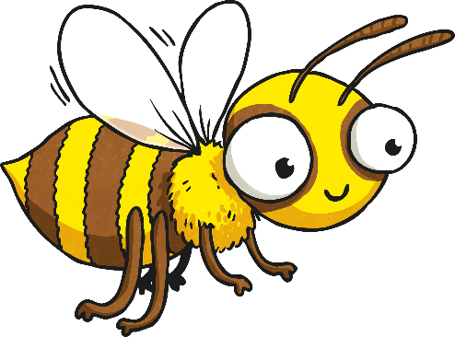
What Is It?
Characteristically, alliteration is the use of a series of words beginning with the same consonant or syllabic sound. While alliteration doesn't usually give much added depth to writing, it can add humour and expression.
Busy buzzing, the bee behaved beautifully.

Slide 28
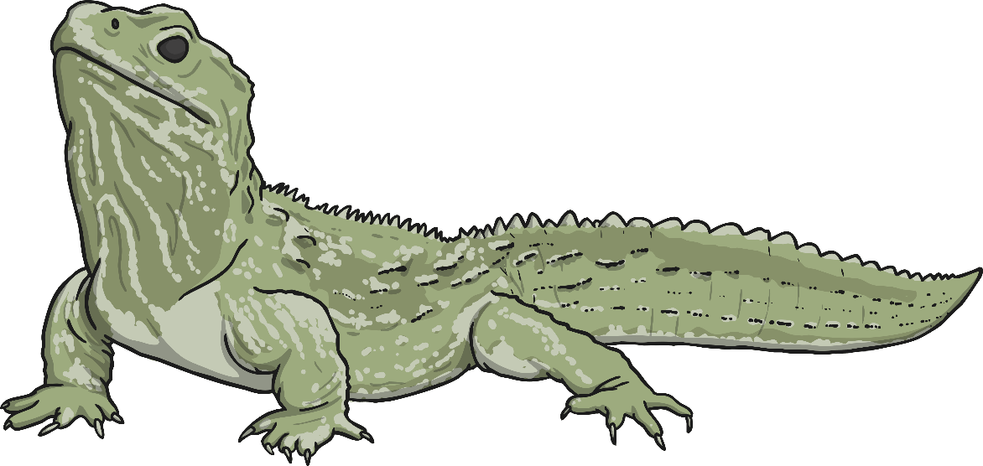
Why Use It?
As mentioned, it might not add to the depth of meaning of your writing, but it will make it sound better. Alliteration can make your words more engaging – and entertaining. And, when your writing engages your audience they are more likely to pay attention and remember what you say.
Larry’s leaping lizard.

Slide 29
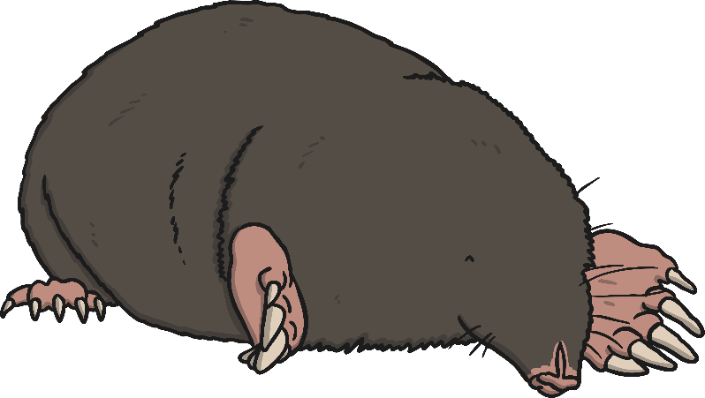
How to Use Alliteration
Alliteration is a technique that gives sentences a little more description, humour and energy. Try playing around with alliterative words and phrases to make your words come alive.
Alliteration is often found in sayings and humorous poetry, so be creative with the words and phrasing of your language.
Make a mountain out of a molehill.

Slide 30

How to Identify Alliteration
The best way to spot alliteration being used is to read out the sentence, listening for the words with the identical consonant sounds. As you read these sentences, identify the alliterative letter or sound.

Slide 31
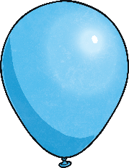
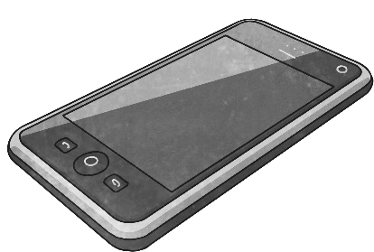
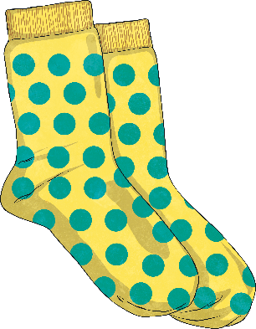
Check out the Consonant
Which letter is being repeated in the following sentences?
Betty and Bob brought back blue balloons from the big bazaar.
Four furious friends fought for the phone.
Sam's shop stocks short, spotted socks.

Slide 32
Example of a shared write:
Imagine-
the heat of the sun
and trap it in a box,
a fluttering, fragile, fluffy feather
falling to the ground
and the stickiness of a cobweb
glistening like a diamond in the sun.
Imagine-
a stack of smooth stones
standing solitary, silently sea watching
a bolt of lightning striking
as powerful as a car crashing into a wall
and a shipwreck
having its last breath.

Slide 33
Themes or patterns in the Imagine poem:
Feelings/touch
Sight
Smells
Sounds
and trap it in a box…
Alliteration
Simile
Metaphor
Personification
Repetition of imagine

Slide 34
Does it create an image in your mind?
What creates this image?
an angry ant as it ambles along

Slide 35
Does it create an image in your mind?
What creates this image?
while the weary lorries trundle by

Slide 36
Does it create an image in your mind?
What creates this image?
the Titanic’s last scream

Slide 37
Magpie
Imagine-
a sad and abandoned naval vessel,
falling for his crew,
a golden owl landing on spaghetti grass,
and the power of a lightning bolt,
as it pierces the sky.
Imagine-
a majestic, monarch butterfly,
fluttering in an open field,
an old, outsider owl,
diving in to take grip of its squirrel,
and a basic, bobbing bottle,
searching for dry land to wash up on

Slide 38
Magpie time
Imagine-
snowflakes waving goodbye,
as they fall from the sky,
an icicle covering the window,
like jewels covering a necklace.
Imagine-
the song of the waves,
as it tickles and folds over the sea,
the impression of a robin,
clicking constantly at the tree.

Slide 39
Magpie time
the lightning was a candle in the sky- flickering and crackling its light.
ferocious fireworks fired frantic colours.
like sugar in water, the fireworks dissolved into the night.
the firework display was a colourful canopy above the crowd of people.
the feather danced up and down like a flamingo dancer.
the feather waved goodbye as it drifted up in the shy
the firework were like flaming arrows coming from nowhere
the boat screamed in absolute pain
the boat boldly bashed onto the sandy shore
lightning loudly licking a tree like a lollipop.

Slide 40
Stanza 1:
Imagine-
Image 1: A ______________ as it _______________________________
Image 2: The_________________________________________________
______________________________________________
Image 3: and ___________________________________________.
Stanza 2:
Imagine-
Image 1: An ____________________________________________
Image 2: A_________________________________________________
Image 3: The ______________________________________________
Image 4: as it ___________________________________________.

Slide 41
Stanza 1:
Imagine-
Image 1: A ______________
as it _______________________________
Image 2: The_________________________________________________
______________________________________________
Image 3: and _______________________
____________________.
Cobweb – alliteration
Butterfly- metaphor
Children fighting with teddy-simile
Imagine-
A carefully crafted creepy cobweb,
with a curious courageous spider blowing in the breeze,
the butterfly’s wings made of large plums and berries
that waves goodbye to each cloud it passes
and siblings fighting over their favourite possession
like two lions fighting over their prey.

Slide 42
Stanza 2:
Imagine-
Image 1: A ______________
as it _______________________________
Image 2: The_________________________________________________
______________________________________________
Image 3: and _______________________
____________________.
Message in a bottle-metaphor
Owl-personification
Pebbles –sight and alliteration
Imagine-
A lifeless vessel laying on the sea bed
as it waits to deliver its awaited message,
the owl screaming into the night
as it chases its prey
and a stack of shiny smooth solitary stones
Stacked staring sadly out to sea.

Slide 43
6 x 6 grid
Sight | Simile | personification | sound | metaphor | personification
alliteration | metaphor | And trap it in a box | Sight | alliteration | Feelings/ touch
Simile | sound | metaphor | smell | personification | alliteration
Feelings/touch | Sight | personification | And trap it in a box | Simile | alliteration
metaphor | alliteration | Simile | Feelings/ touch | Sight | sound
personification | sound | Sight | Feelings/ touch | metaphor | Simile

Slide 44
Example of a shared write:
Imagine-
the heat of the sun
and trap it in a box,
a fluttering, fragile, fluffy feather
falling to the ground
and the stickiness of a cobweb
glistening like a diamond in the sun.
Imagine-
a stack of smooth stones
standing solitary, silently sea watching
a bolt of lightning striking
as powerful as a car
crashing into a wall
and a shipwreck having its last breath.

Slide 45
Wednesday 30th September
Shared write with Mrs Warham:
Imagine-
A carefully crafted creepy cobweb,
with a curious courageous spider blowing in the breeze,
the butterfly’s wings made of large plums and berries
that wave goodbye to each cloud it passes
and siblings fighting over their favourite possession
like two lions brawling over their prey.
Imagine-
A lifeless vessel laying on the sea bed
as it awoke to deliver its awaited message,
the owl screaming into the night
as it chases its prey
and a stack of shiny smooth solitary stones
Stacked staring sadly out to sea.

Slide 46
Does it create an image in your mind?
What creates this image?

Slide 47
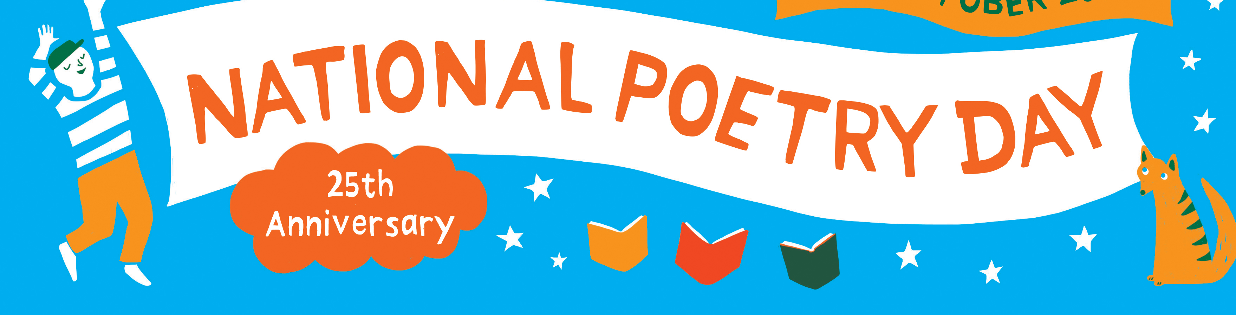

Slide 48
Thursday 1st October
L.O: write stanzas for a poem, creating imagery.

Slide 49
Wednesday 30th September
Shared write with Mrs Warham:
Imagine-
A carefully crafted creepy cobweb,
with a curious courageous spider blowing in the breeze,
the butterfly’s wings made of large plums and berries
that wave goodbye to each cloud it passes
and siblings fighting over their favourite possession
like two lions brawling over their prey.
Imagine-
A lifeless vessel laying on the sea bed
as it awoke to deliver its awaited message,
the owl screaming into the night
as it chases its prey
and a stack of shiny smooth solitary stones
Stacked staring sadly out to sea.

Slide 50
Persuade the class…
In 50 words, persuade the class why your line is the best line from the poem…
There are words and phrases on your table to help you.

Slide 51
Themes or patterns in the Imagine poem:
Feelings/touch
Sight
Smells
Sounds
and trap it in a box…
Alliteration
Simile
Metaphor
Personification
Repetition of imagine

Slide 52
Stanza 1:
Imagine-
Image 1: A ______________ as it _______________________________
Image 2: The_________________________________________________
Image 3: as it ______________________________________________
and ___________________________________________.
Stanza 2:
Imagine-
Image 1: An ____________________________________________
Image 2: A_________________________________________________
Image 3: The ______________________________________________
Image 4: as it ___________________________________________.

Slide 53
Stanza 3:
Imagine-
Image 1: A ______________ as it _______________________________
Image 2: The_________________________________________________
Image 3: as it ______________________________________________
Image 4: and ___________________________________________.
Stanza 4:
Imagine-
Image 1: An ____________________________________________
Image 2: A_________________________________________________
Image 3: The ______________________________________________
Image 4: as it ___________________________________________.

Slide 54
6 x 6 grid
Sight | Simile | personification | sound | metaphor | personification
alliteration | metaphor | And trap it in a box | Sight | alliteration | Feelings/ touch
Simile | sound | metaphor | smell | personification | alliteration
Feelings/touch | Sight | personification | And trap it in a box | Simile | alliteration
metaphor | alliteration | Simile | Feelings/ touch | Sight | sound
personification | sound | Sight | Feelings/ touch | metaphor | Simile

Slide 55
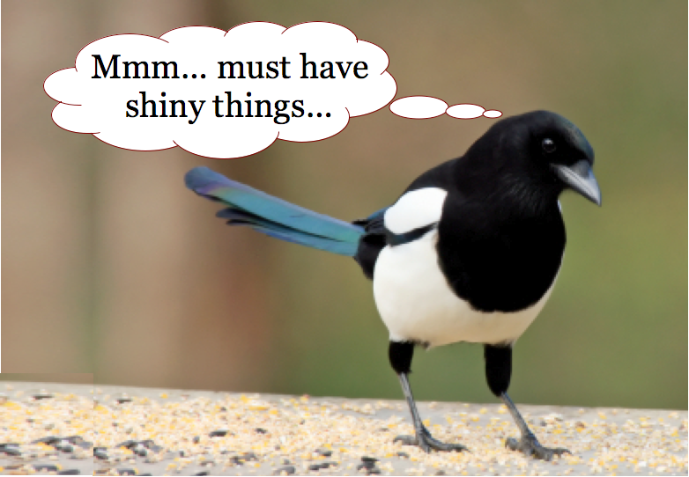

Slide 56
Magpie
Imagine-
a sad and abandoned naval vessel,
falling for his crew,
a golden owl landing on spaghetti grass,
and the power of a lightning bolt,
as it pierces the sky.
Imagine-
a majestic, monarch butterfly,
fluttering in an open field,
an old, outsider owl,
diving in to take grip of its squirrel,
and a basic, bobbing bottle,
searching for dry land to wash up on

Slide 57
Magpie time
Imagine-
the howl of a wolf,
in the eerie midnight breeze,
an eagle stretching its golden wings,
like a phoenix about to take off.
Imagine-
a feather hovering in the wind,
whispering farewell to its maker
and drops of water falling onto a spider’s web,
like a dripping tap.

Slide 58
Magpie time
Imagine-
snowflakes waving goodbye,
as they fall from the sky,
an icicle covering the window,
like jewels covering a necklace.
Imagine-
the song of the waves,
as it tickles and folds over the sea,
the impression of a robin,
clicking constantly at the tree.

Slide 59
Magpie time
Imagine-
lightning like a candle in the sky,
flickering and crackling its light,
and a feather waving goodbye,
as it drifts off on an adventure.
Imagine-
an eagle stretching its golden wings,
in the night sky,
a firework display,
as it paints an impossible canopy above.

Slide 60
Magpie time
Imagine-
chocolate melting in your mouth,
like a chocolate tsunami unfolding,
a broken, bewildered boat lying on a beach,
like a fish that’s carried to land,
a giant hand of lightning reaching out,
and trap it in a box.

Slide 61
Magpie time
the lightning was a candle in the sky- flickering and crackling its light.
ferocious fireworks fired frantic colours.
like sugar in water, the fireworks dissolved into the night.
the firework display was a colourful canopy above the crowd of people.
the feather danced up and down like a flamingo dancer.
the feather waved goodbye as it drifted up in the shy
the firework were like flaming arrows coming from nowhere
the boat screamed in absolute pain
the boat boldly bashed onto the sandy shore
lightning loudly licking a tree like a lollipop.

Slide 62
the smoothness of a cotton coat worn in winter
the deafening rumble of an earthquake
flaming candles dancing while watching the gold moon gleam
the cold wind under a warm cup of tea
listening to the sound of thunder while snuggled up with a cup of tea
a candle flame dancing in front of the crescent Eid
melting chocolate just about to touch your tongue
the sun exploding into ice
explosions of colour as bright as a rainbow
a shooting star waiting to grant a wish
clean cut grass on a Swedish field
the howl of a wolf in the midnight breeze
an eagle, stretching its golden wings in the dark night sky
an ancient shipwreck

Slide 63
Shared Write:
Imagine-
a lonely, lifeless and low-spirited bottle
laying longingly to be loved,
a crystallised cobweb
decorated with pearls of rain,
and an abandoned, dejected shipwreck
waiting to be reunited and restored.
Imagine-
A folk of lightning
stabbing into its prey,
an owl stretching its wings
like an open book,
and a display of marvellous and majestic fireworks
then trap it in a box.
Shared Write:
Imagine-
a lonely, lifeless and low-spirited bottle
laying longingly to be loved,
a crystallised cobweb
decorated with pearls of rain,
and an abandoned, dejected shipwreck
waiting to be reunited and restored.
Imagine-
A folk of lightning
stabbing into its prey,
an owl stretching its wings
like an open book,
and a display of marvellous and majestic fireworks
then trap it in a box.

Slide 64
Friday 2nd October
L.O: practise figurative language to use in a poem.
Feedback

Slide 66
Magpie
An isolated, rejected and inconsolable shipwreck
inhaling its final breath,
pearls of rain decorating cobwebs
like a hot mug of steam covering glasses

Slide 67
Magpie
An old beaten, broken bottle
with many secrets waiting to be unfolded,
a folk of lightning
striking at 12 like a vintage grandfather clock.

Slide 68
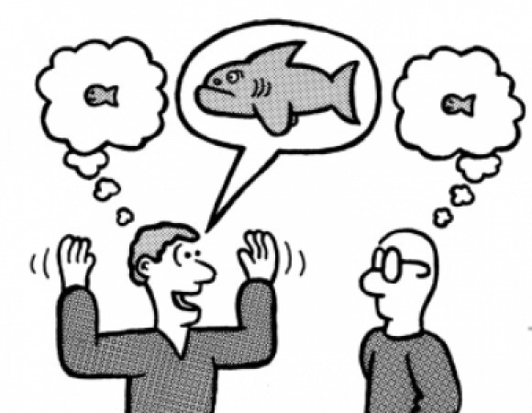
EXAGGERATE
What happens in a classroom?
Let’s exaggerate!

Slide 69
EXAGGERATE-Round 2
What happens in a rainforest?
Let’s exaggerate!

Slide 70
THE SIMILE GAME

Slide 71
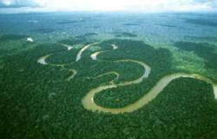

Slide 72
the Amazon River is the river is like the river

Slide 73
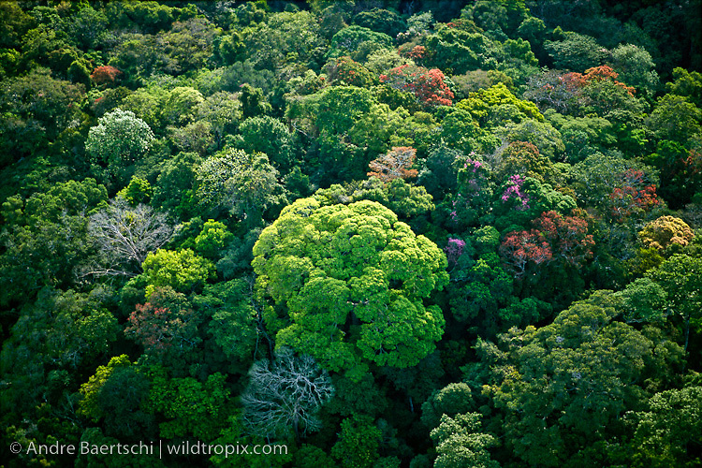

Slide 74
the trees are the trees are like the canopy

Slide 75
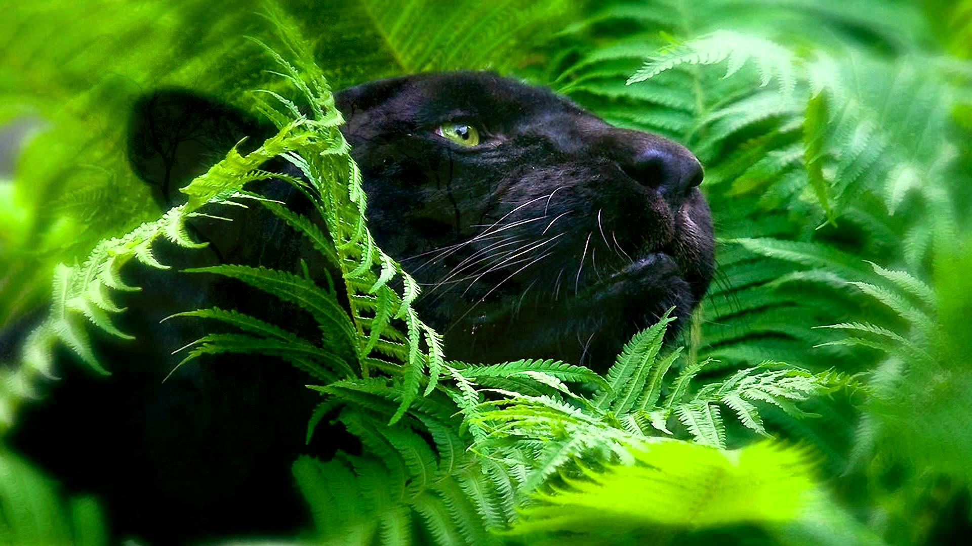

Slide 76
the panther is the panther is like the panther

Slide 77
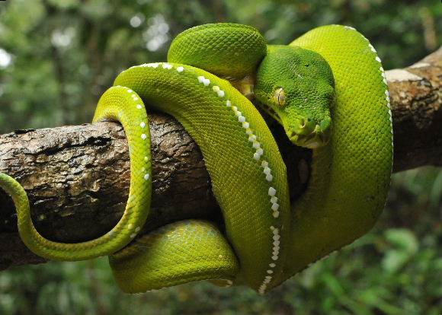

Slide 78
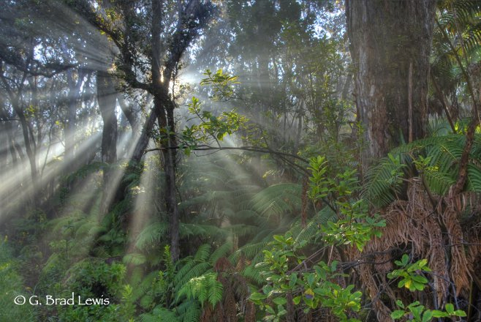

Slide 79
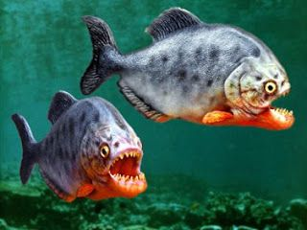

Slide 80
Similes we created as a class:
Amazon River:
The Amazon River is like a water slide
meandering back and forth.
The wide river curled
like a winding ribbon.
The winding river twisted and entwined through the rainforest like a sailor’s rope.
The rainforest trees:
The trees were like a variety of vegetables
in a giant’s bowl
The trees stood tall and proud
Like meerkats on the lookout for predators.
Snake:
The green viper has entwined itself around the tree branch
Like a ribbon wrapped tightly around a present.
The bright emerald scaled snake twisted around the thick log
Like a tightly wrapped coil.
Panther:

Slide 81
Metaphors The crystal blue sky is covered in a soft blanket of clouds the panther’s teeth are sharp daggers The ocean of trees are beneath me | Similes The canopy shields the rainforest like an umbrella
Personification The sun smiles down on the green paradise Millions of leaves snuggle in a vast infinite mosaic of green The canopy shields the rainforest like an umbrella Down below, crouching in the dark, the plants prey | Alliteration

Slide 82
Metaphors The crystal blue sky is covered in a soft blanket of clouds the panther’s teeth are sharp daggers The ocean of trees are beneath me | Similes The canopy shields the rainforest like an umbrella
Personification The sun smiles down on the green paradise Millions of leaves snuggle in a vast infinite mosaic of green The canopy shields the rainforest like an umbrella Down below, crouching in the dark, the plants prey | Alliteration

Slide 83
Magpie Time:
Amazon River:
The river was a bendy as spaghetti on a fork.
The Amazon River is as wiggly as a two-year-old’s drawing.
Panther:
The panther crept as stealthily as a ninja-ready to pounce.
The panther stood out against the green background like a neon colour in the dark.
The panther looked as though midnight has emerald-green eyes.
The rainforest trees:
The trees were standing like broccoli.
From above, the trees looked like a buffet of broccoli.
The trees looked like emerald coral.
The trees looked like a pile of broccoli- waiting to be eaten.

Slide 84
Examples
the sun smiles down on a green paradise
clouds pour hot rains onto its inhabitant below.
a rainbow of glamorous birds glide through the sweltering, incessant heat, like kites, full of pride.
The crystal blue sky is covered in a soft blanket of clouds.
Millions of leaves snuggle in a vast, infinite mosaic of green
The trees are like people reaching up to the sky.
Down below, crouching in the dark, blooming in the sun, the plants pray. They smile at the sun, whilst praying for blessings and hoping for rain.
Thunderstorms appear and are like fireworks rattling the sky
The canopy shields the rainforest,
like an umbrella
The ocean of trees is beneath me

Slide 85
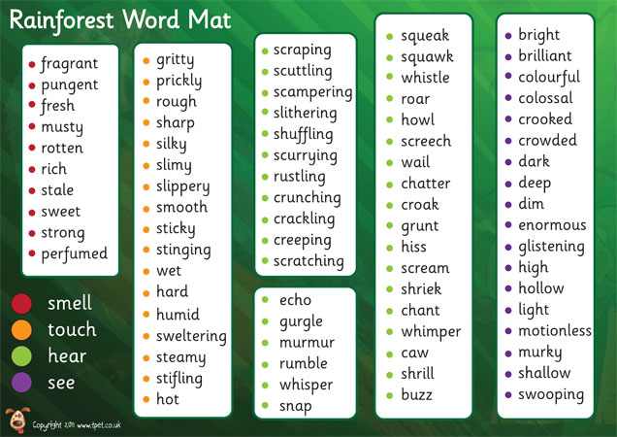
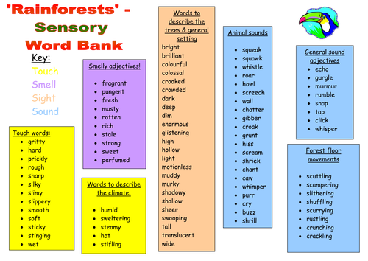

Slide 86
Your task…
Select an image and practise generating language and features to use in your poem.

