Slide 1
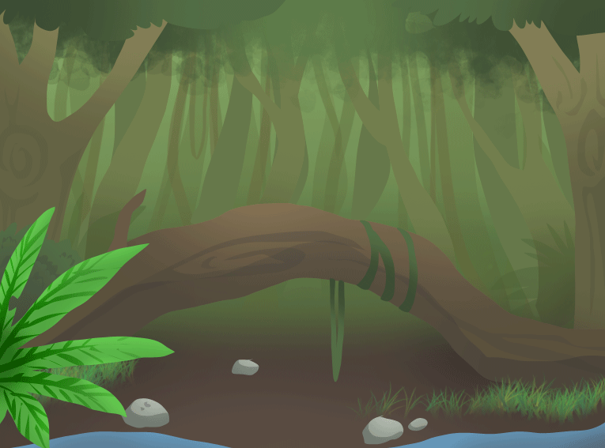
Wednesday 15th October
L.O.: retrieve information from the text.

Slide 2
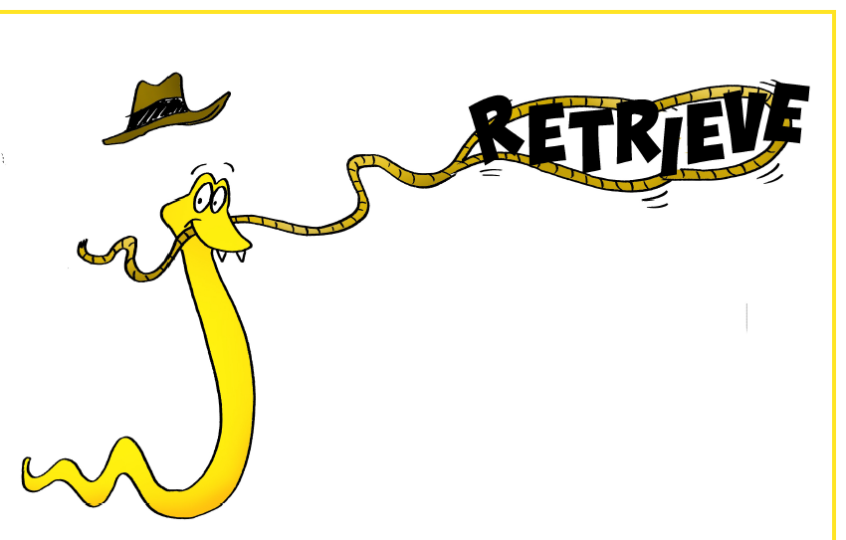

Slide 3
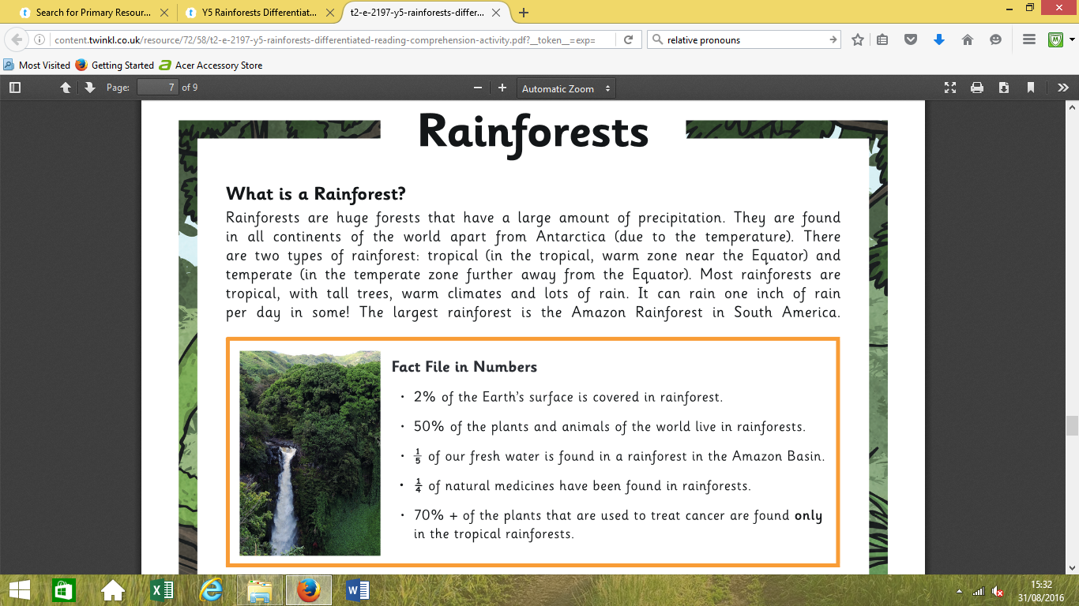

Slide 4
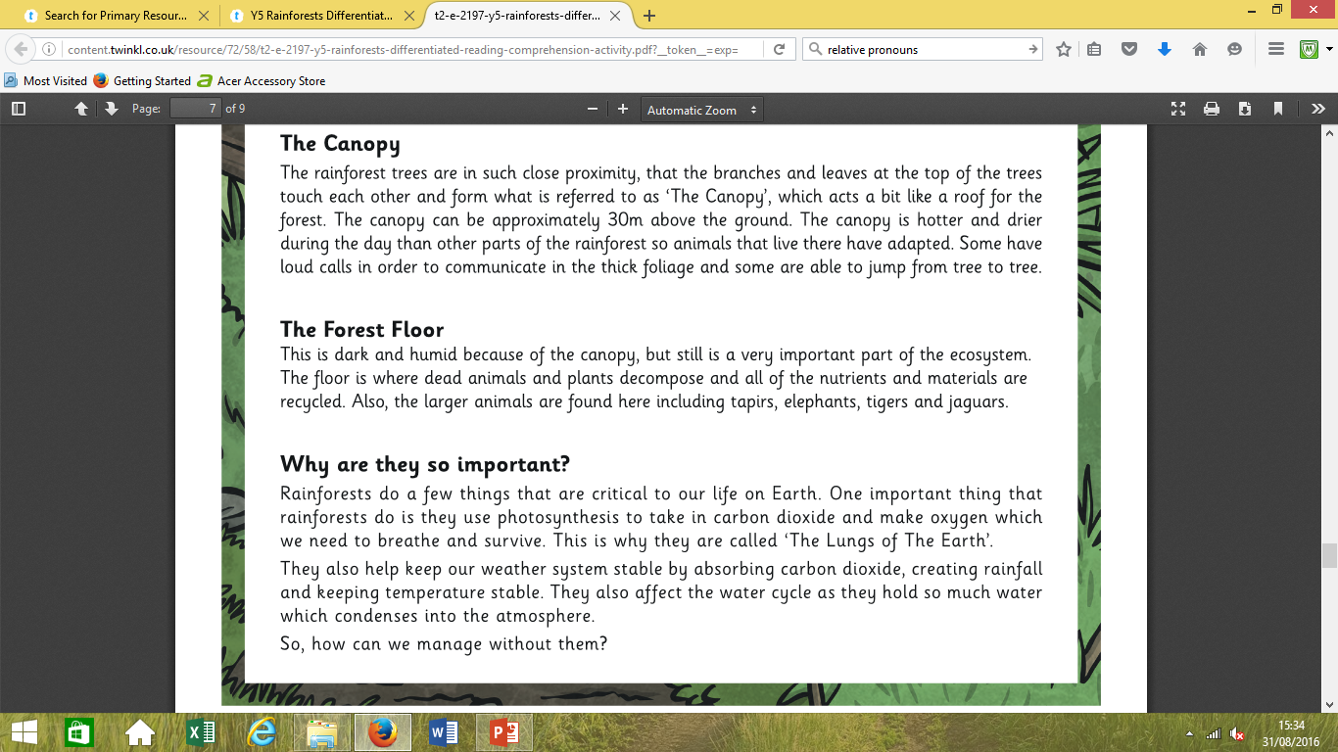

Slide 5
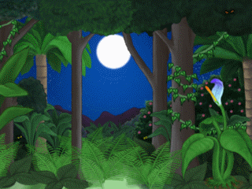
Name two types
of rainforests

Slide 6
In the text, the author mentions
‘fresh water’,
what is the difference
between fresh and salt water?

Slide 7
Near the end of the text,
why does the author say rainforests
are like the ‘lungs of the earth’?

Slide 8
In ‘The Canopy’ section,
what does the author
mean by
‘close proximity’?

Slide 9
A rainforest is an
ecosystem.
What is an
ecosystem?

Slide 10
It is very crowed and leafy
in the canopy.
How do some
animals communicate
because of this
when they can’t see
each other?

Slide 11
Why is the forest
floor dark?

Slide 12
Name one way that
rainforests
affect our
life on Earth.

Slide 13
In the fact file, why
has the author
emphasised
the word ‘only’?

Slide 14
Read the last line. What is your opinion
and why?

Slide 15

https://www.youtube.com/watch?v=wuHuQwA-y5Y

Slide 16

Match it up!

Slide 17
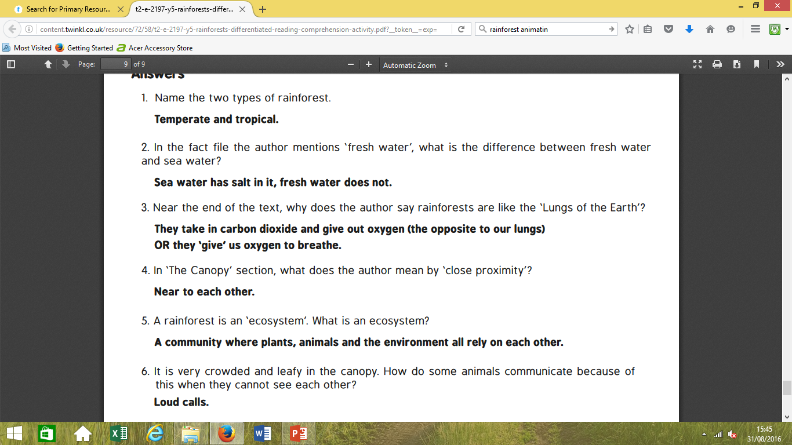

Slide 18
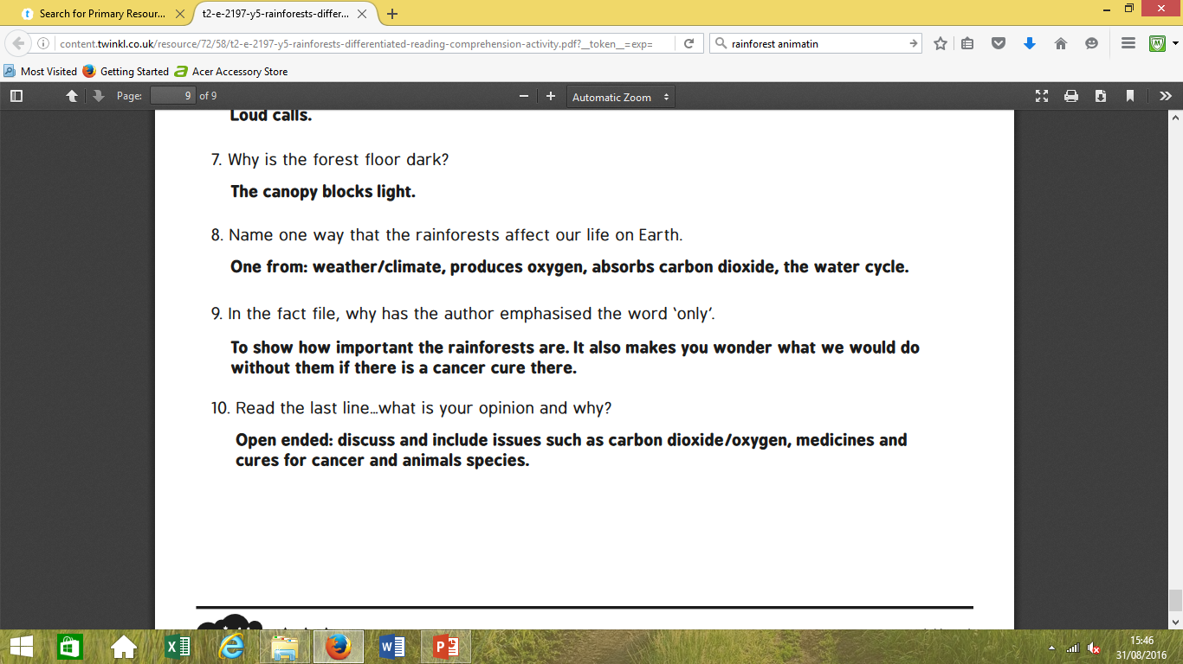

Slide 21
L.O.: retrieve information from the text.

Slide 23
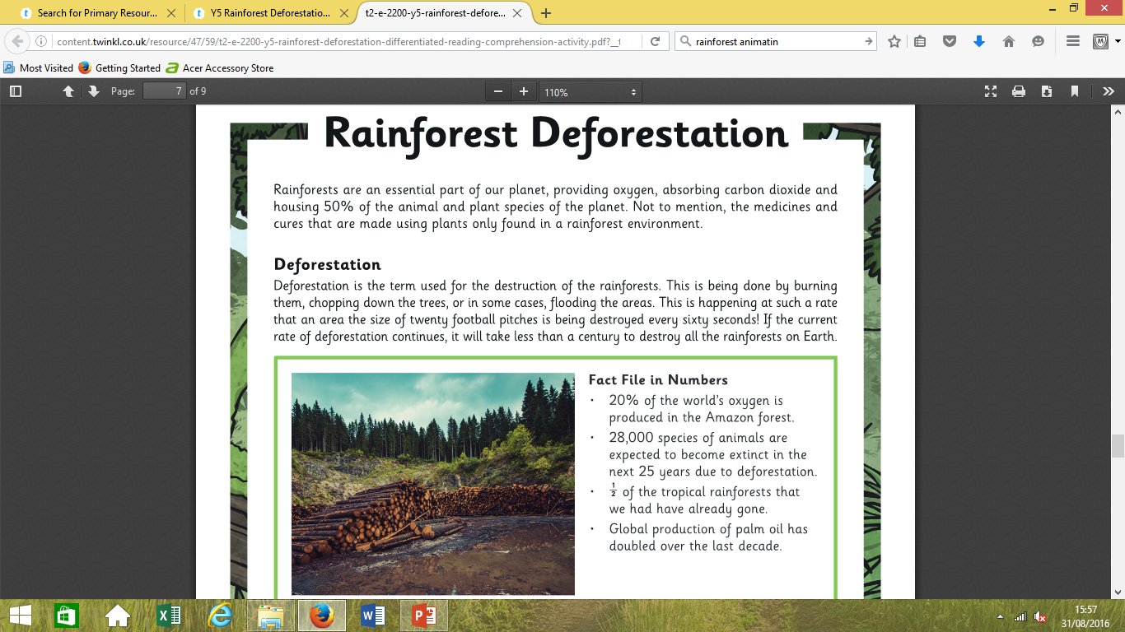

Slide 24
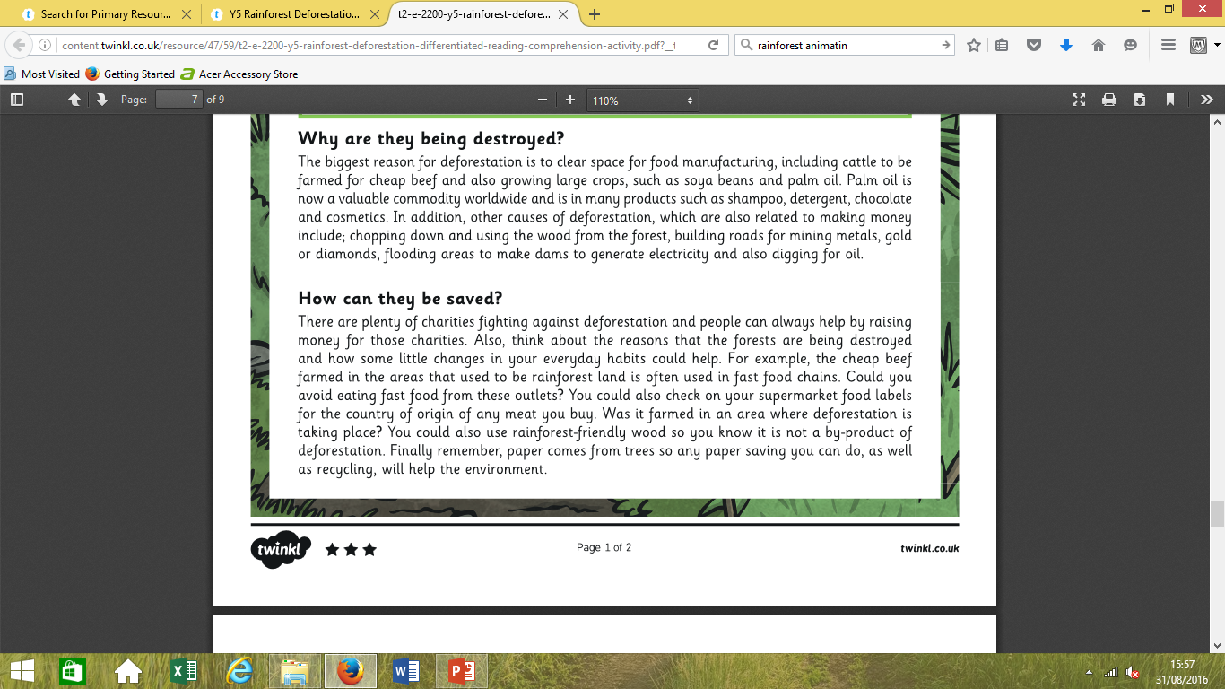

Slide 25
Name a reason not to destroy rainforests
From the introductory paragraph.

Slide 26
Name one of three ways given that a rainforest
can be destroyed.

Slide 27
In the final paragraph, what type of adjective is
‘forest-friendly’?

Slide 28
In the fact file, what does the author say will happen
in the next quarter of a century?

Slide 29
Why does saving paper help save rainforests?

Slide 30
Why has the author used an
exclamation mark in the
‘Deforestation’ paragraph?

Slide 31
In the third paragraph, the author
refers to palm oil
as a ‘valuable commodity’.
What does this mean?

Slide 32
What is the main reason
that deforestation is
happening?

Slide 33
In the ‘How can be saved’
paragraph, why do
you think the author has
asked questions?

Slide 34
What is your opinion
about deforestation?

Slide 35
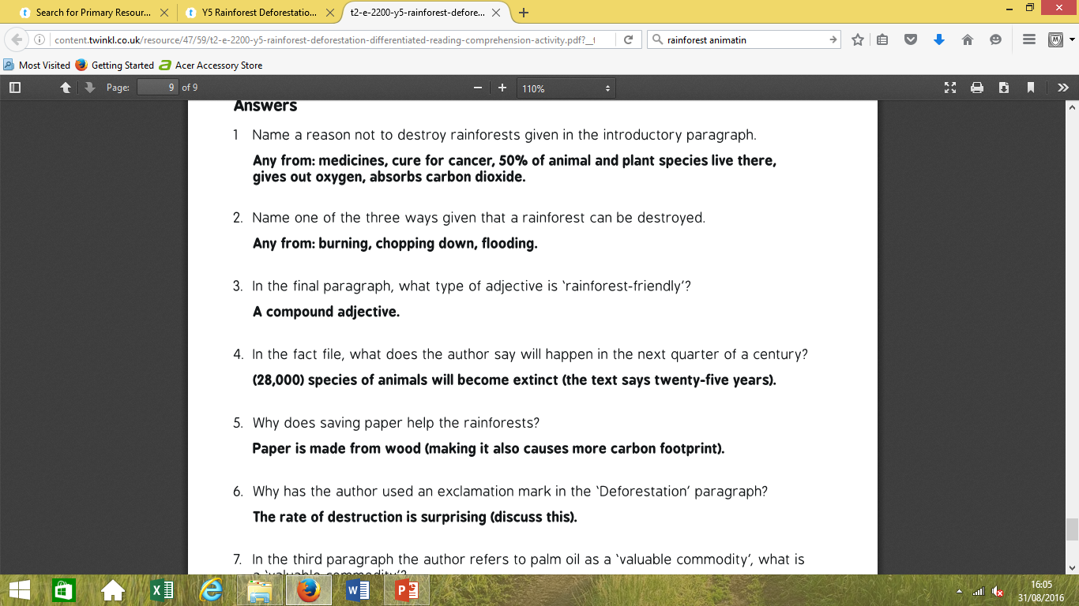

Slide 38


