Slide 1
Monday 19th October
L.O.: Gather facts and figures to use in a persuasive argument.

Slide 2
The more, the more
The more money and time they have, the more satisfied they will be.
The more _________________________________the more________________________________.

Slide 3
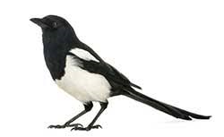
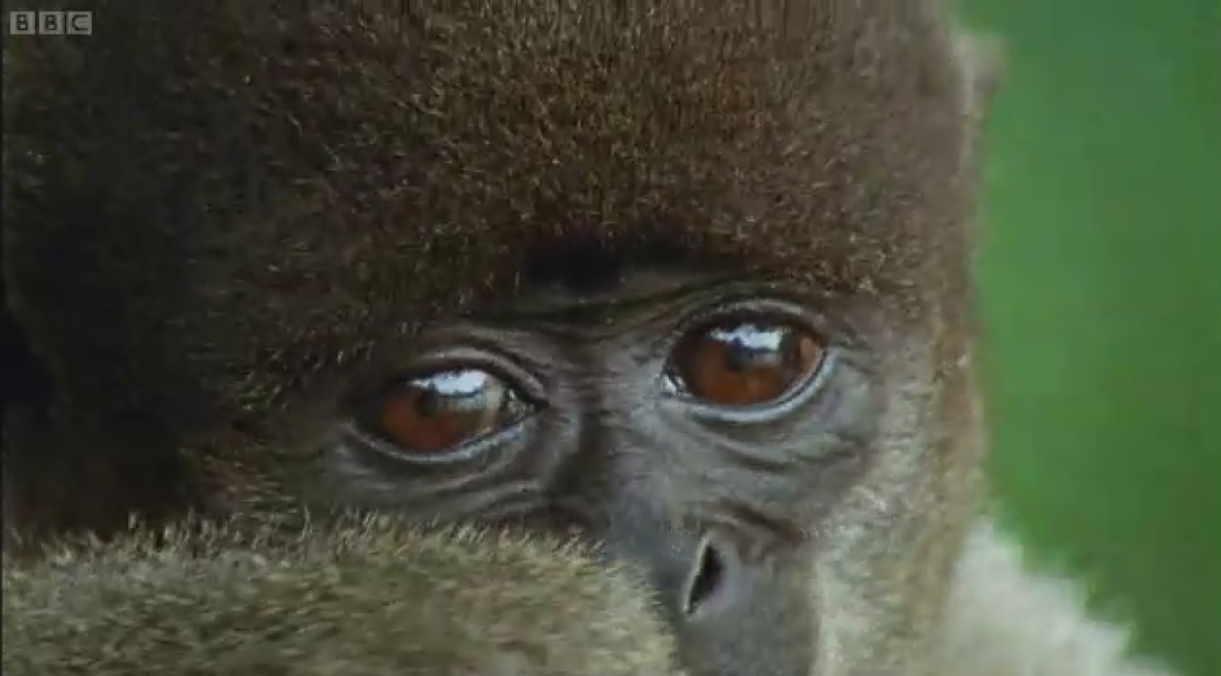

Why Does the
Rainforest Need Protecting?
Watch this video clip about the rainforest - Why might survival in the rainforest be so hard?
Magpie time!
Notes:
WATCH AND MAKE NOTES ON WHITEBOARDS/BOOKS. TEACHER MAKE CLASS COPY OF NOTES AS WE WATCH CLIP

Slide 4
This lesson…
You are going to read through various factual sheets and magpie different facts!
Look at your magpie sheet and decide which argument your fact fits into.
The arguments:
Animals will lose their habitat and become extinct. (environmental)
Loss of oxygen and an increase in carbon dioxide will lead to global warming and climate change. (environmental/economic)
Soil erosion (environmental)
The tribes that live in the rainforest will lose their homes and their culture. (Social)
Animals will lose their habitat and become extinct. (environmental)
Loss of oxygen and an increase in carbon dioxide will lead to global warming and climate change.(environmental/economic)

Slide 5
Which argument do the facts link to?
Animals will lose their habitat and become extinct. (environmental) ______________________________________________________________________________________________________________________________________________________________________________________________________________________________________________ | Soil erosion (environmental) ______________________________________________________________________________________________________________________________________________________________________________________________________________________________________________
Loss of oxygen and an increase in carbon dioxide will lead to global warming and climate change. (environmental/economic) ______________________________________________________________________________________________________________________________________________________________________________________________________________________________________________ | The tribes that live in the rainforest will lose their homes and their culture. (Social) __________________________________ _____________________________________________________________________________________________________________________________________________________________________________________________________________________________________________

Slide 6
Which argument do the facts link to?
Animals will lose their habitat and become extinct. (environmental) ______________________________________________________________________________________________________________________________________________________________________________________________________________________________________________ | ______________________________________________________________________________________________________________________________________________________________________________________________________________________________________________
Loss of oxygen and an increase in carbon dioxide will lead to global warming and climate change. (environmental/economic) ______________________________________________________________________________________________________________________________________________________________________________________________________________________________________________ | __________________________________ _____________________________________________________________________________________________________________________________________________________________________________________________________________________________________________

Slide 7
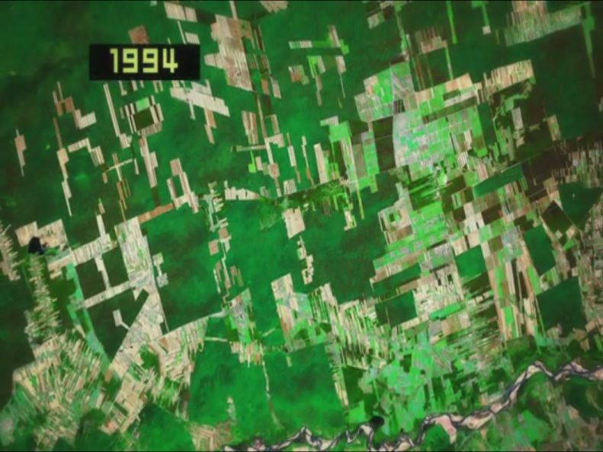

Why Does the
Rainforest Need Protecting?
This video shows the rate of deforestation in Bolivia.
Why do you think trees are being chopped down?
To create fields for farming cattle.
To create fields for growing crops.
To produce timber to make furniture.
To produce wood pulp to make paper.
To create space for housing.

Slide 8
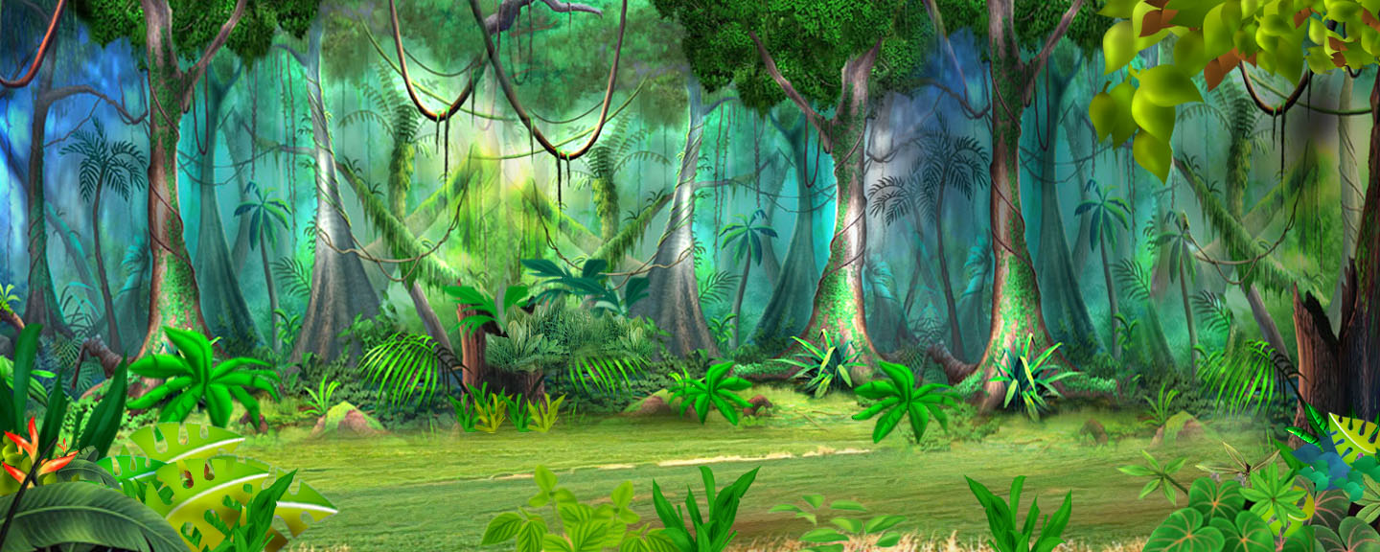
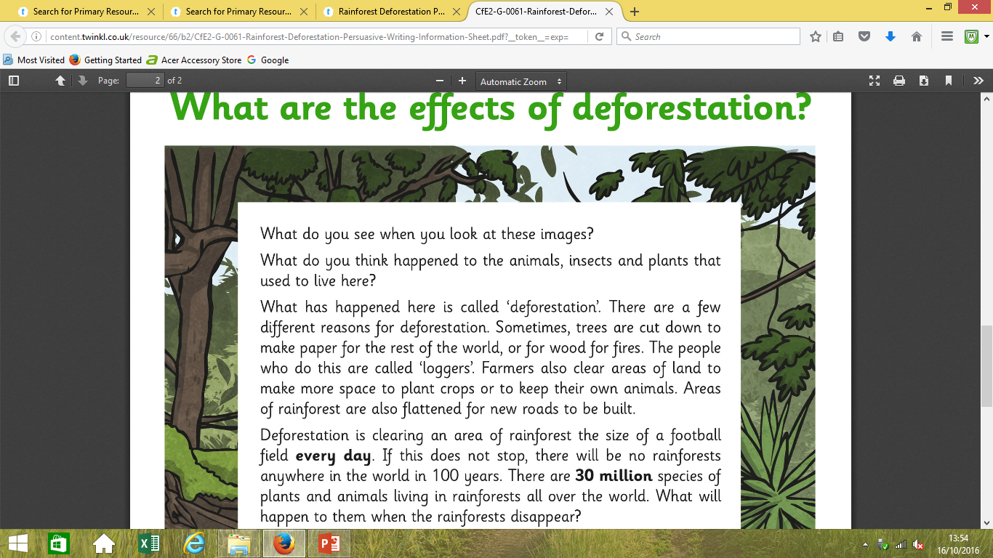

Slide 9
What Did You Decide?
Which effects are positive? Which are negative? How did you choose which were important effects and which were less important? Click on the statements to see which are positive and which are negative.
Water that would have been taken up by tree roots can cause flooding.
Jobs are created in logging transport and manufacturing products.
Land cleared can be used to farm cattle for meat production.
Wood from the removed trees can be used to make paper and other products.
Positive
Negative
Positive
Positive
Less CO₂ is captured by the forests, worsening the effects of global warming.
Negative
The soil where the trees grew is full of nutrients for growing crops.
Positive
Negative
Plants that may have been useful as medicines could be lost.
Positive
Products such as chocolate and coffee can be grown more cheaply on areas of deforested land.
Negative
Rain falling on the bare soil causes soil erosion.
Animals and plants may become extinct through loss of habitat.
Negative
Negative
Tribes lose their cultural identify.
Palm oil grown on deforested land is used in many food and toiletry products.
Negative
Positive
People’s homes may be destroyed.
Selling land raises money for local people.
Positive
Animal habitats are destroyed.
Negative

Slide 10
Why are Rainforests Important?
Rainforests help regulate the Earth’s temperature and weather patterns. Did you know that 20% of our oxygen is produced in the Amazon? But that’s not all they’re good for:
They are home to plants and animals. It took 60 to 100 million years for Rainforests to evolve and it is the home of over 30 million species of plants and animals. When we clear the forests, they all die.
In addition, trees help absorb the harmful carbon dioxide that we humans release in the atmosphere and they provide the oxygen that we need to breathe.
Furthermore, more than 25% of our medicines today come from rainforest plants. We have only explored 1% of the plants available. Just imagine what diseases the 99% that have not been explored can cure!
Moreover, they soak up a lot of rainfall. The rainwater is filtered through the forest floors and supplies water to rivers and irrigation systems. They also help prevent erosion, where the soil is washed away causing blockages that in turn causes floods.
Also, rainforests are home to indigenous people. Many tribes still live in the rainforests. Deforestation destroys their homes too.
If we don’t stop deforestation, more than half of our plant and animal species will be extinct. It is the oldest ecosystem on Earth and they are impossible to replace. It took millions of years for rainforests to develop… how can we replenish fast enough to cope with the rate of deforestation?

Slide 11
Which argument do the facts link to?
Animals will lose their habitat and become extinct. The rainforest gives a home to 50% of the world’s plant and animal species. 28,000 species of animal are expected to become extinct in the next 25 years due to deforestation On average, 137 species become extinct everyday; or 50,000 each year! | Soil erosion 50% of the tropical rainforests we already had are now gone. If the current rate of deforestation continues, the world's rain forests will vanish within 100 years.
Loss of oxygen and an increase in carbon dioxide will lead to global warming and climate change. Areas of rainforest the size of 20 football pitches are cut down every minute. About 15% of carbon dioxide emission across the world is due to deforestation. | The tribes that live in the rainforest will lose their homes and their culture. Millions of people live in tropical rainforests. An estimated 400-500 indigenous Amazonian Indian tribes exist today in the Amazon Rainforest. The many tribes of the Amazon are very diverse in culture and language: there are approximately 180 different languages spoken by these indigenous people.
Notes:
Slide 74-78 to magpie facts from. SLIDE 78 FOR SEN TO USE. LA TO HAVE ADULT SUPPORT- WORK IN GROUPS WITH TA TO SPEED UP PROCESS.

Slide 12
Modal verbs are used to show the level of possibility, indicate ability, show obligation or give permission.
The most common modal verbs are:
will
would
should
could
may
can
shall
ought to
must
might

Slide 13
Use these persuasive sentence starters to persuade humans to stop deforestation.
You will be . .
It will . . .
You’ll never need to . . . again.
Just think how . . .
Now you can . . .
For the rest of your life . . .
It is clear that . . .
It strikes me that . . .
There is no doubt that . . .
I am convinced that . . .
Surely, …
Is it any wonder that… ?
Don’t you think . . . ?
Isn’t it clear that . . . ?
Isn’t it the case that… ?
Does anyone really believe that . . .?
As I see it . . .
As everyone knows . . .
Clearly . . .
Obviously . . .
Inevitably . . .
I would draw your attention to the fact that
Notes:
FINISH IN PARTNERS BY PICKING AN ARGUMENT TO INTRODUCE USING ONE OF THESE PHRASES.

Slide 14
Tuesday 20TH October
L.O. create a shared write for a persuasive text and draft our own version.

Slide 15
If, if, if, then
If the rate of deforestation doesn’t slow down, if animals’ habitats continue to be destroyed, if no one listens, then our rainforests will truly be lost forever.
If _________, if ___________, if ___________, then __________________________________.

Slide 16
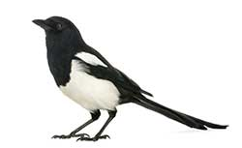
Magpie time!
Finish magpieing yesterdays facts!
Magpie from each other

Slide 17

Listen and write
Animals will lose their habitat and become extinct. | Soil erosion | Loss of oxygen and an increase in carbon dioxide will lead to global warming and climate change. | The tribes that live in the rainforest will lose their homes and their culture.

Slide 18
Why are Rainforests Important?
Rainforests help regulate the Earth’s temperature and weather patterns. Did you know that 20% of our oxygen is produced in the Amazon? But that’s not all they’re good for:
They are home to plants and animals. It took 60 to 100 million years for Rainforests to evolve and it is the home of over 30 million species of plants and animals. When we clear the forests, they all die.
In addition, trees help absorb the harmful carbon dioxide that we humans release in the atmosphere and they provide the oxygen that we need to breathe.
Furthermore, more than 25% of our medicines today come from rainforest plants. We have only explored 1% of the plants available. Just imagine what diseases the 99% that have not been explored can cure!
Moreover, they soak up a lot of rainfall. The rainwater is filtered through the forest floors and supplies water to rivers and irrigation systems. They also help prevent erosion, where the soil is washed away causing blockages that in turn causes floods.
Also, rainforests are home to indigenous people. Many tribes still live in the rainforests. Deforestation destroys their homes too.
If we don’t stop deforestation, more than half of our plant and animal species will be extinct. It is the oldest ecosystem on Earth and they are impossible to replace. It took millions of years for rainforests to develop… how can we replenish fast enough to cope with the rate of deforestation?

Slide 19
Which argument do the facts link to?
Animals will lose their habitat and become extinct. The rainforest gives a home to 50% of the world’s plant and animal species. 28,000 species of animal are expected to become extinct in the next 25 years due to deforestation On average, 137 species become extinct everyday; or 50,000 each year! | Soil erosion 50% of the tropical rainforests we already had are now gone. If the current rate of deforestation continues, the world's rain forests will vanish within 100 years.
Loss of oxygen and an increase in carbon dioxide will lead to global warming and climate change. Areas of rainforest the size of 20 football pitches are cut down every minute. About 15% of carbon dioxide emission across the world is due to deforestation. | The tribes that live in the rainforest will lose their homes and their culture. Millions of people live in tropical rainforests. An estimated 400-500 indigenous Amazonian Indian tribes exist today in the Amazon Rainforest. The many tribes of the Amazon are very diverse in culture and language: there are approximately 180 different languages spoken by these indigenous people.
Notes:
SLIDE 86-87 GIVE TO SEN AND LA TO MAGPIE FROM

Slide 20
Which argument do the facts link to?
Animals will lose their habitat and become extinct. The rainforest gives a home to 50% of the world’s plant and animal species. 28,000 species of animal are expected to become extinct in the next 25 years due to deforestation On average, 137 species become extinct everyday; or 50,000 each year! | Soil erosion 50% of the tropical rainforests we already had are now gone. If the current rate of deforestation continues, the world's rain forests will vanish within 100 years.
Loss of oxygen and an increase in carbon dioxide will lead to global warming and climate change. Areas of rainforest the size of 20 football pitches are cut down every minute. About 15% of carbon dioxide emission across the world is due to deforestation. | The tribes that live in the rainforest will lose their homes and their culture. Millions of people live in tropical rainforests. An estimated 400-500 indigenous Amazonian Indian tribes exist today in the Amazon Rainforest. The many tribes of the Amazon are very diverse in culture and language: there are approximately 180 different languages spoken by these indigenous people.

Slide 21
Our WAGOLL introduction
All teachers adore chocolate: it is estimated that teachers eat an average of 266 chocolate bars every year. There has been considerable debate about whether the teaching staff of St Philip’s CE Primary School should have access to free supplies of chocolate while teaching.

Slide 22
Let’s draft our own version of the introduction!

Slide 23
In my opinion, it would increase the number of happy faces both around the staff room and throughout school. Nobody can deny that chocolate is the favourite snack of most teachers at St Philip’s. In fact, at least 90% of our teaching staff enjoy eating a variety of chocolate on a regular basis. If they were to be given this for free, then it would save them a vast amount of time and money-they would not need to leave the building to purchase chocolate at lunchtime. The more money and time they have, the more satisfied they will be.

Slide 24
Let’s draft our own version of the first persuasive argument.

Slide 25
In my opinion, it would increase the number of happy faces both around the staff room and throughout school. Nobody can deny that chocolate is the favourite snack of most teachers at St Philip’s. In fact, at least 90% of our teaching staff enjoy eating a variety of chocolate on a regular basis. If they were to be given this for free, then it would save them a vast amount of time and money-they would not need to leave the building to purchase chocolate at lunchtime. The more money and time they have, the more satisfied they will be.

Slide 26
^{Wednesday 21st October}
L.O: Plan a persuasive argument

Slide 27


Slide 28
Description : Detail
All teachers adore chocolate: it is estimated that teachers eat an average of 266 chocolate bars every year.

Slide 29
Your turn…
Rainforests are disappearing: ___________________________________________________.
Deforestation is a huge problem: _______________________________________-_________________.
There has been considerable debate about whether ______________________________________________.
Create new sentences to use in your own
persuasive argument

Slide 30
If, if, if, then
If the rate of deforestation doesn’t slow down, if animals’ habitats continue to be destroyed, if no one listens, then our rainforests will truly be lost forever.
If _________, if ___________, if ___________, then __________________________________.

Slide 31
Notes:
Complete your plan

Slide 32
Thursday 22nd October
L.O. write an independent persuasive argument.

Slide 33
Our WAGOLL introduction
All teachers adore chocolate: it is estimated that teachers eat an average of 266 chocolate bars every year. There has been considerable debate about whether the teaching staff of St Philip’s CE Primary School should have access to free supplies of chocolate while teaching.

Slide 34
Introduction:
All ____________________________: it is estimated that _____________________________.
There has been considerable debate about whether the _________________________________________________________________should________________________________________________________.

Slide 35
In my opinion, it would increase the number of happy faces both around the staff room and throughout school. Nobody can deny that chocolate is the favourite snack of most teachers at St Philip’s. In fact, at least 90% of our teaching staff enjoy eating a variety of chocolate on a regular basis. If they were to be given this for free, then it would save them a vast amount of time and money-they would not need to leave the building to purchase chocolate at lunchtime. The more money and time they have, the more satisfied they will be.

Slide 36
First argument
In my opinion,_______________________________. Nobody can deny that _______________________________.
In fact,______________________________.
If, if, if, then_________________________________
The more,______________, the more__________________

Slide 37
In fact,_________________________________.
I would like to draw your attention to the fact that
_______________________________________.

Slide 38
First argument
In my opinion,_____________________________________. Nobody can deny that _______________________________.
In fact,______________________________.
If, if, if, then_________________________________
The more,______________, the more__________________

Slide 39
Second argument
Secondly, we passionately believe that _______________. I would like to draw your attention to the fact that _________________________________________________.
WABBITS/ ing starter
Rhetorical question

Slide 40
Third argument
Thirdly, and finally, I am convinced that ______________. As I see it, __________________________________. There is no doubt that __________________.

Slide 41
Conclusion
Considering all the arguments presented, I strongly believe that _____________________________________________________________________________________________. The question is: what do you think?

Slide 42
Friday 23rd October
L.O. Complete and edit a persuasive argument.

