Slide 1
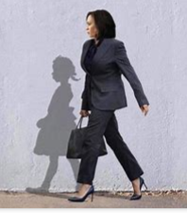

Why might the shadow be different from the woman?

Slide 2
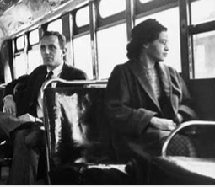
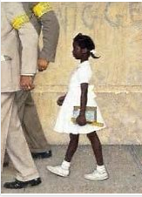
Anyone seen these?
Do you know the tag lines that go with them?

Slide 3
Rosa sat
So Ruby could walk
Who are these people?
So Kamala could run…and win!

Slide 4
What do we remember about Rosa Parks?

Slide 5
She started a bus protest in the USA at a time when black people had to sit in a separate part of the bus to white people

Slide 6
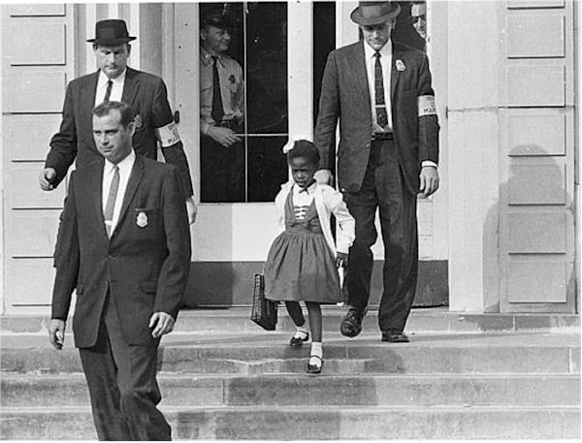
This little girl is Ruby Bridges – she was the first black child to go to a school that had previously only had white children

Slide 7
Other children refused to be taught with her…teachers refused to teach her!

Slide 8
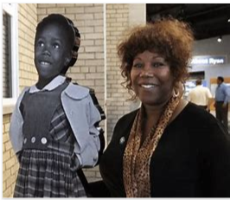
Ruby continues to spend her life campaigning for equality

Slide 9
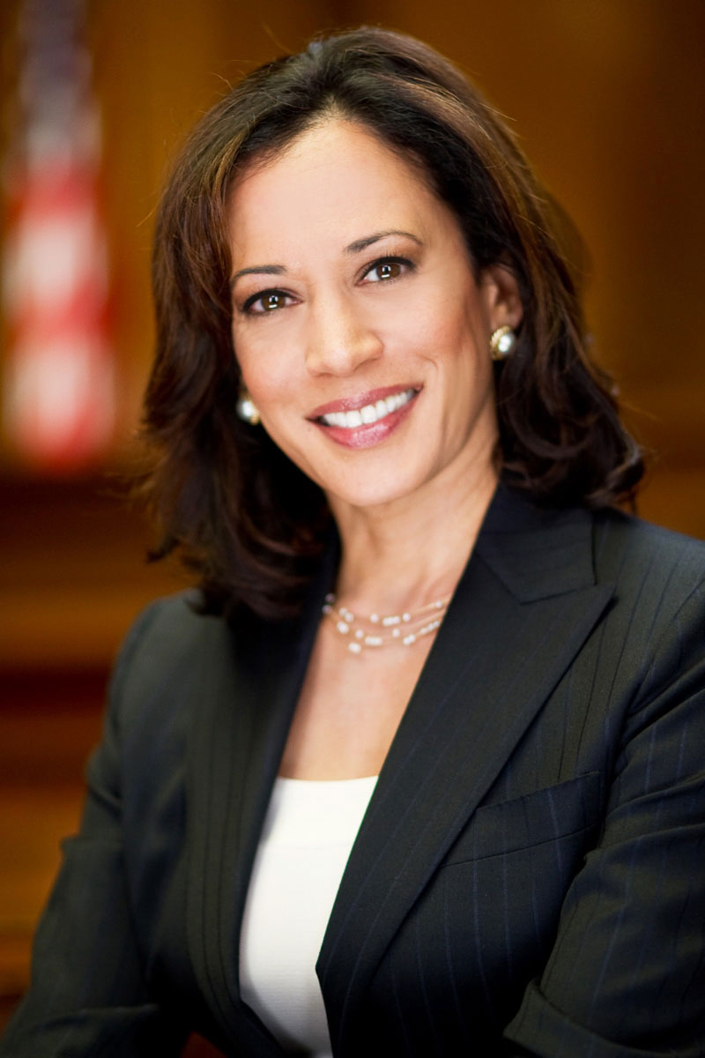
Who is this woman?
Why is she famous?
https://www.youtube.com/watch?v=XYkZkpLQUS0

Slide 10
Kamala Harris is the first woman be elected as Vice President in the USA
As well as the first person of colour to hold that office

Slide 11
Now do we understand the shadow?

Slide 12
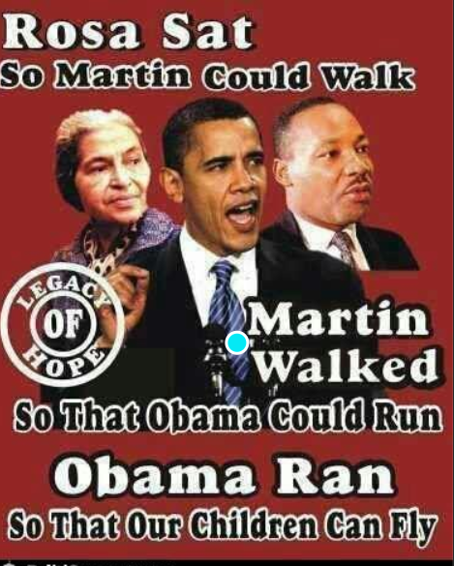

Slide 13
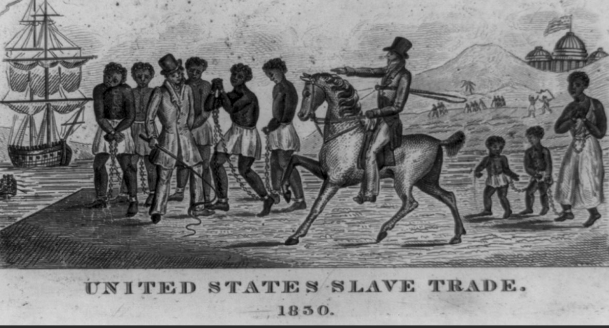
Remember -For many years, black people were used as slaves in the USA – they could not have imagined a world where they could be free…or successful….
Inspirational people have made this change happen…these people had what characteristics/values?

Slide 15
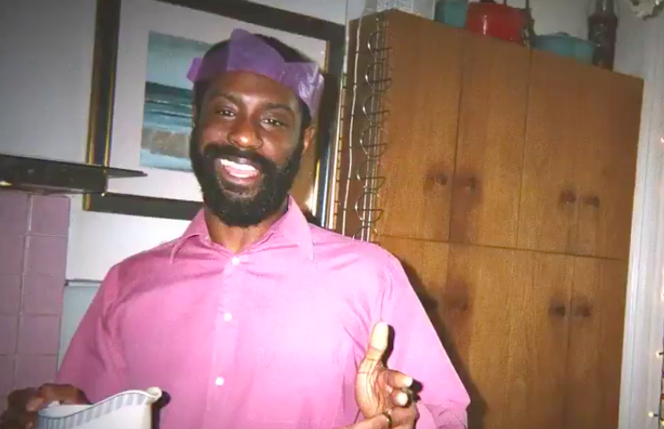
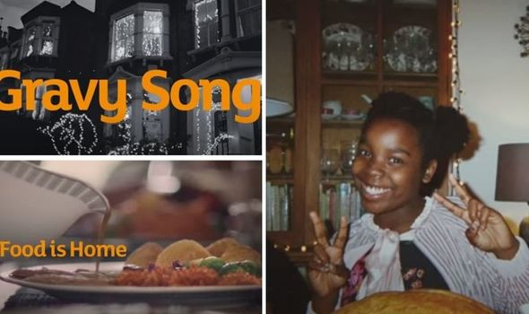

Sadly, racism is not just an American thing of long ago….Isaac knew about how this video led people to complain in this country this year!...just because the family featured are black.
https://www.youtube.com/watch?v=GqtcpLywgRU

Slide 16

We’ve created some graffiti style art using the French words for terms to do with equality and fairness: France was one of the first modern countries to call for equality for all people in a revolution 200 years ago

Slide 17
Who has inspired you and why?
Is it someone in your family or one of your friends?
Is it someone you know from a club or team you go to?
Is it someone you don’t know – from TV, social media, cinema?...from sport or politics?
Write onto your post it note now who it is and why they have inspired you

Slide 18
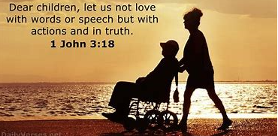


As we pray, lets think about our own attitudes to people from different communities – races – religions – languages
Think about our Christian value of generosity – having an open mind and being willing to share our time and share our friendship with new and different people
Think about our PSHCE theme of Falling out and getting on
Our British Values – of mutual respect

Slide 19
Merci pour les gens inspirants du passé Merci que nous vivons dans un pays libre où nous essayons de traiter les gens également Nous aider à être généreux et gentils avec les gens. Amen | Thank you for the inspiring people from the past Thank you that we live in a free country where we try to treat people equally Help us to be generous and kind with people. Amen
Merci pour les values

