Slide 1


Slide 3


1) What is the ratio of cookies to donuts?
2) The ratios show shaded parts to non-shaded
parts. Match the ratios to the bar models.
3 : 5
1 : 3
3 : 1

Slide 4
1) What is the ratio of cookies to donuts?
2) The ratios show shaded parts to non-shaded
parts. Match the ratios to the bar models.
7 : 5
3 : 5
1 : 3
3 : 1

Slide 6
For every 2 red counters, there’s 1 yellow counter.
If there are 6 red counters, how many yellow counters are there?
3
2
1
4
2
6
3
If there are 7 yellow counters, how many red counters are there?
14

Slide 7

Activity 1
Have a think
For every 3 yellow counters, there’s 2 red counters.
If there are 6 red counters, how many yellow counters are there?
If there are 18 yellow counters, how many red counters are there?

Slide 8
Activity 1
For every 3 yellow counters, there’s 2 red counters.
If there are 6 red counters, how many yellow counters are there?
9
If there are 18 yellow counters, how many red counters are there?
3
2
6
4
9
6

Slide 9
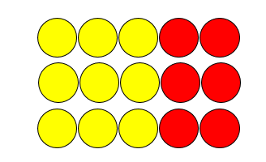
Activity 1
For every 3 yellow counters, there’s 2 red counters.
If there are 6 red counters, how many yellow counters are there?
If there are 18 yellow counters, how many red counters are there?
12 red counters

Slide 10
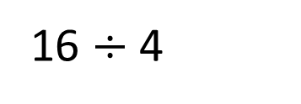
The ratio of red to yellow counters is 3 : 1
There are 16 counters in total.
How many counters are yellow?
R
4
4
4
16
Y
4
16 $÷$ 4

Slide 11
Activity 2
Have a think
The ratio of red to yellow counters is 4 : 2
There are 18 counters in total.
How many counters are red?

Slide 12
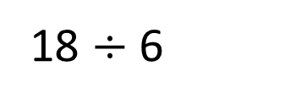
Activity 2
The ratio of red to yellow counters is 4 : 2
There are 18 counters in total.
How many counters are red?
3
3
3
3
R
18
3
3
Y
18 $÷$ 6

Slide 13


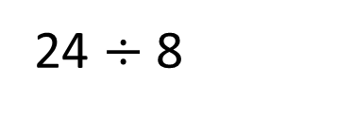
Dora is practising her shooting skills.
In total she takes 24 penalties.
For every 5 penalties she scores, she misses 3
15
How many penalties does Dora score?
S
3
3
3
3
3
24 $÷$ 8
24
M
3
3
3
How many more penalties does Dora score than miss?
6

Slide 14
Activity 3
Have a think
Tommy has a packet of sweets.
For every 2 red sweets there are 3 green sweets.
If there are 30 sweets in the packet in total, how many of each colour are there?

Slide 15


Activity 3
R
6
6
30
G
6
6
6
30 $÷$ 5
12 red sweets and 18 green sweets.

