Slide 1
Week beg
12th April

Slide 2
13.4.21
LO: To understand and link ratio and fractions

Slide 3

Useful websites….
https://vimeo.com/516637261
https://www.bbc.co.uk/bitesize/topics/zsq7hyc/articles/z8kfnbk
https://www.bbc.co.uk/bitesize/topics/zsq7hyc/articles/z2nr4wx --practise questions

Slide 4
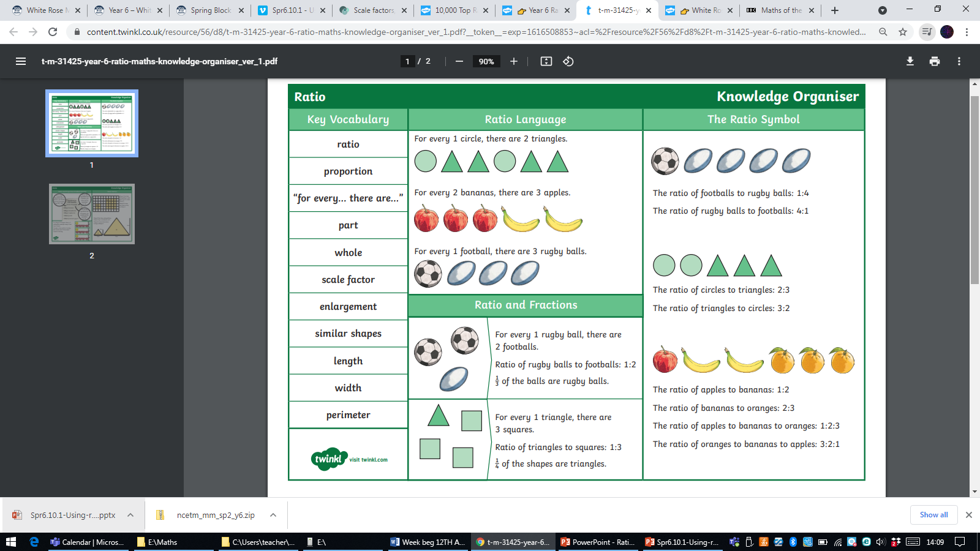
Crucial Vocabulary

Slide 6
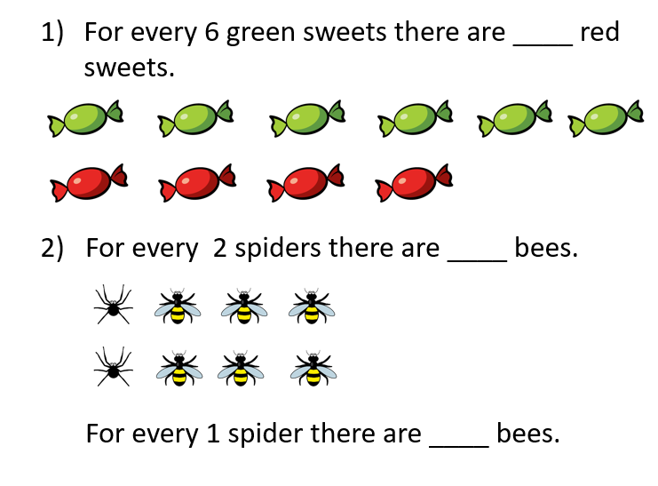
Recap- what is ratio?
Ratio shows the relationship between a set of values.

Slide 7


7
There are ___ counters altogether.
4
There are ___ yellow counters.
3
There are ___ red counters.
$\frac{\text{4}}{\text{7}}$
What fraction of the counters are yellow?
$\frac{\text{3}}{\text{7}}$
What fraction of the counters are red?
4
3
For every ___ yellow counters there are ___ red counters.
4
3
The ratio of yellow counters to red counters is ___ to ___

Slide 8


7
There are ___ shapes altogether.
5
There are ___ squares.
2
There are ___ circles.
$\frac{\text{5}}{\text{7}}$
What fraction are squares?
$\frac{\text{2}}{\text{7}}$
What fraction are circles?
5
2
For every ___ squares there are ___ circles.
5
2
The ratio of squares to circles is ___ to ___

Slide 9


$\frac{\text{2}}{\text{5}}$
What fraction of the bar is shaded?
$\frac{\text{3}}{\text{5}}$
What fraction of the bar not shaded?
Write the ratio of shaded to non-shaded parts.
2
3
For every ___ shaded parts there are ___ non-shaded parts.
2 to 3 2:3
Write the ratio of non-shaded to shaded parts.
3 to 2 3:2

Slide 10



1 to 2 to 4
For every 1 blue part, there are 2 yellow parts and 4 green parts.
$\frac{\text{1}}{\text{7}}$
What fraction of the bar is shaded blue?
$\frac{\text{2}}{\text{7}}$
What fraction of the bar is shaded yellow?
$\frac{\text{4}}{\text{7}}$
What fraction of the bar is shaded green?

Slide 11



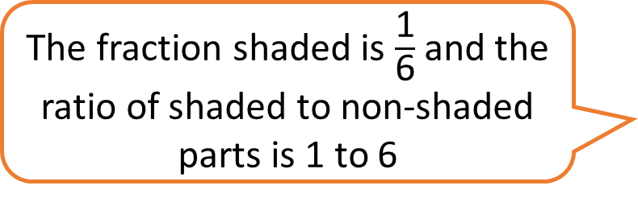
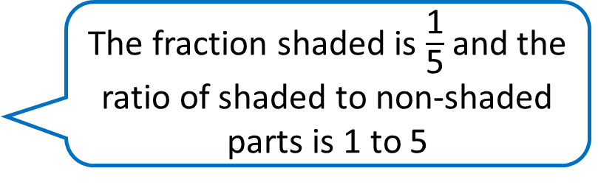
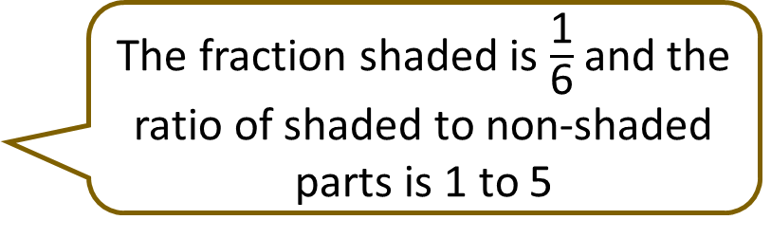
The fraction shaded is $\frac{\text{1}}{\text{5}}$ and the ratio of shaded to non-shaded parts is 1 to 5
The fraction shaded is $\frac{\text{1}}{\text{6}}$ and the ratio of shaded to non-shaded parts is 1 to 6
The fraction shaded is $\frac{\text{1}}{\text{6}}$ and the ratio of shaded to non-shaded parts is 1 to 5
Who is correct?

Slide 12

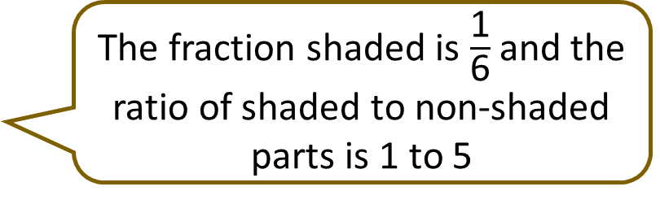
The fraction shaded is $\frac{\text{1}}{\text{5}}$ and the ratio of shaded to non-shaded parts is 1 to 5
The fraction shaded is $\frac{\text{1}}{\text{6}}$ and the ratio of shaded to non-shaded parts is 1 to 6
The fraction shaded is $\frac{\text{1}}{\text{6}}$ and the ratio of shaded to non-shaded parts is 1 to 5
For every 1 shaded part there are ___ non-shaded parts.
5

Slide 13



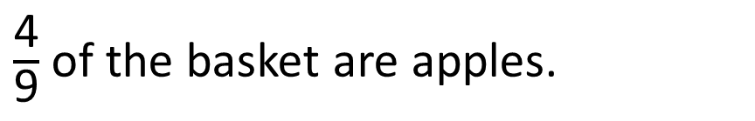
A fruit basket contains apples and pears.
$\frac{\text{4}}{\text{9}}$ of the basket are apples.
Apples
Pears
What is the ratio of pears to apples?
For every ___ pears there are ___ apples.
5
4
5 to 4

Slide 14
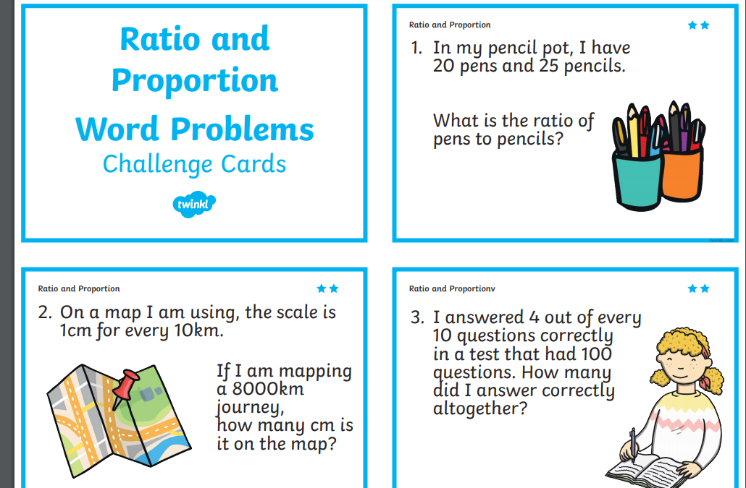
Triangles/Squares- mixed pairs whiterose activity- need coloured colours, headphones, laptops/ IPADS. https://vimeo.com/516638393
Photo for books
Octagons- Indep- class work with Mrs Cooper

Slide 15
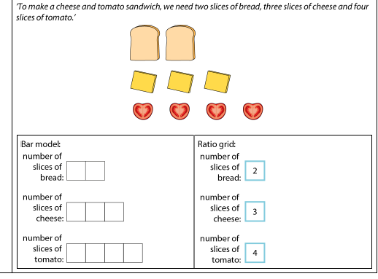
Hexagons- Guided Mrs Lund
Ratio challenges (NCTM). Work through powerpoint

Slide 16

Tuesday
Dividing fractions

Slide 17


Divide Fractions by Integers (1)
Diving
Use the diagrams to help you answer these calculations.
4
2
9
3
6
1
÷
2
=
÷
3
=
÷
6
=
7
7
11
11
9
9

Slide 18


Divide Fractions by Integers (1)
Deeper
Do you agree? Explain your method and reasoning.
12
3
9
3
36
3
?
÷
3
=
÷
12
=
÷
4
=
?
12
12
40
40
17
17
?
The missing number in all these calculations is 12.
He is correct.

Slide 19







Divide Fractions by Integers (1)
Deepest
Work out the values of the symbols.
10
16
40
1
1
4
÷
8
=
÷
2
=
÷
=
30
15
5
71
71

Slide 20
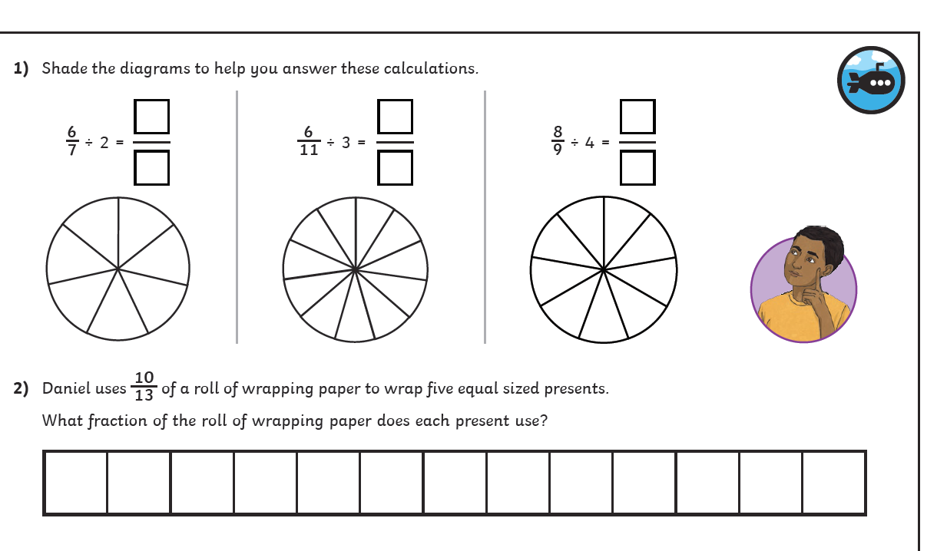
Over to you…

