Slide 2
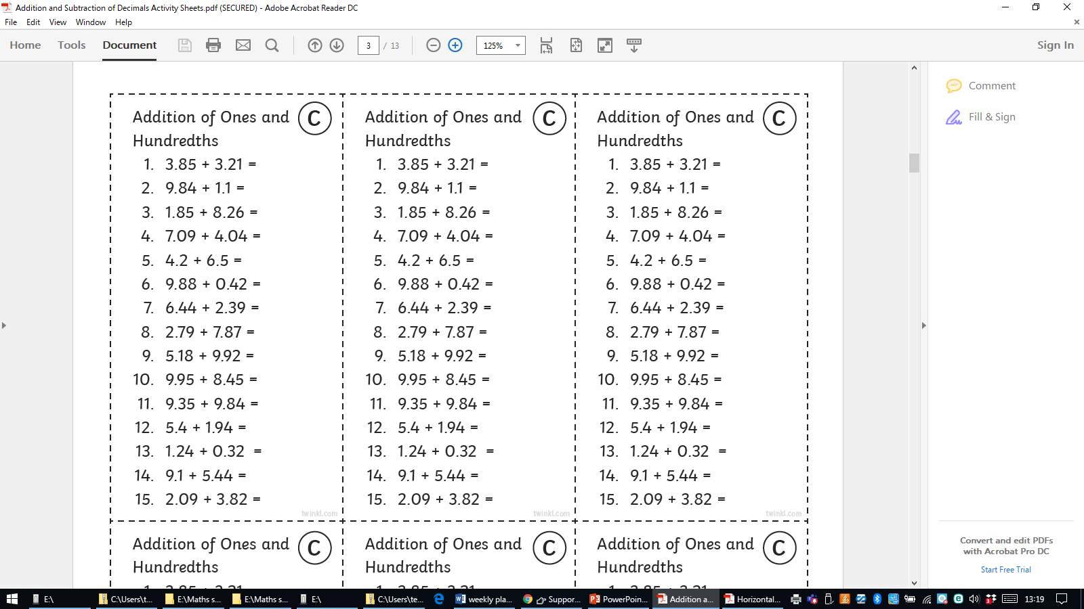
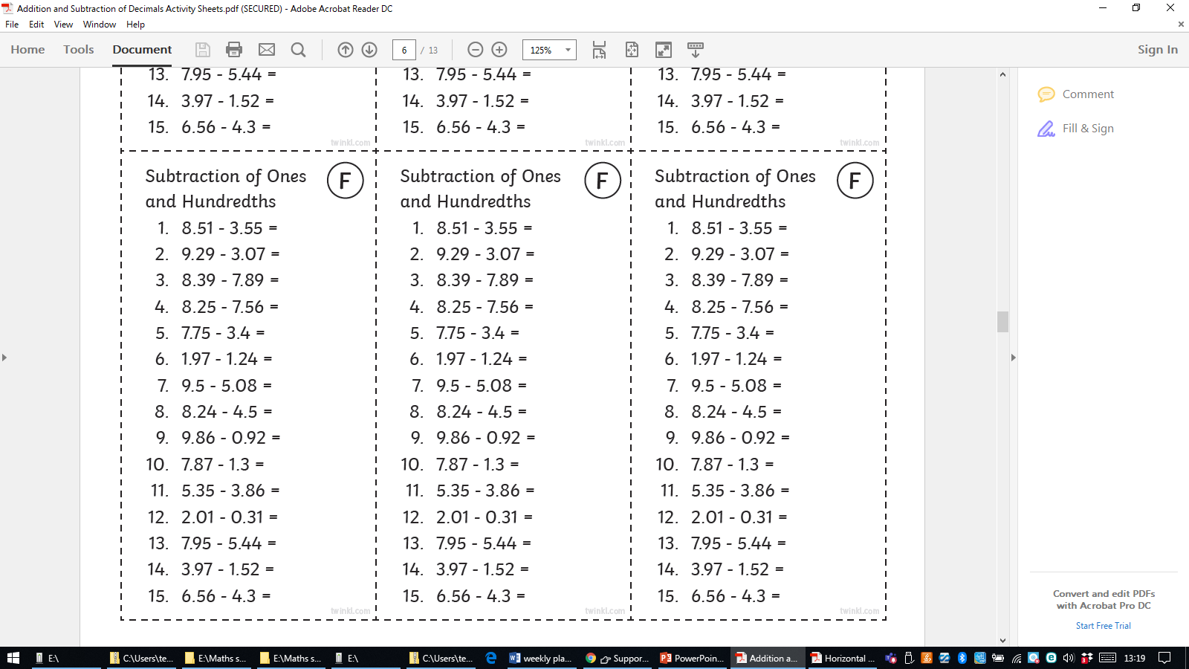
6/5/21 (Thurs)
LO: To multiply decimals
Starter task- adding and subtracting practice- stick in books and solve!

Slide 4
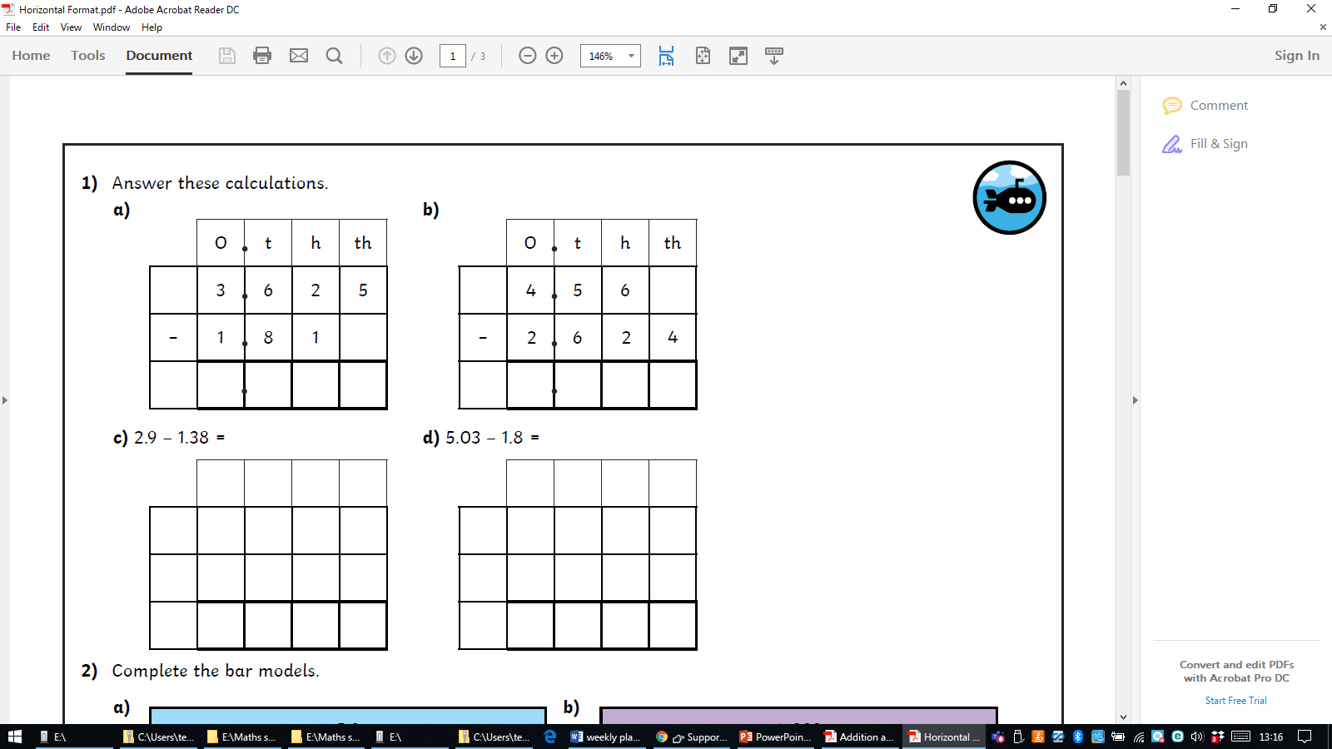

Slide 6
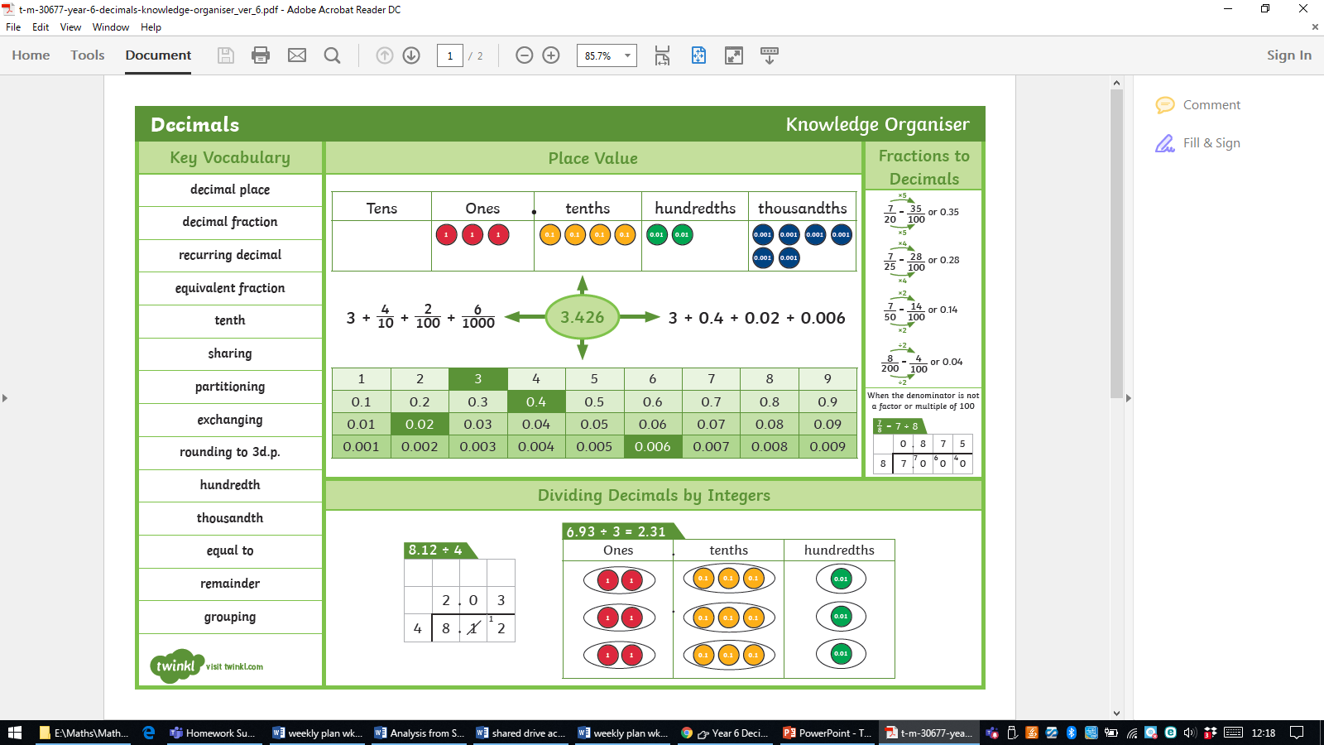

Slide 7
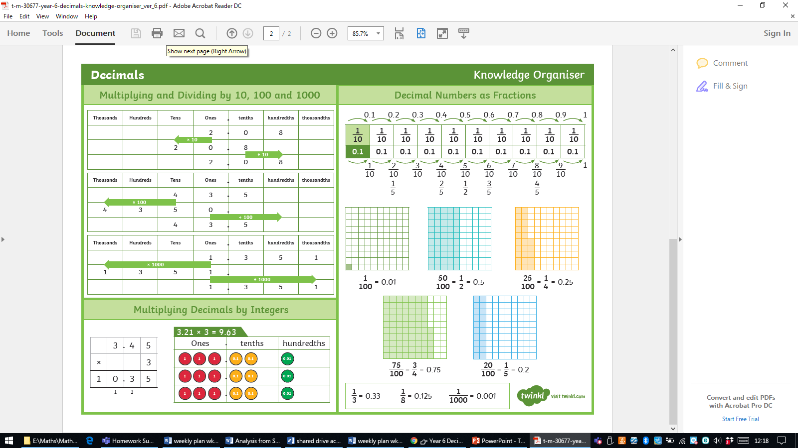

Slide 8

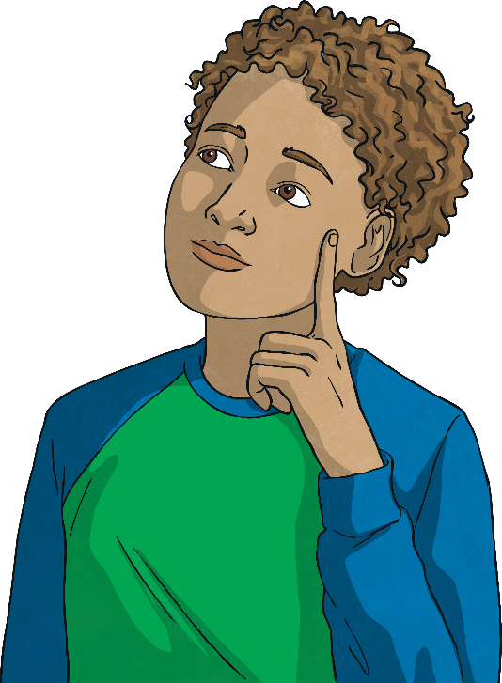

Multiply Decimals by Integers
Diving
Use bar model B to help you give the total value of bar model A.
A
2.67
2.67
2.67
2.67
B
0.89
0.89
0.89
= 2.67
A = 2.67 × 4 = 10.68

Slide 9

Multiply Decimals by Integers
Deeper
Anna is using a place value chart to help her find the answer to this missing digit multiplication question.
Ones | Tenths | Hundredths
1
1
1
1
0.1
0.1
0.01
.
× 2 = 8.64
1
1
1
1
0.1
0.1
0.01
a)
Is Anna correct? If not, what multiplication calculation does Anna’s place value chart represent?
Anna has represented 4.21 × 2 = 8.42

Slide 10
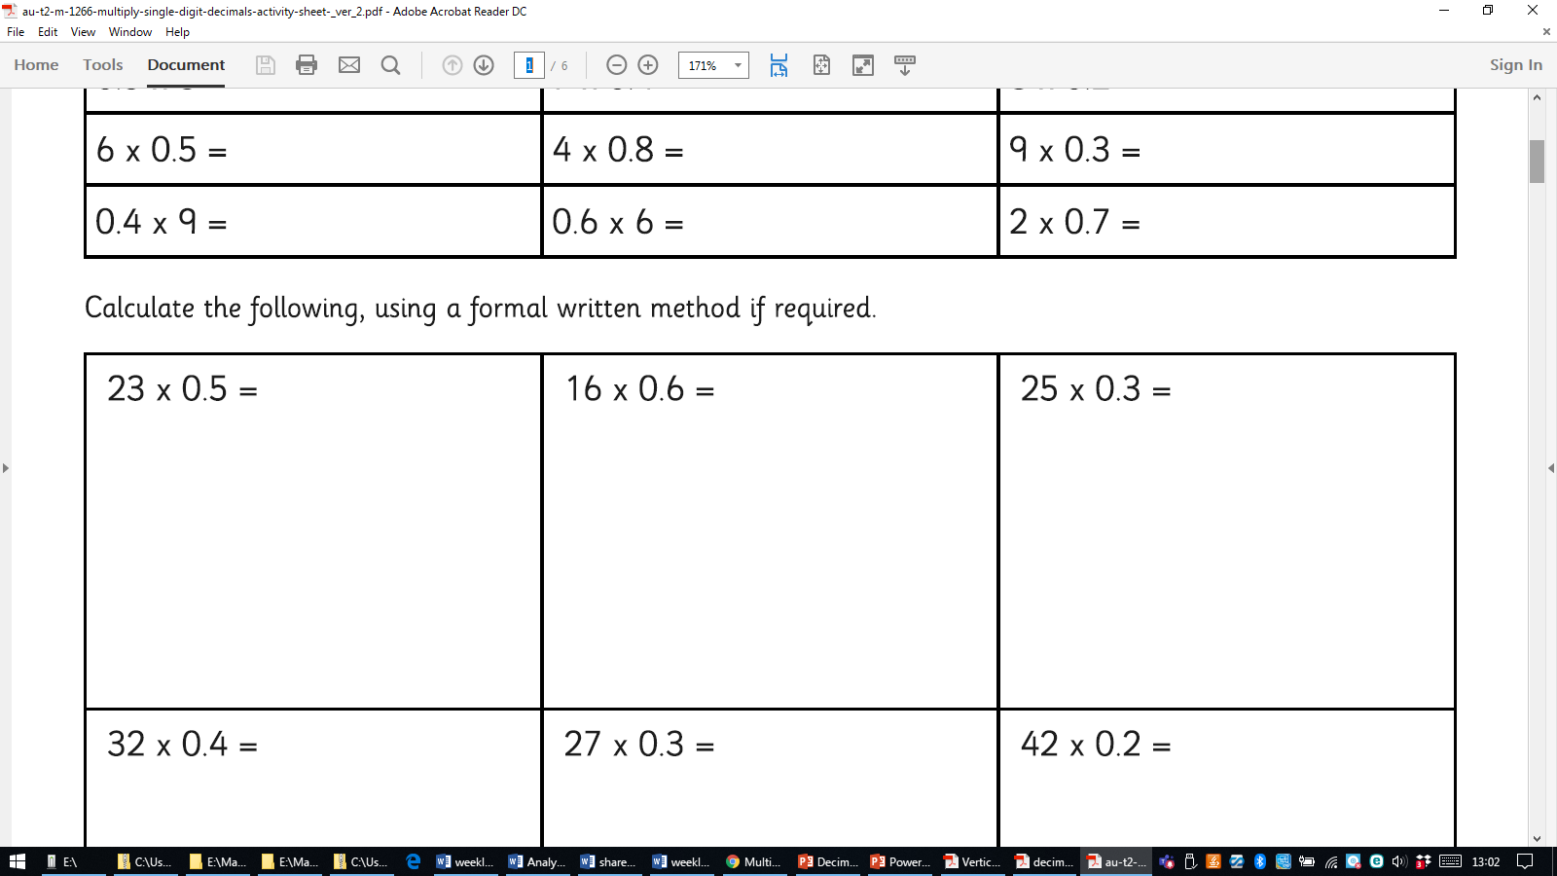
Now try these…complete the first three mentally…
https://corbettmathsprimary.com/2018/07/20/multiplying-decimals-video/

Slide 11
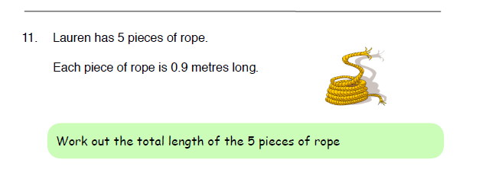

Slide 12
Triangles- (Miss McAinsh)-
mult 10, 100, 1000
Squares- Mixture of questions (Mrs Lund)
Hexagons/Octagons – Corbett maths
questions- slide 8 first then problem
solving questions

Slide 13
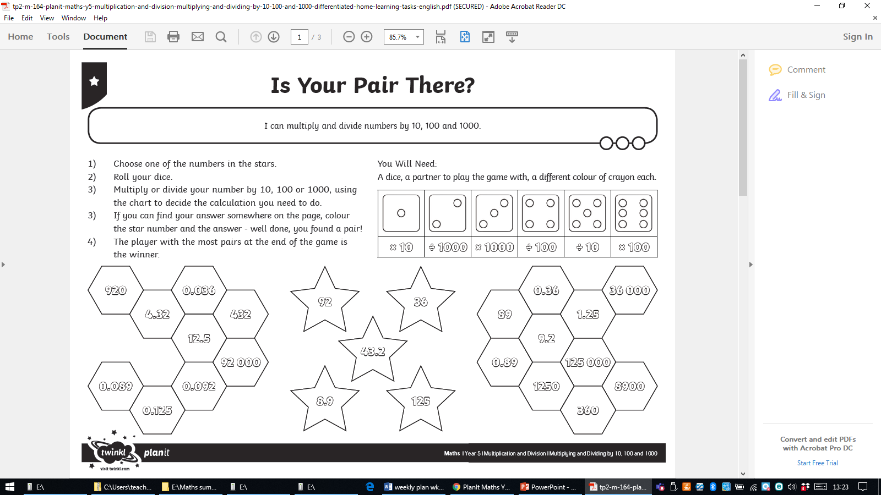

Slide 14
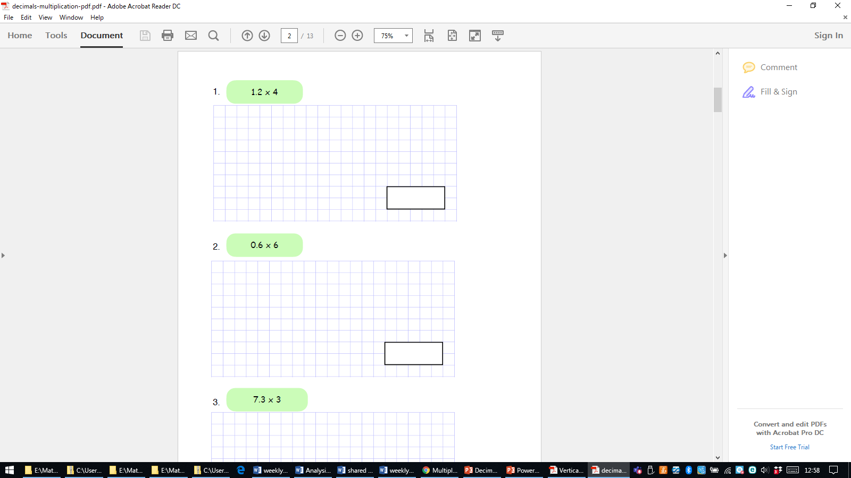
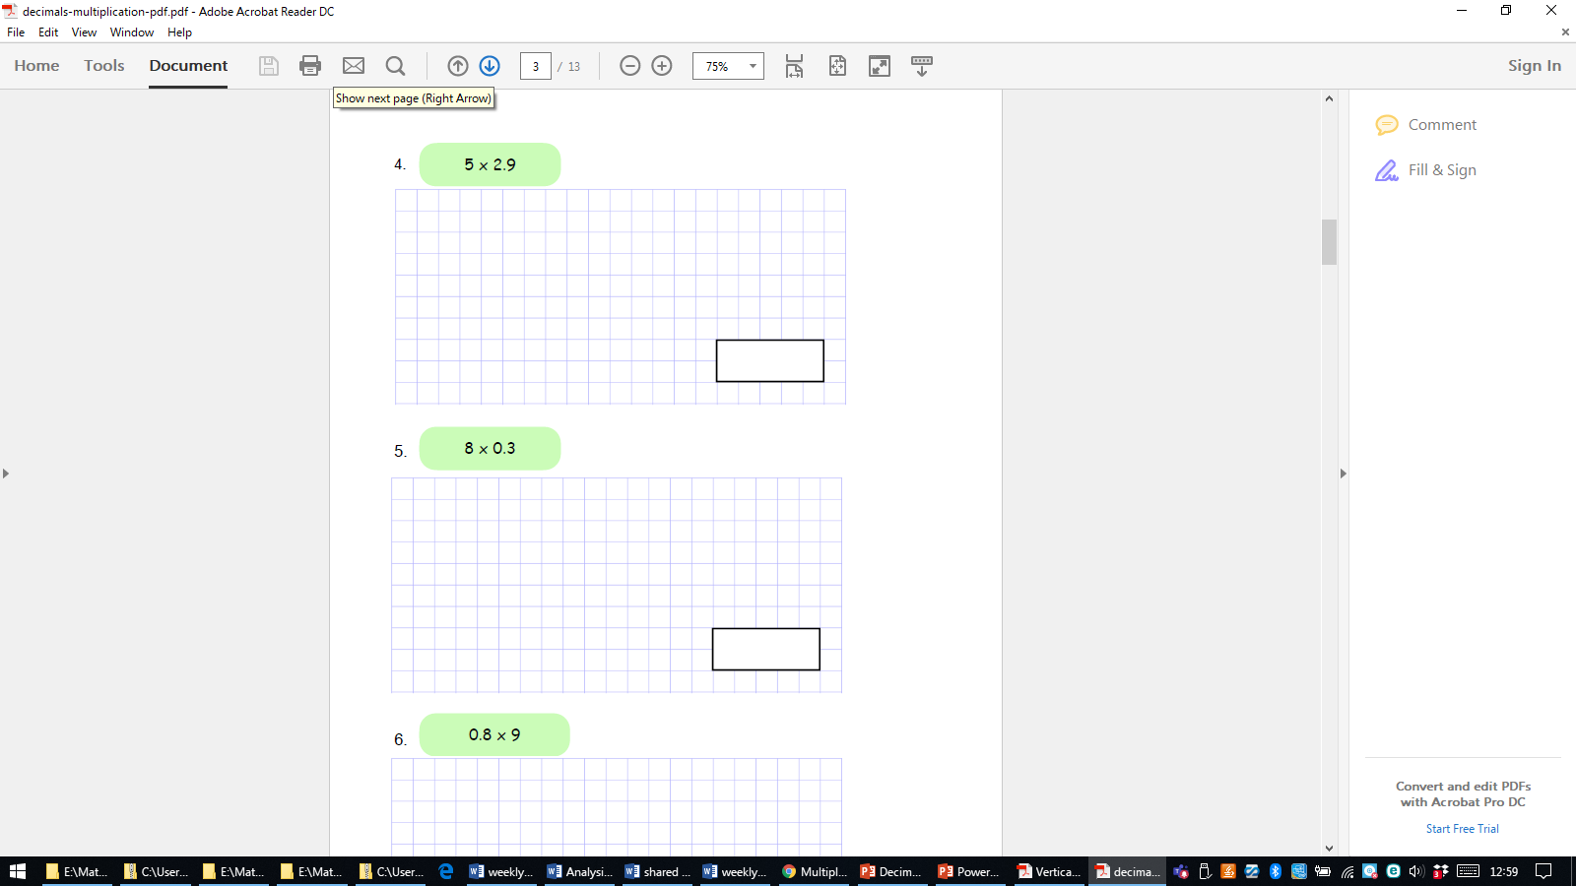
Hexagons/Octagons – Corbett maths questions

Slide 15
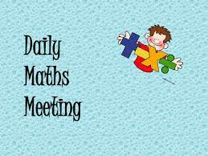

Thurs
Square, cubed and prime numbers

Slide 16
What is a square number?
Write five examples on
your whiteboards

Slide 17
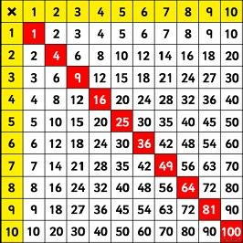

Slide 18
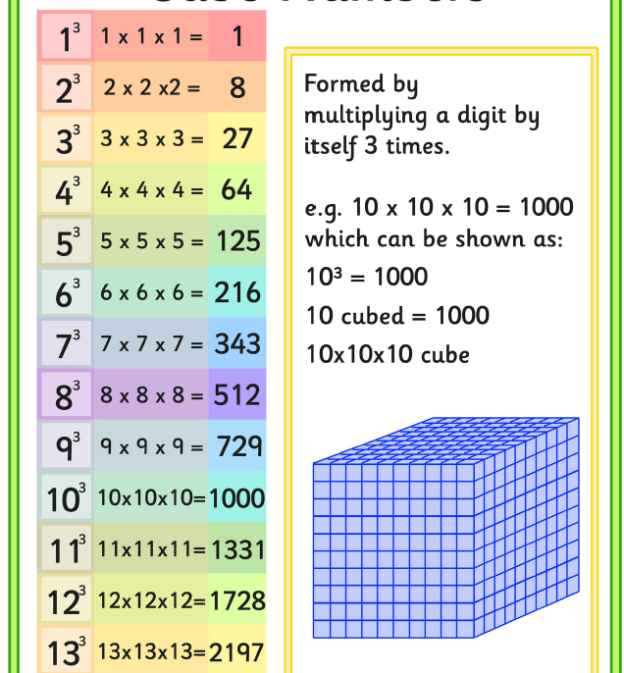
What are cubed numbers?

Slide 19
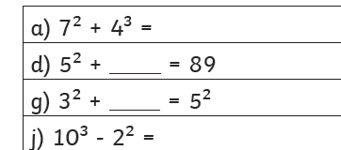
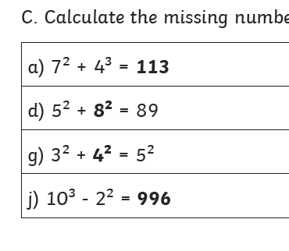
Problem solving ?

Slide 20
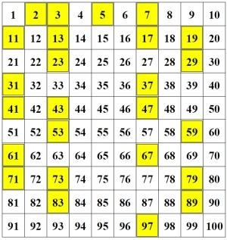
Prime numbers- why are all these prime numbers ?
https://www.mathsisfun.com/prime_numbers.html

Slide 21
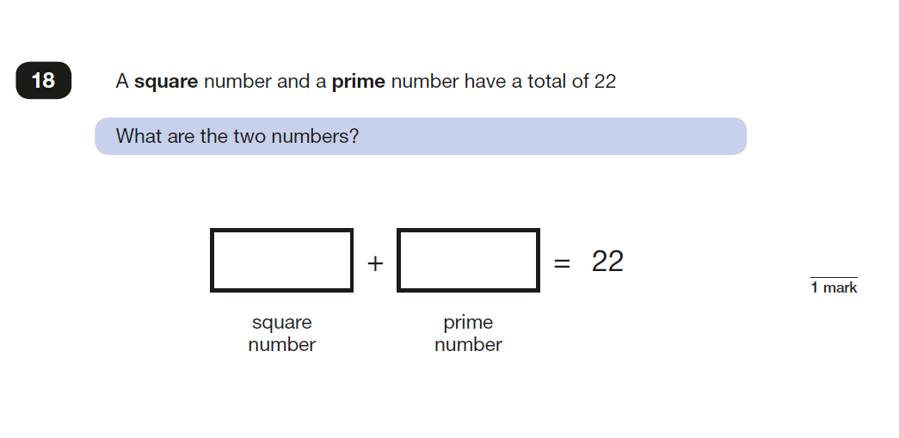
Problem solving…

