Slide 1
Tuesday 30th June
L.O. : identify how animals and plants are adapted to suit their environment in different ways and that adaptation may lead to evolution.

Slide 2
Describe the environment that you think a fox lives in and how they think a fox’s characteristics are adapted to this environment (how do their characteristics suit their habitat/environment and allow them to survive?)
Fox

Slide 3
Where might these foxes live?
Notes:
Learning objective: identify how animals and plants are adapted to suit their environment in different ways and that adaptation may lead to evolution.
Introduction – give children a ‘fox’ and ask them to describe the environment that they think their fox lives in and how they think their fox’s characteristics are adapted to this environment (how do their characteristics suit their habitat/environment and allow them to survive).
Why do children think these foxes differ so much? Note that in the arctic the fur is an obvious difference – colour and length.
How would a red fox, like the ones we have in the UK fare in the arctic?– Not very well because it would be cold and vulnerable to predators. We call this adaptation when certain characteristics become more common because they are more likely to help living things survive.
We call this process of organisms changing over time evolution.
Why do foxes come in so many different ‘versions’? They all have a common ancestor and in certain environments certain features would have helped specific foxes to survive into adulthood and reproduce, passing on their genetic characteristics, so that eventually certain characteristics end up being ‘selected’ naturally and become the common form of that fox (natural selection). Common ancestor, adapted to different environments.

Slide 4
Why do you think these foxes differ so much? Note that in the arctic the fur is an obvious difference – colour and length.
How would a red fox, like the ones we have in the UK fare in the arctic?
Not very well because it would be cold and vulnerable to predators. We call this adaptation when certain characteristics become more common because they are more likely to help living things survive.
We call this process of organisms changing over time evolution.

Slide 5
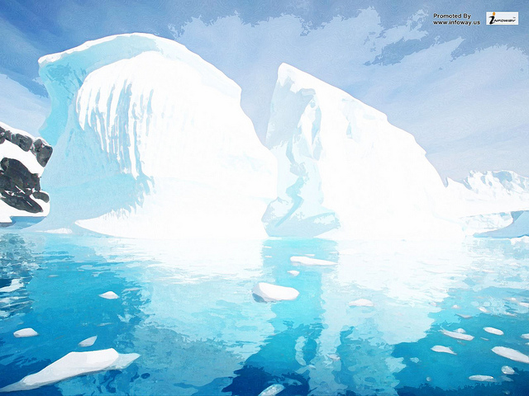
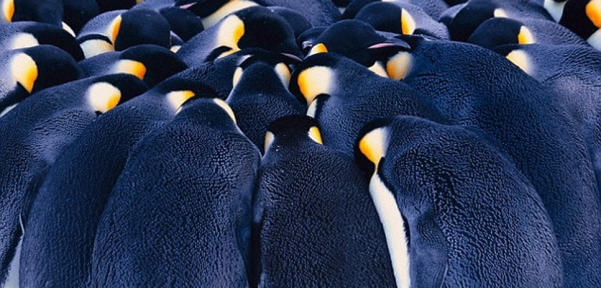
Why do penguins huddle together?
Penguins huddle together to stay warm
Do you think it works?
Let’s test it!!
https://www.youtube.com/watch?v=OL7O5O7U4Gs
Notes:
Learning objective: identify how animals and plants are adapted to suit their environment in different ways and that adaptation may lead to evolution.

Slide 6
Penguins have adapted their behaviour to stay warm
Notes:
Learning objective: identify how animals and plants are adapted to suit their environment in different ways and that adaptation may lead to evolution.
Behavioural adaptation of Emperor penguins – huddling, where the penguins group together for warmth.
The huddling behaviour is especially useful during storms. In these conditions temperatures can drop to -40 degrees, with very fast winds.
Through the huddling behaviour, the penguins reduce their heat (energy) loss to approximately half the heat (energy) loss of penguins standing in isolation.
As the penguins huddle together, the penguins standing on the outside of the huddle where the wind is blowing get cold. These penguins move to the sides of the huddle to get out of the wind. Now other penguins stand in full wind, and then they too move to the sides of the huddle, out of the wind. The result is a continuous shift of penguins, every penguin taking its turn standing in the cold wind.
This youtube video shows penguins huddling and from 2:21 mins shows the constant movement of the penguins to keep warm. https://www.youtube.com/watch?v=OL7O5O7U4Gs
Activity suggestion: Could get students to model this outside/in hall if appropriate for your class.

Slide 7
What does this tell you about this strategy for the penguins??

Slide 8
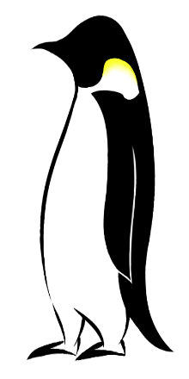
Go penguins!
Behavioural adaptation of Emperor penguins – huddling, where the penguins group together for warmth.
The huddling behaviour is especially useful during storms. In these conditions temperatures can drop to -40 degrees, with very fast winds.
Through the huddling behaviour, the penguins reduce their heat (energy) loss to approximately half the heat (energy) loss of penguins standing in isolation.
As the penguins huddle together, the penguins standing on the outside of the huddle where the wind is blowing get cold. These penguins move to the sides of the huddle to get out of the wind. Now other penguins stand in full wind, and then they too move to the sides of the huddle, out of the wind. The result is a continuous shift of penguins, every penguin taking its turn standing in the cold wind.

Slide 9
Natural selection occurs in a population as a result of variation so as to deal with a changing environment. Natural selection in the animal world takes place over huge time scales, but that there are examples where it has happened over decades (in microorganisms it happens much quicker) through favourable mutations (random changes in characteristics). Mutations can prove useful in the game of survival!
Example: the peppered moth and the industrial revolution.

Slide 10
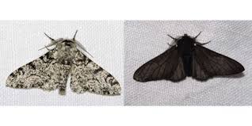
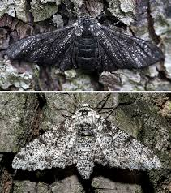
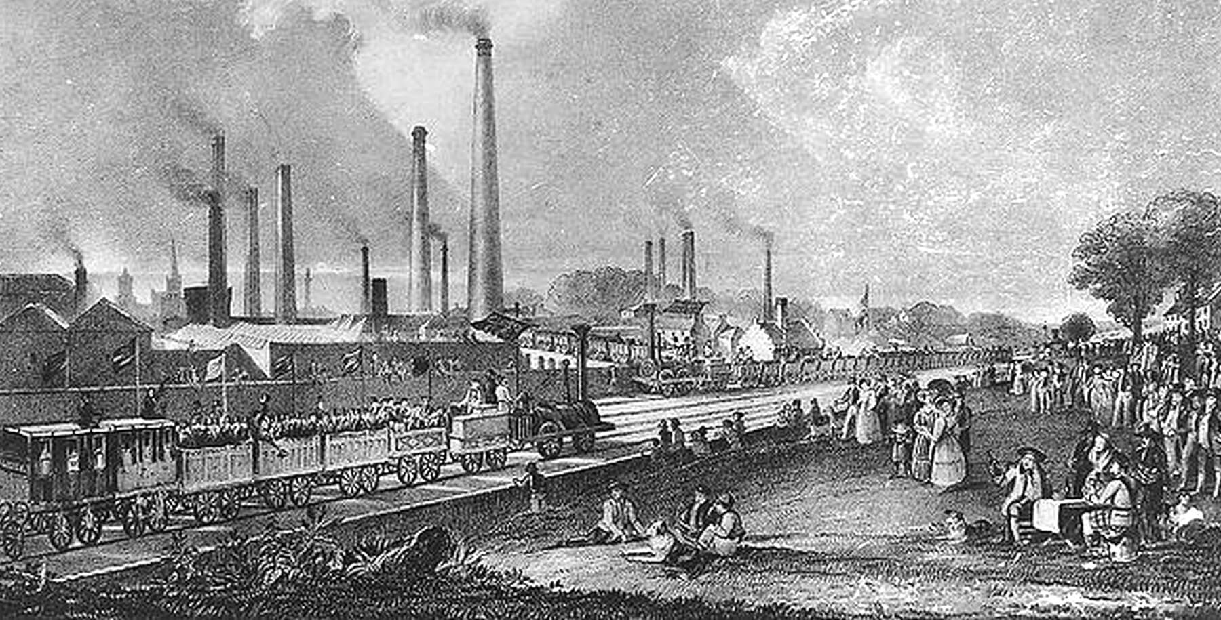
Peppered Moths
Notes:
Learning objective: identify how animals and plants are adapted to suit their environment in different ways and that adaptation may lead to evolution.
Highlight that natural selection occurs in a population as a result of variation so as to deal with a changing environment. Explain that generally natural selection in the animal world takes place over huge time scales, but that there are examples where it has happened over decades (in microorganisms it happens much quicker) through favourable mutations (random changes in characteristics). Mutations can prove useful in the game of survival!
Show children the example of the peppered moth and the industrial revolution.
The lighter coloured moth was originally more common because they could camouflage better on trees, and so avoid predators.
Then in the nineteenth century Britain’s industrial revolution caused sooty air pollution which turned the trees in towns and cities black.
Now the black moths were better camouflaged on the blackened trees and so could better avoid predators. The black moths became more common.
In the mid-twentieth century the air pollution improved and trees became cleaner. So the pale peppered moths became more common once again as they were better camouflaged from predators.
Activity suggestion: Ask students to create a story board/comic strip depicting natural selection of the peppered moth.
The speed with which an organism reproduces plays a role in evolution as it affects the length of time a successful characteristic can spread through a population. Organisms that reproduce quickly, such as insects, will evolve quickly; those that reproduce slowly, such as humans, will evolve slowly.

Slide 11
The lighter coloured moth was originally more common because they could camouflage better on trees, and so avoid predators.
Then in the nineteenth century Britain’s industrial revolution caused sooty air pollution which turned the trees in towns and cities black.
Now the black moths were better camouflaged on the blackened trees and so could better avoid predators. The black moths became more common.
In the mid-twentieth century the air pollution improved and trees became cleaner. So the pale peppered moths became more common once again as they were better camouflaged from predators.

Slide 12
The speed with which an organism reproduces plays a role in evolution as it affects the length of time a successful characteristic can spread through a population. Organisms that reproduce quickly, such as insects, will evolve quickly; those that reproduce slowly, such as humans, will evolve slowly.

Slide 13
Today…
You are going to research how various plant and animal species have adapted to survive in their extreme habitats.
You will need your research for your task next week where you will be designing your very own species!

Slide 14
What you will research:
Camels and how they have adapted
Cacti – what do they do to survive in dessert?
Artic fox- how have they adapted?
Refer to your species cards to gather your facts.
The more species you research, the more ideas you have for next week!

Slide 15
Some websites…
Some clips to watch:
https://www.bbc.co.uk/bitesize/clips/z8sjxnb
https://www.youtube.com/watch?v=YX8VQIJVpTg
Our own Science page where you should have gathered facts at home:
https://www.stphilipssouthport.com/science-3/

