Slide 1
Tuesday 7th July
L.O. research and identify how animals and plants are adapted to suit their environment in different ways and that adaptation may lead to evolution.

Slide 2
Most environments, however extreme, have some form of life in them – living things that have evolved to survive in those conditions against the odds (and often monopolise them). These organisms have certain adaptations that enable them to thrive in extreme conditions e.g. very hot, very cold.

Slide 3
Extreme survival
How can cacti survive in deserts?
Notes:
Learning objective: identify how animals and plants are adapted to suit their environment in different ways and that adaptation may lead to evolution.
Explain that most environments, however extreme, have some form of life in them – living things that have evolved to survive in those conditions against the odds (and often monopolise them). These organisms have certain adaptations that enable them to thrive in extreme conditions e.g. very hot, very cold.
Show children the image of a cactus and ask how cacti are adapted to living in desert areas (i.e. very dry conditions as well as extremes of temperature).
They have stems that can store water (they swell after a rain storm and can store a supply of water for many months); a widespread shallow root system that can collect water from a large area (the roots are shallow so that they collect the water in the top layers of the soil as soon as it has fallen); and spines instead of leaves that minimises the surface area of the plant, in turn reducing water loss through transpiration (evaporation of water from plant leaves). The spines also protect cacti from animals that might want to eat them.
Ask children how plants could be adapted to survive extreme cold. Watch the BBC video clip that describes how plants are adapted to live in very cold conditions:
http://www.bbc.co.uk/education/clips/z8sjxnb

Slide 4
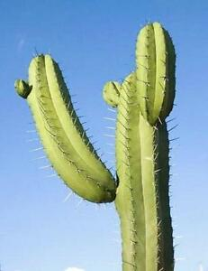
They have stems that can store water (they swell after a rain storm and can store a supply of water for many months).
They have a widespread shallow root system that can collect water from a large area (the roots are shallow so that they collect the water in the top layers of the soil as soon as it has fallen).
They also have spines instead of leaves that minimises the surface area of the plant, in turn reducing water loss through transpiration (evaporation of water from plant leaves).
The spines also protect cacti from animals that might want to eat them.

Slide 5
How could plants be adapted to survive extreme cold?

Slide 6

http://www.bbc.co.uk/education/clips/z8sjxnb

Slide 7
Features of a camel that make it survive in the desert…
a double row of long eyelashes (to keep sand out of their eyes)
nostrils which can close (to prevent sand going up its nose), thick lips (so can eat prickly desert plants without feeling pain)
store of fat in hump (which can be used for energy if there is no food available)
long strong legs (to keep their bodies away from hot ground), and thick leathery pads (to protect feet from hot sand) on flat
wide feet (to make walking on sand easier, less likely to sink into it) and on knees.
They also have thick fur to keep them warm during cold, desert nights.

Slide 8
https://www.youtube.com/watch?v=YX8VQIJVpTg

Slide 9
How do penguins survive in Antarctica?
Notes:
Learning objective: identify how animals and plants are adapted to suit their environment in different ways and that adaptation may lead to evolution.
Penguins - note that they have webbed feet for powerful swimming and their bodies are streamlined to reduce drag in water.
Their wings, shaped like flippers, help them fly underwater at speeds of up to 15 mph.
Penguins have tightly packed, overlapping feathers which provide waterproofing and warmth.
Their thick skin with a layer of blubber (fat) underneath keeps them warm and their black back feathers absorb warmth from the sun.
However, explain that while such adaptations might help, penguins can get overheated if the sun is shining so they have also had to evolve patches which have few or no feathers, e.g. around the foot of their beak & their eyes, to allow heat to escape from their bodies. They lift up their wings to lose heat too by increasing their surface area & allowing air to circulate under their wings where again there are not many feathers.
They also pant like a dog sometimes.

Slide 10
How do they survive?
They have webbed feet for powerful swimming and their bodies are streamlined to reduce drag in water.
Their wings, shaped like flippers, help them fly underwater at speeds of up to 15 mph.
Penguins have tightly packed, overlapping feathers which provide waterproofing and warmth.
Their thick skin with a layer of blubber (fat) underneath keeps them warm and their black back feathers absorb warmth from the sun.
However, while such adaptations might help, penguins can get overheated if the sun is shining so they have also had to evolve patches which have few or no feathers, e.g. around the foot of their beak & their eyes, to allow heat to escape from their bodies. They lift up their wings to lose heat too by increasing their surface area & allowing air to circulate under their wings where again there are not many feathers.
They also pant like a dog sometimes.

Slide 11
Design your own survivor
You will design a plant/animal that can survive in the environment you have been given.
You need to think about each aspect of the environment (e.g. high temperatures, little water) and plan kinds of features that will allow your plant/animal to survive.
Use the design questions to help you to do this.
Draw and label a diagram of your plant/animal.
Notes:
Learning objective: identify how animals and plants are adapted to suit their environment in different ways and that adaptation may lead to evolution.
Activity suggestion:
Design your own survivor: Children to work in groups to design a plant and/or animal that can survive in a given environment.
Hand out a sample environment to each group (see environment examples powerpoint – printed and laminated) and encourage children to consider each aspect of the environment first so as to plan out the kinds of features that will ideally allow their animal and/or plant to survive successfully.
Children could be given specific roles/responsibilities within their groups.
Children to use the design questions provided (see design questions – design your own survivor), plan and then to draw a technical illustration of animal and/or plant.
Get children to share their ideas and design to get feedback and further ideas to improve their design. Ask more able children to make suggestions as to the value and contribution of their living things to the environment (e.g. eats insects that would otherwise damage the trees, potentially to extinction).
Share designs and environments and get children to explain why their living things will survive.
Ask children to consider what might happen if a new predator or disease or change in climate occurs – what characteristics might select some individuals over others (thicker fur, larger eyes, disease resistant strains of a plant, etc.).
Talk about extinction and note that sometimes changes or events can be too extreme for a specific species to survive and it will die out.
You could develop this task further into a project and ask students to make a model of the plant/animal that they have designed.

Slide 12

Task
Take inspiration from the images you have just looked at and use your worksheets to create your own creature! Remember that it can be as crazy as you want!

Slide 13
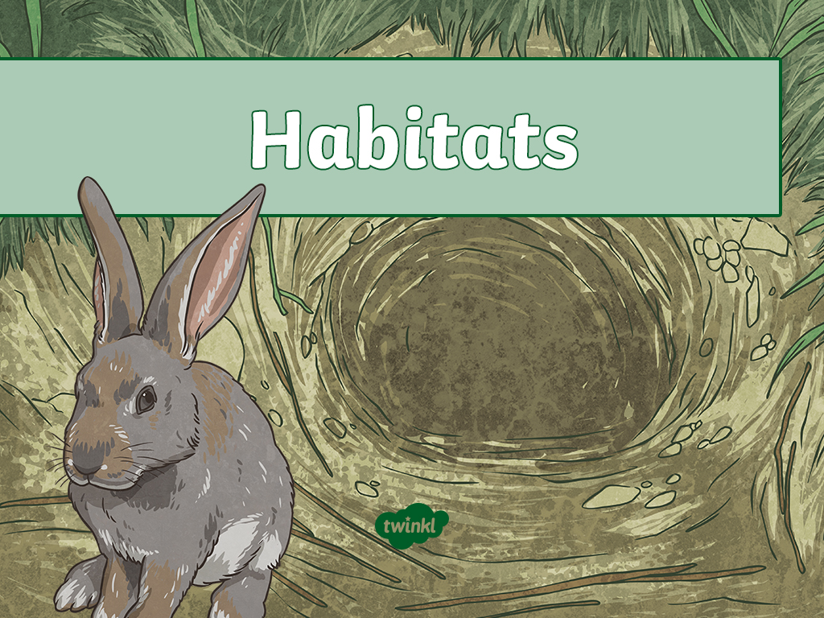

Slide 14
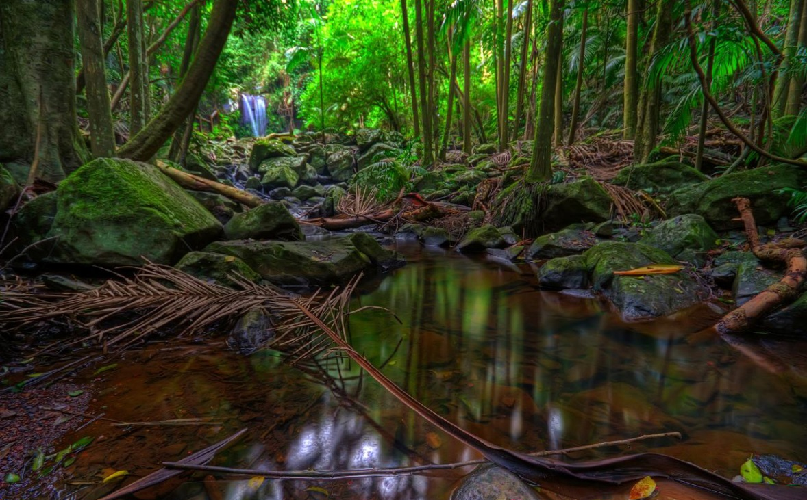
Rainforest
Photo courtesy of tauntingpanda (@flickr.com) - granted under creative commons licence

Slide 15
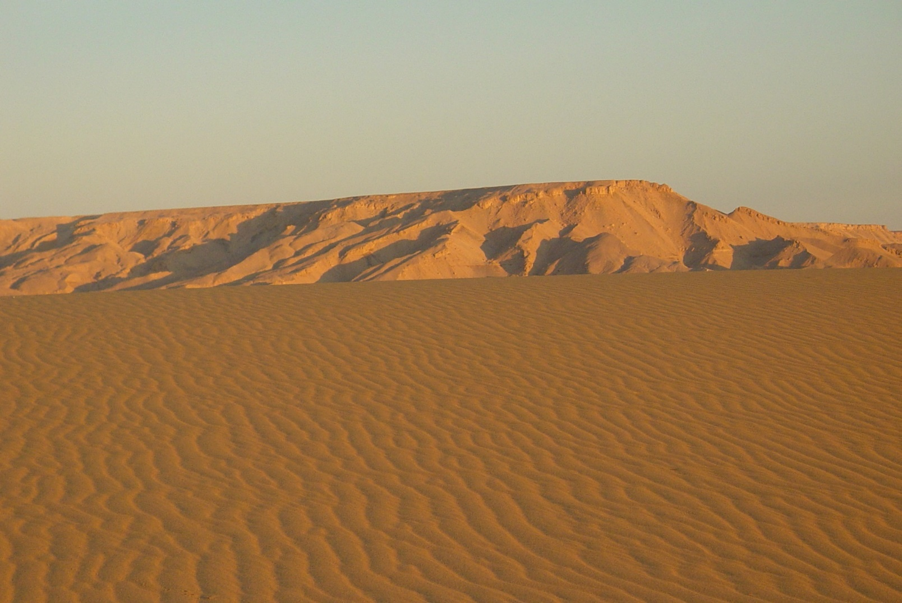
Desert
Photo courtesy of Jungle_Boy (@flickr.com) - granted under creative commons licence

Slide 16
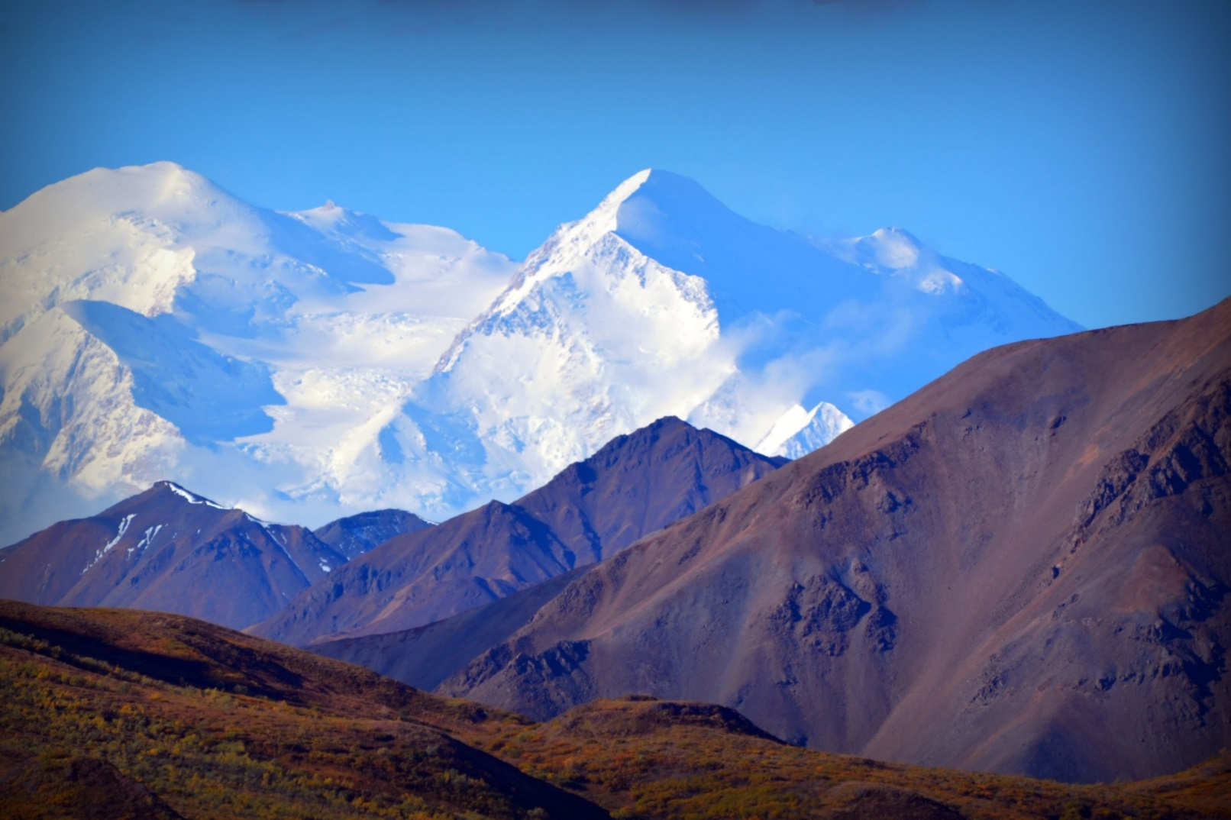
Mountains
Photo courtesy of blmiers2 (@flickr.com) - granted under creative commons licence

Slide 17
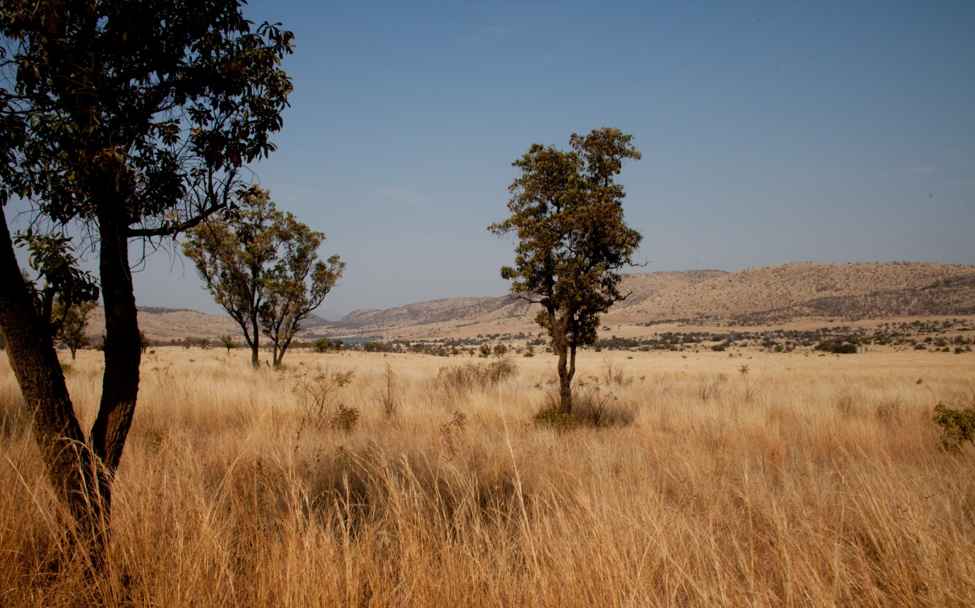
African Plains
Photo courtesy of blmiers2 (@flickr.com) - granted under creative commons licence

Slide 18
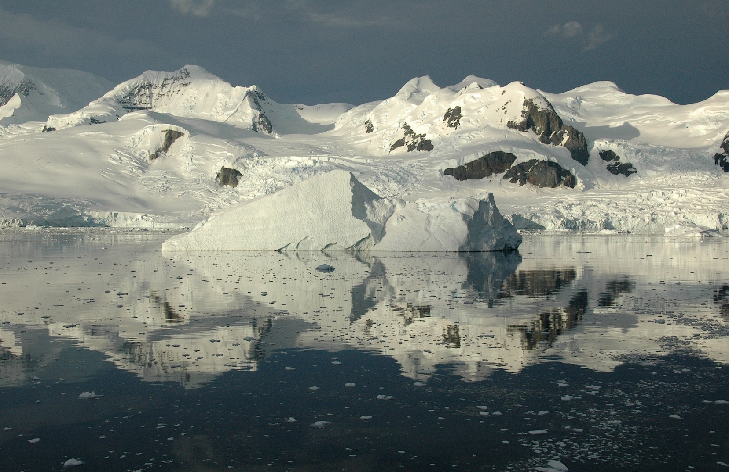
Arctic
Photo courtesy of Rita Willaert (@flickr.com) - granted under creative commons licence

Slide 19
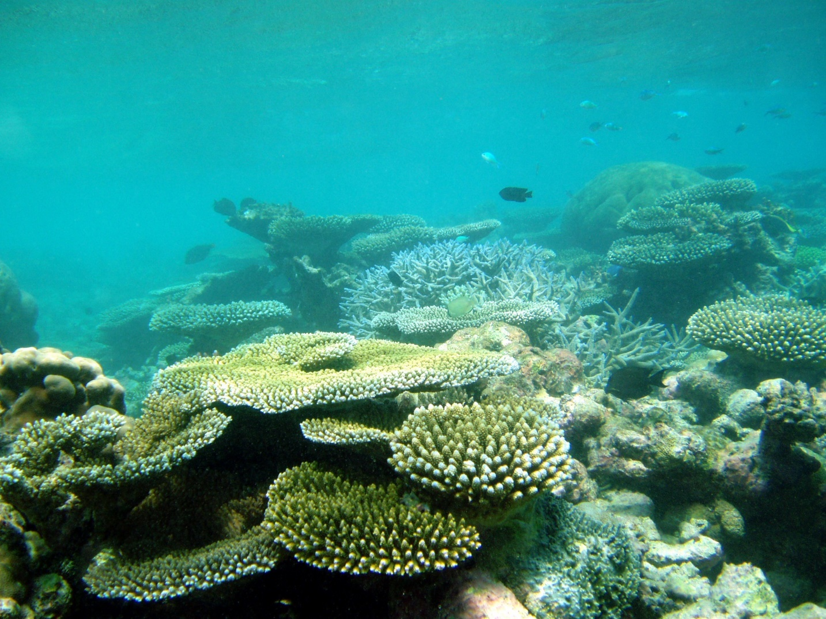
Corals
Photo courtesy of ccharmon (@flickr.com) - granted under creative commons licence

Slide 20
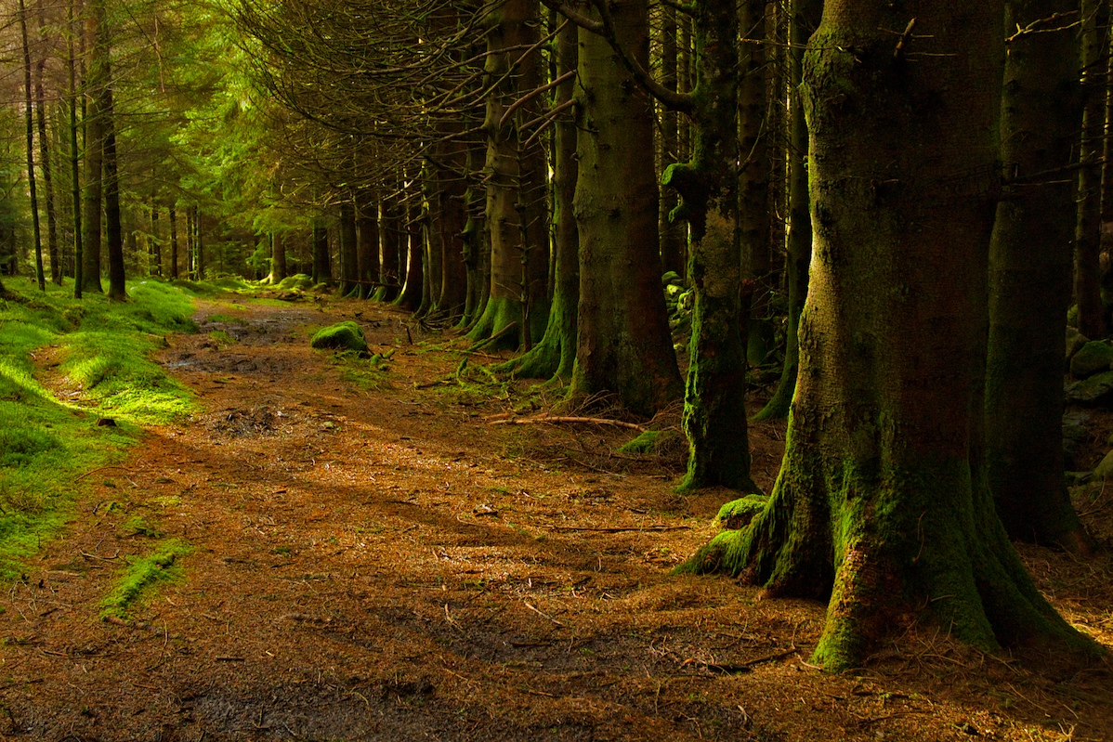
Woodland
Photo courtesy of erwlas (@flickr.com) - granted under creative commons licence

Slide 21
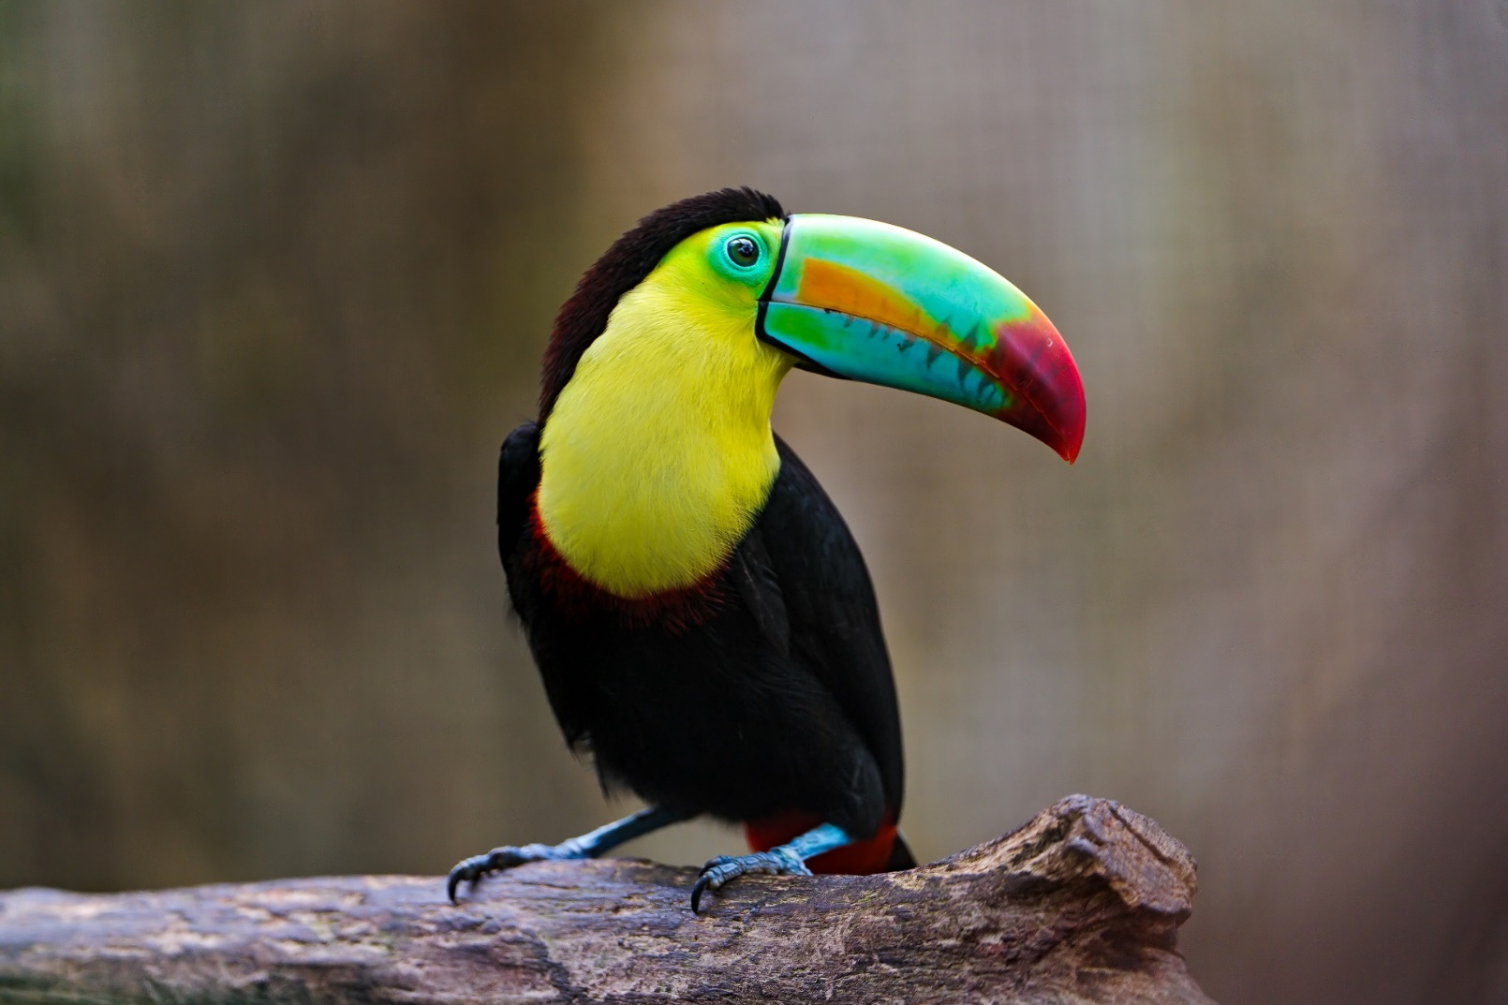
Toucan
Photo courtesy of ecollc (@flickr.com) - granted under creative commons licence

Slide 22
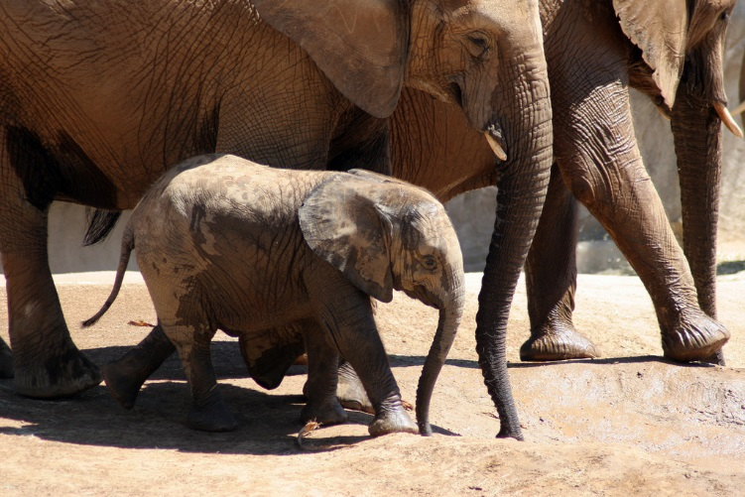
Elephants
Photo courtesy of ecollc (@flickr.com) - granted under creative commons licence

Slide 23
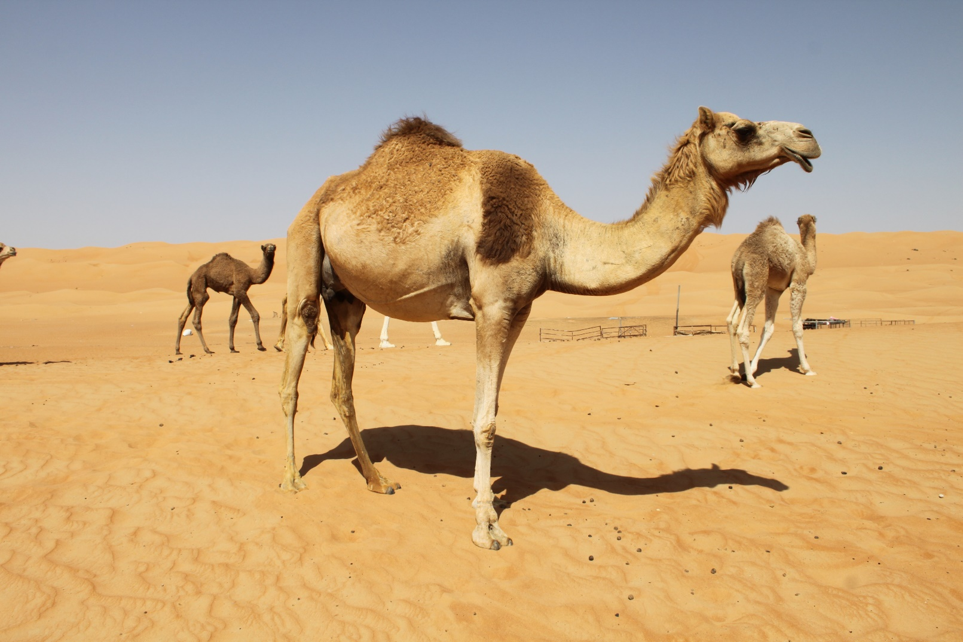
Camel
Photo courtesy of Liam (@flickr.com) - granted under creative commons licence

Slide 24
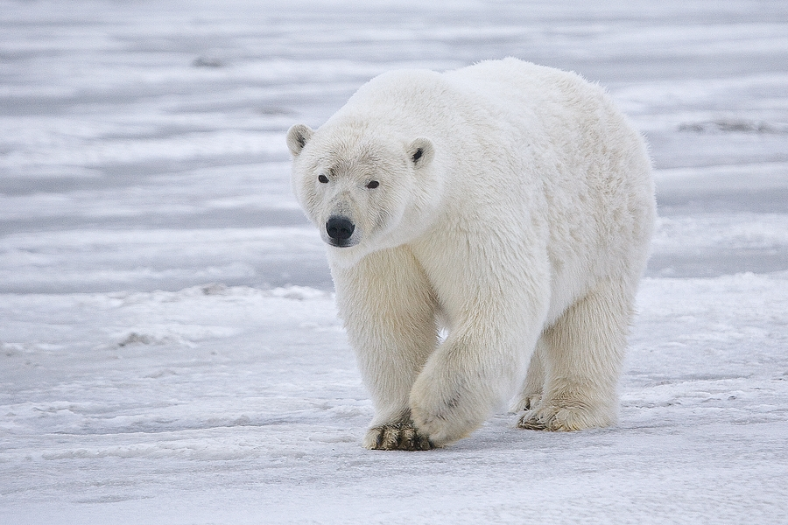
Polar Bear
Photo courtesy of frubyblossom (@flickr.com) - granted under creative commons licence

Slide 25
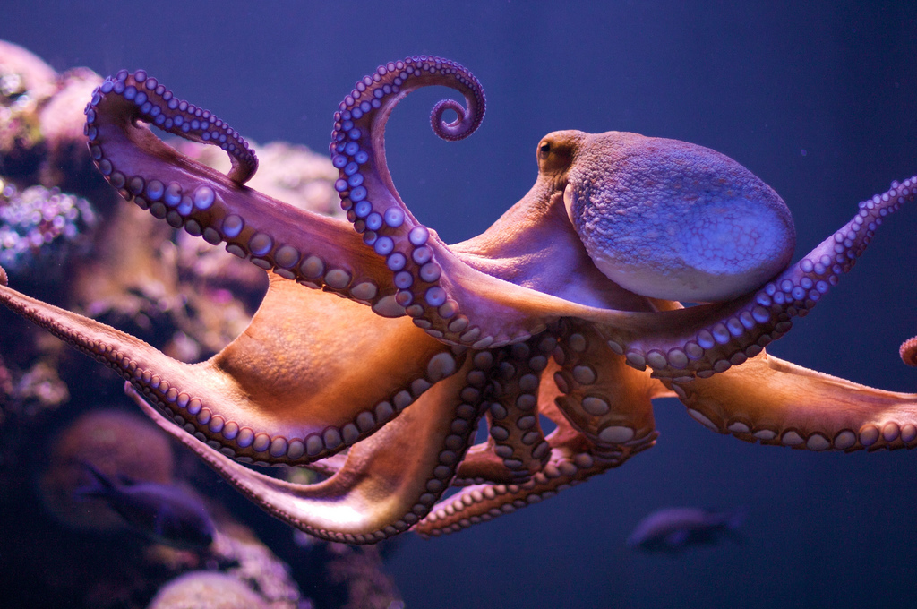
Octopus
Photo courtesy of Morten Brekkevold (@flickr.com) - granted under creative commons licence

Slide 26
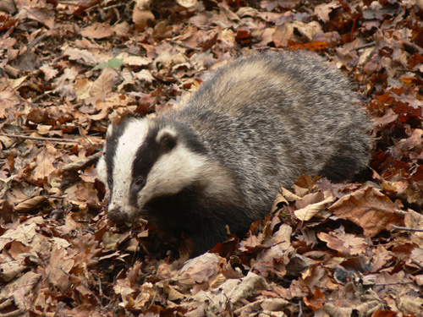
Badger
Photo courtesy of Fryerman (@flickr.com) - granted under creative commons licence

Slide 27
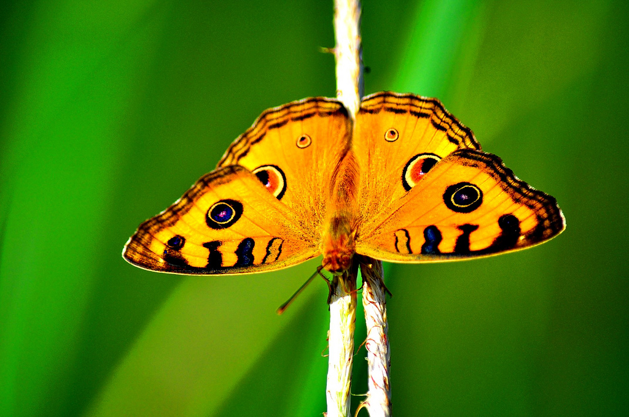
Butterfly
Photo courtesy of whologwhy (@flickr.com) - granted under creative commons licence

Slide 28
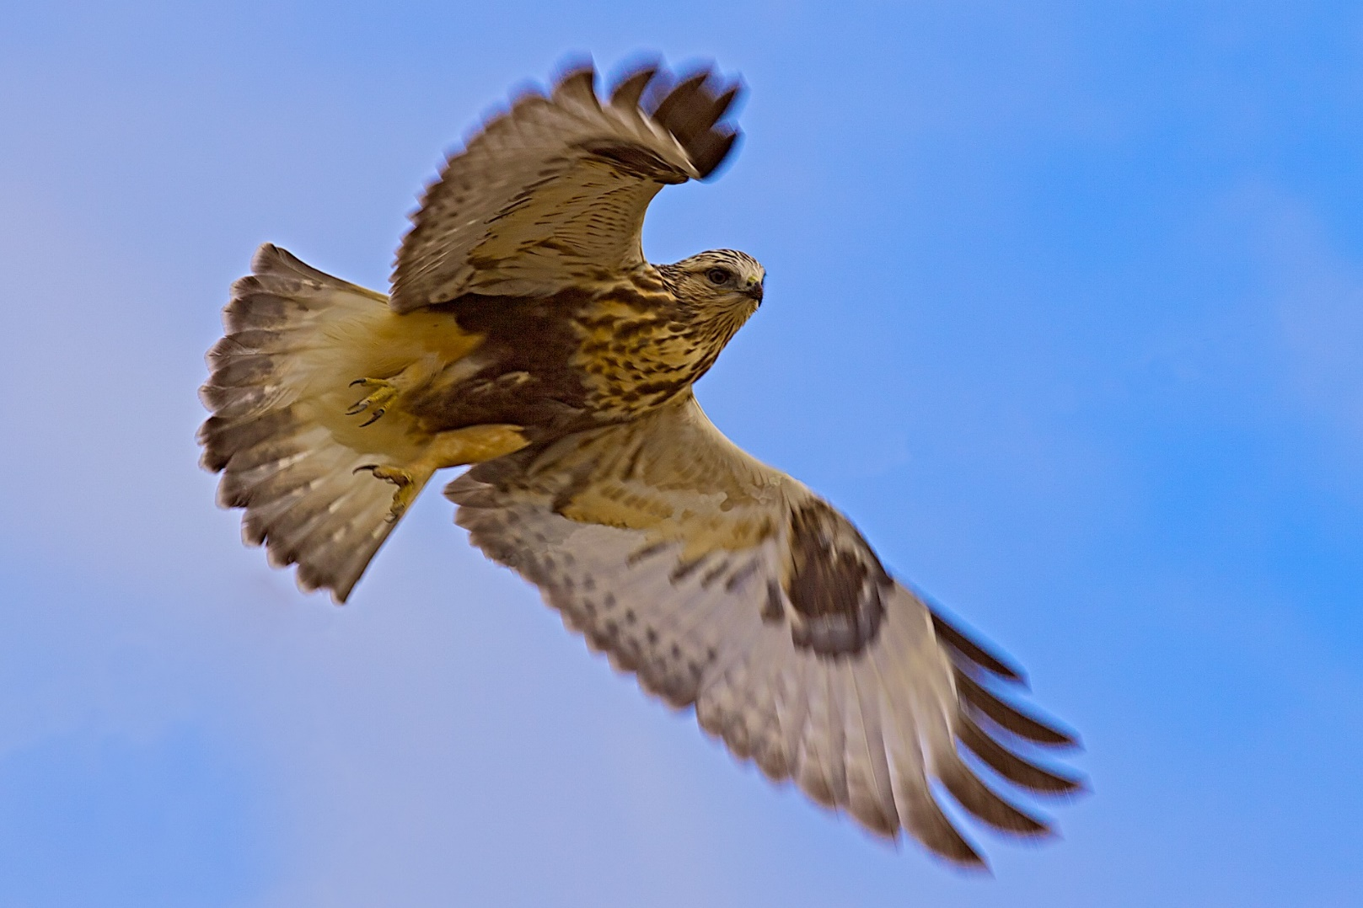
Hawk
Photo courtesy of fyngyrz (@flickr.com) - granted under creative commons licence

Slide 29
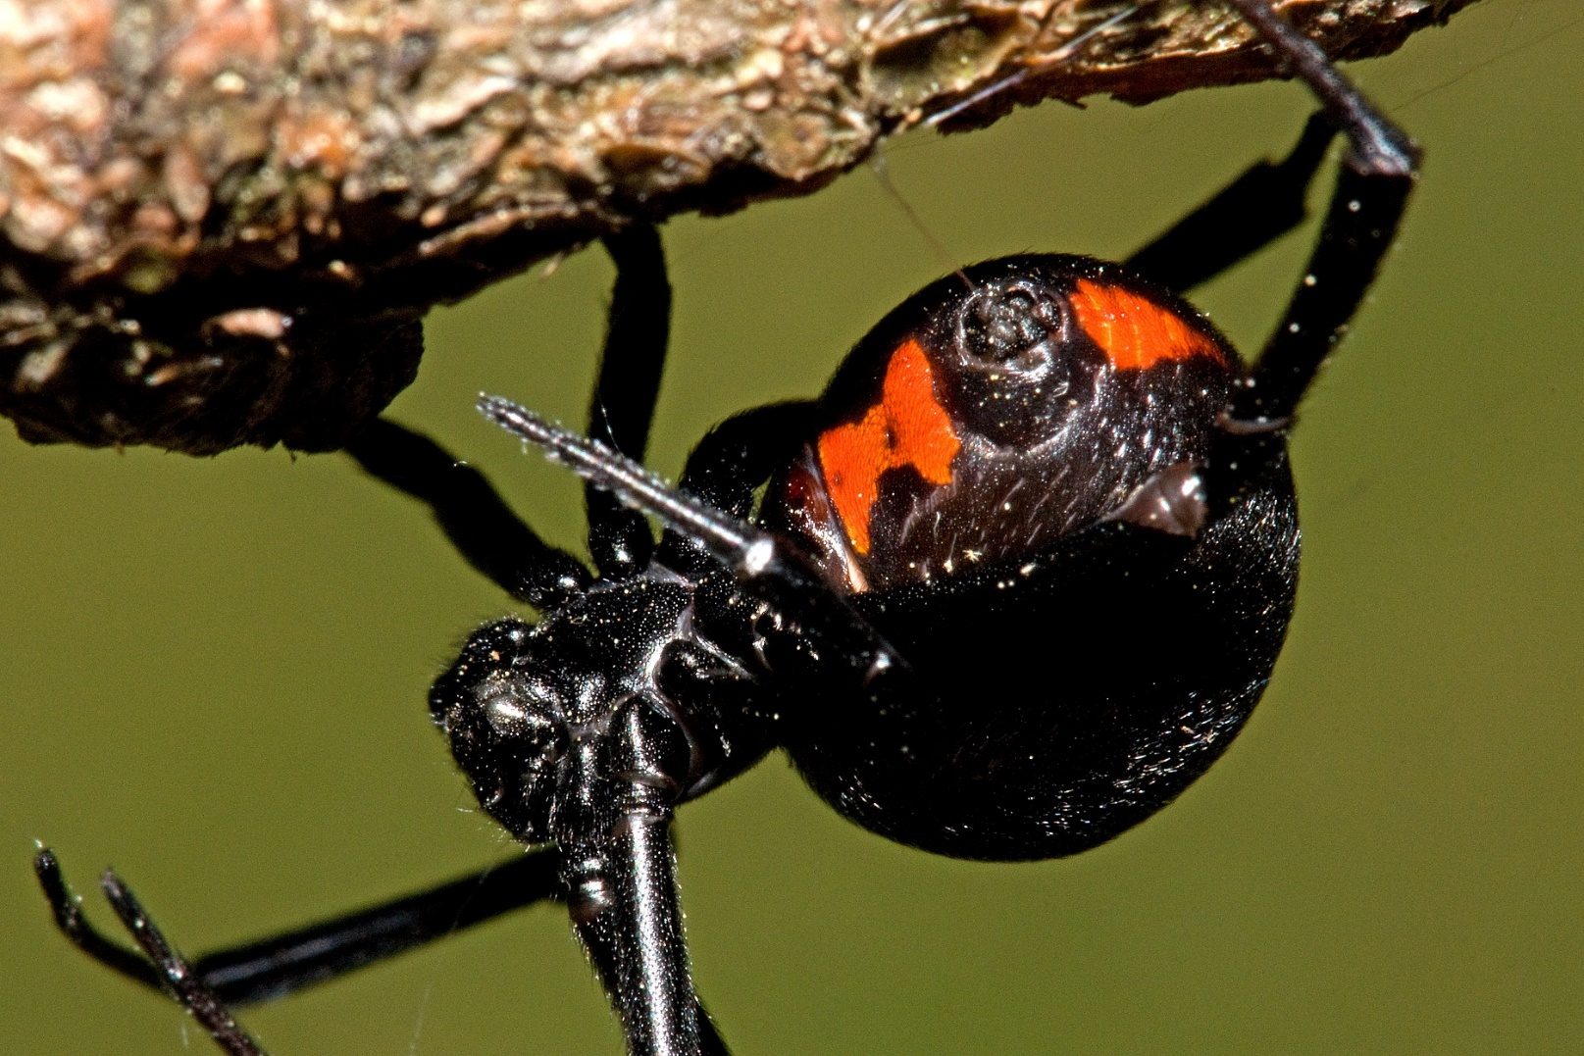
Spider
Photo courtesy of e_monk (@flickr.com) - granted under creative commons licence

