Slide 1
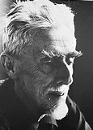
MC Escher
Optical Illusional Art

Slide 2
Learning objectives;
To learn about the artist MC Escher.
To study his work, particularly his optical illusions.
To compare and contrast his work, making observations and giving opinions.
To create a black & white composition inspired by the work of Escher.

Slide 3
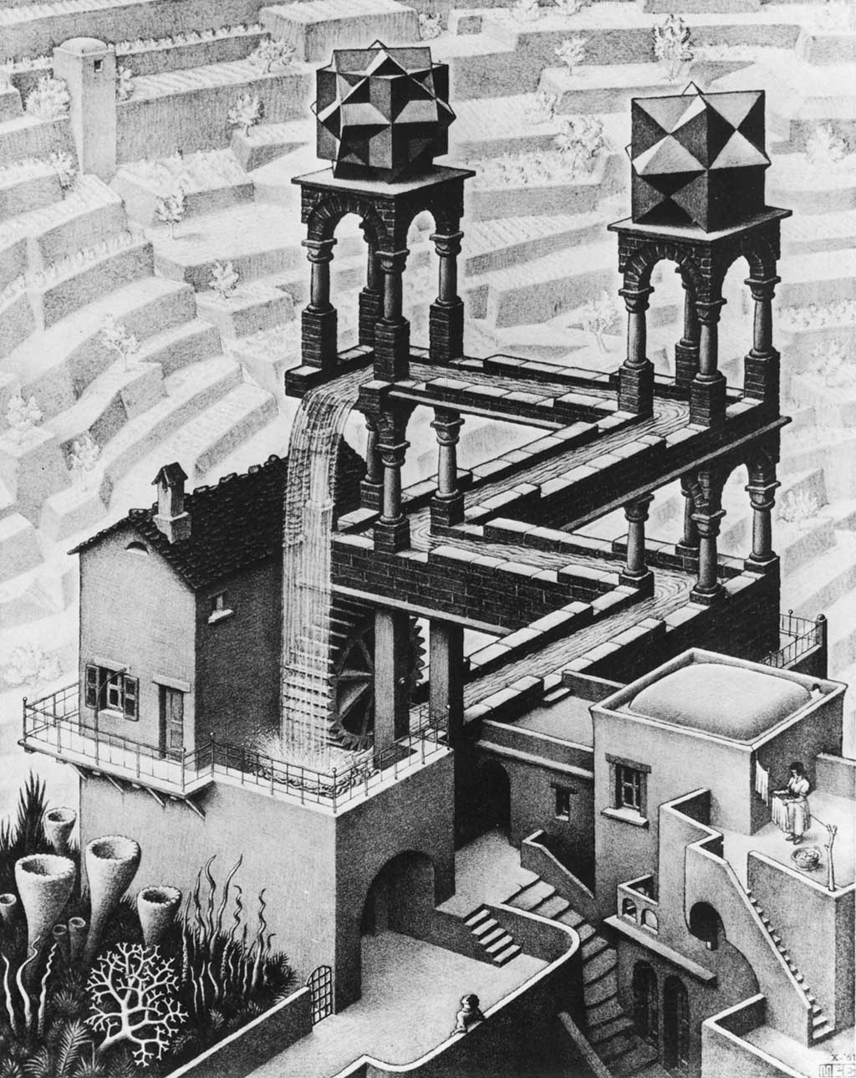
Maurits Cornelis Escher was a Dutch graphic artist who made mathematically-inspired woodcuts, lithographs, and mezzotints. Despite wide popular interest, Escher was somewhat neglected in the art world, even in his native Netherlands. He was 70 before a retrospective exhibition was held. In the twenty-first century, he became more widely appreciated, with exhibitions across the world.

Slide 4
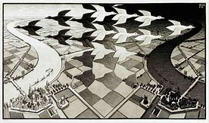
His work features mathematical objects and operations including impossible objects, explorations of infinity, reflection,
symmetry, perspective,
geometry, and tessellations.
Although Escher believed he had no mathematical ability, he interacted with many famous mathematicians, and conducted his own research into tessellation.
Look carefully at the picture above. This is called ‘Day & Night’. Each of the flying geese can be seen as separate of the gap between each other using the contrast of black against white.

Slide 5
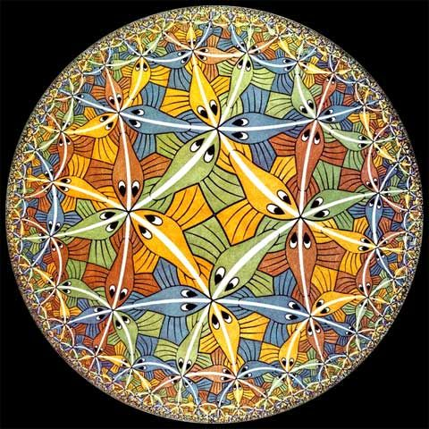
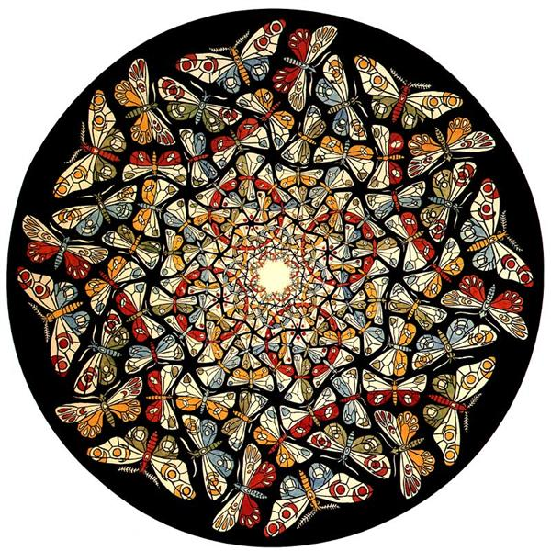
Early in his career, he drew inspiration from nature, making studies of insects, landscapes, and plants such as lichens, all of which he used as details in his artworks. He travelled in Italy and Spain, sketching buildings, townscapes, architecture and the tiling of the Alhambra and the Mezquita of Cordoba, and became steadily more interested in their mathematical structure.
Here you can see the influence from nature (butterflies and fish) and the tiling of Cordoba. These are in colour unlike the majority of Escher’s work. These are excellent examples of his use of hyperbolic tessellation.
‘Outer Limits’ 1959

Slide 6
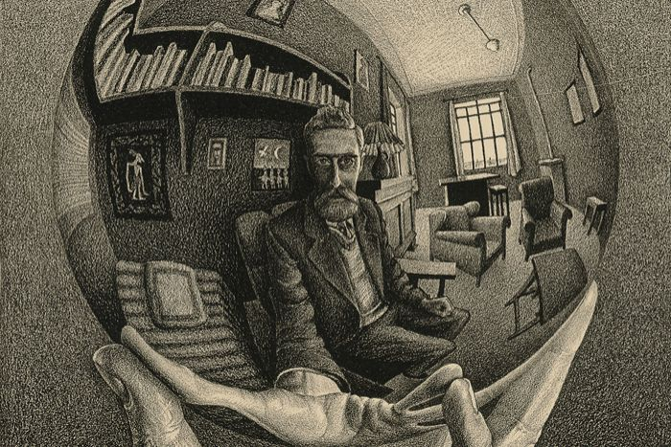
Optical Illusion, Mathematics, Science or art?
Much of Escher’s work involves optical illusion. Stairs that appear to be going up and down at the same time; people in buildings that apear the correct way up whichever way you turn it and images that can be more than one thing at the same time.

Slide 7
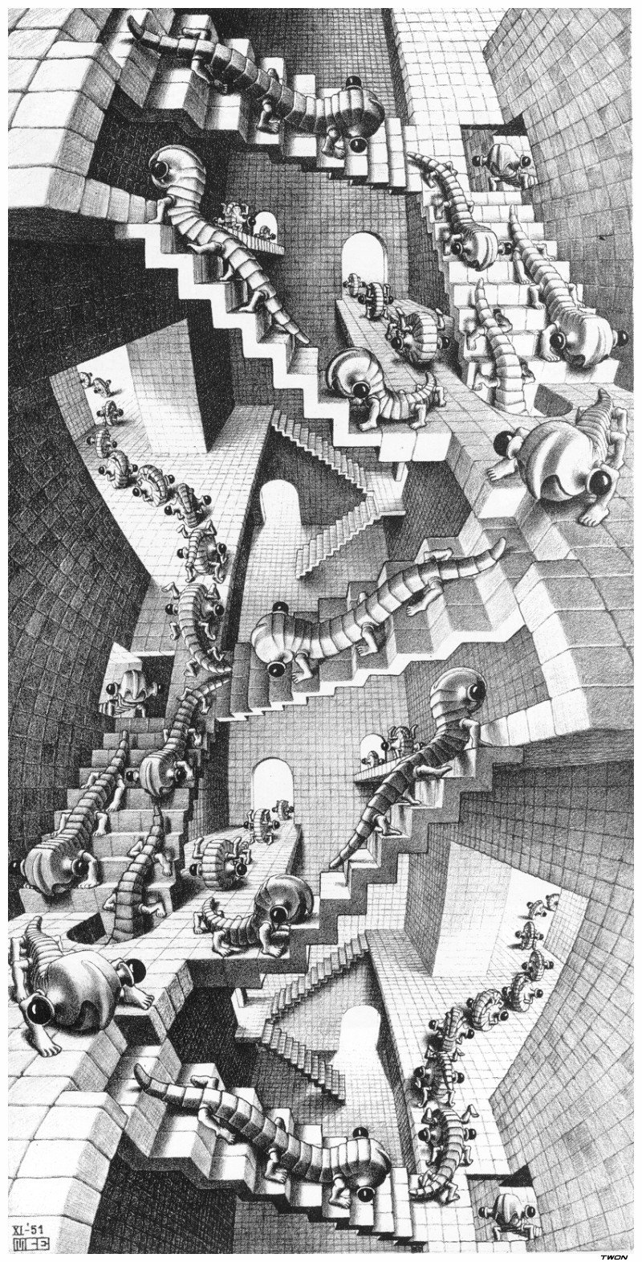
House of Stairs, 1951, is another of Escher’s lithograph prints. Works of art like this inspire one to look into the details and think beyond what the eye can see.
In it one can see the interior of a very tall structure full of stairs and doorways. There are 46 creatures crawling up and down the stairs.
These lizard-like creatures were created by Escher and they are referred to as “wentelteefje.”
The theme of this print is, once again, the defying of logic, as there are so many impossibilities in it if one looks closely and thinks shrewdly.

Slide 8
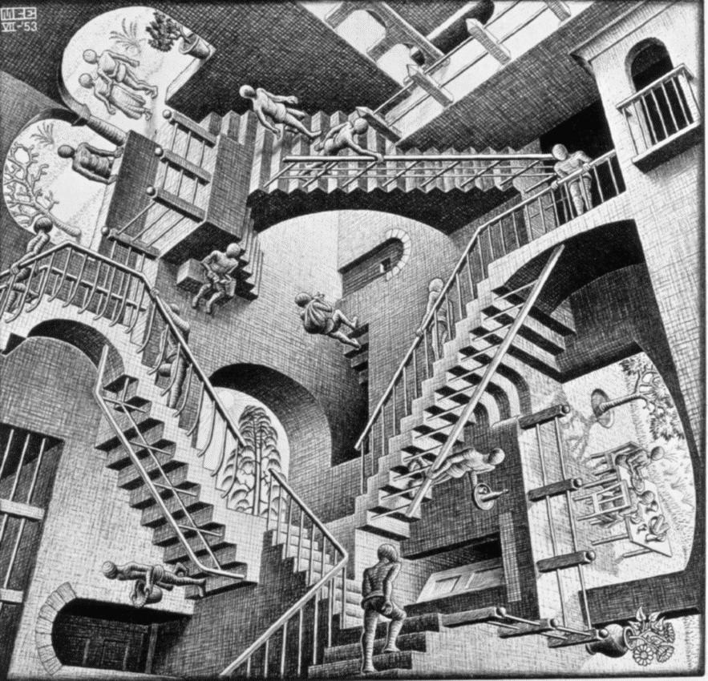
Relativity 1953
Several of the worlds that he drew were built around impossible objects. After 1924, Escher turned to sketching landscapes in Italy and Corsica with irregular perspectives that are impossible in natural form. His first print of an impossible reality was Still Life and Street (1937); impossible stairs and multiple visual and gravitational perspectives feature in popular works such as Relativity (1953).

Slide 9
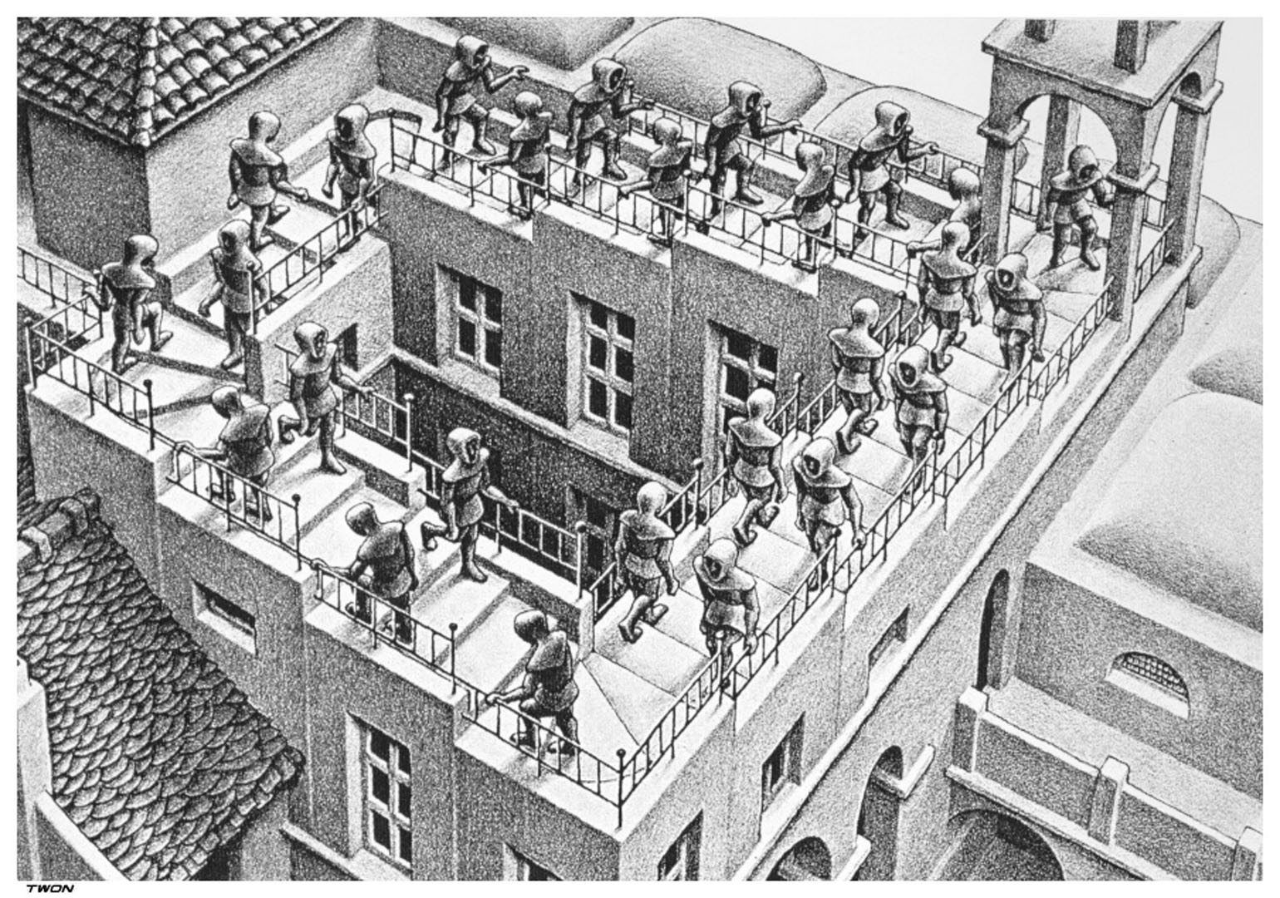
The Story of a Stairway That Never Ends
‘Ascending & Descending’ 1960
Look carefully at this picture. Amazingly, all the figures are either walking upstairs of downstairs, passing each other as you would on any stairway.
Now look at the staircase itself.It is going at the same time as going down, depending on your focus.

Slide 10
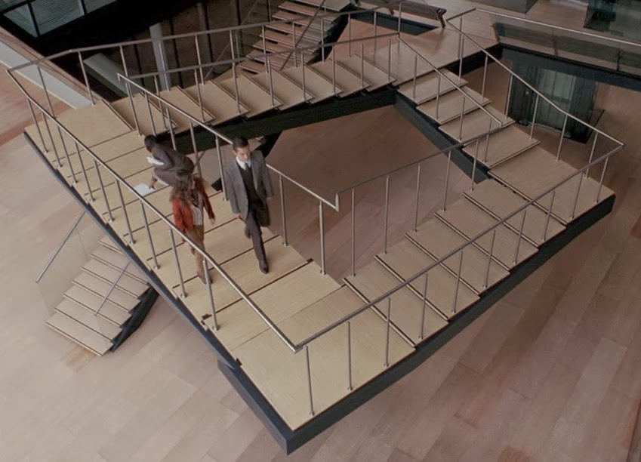
Take the stairs portrayed in the 2010 motion picture “Inception.” If you’re one of those people who see the architecture in everything, you probably remember the scene where Joseph Gordon-Levitt expounds on what he calls “paradoxical architecture” while leading a mesmerized Ellen Page up a very convincing model of the enigmatic Penrose Stair. “In dreams,” he tells her, “you can cheat architecture into impossible shapes.”
Alternatively known as the Impossible Stairway or Escherian Stairwell, Escher employed a similar technique in his lithograph “Ascending and Descending”) this optical illusion of a staircase that never ends is actually credited to a British mathematician & his son, Lionel Penrose; hence the name Penrose Stair.

Slide 11
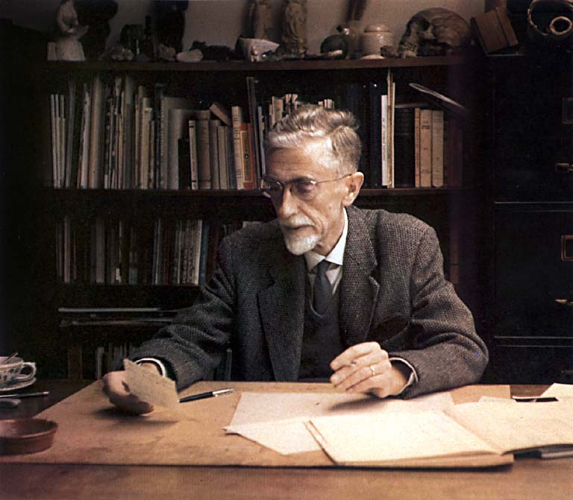
Escher's art became well known among scientists and mathematicians, and in popular culture, especially after it was featured by Martin Gardner in his April 1966 Mathematical Games column in ‘Scientific American’. Apart from being used in a variety of technical papers, his work has appeared on the covers of many books and albums. He was one of the major inspirations of Douglas Hofstadter's Pulitzer Prize-winning 1979 book Gödel, Escher, Bach.

Slide 12
Activity tasks
Find as many different examples of Escher’s Optical Illusions as you can.
Which one do you like best? Why? What do you like/admire about it?
Select one of his peices of art, an illusion or tessellation and create your own composition. Look at the shapes he used to create some of his illusions.
Escher mostly worked in black and white so you will only need a pencil.
You could try charcoal or black pen if you have either available.

