Slide 1
David Oliveira and
Alexander Calder
Sculpture art

Slide 2
Learning objectives;
To learn about the artists Alexander Calder and David Oliveira
To say what you like/dislike about their work.
To compare the work of the two sculptors.

Slide 3
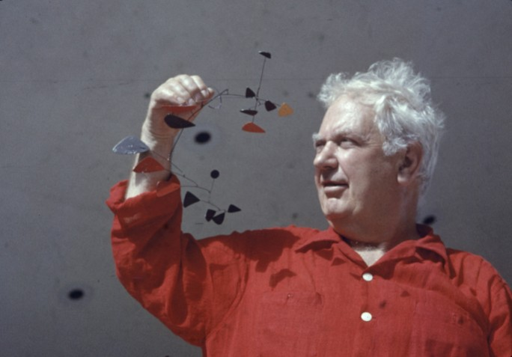
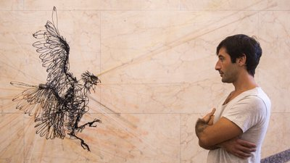
Alexander Calder David Oliveira
(1898-1976) (1980- present day)
American Portuguese
Alexander Calder was born in Philadelphia, USA.
He liked making sculptures that moved.
Alexander Calder studied engineering at university.
He often made his sculptures very small and then enlarged them.
David Oliveira was born in Lisbon, Portugal.
His wire sculptures play tricks
on your eyes because they
look like drawings but they
are three dimensional.
His focus was on the human & animal form.

Slide 4
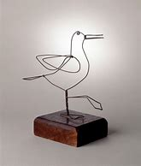
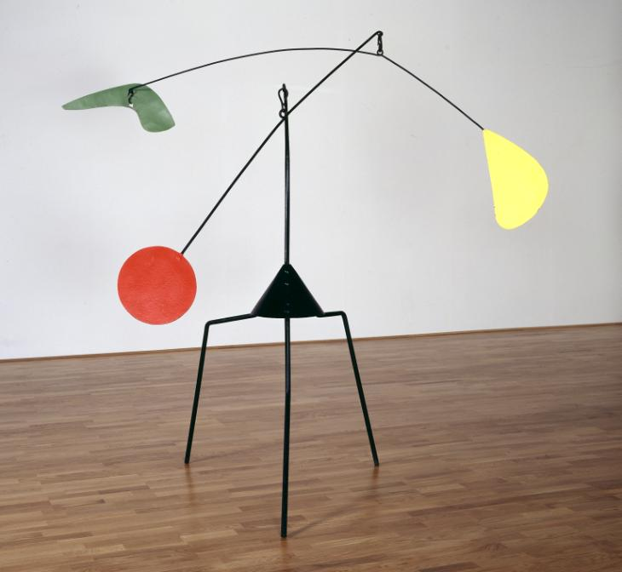
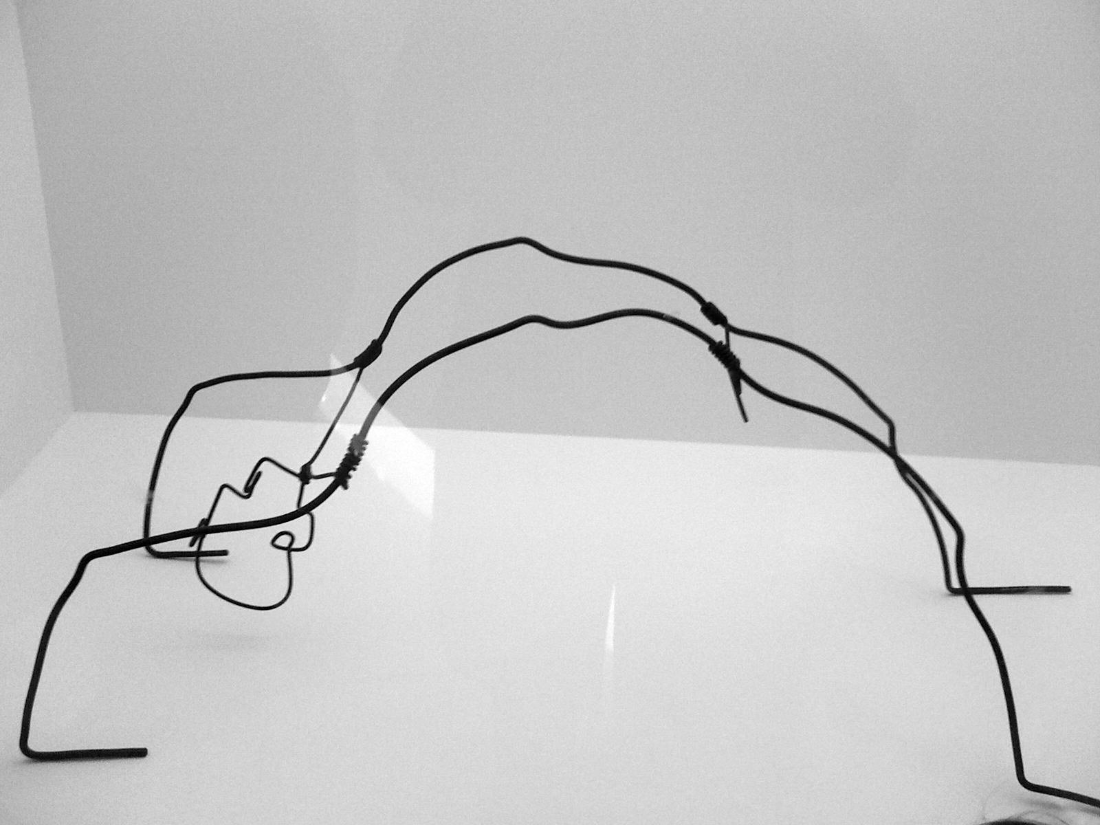
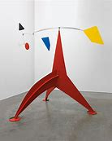
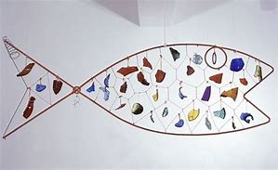
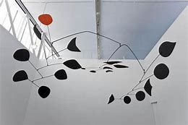
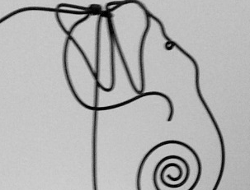
Alexander Calder sculptures

Slide 5
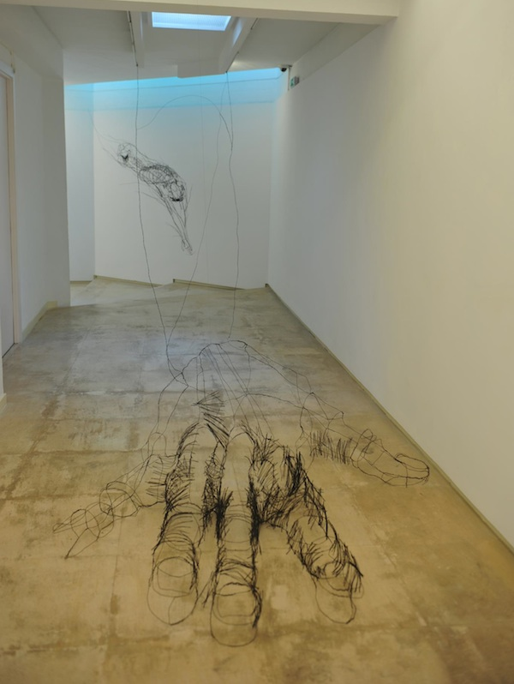
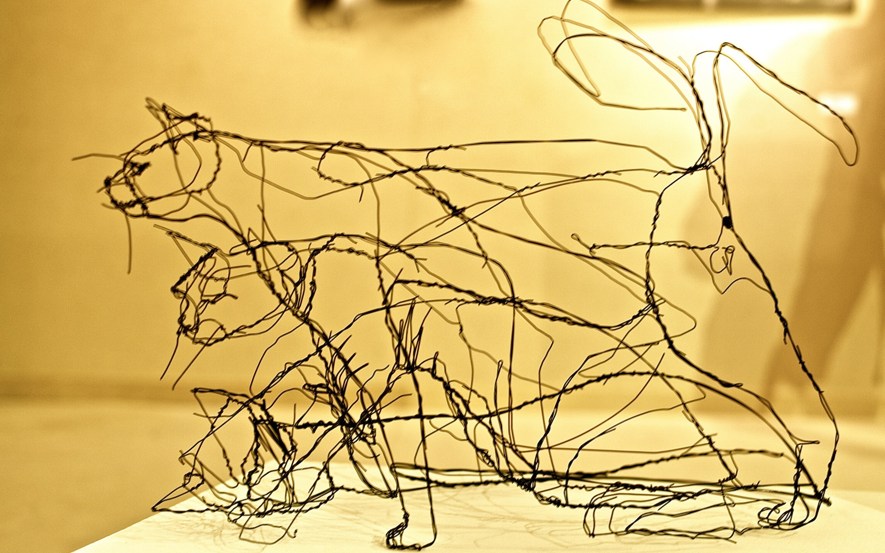
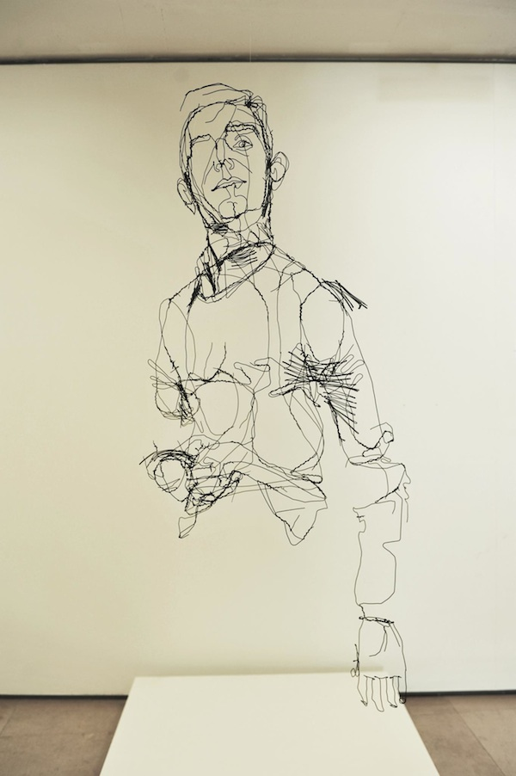
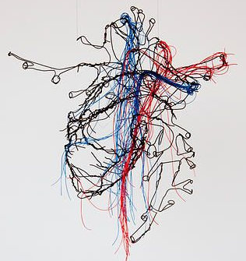
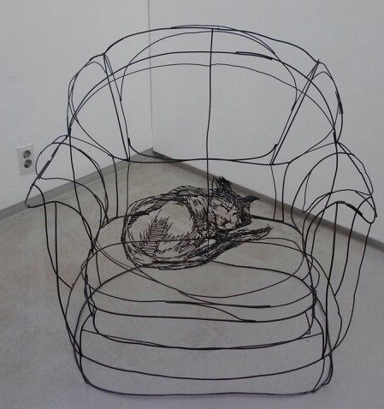
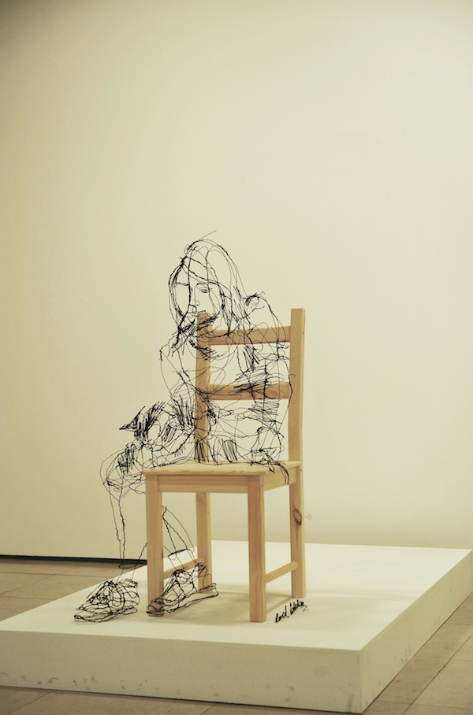
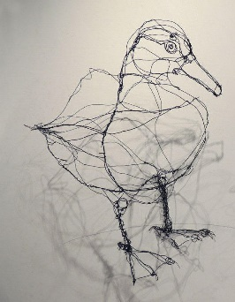
David Oliveira sculptures

Slide 6
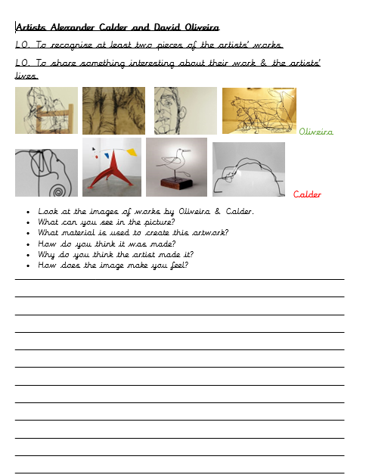
Activity
First read the two information sheets; one on each artist.
Now, complete the worksheet comparing the two sculptors. Which sculptor’s work do you prefer?
Why?

