Slide 1
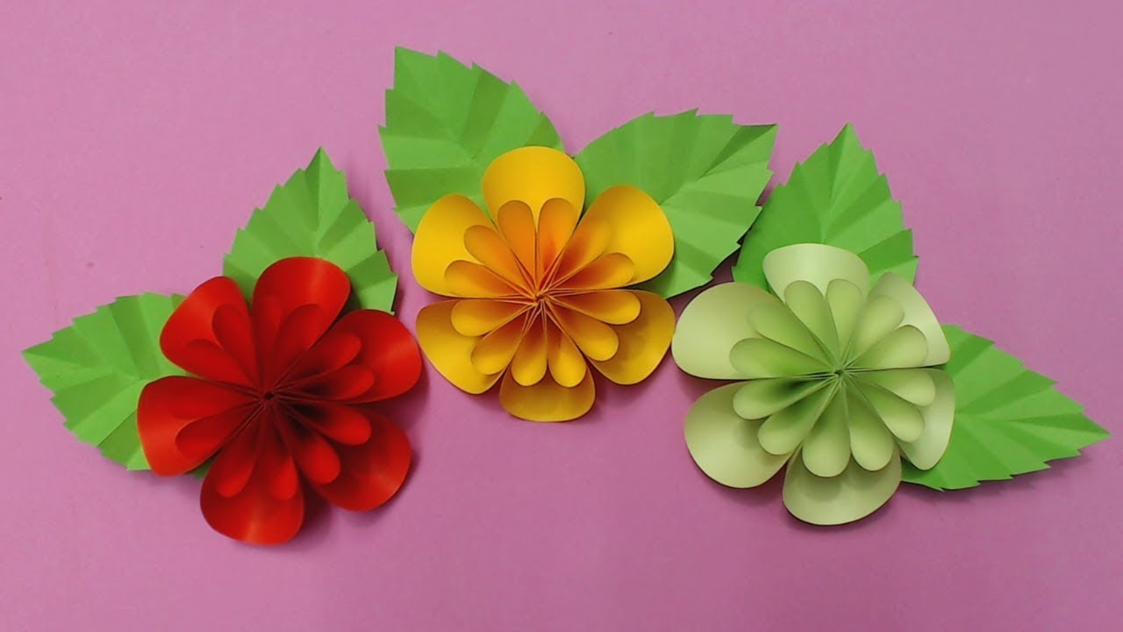
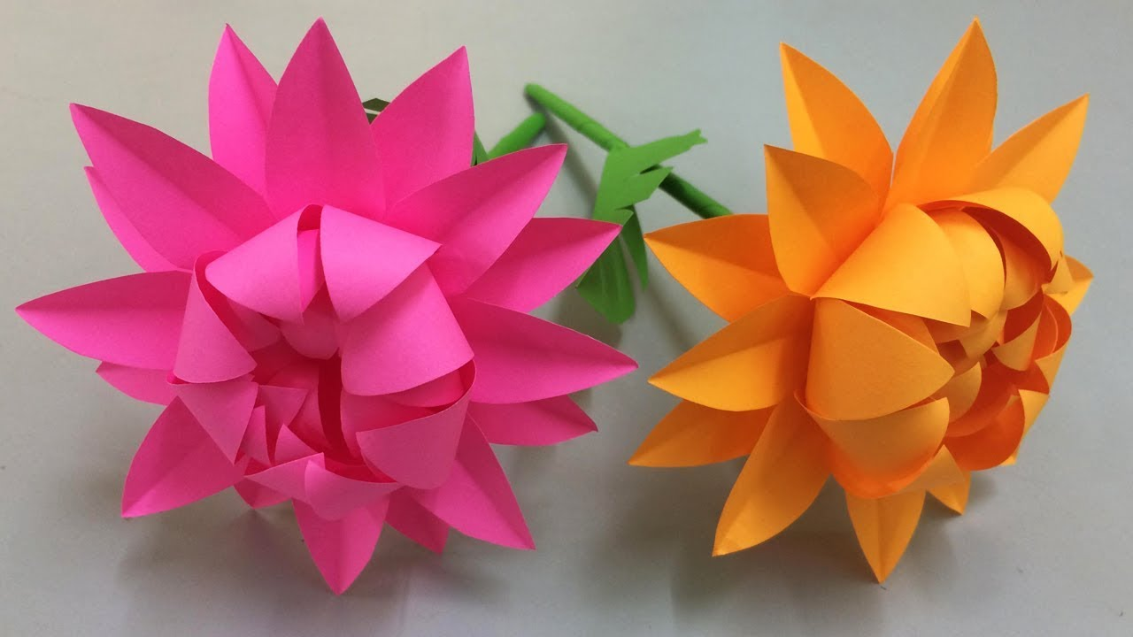
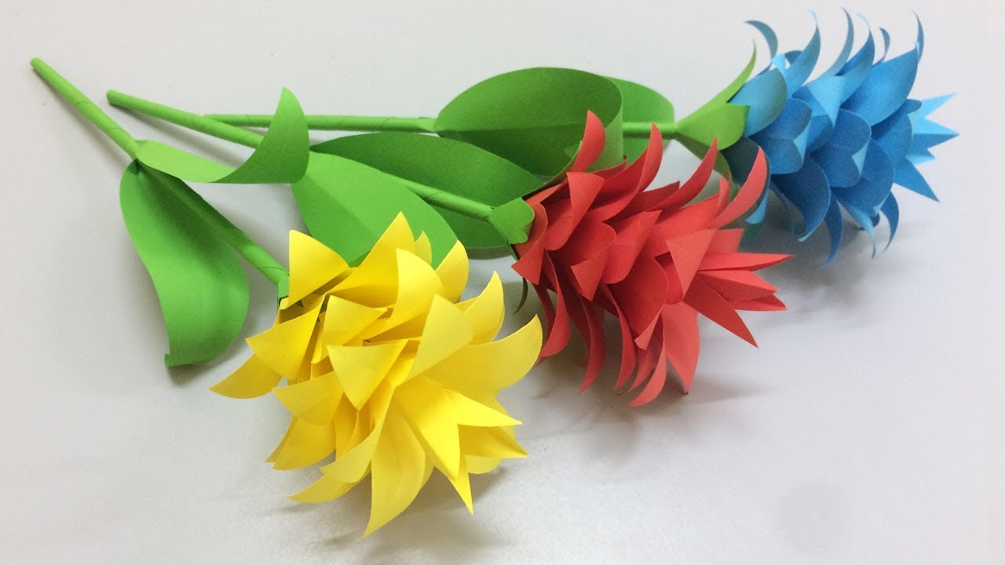
Plant Sculpture
Creating flowers from paper

Slide 2
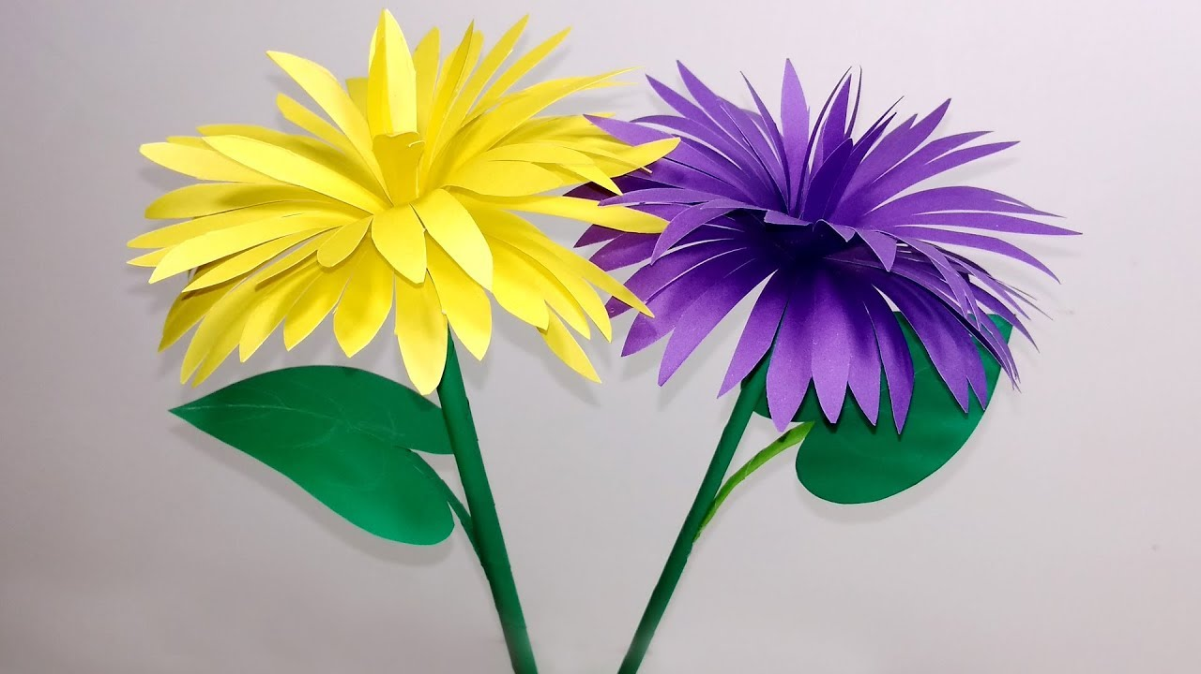
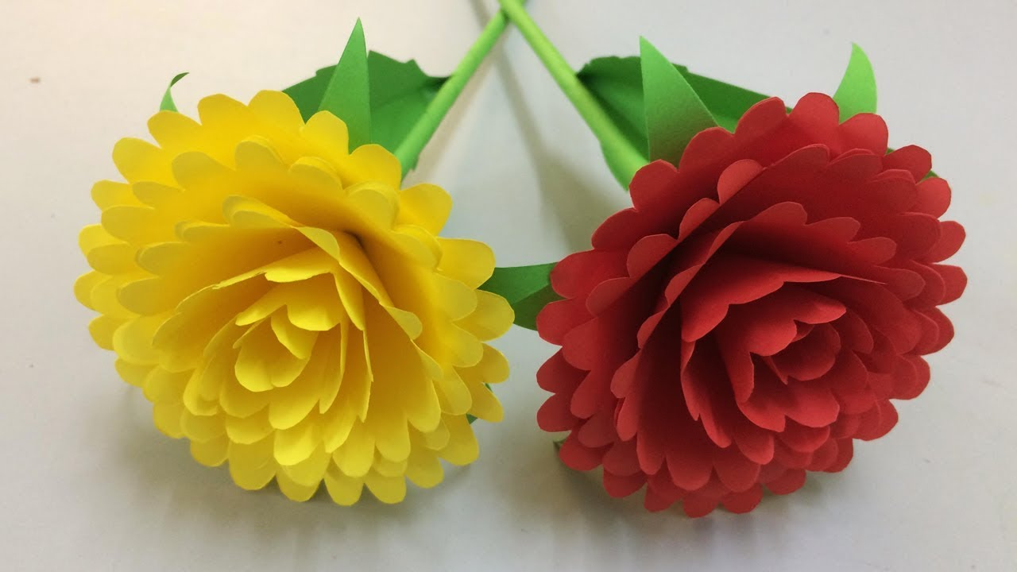
Paper flower making
You too can make beautiful paper
flowers like these.
But first, let us look at some other, simpler ways of making flowers from paper.

Slide 3
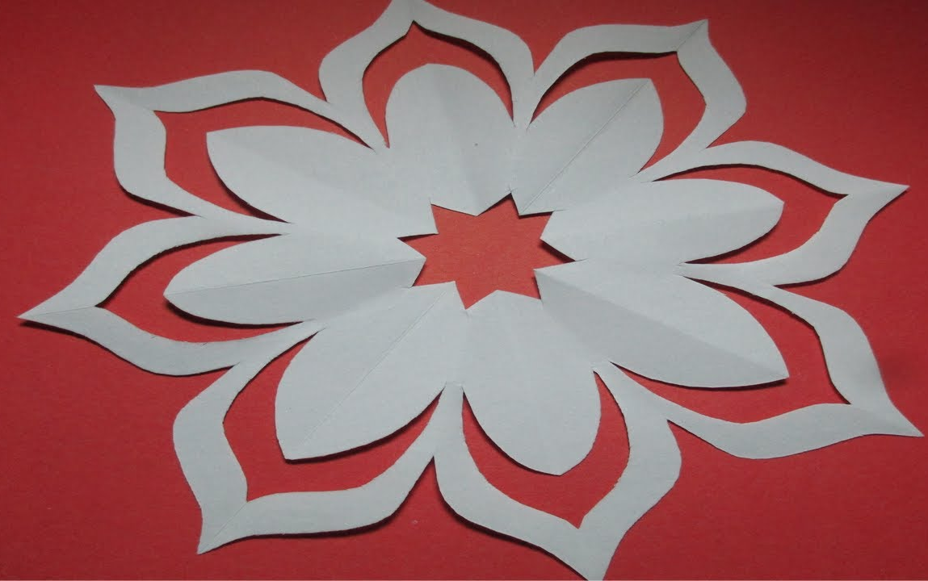
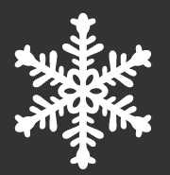
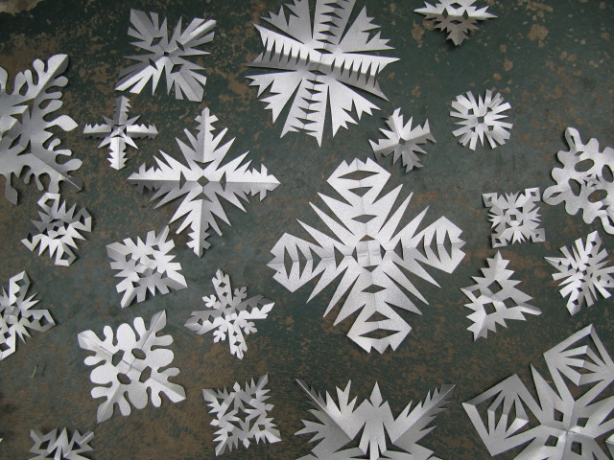
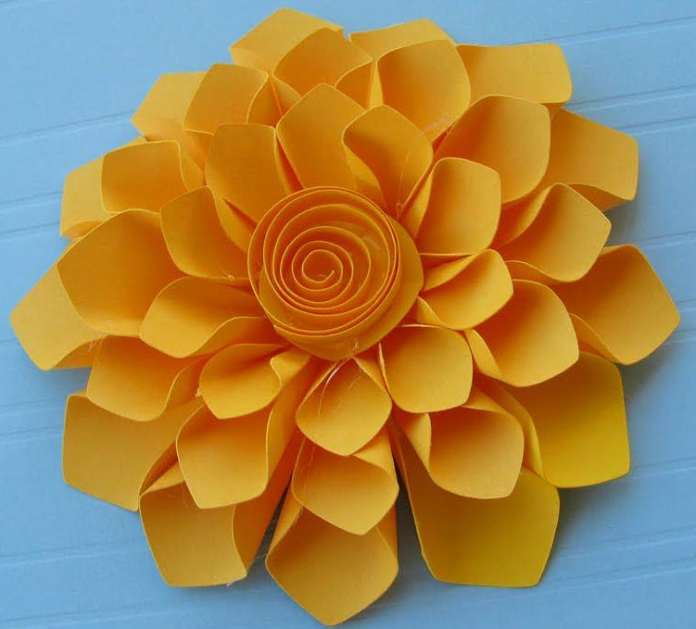
Cutting Paper Patterns
You have all made snowflakes by folding paper and then cutting out shapes.
You use this same simple procedure to create more complex flowers.

Slide 4

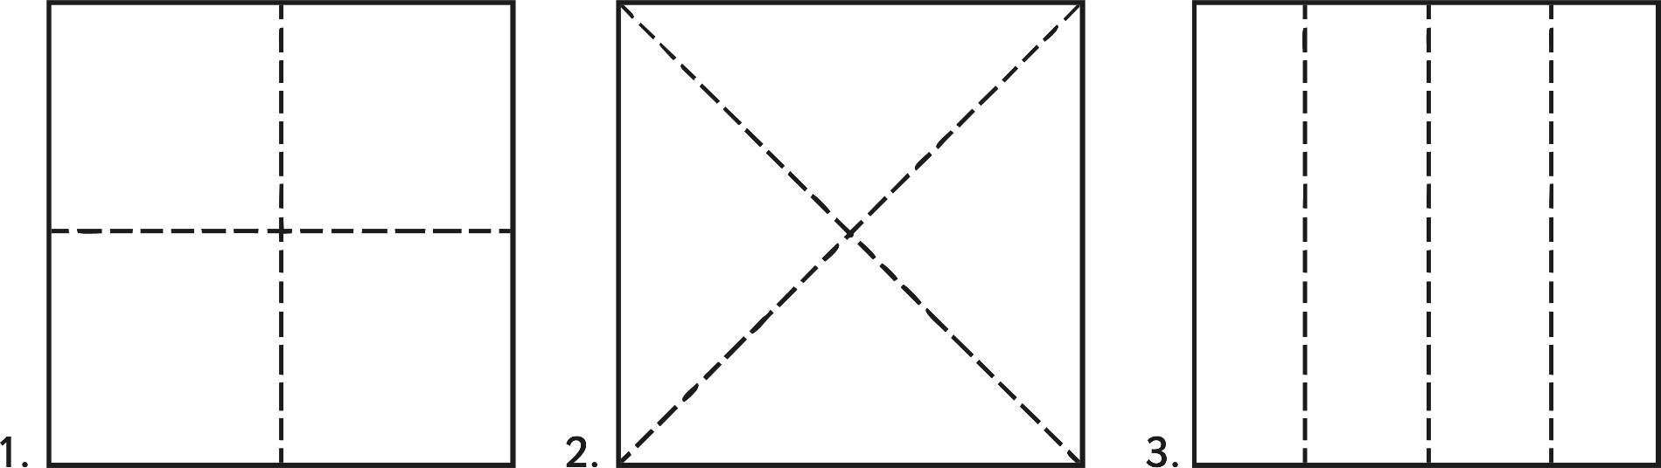
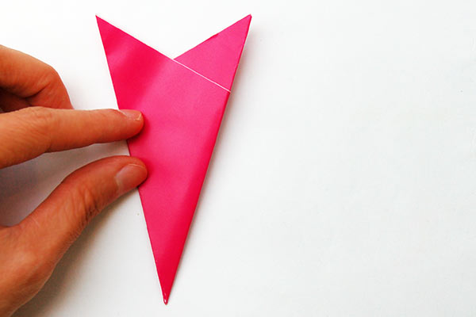
First of all, folding the paper
First, you need to choose the paper you want to use. Some designs require square paper, some circular and others, you cut out specific shapes.
Some designs require careful folding. Each stage in the correct order
You can fold the paper in different ways. Depending on how you fold the paper, the pattern
you cut into it will change.

Slide 5

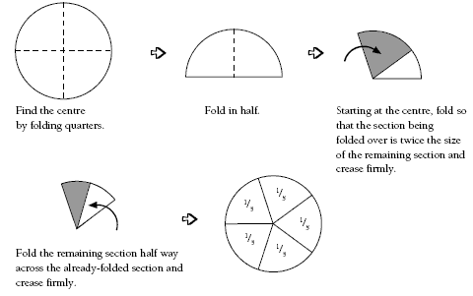
Folding the paper continued
There is only one way to fold a circle if you want to create a proper pattern.
You may want to use a circular piece of paper. Circles are often used for paper flowers.
Many paper flower designs use layers of circles or a number of them made into shapes and stuck together.

Slide 6
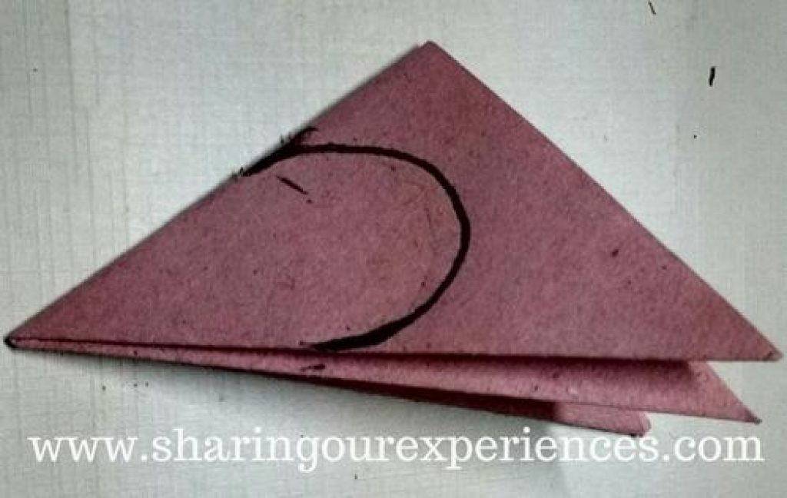
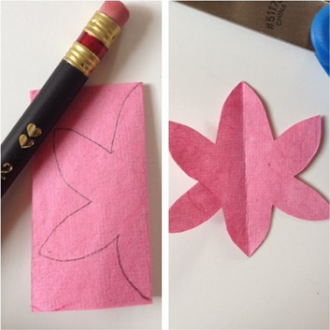
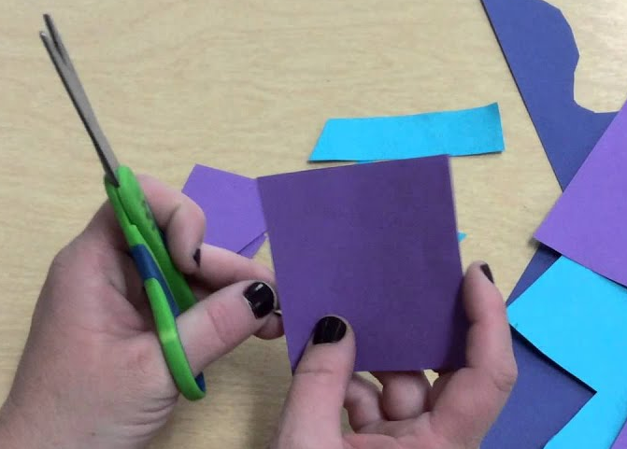
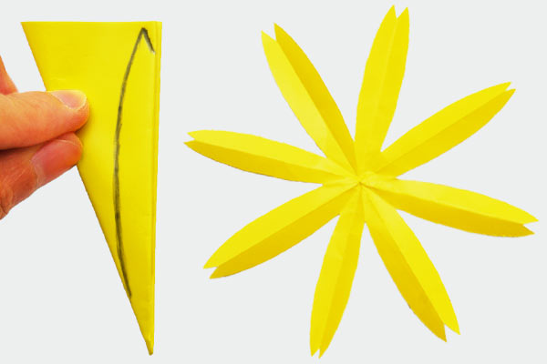
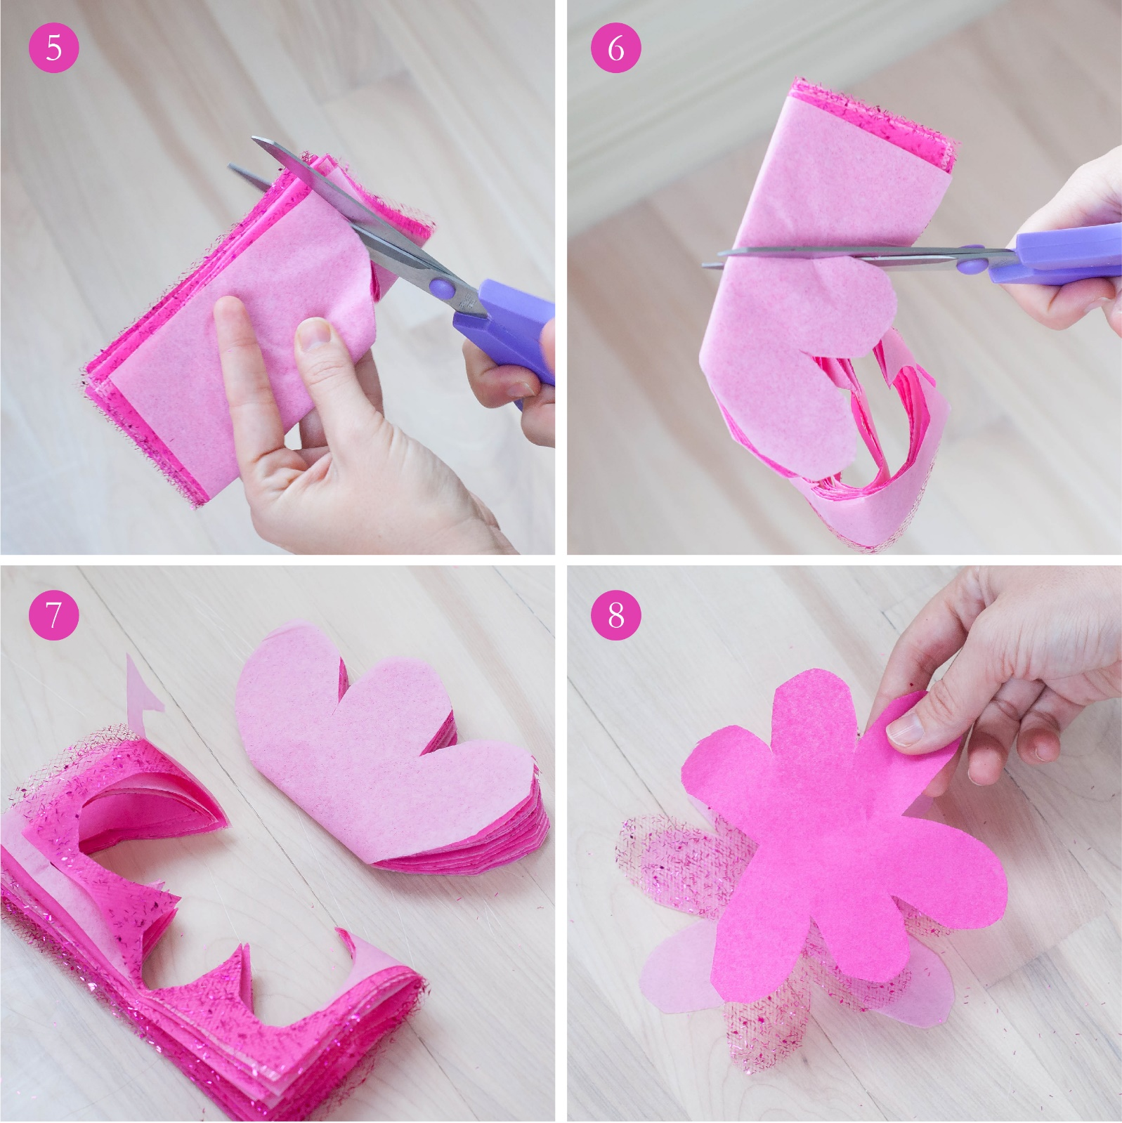
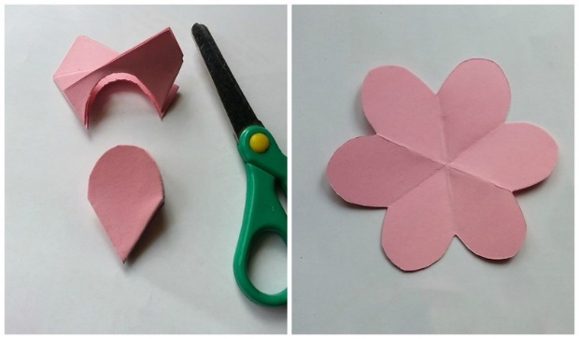
Cutting out the shapes
Once you have decided on your shape of paper and folded it, it is time to draw on your shape to be cut out.
Draw the curve or the petal shape you need. Make sure you draw it on the correct side of the folded paper.
Make sure you cut the correct side. You do not usually cut the folded side.
Sometimes, you will need lots of the same shape (petals).

Slide 7
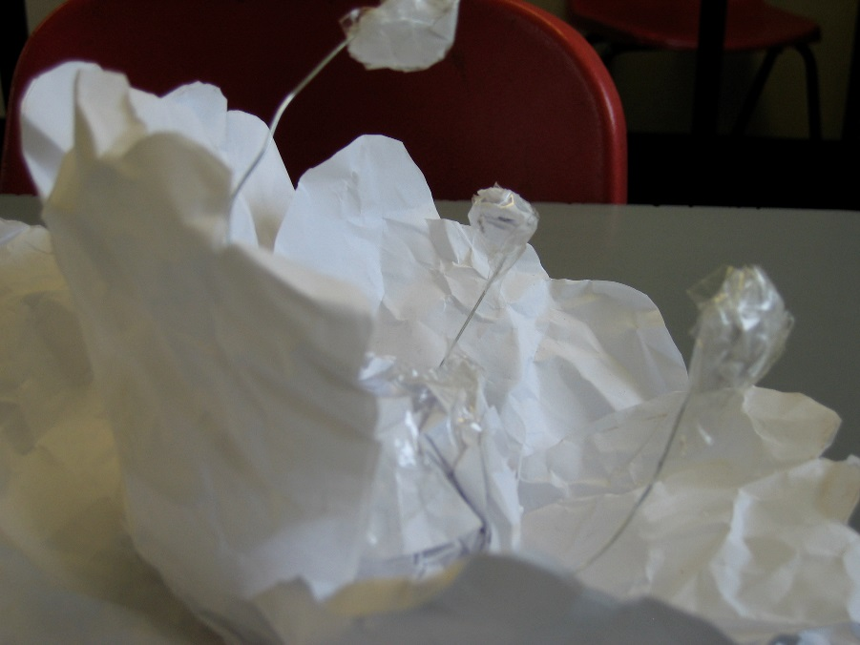
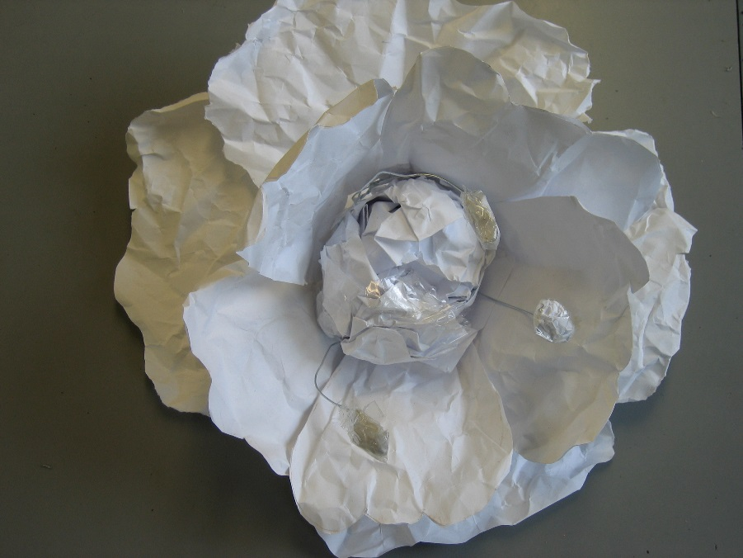
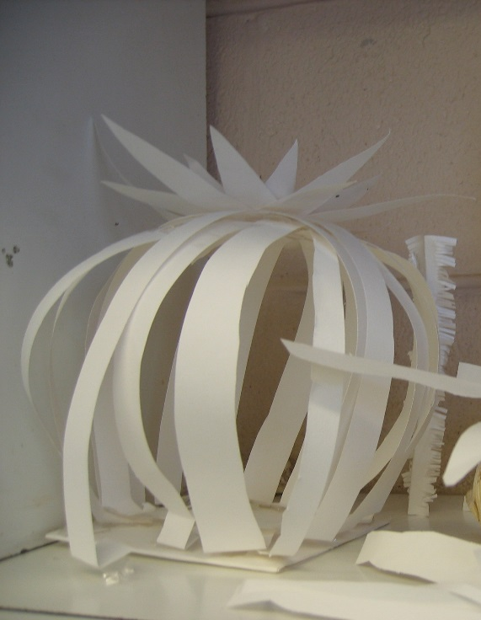
Paper scrunching
Another option is to scrunch the paper, or mould it into shape rather than folding and cutting.
You will probably still need to stick parts of your flower together if you select this method.
Are you going to use coloured paper or paint it once you have made it?

Slide 8
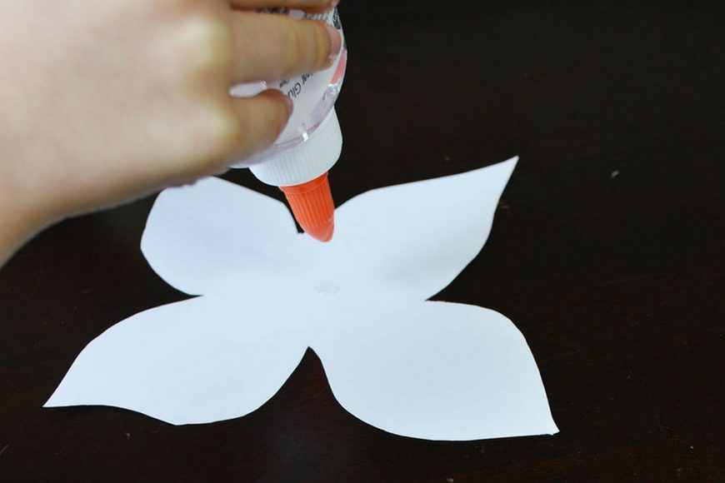
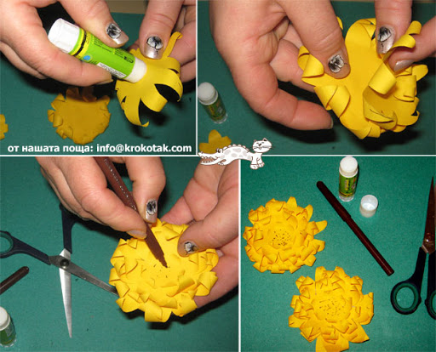
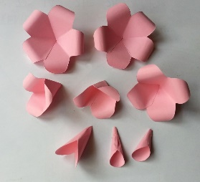
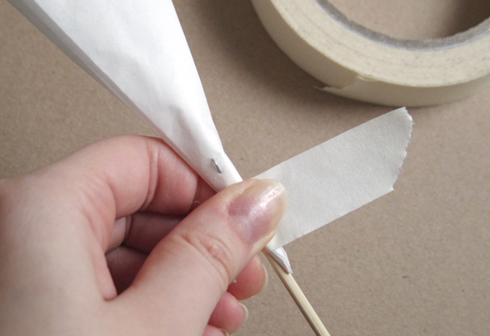
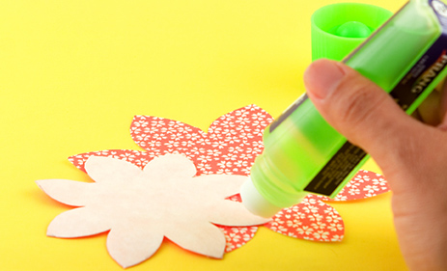
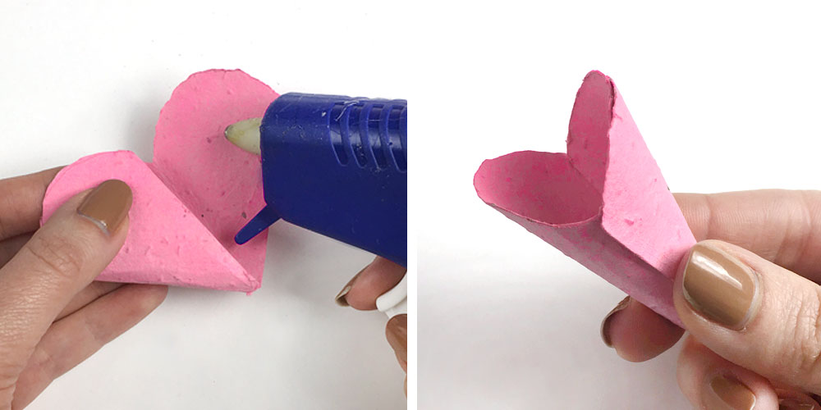
Sticking, gluing, taping, attaching
Some designs will require you to stick layers together, others to stick individual pieces you have made together.
You can use a glue stick, liquid glue, a glue gun or tape.
There are different ways for you to
attach the petals, stem, leaves etc.

Slide 9
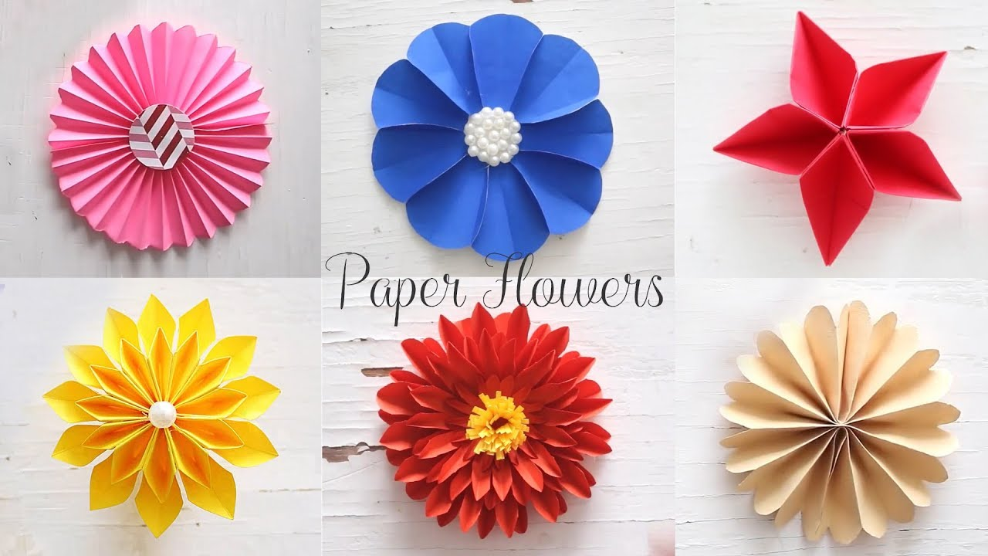
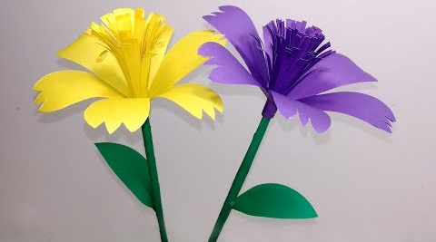
Now it is your turn!
To make simple paper flowers, I found this website is very good. You can pause the video as you go along.
https://www.youtube.com/watch?v=d9mTJ7jCJk4
These are more complicated but good fun.
https://www.youtube.com/watch?v=w15iD86lMcs

