Slide 1
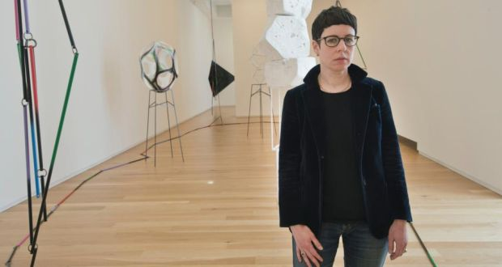
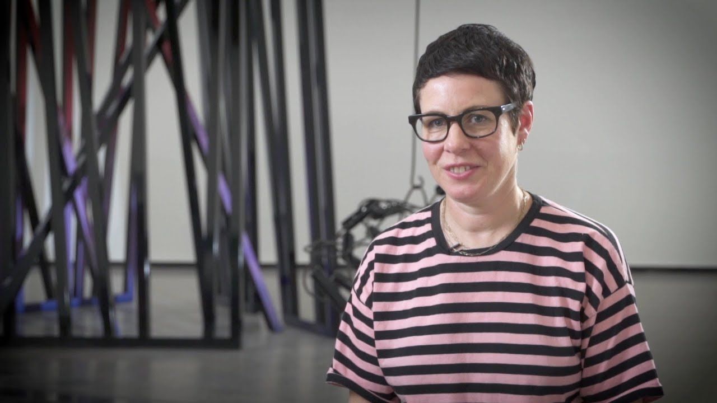
Eva Rothschild
Sculptor

Slide 2
Learning objectives;
To describe the work of sculptor Eva Rothschild.
To make a sculpture using line, shape, form and space.
To use a new media- sweets, to create a sculpture.
Success Criteria;
I can create geometric shapes with sweets and cocktail sticks.
I can join shapes together to create a sculpture.
I can say something about the sculptor Eva Rothschild.
I can describe some shapes that Eva Rothschild uses in her work.

Slide 3
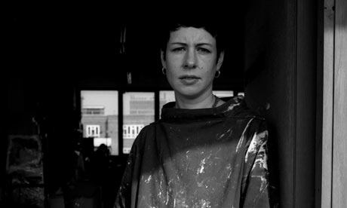
Eva Rothschild
Eva Rothschild is an Irish artist, living in London.
She was born in Dublin, in 1972.
Rothschild mainly works in sculpture, making abstract works in diverse materials including leather, paper, wood, Plexiglass and metal.
There are lots of lines, corners, and geometric shapes in her work.

Slide 4
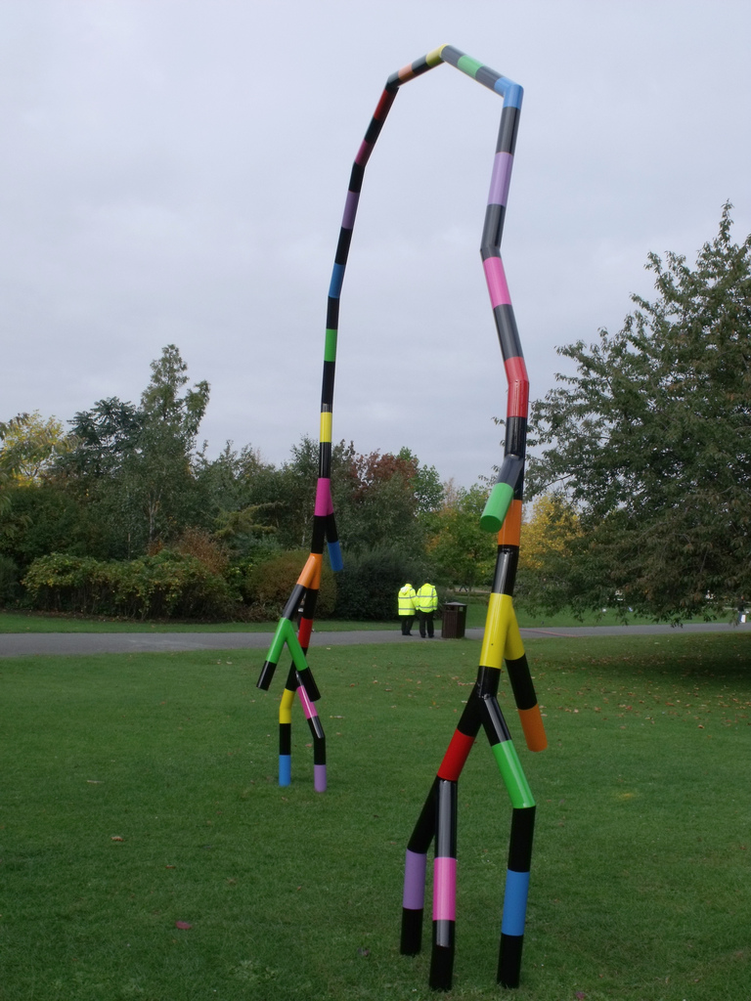
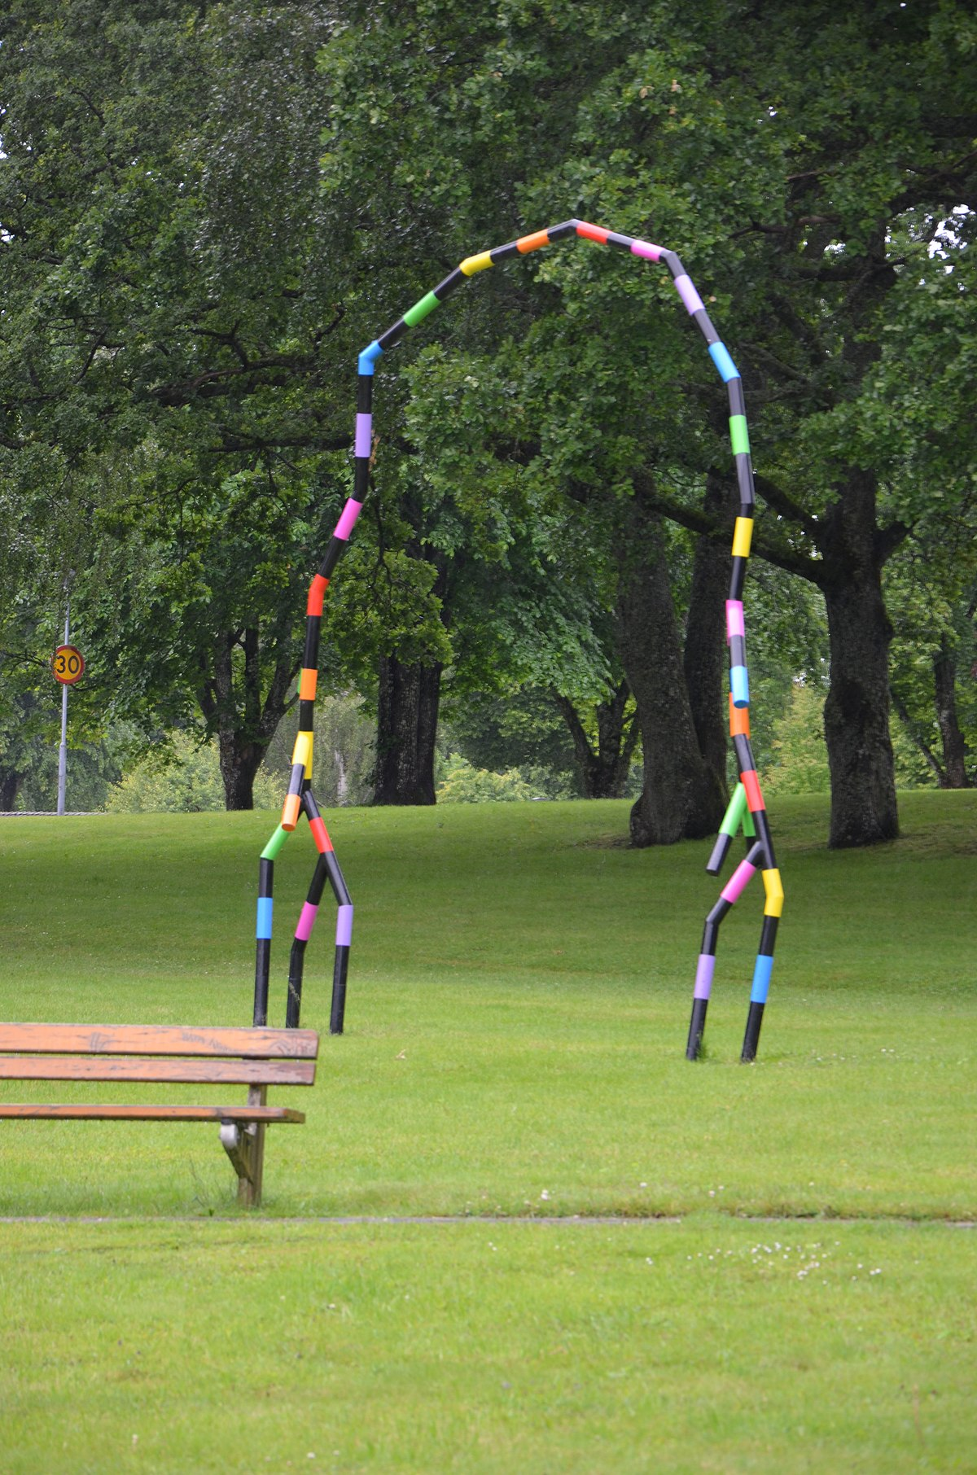
Someone and Someone, 2008
Rothschild made this arch from aluminium and painted the bright coloured stripes with enamel paint.
This sculpture was exhibited in a public space, for people to enjoy when they went for a walk or played in the park.
What does it make you think of?
Have you seen anything similar?

Slide 5
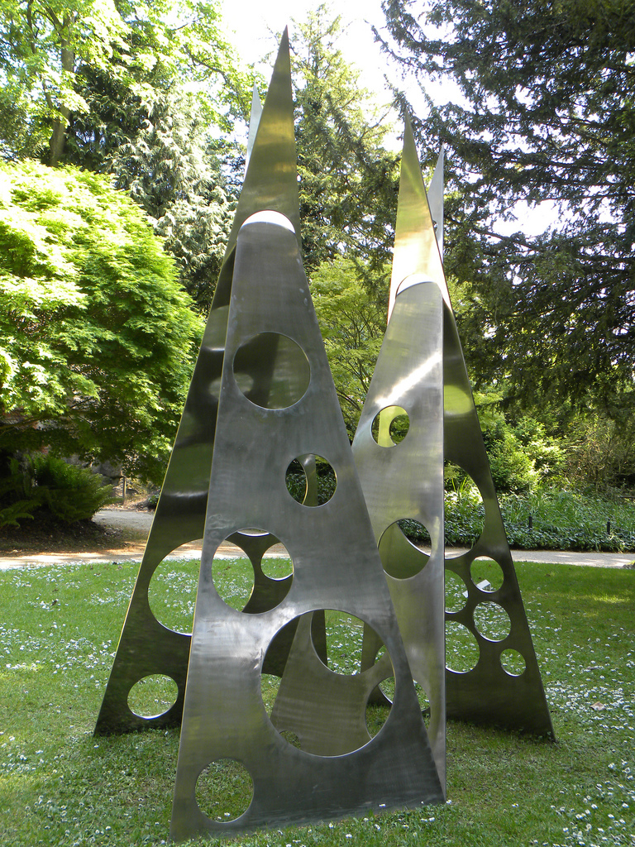
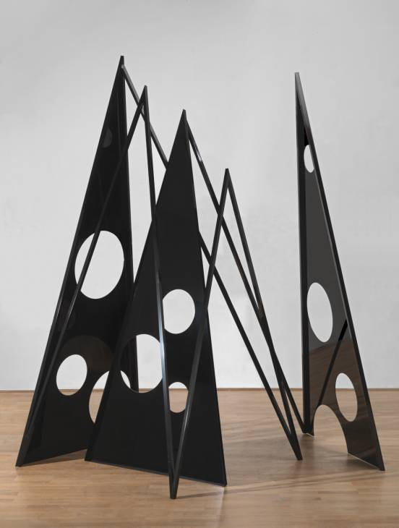
Meta, 2004
Legend, 2009
These sculptures are made from metal, with holes cut into them.
What shapes can you see in these sculptures?
What do you think she was thinking about when she created them?

Slide 6
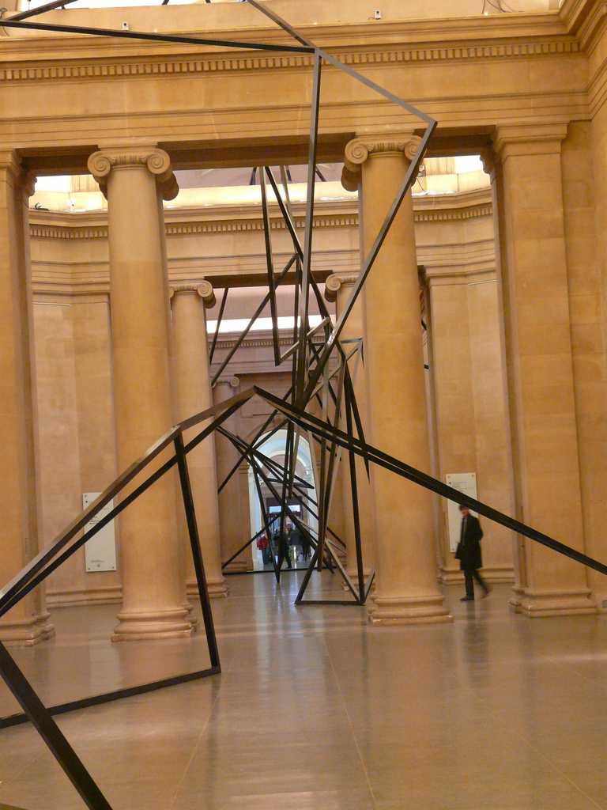
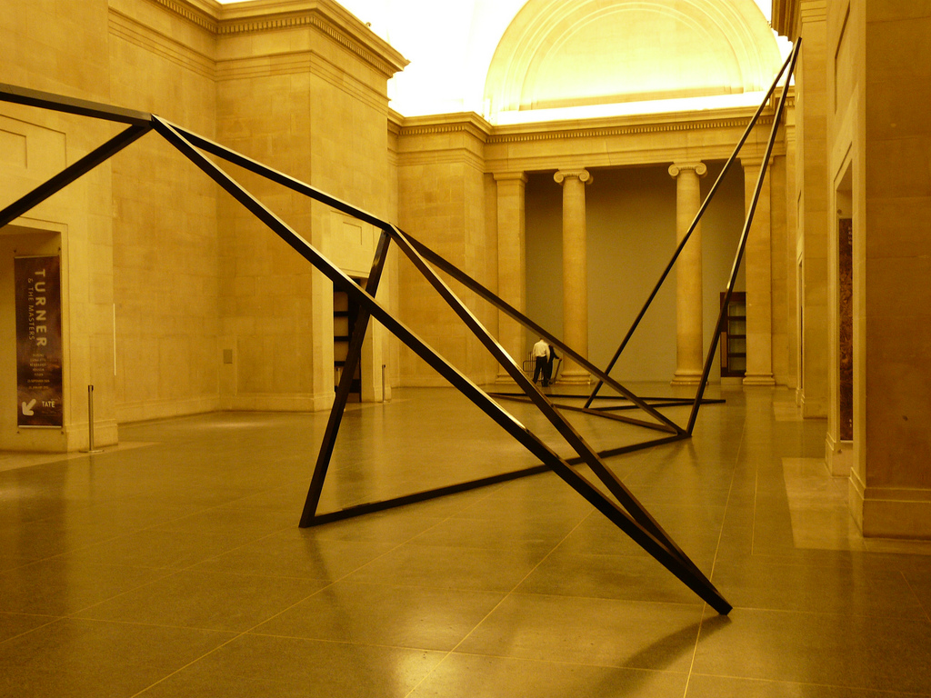
Cold Corners, 2009
Rothschild made this huge sculpture to go inside the Tate Britain.
It stretches for more than 70 metres!
The sculpture is minimalist. It is simple and does not have much detail.
It contrasts with the grand design of the building.
Visitors walk around and through the sculpture, viewing it from different angles.

Slide 7
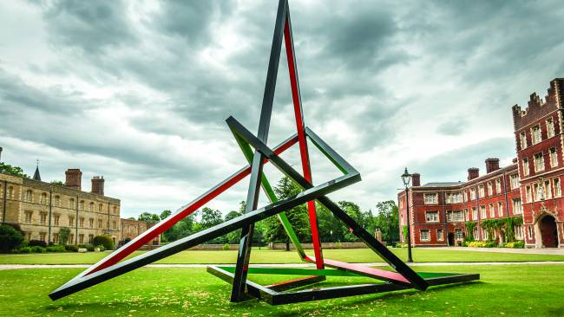
This and This and This
This and This and This is a sculpture that comes in sections, separate parts whose geometrical simplicity makes them seemingly independent, were it not that the colour running along the inside of each triangular section divides them into pairs.
The black running along the outside joins them all up, like the drawing of one continuous line, taking the measure of invisible boundaries in space by ricocheting between them at visually startling angles.
Pyramidal structures recall both the most durable of monuments and the most makeshift of shelters and Rothschild’s machined aluminium and steel framework supports both these alternatives. However, the important point is that it does not come to a standstill in material form, but uses form to activate more than one idea at a time.

Slide 8
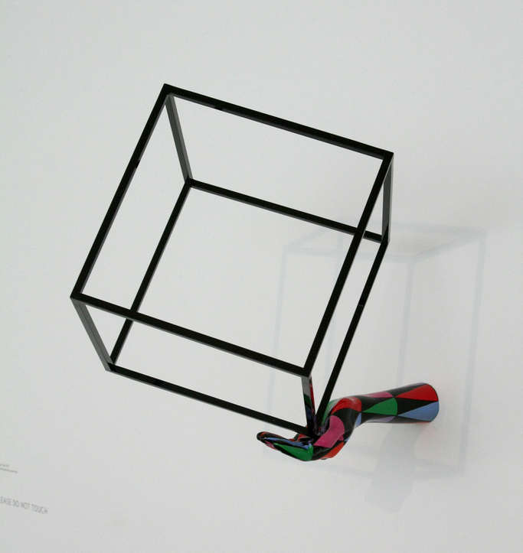
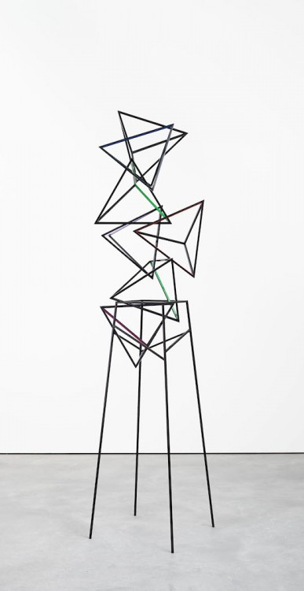
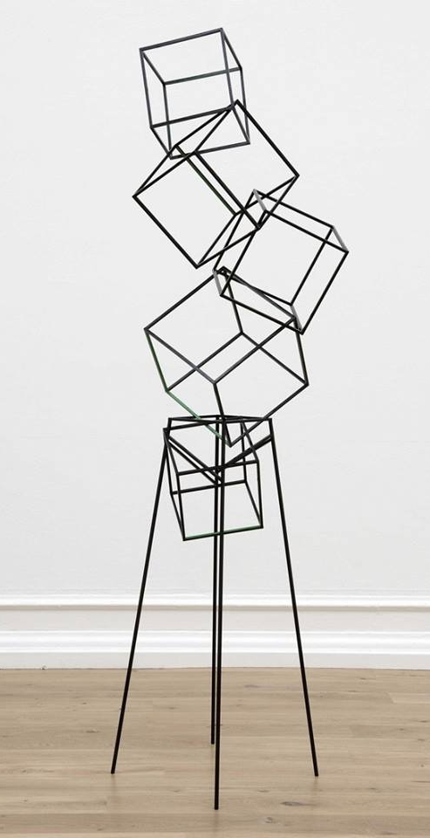
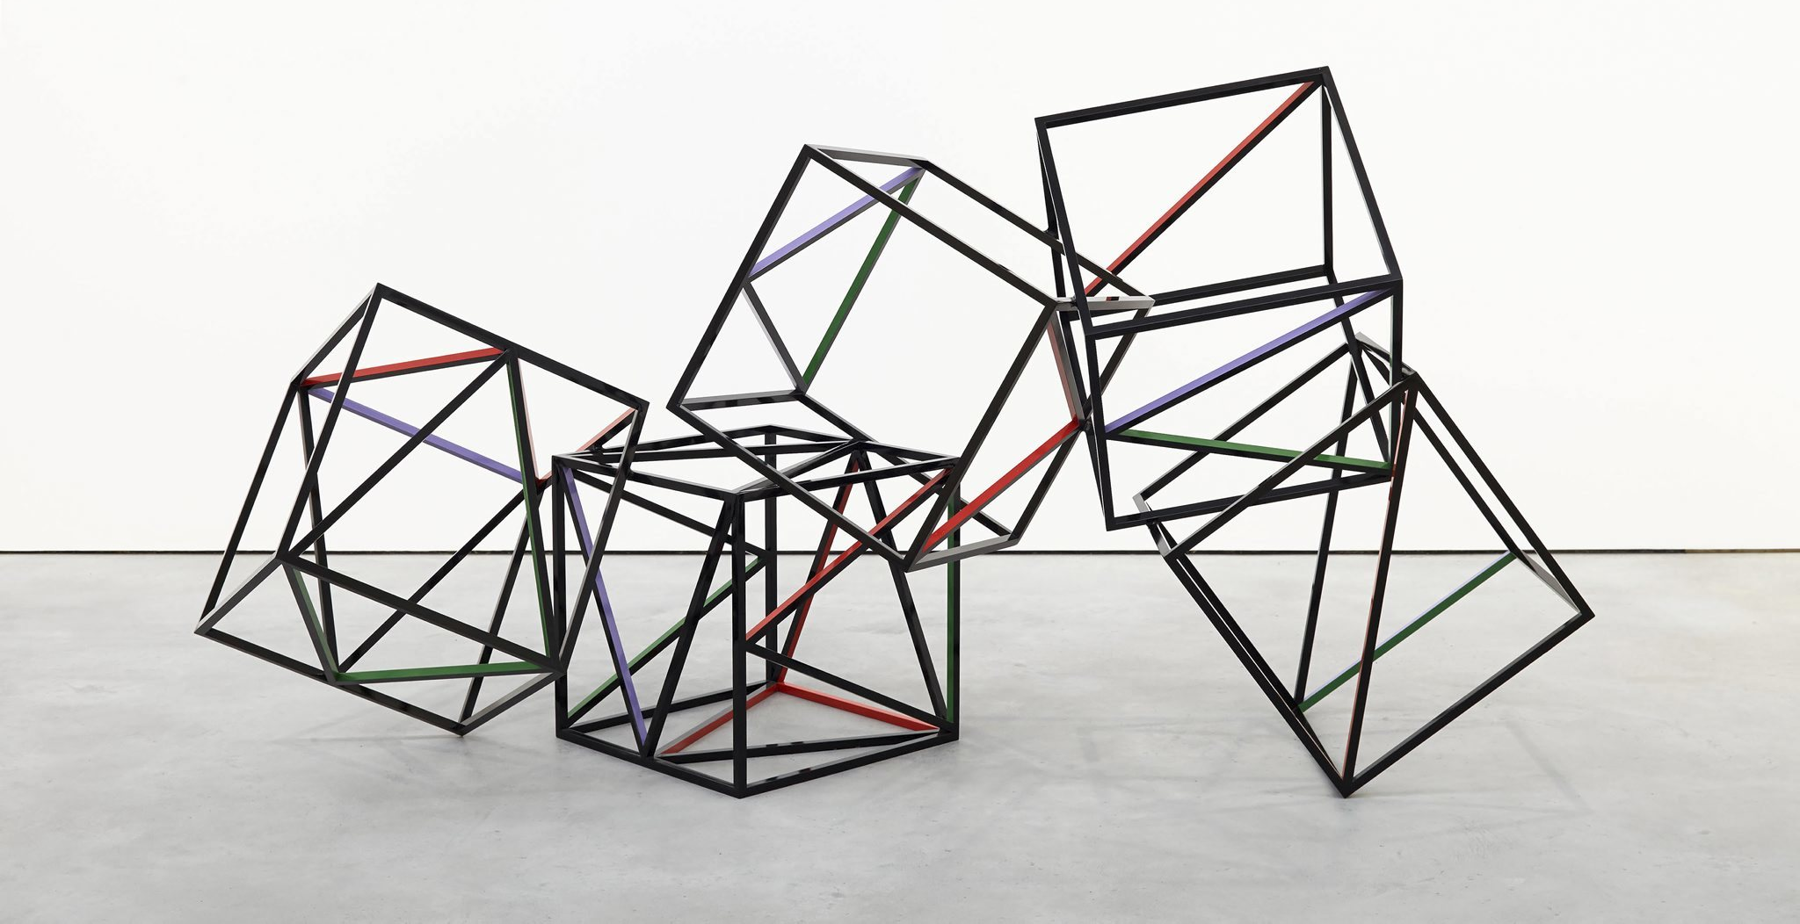
More of Rothschild’s Sculptures
Look at the shapes she creates in her sculptures.
Think about how she connects each piece.
What the Eye Wants, 2014
Cubes
Tumbling Dice
Magic Time

Slide 9
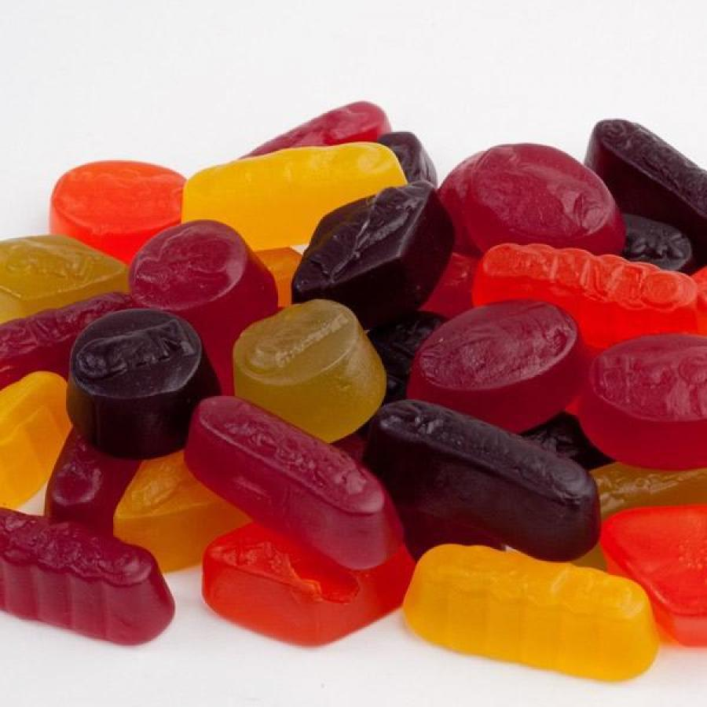
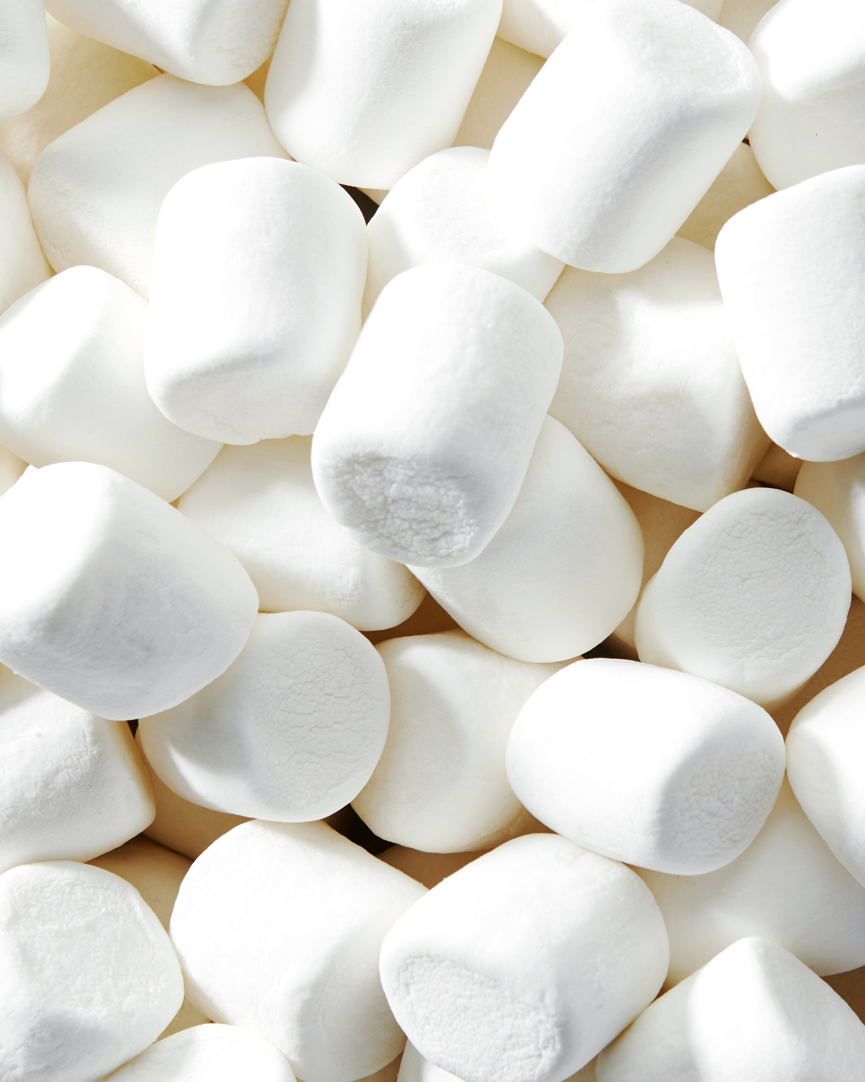
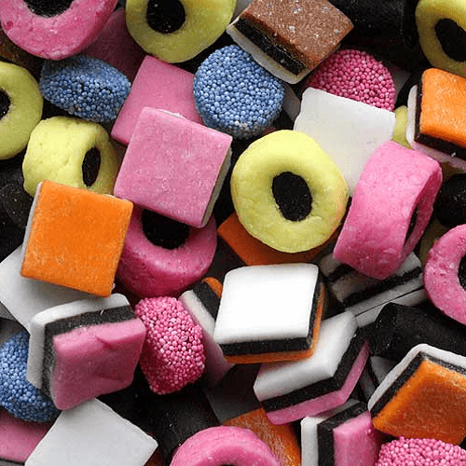
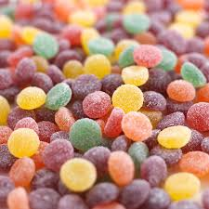
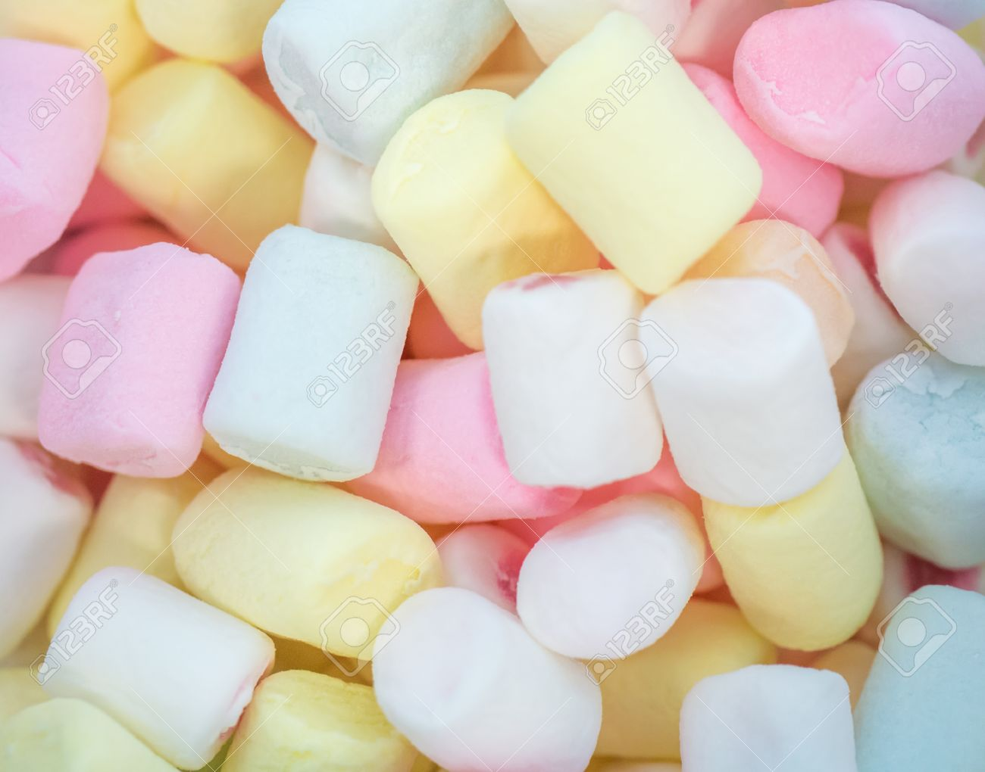
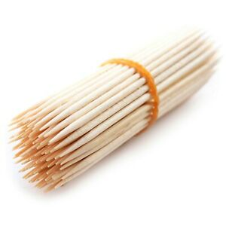
Your Sculpture Challenge
Use only your choice of sweets (you can mix them up) and cocktail sticks to create your own sculpture.
Think about the shapes you are going to use in your artwork.
Are you going to make your sculpture tall or wide?
Will it be able to stand up on its own?

Slide 10
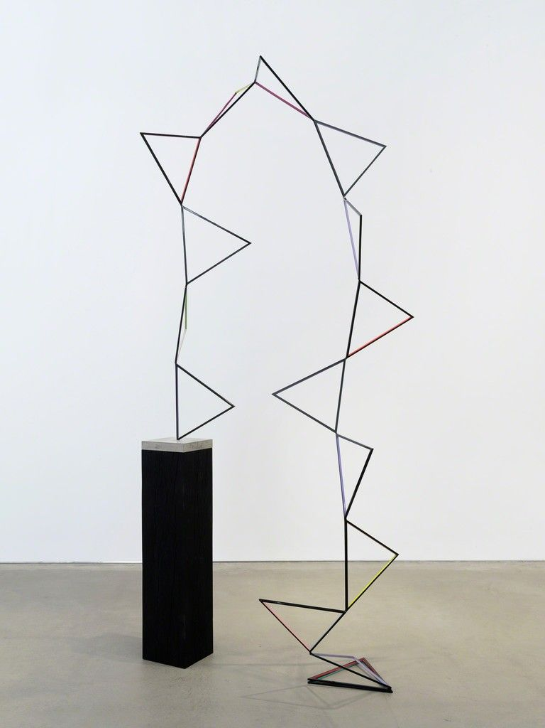
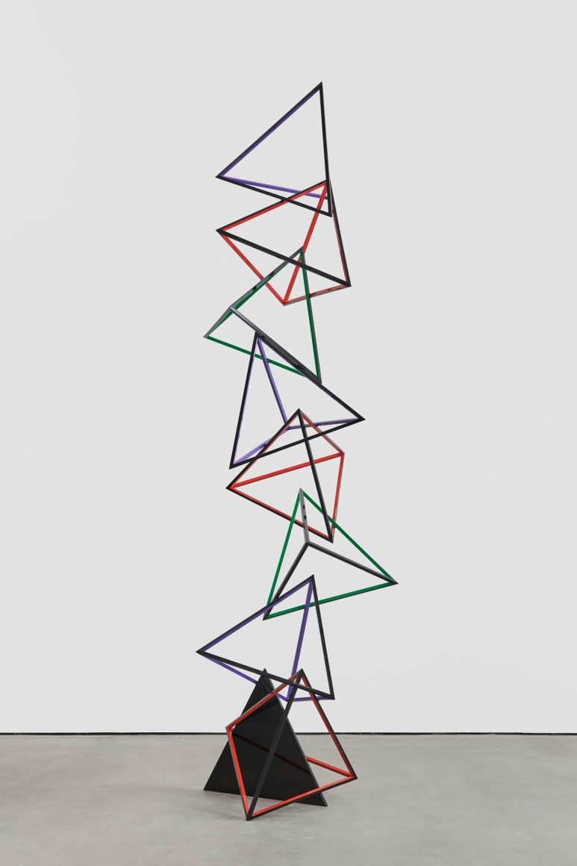
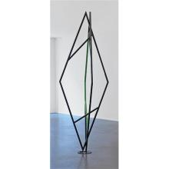
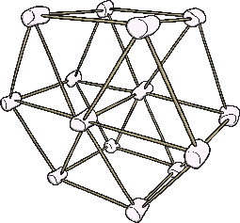
Reflection
What shapes did you use?
Were some shapes stronger than others?
How tall is your sculpture?
Did it stand up on its own?
Would you change the materials that you used?
If so, why?

