Slide 1
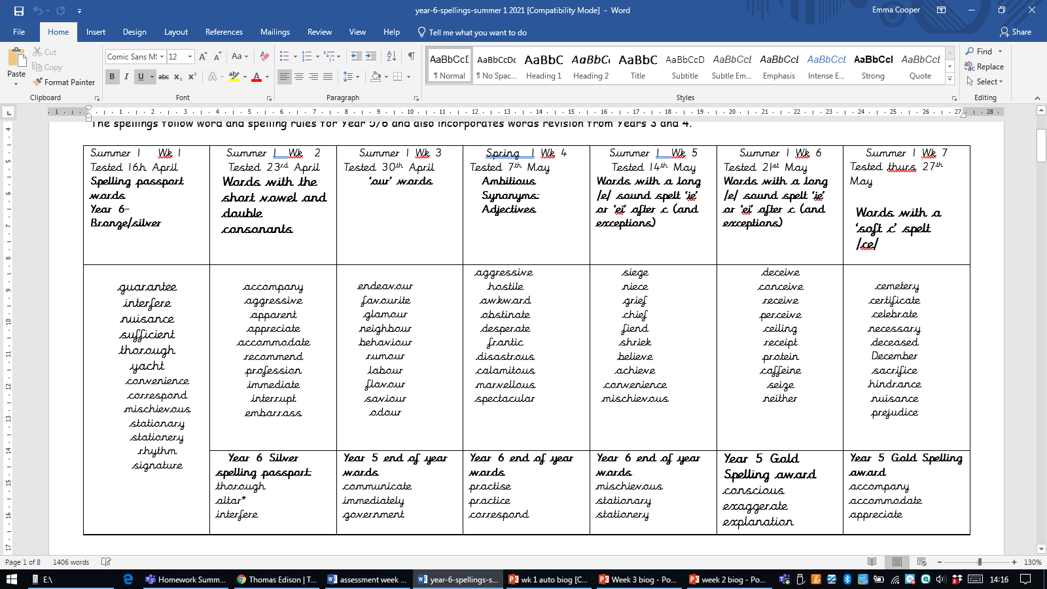
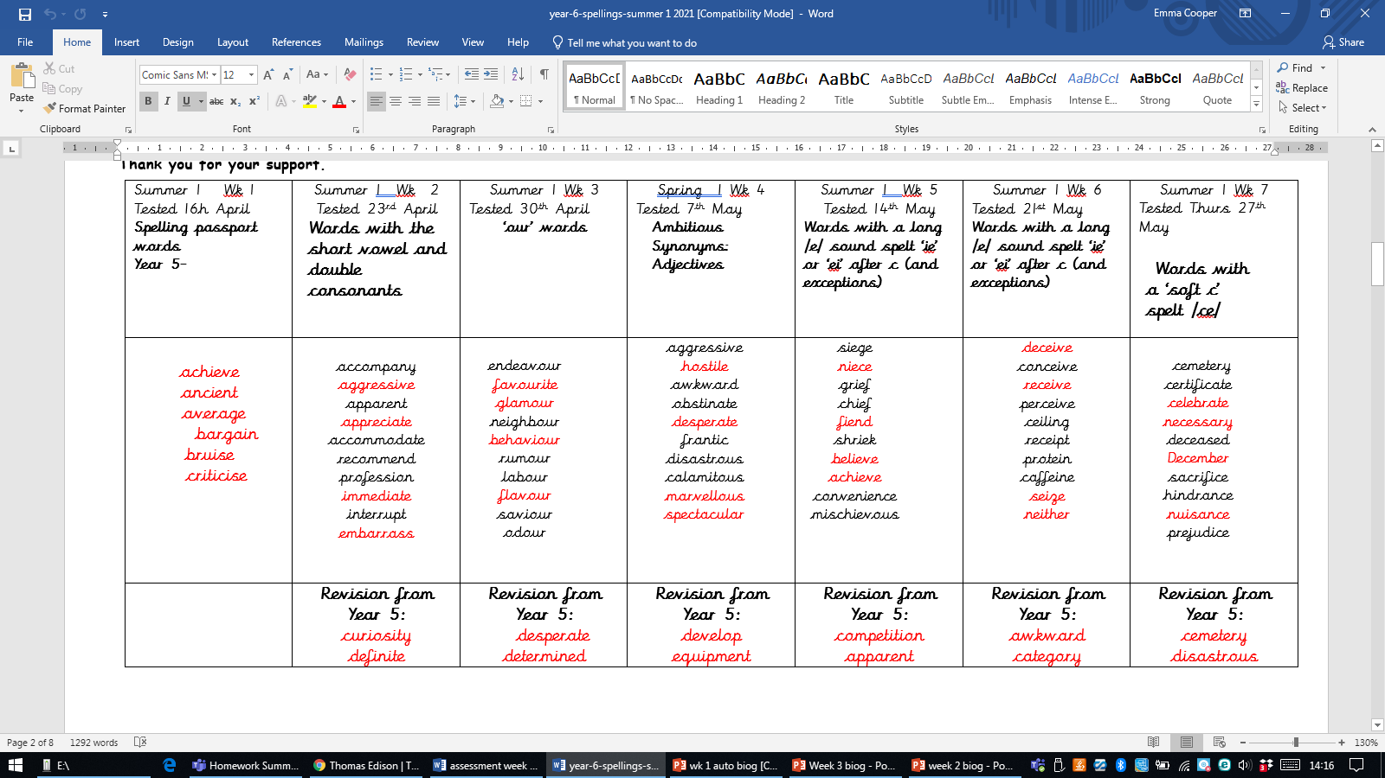
Week beginning
Monday
April 26th 2021
Pick 6- find meanings and then write sentences into your book

Slide 2

SPAG…To understand the difference between active and passive voice

Slide 4
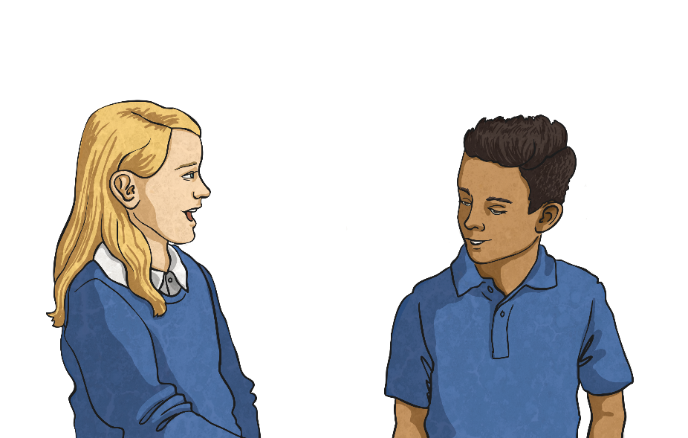
What Are Active and Passive Voice?
Active Voice
In an active sentence, the subject performs the action (the verb) to the object.
Passive Voice
In a passive sentence, the thing that would normally be the object gets turned into the subject through the use of the passive form of the verb. They often include a prepositional phrase starting with ‘by’.

Slide 5

Identifying Parts of the Sentence
To be able to recognise and use active and passive voice, you must be able to identify the parts of the sentence. In the following sentences, identify the subject, action (the verb) and object:
The plane is boarded by the family.
The plane is boarded by the family.
The damage was caused by the storm.
The damage was caused by the storm.
Issac threw a ball at the window.
Issac threw a ball at the window.
The magician pulled a rabbit from the hat.
The magician pulled a rabbit from the hat.
Helen practised her recorder every day.
Helen practised her recorder every day.
The flowers were grown by my nan.
The flowers were grown by my nan.
Did you notice the preposition ‘by’ in some of these sentences?

Slide 6
Active or Passive Voice?
Now, sort these sentences into the correct places in the table below:
The plane is boarded by the family.
The magician pulled a rabbit from the hat.
Issac threw a ball at the window.
Helen practised her recorder every day.
The flowers were grown by my nan.
The damage was caused by the storm.
Active
Passive
The magician pulled a rabbit from the hat.
Issac threw a ball at the window.
Helen practised her recorder every day.
The plane is boarded by the family.
The damage was caused by the storm.
The flowers were grown by my nan.

Slide 7

Quick Quiz 1
Which sentence is written in the passive voice?
Keira played for the netball team.
The tasty meal was cooked by my mum.
The tasty meal was cooked by my mum.
My little brother always wakes up early.
I am lucky to be going on holiday to France with
my best friend’s family.

Slide 8
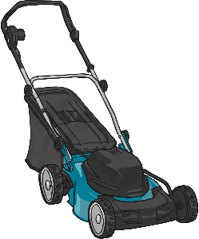
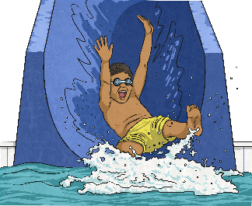

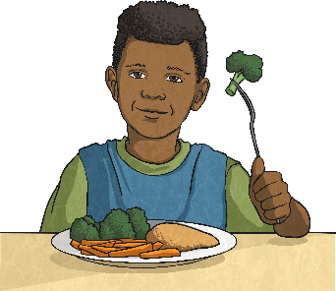
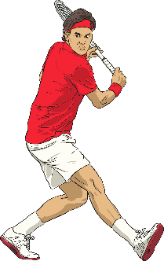
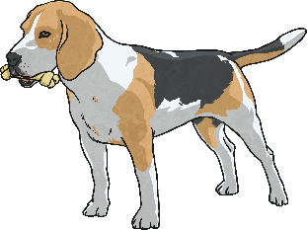

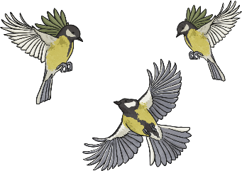
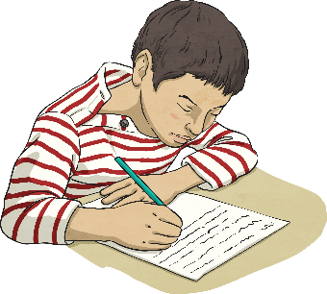
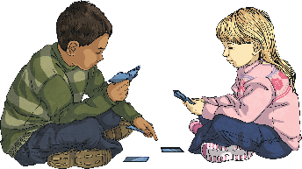
Your Turn – Active Sentences
Choose a square to reveal a picture. Write an active sentence about the picture:
?
?
?
?
?
?
?
?
?
?

Slide 9
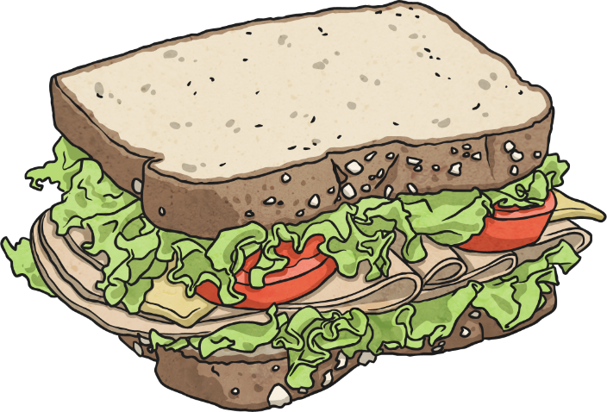
Changing Sentences
It is possible to change a sentence from active to passive voice, or from passive to active voice. It is important that you do not change the tense of the sentence. Have a go at altering these sentences:
On the plain, the lioness chased an antelope.
On the plain, an antelope was chased by the lioness.
Harry ate sandwiches for lunch.
Sandwiches were eaten by Harry for lunch.
The carrots are always eaten by my brother.
My brother always eats the carrots.
Are your new sentences active or passive?

Slide 10


Tricky Passive Sentences
Read these passive sentences. What do you notice about them?
The jewellery was stolen.
The jewellery was stolen.
The bicycle was ridden.
The bicycle was ridden.
The present was opened.
The present was opened.
They all have an action and a subject but none of them have a object. Sometimes the prepositional (by…) phrase can be removed and the sentence will still make sense – you just won’t know who/what performed the verb.

Slide 11
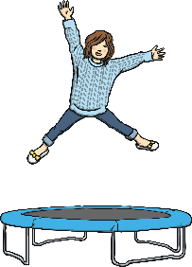

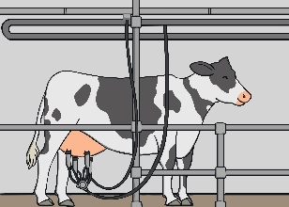
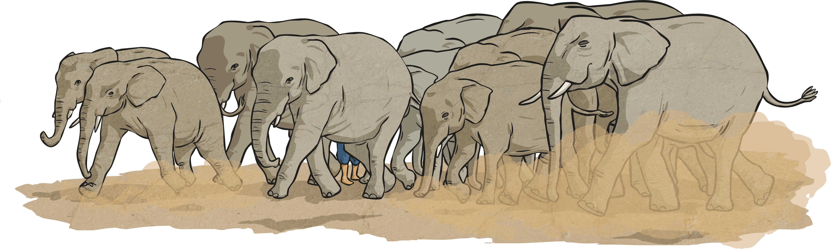
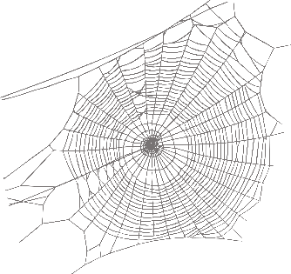
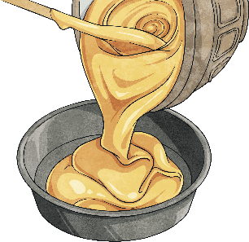
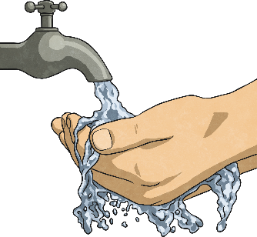
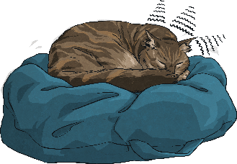
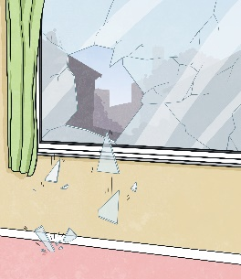
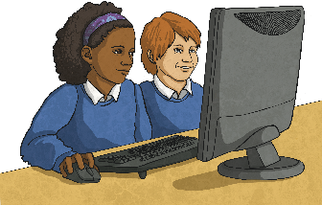
Your Turn – Passive Sentences
Choose a square to reveal a picture. Write a passive sentence about the picture:
?
?
?
?
?
?
?
?
?
?

Slide 12
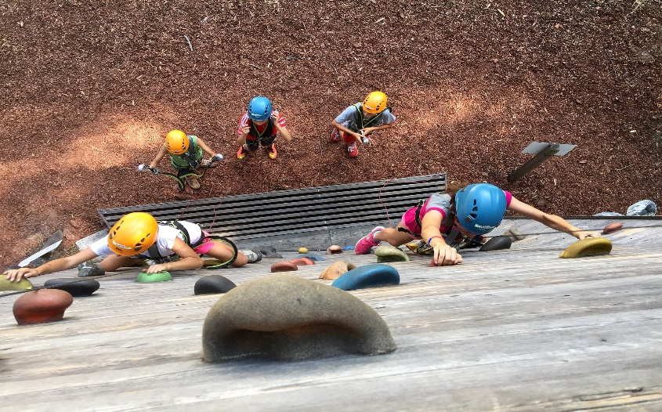
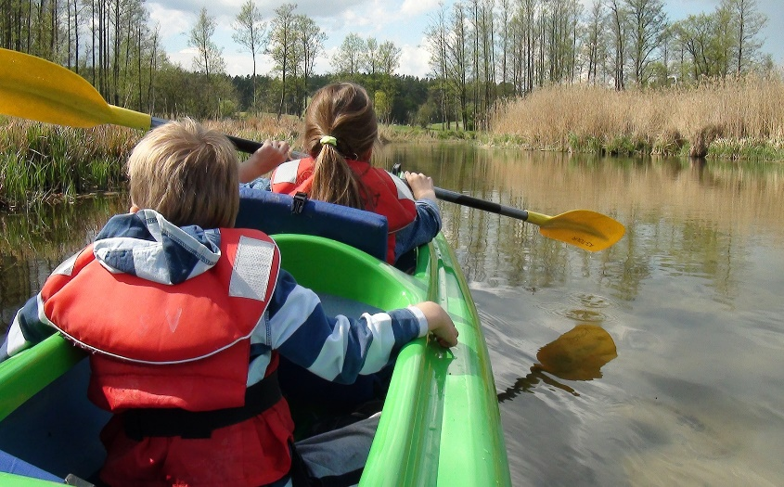
Amazing Active Voice
Can you write descriptions of these photos in the active voice?
The children enjoyed climbing during their school camp.
They spent the day kayaking down the river.

Slide 13
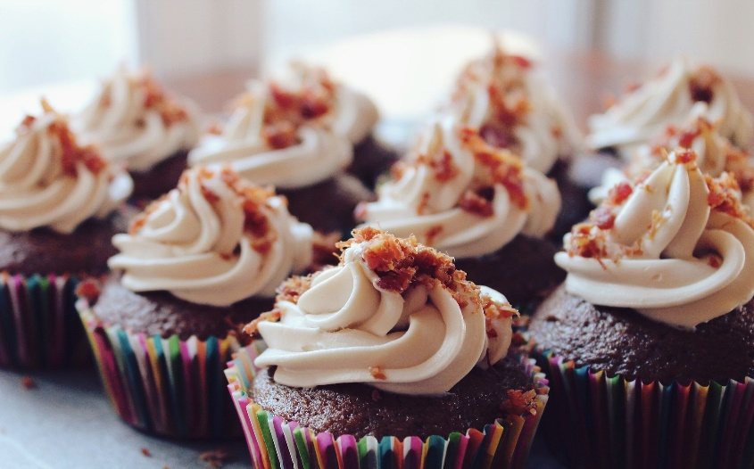
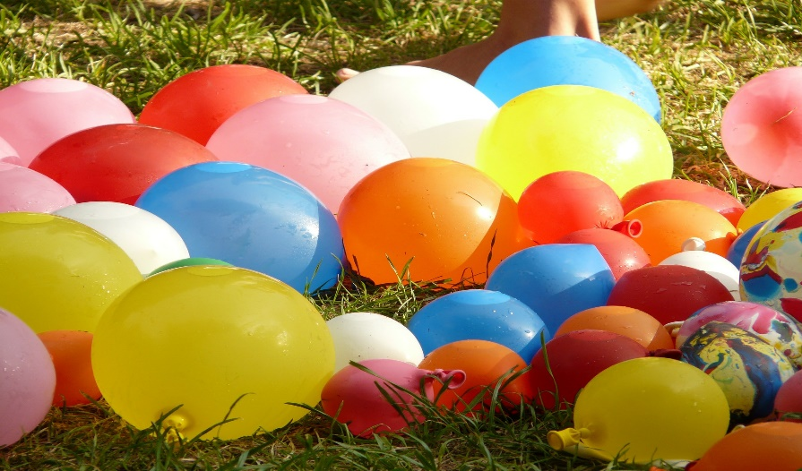
Perfect Passive Voice
Can you write descriptions of these photos in the passive voice?
Tasty cupcakes were baked by my aunt for my birthday party.
The water balloons were blown up by my brother for the water fight.

Slide 14
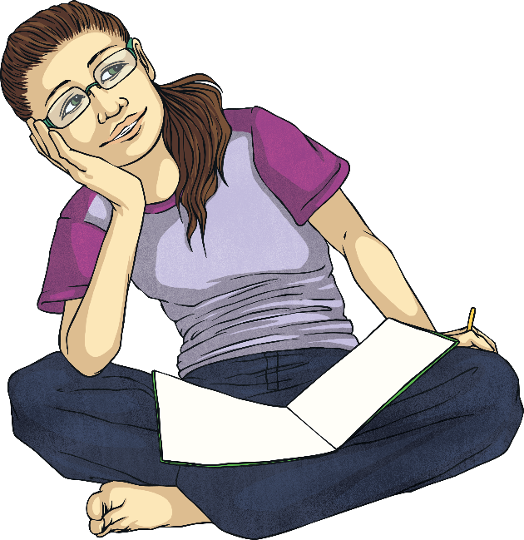
Quick Quiz 2
Underline the objects in these active sentences:
I climbed the tallest tree in the park yesterday.
I climbed the tallest tree in the park yesterday.
The class boarded the coach noisily to go on their trip to London.
The class boarded the coach noisily to go on their trip to London.
We eat our lunch on the field in the summer.
We eat our lunch on the field in the summer.

Slide 15
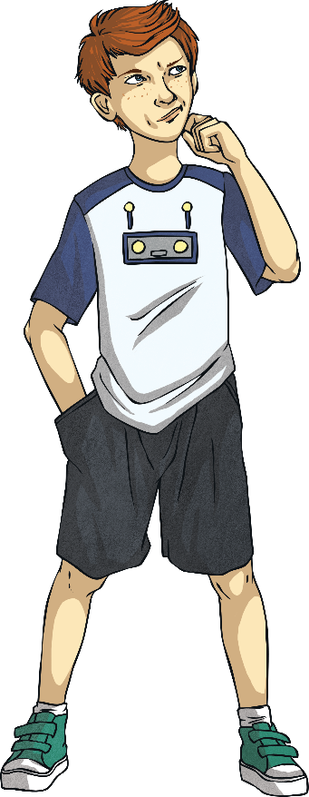
Quick Quiz 3
Rewrite these sentences in the passive voice:
Gina visited the library regularly.
The library was visited by Gina regularly.
My family always eat turkey for Christmas dinner.
Turkey is always eaten by my family for Christmas dinner.
The lazy girl ignored her alarm clock.
The alarm clock was ignored by the lazy girl.

Slide 16

Summer 1 week 3

Slide 17


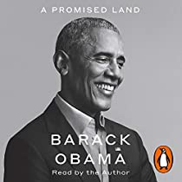



LO: To identify key features of autobiographies

Slide 18
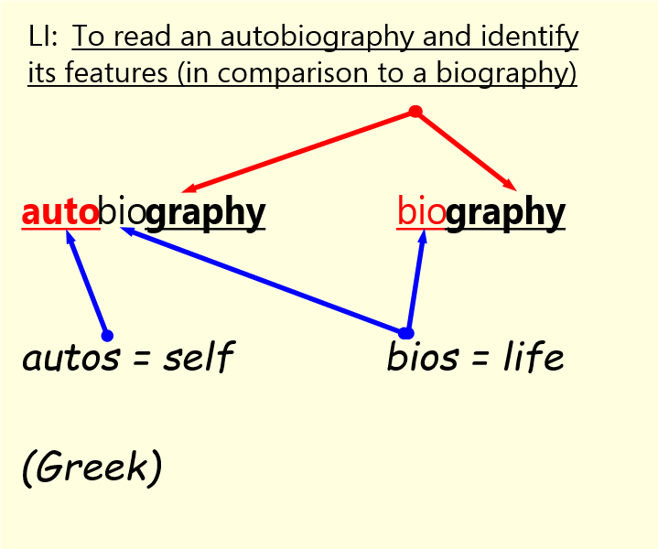

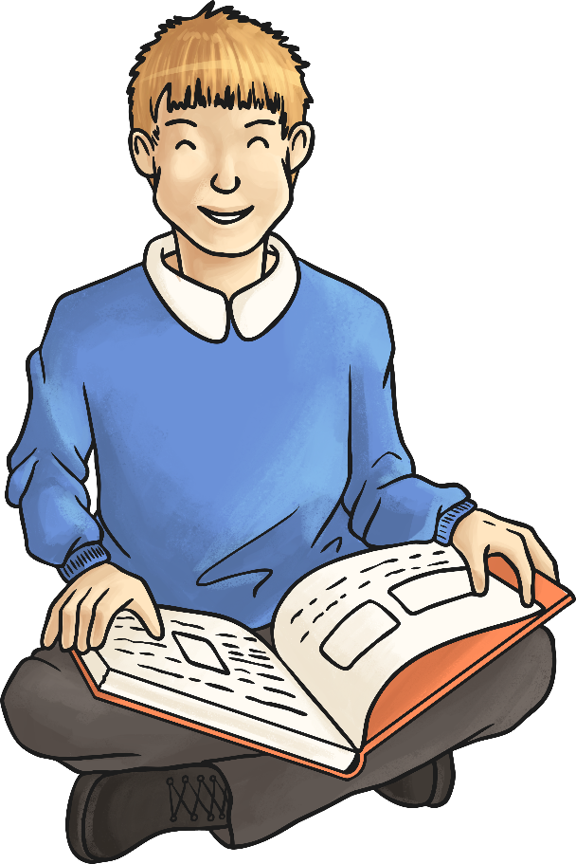
What does the prefix ‘auto’ mean?

Slide 19
Autobiographies
‘Auto’ means ‘self’ therefore an autobiography is self-written. It is an account of someone’s life, written by the person themselves, in chronological order. An autobiography is different to a biography because it is written in the first person, explaining important events in their life. The subject may write about what has influenced them and include details of their feelings during different experiences they have had.
Autobiographies are primary historical sources of information whereas biographies are secondary sources.
To remember the difference … auto = self.

Slide 20
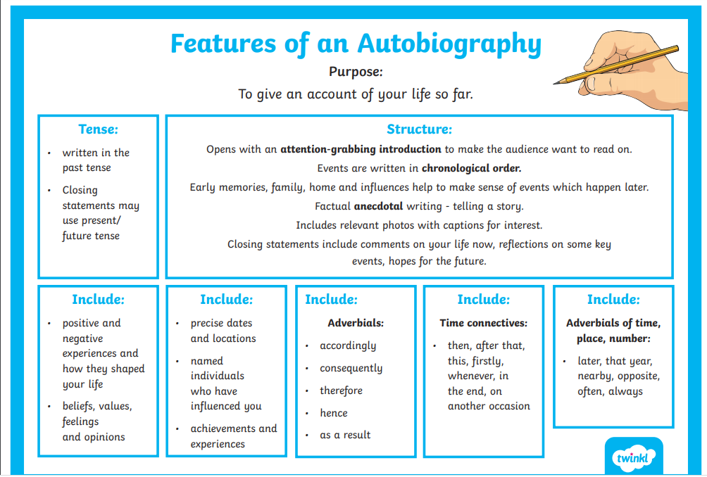

Slide 21
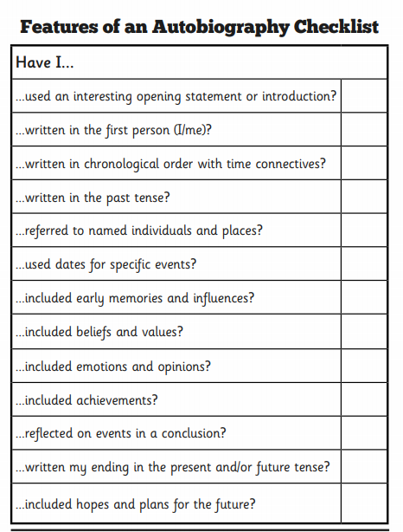
Over to you…Blue and Orange group
Autobiographies contain:
Past tense,
1st person,
speech,
description
Facts and opinions
Quotes from others
Create a colour coded key
and highlight the features
on the extracts.

Slide 22
Red and Yellow group
Use the word mat to colour code features you can see in your extracts

Slide 23
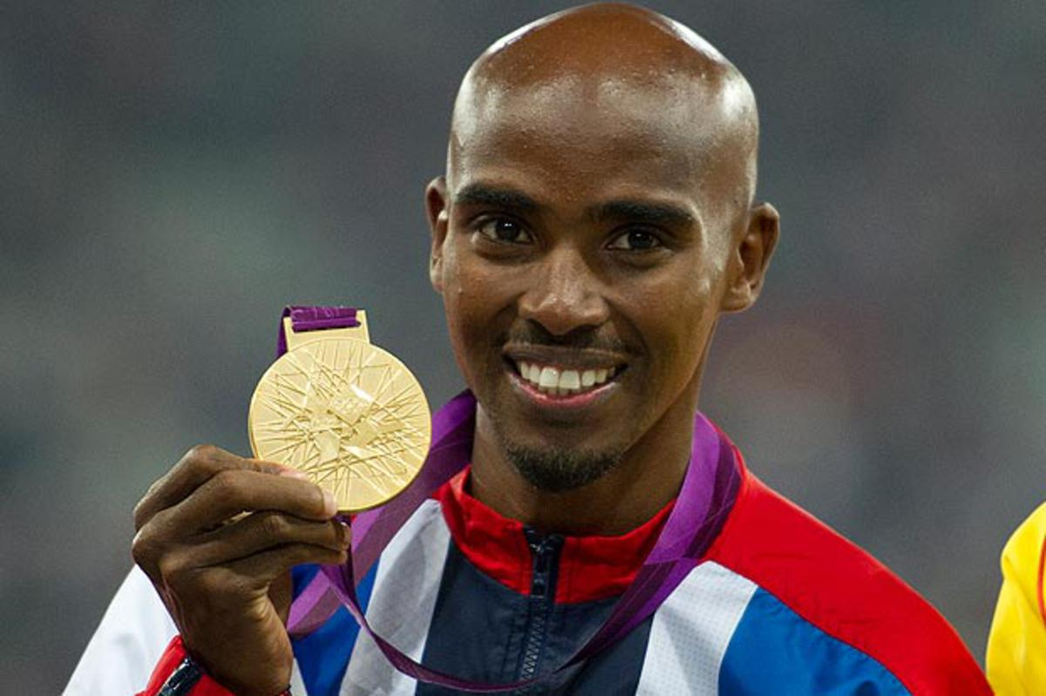
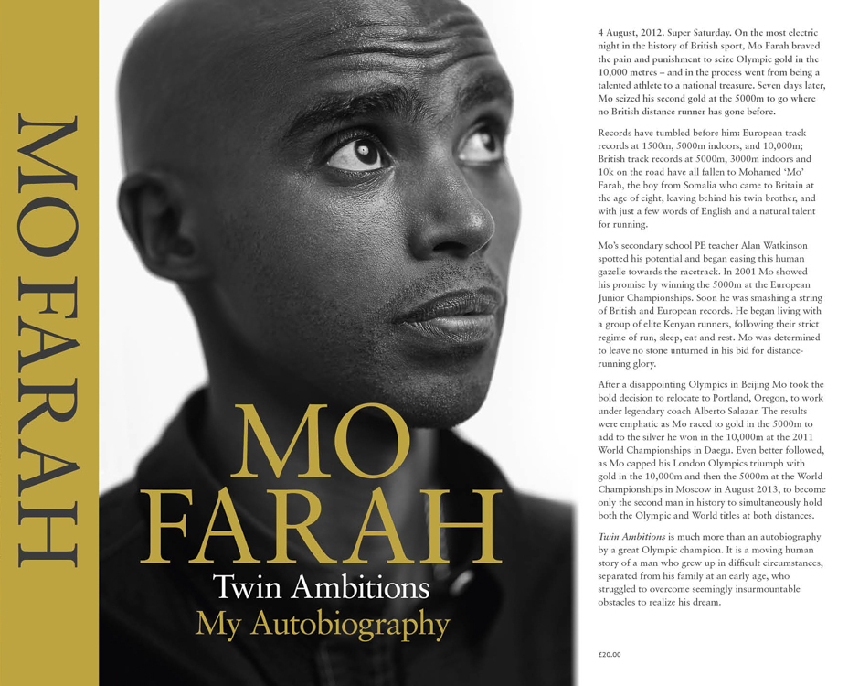
Looking at an autobiography
We are going to look at part of the autobiography of Mo Farah.
He is a British athlete who has won a lot of gold medals at the Olympics.
https://www.youtube.com/watch?v=C93qwVmBseE

Slide 24
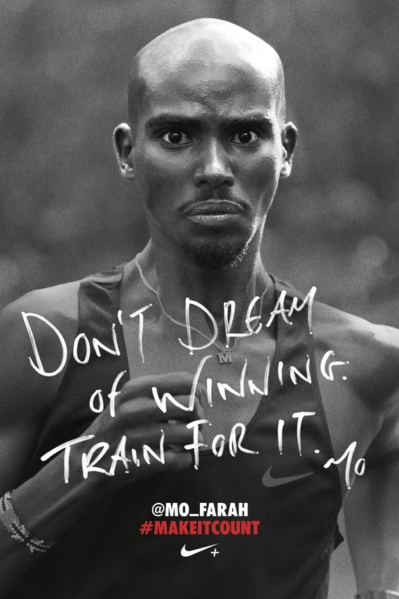
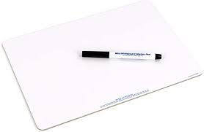
Race Day
“My hands are trembling. My eyes feel as though they’re about to burst out of their sockets”.
“It’s the biggest day, the biggest moment of my life. Everything has been leading to this. I’m looking around and telling myself, “This is my moment. This is it”. I am ready to race”.
How is Mo Farah feeling before his race? Show not tell sentences on your whiteboards- you are Mo Farah!
How do you know?
Identify the first person words!

Slide 25
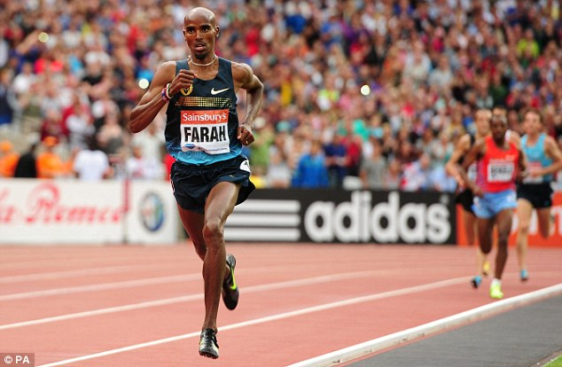
In the Race
“The race gets faster. But I’m calm. I know I’ve got my sprint finish. As long as I’m near the front with two laps to go, I’m good”.
“This is my race. My time. I’m not going to lose to anyone. Not here. Not in front of my home crowd, with everyone in the country cheering me”.
Write at least 3 words to describe how you think Mo is feeling during the race.
Show not tell sentences on your whiteboards- you are Mo Farah!

Slide 26
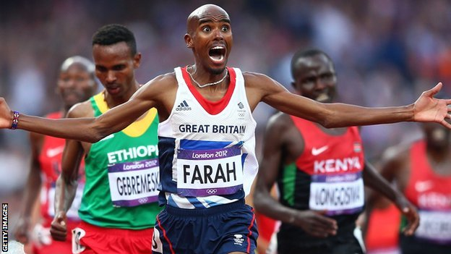
Winning the Race
“It’s only once I cross the line that it hits me. I’ve won”.
“The whole stadium just erupts. The crowd is unbelievable. The noise is deafening – like nothing I’ve ever heard before. Everywhere I look is this mass of noise and colour”.
How do you think Mo feels now he has won the race?
How do you think the people watching are feeling?
Short extract in your English books – first person writing! Use show not tell!

Slide 27
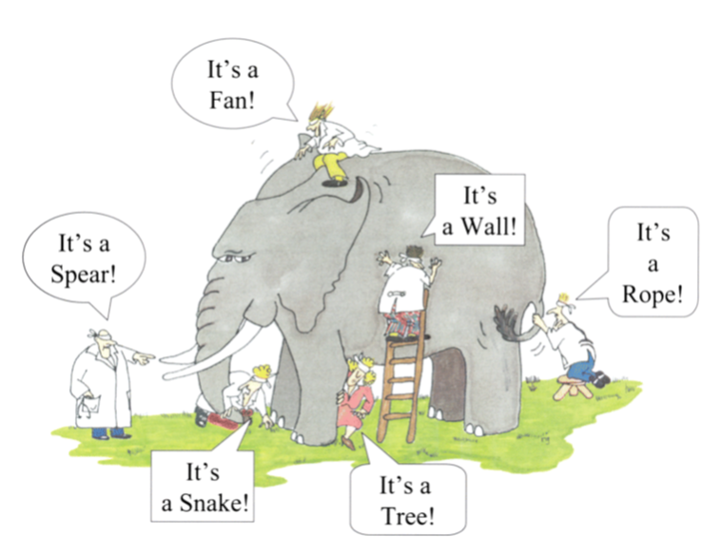
LO: To write an autobiographical account from another perspective

Slide 28

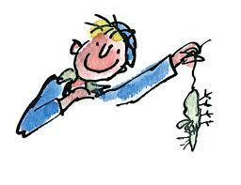
‘Boy’ by Roald Dahl- The Great Mouse Plot!
https://www.youtube.com/watch?v=GYIUqHpu-q0
27 mins 52 seconds in
Which parts from The Great Mouse Plot do you think Roald Dahl exaggerated?
What do you think Mrs Pratchett was like in real life?
Do you think the boys really thought they had killed her?
Did she watch them getting caned?
Could this actually have happened?
“ An autobiography is a book a person writes about his own life and it is usually full of all sorts of boring details. This is not an autobiography. (Roald Dahl, Boy, page 7)

Slide 29
‘Boy’ by Roald Dahl- the mouse incident!
https://www.youtube.com/watch?v=GYIUqHpu-q0
27 mins 52 seconds in
Think about the character of Mrs Pratchett.
Is she really just a victim in this story bullied by young boys?
Was she being harassed by Roald Dahl and his friends?
Do you actually feel sorry for her?

Slide 30

https://www.youtube.com/watch?v=GYIUqHpu-q0
27 mins 52 seconds in
‘Boy’ by Roald Dahl- The Great Mouse Plot!
Paired work- Over to you! Write about this incident from Mrs Pratchett’s point of view.
Think carefully about how you want your reader to feel about her- do you want them to like her? Hate her? Feel sorry for her?
Remember to exaggerate the incident in the style of Roald Dahl.
SHOW NOT TELL!

Slide 31

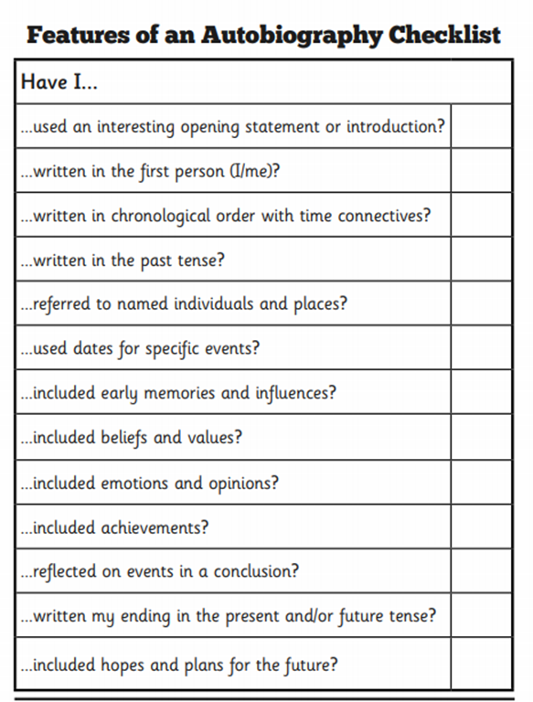
https://www.youtube.com/watch?v=GYIUqHpu-q0
27 mins 52 seconds in
‘Boy’ by Roald Dahl- The Great Mouse Plot!
As you write tick off the features on the checklist that you have included.

Slide 32


Slide 34
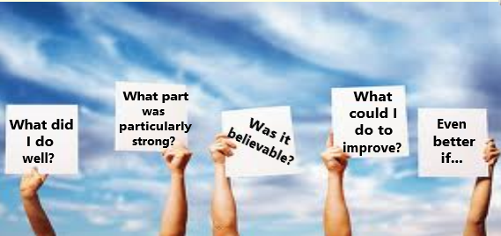
Self evaluation!

Slide 35
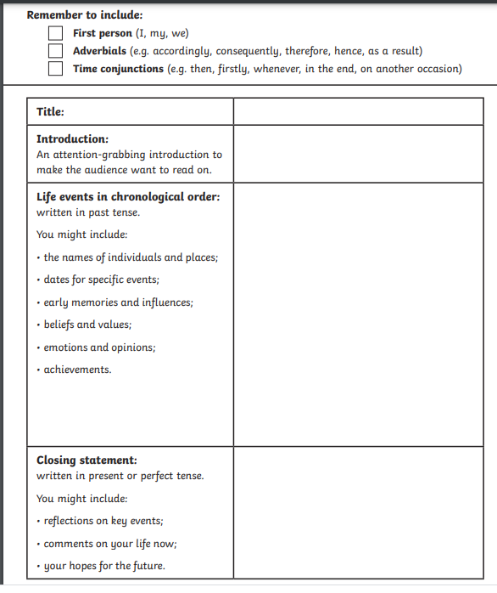
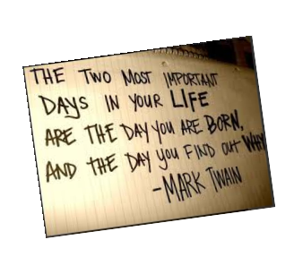
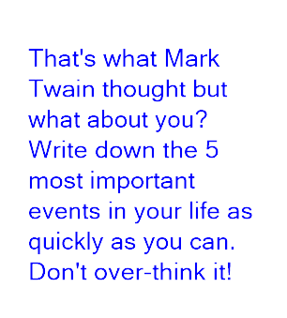

Slide 36



What tone will your extrac have?

Slide 37
Your Task:
Write about a time in your life you have felt nervous or excited. It can be real or made up.
Was it your first day in Grange?
Was it going on stage to sing, dance or perform?
Was it going to the dentist?
Was it at Christmas or your birthday party?
Was it playing in a match or running a race?
Was it going to a concert or to see your favourite team play?
Was it going somewhere new for the first time?
How did you feel before?
How did you feel during?
How did you feel after?
Try to tell the story using as much detail as you can.

