Slide 1



Slide 2


Slide 3
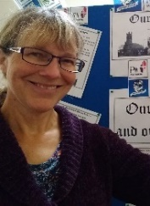
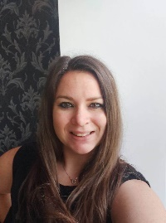
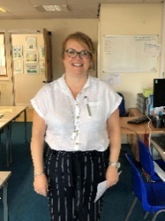
Year 6 staff
Mrs Cooper
Mrs Lund
Mon am, Tues all day,
Weds all day, Fri am
Mrs Warham
Mrs Day
Mon am, Tues pm,
Weds am, Thurs am

Slide 4
School website
We will be using and updating our school website and class page frequently over the year. Please keep up to date of any announcements.
Contact details are on the homepage so if you are needing to get in contact with school-
admin@sps.sefton.school
coopere@sps.sefton.school

Slide 5

Our School Vision:

Slide 6

Medical
Any medication updates – please let us know of any changes
If your child needs any prescribed medication, a medical form needs to be filled in at the office before we are able to administer it.
Thank you

Slide 7


Housekeeping!
Please name all clothing
PE is on Monday and Friday afternoons- no earrings
Please make sure your child has a water bottle each day
Healthy snacks can be brought in for morning break time – fruit, vegetable sticks, cereal bars (no sweets or nuts please).

Slide 8
Uniform
BOYS WINTER UNIFORM
GREY TROUSERS (NO OTHER COLOUR)
WHITE SHIRT
NAVY LONG SLEEVED JUMPER
SCHOOL TIE
DARK COLOURED SCHOOL SHOES.
DARK SOCKS
GIRLS WINTER UNIFORM
NAVY SKIRT OR PINAFORE DRESS
WHITE BLOUSE
NAVY LONG SLEEVED CARDIGAN
SCHOOL TIE
NAVY TIGHTS / NAVY OR WHITE SOCKS
DARK COLOURED SCHOOL SHOES.
Find the full uniform
list on our website

Slide 9
Attendance and punctuality
It is crucial for children to arrive on time to school. Children’s activities start at 8:45 (staggered times) which is either spellings and grammar or Maths key skills. If they are late- they are missing learning time.
If your child is being collected at the end of the day, please arrive on time for 3:20pm.
Please do not allow children on the adventure playground before and after the school day.
Please note that no term time holidays will be authorised and fines will be in place.

Slide 10


Slide 11
Covid and attendance…
Attendance at school is mandatory for all children unless they are sick or have an appointment.
The usual rules on absence continue to apply. Well children are expected to attend daily, arrive on time and have the things that they need. Reading books should be brought to school daily. Limit the amount of things brought into school please.
Parents have a vital role to play in deciding when to keep a child off school but we appreciate that this is now complicated by the current situation. Children have already missed so much time in school so I would urge you to send them to school wherever possible.
It’s a difficult judgement call but if in the past you would have sent your child to school with a runny nose, slight tummy pain, minor headache or just a bit under the weather it is still probably ok, if you feel they can manage the day to send them in. We will always contact you if we have concerns about your child. Each case is different so feel free to speak to Mrs Edward.

Slide 12
Covid and attendance…
First Response
If your child is absent you must contact the school office by telephone or email to report your child's absence giving clear details of the reason for absence. Failure to do so means that our First Response kicks in and if we cannot get hold of you and we are unable to make contact with you via your emergency contact details, it might be necessary for a senior leader to come to your house!
This is part of our safeguarding response to ensure everyone is safe and well. As you can imagine, a home visit takes up a lot of time and it is usually the case that families have forgotten to call us. I’m sure you don’t want us on your doorstep so please remember to give us a call. Thank you
Some Covid reminders
Symptoms are Fever above 37.8, persistent cough, shortness of breath, loss of taste or smell
To Book a test call 119. If you or your child are awaiting a test result do not come to school and do not come to the playground even if you are symptom free.
See our Covid Pages of the website for additional guidance.

Slide 13
Cashless school payments
https://schoolgateway.co.uk/help/
As much as possible we are a cashless school now!

Slide 14
Homework
Homework will be given out on a Friday.
Spelling test on the following Friday.
Homework to be given in by Wednesday. Please let us know if any homework is too difficult so we can give a little extra help at school.
Please help your child to learn their spellings and tables each week.

Slide 15

Spellings
We are having a huge emphasis on spellings this year. Children need to be practising their spellings daily and not for a spelling test.
In Year 6, children need to be able to spell words from the Year 3 and 4 curriculum list as well as the Year 5 and 6. They must show they can spell these words correctly in their writing.
Spelling sheet for this half term has been sent home already and is on the class web page.

Slide 16
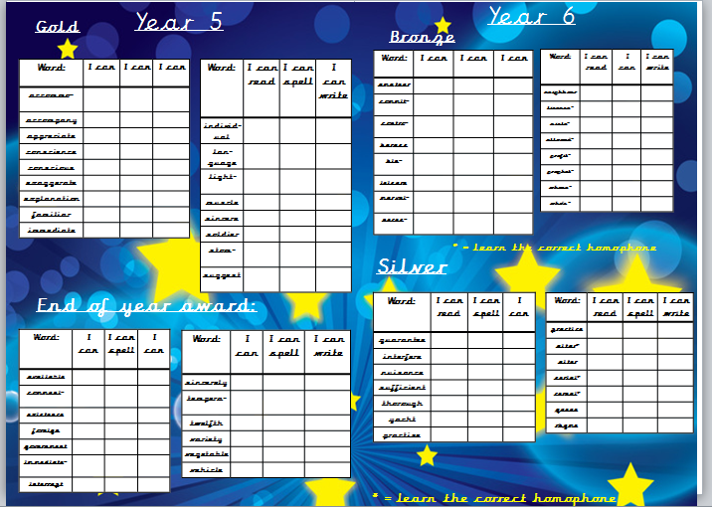

Slide 17


Slide 18
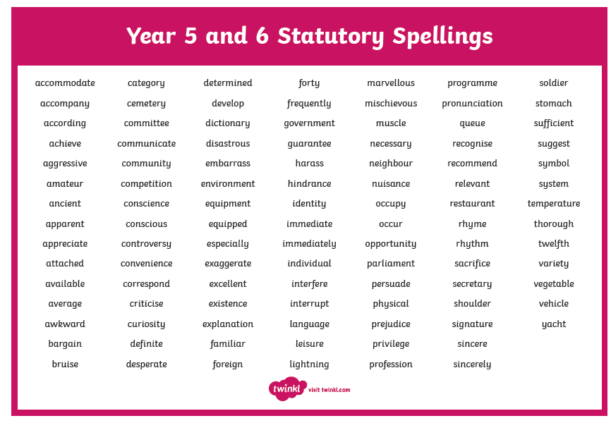

Slide 19

Times tables
As you will be aware, we have the Bronze, Silver and Gold badges in school.
Children must practise their times tables daily. Even if they think they know them- by Year 6 they must be quick to recall them.
There are also various sites to use:
https://www.youtube.com/watch?v=4BLZKOjNKfk

Slide 20
Reading at home:
Reading Journals
Children will be expected to write their own reading comments in their purple book each day.
Children will have a reading activity to complete each week.
Spellings should be practised in their homework book that covers 2 pages.

Slide 21
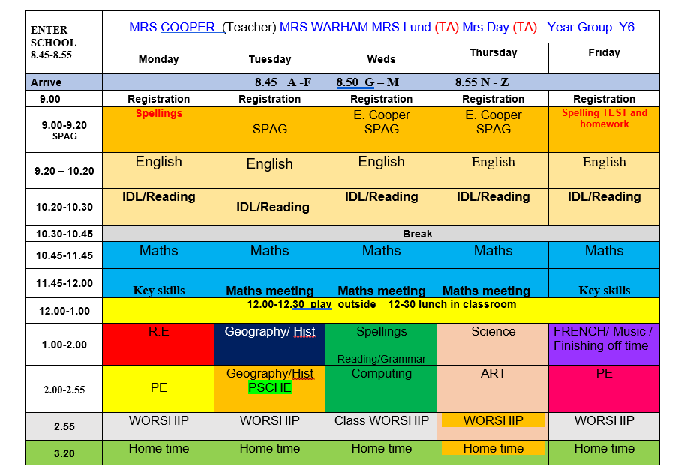
Class Timetable

Slide 22
Curriculum
Curriculum map/newsletter is on our website.

Slide 23



Behaviour and
Good To Be Green
Very high expectations
Manners
Greetings
Can do attitudes

Slide 24
Behaviour and
Good To Be Green
No specific Golden Time on a Friday afternoon but classes will be rewarded for behaviour which follows our school standards.
10 Green week certificates being given still
Red cards- letter home to parents on a Friday
Yellow cards- miss some of break time.

Slide 25
St Philip’s Standards
Be ready
Be Respectful
Be Responsible
Fantastic Walking

Slide 26

Fantastic Walking
Walking properly makes you feel great.
We are going to be doing fantastic walking, All THE TIME!
Head up
Arms by your sides
Slow pace.

Slide 27

Walking home
If you would like your children to walk home from school on their own, please could you write a letter explaining the days fully and sign it. This is for the safety of your children as they will be let out at the end of the day by a number of different teachers.
Thanks for your co-operation.

Slide 28
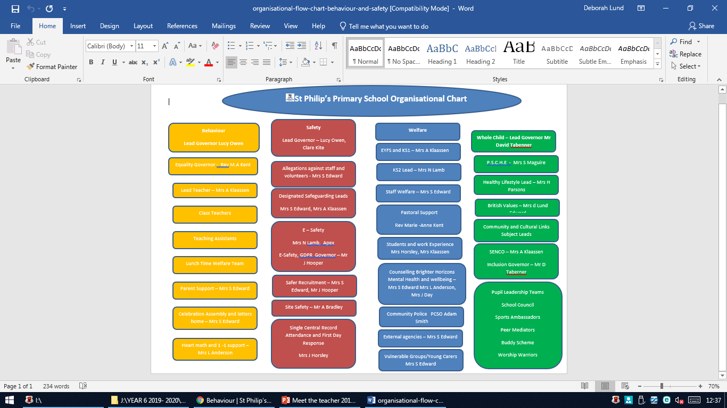

Slide 29
ST PHILIP’S CE PRIMARY SUPPORT TRIANGLE
SENDCO - Mrs Klaassen
SEN Support
Targeted Support
Enhanced Quality First,
Quality First – Universal Offer for all
High Needs Funding
EHCP’s
Specialist

Slide 30
Responsibilities
Children have jobs around the school which will be changed termly so as to give as many children as possible the opportunity to try out different things.

Slide 31
School Trips…
Liverpool Cathedral
Local visits to Southport
Winmarleigh Residential? Dependent on Government guidance

Slide 32
Permissions letter
Please ensure the letter regarding PG certificate material, local trips that don’t involve voluntary contributions and photo permission for education related websites beyond school, has been returned to school.

Slide 33
Children’s greatest fear regarding year 6 was:
SATS
We’ve tried to reassure them that they’ll be ready for them when they do them.
It’s never as bad as they think it will be – we make them feel special during SATS week.
Some children enjoy the challenge!
Hopefully they’ll be happy with their
results.
The SATs tests will take place throughout the week, starting on Monday 10th and ending on Thursday 13th May.

Slide 34

Parent’s evening:
To be confirmed…

Slide 35
Subject ladders
We have English and Maths ladders for you to download on our website. Please read them and refer to them throughout the year as they show the expectations for your child in Year 6.

Slide 36

Assessment

Slide 37


Slide 38

Year 6- band 6

Slide 39


Slide 40

Volunteers are very welcome!

Slide 41

.
Check website for information:
http://www.stphilipssouthport.com/
and Twitter!

