Slide 1
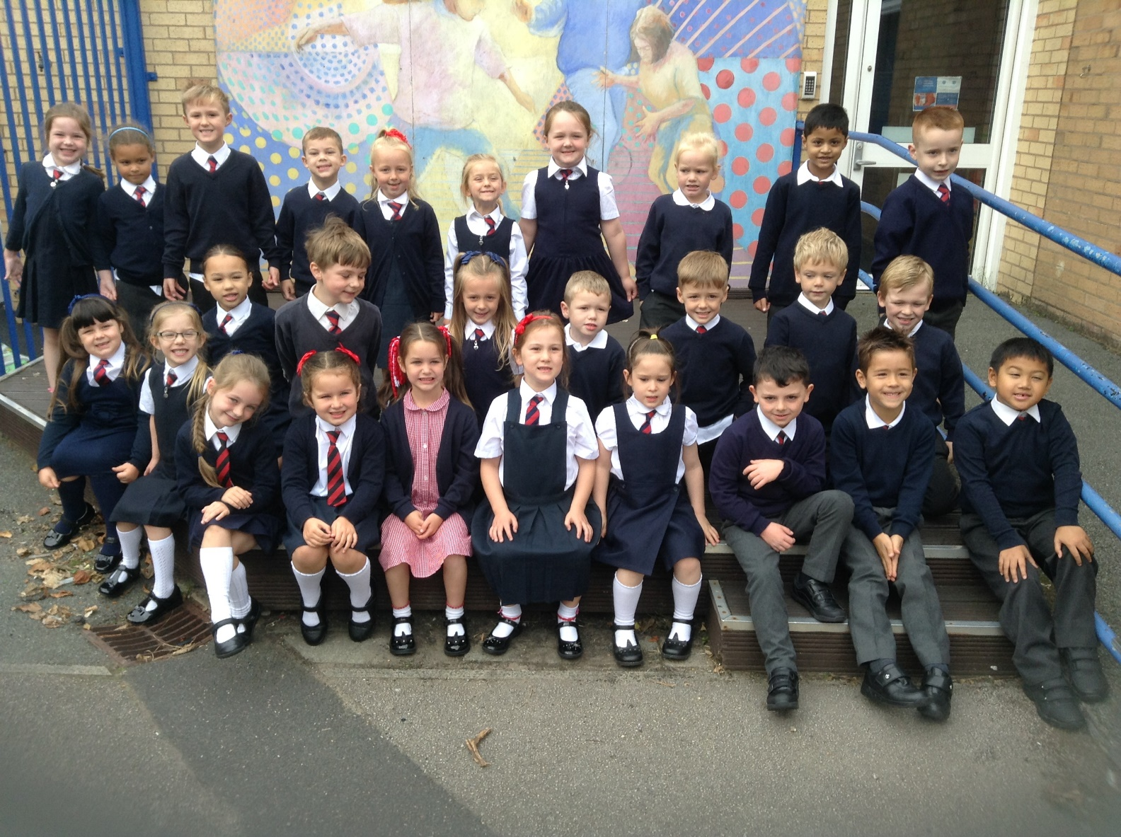
Welcome to year 1

Slide 2

What are our school’s core
Christian values?

Slide 3
What are our school’s core
Christian values?
Koinonia
Courage, Wisdom, Friendship, Forgiveness and Trust

Slide 4

Our Christian Vision…
Happiness, love and security abound
Everyone is special
Every achievement is celebrated
Relationships and teamwork matter
A beacon of light in the community
Christ in Everything we Do!

Slide 5
Year 1 staff
Mrs Bond
Mrs Wareing
Plus
Mrs Klaassen teaches Year 1 on a Thursday morning

Slide 6
Routines
Start time 8.45
Finish at 3.15pm.
If your child is absent from school please send a letter to the class teacher
It’s really important to be on time (whenever possible) as morning activities start as soon as we arrive at school.

Slide 7

Housekeeping!
Please name all uniform –
Boys’ winter uniform Girls’ winter uniform
Grey trousers Navy skirt or pinafore
White shirt White blouse
Navy long sleeved jumper Navy long sleeved cardigan
School tie School tie
Please make sure your child has a water bottle each day
Wednesdays and Thursdays are PE days. Please make sure PE kits are worn to school on those days.
PE kit – blue shorts and white t-shirt (eg on website) Children are allowed to wear navy blue tracksuit bottoms and hoodies for outside PE during the winter.
We are struggling for space to store bags. Please could the children bring school book bags which are flat so fit into trays easily.

Slide 8
Class Timetable

Slide 9

Medical
Any medication updates – please let us know of any changes
Please check your child’s inhaler is still in date.
We have been advised that children should use a spacer when taking their inhaler - if possible please send one into school.
If your child needs any prescribed medication, a medical form needs to be filled in at the office before we are able to administer it.
Thank you

Slide 10
Homework
Homework will be given out on a Friday to be returned by Wednesday.
I would be really grateful if you could return homework on time so I have chance to mark it before Friday – Thank you.
Spellings will be tested each Friday.
Weekly spelling will be put on the website.
Please try to read with your child every day.
Please let us know if any homework is too difficult so we can give a little extra help at school.
Thank you

Slide 11
Reading
Your children will continue reading through the colour bands
Please try and read at home every night.
In school the children will be involved in
Shared reading
1:1 reading with an adult
Reading across the curriculum.
Story time at the end of the day.

Slide 12
Phonics
Work in phase groups.
20 minutes daily.
Session involves re-visiting phonemes, learning new phonemes, blending sounds together and applying their knowledge in reading and writing.
‘Real’ and ‘Alien’ words.
Children will receive spellings based on what they have been doing in phonics. They will have a test every Friday.
Phonics check will take place in June

Slide 13
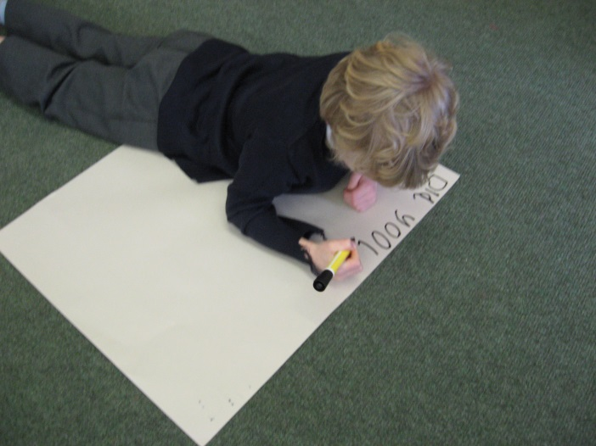
Writing
Shared and Guided writing tasks.
Independent tasks.
Cursive font
Lots of speaking and listening activities to help their writing.

Slide 14
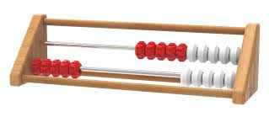
Maths
Practical activities.
Recording in Maths books.
Use of Numicon and other practical resources.
10/15 minutes per day developing number fluency using rekenrek

Slide 15
Badges
Spelling badges
We work towards out bronze, silver and gold spelling badges
throughout the year

Slide 16
ST PHILIP’S CE PRIMARY SUPPORT TRIANGLE
SENDCO - Mrs Klaassen
SEN Support
Targeted Support
Enhanced Quality First,
Quality First – Universal Offer for all
High Needs Funding
EHCP’s
Specialist

Slide 17

Curriculum
Curriculum map and autumn newsletter is on the website.
Website
Please keep checking the website dates and news.
We will try to keep the website updated with lots of photos of your children at work and play.
Trips
You will also find information about after school clubs on the website.

Slide 18
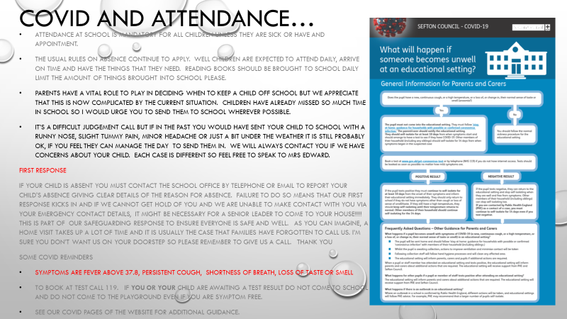

Slide 19
Assessment
Assessment takes place at the end of each half term.
We track progress using Target Tracker.
The children work to meet all the objectives on the curriculum ladders (you can find these on the website)
Your children are in Year 1 so we are in Band 1
Each band has been split into six sections
Beginning and Beginning Plus ( B and B+)
Working Within and Working within Plus – Up to 70% of the statements are confidently achieved (W and W+)
Secure and Secure Plus (S and S+)
We aim for most children to make 6 bands of progress each year
If you’d like more information, there is a full explanation of the assessment process on the website.

Slide 20


Slide 21
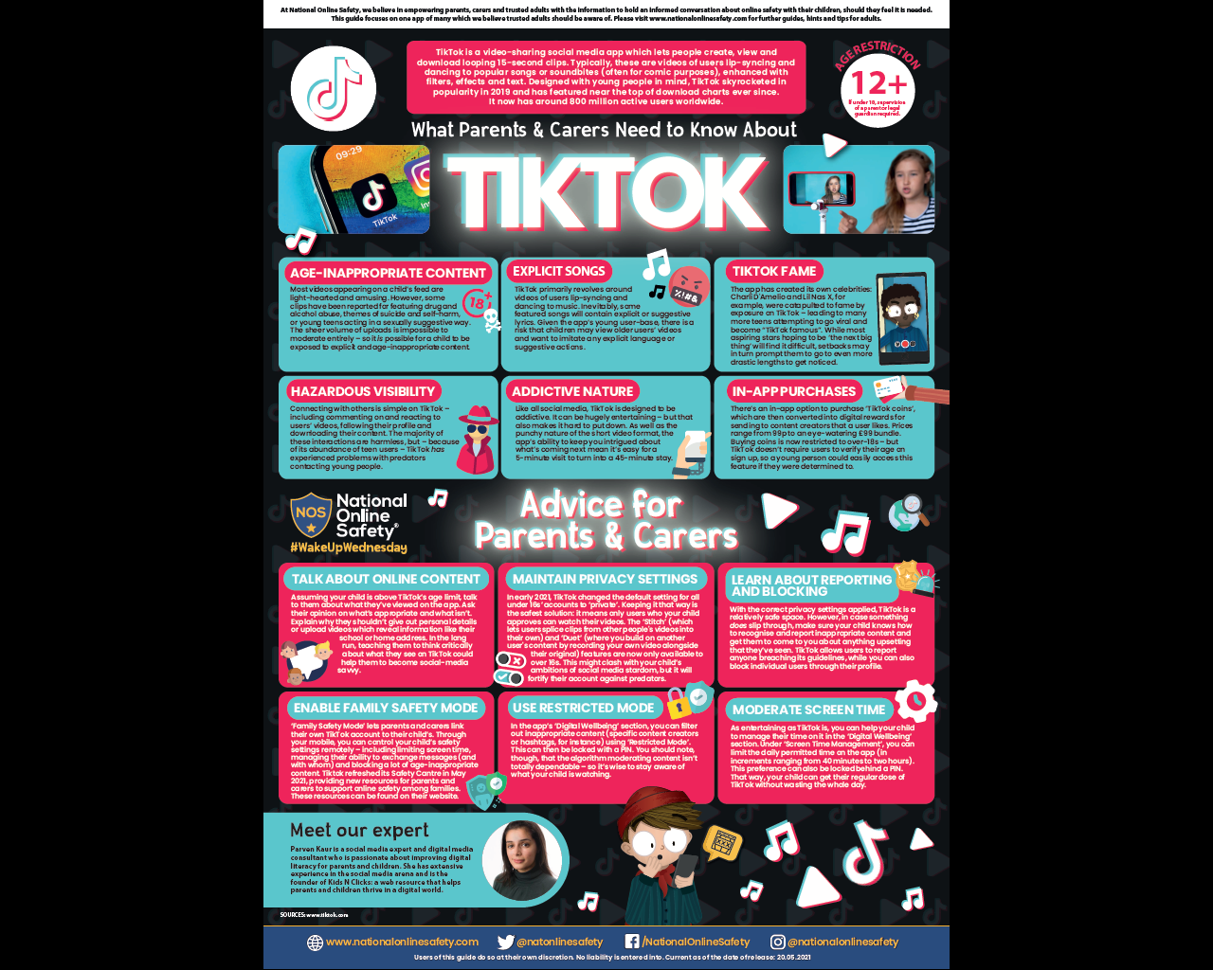

User friendly guides on all areas of ICT, gaming, social media and top tips for online safety.
To sign up please download the app, choose parent as your role and make use of the advice and support offered plus the online training support.

Slide 22
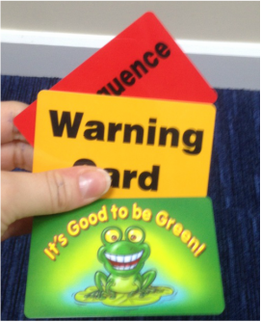

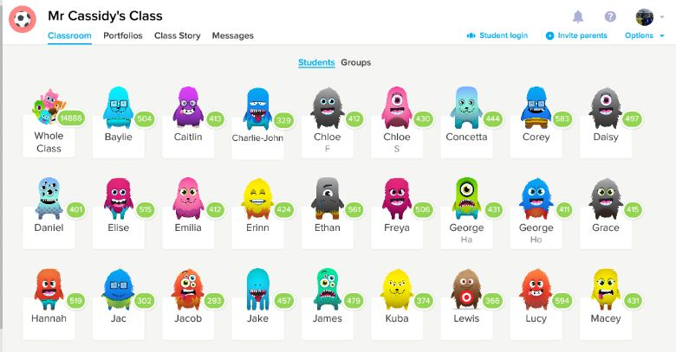
Behaviour!
Behaviour flow chart is on the web site
Children are awarded dojos for following the class rules – there is a prize at the end of the week
If children are not following the class rules a verbal warning is given before a card is issued

Slide 23
St Philip’s Standards
Be ready
Be Respectful
Be Responsible
Fantastic Walking

Slide 24
Website and Twitter
Please remember the website holds lots of information and photos of your children.
Also twitter gives instant updates of what is going on in school.

Slide 25
Lovely to meet you all and thank you for coming.
Please don’t hesitate to ask if there is anything you’re unsure about.

