Slide 1
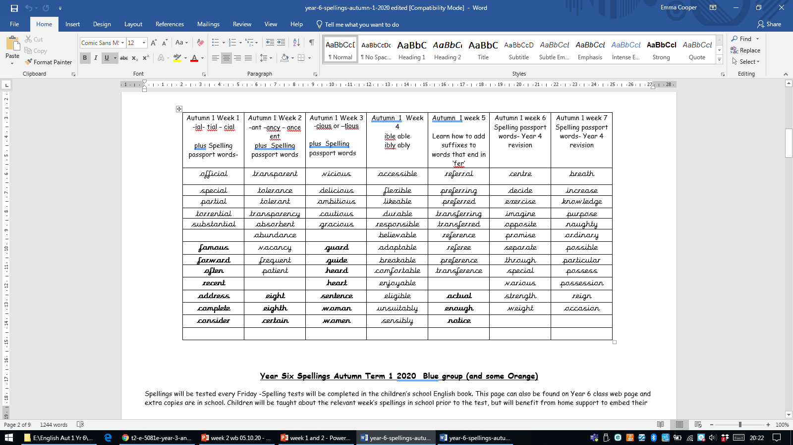
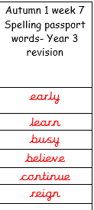
Week 7

Slide 2
Monday 18th October
L.O: To learn and magpie features from a persuasive text.

Slide 3
What is
persuasion?
Notes:
Children discuss what they think persuasion is used for- different contexts. What makes something persuasive?

Slide 4
When would you need
to use
persuasion?
Notes:
Children discuss what they think persuasion is used for- different contexts. What makes something persuasive?

Slide 5
What makes a text
persuasive?
Notes:
Children discuss what they think persuasion is used for- different contexts. What makes something persuasive?

Slide 6
OUR PURPOSE:
WHAT: We are learning how to write a persuasive argument about reducing the impact of deforestation.
WHY: to persuade officials, companies, environmentalists to protect our rain forests.
WHO: officials, companies, environmentalists

Slide 7

https://www.youtube.com/watch?v=nNq_xiuif5M
Notes:
Children watch and discuss what they know so far about deforestation

Slide 8
Discuss…
What are the effects of deforestation??
What have you learnt in Geography so far??
Let’s make a list!!

Slide 9

An example of a persuasive argument…

Slide 10
The title… what do you notice?
Should teachers be allowed to eat chocolate?

Slide 11
The title… what do you notice?
Should teachers be allowed to eat chocolate?

Slide 12
As we read the WAGOLL…
Highlight as we read on your own copy that you have in partners.
Why have I highlighted certain words or phrases already on the board? Why are they relevant?

Slide 13
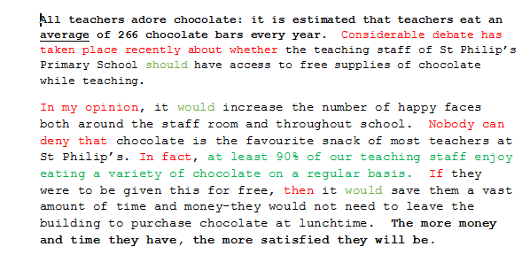

Slide 14
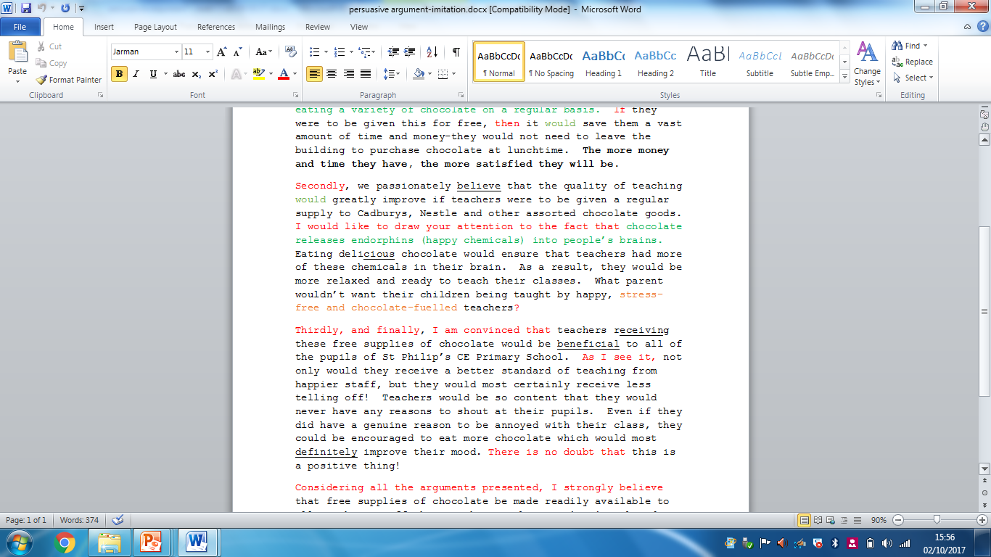

Slide 15
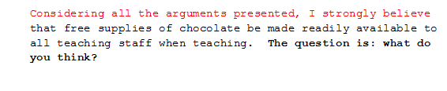

Slide 16
MORE EXAMPLES OF PERSUASIVE TEXTS…

Slide 17
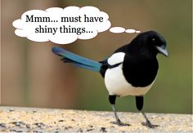
Magpie time!
https://www.pobble.com/works/persuasive-writing-eoin
https://www.pobble.com/works/writing-persuasively-food-choices
https://www.pobble.com/works/emilys-persuasive-argument-2
https://www.pobble.com/works/claudias-persuasive-argument
https://www.pobble.com/works/school-uniform-persuasive-text-ellie
https://www.pobble.com/works/izzys-persuasive-argument
https://www.pobble.com/works/persuasive-article-elephants-captivity
Notes:
SEE LETTERS IN FILE PRINTED. IF MORE NEED PRINTING, HERE ARE THE LINKS.

Slide 18
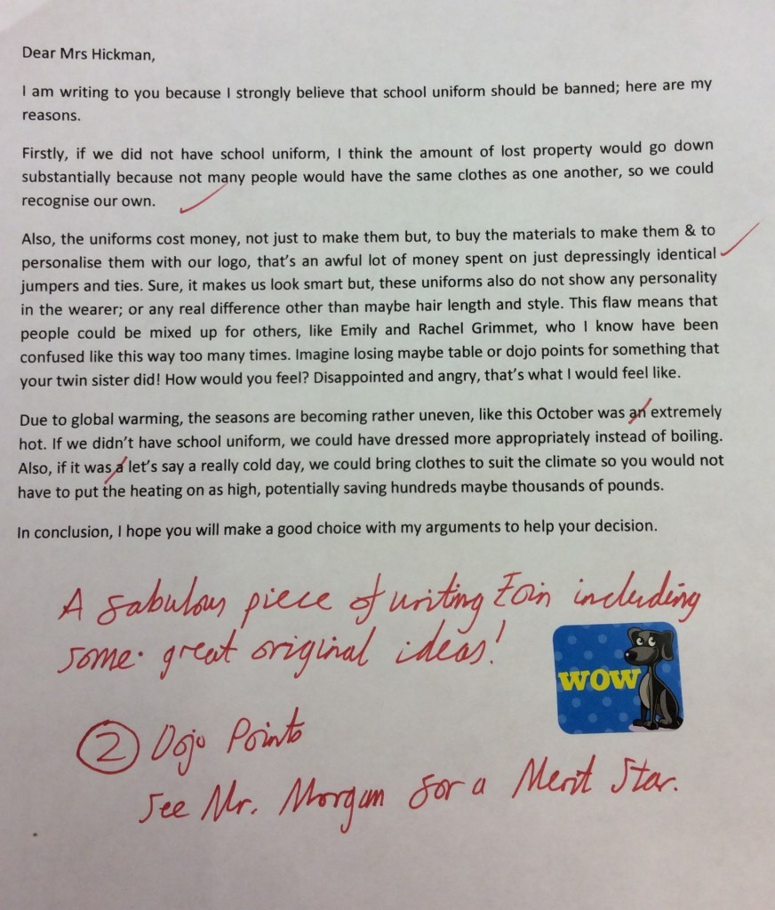
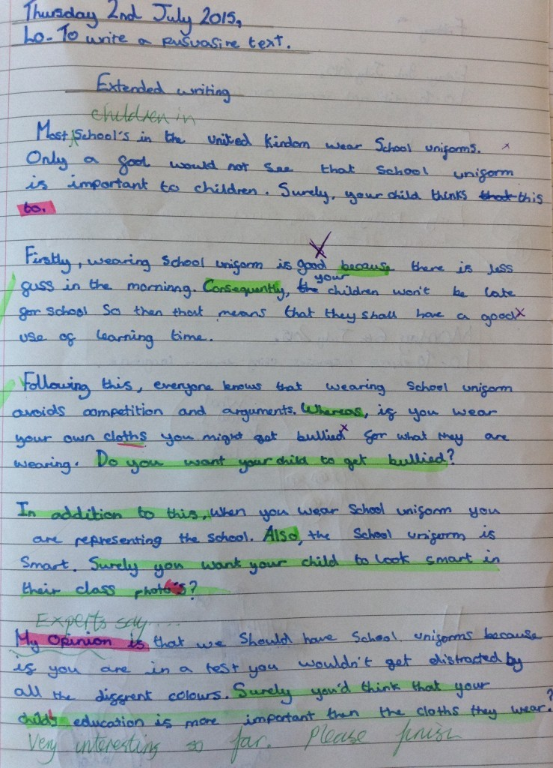

Slide 19
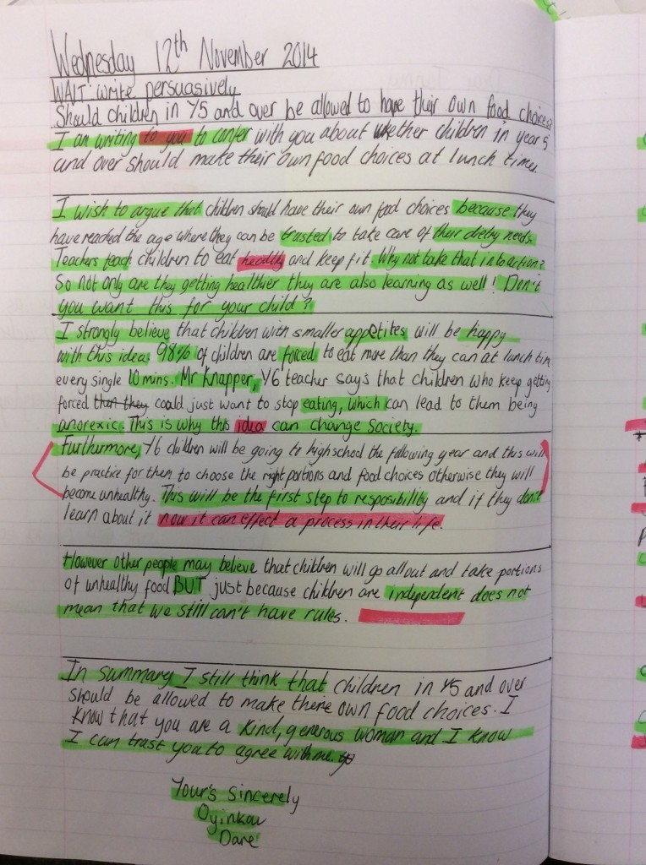

Slide 20
Feature | Magpied Feature
________________________________________________________ | ___________________________________________________________________________________________________________________________________________________________________________
________________________________________________________ | ___________________________________________________________________________________________________________________________________________________________________________
________________________________________________________ | ___________________________________________________________________________________________________________________________________________________________________________
________________________________________________________ | ___________________________________________________________________________________________________________________________________________________________________________
________________________________________________________ | ____________________________________________________________________________________________________________________________________________________________________________________________________________________________________
Mon
Notes:
SLIDE 39-40 DOUBLE SIDED FOR HA AND UPPER MA

Slide 21
Feature | Magpied Feature
________________________________________________________ | ___________________________________________________________________________________________________________________________________________________________________________
________________________________________________________ | ___________________________________________________________________________________________________________________________________________________________________________
________________________________________________________ | ___________________________________________________________________________________________________________________________________________________________________________
________________________________________________________ | ___________________________________________________________________________________________________________________________________________________________________________
________________________________________________________ | ____________________________________________________________________________________________________________________________________________________________________________________________________________________________________

Slide 22
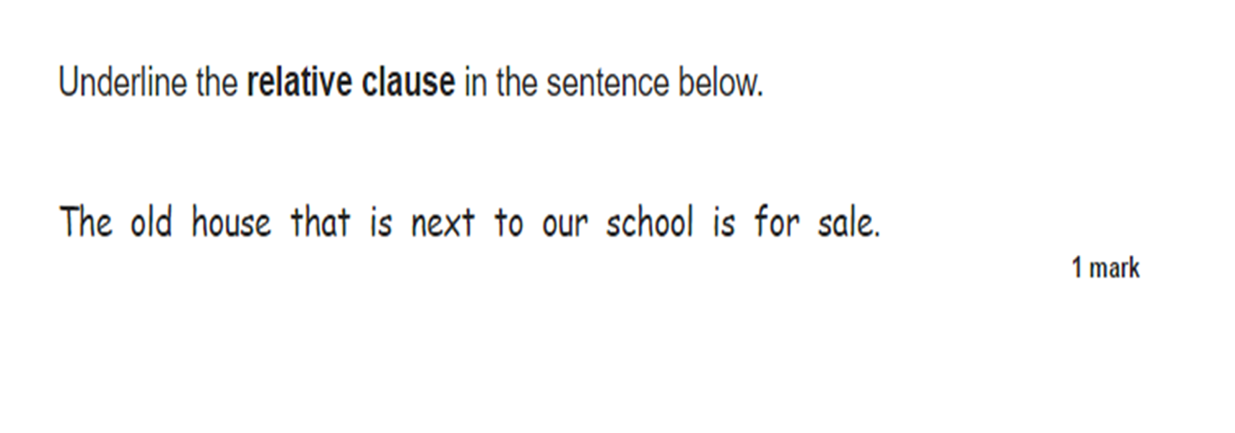
SPAG L.O. FOR THIS WEEK: Mon pm lesson
L.O:To use modal verbs in sentences.

Slide 23
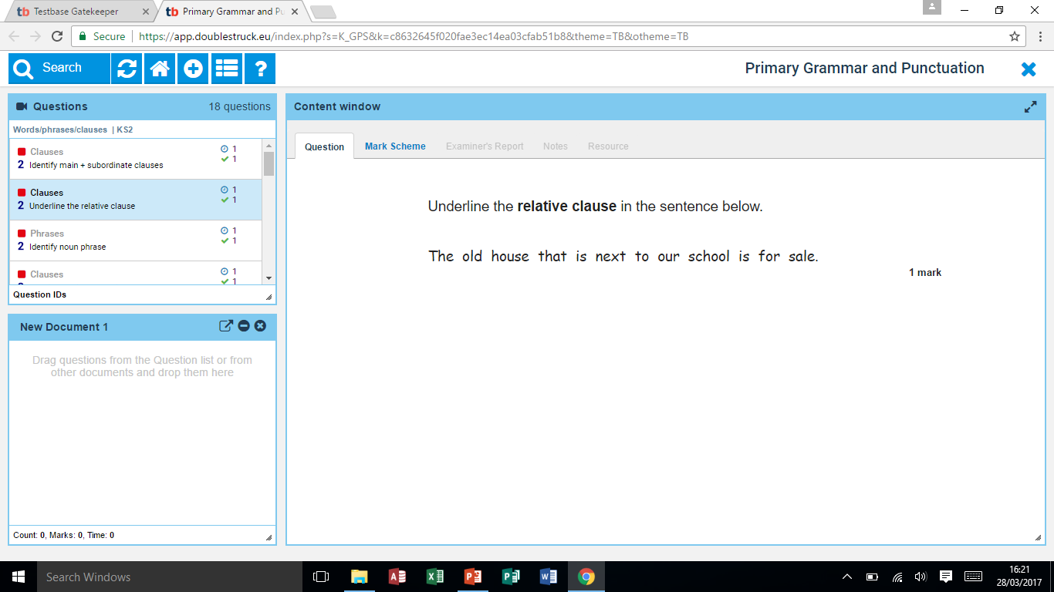

Slide 24
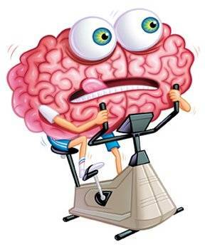
SPAG Warm up!

Slide 25
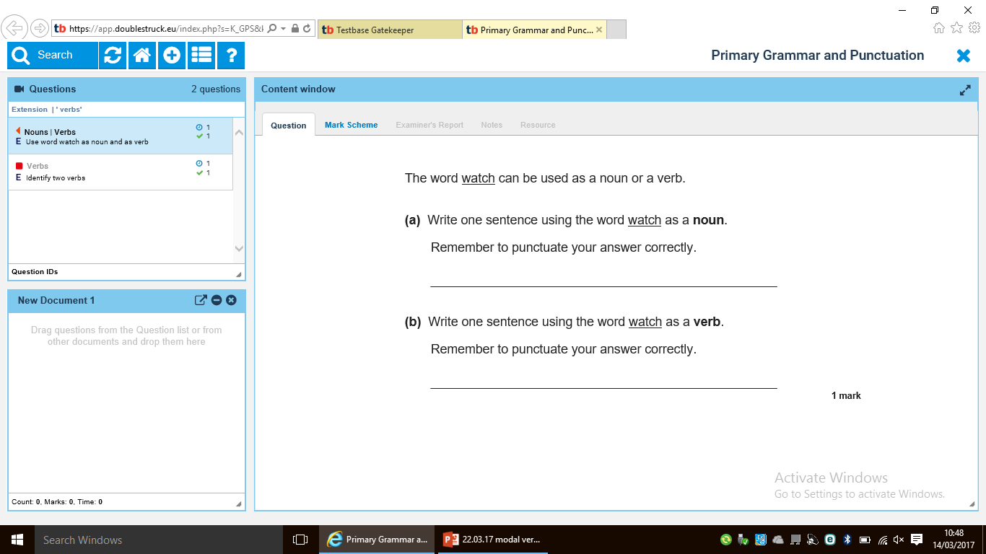

Slide 26
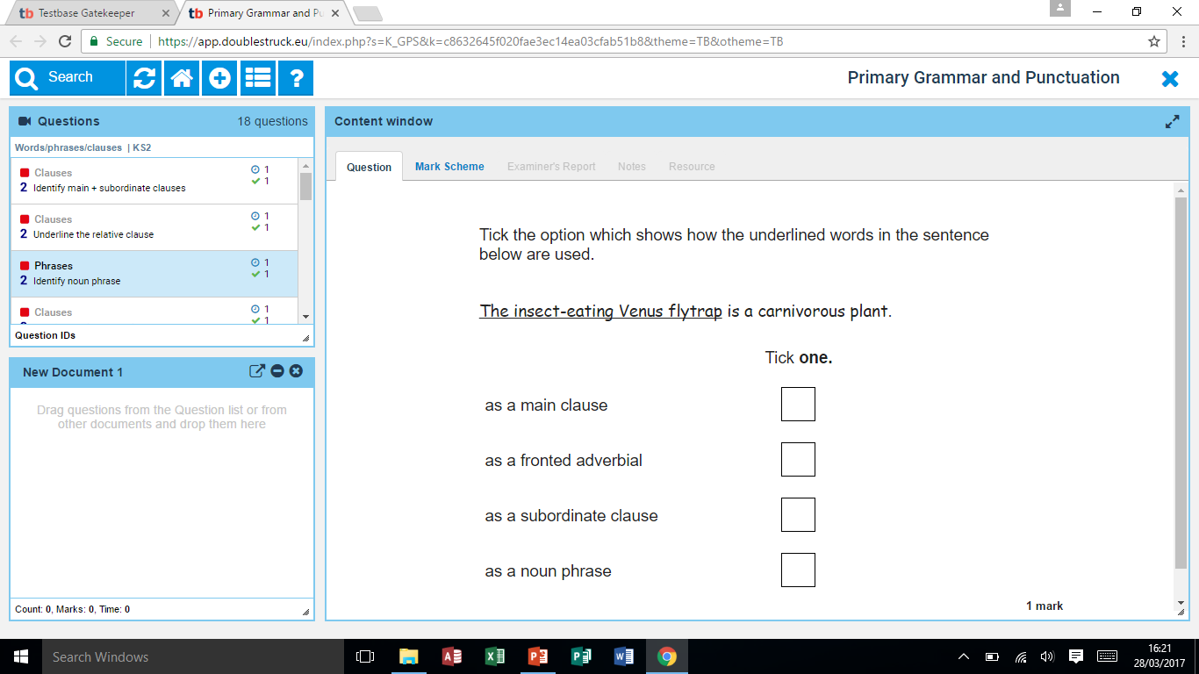

Slide 27
Possibility
Modal verbs can be used when we want to show how likely something is to happen. For example:
It might rain tomorrow.
We might have fish and chips for tea.
We could walk to the shops.
It will be sunny tomorrow.

Slide 28


Modal Verbs for Possibility: The Rules
Modal verbs can have many uses. In most cases, they work with another verb to describe the possibility of something happening or to describe to what degree of certainty something is known.
Look at these sentences that contain modal verbs:
The rounders team could win the tournament.
Humpty Dumpty will fall off the wall.

Slide 29




Modal Verbs for Commands : The Rules
Modal verbs can also express commands or the obligation for someone to do something.
You must not do that ever again.
You must come back home now.
You will tidy your room.

Slide 30
Permission
Modal verbs are used to give or ask for permission for an activity. For example:
You may have another biscuit.
You can get down from the table now.
Could I go to the toilet, please?

Slide 31
Ability
Modal verbs can be used when we want to show a skill or someone's ability to do something. For example:
Jack can sing.

Slide 32




Modal Verbs for Ability : The Rules
Modal verbs can also express an ability to do another verb.
I can sing beautifully.
I cannot ride a skateboard.

Slide 33
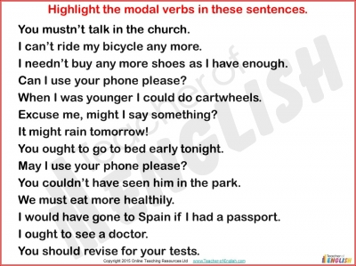
Underline the modal verb.

Slide 34
Mon

Slide 35
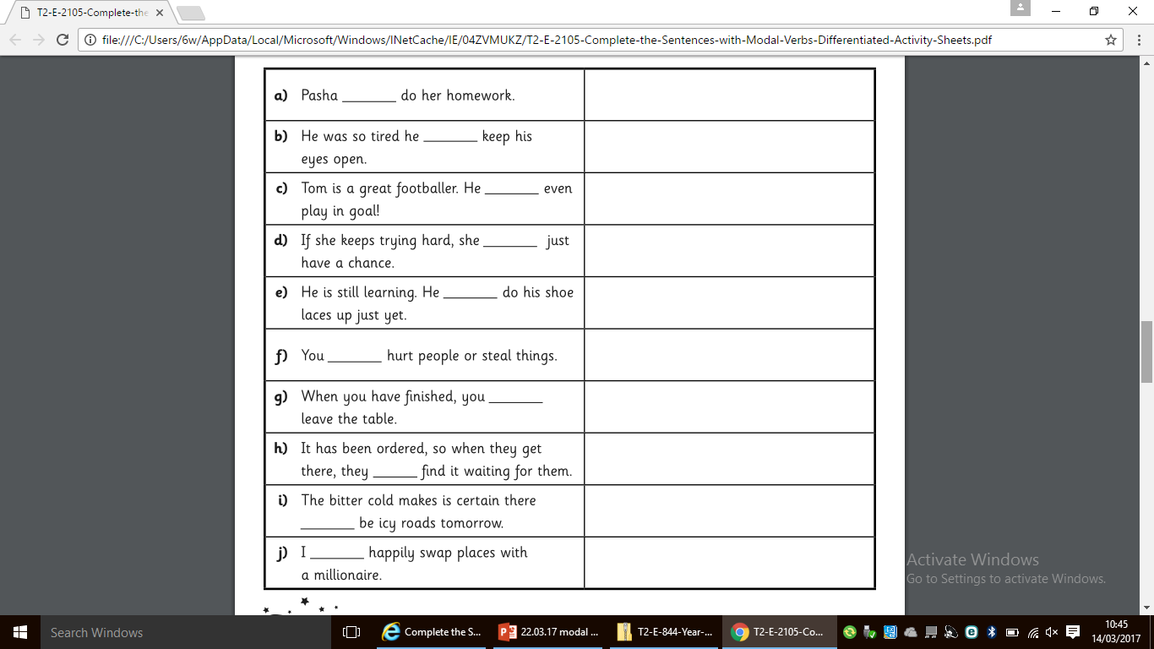
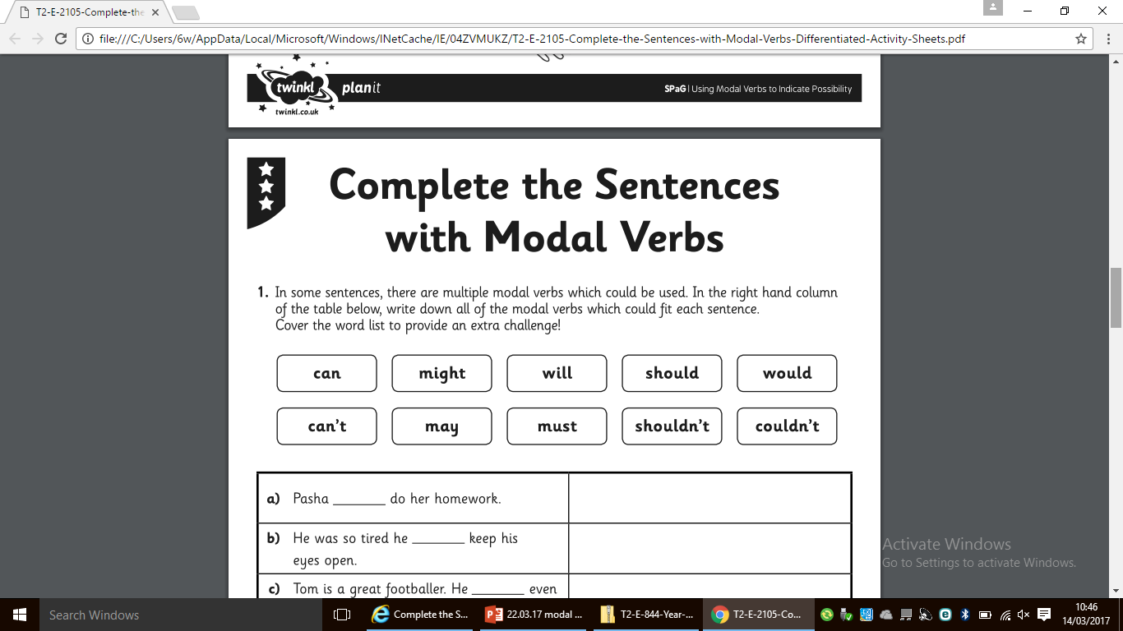

Slide 36
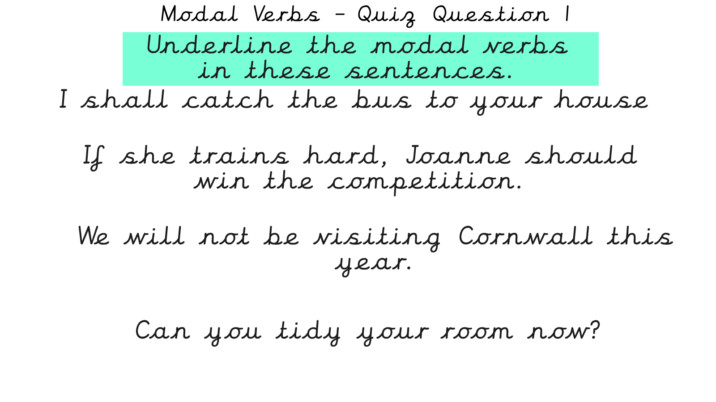

Slide 38
Modal Verbs – Quiz Question 1
Underline the modal verbs in these sentences.
I shall catch the bus to your house
If she trains hard, Joanne should
win the competition.
We will not be visiting Cornwall this year.
Can you tidy your room now?

Slide 39
Modal Verbs – Quiz Question 2
Which event is most likely to happen?
We could go out for lunch today.
This afternoon, Josie might play tennis.
The sun will come out tomorrow.
Michael should get a shower tonight.

Slide 40
Modal Verbs – Quiz Question 3
Tick one box in each row to show how the modal verb affects the meaning of the sentence.
Sentence | Modal verb indicates certainty | Modal verb indicates possibility
Ferrari might win the drivers’ championship this season.
Lily can ride her bike without stabilisers.
It will snow this winter.
✔
✔
✔

Slide 41
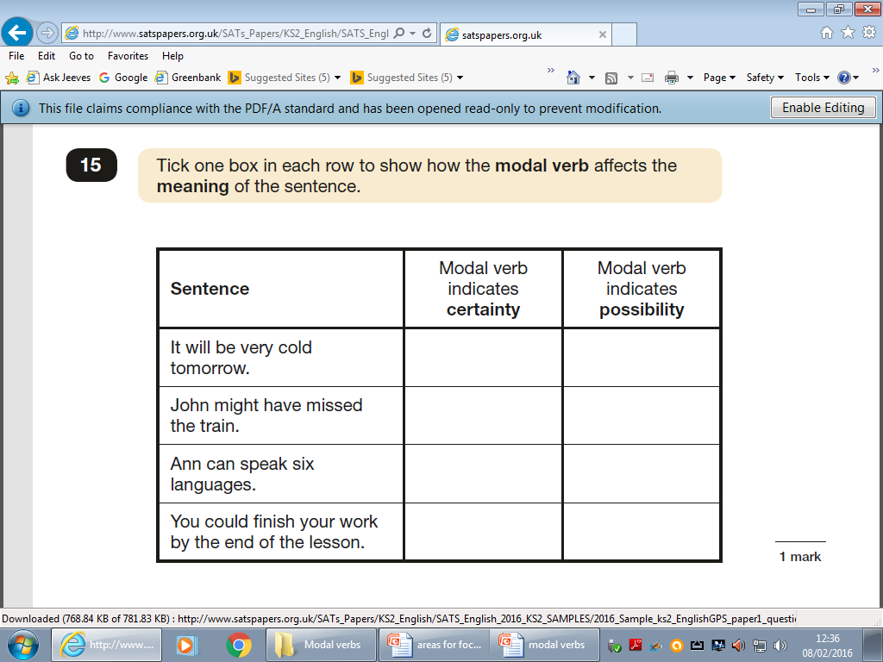
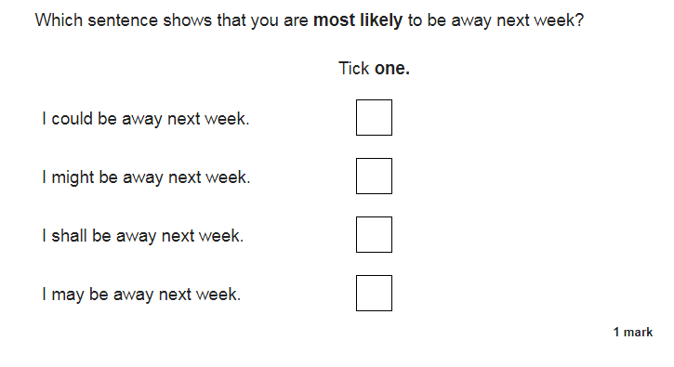
Mon

Slide 43
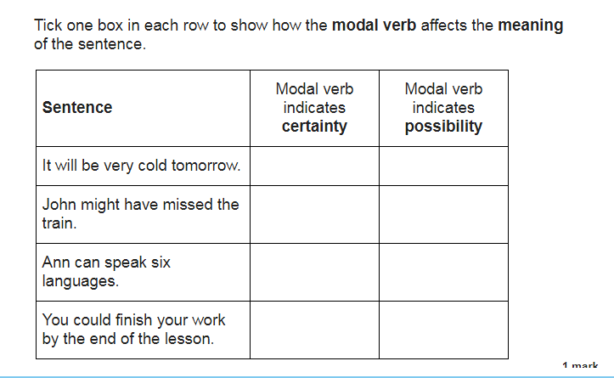

Slide 44
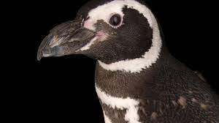
https://www.naturalcurriculum.co.uk/grammar/year-6-grammar-lessons/modal-verbs/magellanic-penguin-2/screen-1/

Slide 45


Thursday 15th October
L.O. To learn and perform a text.
Features of persuasive writing…

Slide 46
Conjunctions and key phrases:
In my opinion
I would like to draw your attention to the fact…
As I see it,
Even if…
There is no doubt…
Considering all the arguments presented,
The question is…
Considerable debate
In addition,
Secondly,
As a result,
Thirdly and finally,

Slide 47
All together now…
All teachers adore chocolate: it is estimated that teachers eat an average of 266 chocolate bars every year. Considerable debate has taken place recently about whether the teaching staff of St Philip’s Primary School should have access to free supplies of chocolate while teaching.
Introduction
Notes:
Children learn and do actions as a class to learn the introduction

Slide 48
Paragraph 1:
In my opinion, it would increase the number of happy faces both around the staff room and throughout school. Nobody can deny that chocolate is the favourite snack of most teachers at St Philip’s. In fact, at least 90% of our teaching staff enjoy eating a variety of chocolate on a regular basis. If they were to be given this free, it would save them a vast amount of money. In addition, it would also save them time because they would not need to leave the building to purchase chocolate at lunchtime.
Notes:
Split the paragraphs in half for children to learn in either pairs or small groups.

Slide 49
Paragraph 2:
Secondly, we passionately believe that the quality of teaching would greatly improve if teachers were to be given a regular supply to Cadburys, Nestle and other assorted chocolate goods. I would like to draw your attention to the fact that chocolate releases endorphins (happy chemicals) into people’s brains. Eating delicious chocolate would ensure that teachers had more of these chemicals in their brain. As a result, they would be more relaxed and ready to teach their classes. What parent wouldn’t want their children being taught by happy, stress-free and chocolate-fuelled teachers?
Notes:
Split the paragraphs in half for children to learn in either pairs or small groups.

Slide 50
Paragraph 3:
Thirdly, and finally, I am convinced that teachers receiving these free supplies of chocolate would be beneficial to all of the pupils of St Philip’s CE Primary School. As I see it, not only would they receive a better standard of teaching from happier staff, but they would most certainly receive less telling off! Teachers would be so content that they would never have any reasons to shout at their pupils. Even if they did have a genuine reason to be annoyed with their class, they could be encouraged to eat more chocolate which would most definitely improve their mood. There is no doubt that this is a positive thing!
Notes:
Split the paragraphs in half for children to learn in either pairs or small groups.

Slide 51

Let’s hear it!
Notes:
Children share their actions and learnt text and present to class.

Slide 52
Conclusion:
Considering all the arguments presented, I strongly believe that free supplies of chocolate be made readily available to all teaching staff when teaching. The question is: what do you think?
Notes:
As a class, learn the conclusion.

Slide 53
What key words and phrases have we learnt that we need to use in our persuasive texts??
Let’s add to our working wall!

Slide 54
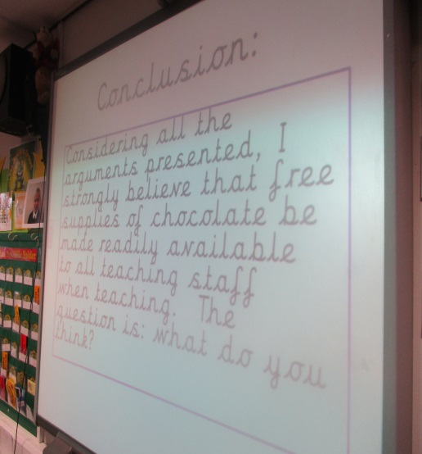
Tuesday 19th October
L.O: Learn a persuasive text.
Tuesday 19th October
L.O: Learn a persuasive text.
This lesson, we have explored, ‘magpied’ and learnt persuasive features from a persuasive text to help us with planning our very own persuasive text.
This lesson, we have explored, ‘magpied’ and learnt persuasive features from a persuasive text to help us with planning our very own persuasive text.

Slide 55
Wednesday 20th October
L.O. To box up a persuasive argument.

Slide 56
Let’s read and review the features
in the WAGOLL…

Slide 57
All teachers adore chocolate: it is estimated that teachers eat an average of 266 chocolate bars every year. Considerable debate has taken place recently about whether the teaching staff of St Philip’s Primary School should have access to free supplies of chocolate while teaching.
Introduction

Slide 58
Paragraph 1:
In my opinion, it would increase the number of happy faces both around the staff room and throughout school. Nobody can deny that chocolate is the favourite snack of most teachers at St Philip’s. In fact, at least 90% of our teaching staff enjoy eating a variety of chocolate on a regular basis. If they were to be given this free, it would save them a vast amount of money. In addition, it would also save them time because they would not need to leave the building to purchase chocolate at lunchtime.

Slide 59
Paragraph 2:
Secondly, we passionately believe that the quality of teaching would greatly improve if teachers were to be given a regular supply to Cadburys, Nestle and other assorted chocolate goods. I would like to draw your attention to the fact that chocolate releases endorphins (happy chemicals) into people’s brains. Eating delicious chocolate would ensure that teachers had more of these chemicals in their brain. As a result, they would be more relaxed and ready to teach their classes. What parent wouldn’t want their children being taught by happy, stress-free and chocolate-fuelled teachers?

Slide 60
Paragraph 3:
Thirdly, and finally, I am convinced that teachers receiving these free supplies of chocolate would be beneficial to all of the pupils of St Philip’s CE Primary School. As I see it, not only would they receive a better standard of teaching from happier staff, but they would most certainly receive less telling off! Teachers would be so content that they would never have any reasons to shout at their pupils. Even if they did have a genuine reason to be annoyed with their class, they could be encouraged to eat more chocolate which would most definitely improve their mood. There is no doubt that this is a positive thing!

Slide 61
Conclusion:
Considering all the arguments presented, I strongly believe that free supplies of chocolate be made readily available to all teaching staff when teaching. The question is: what do you think?

Slide 62
All teachers adore chocolate: it is estimated that teachers eat an average of 266 chocolate bars every year. Considerable debate has taken place recently about whether the teaching staff of St Philip’s Primary School should have access to free supplies of chocolate while teaching.
Introduction

Slide 63
Paragraph 1:
In my opinion, it would increase the number of happy faces both around the staff room and throughout school. Nobody can deny that chocolate is the favourite snack of most teachers at St Philip’s. In fact, at least 90% of our teaching staff enjoy eating a variety of chocolate on a regular basis. If they were to be given this free, it would save them a vast amount of money. In addition, it would also save them time because they would not need to leave the building to purchase chocolate at lunchtime.

Slide 64
Paragraph 2:
Secondly, we passionately believe that the quality of teaching would greatly improve if teachers were to be given a regular supply to Cadburys, Nestle and other assorted chocolate goods. I would like to draw your attention to the fact that chocolate releases endorphins (happy chemicals) into people’s brains. Eating delicious chocolate would ensure that teachers had more of these chemicals in their brain. As a result, they would be more relaxed and ready to teach their classes. What parent wouldn’t want their children being taught by happy, stress-free and chocolate-fuelled teachers?

Slide 65
Paragraph 3:
Thirdly, and finally, I am convinced that teachers receiving these free supplies of chocolate would be beneficial to all of the pupils of St Philip’s CE Primary School. As I see it, not only would they receive a better standard of teaching from happier staff, but they would most certainly receive less telling off! Teachers would be so content that they would never have any reasons to shout at their pupils. Even if they did have a genuine reason to be annoyed with their class, they could be encouraged to eat more chocolate which would most definitely improve their mood. There is no doubt that this is a positive thing!

Slide 66
Conclusion:
Considering all the arguments presented, I strongly believe that free supplies of chocolate be made readily available to all teaching staff when teaching. The question is: what do you think?

Slide 67
Conjunctions and key phrases:
In my opinion
I would like to draw your attention to the fact…
As I see it,
Even if…
There is no doubt…
Considering all the arguments presented,
The question is…
Considerable debate
In addition,
Secondly,
As a result,
Thirdly and finally,

Slide 68
This lesson…
We are going to ‘Box Up The Text’.
This means, we are going to identify each part of the WAGOLL and magpie features from it closely!
This will greatly help us next week when we plan OUR OWN!

Slide 69
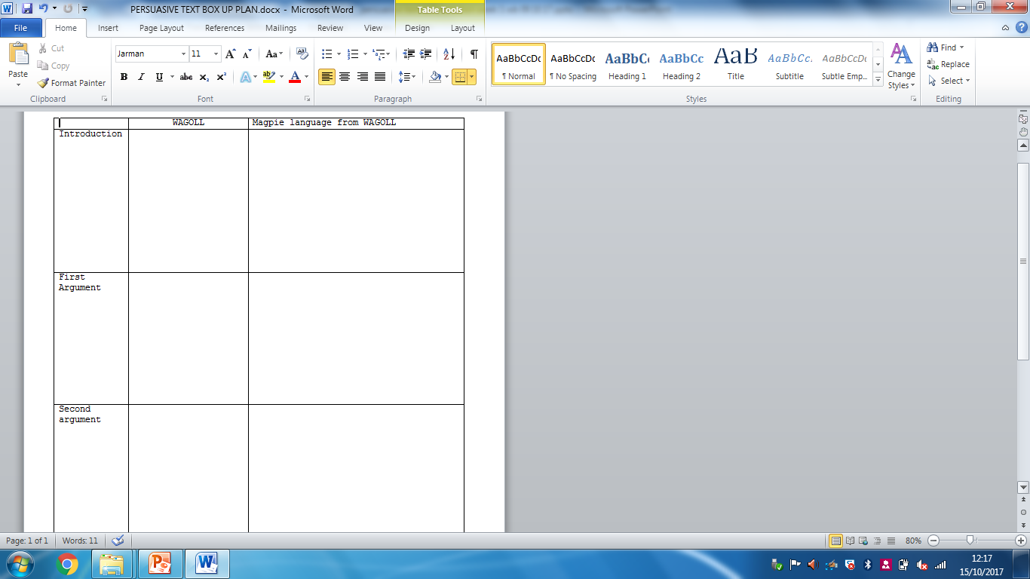
Box up the text!
Notes:
SEE DIFFERENTIATED SHEETS

Slide 70
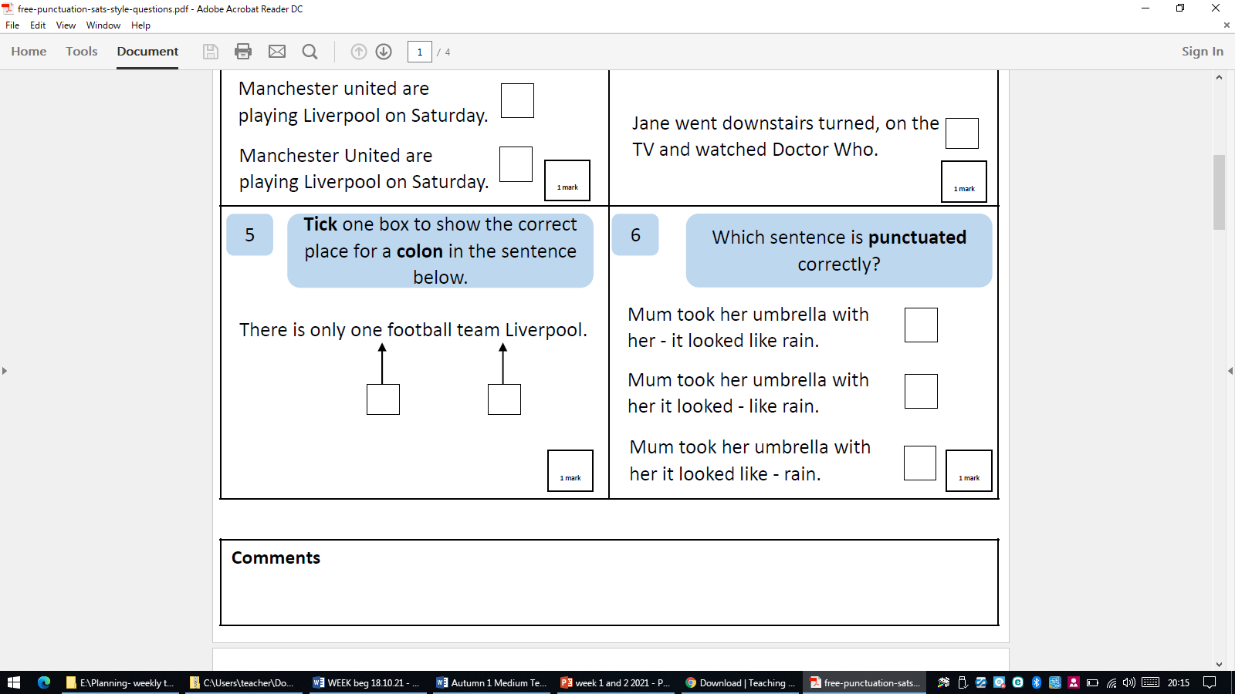
SPAG
Thursday 21st October
L.O. To practise the use of colons
https://www.bbc.co.uk/bitesize/topics/zmfc7ty/articles/z6cxxyc

Slide 71
The question is: ?
The question is:
_____________________________?

Slide 72
Description : Detail
All teachers adore chocolate: it is estimated that teachers eat an average of 266 chocolate bars every year.

Slide 73
Your turn…
Rainforests are disappearing: ___________________________________________________.
Deforestation is a huge problem: _______________________________________-_________________.
There has been considerable debate about whether ______________________________________________.

Slide 74
Our WAGOLL introduction
All teachers adore chocolate: it is estimated that teachers eat an average of 266 chocolate bars every year. There has been considerable debate about whether the teaching staff of St Philip’s CE Primary School should have access to free supplies of chocolate while teaching.

Slide 75
The more, the more
The more money and time they have, the more satisfied they will be.
The more _________________________________the more________________________________.

Slide 76
Thursday 21st October
L.O.: To gather facts and figures to use in a persuasive argument.

Slide 77
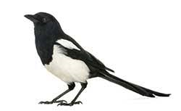
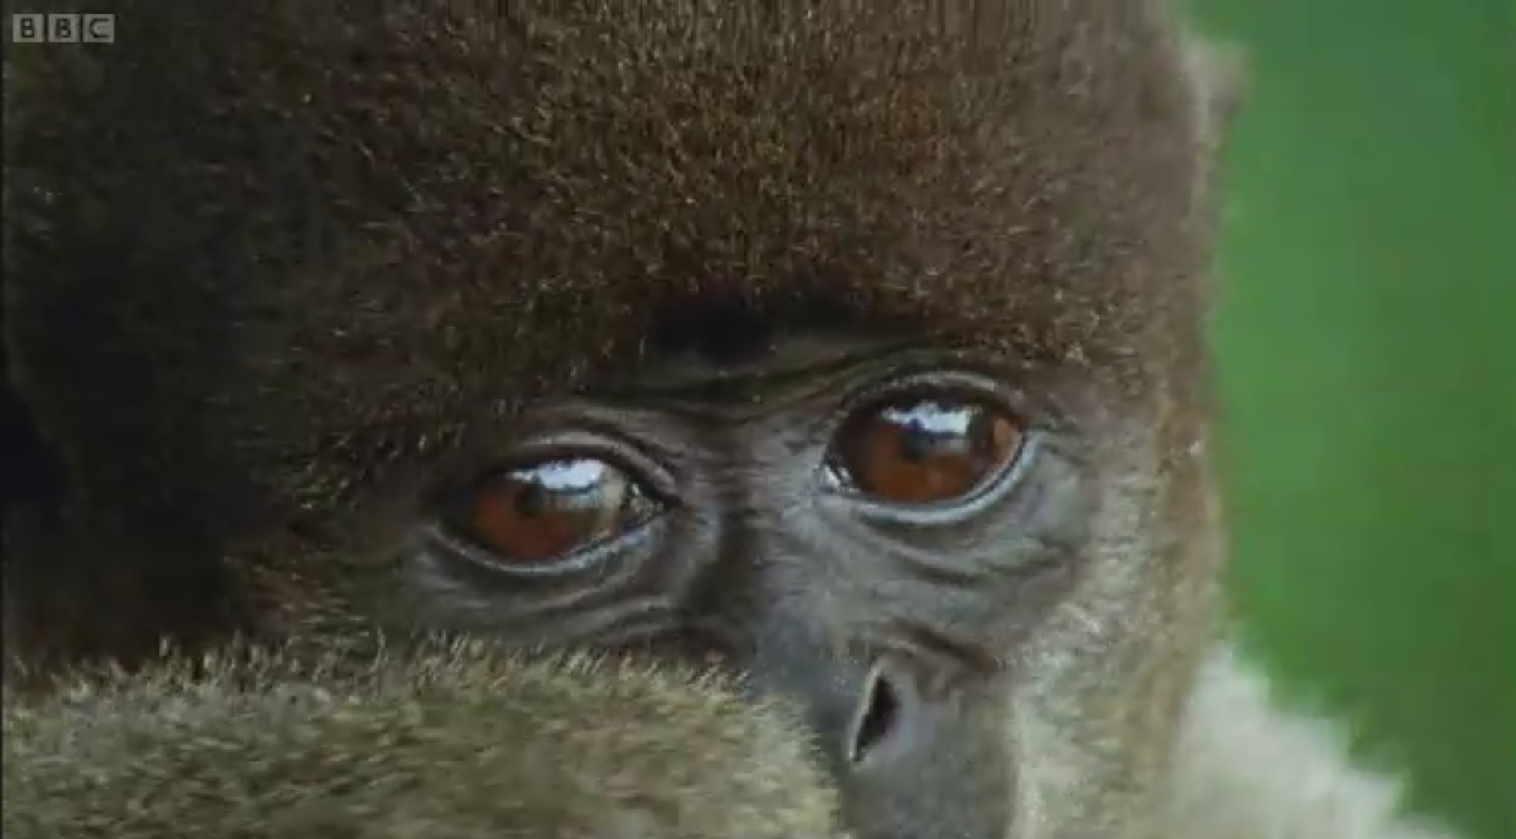

Why Does the
Rainforest Need Protecting?
Watch this video clip about the rainforest - Why might survival in the rainforest be so hard?
Magpie time!
Notes:
WATCH AND MAKE NOTES ON WHITEBOARDS/BOOKS. TEACHER MAKE CLASS COPY OF NOTES AS WE WATCH CLIP

Slide 78
This lesson…
You are going to read through various factual sheets and magpie different facts!
Look at your magpie sheet and decide which argument your fact fits into.
The arguments:
Animals will lose their habitat and become extinct. (environmental)
Loss of oxygen and an increase in carbon dioxide will lead to global warming and climate change. (environmental/economic)
Soil erosion (environmental)
The tribes that live in the rainforest will lose their homes and their culture. (Social)
Animals will lose their habitat and become extinct. (environmental)
Loss of oxygen and an increase in carbon dioxide will lead to global warming and climate change.(environmental/economic)

Slide 79
Which argument do the facts link to?
Animals will lose their habitat and become extinct. (environmental) ______________________________________________________________________________________________________________________________________________________________________________________________________________________________________________ | Soil erosion (environmental) ______________________________________________________________________________________________________________________________________________________________________________________________________________________________________________
Loss of oxygen and an increase in carbon dioxide will lead to global warming and climate change. (environmental/economic) ______________________________________________________________________________________________________________________________________________________________________________________________________________________________________________ | The tribes that live in the rainforest will lose their homes and their culture. (Social) __________________________________ _____________________________________________________________________________________________________________________________________________________________________________________________________________________________________________

Slide 80
Which argument do the facts link to?
Animals will lose their habitat and become extinct. (environmental) ______________________________________________________________________________________________________________________________________________________________________________________________________________________________________________ | ______________________________________________________________________________________________________________________________________________________________________________________________________________________________________________
Loss of oxygen and an increase in carbon dioxide will lead to global warming and climate change. (environmental/economic) ______________________________________________________________________________________________________________________________________________________________________________________________________________________________________________ | __________________________________ _____________________________________________________________________________________________________________________________________________________________________________________________________________________________________________

Slide 81


Why Does the
Rainforest Need Protecting?
This video shows the rate of deforestation in Bolivia.
Why do you think trees are being chopped down?
To create fields for farming cattle.
To create fields for growing crops.
To produce timber to make furniture.
To produce wood pulp to make paper.
To create space for housing.

Slide 82
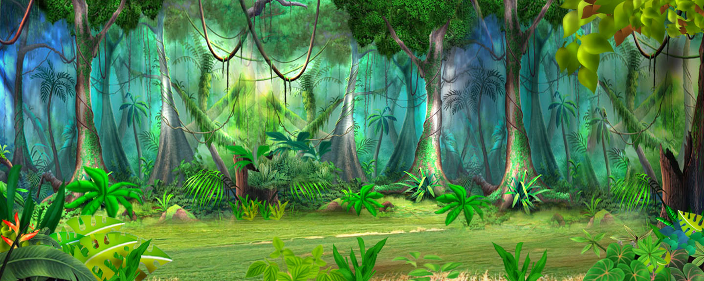
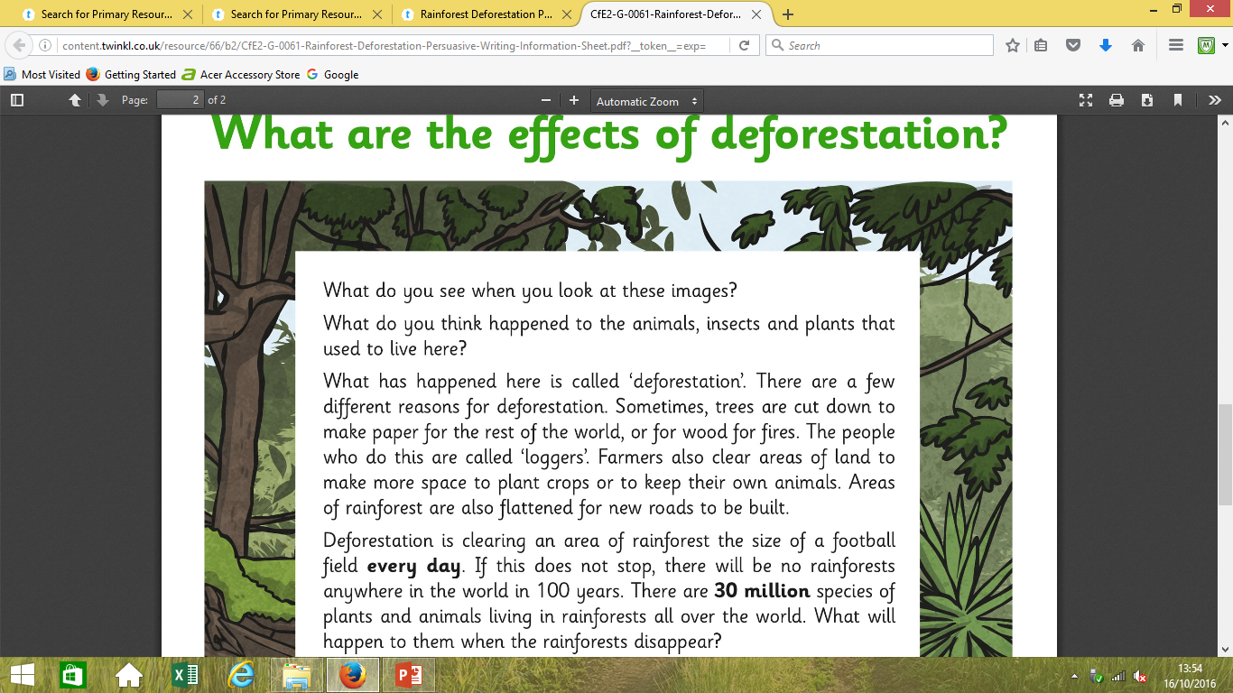

Slide 83
What Did You Decide?
Which effects are positive? Which are negative? How did you choose which were important effects and which were less important? Click on the statements to see which are positive and which are negative.
Water that would have been taken up by tree roots can cause flooding.
Jobs are created in logging transport and manufacturing products.
Land cleared can be used to farm cattle for meat production.
Wood from the removed trees can be used to make paper and other products.
Positive
Negative
Positive
Positive
Less CO₂ is captured by the forests, worsening the effects of global warming.
Negative
The soil where the trees grew is full of nutrients for growing crops.
Positive
Negative
Plants that may have been useful as medicines could be lost.
Positive
Products such as chocolate and coffee can be grown more cheaply on areas of deforested land.
Negative
Rain falling on the bare soil causes soil erosion.
Animals and plants may become extinct through loss of habitat.
Negative
Negative
Tribes lose their cultural identify.
Palm oil grown on deforested land is used in many food and toiletry products.
Negative
Positive
People’s homes may be destroyed.
Selling land raises money for local people.
Positive
Animal habitats are destroyed.
Negative

Slide 84
Why are Rainforests Important?
Rainforests help regulate the Earth’s temperature and weather patterns. Did you know that 20% of our oxygen is produced in the Amazon? But that’s not all they’re good for:
They are home to plants and animals. It took 60 to 100 million years for Rainforests to evolve and it is the home of over 30 million species of plants and animals. When we clear the forests, they all die.
In addition, trees help absorb the harmful carbon dioxide that we humans release in the atmosphere and they provide the oxygen that we need to breathe.
Furthermore, more than 25% of our medicines today come from rainforest plants. We have only explored 1% of the plants available. Just imagine what diseases the 99% that have not been explored can cure!
Moreover, they soak up a lot of rainfall. The rainwater is filtered through the forest floors and supplies water to rivers and irrigation systems. They also help prevent erosion, where the soil is washed away causing blockages that in turn causes floods.
Also, rainforests are home to indigenous people. Many tribes still live in the rainforests. Deforestation destroys their homes too.
If we don’t stop deforestation, more than half of our plant and animal species will be extinct. It is the oldest ecosystem on Earth and they are impossible to replace. It took millions of years for rainforests to develop… how can we replenish fast enough to cope with the rate of deforestation?

Slide 85
Which argument do the facts link to?
Animals will lose their habitat and become extinct. The rainforest gives a home to 50% of the world’s plant and animal species. 28,000 species of animal are expected to become extinct in the next 25 years due to deforestation On average, 137 species become extinct everyday; or 50,000 each year! | Soil erosion 50% of the tropical rainforests we already had are now gone. If the current rate of deforestation continues, the world's rain forests will vanish within 100 years.
Loss of oxygen and an increase in carbon dioxide will lead to global warming and climate change. Areas of rainforest the size of 20 football pitches are cut down every minute. About 15% of carbon dioxide emission across the world is due to deforestation. | The tribes that live in the rainforest will lose their homes and their culture. Millions of people live in tropical rainforests. An estimated 400-500 indigenous Amazonian Indian tribes exist today in the Amazon Rainforest. The many tribes of the Amazon are very diverse in culture and language: there are approximately 180 different languages spoken by these indigenous people.
Notes:
Slide 74-78 to magpie facts from. SLIDE 78 FOR SEN TO USE. LA TO HAVE ADULT SUPPORT- WORK IN GROUPS WITH TA TO SPEED UP PROCESS.

Slide 86
Modal verbs are used to show the level of possibility, indicate ability, show obligation or give permission.
The most common modal verbs are:
will
would
should
could
may
can
shall
ought to
must
might

Slide 87
Use these persuasive sentence starters to persuade humans to stop deforestation.
You will be . .
It will . . .
You’ll never need to . . . again.
Just think how . . .
Now you can . . .
For the rest of your life . . .
It is clear that . . .
It strikes me that . . .
There is no doubt that . . .
I am convinced that . . .
Surely, …
Is it any wonder that… ?
Don’t you think . . . ?
Isn’t it clear that . . . ?
Isn’t it the case that… ?
Does anyone really believe that . . .?
As I see it . . .
As everyone knows . . .
Clearly . . .
Obviously . . .
Inevitably . . .
I would draw your attention to the fact that
Notes:
FINISH IN PARTNERS BY PICKING AN ARGUMENT TO INTRODUCE USING ONE OF THESE PHRASES.

Slide 88
Tuesday 2nd November
L.O. create a shared write for a persuasive text and draft our own version.

Slide 89
If, if, if, then
If the rate of deforestation doesn’t slow down, if animals’ habitats continue to be destroyed, if no one listens, then our rainforests will truly be lost forever.
If _________, if ___________, if ___________, then __________________________________.

Slide 90
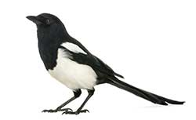
Magpie time!
Finish magpieing yesterdays facts!
Magpie from each other

Slide 91

Listen and write
Animals will lose their habitat and become extinct. | Soil erosion | Loss of oxygen and an increase in carbon dioxide will lead to global warming and climate change. | The tribes that live in the rainforest will lose their homes and their culture.

Slide 92
Why are Rainforests Important?
Rainforests help regulate the Earth’s temperature and weather patterns. Did you know that 20% of our oxygen is produced in the Amazon? But that’s not all they’re good for:
They are home to plants and animals. It took 60 to 100 million years for Rainforests to evolve and it is the home of over 30 million species of plants and animals. When we clear the forests, they all die.
In addition, trees help absorb the harmful carbon dioxide that we humans release in the atmosphere and they provide the oxygen that we need to breathe.
Furthermore, more than 25% of our medicines today come from rainforest plants. We have only explored 1% of the plants available. Just imagine what diseases the 99% that have not been explored can cure!
Moreover, they soak up a lot of rainfall. The rainwater is filtered through the forest floors and supplies water to rivers and irrigation systems. They also help prevent erosion, where the soil is washed away causing blockages that in turn causes floods.
Also, rainforests are home to indigenous people. Many tribes still live in the rainforests. Deforestation destroys their homes too.
If we don’t stop deforestation, more than half of our plant and animal species will be extinct. It is the oldest ecosystem on Earth and they are impossible to replace. It took millions of years for rainforests to develop… how can we replenish fast enough to cope with the rate of deforestation?

Slide 93
Which argument do the facts link to?
Animals will lose their habitat and become extinct. The rainforest gives a home to 50% of the world’s plant and animal species. 28,000 species of animal are expected to become extinct in the next 25 years due to deforestation On average, 137 species become extinct everyday; or 50,000 each year! | Soil erosion 50% of the tropical rainforests we already had are now gone. If the current rate of deforestation continues, the world's rain forests will vanish within 100 years.
Loss of oxygen and an increase in carbon dioxide will lead to global warming and climate change. Areas of rainforest the size of 20 football pitches are cut down every minute. About 15% of carbon dioxide emission across the world is due to deforestation. | The tribes that live in the rainforest will lose their homes and their culture. Millions of people live in tropical rainforests. An estimated 400-500 indigenous Amazonian Indian tribes exist today in the Amazon Rainforest. The many tribes of the Amazon are very diverse in culture and language: there are approximately 180 different languages spoken by these indigenous people.
Notes:
SLIDE 86-87 GIVE TO SEN AND LA TO MAGPIE FROM

Slide 94
Which argument do the facts link to?
Animals will lose their habitat and become extinct. The rainforest gives a home to 50% of the world’s plant and animal species. 28,000 species of animal are expected to become extinct in the next 25 years due to deforestation On average, 137 species become extinct everyday; or 50,000 each year! | Soil erosion 50% of the tropical rainforests we already had are now gone. If the current rate of deforestation continues, the world's rain forests will vanish within 100 years.
Loss of oxygen and an increase in carbon dioxide will lead to global warming and climate change. Areas of rainforest the size of 20 football pitches are cut down every minute. About 15% of carbon dioxide emission across the world is due to deforestation. | The tribes that live in the rainforest will lose their homes and their culture. Millions of people live in tropical rainforests. An estimated 400-500 indigenous Amazonian Indian tribes exist today in the Amazon Rainforest. The many tribes of the Amazon are very diverse in culture and language: there are approximately 180 different languages spoken by these indigenous people.

Slide 95
Our WAGOLL introduction
All teachers adore chocolate: it is estimated that teachers eat an average of 266 chocolate bars every year. There has been considerable debate about whether the teaching staff of St Philip’s CE Primary School should have access to free supplies of chocolate while teaching.

Slide 96
Shared write- Introduction -Mrs Cooper’s group
Should teachers be able to have access to free chocolate?
We believe that the majority of teachers, in fact 90 %, love chocolate. It is clear, that teachers just want chocolate treats and I am convinced that chocolates make teachers happy!
In my opinion, if teachers have more chocolate, if it is free, if this is available at all times, then children will also be happier!
There is no doubt that this move will benefit the children as well as the teachers!

Slide 97
Shared write- Introduction -Mrs Cooper’s group
Should teachers be able to have access to free chocolate?
We believe that the majority of teachers, in fact 90 %, love chocolate. It is clear, that teachers just want chocolate treats and I am convinced that chocolates make teachers happy!
In my opinion, if teachers have more chocolate, if it is free, if this is available at all times, then children will also be happier!
There is no doubt that this move will benefit the children as well as the teachers!

Slide 98
Let’s draft our own version of the introduction!

Slide 99
In my opinion, it would increase the number of happy faces both around the staff room and throughout school. Nobody can deny that chocolate is the favourite snack of most teachers at St Philip’s. In fact, at least 90% of our teaching staff enjoy eating a variety of chocolate on a regular basis. If they were to be given this for free, then it would save them a vast amount of time and money-they would not need to leave the building to purchase chocolate at lunchtime. The more money and time they have, the more satisfied they will be.

Slide 100
Let’s draft our own version of the first persuasive argument.

Slide 101
In my opinion, it would increase the number of happy faces both around the staff room and throughout school. Nobody can deny that chocolate is the favourite snack of most teachers at St Philip’s. In fact, at least 90% of our teaching staff enjoy eating a variety of chocolate on a regular basis. If they were to be given this for free, then it would save them a vast amount of time and money-they would not need to leave the building to purchase chocolate at lunchtime. The more money and time they have, the more satisfied they will be.

Slide 102
Week 7
Weds- practise
Forwards and backwards
e.g breath htaerb

Slide 103
^{Wednesday 21st October}
L.O: Plan a persuasive argument

Slide 104


Slide 105
Description : Detail
All teachers adore chocolate: it is estimated that teachers eat an average of 266 chocolate bars every year.

Slide 106
Your turn…
Rainforests are disappearing: ___________________________________________________.
Deforestation is a huge problem: _______________________________________-_________________.
There has been considerable debate about whether ______________________________________________.
Create new sentences to use in your own
persuasive argument

Slide 107
If, if, if, then
If the rate of deforestation doesn’t slow down, if animals’ habitats continue to be destroyed, if no one listens, then our rainforests will truly be lost forever.
If _________, if ___________, if ___________, then __________________________________.

Slide 108
Modal verbs are used to show the level of possibility, indicate ability, show obligation or give permission.
The most common modal verbs are:
will
would
should
could
may
can
shall
ought to
must
might

Slide 109
Use these persuasive sentence starters to persuade humans to stop deforestation.
You will be . .
It will . . .
You’ll never need to . . . again.
Just think how . . .
Now you can . . .
For the rest of your life . . .
It is clear that . . .
It strikes me that . . .
There is no doubt that . . .
I am convinced that . . .
Surely, …
Is it any wonder that… ?
Don’t you think . . . ?
Isn’t it clear that . . . ?
Isn’t it the case that… ?
Does anyone really believe that . . .?
As I see it . . .
As everyone knows . . .
Clearly . . .
Obviously . . .
Inevitably . . .
I would draw your attention to the fact that
Notes:
FINISH IN PARTNERS BY PICKING AN ARGUMENT TO INTRODUCE USING ONE OF THESE PHRASES.

Slide 110
Notes:
Complete your plan

Slide 111
Thursday 22nd October
L.O. To complete planning and then write an independent persuasive argument.

Slide 112
Our WAGOLL introduction
All teachers adore chocolate: it is estimated that teachers eat an average of 266 chocolate bars every year. There has been considerable debate about whether the teaching staff of St Philip’s CE Primary School should have access to free supplies of chocolate while teaching.

Slide 113
Introduction:
All ____________________________: it is estimated that _____________________________.
There has been considerable debate about whether the _________________________________________________________________should________________________________________________________.

Slide 114
In my opinion, it would increase the number of happy faces both around the staff room and throughout school. Nobody can deny that chocolate is the favourite snack of most teachers at St Philip’s. In fact, at least 90% of our teaching staff enjoy eating a variety of chocolate on a regular basis. If they were to be given this for free, then it would save them a vast amount of time and money-they would not need to leave the building to purchase chocolate at lunchtime. The more money and time they have, the more satisfied they will be.

Slide 115
First argument
In my opinion,_______________________________. Nobody can deny that _______________________________.
In fact,______________________________.
If, if, if, then_________________________________
The more,______________, the more__________________

Slide 116
In fact,_________________________________.
I would like to draw your attention to the fact that
_______________________________________.

Slide 117
First argument
In my opinion,_____________________________________. Nobody can deny that _______________________________.
In fact,______________________________.
If, if, if, then_________________________________
The more,______________, the more__________________

Slide 118
Second argument
Secondly, we passionately believe that _______________. I would like to draw your attention to the fact that _________________________________________________.
WABBITS/ ing starter
Rhetorical question

Slide 119
Third argument
Thirdly, and finally, I am convinced that ______________. As I see it, __________________________________. There is no doubt that __________________.

Slide 120
Conclusion
Considering all the arguments presented, I strongly believe that _____________________________________________________________________________________________. The question is: what do you think?

Slide 121
Friday 23rd October
L.O. Complete and edit a persuasive argument.

