Slide 1
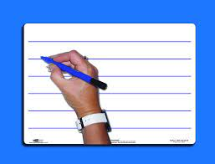
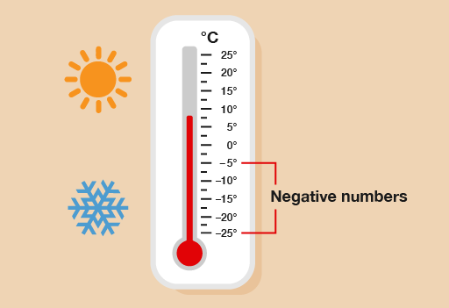
Week 3
21.9.21
LO: To order and compare positive and negative numbers
White boards! What do you know about negative numbers? When might you see them being used?

Slide 2
Let’s count!
Count in 2’s backwards from 12.
Count backwards in 5’s from 30.
Count backwards in 10’s from 50.

Slide 3
Revision- Watch the clip!
https://www.bbc.co.uk/bitesize/topics/znwj6sg/articles/zxthnbk

Slide 4
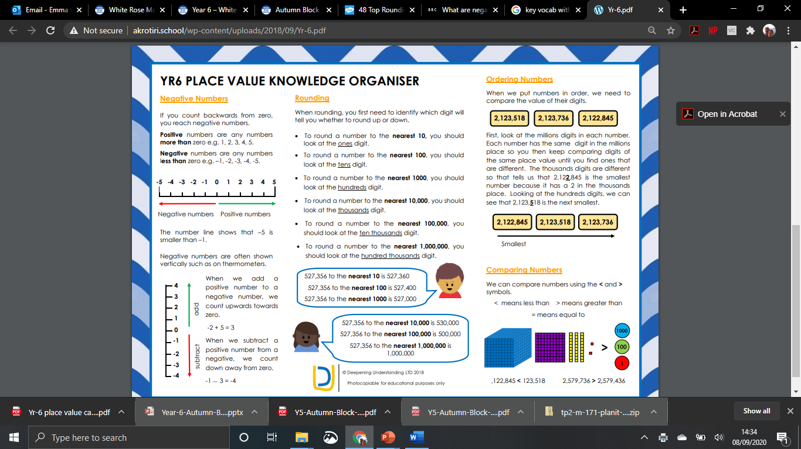
Stick
in
books…

Slide 8
Key vocabulary:
greater than
fewer than
minus
positive numbers
negative numbers
difference between

Slide 9


https://www.bbc.co.uk/bitesize/topics/znwj6sg/articles/zxthnbk
A
B
C
D
E
-5 |  |  |  |  |  |  |  |  |  | 5
Revision
© Classroom Secrets Limited 2018

Slide 10
Introduction
What number does each arrow point to?
A
B
C
D
E
-5 | -4 |  |  | -1 | 0 |  | 2 |  | 4 | 5
© Classroom Secrets Limited 2018

Slide 11
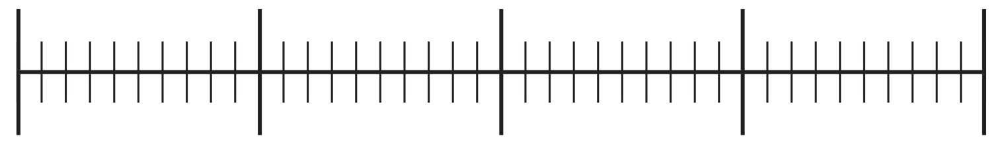
Varied Fluency 1
Put the numbers below in the correct place
on the number line.
10
-13
2
-7
18
-20
20
© Classroom Secrets Limited 2018

Slide 12
Varied Fluency 1
Put the numbers below in the correct place
on the number line.
10
-13
2
-7
18
10
-13
-7
2
18
-20
20
© Classroom Secrets Limited 2018

Slide 13


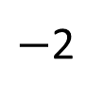
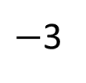
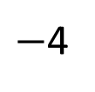
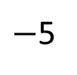
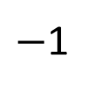
Talk about it!
Have a think
The number line looks correct to me!
$−$1
$−$2
$−$3
$−$4
$−$5
0
1
2
3
4
5

Slide 14
Can you order this set of numbers starting with the coldest?
20
- 20
- 2
5
- 15
10

Slide 15
Negative Numbers
6
5
4
Getting warmer
3
The temperature
scale is often seen vertically.
2
1
Water freezing
0
- 1
As the temperature goes below freezing we use negative numbers.
- 2
Getting colder
- 3
- 4
- 5
- 6

Slide 16
Varied Fluency 2
If the temperature in London is 23°C and the temperature in Greenland is -12°C, the difference between the two temperatures is 35°C.
True or False?
Talk task…
© Classroom Secrets Limited 2018

Slide 17
Varied Fluency 2
If the temperature in London is 23°C and the temperature in Greenland is -12°C, the difference between the two temperatures is 35°C.
True or False?
True
© Classroom Secrets Limited 2018

Slide 18
Over to you….
https://vimeo.com/454667428
Triangles -Work through video. Then ordering negative numbers sheet independently .
Squares- Whiterose sheet – Mrs Lund
Octagons slide 22/ Hexagons- slide 21

Slide 19
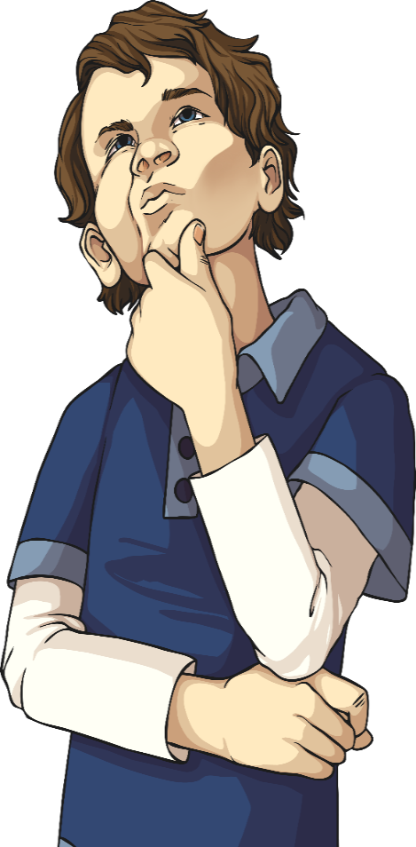
Triangles
Order the following numbers from smallest to largest:
34, -23, 14, -12, 41, -2, -24, 13
9⁰C, -7⁰C, -9⁰C, 3⁰C, -5⁰C, 0⁰C, -12⁰C
45, 67, -23, 28, -12, 78, -59, -1

Slide 20
Triangles
Order the following numbers from smallest to largest:
34, -23, 14, -12, 41, -2, -24, 13
9⁰C, -7⁰C, -9⁰C, 3⁰C, -5⁰C, 0⁰C, -12⁰C
45, 67, -23, 28, -12, 78, -59, -1

Slide 21
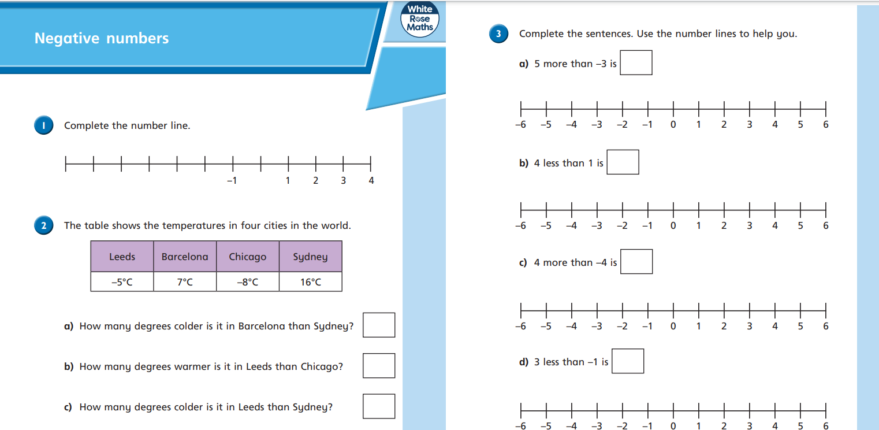
Squares- Whiterose sheet

Slide 22
Hexagons: Over to you…
Order smallest to biggest:
-56, -87, 42, 5, -21
55, -68, -94, 4
-100 60, -77, 36, -46
59, -82, -5, 7, -10
-45, 52, 31, 6, -93
Compare:
6. 34 < or > -17
7. -45 < or > 5
8. 65 < or > -3
9. -37 < or > 20
10. 18 < or > -3
Extension- Compare:
1. 64 < or > -87
2. -85 < or > 95
3. 75 < or > -13
4. -67 < or > 20
5. 108 < or > -93
Spot the mistake:
6. -5, 5, 15, 25, 30
7. -18, -12, -6, 6
8. -9, -6, -3, 3, 6,
9. 30, 15, 0, -15, -20
10. -65, -25, -25, -65

Slide 23
Order smallest to biggest:
-56, -87, 42, 5, -21
55, -68, -94, 4
-100 60, -77, 36, -46
59, -82, -5, 7, -10
-45, 52, 31, 6, -93
Compare:
6. 34 < or > -17
7. -45 < or > 5
8. 65 < or > -3
9. -37 < or > 20
10. 18 < or > -3
Order smallest to biggest:
-56, -87, 42, 5, -21
55, -68, -94, 4
-100 60, -77, 36, -46
59, -82, -5, 7, -10
-45, 52, 31, 6, -93
Compare:
6. 34 < or > -17
7. -45 < or > 5
8. 65 < or > -3
9. -37 < or > 20
10. 18 < or > -3
Order smallest to biggest:
-56, -87, 42, 5, -21
55, -68, -94, 4
-100 60, -77, 36, -46
59, -82, -5, 7, -10
-45, 52, 31, 6, -93
Compare:
6. 34 < or > -17
7. -45 < or > 5
8. 65 < or > -3
9. -37 < or > 20
10. 18 < or > -3
Order smallest to biggest:
-56, -87, 42, 5, -21
55, -68, -94, 4
-100 60, -77, 36, -46
59, -82, -5, 7, -10
-45, 52, 31, 6, -93
Compare:
6. 34 < or > -17
7. -45 < or > 5
8. 65 < or > -3
9. -37 < or > 20
10. 18 < or > -3
To print Hex/ Octagons

Slide 24
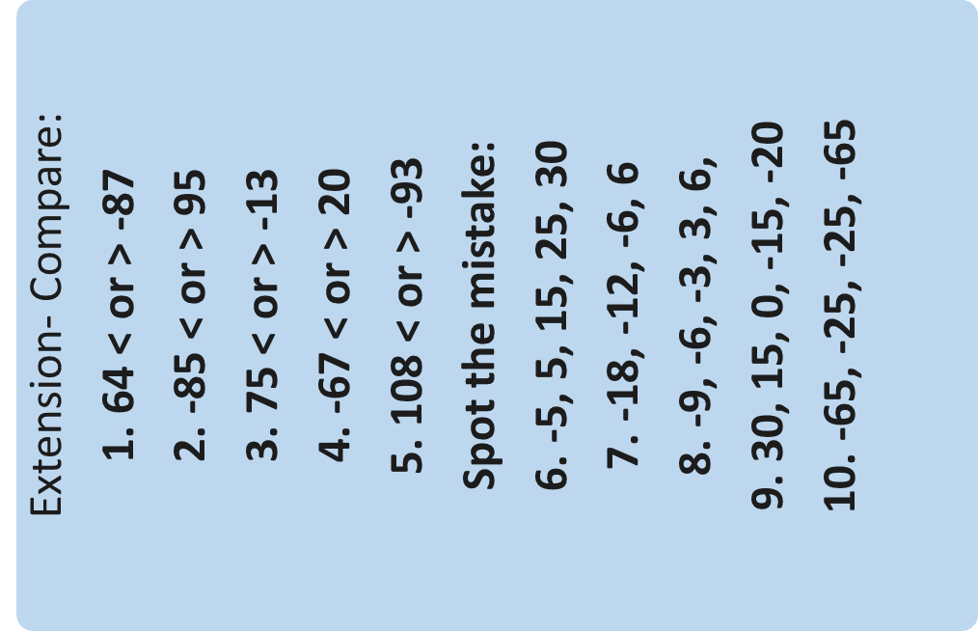

Slide 25
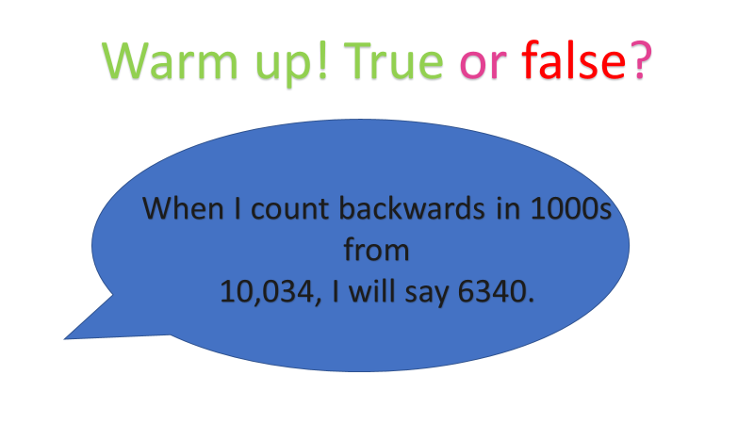
23.09.21
L.O. To find the difference between positive and negative numbers.

Slide 26
Warm up! True or false?
When I count backwards in 1000s from
10,034, I will say 6340.

Slide 27
Key vocabulary:
greater than
fewer than
minus
positive numbers
negative numbers
difference between

Slide 28
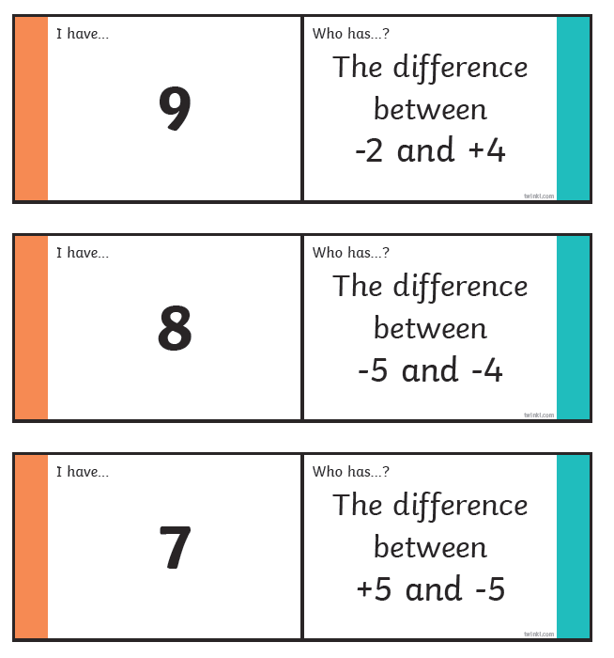
Triangles in input

Slide 29
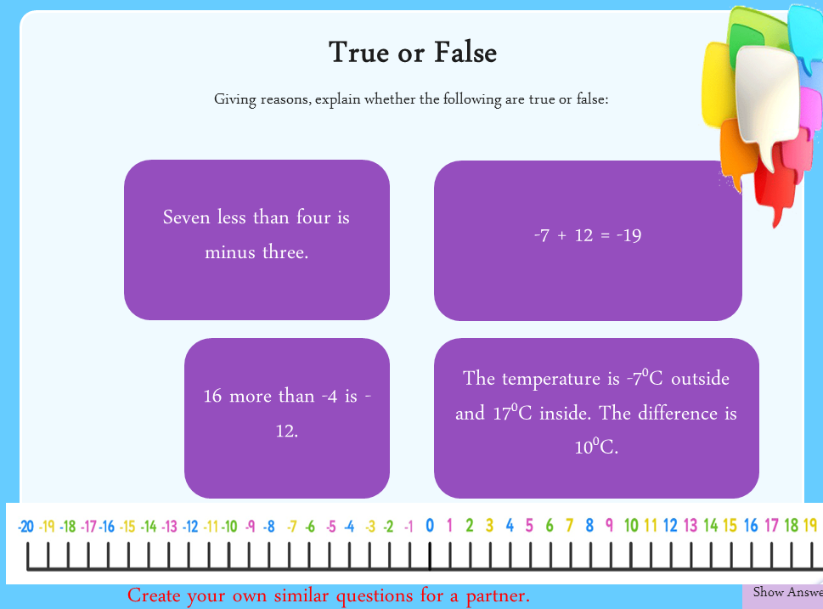

Slide 30

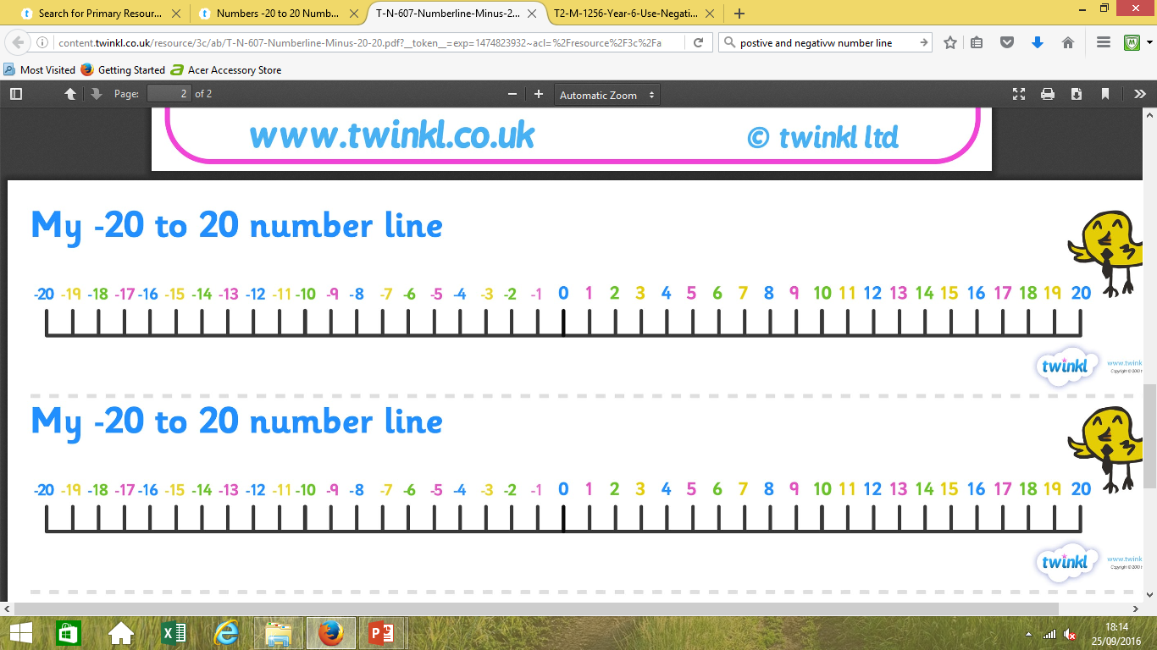
True or False
Giving reasons, explain whether the following are true or false:
Seven less than four is minus three.
False - the answer is 5. The answer goes through 0, so +7 to 0, and +5 more to 5.
True
-7 + 12 = -19
False - the answer is 12. The answer goes through 0, so +4 to 0, and +12 more to 12.
False - the answer is 24⁰C. The answer goes through 0, so -7 to 0 is 7, and 0 to 17 is 17. 7 + 17 = 24.
16 more than -4 is -12.
The temperature is -7⁰C outside and 17⁰C inside. The difference is 10⁰C.
Hide
Answers
Create your own similar questions for a partner.
Show Answers

Slide 31
True or false?
-34
<
-60
I know that -34 is _______than -60 because___________________________________________________.

Slide 32
Difference between:
-2 and 15

Slide 33
Difference between:
-18 and 22

Slide 34
Difference between:
-27 and 38

Slide 35
Reasoning 1
Which is the odd one out? Explain why.
Talk about it!
a
the difference between 3 and -4
b
9 more than -2
c
the difference between -5 and 2
d
10 more than -4
© Classroom Secrets Limited 2018

Slide 36
Reasoning 1
Which is the odd one out? Explain why.
The odd one out is ‘d’ because the answer is 6, the other answers are 7.
a
the difference between 3 and -4
b
9 more than -2
c
the difference between -5 and 2
d
10 more than -4
© Classroom Secrets Limited 2018

Slide 37
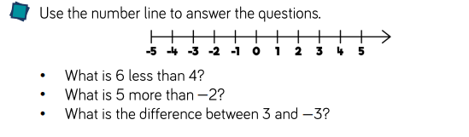

Slide 38
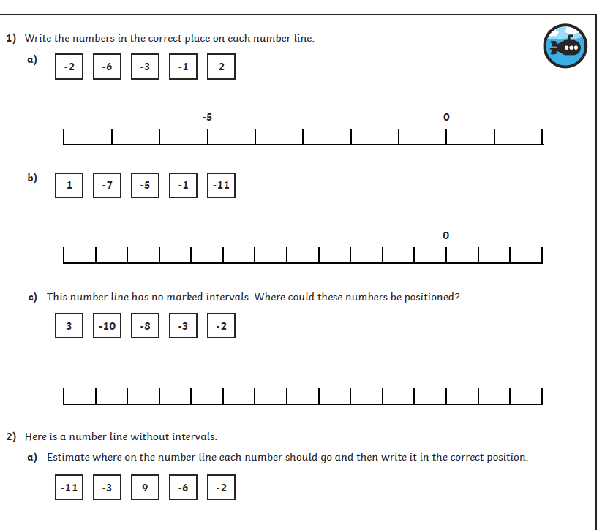
Thurs- Over to you….
Triangles- Negative number line worksheet
Revise using IPADs then complete https://www.theschoolrun.com/what-are-negative-numbers
Squares-Mrs Cooper
Hexagons- Negative number differences- temp - Mrs Lund
Octagons- independent- temp sheet

Slide 39
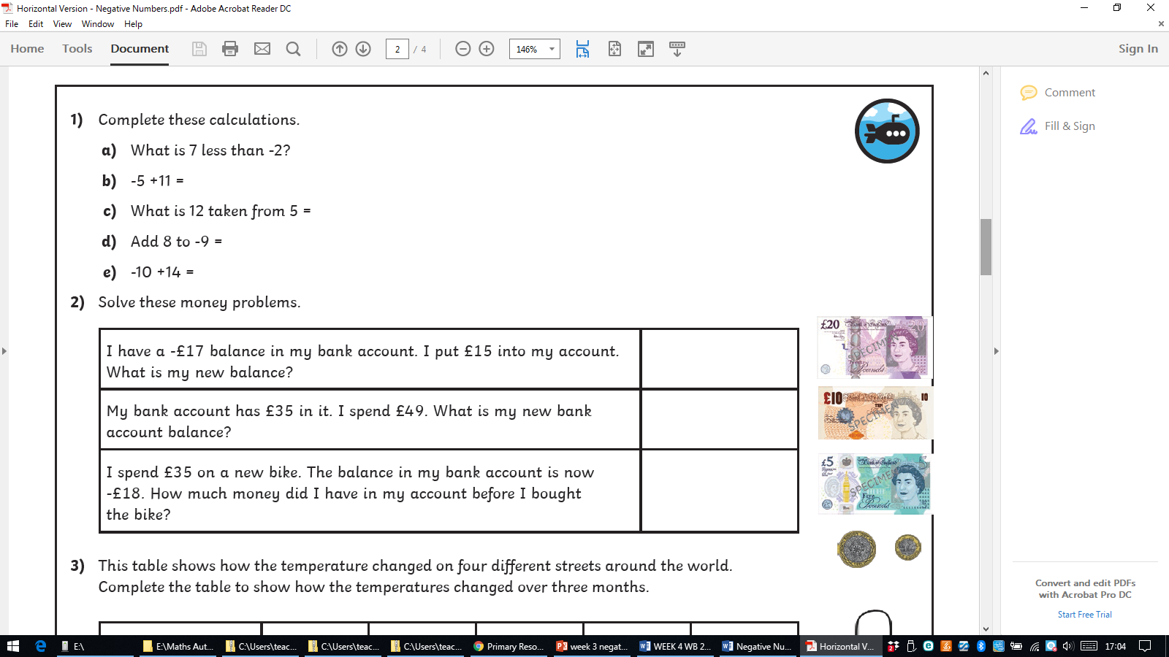
Hexagons- Negative number differences- temp

Slide 40
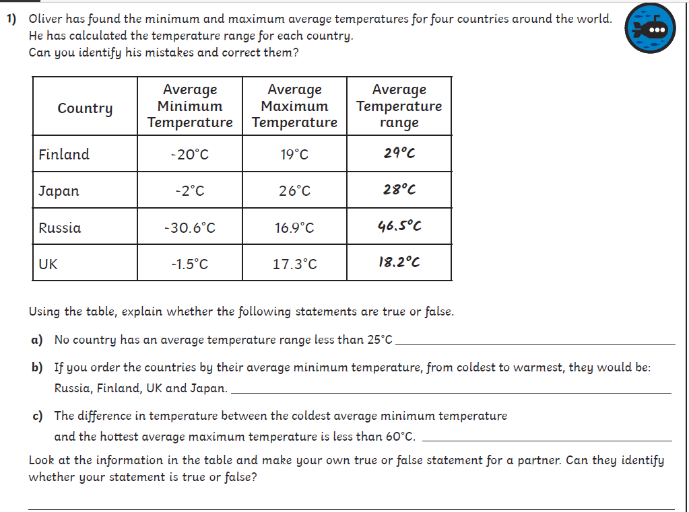
Octagons

Slide 41
Octagons

Slide 42
Varied Fluency 2
On the surface of Jupiter, the temperature can be as low
as -160°C. At the top of Jupiter’s atmosphere, the temperature can increase by 885°C.
What is the temperature at the top of Jupiter’s atmosphere?
© Classroom Secrets Limited 2018

Slide 43
Find the difference:
-15 and 8
4 and -2
20 and -3
-9 and 32
16 and -4
32 and -5
-18 and 4
-12 and 23
-4 and 37
56 and – 12
9 and – 27
-65 and 33
Squares

Slide 44
Find the difference:
-15 and 8
4 and -2
20 and -3
-9 and 32
16 and -4
32 and -5
-18 and 4
-12 and 23
-4 and 37
56 and – 12
9 and – 27
-65 and 33
Squares

Slide 45
Week 3
Monday 27th September
LO: To understand and use negative numbers (problem solving)

Slide 46
Let’s count! True or False?
When I count backwards in 50s
from 10 I will say -150.
Explain how you know.

Slide 47
Varied Fluency 4
Complete the part-whole model.
49
-91
© Classroom Secrets Limited 2018

Slide 48
Varied Fluency 4
Complete the part-whole model.
49
-140
-91
© Classroom Secrets Limited 2018

Slide 49
True or false?
4 less than -5 is -9

Slide 50
True or false?
8 more than -7 is -15

Slide 51

Talk about it….

Slide 52
True or false?
-34
<
-60
I know that -34 is _______than -60 because___________________________________________________.

Slide 53
Varied Fluency 2
On the surface of Jupiter, the temperature can be as low
as -160°C. At the top of Jupiter’s atmosphere, the temperature can increase by 885°C.
What is the temperature at the top of Jupiter’s atmosphere?
-160 + 885 = 725°C
© Classroom Secrets Limited 2018

Slide 54
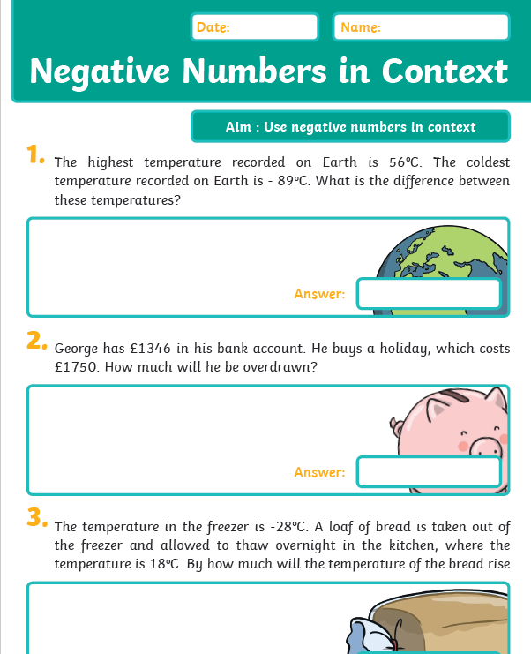
Weds - Over to you….
Triangles- Negative number problems – Mrs Lund
Squares/Hexagons-Mrs Cooper-
Hexagons - Mrs Warham (grp) Rest in class
Problem solving- slides
Octagons-Mrs Day (out room)

Slide 55
Squares/Hex

Slide 56
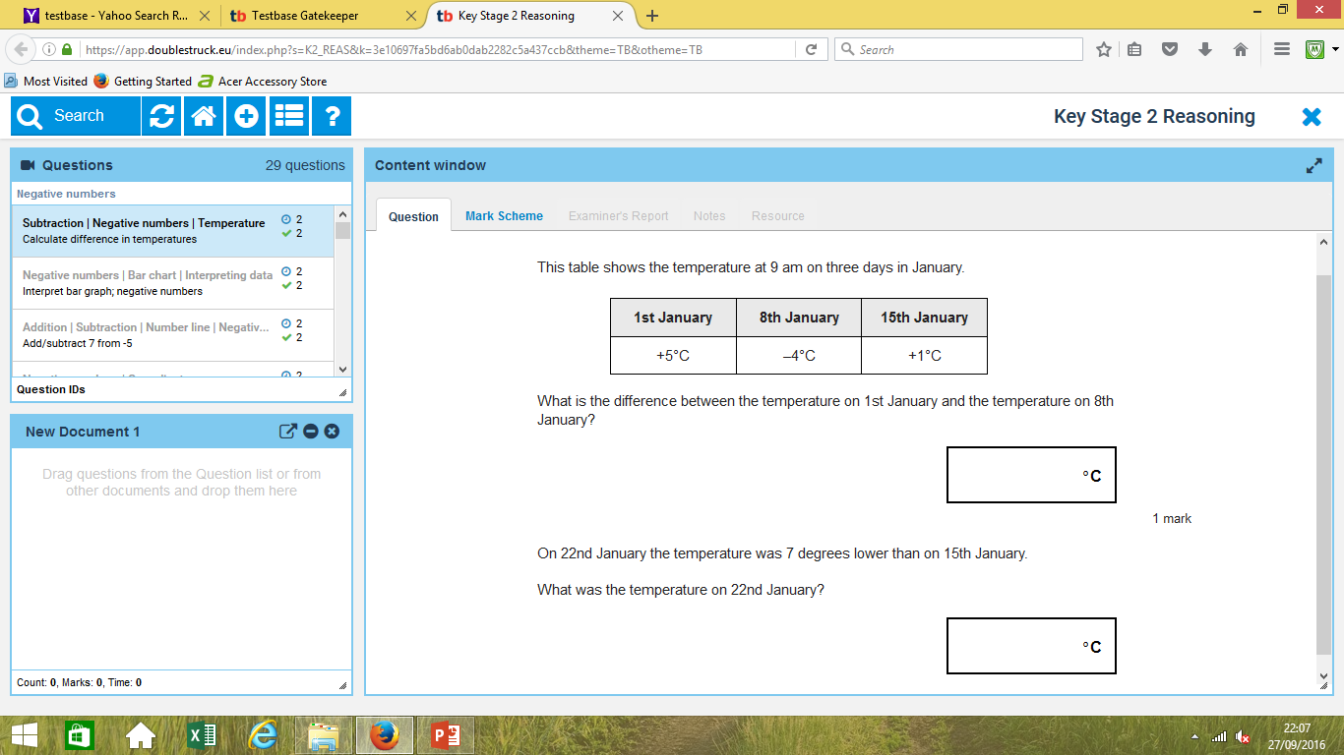
Squares/Hex

Slide 57
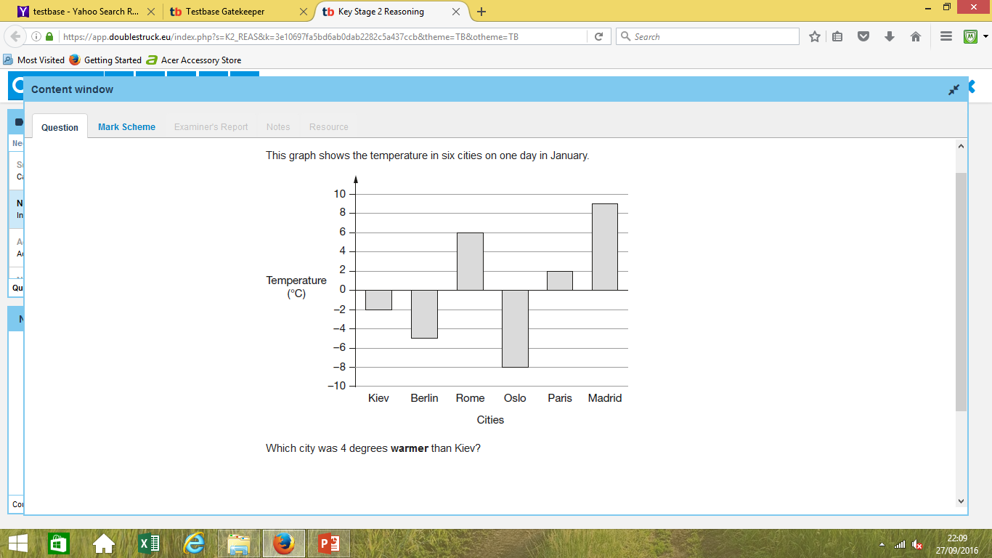
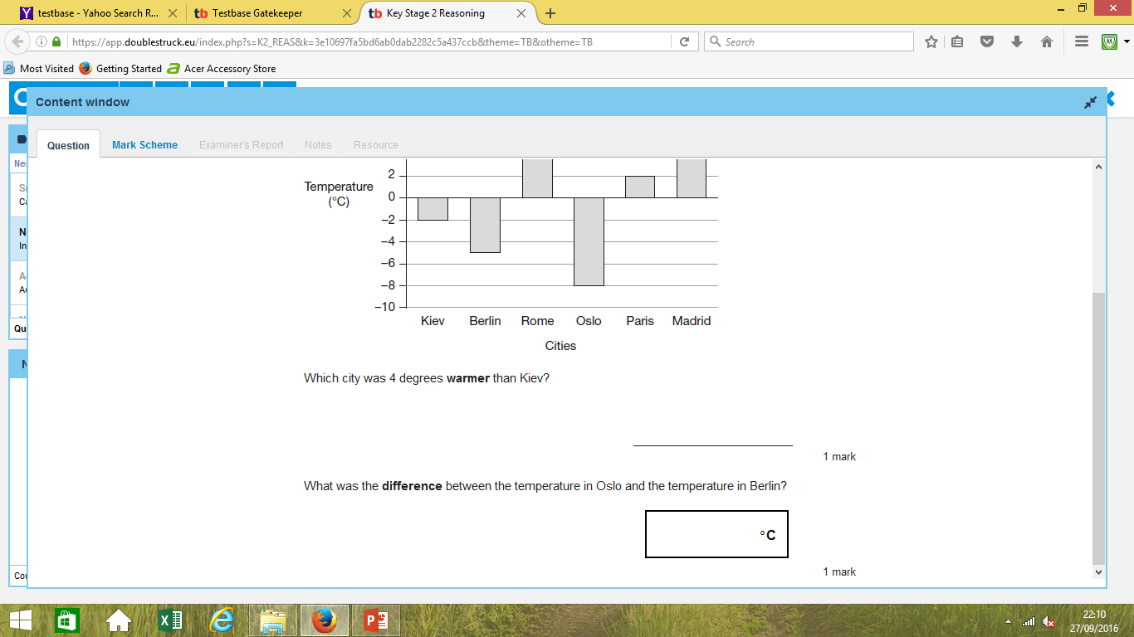
Squares/Hex

Slide 58
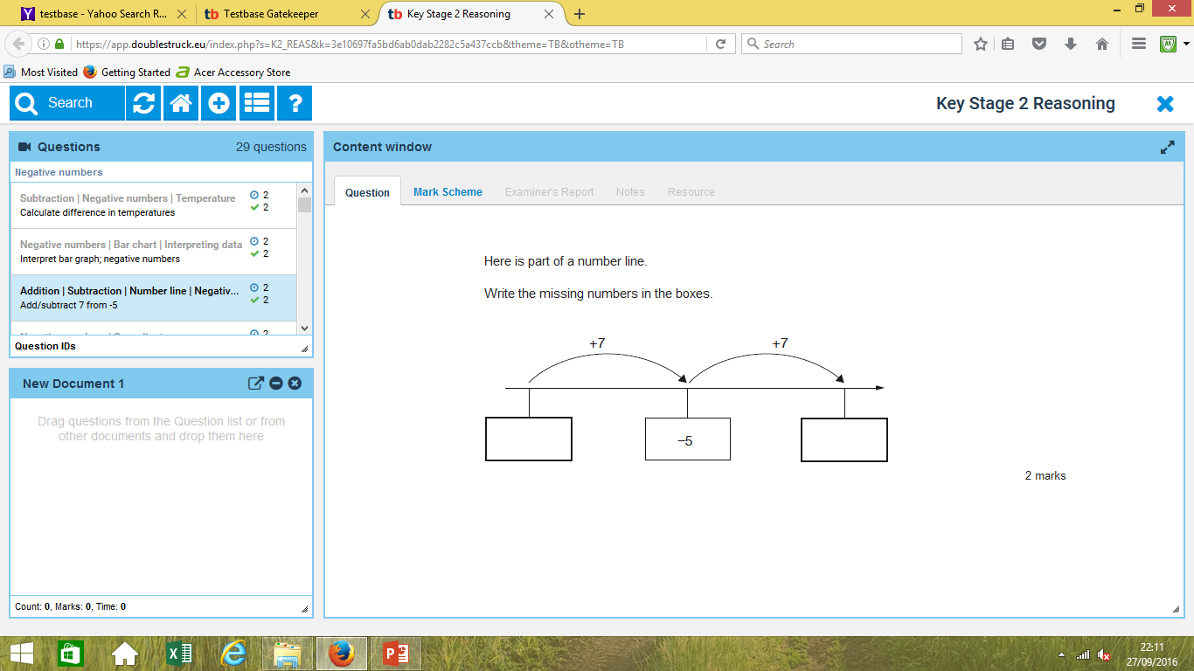

Slide 59
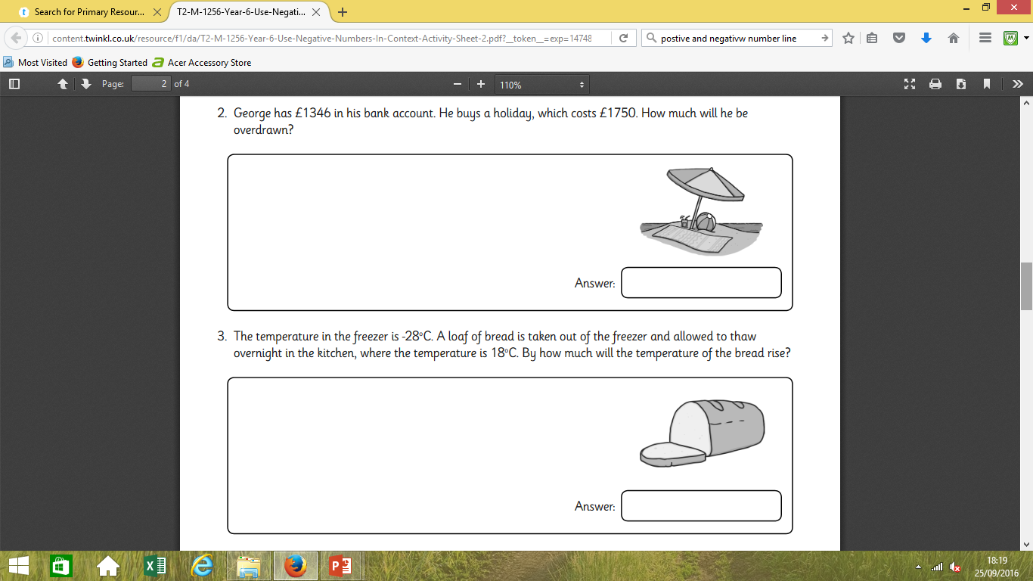
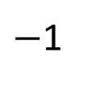
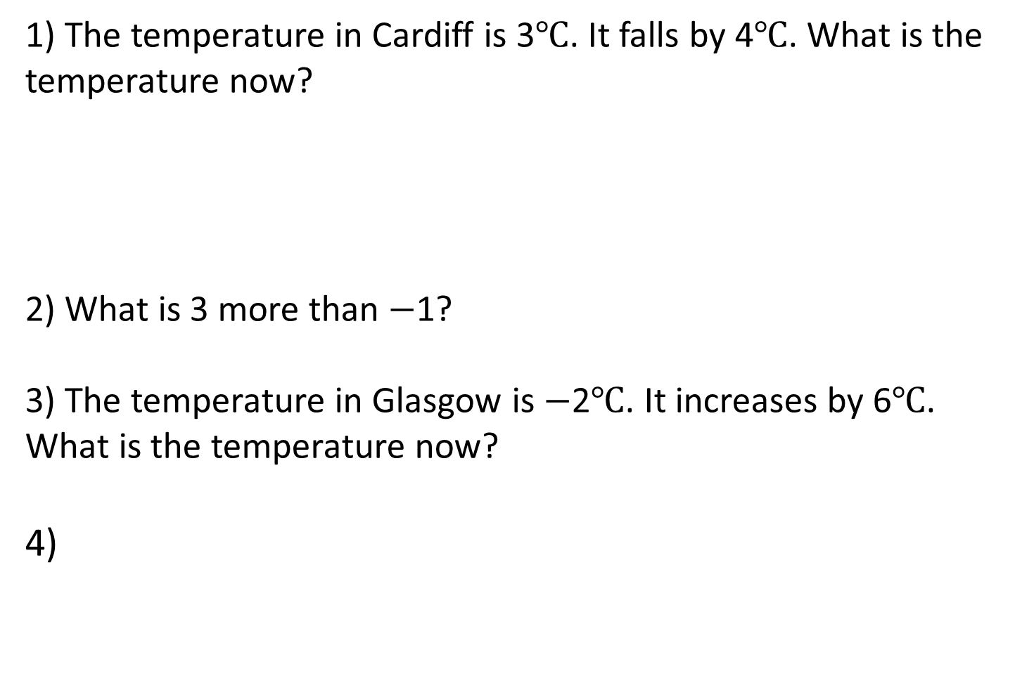
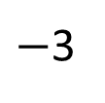
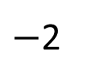
Triangles
1) The temperature in Cardiff is 3$℃$. It falls by 4$℃$. What is the temperature now?
2) What is 3 more than $−$1?
3) The temperature in Glasgow is $−$2$℃$. It increases by 6$℃$. What is the temperature now?
4)
$−$3
$−$2
$−$1
0
1
2
3
4.

Slide 60
Triangles
1) The temperature in Cardiff is 3$℃$. It falls by 4$℃$. What is the temperature now?
2) What is 3 more than $−$1?
3) The temperature in Glasgow is $−$2$℃$. It increases by 6$℃$. What is the temperature now?
4)
$−$3
$−$2
$−$1
0
1
2
3
4.

Slide 61
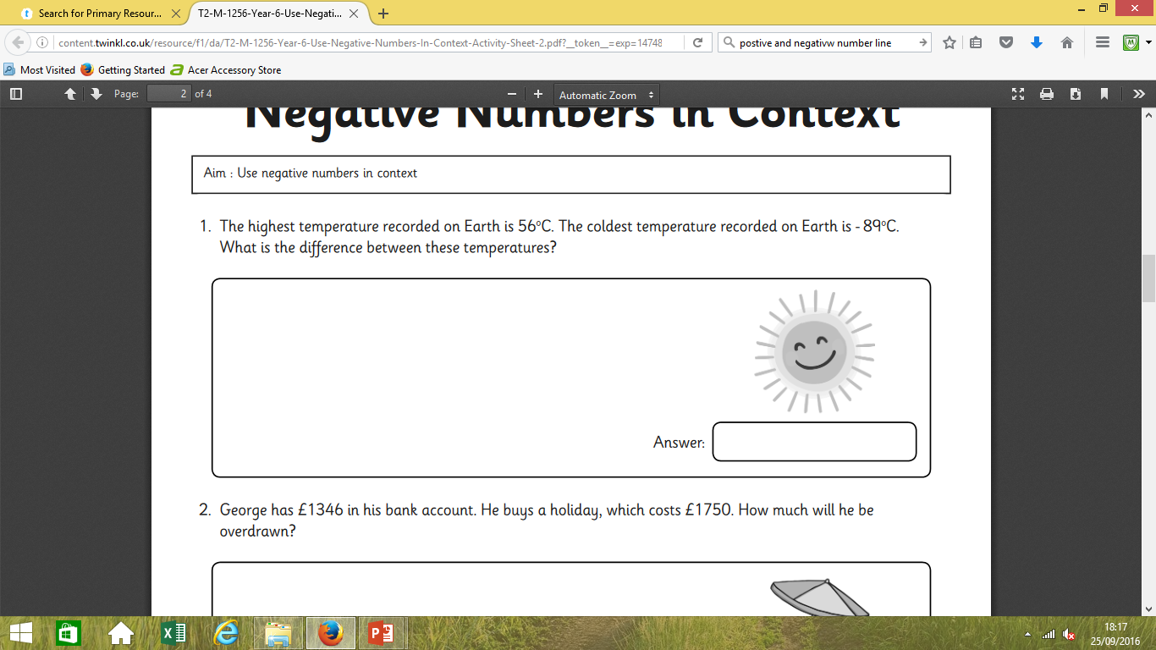
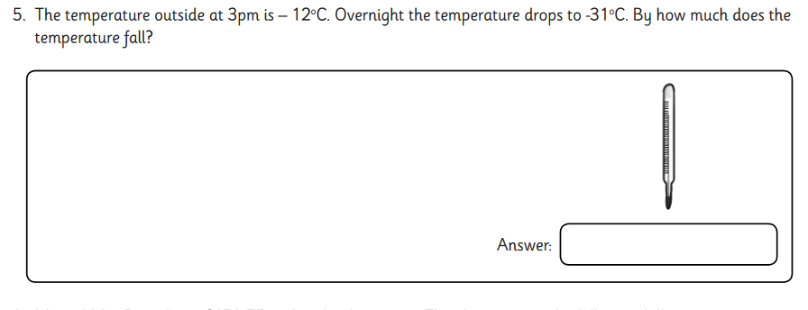
Triangles

Slide 62
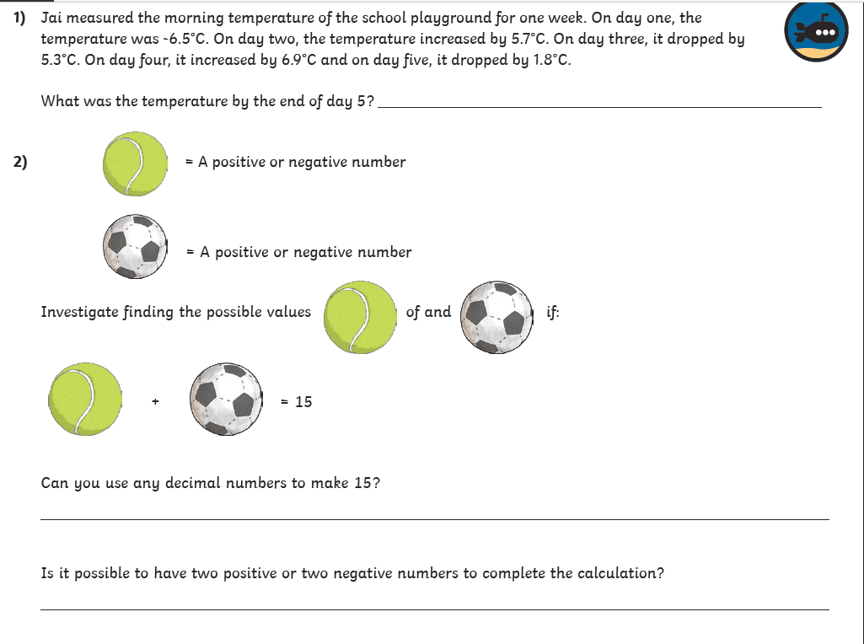
Octagons- problem solving Mrs Day

Slide 63
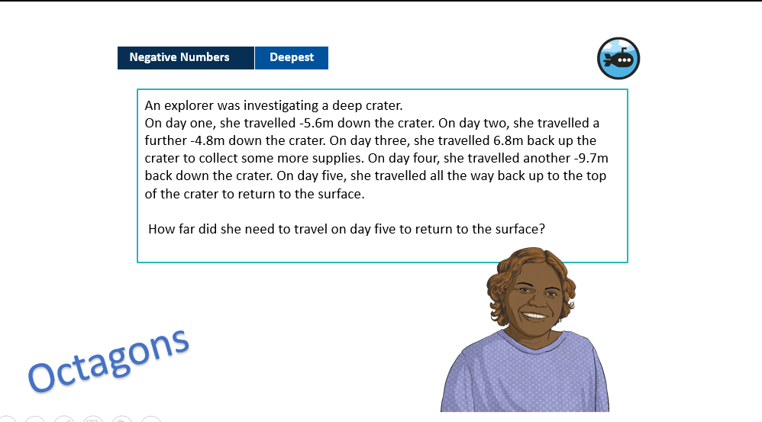

Slide 64

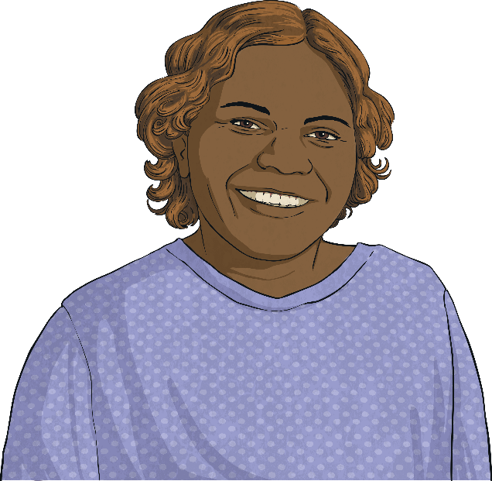
Negative Numbers
Deepest
An explorer was investigating a deep crater.
On day one, she travelled -5.6m down the crater. On day two, she travelled a further -4.8m down the crater. On day three, she travelled 6.8m back up the crater to collect some more supplies. On day four, she travelled another -9.7m back down the crater. On day five, she travelled all the way back up to the top of the crater to return to the surface.
How far did she need to travel on day five to return to the surface?
13.3m
Octagons

Slide 67
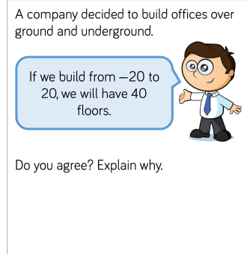

Slide 68
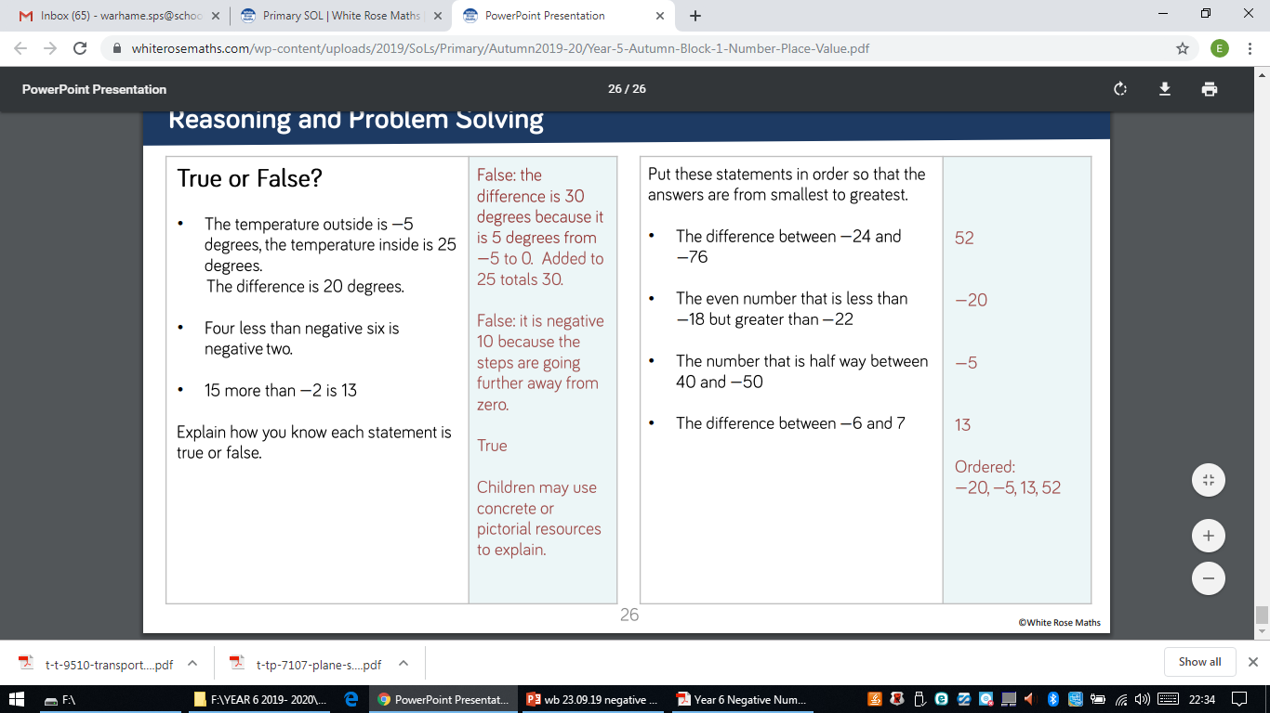

Slide 70
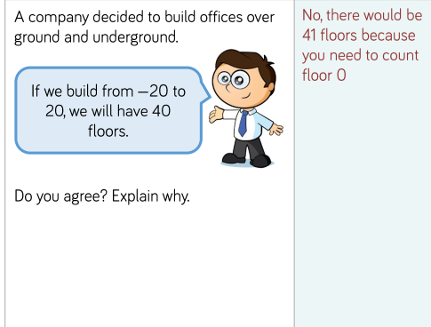

Slide 72
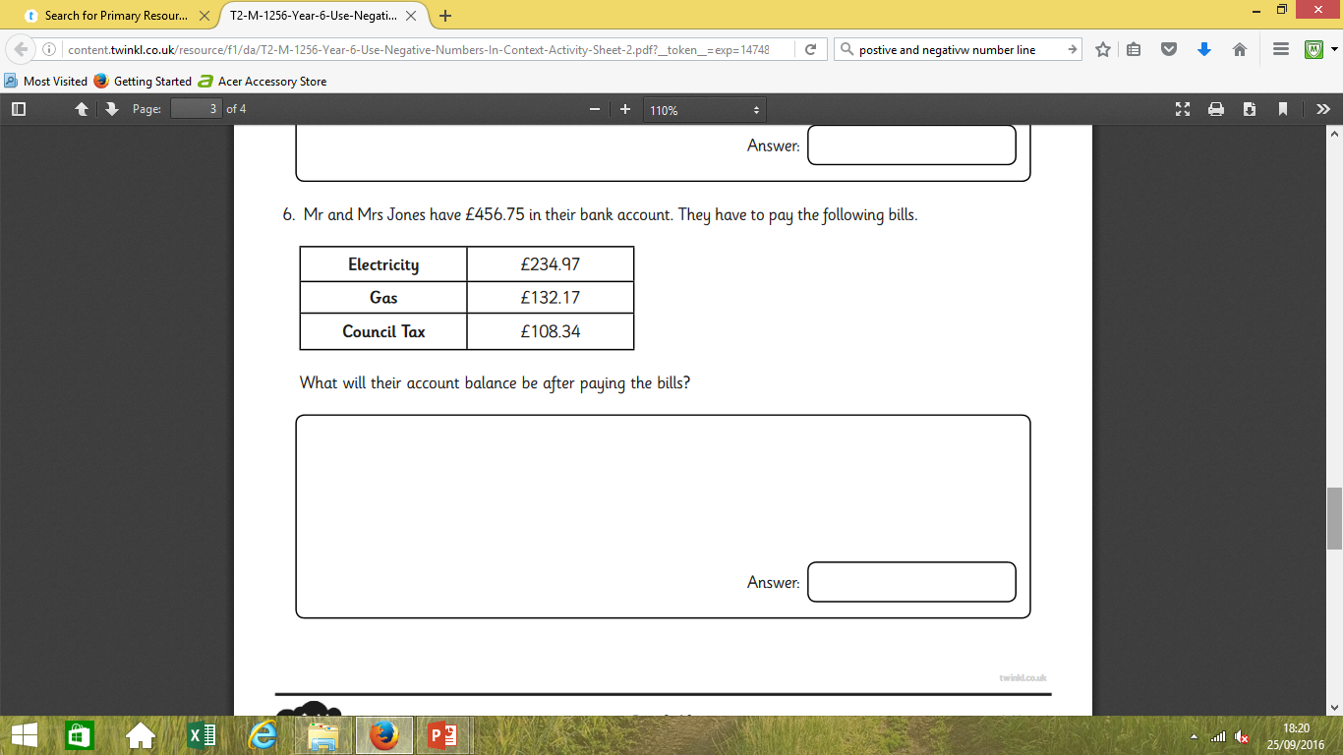

Slide 73
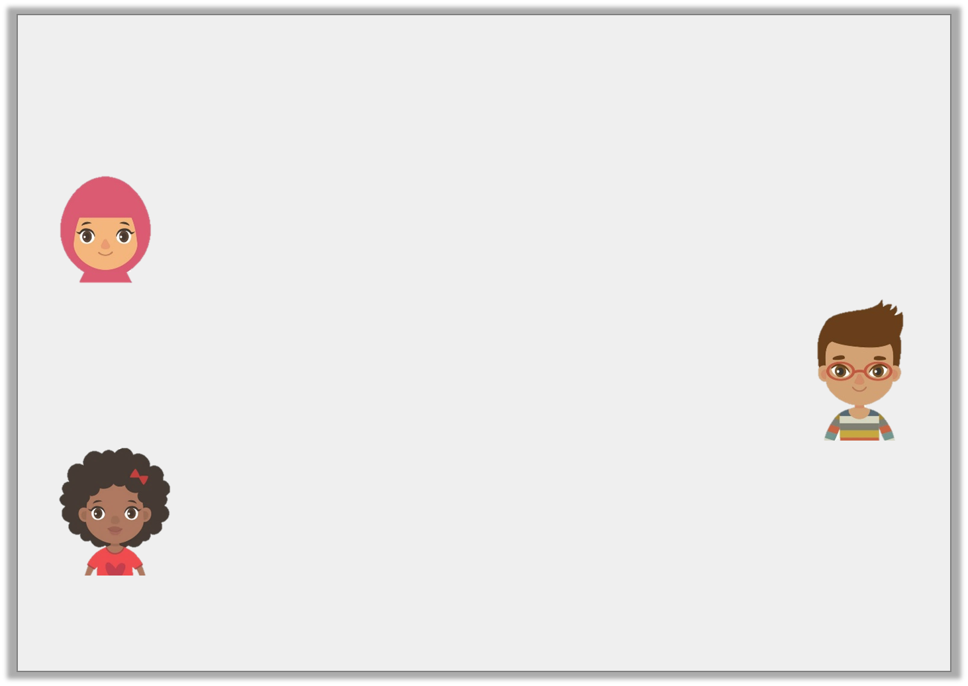
Problem Solving 1
Work out the answers to the children’s questions, then order them from smallest to largest.
What is the difference between 21°C and -32°C?
Hafsa
Which number is halfway between -6 and 48?
Josh
What is 27 greater than
-28?
Isabel
© Classroom Secrets Limited 2018

Slide 74
Problem Solving 1
Work out the answers to the children’s questions, then order them from smallest to largest.
Order: -1, 21, 53
What is the difference between 21°C and -32°C?
53
Hafsa
Which number is halfway between -6 and 48?
21
Josh
What is 27 greater than
-28?
-1
Isabel
© Classroom Secrets Limited 2018

Slide 75
Talk task
Problem Solving 2
Ben had £23 in his bank account. On Monday, he paid his phone bill and bought a t-shirt. His account is now overdrawn by £42. If the phone bill was £39, how much was Ben’s t-shirt?
© Classroom Secrets Limited 2018

Slide 76
Problem Solving 2
Ben had £23 in his bank account. On Monday, he paid his phone bill and bought a t-shirt. His account is now overdrawn by £42. If the phone bill was £39, how much was Ben’s t-shirt?
-42 + 39 = -3
The difference between -3 and 23 is 26.
£26
© Classroom Secrets Limited 2018

Slide 77
Negative Numbers
Diving
Match the answer to these statements to the correct place on the number line.
What is 12 less than 5? | -10 +14 = | What is 17 taken from 7? | Add 9 to -8 = | 2 - 11 =
-7
4
-10
1
-9
-10 -9 -8 -7 -6 -5 -4 -3 -2 -1 0 1 2 3 4 5 6 7 8 9 10

Slide 78
Negative Numbers
Diving
This table shows how the temperature changed on four different streets around the world. Complete the table to show how the temperatures changed over three months.
Town | October | Temperature change | November | Temperature Change | December
Study Street | 13°C | -10°C |  | -7°C
Reasoning Road | -1°C | +5°C |  | -6°C
Problem-Solving Place | -5.5°C |  | 7.5°C |  | -11.5°C
3°C
-4°C
4°C
-2°C
+12°C
-19°C

Slide 79
Negative Numbers
Deeper
Miriam has found the minimum and maximum average temperatures for four countries around the world. She has calculated the temperature range for each country.
Can you identify her mistakes and correct them?
Country | Average Minimum Temperature | Average Maximum Temperature | Average Temperature Range
Canada | -29°C | 15°C
China | -12°C | 21°C
Sweden | -16.6°C | 17.9°C
44°C
43°C
Correct
33°C
34.5°C
33.5°C

Slide 80
Varied Fluency 1
Complete the number line.
-56
-52
-51
© Classroom Secrets Limited 2018

Slide 81
Varied Fluency 1
Complete the number line.
-56
-52
-51
-55
-54
-53
-50
-49
-48
© Classroom Secrets Limited 2018

Slide 82
Talk task
Spot the mistake:
-80, -60, -30, -20
What is wrong with
this sequence of
numbers?
Spot the mistake:
60, 45, 30, 15, 0, -5
What is wrong with
this sequence of
numbers?

Slide 83
Varied Fluency 3
Fill in the blanks to make the statements correct.
12 | – | 56 | > |  | – | 50
 | – | 43 | < | 41 | – | 89
© Classroom Secrets Limited 2018

Slide 84
Varied Fluency 3
Fill in the blanks to make the statements correct.
any number < 6
any number > -5
12 | – | 56 | > |  | – | 50
 | – | 43 | < | 41 | – | 89
© Classroom Secrets Limited 2018

Slide 85
True or false?
-54
<
-20
I know that -54 is ________than -20 because___________________________________________________.

Slide 86
Reasoning 2
Which is the odd one out?
Explain why.
A | 50 | – | 75 | = | 0 | – | 25
B | 30 | – | 80 | = | 40 | – | 90
C | 35 | – | 60 | = | 63 | – | 88
© Classroom Secrets Limited 2018

Slide 87
Reasoning 2
Which is the odd one out?
Explain why.
B is the odd one out because…
A | 50 | – | 75 | = | 0 | – | 25
B | 30 | – | 80 | = | 40 | – | 90
C | 35 | – | 60 | = | 63 | – | 88
© Classroom Secrets Limited 2018

Slide 88
Reasoning 2
Which is the odd one out?
Explain why.
B is the odd one out because A and C both equal -25 whereas B equals -50.
A | 50 | – | 75 | = | 0 | – | 25
B | 30 | – | 80 | = | 40 | – | 90
C | 35 | – | 60 | = | 63 | – | 88
© Classroom Secrets Limited 2018

Slide 89


