Slide 1

Are you a times table expert?!!

Slide 2
Do now…
X | 6 | 3 | 5 | 12 | 9 | 2 | 7 | 10 | 8 | 11 | 4
3
8
11
6
7
4
9
2
12
10
5

Slide 3
Do now…
X | 6 | 3 | 5 | 12 | 9 | 2 | 7 | 10 | 8 | 11 | 4
3
8
11
6
7
4
9
2
12
10
5

Slide 4
Do now…
X | 6 | 3 | 5 | 12 | 9 | 2 | 7 | 10 | 8 | 11 | 4
3 | 18 | 9 | 15 | 36 | 27 | 6 | 21 | 30 | 24 | 33 | 12
8 | 48 | 24 | 40 | 96 | 72 | 16 | 56 | 80 | 64 | 88 | 32
11 | 66 | 33 | 55 | 132 | 99 | 22 | 77 | 110 | 88 | 121 | 44
6 | 36 | 18 | 30 | 72 | 54 | 12 | 42 | 60 | 48 | 66 | 24
7 | 42 | 21 | 35 | 84 | 63 | 14 | 49 | 70 | 56 | 77 | 28
4 | 24 | 12 | 20 | 48 | 36 | 8 | 28 | 40 | 32 | 44 | 16
9 | 54 | 27 | 45 | 108 | 81 | 18 | 63 | 90 | 72 | 99 | 36
2 | 12 | 6 | 10 | 24 | 18 | 4 | 14 | 20 | 16 | 22 | 8
12 | 72 | 36 | 60 | 144 | 108 | 24 | 84 | 120 | 96 | 121 | 48
10 | 60 | 30 | 50 | 120 | 90 | 20 | 70 | 100 | 80 | 110 | 40
5 | 30 | 15 | 25 | 60 | 45 | 10 | 35 | 50 | 40 | 55 | 20

Slide 5
17.12.21
L.O: understand the order of operations.
L.O. solve problems using BODMAS. (Octagons)
L.O. solve times table problems. (Triangles)

Slide 6



Slide 7
Crucial Vocabulary:
Brackets
Order
Multiplication
Division
Addition
Subtraction
Equal

Slide 8

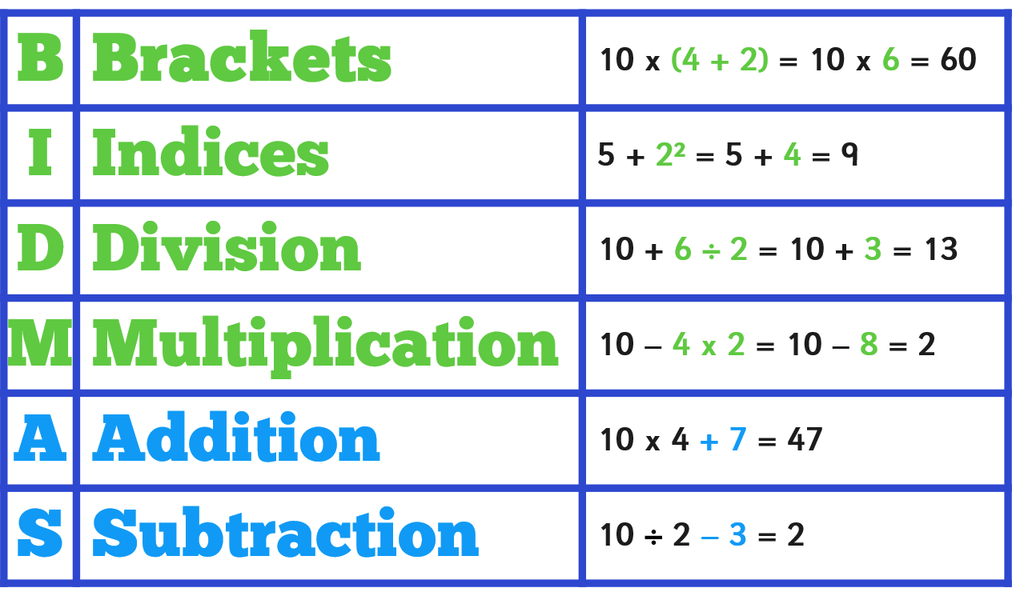
Crucial Vocabulary

Slide 9

Calculate anything in brackets first.
10 x (4+2) = 10 x 6 = 60 not 10 x (4 + 2) = 40 + 2 = 42
Compare these calculations:
10 ÷ (2 + 3) =
10 ÷ 5 = 2
10 ÷ 2 + 3 =
5 + 3 = 8
(6 + 2) x 8 =
8 x 8 = 64
6 + 2 x 8 =
6 + 16 = 22

Slide 10
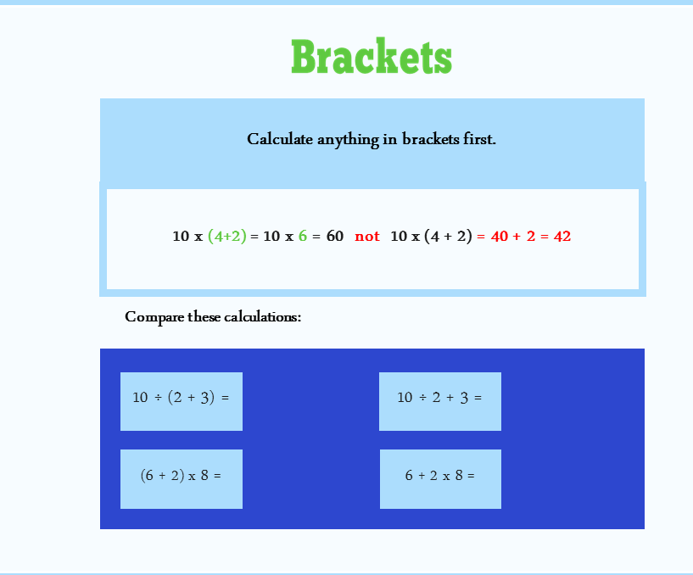

Slide 11

This relates to powers or roots of numbers
(squared, cubed etc.). Calculate powers or roots before multiplication/division/addition/subtraction.
5 + 2² = 5 + 4 = 9 not 5 + 2² = 7² = 49
Compare these calculations:
10 – 2³ =
10 – 8 = 2
(10 – 2)³ =
8³ = 512
12 + √4 =
12 + 2 = 14
√(12 + 4) =
√16 = 4

Slide 12

Division and multiplication come before addition and subtraction.
10 + 6 ÷ 2 = 10 + 3 = 13 not 10 + 6 ÷ 2 = 16 ÷ 2 = 8
10 – 4 x 2 = 10 – 8 = 2 not 10 – 4 x 2 = 6 x 2 = 12
Compare these calculations:
12 – 2 x 5 =
12 – 10 = 2
12 – 2 x 5 =
10 x 5 = 50
8 + 10 ÷ 2
8 + 5 = 13
8 + 10 ÷ 2 =
18 ÷ 2 = 9

Slide 13
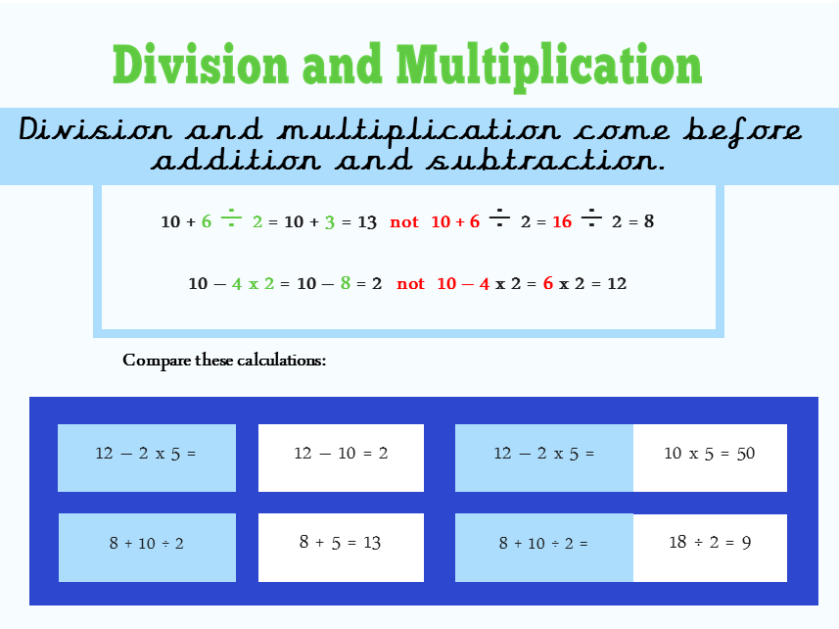

Slide 14

Use the following numbers to
make the answers below
remembering the order
of operations:
2
3
5
11
5 + 3 x 2
4
(5 + 3) ÷ 2 or
(5 – 3) x 2
21
(5 + 2) x 3
6
(5 – 2) + 3
Can you make your own?

Slide 15
Let me show you…

Slide 16

Put in the Brackets
Put brackets into these number sentences so they are true:
(
)
no brackets
15 + 7 × 4 = 88
18 – 9 – 2 = 11
8 × 4 – 2 × 5 = 22
16 ÷ 8 – 4 = 4
9 + 12 ÷ 7 – 4 = 7
(
)
(
)
Show
Answers
Create some of your own for a partner.
Hide
Answers

Slide 17
Over to you…

Slide 18
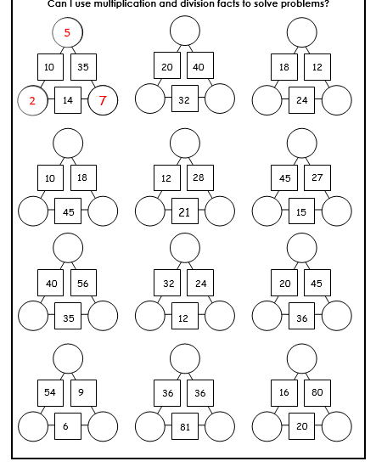
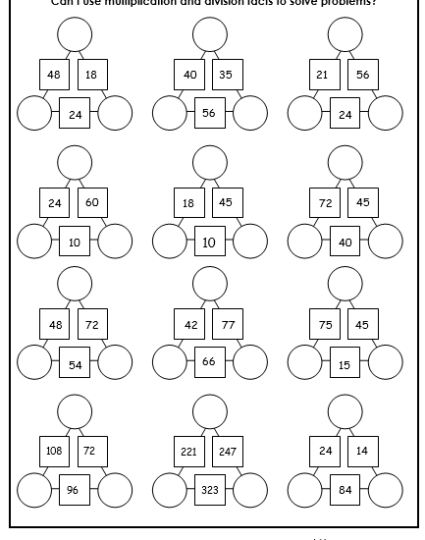
Triangles
Ext:
Factors/
Multiples
puzzle

Slide 19
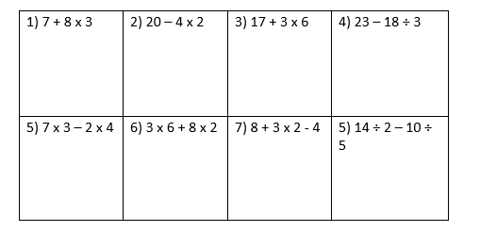
Squares –Miss Avery

Slide 20
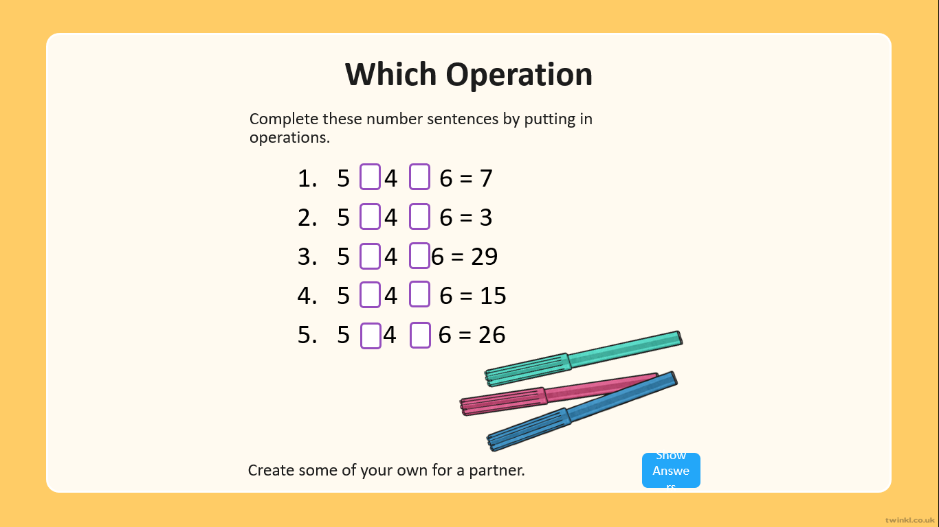
Squares: Miss Avery

Slide 21
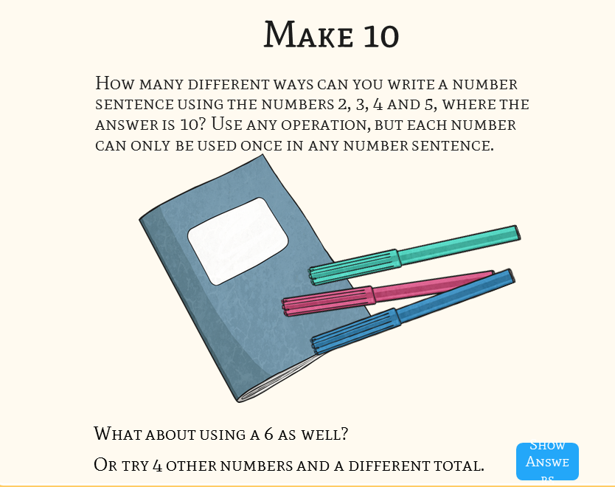
Squares: Miss Avery

Slide 22
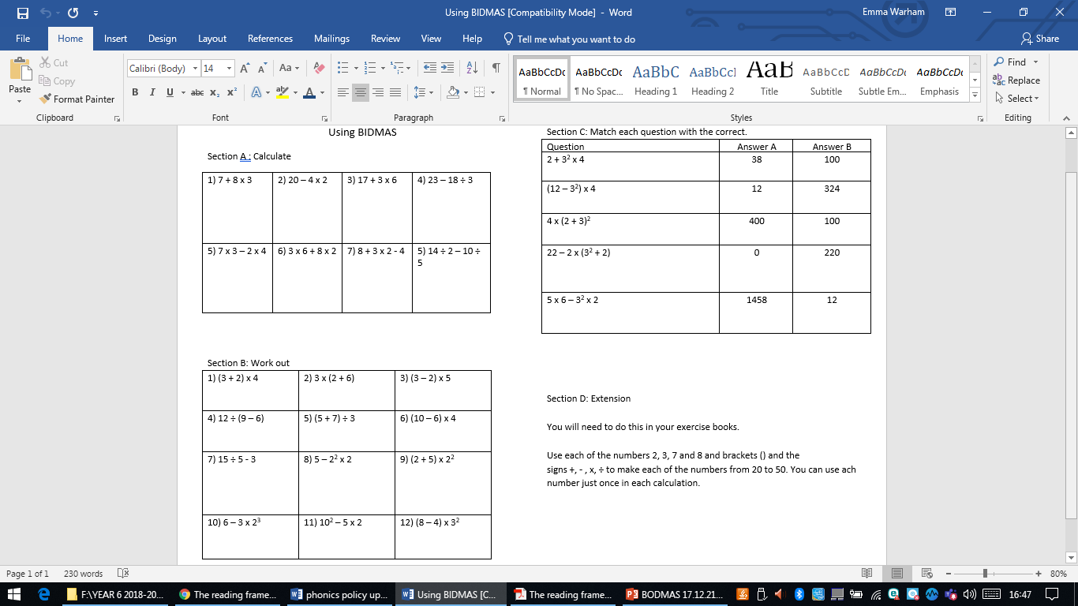
Hexagons: Working with Mrs Warham

Slide 23
Octagons…

Slide 24
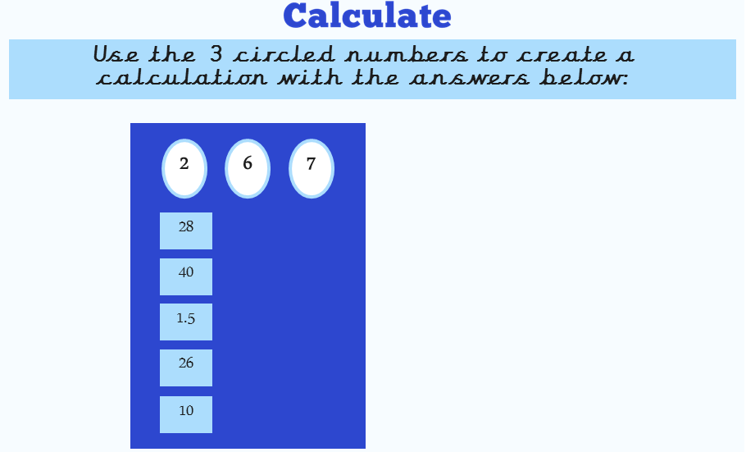
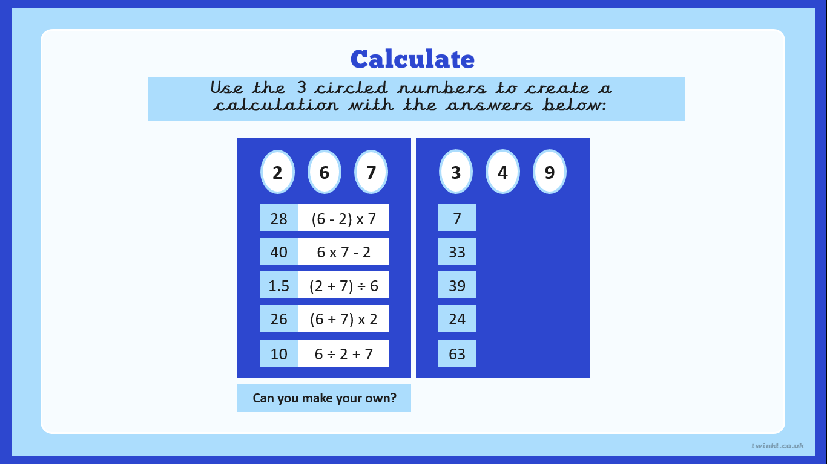

Slide 25
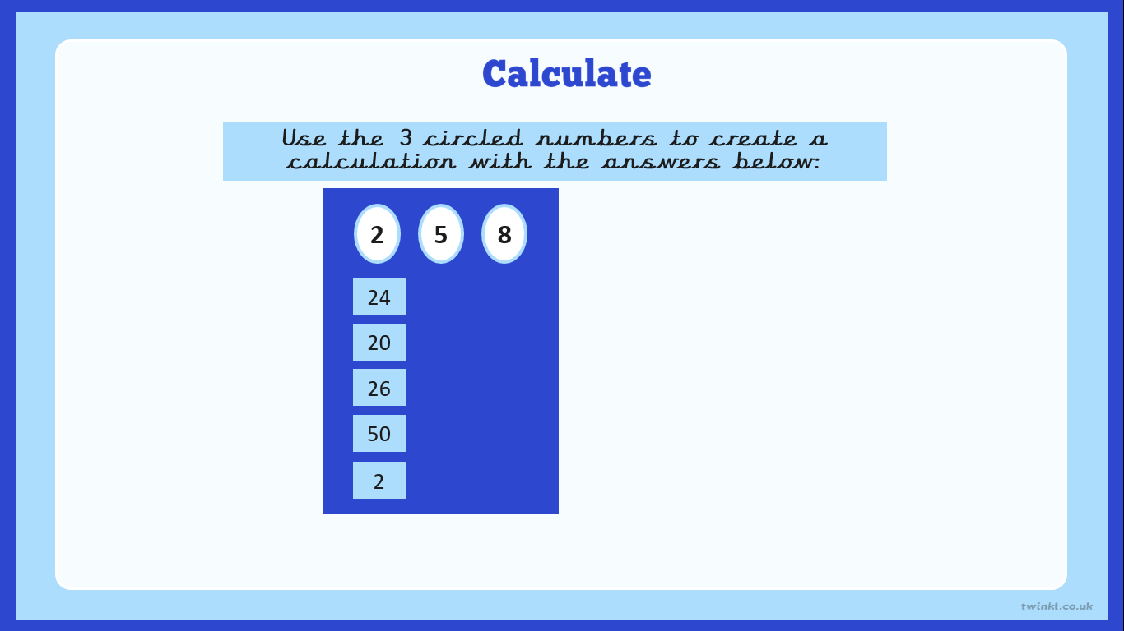
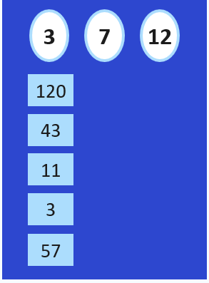

Slide 26
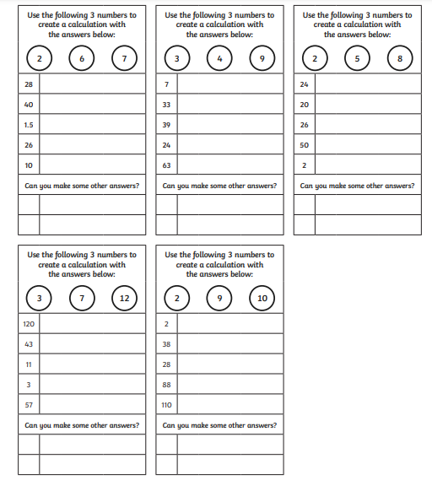

Slide 27
Answers…

Slide 28

Make 10
How many different ways can you write a number sentence using the numbers 2, 3, 4 and 5, where the answer is 10? Use any operation, but each number can only be used once in any number sentence.
2 × 5
3 × 4 – 2
4 × 5 ÷ 2
(4 – 2) × 5
2 + 3 + 5
2 × 5 × (4 – 3)
other answers possible
What about using a 6 as well?
Or try 4 other numbers and a different total.
Show
Answers
Hide
Answers

Slide 29
Which Operation
Complete these number sentences by putting in operations.
5 4 6 = 7
5 4 6 = 3
5 4 6 = 29
5 4 6 = 15
5 4 6 = 26
-
+
+
-
+
×
+
+
×
+
Hide
Answers
Create some of your own for a partner.
Show
Answers

Slide 30
Use the 3 circled numbers to create a
calculation with the answers below:
2
6
7
3
4
9
28
(6 - 2) x 7
7
9 ÷ 3 + 4
40
6 x 7 - 2
33
4 x 9 – 3
1.5
(2 + 7) ÷ 6
39
(9 + 4) x 3
or 4 x 9 + 3
26
(6 + 7) x 2
24
(9 - 3) x 4
10
6 ÷ 2 + 7
63
(3 + 4) x 9
Can you make your own?
Can you make your own?

Slide 31
Use the 3 circled numbers to create a
calculation with the answers below:
2
5
8
3
7
12
24
(5 - 2) x 8
120
(7 + 3) x 12
20
8 ÷ 2 x 5
43
3 x 12 + 7
26
(8 + 5) x 2
11
12 ÷ 3 + 7
50
(8 + 2) x 5
3
12 ÷ (7 - 3)
2
(8 + 2) ÷ 5
57
(12 + 7) x 3
Can you make your own?
Can you make your own?

Slide 32
Use the 3 circled numbers to create a calculation with the answers below:
2
9
10
2
2 ÷ (10 - 9)
38
(10 + 9) x 2
28
9 x 2 + 10
88
10 x 9 – 2
110
(9 + 2) x 10
Can you make your own?

Slide 33
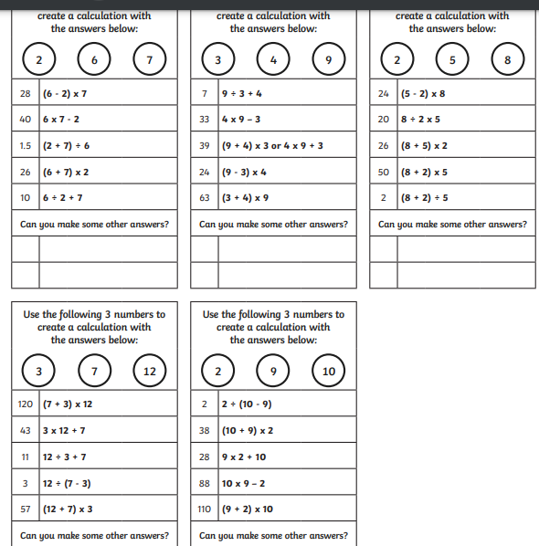

Slide 34
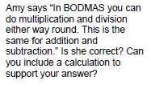
Plenary

Slide 35
If…then…
This is important because…

Slide 36

Next step:
Next step:
Next step:
Next step:
Next step:
Next step:

