Slide 1


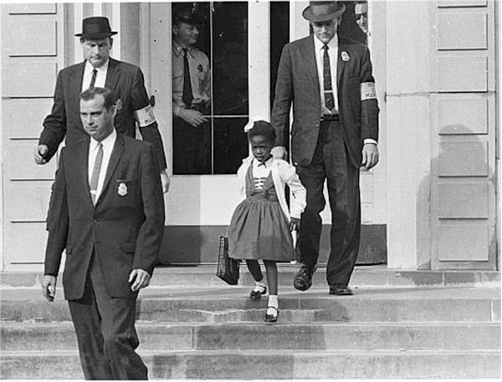
The Lord is with us –
His spirit is here.

Slide 2


Slide 3

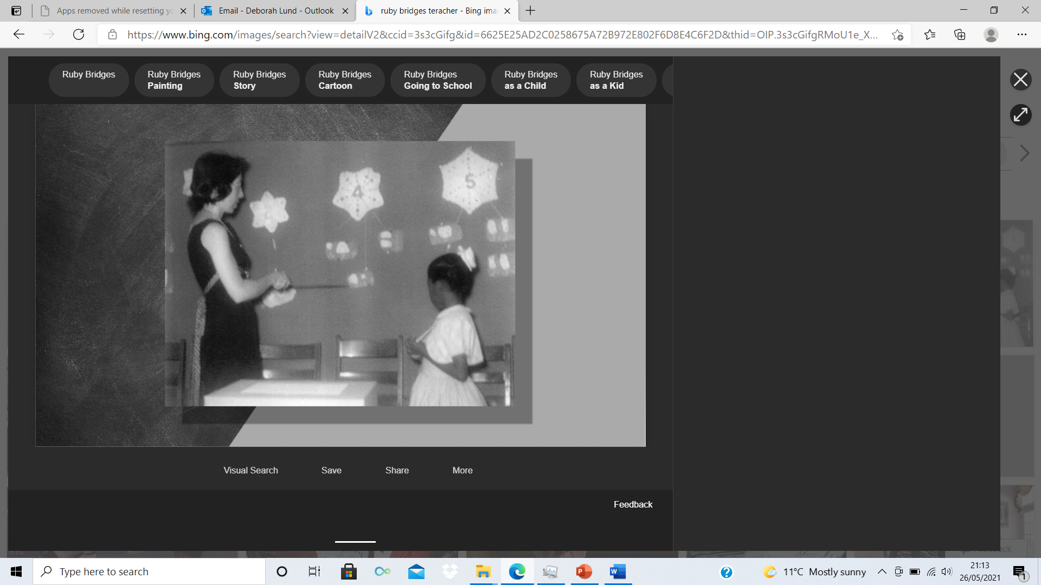

Slide 4
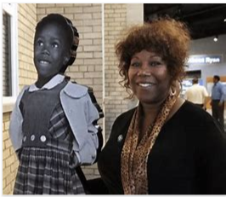

Slide 5
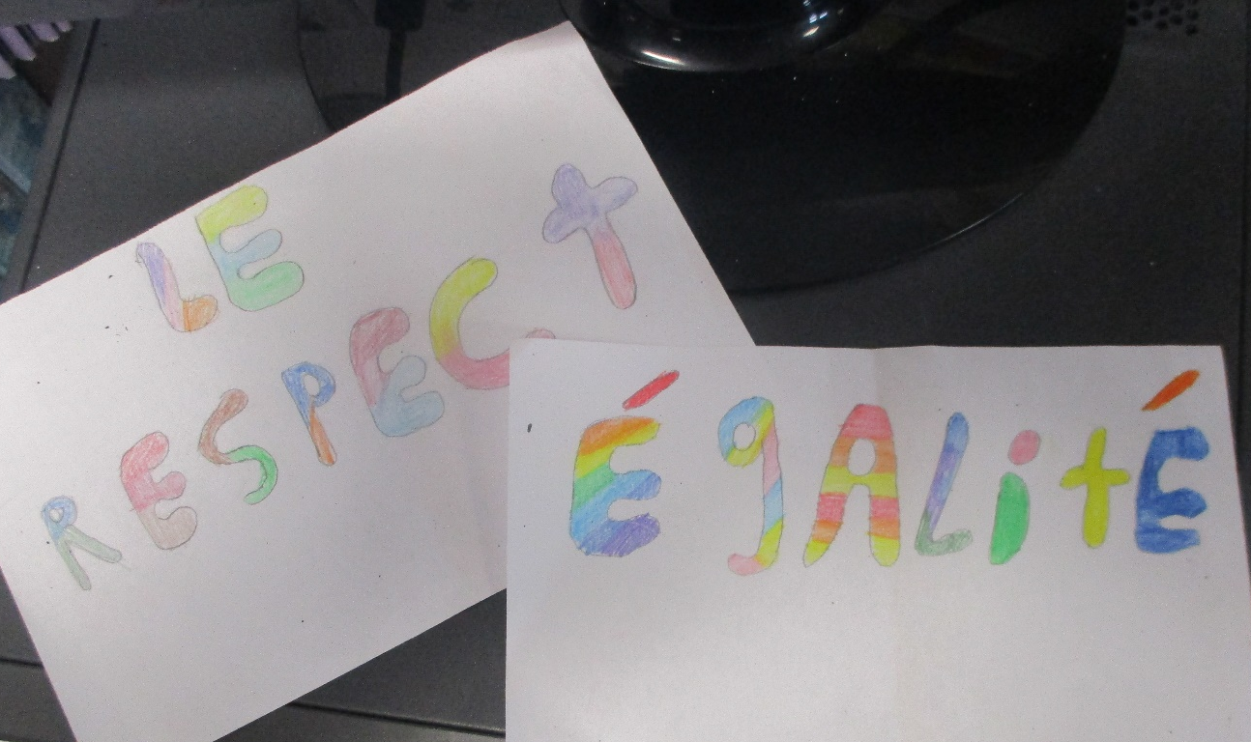
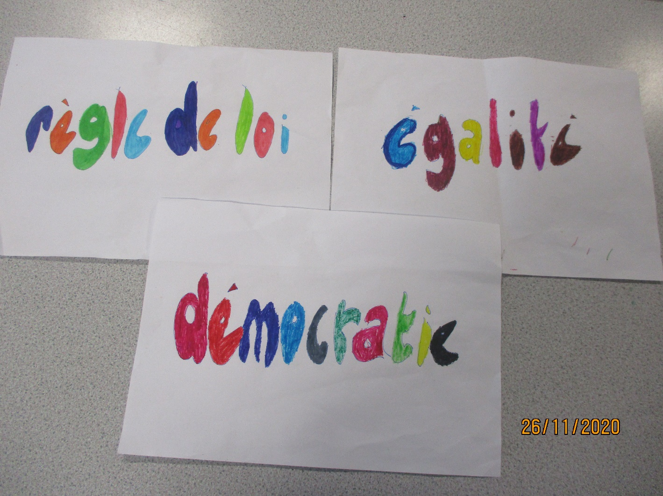
This little girl is Ruby Bridges – she was the first black child to go to a school that had previously only had white children

Slide 6
This little girl is Ruby Bridges – she was the first black child to go to a school that had previously only had white children

Slide 7

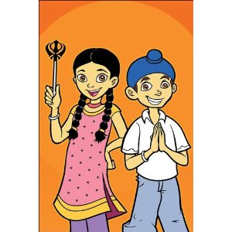
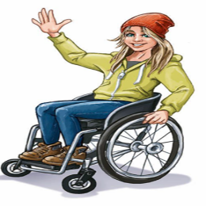
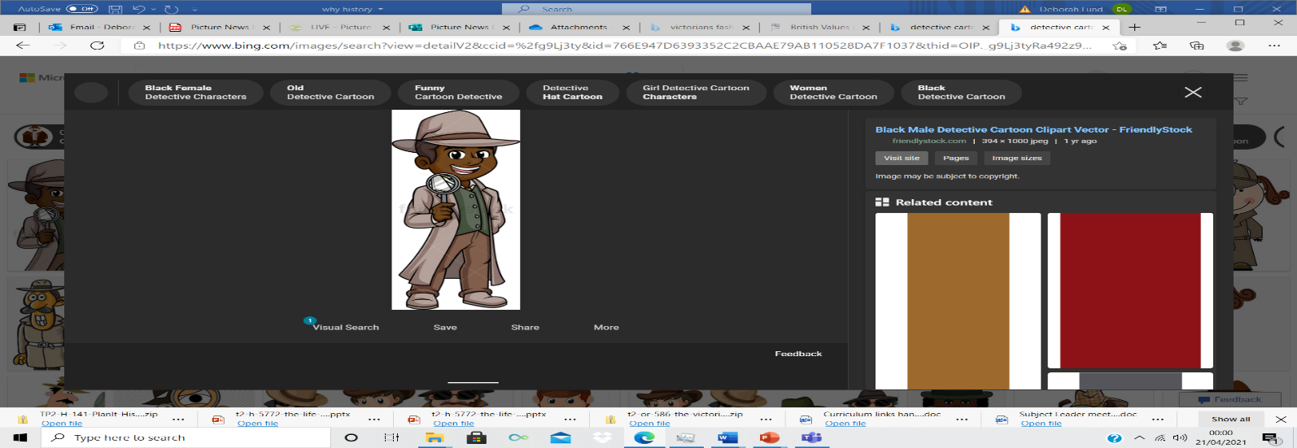

Slide 8
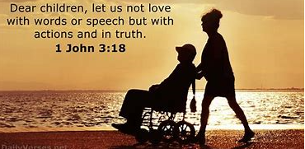
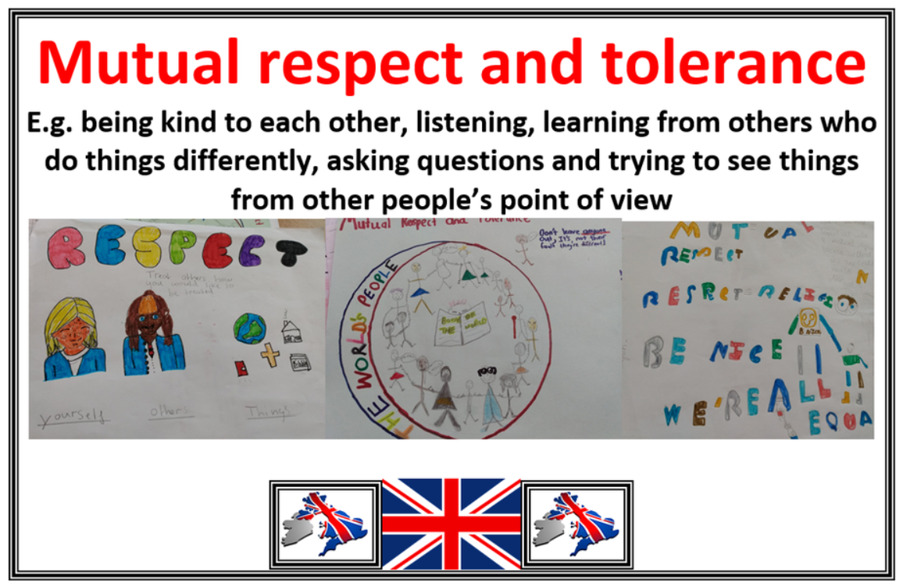
As we pray, lets think about our own attitudes to people from different communities – races – religions – languages
We can be inspired by the perseverance shown by people like Ruby in the past.
Our British Value – of mutual respect

Slide 9
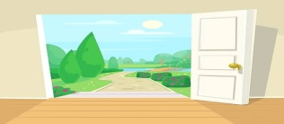
Merci pour les gens inspirants du passé Merci que nous vivons dans un pays libre où nous essayons de traiter les gens également Nous aider à être généreux et gentils avec les gens. Amen | Thank you for the inspiring people from the past Thank you that we live in a free country where we try to treat people equally Help us to be generous and kind with people. Amen
Merci pour les values

