Slide 1
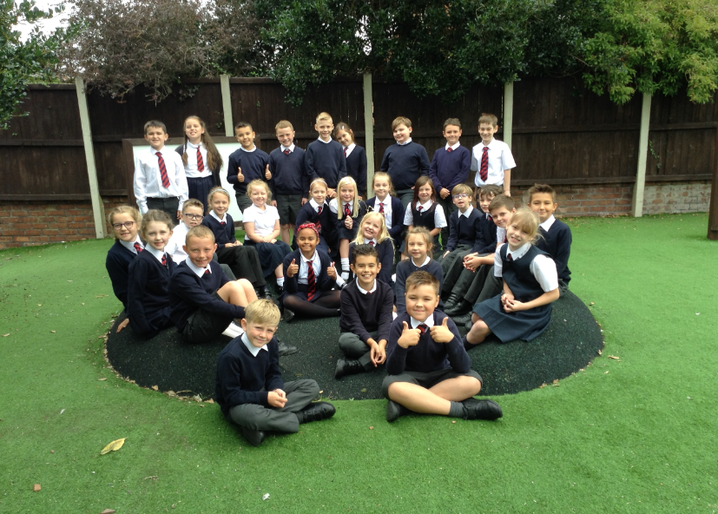
Welcome to year 4

Slide 2

What are our school’s core
Christian values?

Slide 3
What are our school’s core
Christian values?
Koinonia
Courage, Wisdom, Friendship, Forgiveness and Trust

Slide 4

Our Christian Vision…
Happiness, love and security abound
Everyone is special
Every achievement is celebrated
Relationships and teamwork matter
A beacon of light in the community
Christ in Everything we Do!

Slide 5
Year 4 staff
Teachers
Mrs Afford
Mr Vernon (Thursdays)
Support staff - Mrs Westby (mornings)
Mrs Owen (interventions)

Slide 6
Routines
Doors open at 8.45, Registration at 8.55
Finish at 3.20pm.
If your child is absent from school, please telephone the school as soon as possible.
It’s really important to be on time (whenever possible) as morning activities start as soon as we arrive at school.

Slide 7

Housekeeping!
Please name all uniform –
Boys’ winter uniform Girls’ winter uniform
Grey trousers Navy skirt or pinafore
White shirt White blouse
Navy long sleeved jumper Navy long sleeved cardigan
School tie School tie
PE will be on Tuesdays and Thursdays so please come to school in your PE kit on those days (including blue jogging bottoms and blue jumpers/hoodies when it’s cold). White or black trainers suitable for sport NOT fashion may be worn. You are not allowed to wear jewellery for PE (including earrings) so please make sure you have removed these before you come to school.
The above also applies to swimming.
Please make sure your child has a water bottle each day
We are struggling for space to store bags. Please could the children bring school book bags.

Slide 8
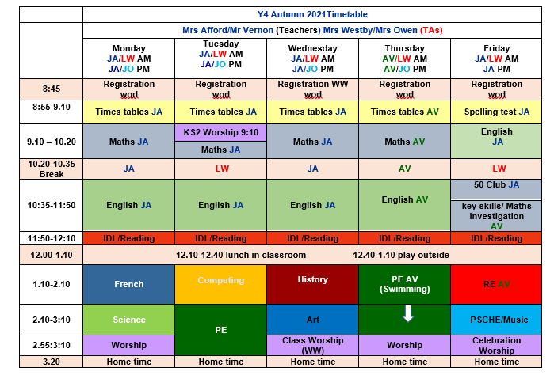
Class Timetable

Slide 9
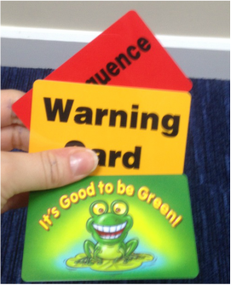

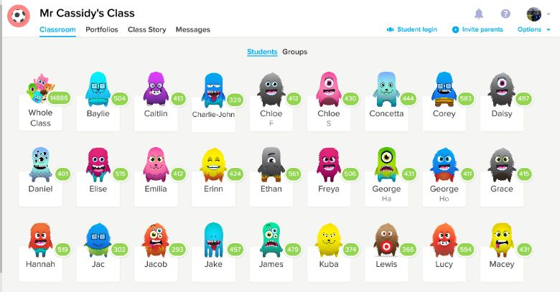
Behaviour!
Behaviour flow chart is on the web site
Children are awarded dojos for following the class rules – there is a prize at the end of the week
If children are not following the class rules a verbal warning is given before a card is issued

Slide 10
St Philip’s Standards
Be ready
Be Respectful
Be Responsible
Fantastic Walking

Slide 11
Badges
Spelling and times tables badges
Times tables badges
We work towards the bronze, silver and gold badges, continuing from any badges your child may have already achieved.
Spelling badges (tests are carried out termly)
Ongoing throughout the year

Slide 12

Medical
Any medication updates – please let us know of any changes
Please check that your child’s inhaler is in date.
We have been advised that children should use a spacer when taking their inhaler - if possible please send one into school.
If your child needs any prescribed medication, a medical form needs to be filled in at the office before we are able to administer it.
Thank you

Slide 13
Homework
Homework will be given out on a Friday to be returned on Wednesday.
We would be really grateful if you could return homework on time so I have chance to mark it before handing out new homework on the Friday – Thank you.
Spellings will be tested each Friday.
Weekly spellings will be sent home weekly and will be put on the website.
Please try to read with your child every day.
Please let us know if any homework is too difficult so we can give a little extra help at school.
Thank you

Slide 14
Reading
Your children will continue reading through the colour bands. Once completed, they will move onto library books.
Please try and read at home every night.
In school the children will be involved in
Shared reading.
Reading across the curriculum.
Story time at the end of the day.

Slide 15

Curriculum
Curriculum map and autumn newsletter is on the website.
Website
Please keep checking the website dates and news.
We will try to keep the website updated with lots of photos of your children at work and play.
Trips
You will also find information about after school clubs on the website.

Slide 16
Covid and attendance…
Attendance at school is mandatory for all children unless they are sick or have and appointment.
The usual rules on absence continue to apply. Well children are expected to attend daily, arrive on time and have the things that they need. Reading books should be brought to school daily Limit the amount of things brought into school please.
Parents have a vital role to play in deciding when to keep a child off school but we appreciate that this is now complicated by the current situation. Children have already missed so much time in school so I would urge you to send them to school wherever possible.
It’s a difficult judgement call but if in the past you would have sent your child to school with a runny nose, slight tummy pain, minor headache or just a bit under the weather it is still probably ok, if you feel they can manage the day to send them in. We will always contact you if we have concerns about your child. Each case is different so feel free to speak to Mrs Edward.
First Response
If your child is absent you must contact the school office by telephone or email to report your child's absence giving clear details of the reason for absence. Failure to do so means that our First Response kicks in and if we cannot get hold of you and we are unable to make contact with you via your emergency contact details, it might be necessary for a senior leader to come to your house!!!!! This is part of our safeguarding response to ensure everyone is safe and well. As you can imagine, a home visit takes up a lot of time and it is usually the case that families have forgotten to call us. I’m sure you don’t want us on your doorstep so please remember to give us a call. Thank you
Some Covid reminders
Symptoms are Fever above 37.8, persistent cough, shortness of breath, loss of taste or smell
To Book at test call 119. If you or your child are awaiting a test result do not come to school and do not come to the playground even if you are symptom free.
See our Covid Pages of the website for additional guidance.

Slide 17
Assessment
Assessment takes place at the end of each half term.
We track progress using Target Tracker.
The children work to meet all the objectives on the ladders.
Your children are in Year 4 so we are in Band 4
Each band has been split into six sections
Beginning and Beginning Plus ( B and B+)
Working Within and Working within Plus – Up to 70% of the statements are confidently achieved (W and W+)
Secure and Secure Plus (S and S+)
We aim for most children to make 6 bands of progress each year
If you’d like more information, here is a full explanation of the assessment process on the website.
To support our Teacher assessment, at the end of KS1, we use the Teacher assessment framework.
Please make sure you have taken:
English and maths ladders
Writing assessment sheet
Spelling lists

Slide 18
age related expectation: children would need to reach the w+ /secure (s) step at the end of the appropriate year.
Secure + represents the consolidation of the band and shows children are working at Greater Depth
It is important to recognise that all children progress at different levels and children with a particular learning need may not be working within their year group band.
It is important for children to have opportunities to apply their understanding in a range of challenging real life contexts, and to demonstrate their mastery of a particular skill at a deep and thorough level before moving on.
Notes:
Secure + demonstrates the foundation from which a pupil may proceed onto the criteria in the following band. Pupils will need to pass through secure + to start the next band
We would expect children who are secure (s) in the band of statements they are working on to have these experiences, and therefore be working at the secure + (s+) step before being assessed against the following year band statements.

Slide 19
‘Age related expectations’: children should reach the secure (s) step by the end of the appropriate year. To move from secure (s) in one year band to the next is 6 steps over 6 half terms = 1 step or 1 point of progress each half term.
Year 4 – band 4 (age related expectations)
Autumn 1 Secure + | Autumn 2 Beginning | Spring 1 Beginning + | Spring 2 Within | Summer 1 Within + | Summer 2 Secure
A child leaving primary school as a band 6 secure is said to be ‘secondary ready’ and reaching age related expectations.

Slide 20
This year there is an increased emphasis on accurate spelling of the Year 3 and 4 word lists and spelling requirements as listed by the DfE- mainly suffixes/ prefixes/ common homophones ; and also of the rapid recall of times tables.
We are promoting these as they are a fundamental part of English and Maths. English is now being taught in schools as you would teach a foreign language- examining grammar, spelling, syntax etc; and Times Tables form such a crucial role in the understanding of number and number operations, such as fractions, that it is essential these are promoted at home as well as in school. This year, there is now a National Assessment in knowledge of Times Tables, at the end of Year 4.
We use a spelling booklet (Spelling Passport) which enables children to progress through set phonic patterns and phoneme rules for spellings, and learn words from the statutory list for Y3/Y4. We award certificates and badges, similar to those you will have seen for the knowledge of times tables.

Slide 21
ST PHILIP’S CE PRIMARY SUPPORT TRIANGLE
SENDCO - Mrs Klaassen
SEN Support
Targeted Support
Enhanced Quality First,
Quality First – Universal Offer for all
High Needs Funding
EHCP’s
Specialist

Slide 22
Website and Twitter
Please remember the website holds lots of information and photos of your children.
Also twitter gives instant updates of what is going on in school.

Slide 23


Slide 24
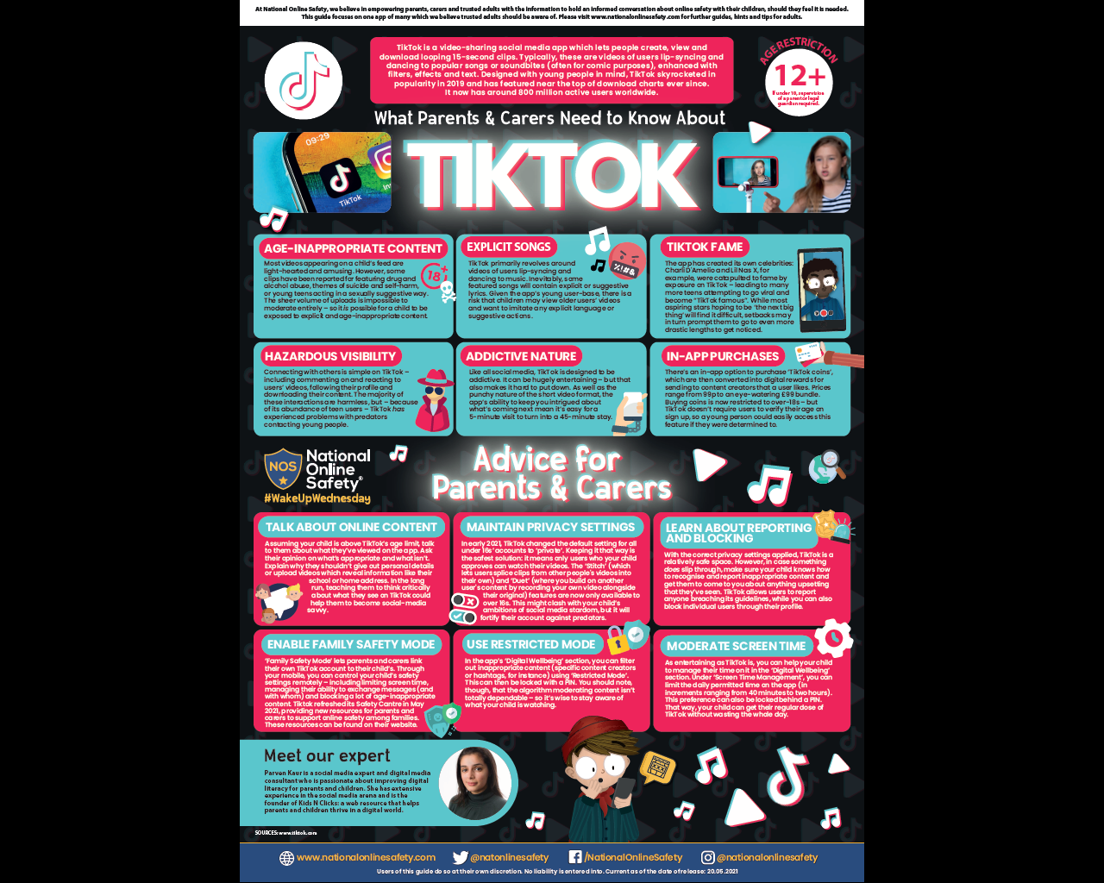

User friendly guides on all areas of ICT, gaming, social media and top tips for online safety.
To sign up please download the app, chose parent as your role and make use of the advice and support offered plus the online training support.

Slide 25
There are a lot of extra school clubs now. Please check if your child is attending, where to collect them from and at what time. These clubs can count towards the Children’s University at which they receive certificates for their efforts and willingness to develop interests beyond the classroom.

Slide 26
Thank you for your time this evening and for listening. Any messages for the class teachers can be given to the TA on the junior door. Mrs Afford is available to see you if you wish to make an appointment, on Monday, Tuesday or Friday and Mr Vernon on Thursday Wednesday evenings are staff meetings.
Any questions?

