Slide 1


Welcome to Year 4!

Slide 2


Slide 3

We have codes of conduct for Governors, staff and parents and expect all members of our school community to abide by these.
Our School Vision:

Slide 4
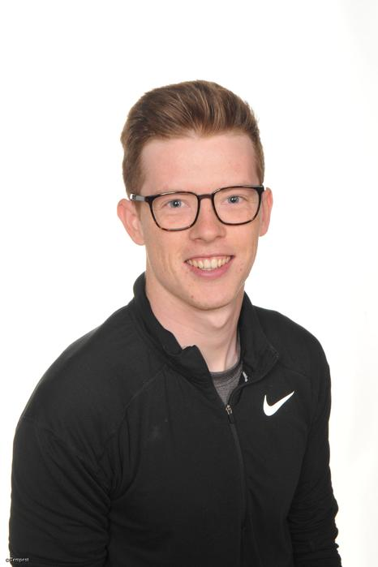
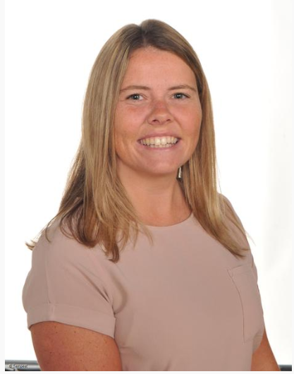
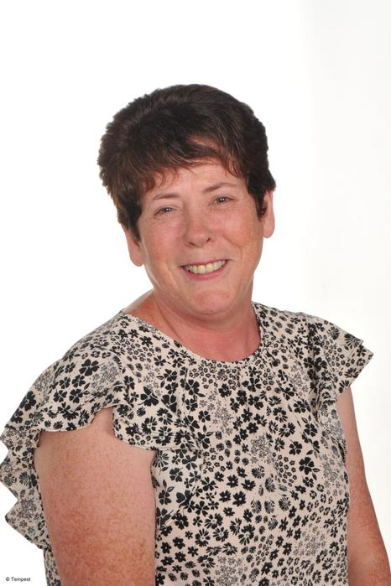
Who will be teaching you?
Mr Vernon
Mon-Fri
Miss Samuel
French, Music PSCHE
Mrs Edwards
Teaching Assistant

Slide 5
School website and how to contact us
We will be using and updating our school website and class page frequently over the year. Please keep up to date of any announcements. https://www.stphilipssouthport.com/
Contact details are on the homepage so if you are needing to get in contact with school-
head@sps.sefton.school
admin@sps.sefton.school
vernona@sps.sefton.school
Mrs Edward says please be respectful of teachers work life balance. Emails should be proportionate and at sensible times.
Parent Whatsapp use should be respectful of all members of the school community.
Staff are not able to have lengthy conversations at the start of the school day and any more than a brief chat at the end of the day needs to be a planned appointment.
Mrs Edward is usually on the path at the start and end of each day if you need a quick word.

Slide 6

Medical
Any medication updates – please let us know of any changes
If your child needs any prescribed medication, a medical form needs to be filled in at the office before we are able to administer it.
Thank you

Slide 7


Housekeeping!
Please name all clothing
PE is on Tuesday and Thursday afternoons- no earrings
Please make sure your child has a water bottle each day
Healthy snacks can be brought in for Junior morning break time – fruit, vegetable sticks, cereal bars (no sweets or nuts please).
Infants receive a piece of fruit each day
Swimming will be until Christmas.

Slide 8
Uniform
BOYS WINTER UNIFORM
GREY TROUSERS (NO OTHER COLOUR)
WHITE SHIRT
NAVY LONG SLEEVED JUMPER
SCHOOL TIE
DARK COLOURED SCHOOL SHOES – not trainers
DARK SOCKS
GIRLS WINTER UNIFORM
NAVY SKIRT OR PINAFORE DRESS
WHITE BLOUSE
NAVY LONG SLEEVED CARDIGAN
SCHOOL TIE
NAVY TIGHTS / NAVY OR WHITE SOCKS
DARK COLOURED SCHOOL SHOES – not trainers
Find the full uniform
list on our website

Slide 9
Attendance and punctuality
It is crucial for children to arrive on time to school. Children’s activities start at 8:45 which is either spellings and grammar or Maths key skills. If they are late- they are missing learning time.
If your child is being collected at the end of the day, please arrive on time for 3:20pm.
Please do not allow children on the adventure playground before and after the school day.
Please note that no term time holidays will be authorised and fines will be in place.

Slide 10


Slide 11
Attendance…
First Response
If your child is absent you must contact the school office by telephone or email to report your child's absence giving clear details of the reason for absence. Failure to do so means that our First Response kicks in and if we cannot get hold of you and we are unable to make contact with you via your emergency contact details, it might be necessary for a senior leader to come to your house!
This is part of our safeguarding response to ensure everyone is safe and well. As you can imagine, a home visit takes up a lot of time and it is usually the case that families have forgotten to call us.
TERM TIME HOLIDAYS ARE NEVER AUTHORISED. Families may be eligible for a fine from the Local Authority.

Slide 12
Cashless school payments
https://schoolgateway.co.uk/help/
All payments are made electronically on our payment and booking system.

Slide 13
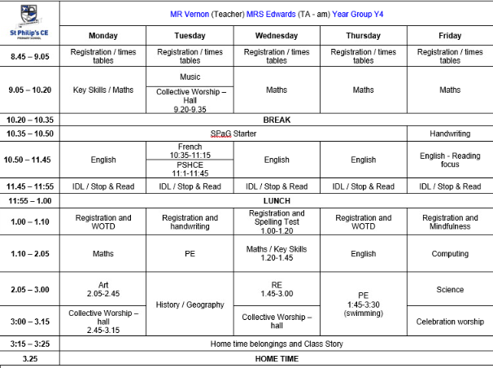
Class Timetable

Slide 14
Curriculum
Curriculum map/newsletter is on our website.

Slide 15

Essential Letters and Sounds (ELS) is our chosen DfE validated phonics programme.
Children will experience the joy of language whilst rapidly acquiring the phonics skills they need to become fluent, independent readers and writers.
How do we teach phonics?
We use a simple, consistent approach to teaching phonics
We have mnemonics and rhymes to support learning and recall
We teach phonics every single day from the first days of Reception
Phonics throughout the day to review new sounds and graphemes taught
Lots of opportunities for oral blending - /c/ /oa/ /t/
We teach the ‘code’ for reading, alongside teaching vocabulary

Slide 16


ELS Progression

Slide 17

ELS Progression

Slide 18
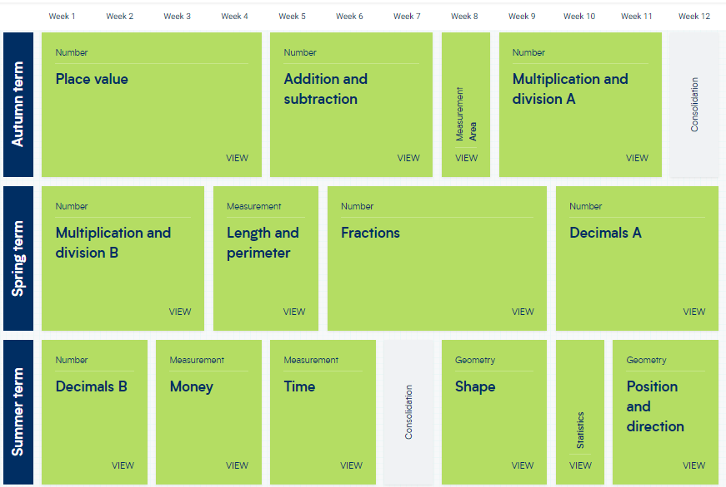
White Rose resources – Maths mastery

Slide 19

Assessment

Slide 20


Slide 21

Year 5- band 5

Slide 22
Homework
Homework will be given out on a Friday.
Spelling test on the following Wednesday.
Homework to be given in by Tuesday. Please let us know if any homework is too difficult so we can give a little extra help at school.
Please help your child to learn their spellings and tables each week.

Slide 23

Spellings
We are having a huge emphasis on spellings this year. Children need to be practising their spellings daily and not for a spelling test.
In Year 4, children need to be able to spell words from the Year 3 and 4 curriculum list. They must show they can spell these words correctly in their writing.
Spelling sheet for this half term has been sent home already and is on the class web page.

Slide 24
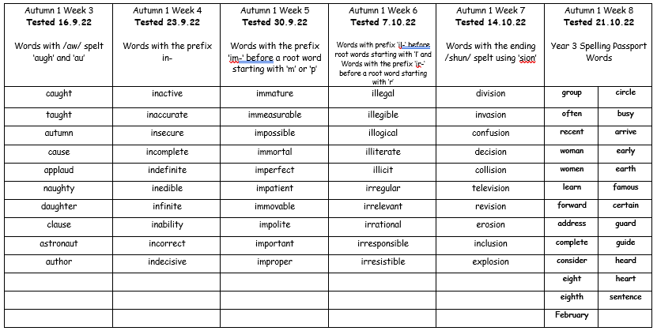

Slide 25


Slide 26


Times tables
As you will be aware, we have the Bronze, Silver and Gold badges in school.
Children must practise their times tables daily. Even if they think they know them- by Year 5 they must be quick to recall them.
There are also various sites to use:
https://www.youtube.com/watch?v=4BLZKOjNKfk

Slide 27
Reading at home:
Reading Journals
Children will be expected to write their own reading comments in their Reading log book each day.
Reading recommenders

Slide 28
ST PHILIP’S CE PRIMARY SUPPORT TRIANGLE
SENDCO - Mrs Klaassen
SEN Support
Targeted Support
Enhanced Quality First,
Quality First – Universal Offer for all
High Needs Funding
EHCP’s
Specialist

Slide 29



Behaviour and
Good To Be Green
Very high expectations
Manners
Greetings
Can do attitudes

Slide 30
Behaviour and
Good To Be Green
10 Green week certificates being given still
Red cards- letter home to parents on a Friday
Yellow cards- miss some of break time.

Slide 31
St Philip’s Standards
Be Ready
Be Respectful
Be Responsible
Fantastic Walking

Slide 32

Fantastic Walking
Walking properly makes you feel great.
We are going to be doing fantastic walking, All THE TIME!
Head up
Arms by your sides
Slow pace.

Slide 33

Walking home
We have parents and carers come for children by the rock climbing wall. 3:25 pick up.
Please inform the office if there is a change from normal routine. We will have to check permissions if we are unaware of any changes.
Thanks for your co-operation.

Slide 34
Responsibilities
History Ambassadors
Eco Warriors
Student Council
Worship Warriors
Health Champions

Slide 35
School Trips…
Dates to be confirmed…
Local visits to Southport for Geog and science
Rock and River
Payment plans will be available. Please contact the office if you think you would benefit from this

Slide 36

Parent’s meeting:
Weds 18th October 2023
2pm onwards

Slide 37

Please check your filters

Slide 38


Slide 39


User friendly guides on all areas of ICT, gaming, social media and top tips for online safety. Check all age reccomendations on games and Apps.
To sign up please download the app, chose parent as your role and make use of the advice and support offered plus the online training support.

Slide 40

Volunteers are very welcome!
Safer Recrutiment Checks will be completed.

Slide 41

Check website for information:
http://www.stphilipssouthport.com/
and Twitter!

Slide 42

Any questions?

