Slide 1
Year 6 Residential
Anderton centre
Fri 21st June- sun 23rd 2024
https://andertoncentre.co.uk/

Slide 2
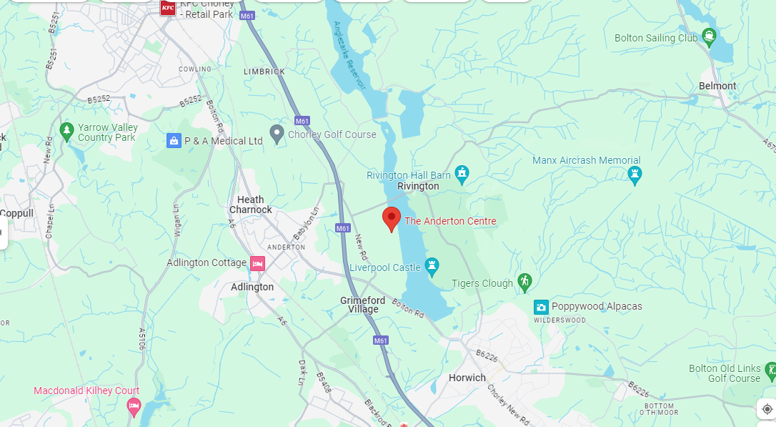
Where is the Anderton centre?

Slide 3
Fri 21st June
Please drop the children at school at 9 am with their luggage and packed lunch for the Fri. We will leave school at 12 to arrive at the centre by 1 pm.
They will come into the hall- be given a luggage label to tie onto their bag, hand in any named medication and money (named envelope).
Once they have dropped their luggage in the hall they will go to their Year 6 classroom for the morning.

Slide 4
Who is going?
Mrs Cooper
Mrs Edward
Mr Vernon
Mrs Wright
Children are in 3 groups for activities.

Slide 5
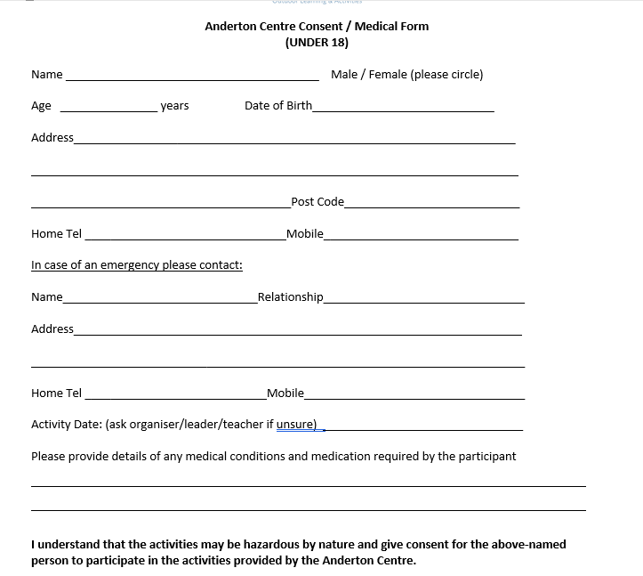
Medical forms
We must have medical forms (Parts 1 and 2) for every child- if possible please complete after the meeting today.
Medicines include travel tablets.

Slide 6
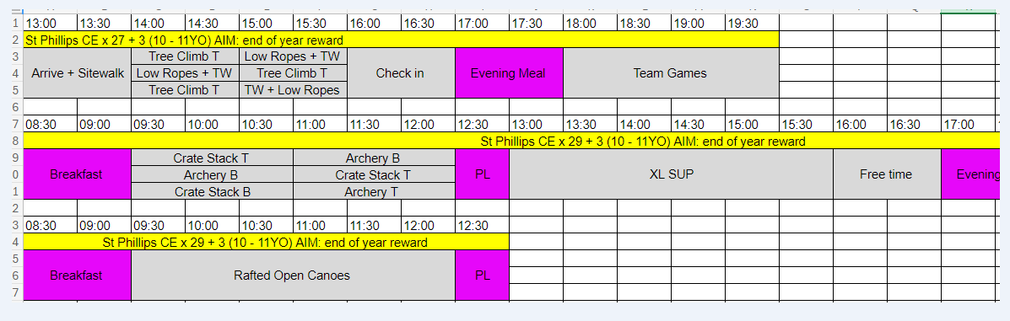
Activities

Slide 7
Money
There is a small tuck shop on site- the children can bring up to £10 to spend. Please send in a named envelope and give in on the Friday morning .
This will be kept safe by staff until it is our turn to use the shop.

Slide 8
Food
There is plenty of choice and plenty of it!
Please do not pack any extra snacks in their bags.
The only food they need is their packed lunch for the first day- please ensure they have a named refillable water
bottle with them.

Slide 9
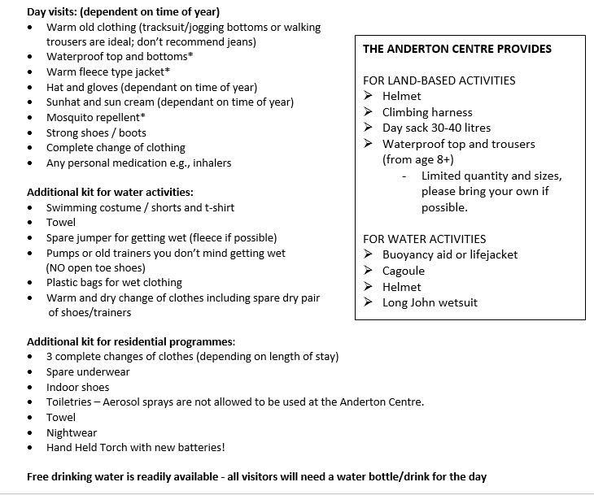
Kit list
Please name everything!
Bin bags!

Slide 10
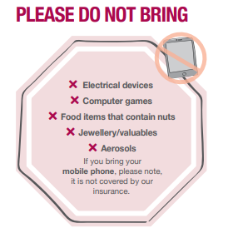
No phones are allowed! Any problems we will contact you.
Wifi is not good there- we will try and tweet photos but it is not always possible.
Please ensure you have given Twitter permission.

Slide 11
Rooms and groups
Children will be picking two children to be in room/group with- they will definitely be with one of them. They will not know groups or rooms until we get there.
The majority of the bedrooms sleep between 3 to 4 in bunk beds in each room. Sheets, duvets and pillows are provided. All rooms are en-suite

Slide 12

Sun 23rd June
The coach will leave the Anderton centre at approximately 1.15 pm to travel back to school.
Any delays we will send a message out- we aim to be back by 2.15 pm.

Slide 13


