Slide 1
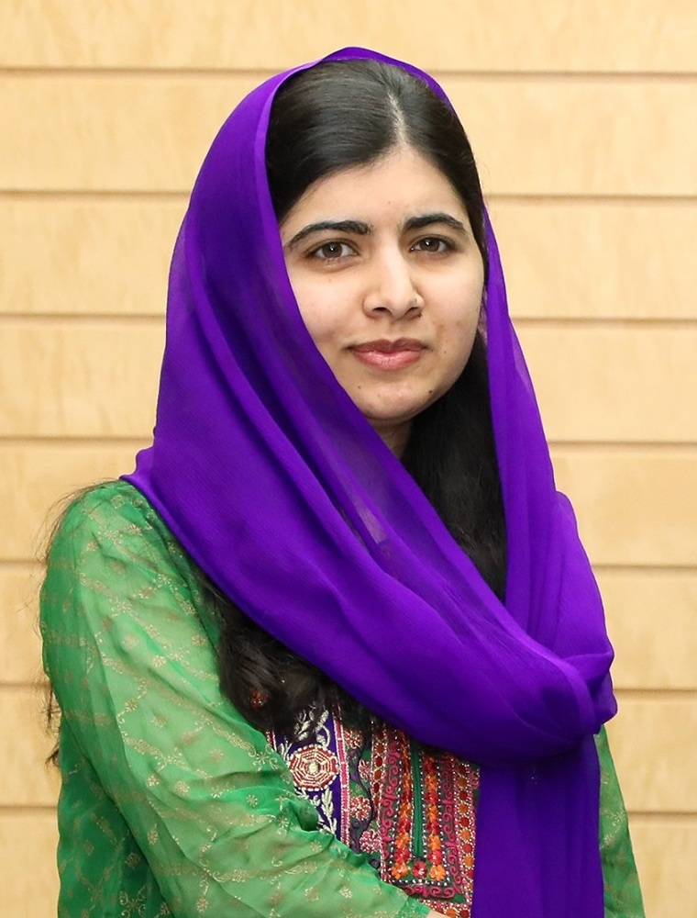
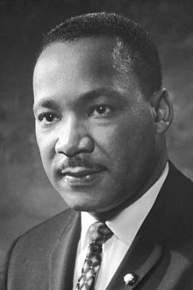
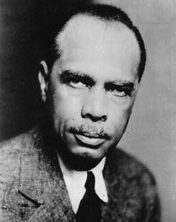
Justice
https://www.youtube.com/watch?v=pOQjcVExQbY

Slide 2

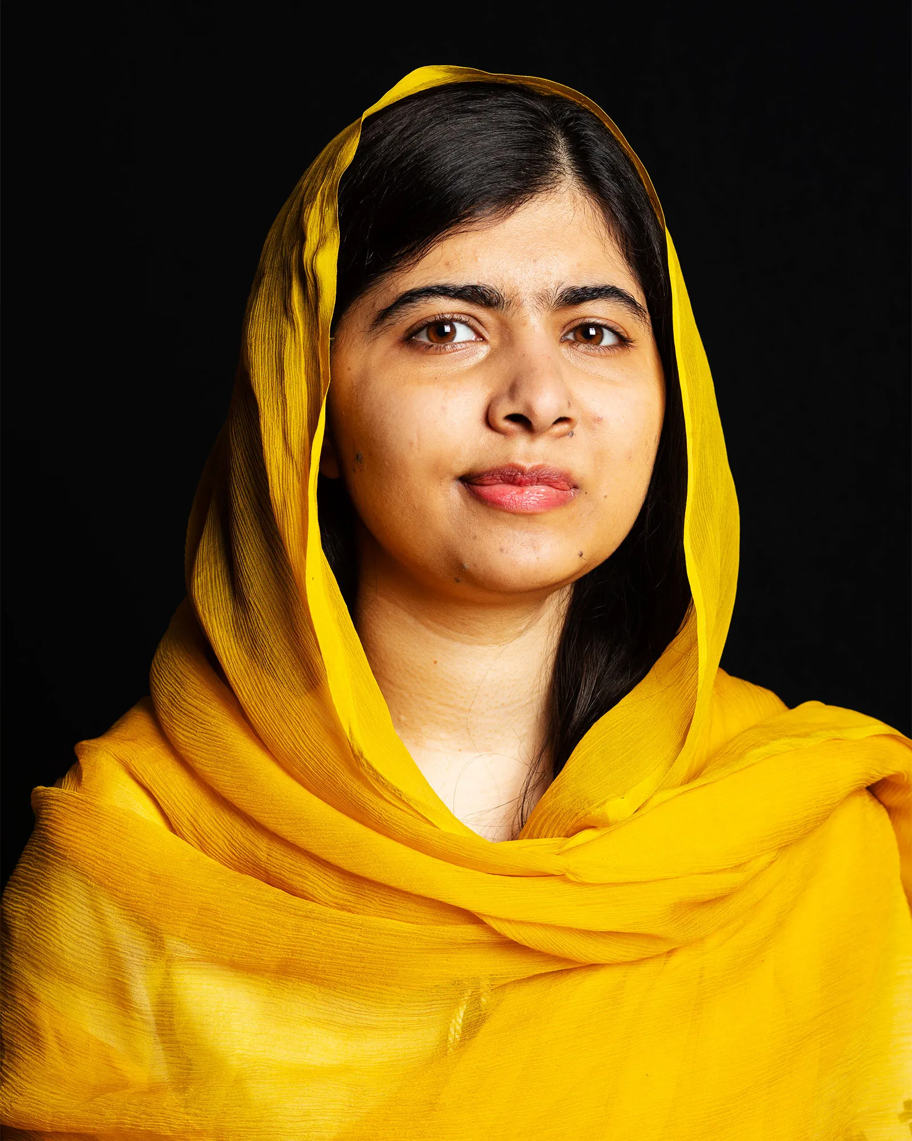
Malala Yousafzai
Malala was 15 when she was shot. Her first speech: “How Dare the Taliban Take Away My Basic Right to Education?”
She stood up for the right for girls to have education even though it was dangerous.
She thought it was unfair that girls couldn’t have education
Malala Yousafzai
https://www.youtube.com/watch?v=FnloKzEAX7o

Slide 3

James Weldon Johnson

Slide 4
Who was he?
Born in 1871 in Jacksonville, Florida, Johnson was heavily influenced by his mother, who passed on her love of music and literature, interests that would follow him throughout his career.
After graduating in 1894 from Atlanta University, a historically Black college, Johnson returned to Jacksonville and taught at the Stanton elementary school for Black students. Once he became principal, Johnson expanded the school to include high school education.

Slide 5
Why is he important?
While at Stanton, he also began studying law and in 1898 became the first Black man admitted to the Florida Bar (law offices) since Reconstruction.
In 1901, Johnson moved with his brother, a composer, to New York City to write for musical theatre. Together, they composed about 200 songs for Broadway. In New York, Johnson began making connections to influential members of the Black community, leading to the next stage of his career in diplomacy.

Slide 6
What is the Bars purpose ?
The Florida Bar's core functions are to: Regulate the practice of law in Florida; ensure the highest standards of legal professionalism in Florida; and protect the public by prosecuting unethical attorneys and preventing the unlicensed practice of law.

Slide 7
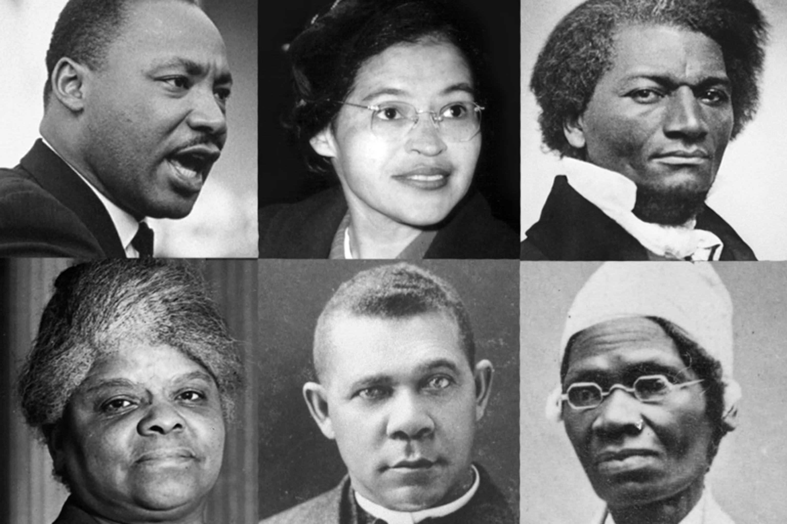
‘Darkness cannot drive out darkness, only light can do that’.
I have a dream that my four little children will one day live in a nation where they will not be judged by the colour of their skin but by their character.
I’ve chosen Martin Luther king because he was trying to stop the issue of racism against black people. He believed it was unfair black people had less authority and were treated differently to white people.

Slide 8
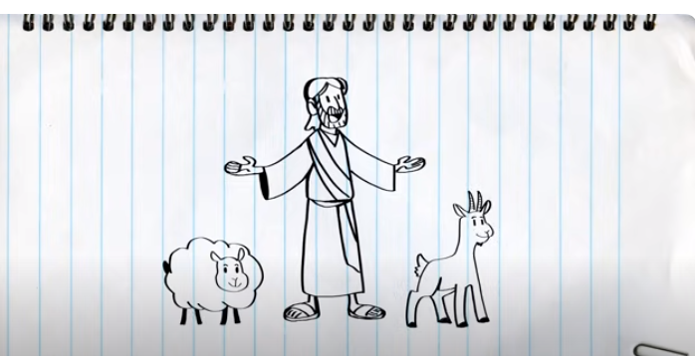
BIBLE LINK
https://www.youtube.com/watch?v=iWSkdx-XwWY

Slide 9
Philippians 1:6 “…being confident of this, that he who began a good work in you will carry it on to completion until the day of Christ Jesus.”
Hebrews 10:24-25 “And let us consider how we may spur one another on toward love and good deeds, not giving up meeting together, as some are in the habit of doing, but encouraging one another—and all the more as you see the Day approaching.”

Slide 10

WHAT HAVE YOU LEARNT TODAY?

Slide 11
HOW WILL YOU GO AND SPREAD
JUSTICE IN THE WORLD?

Slide 12

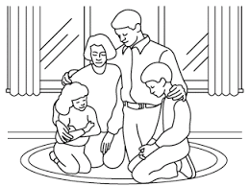
Do unto others as you would have them do unto you.

