Slide 1
Worship- Courage and perseverance
Autumn
https://www.youtube.com/watch?v=tKml80alH3Y

Slide 2
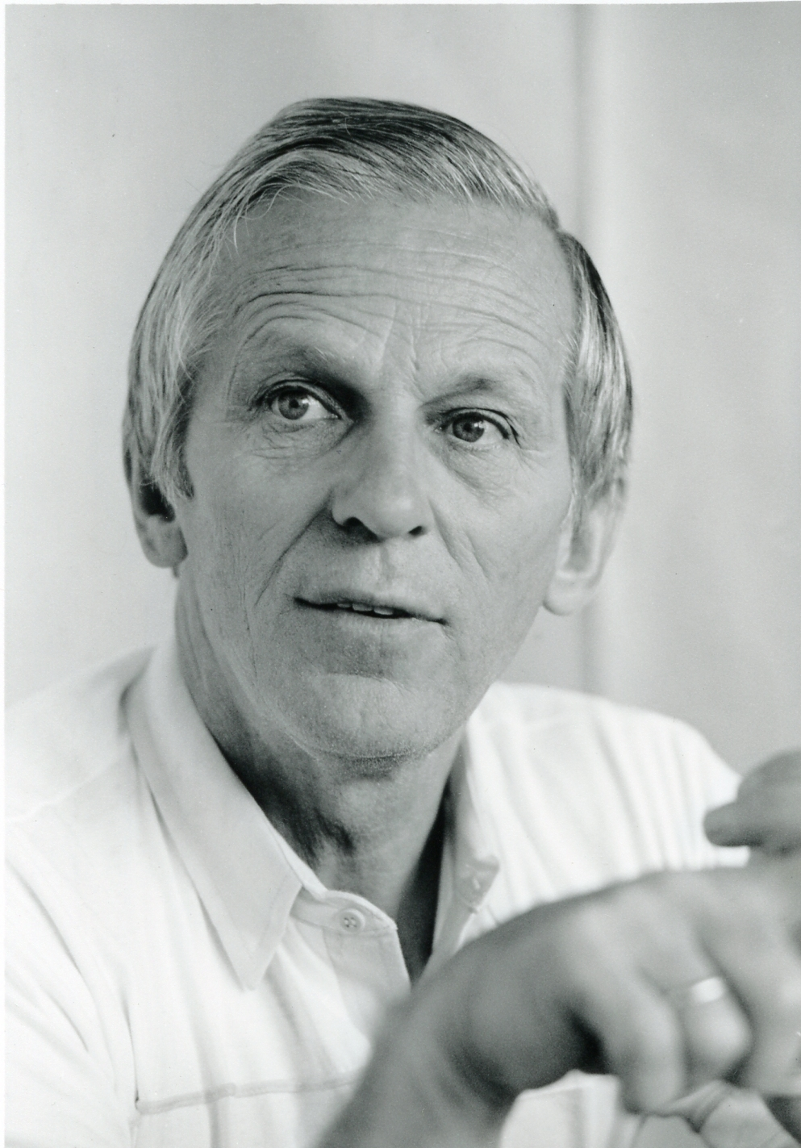

Cora
Brother Andrew- Does anyone know who Brother Andrew is?

Slide 3
Brother Andrew-was a Christian. He went on his first trip in 1955 he went to West Berlin. His suitcase contained his Bible, a change of clothes and hundreds of tracts entitled The Way of Salvation, which he intended to give away. The trip was to change his life. Behind the Iron Curtain, he discovered churches desperately in need of Bibles, support and prayer. Above all, he found a group of Christians who felt isolated and alone and who thought the rest of the world had forgotten them. That young man became known as Brother Andrew. And his trip changed the world. Over the years he was to travel many times behind the Iron Curtain, courageously putting his life on the line to smuggle Bibles at the height of the Cold War.
Cora

Slide 4
His work went on to span many decades and different places. In his book God’s Smuggler, Brother Andrew’s autobiography, he details dangerous border crossings in his blue VW Beetle – which became known as ‘the miracle car’, for its ability to miraculously keep going. He said a prayer to say as he snuck Bibles and Christian literature across the border: “Lord, in my luggage I have Scripture I want to take to Your children. When You were on earth, You made blind eyes see. Now, I pray, make seeing eyes blind. Do not let the guards see those things You do not want them to see.”
Cora

Slide 5
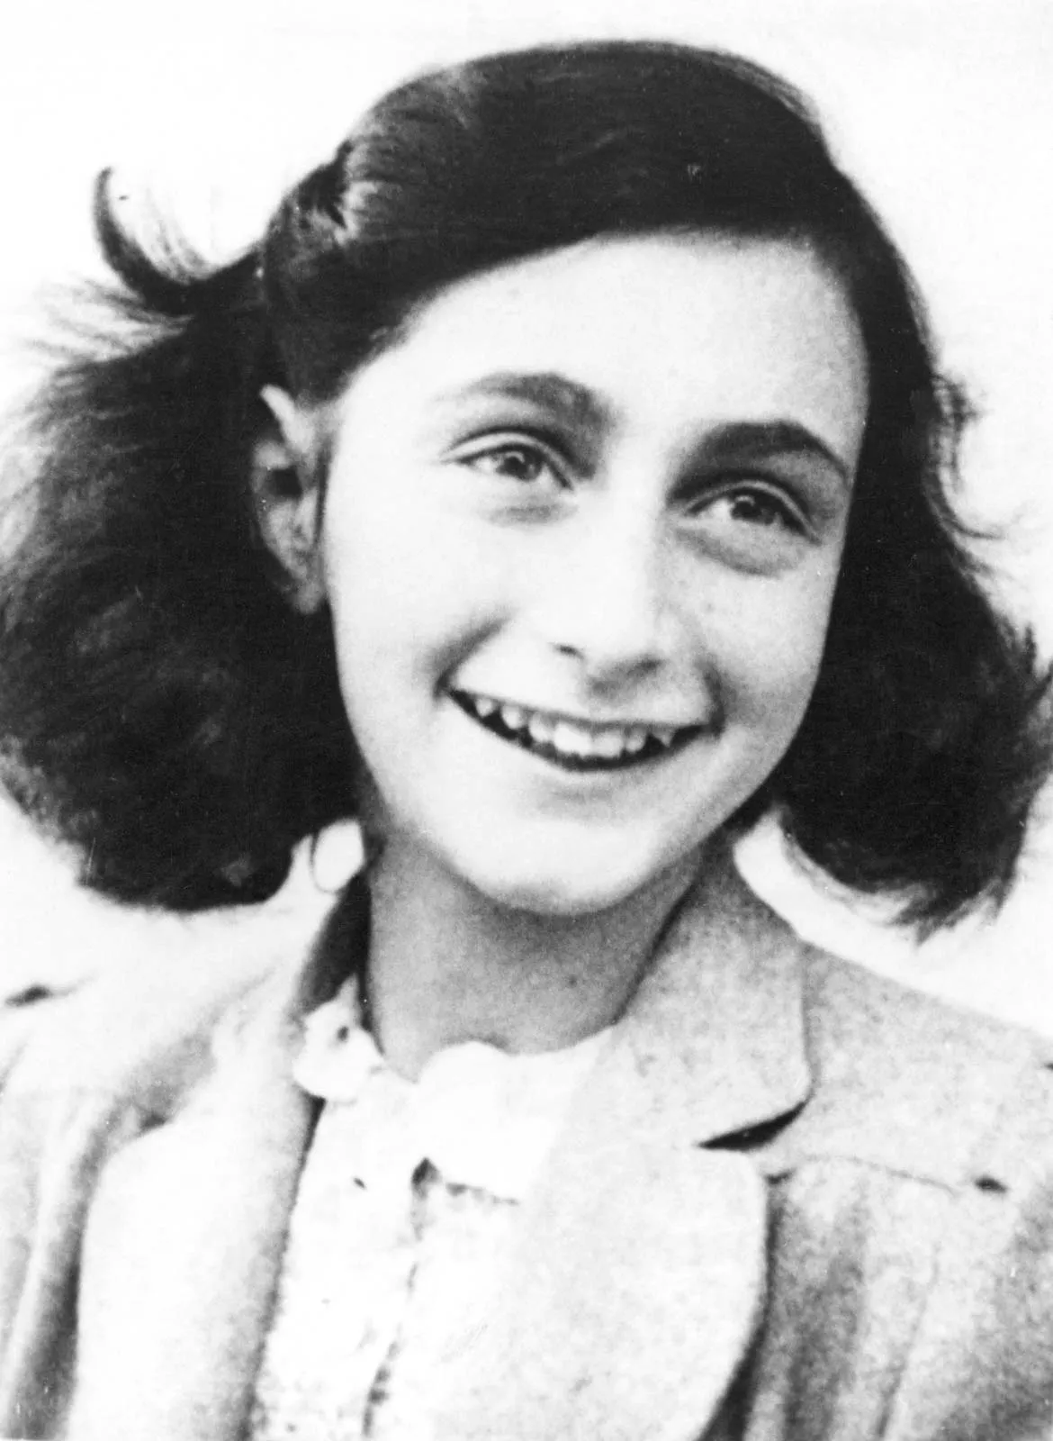
Anne Frank
What do we already know about Anne Frank?
Evie

Slide 6
Evie
Anne Frank, a Jewish teenager, wrote a diary of her family's two years in hiding (1942–44) during the German occupation of the Netherlands in World War II, and the book—which was first published in 1947, two years after Anne's death in a concentration camp.
She showed courage and perseverance by staying in hiding for two years straight and trying to have positive thoughts in the concentration camp

Slide 7
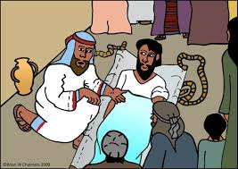
Bible story
Jake
https://www.google.com/search?q=paralysed+man+bible+story+you&rlz=1C1GCEA_enGB1117&oq=paralysed+man+bible+story+you&gs_lcrp=EgZjaHJvbWUyBggAEEUYOTIHCAEQIRigATIHCAIQIRigAdIBCDcyODdqMGoxqAIAsAIA&sourceid=chrome&ie=UTF-8#fpstate=ive&vld=cid:e68c2977,vid:8cmppSIQUX4,st:0

Slide 8

Questions about the Bible story…
How did the paralysed man’s friends show perseverance?
When have you ever shown perseverance? (Hands up)

Slide 9

Let us pray
Cora and Jake

Slide 10
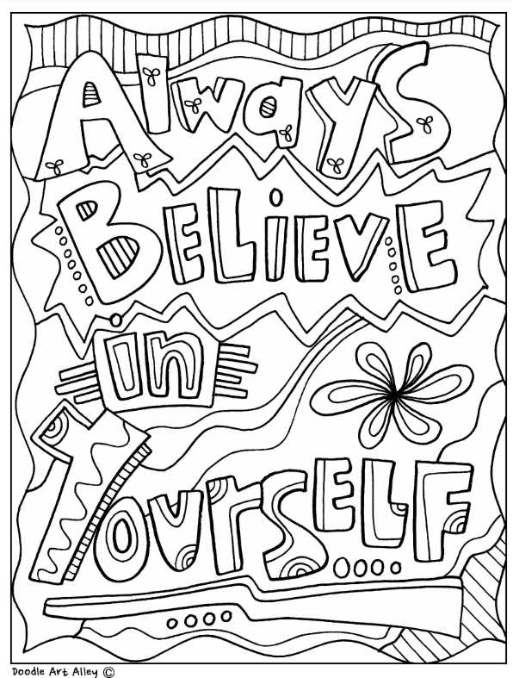

What does the Bible say?
Be strong and courageous. Do not be afraid or terrified because of them, for the LORD your God goes with you; he will never leave you nor forsake you.
Evie

Slide 11
Be strong and courageous. Do not be afraid or terrified because of them, for the LORD your God goes with you; he will never leave you nor forsake you. Deuteronomy 31 verse 6
Be strong and courageous. Do not be afraid or terrified because of them, for the LORD your God goes with you; he will never leave you nor forsake you. Deuteronomy 31 verse 6

