Slide 1


Welcome to Year 5!

Slide 2


Slide 3

We have codes of conduct for Governors, staff and parents and expect all members of our school community to abide by these.
Our School Vision:

Slide 4
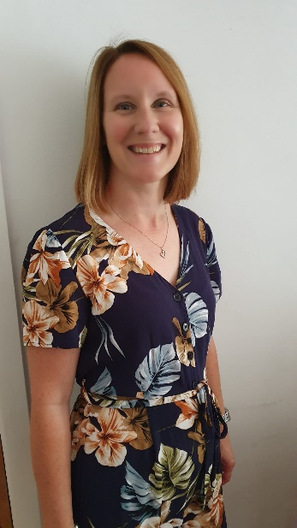
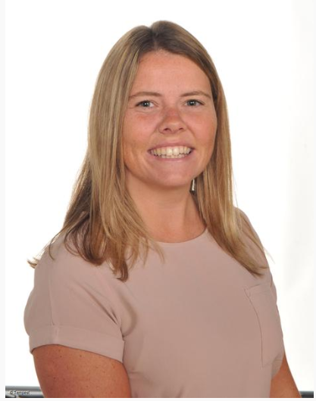
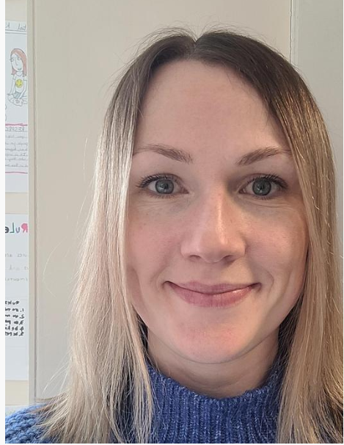
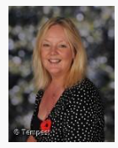
Who will be teaching you?
Mrs Cooper Mon- Tues
RE
P.E
Maths
English
Mrs Ibison Weds- Fri
Science
Computing
Maths
English
Art
P.E
Miss Samuel
French, Music PSCHE
Mrs Westby
Teaching Assistant

Slide 5
School website and how to contact us
We will be using and updating our school website and class page frequently over the year. Please keep up to date of any announcements. https://www.stphilipssouthport.com/
Contact details are on the homepage so if you are needing to get in contact with school-
head@sps.sefton.school
admin@sps.sefton.school
coopere@sps.sefton.school
ibisonm@sps.sefton.school
Mrs Edward says please be respectful of teachers work life balance. Emails should be proportionate and at sensible times.
Parent Whatsapp use should be respectful of all members of the school community.
Staff are not able to have lengthy conversations at the start of the school day and any more than a brief chat at the end of the day needs to be a planned appointment.
Mrs Edward is usually on the path at the start and end of each day if you need a quick word.

Slide 6

Medical
Any medication updates – please let us know of any changes
If your child needs any prescribed medication, a medical form needs to be filled in at the office before we are able to administer it.
Thank you

Slide 7


Housekeeping!
Please name all clothing
PE is on Thursday and Friday afternoons- no earrings
Please make sure your child has a water bottle each day
Healthy snacks can be brought in for Junior morning break time – fruit, vegetable sticks, cereal bars (no sweets or nuts please).
Infants receive a piece of fruit each day
Swimming will be after Christmas.

Slide 8
Uniform
BOYS WINTER UNIFORM
GREY TROUSERS (NO OTHER COLOUR)
WHITE SHIRT
NAVY LONG SLEEVED JUMPER
SCHOOL TIE
DARK COLOURED SCHOOL SHOES – not trainers
DARK SOCKS
GIRLS WINTER UNIFORM
NAVY SKIRT OR PINAFORE DRESS
WHITE BLOUSE
NAVY LONG SLEEVED CARDIGAN
SCHOOL TIE
NAVY TIGHTS / NAVY OR WHITE SOCKS
DARK COLOURED SCHOOL SHOES – not trainers
Find the full uniform
list on our website

Slide 9
Attendance and punctuality
It is crucial for children to arrive on time to school. Children’s activities start at 8:45 which is either spellings and grammar or Maths key skills. If they are late- they are missing learning time.
If your child is being collected at the end of the day, please arrive on time for 3:20pm.
Please do not allow children on the adventure playground before and after the school day.
Please note that no term time holidays will be authorised and fines will be in place.

Slide 10


Slide 11
Attendance…
First Response
If your child is absent you must contact the school office by telephone or email to report your child's absence giving clear details of the reason for absence. Failure to do so means that our First Response kicks in and if we cannot get hold of you and we are unable to make contact with you via your emergency contact details, it might be necessary for a senior leader to come to your house!
This is part of our safeguarding response to ensure everyone is safe and well. As you can imagine, a home visit takes up a lot of time and it is usually the case that families have forgotten to call us.
TERM TIME HOLIDAYS ARE NEVER AUTHORISED. Families may be eligible for a fine from the Local Authority.

Slide 12
Cashless school payments
https://schoolgateway.co.uk/help/
All payments are made electronically on our payment and booking system.

Slide 13
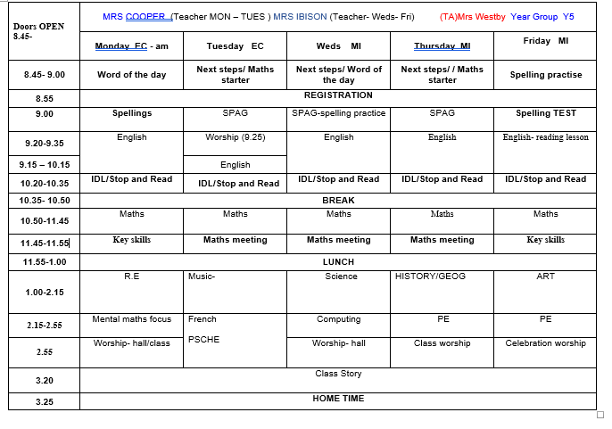
Class Timetable

Slide 14
Curriculum
Curriculum map/newsletter is on our website.

Slide 15
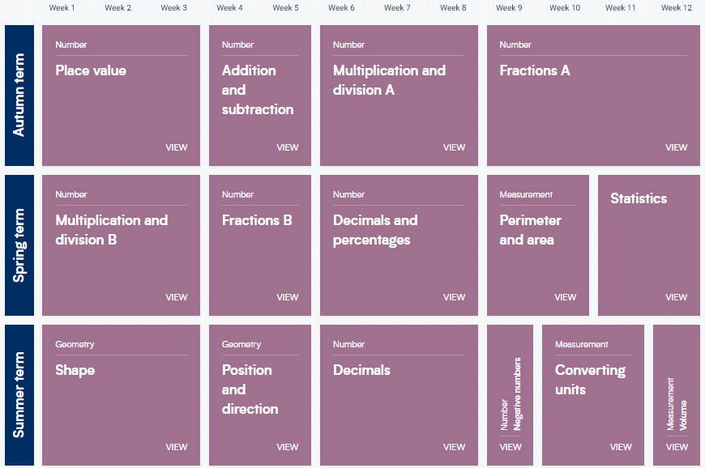
White Rose resources – Maths mastery

Slide 16
Subject ladders
We have English ladders for you to download on our website. Please read them and refer to them throughout the year as they show the expectations for your child in Year 5.
Pre-teaching / revision resources
https://st-philips-church-of-england-primary-school.secure-primarysite.net/curriculum-34/

Slide 17

Essential Letters and Sounds (ELS) is our chosen DfE validated phonics programme.
Children will experience the joy of language whilst rapidly acquiring the phonics skills they need to become fluent, independent readers and writers.
How do we teach phonics?
We use a simple, consistent approach to teaching phonics
We have mnemonics and rhymes to support learning and recall
We teach phonics every single day from the first days of Reception
Phonics throughout the day to review new sounds and graphemes taught
Lots of opportunities for oral blending - /c/ /oa/ /t/
We teach the ‘code’ for reading, alongside teaching vocabulary

Slide 18

Assessment

Slide 19


Slide 20

Year 5- band 5

Slide 21
Homework
Homework will be given out on a Friday.
Spelling test on the following Friday.
Homework to be given in by Wednesday. Please let us know if any homework is too difficult so we can give a little extra help at school.
Please help your child to learn their spellings and tables each week.

Slide 22

Spellings
We are having a huge emphasis on spellings this year. Children need to be practising their spellings daily and not for a spelling test.
In Year 5, children need to be able to spell words from the Year 3 and 4 curriculum list as well as the Year 5 and 6. They must show they can spell these words correctly in their writing.
Spelling sheet for this half term has been sent home already and is on the class web page.

Slide 23
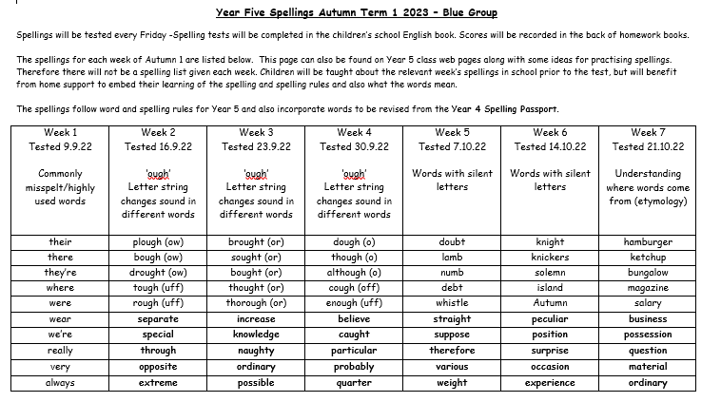

Slide 24
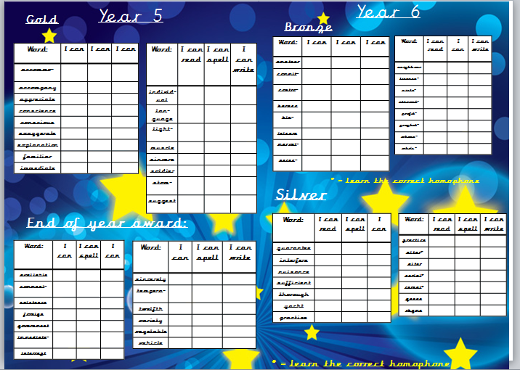

Slide 25



Slide 26
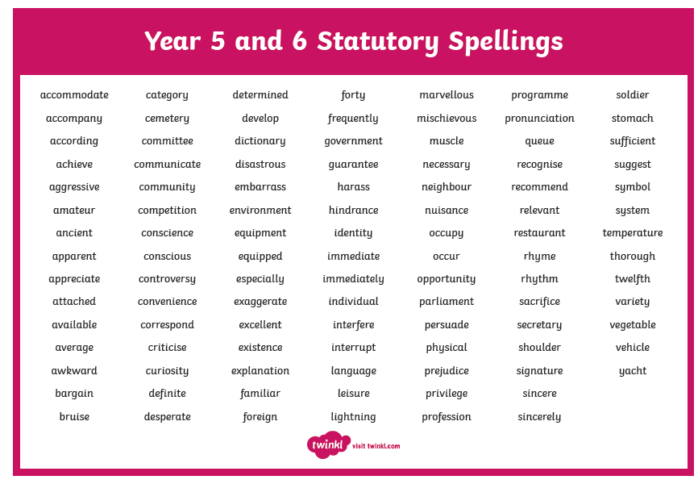

Slide 27


Times tables
As you will be aware, we have the Bronze, Silver and Gold badges in school.
Children must practise their times tables daily. Even if they think they know them- by Year 5 they must be quick to recall them.
There are also various sites to use:
https://www.youtube.com/watch?v=4BLZKOjNKfk

Slide 28
Reading at home:
Reading Journals
Children will be expected to write their own reading comments in their Reading log book each day.
Reading recommenders

Slide 29
ST PHILIP’S CE PRIMARY SUPPORT TRIANGLE
SENDCO - Mrs Klaassen
SEN Support
Targeted Support
Enhanced Quality First,
Quality First – Universal Offer for all
High Needs Funding
EHCP’s
Specialist

Slide 30



Behaviour and
Good To Be Green
Very high expectations
Manners
Greetings
Can do attitudes

Slide 31
Behaviour and
Good To Be Green
10 Green week certificates being given still
Red cards- letter home to parents on a Friday
Yellow cards- miss some of break time.

Slide 32
St Philip’s Standards
Be Ready
Be Respectful
Be Responsible
Fantastic Walking

Slide 33

Fantastic Walking
Walking properly makes you feel great.
We are going to be doing fantastic walking, All THE TIME!
Head up
Arms by your sides
Slow pace.

Slide 34

Walking home
If you would like your children to walk home from school on their own, please could you complete the form explaining the days fully and sign it. This is for the safety of your children as they will be let out at the end of the day by a number of different teachers.
Thanks for your co-operation.

Slide 35
Responsibilities
History Ambassadors
Eco Warriors
Student Council
Worship Warriors
Health Champions
Reading Ambassadors

Slide 36
School Trips…
Liverpool Cathedral and
Princes road synagogue
Local visits to Southport
Crucial Crew
The Atkinson – Ancient Egypt

Slide 37

Parent’s meeting:
Weds 18th October
2pm onwards

Slide 38

Please check your filters

Slide 39


Slide 40


User friendly guides on all areas of ICT, gaming, social media and top tips for online safety. Check all age reccomendations on games and Apps.
To sign up please download the app, chose parent as your role and make use of the advice and support offered plus the online training support.

Slide 41

Volunteers are very welcome!
Safer Recruitment Checks will be completed.

Slide 42

Check website for information:
http://www.stphilipssouthport.com/
and Twitter!

Slide 43

Any questions?

