Slide 1

Welcome
Reception Skills Workshop

Slide 2


Phonics
ELS Phonics
What is phonics?
All words are made up of sounds. We have 26 letters in our alphabet but the English language is made up of 42 sounds.
c/a/t sh/ee/p ch/i/ck phonemes
We use ELS Phonics to introduce and teach phonics. Fun, interactive, multi-sensory with each sound introduced through a rhyme.
Grapheme tiles – what can you do at home?
Please do look at the videos on the school website !
We need to know our sounds not just our letter names.

Slide 3
Reading
Why is reading so important?
Without knowing our sounds we are going to make little progress with reading.
Please make sure that you practice the sounds at home to enable children to progress in reading.
Expectation for reading – at least 3 times a week, Please complete the diary every time !

Slide 4
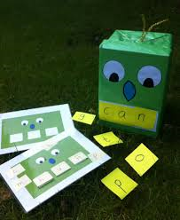

Daily Phonics
First sounds
s a t p i n
Blend
sat pin nip sit pit pat pip sip
Robot arms, blending hands – what are they?
Please also practice the words written in the diary – these are high frequency words ( can’t be blended ).

Slide 5


Maths
NUMBER
Strong focus on number and developing the children’s understanding of the patterns that underpin early number.
Numicon

Slide 6
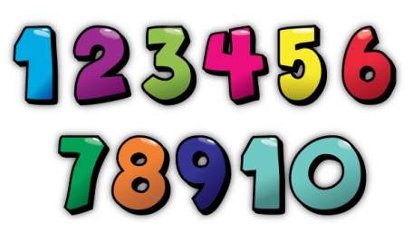

Maths
Counting groups of objects accurately
Rote counting in order
Starting at 0 and 1 but other numbers too!
3 to 19 or 9 to 21
Equally important is counting backwards
20,19,18,17
Emphasising teens

Slide 7
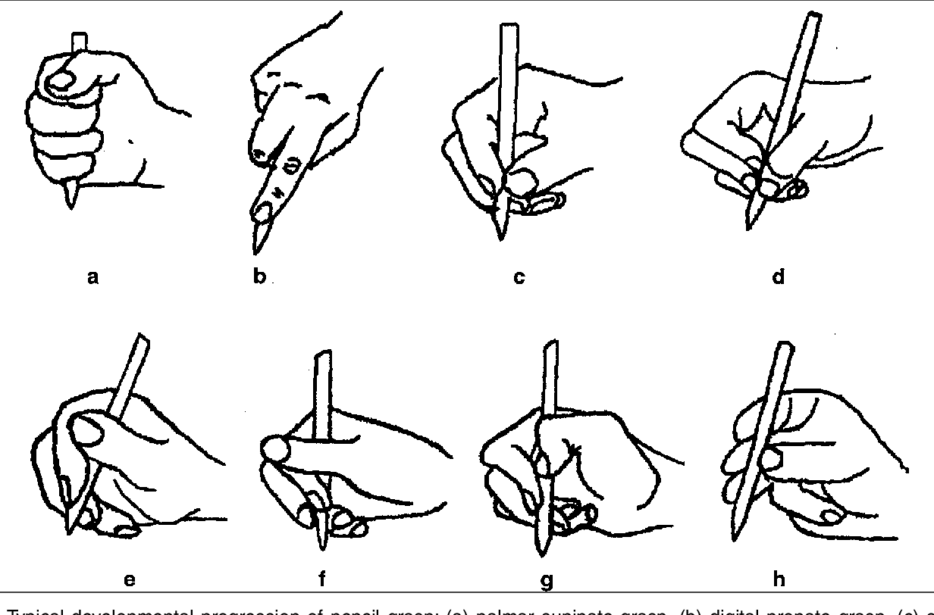
Writing
Please make sure that you are discouraging palmer grip or anything similar.
Pencil grips
Lots of writing at home
Tracing
Independent writing
Malleable play
Children should be at stage C or D when coming to school .

Slide 8
Homework
What is the expectation for homework?
Please get your child to complete homework INDEPENDENTLY.
Homework should be completed.

Slide 9
Any questions?

