Slide 1

2025 SATS Briefing for KS2 Parents

Slide 2



What does SATs stand for?
Statutory Assessment Tasks and Tests (also includes Teacher Assessment)
At the end of Key Stage 2 (at age 11)

Slide 3

What level should children be at?
After SATS you will be informed if your child is working:
above expected level,
at expected level,
below expected level.

Slide 4
How are the children assessed?
There are two sorts of assessments:
A) Teacher assessments
B) Tests
For children who are unable to access the tests, the only statutory assessment is teacher assessment and those children do not take the tests.

Slide 5
What does teacher assessment involve and is it different from testing?
Teacher assessment draws together everything the teacher or teachers know about a child, including normal class lessons, observations, marked work and school assessments.
Teacher assessment is not a ‘snapshot’ like tests and is therefore more reliable.
Due to the above, there can be a difference between teacher assessment results and test levels.

Slide 6
Teacher Assessments:
English:
Speaking and Listening
Reading
Writing
Maths:
Using and Applying
Number and Algebra
Shape, Space and Measures
Handling Data

Slide 7
WHAT WILL BE ASSESSED?
ASSESSED BY TESTS (marked externally)
READING
SPaG
MATHS
ONE PAPER
Reading booklet and associated answer booklet.
Paper 1, short answer questions.
Paper 2, spelling.
Paper 1, arithmetic
Paper 2, reasoning
Paper 3, reasoning
* No Calculator Paper
CONTINUOUS TEACHER ASSESSMENT
WRITING
CONTINUOUS TEACHER ASSESSMENT
SCIENCE

Slide 8
Teacher Assessments: (cont.)
Science:
Scientific Enquiry
Life Processes
Materials and their Properties
Physical Processes

Slide 9
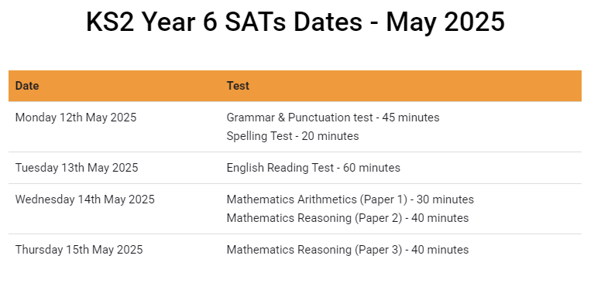
Please avoid taking your child out of school during this time and in the weeks leading up to the tests.
This will be a busy term!

Slide 10

How is SATs week organised?
A timetable is issued to school, telling us on which days tests must be administered.
We can determine at what time tests begin.
Tests are completed in classrooms, with any displays that may help covered over.
The LA monitor 10% of schools per year.
Children are divided into groups for test administration to ensure they are properly supported and feel secure.

Slide 11

What do the tests involve?

Slide 12



ENGLISH

Slide 13
Reading Comprehension
The texts in the English reading booklet will not be linked by a theme. The booklet will contain three or four different texts.
Instead of being given 15 minutes reading time and 45 minutes to answer the questions, children will have a total of one hour to read the texts and complete the questions at their own pace.

Slide 14
The reading answer booklet will comprise of approximately 35 to 40 questions (totalling 50 marks). The questions are:
shorter, closed response items (such as multiple choice and matching questions)
shorter, open response items
longer, open response items that require children to explain and comment on the texts in order to demonstrate a full understanding.
Questions are worth 1, 2 or 3 marks.

Slide 15
READING SKILLS ASSESSED
The most crucial aspects of reading at the end of Key Stage 2 are:-
Accuracy (decoding familiar and unfamiliar words correctly)
Fluency (speed and confidence)
Comprehension (drawing meaning from text)
Understanding, describing, selecting or retrieving information from the texts.
Inferring or interpreting information from texts.
Identifying and commenting on the structure and organisation of texts.
Explaining and commenting on the writers’ use of language.
Identifying and commenting on writers’ purposes and viewpoints, and the overall effect of the text on the reader.

Slide 16
English grammar, punctuation and spelling
The test will assess children’s abilities in the following technical aspects of English:
grammar;
punctuation;
spelling;
vocabulary.

Slide 17
English – Grammar Punctuation and Spelling
PAPER 1
45 minutes to complete the test, answering grammar and punctuation questions in the test paper.
PAPER 2
Spelling Test (20 words)
(marked externally)

Slide 18
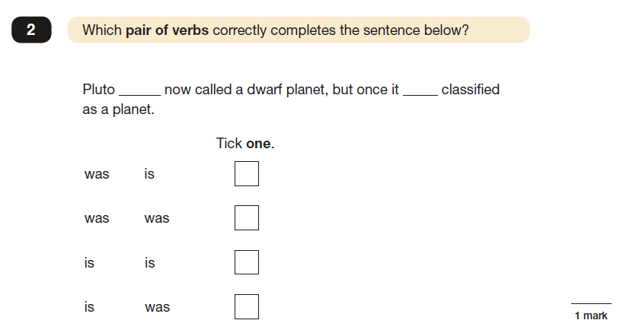
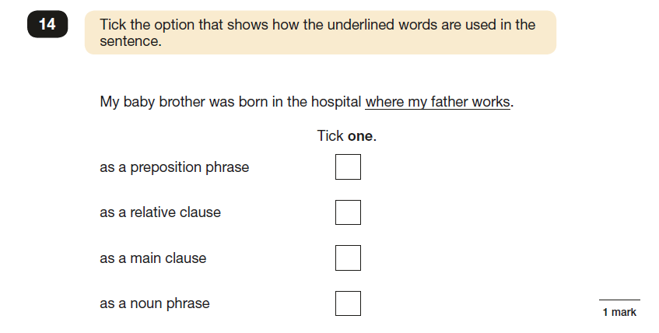
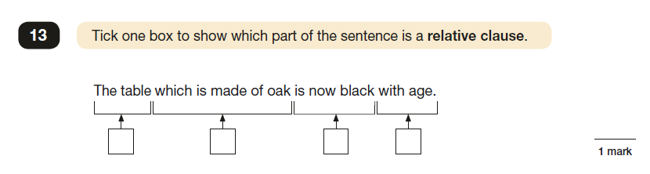
English Grammar, Punctuation and Spelling
Sample questions

Slide 19

MATHS
Maths test consists of:
two reasoning test papers, Paper 2 and Paper 3, each lasting 40 minutes
arithmetic test paper 1, lasting 30 minutes
Children’s marks from all three tests are aggregated to calculate their overall mathematics score/level.
Teachers may read questions in both written papers to pupils if asked.

Slide 20
MATHS
MATHS (marked externally)
PAPER 1
Arithmetic - lasts for 30 minutes.
PAPER 2
Reasoning - lasts for 40 minutes.
PAPER 3
Reasoning - lasts for 40 minutes.
NO CALCULATORS are allowed.

Slide 21
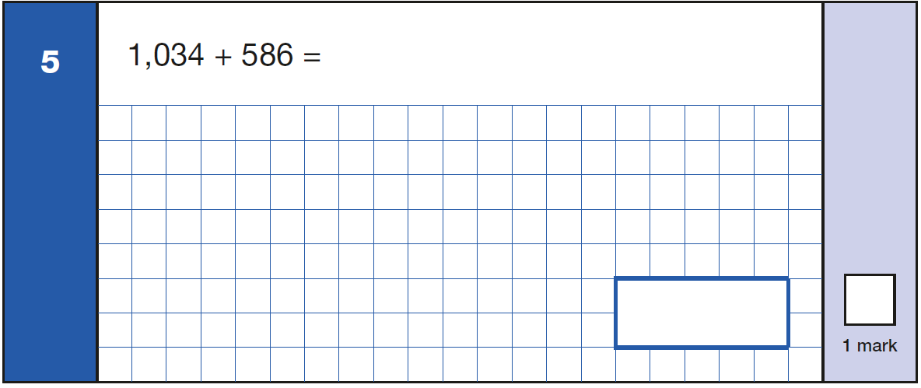
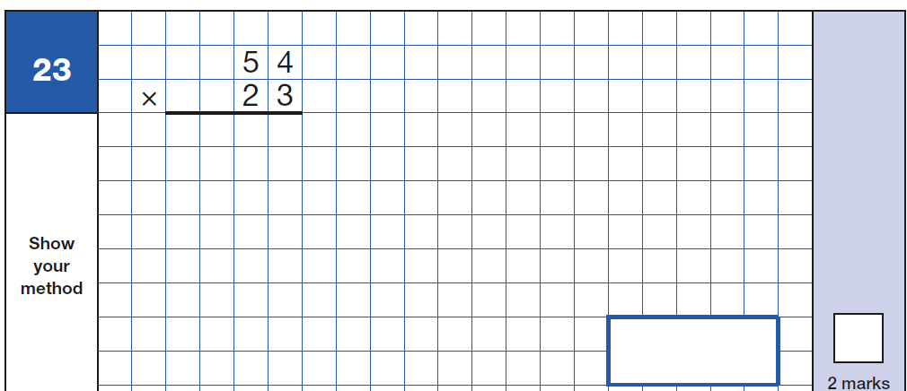
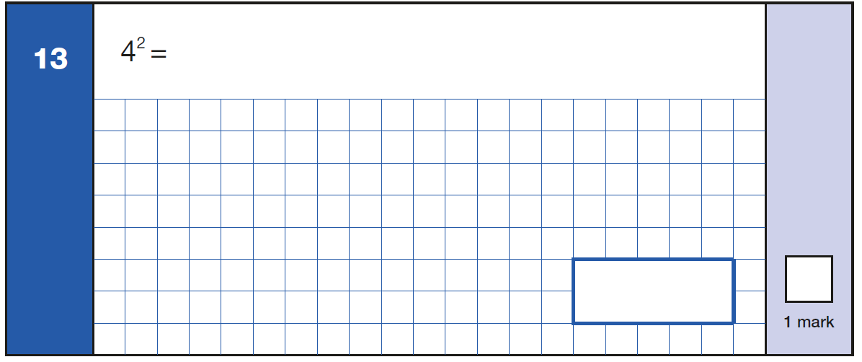
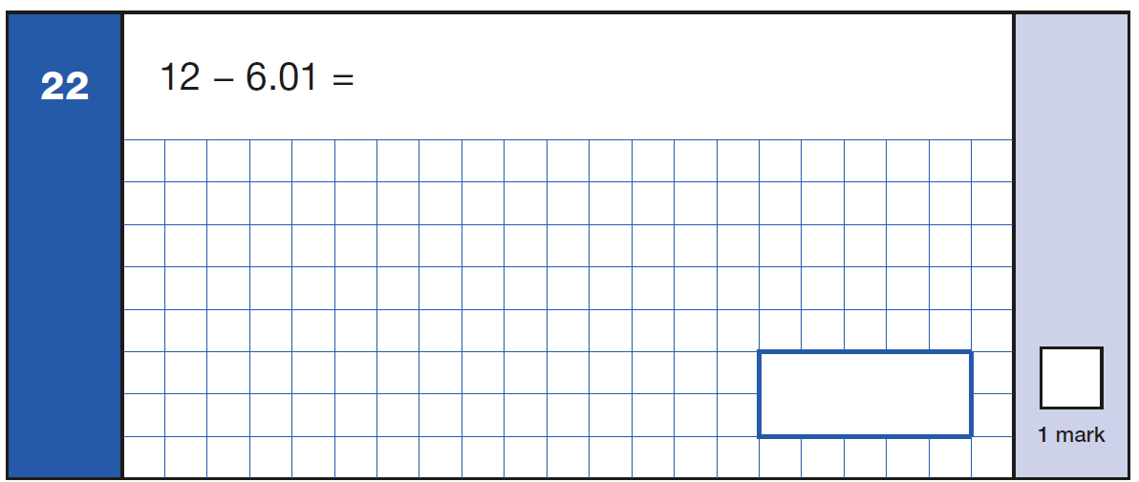
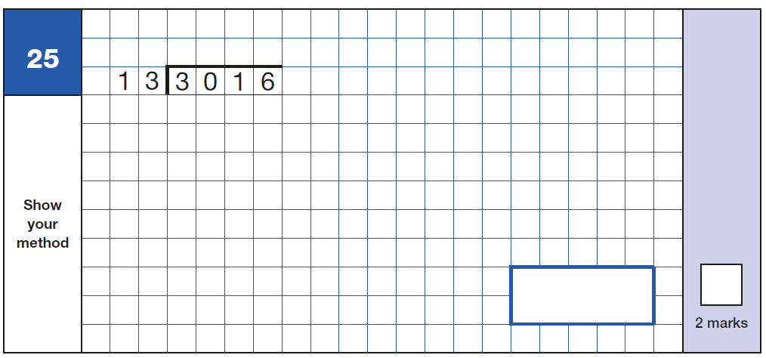
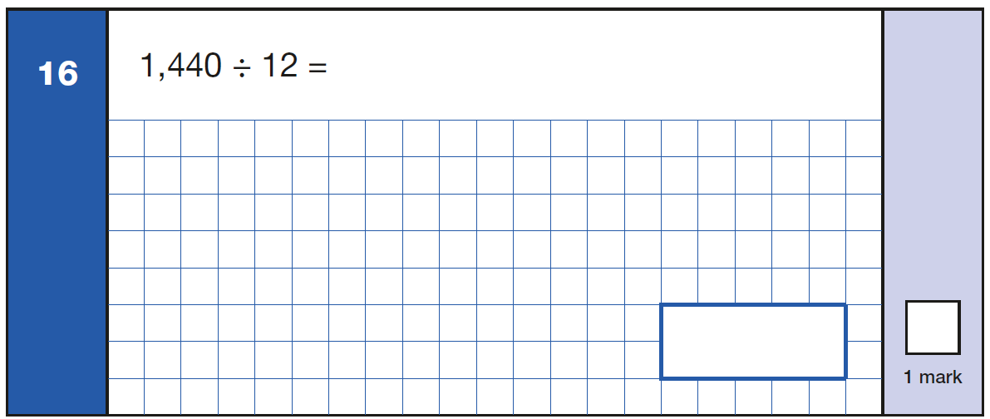
Sample arithmetic questions

Slide 22
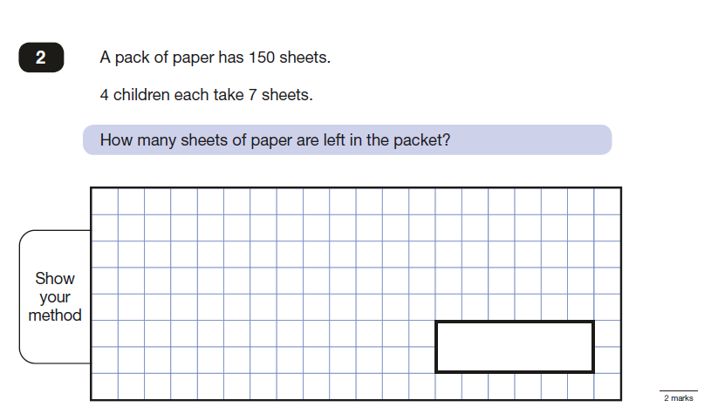
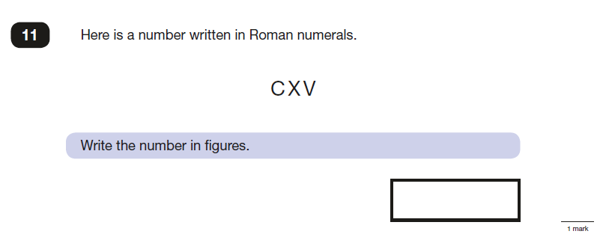
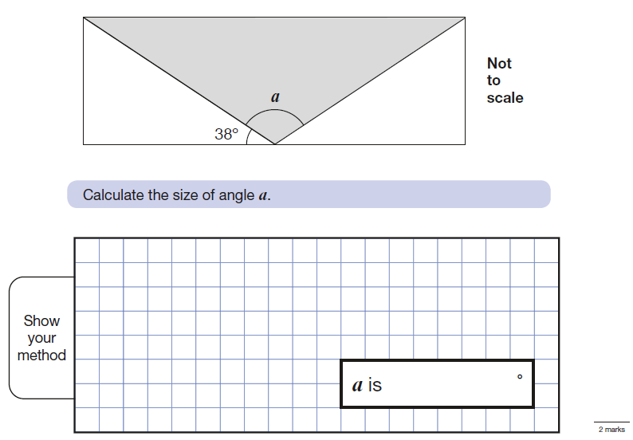
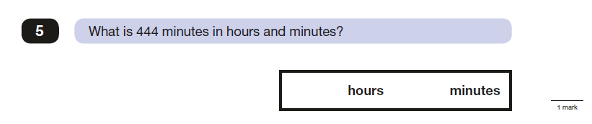
Sample reasoning questions

Slide 23
WRITING
There is a greater focus on the progress children make throughout the school year, as opposed to a test-day snapshot of what they know.
Teachers will assess children’s writing composition. Children’s results for English writing will be a judgement of their work throughout Year 6.
Children's grammar, punctuation and spelling skills will be assessed as part of their writing, but their creativity and writing style will also be evaluated.
Schools will moderate their judgements with other local schools and may be moderated by their Local Authorities too.

Slide 24

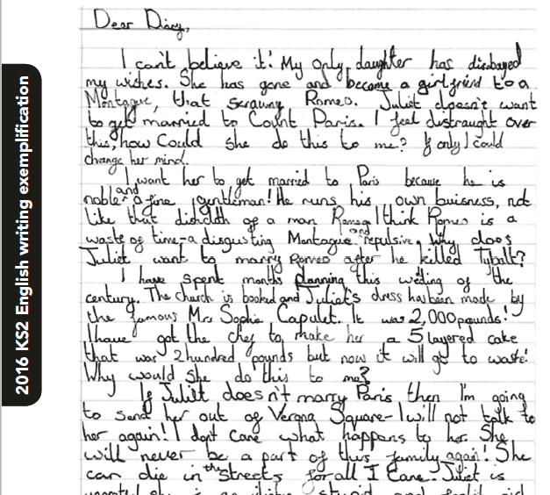
What is the
‘Expected Standard’ in writing?
Children are expected to be able to write using a range of different genres.

Slide 25
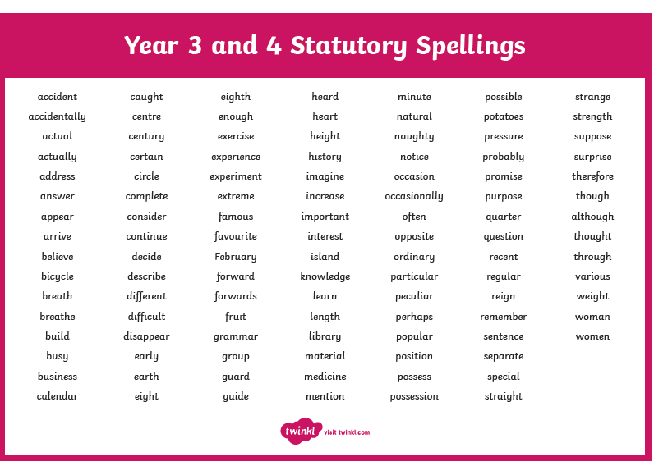

Slide 26
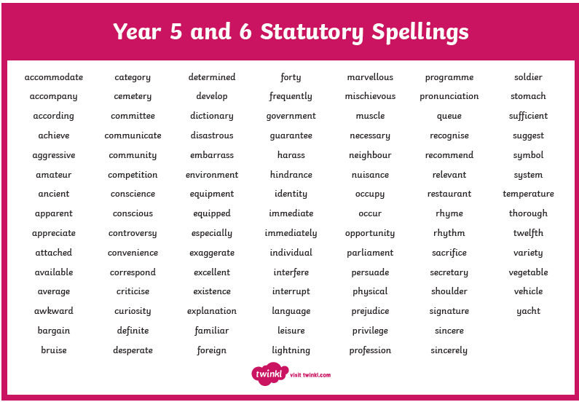

Slide 27

What help can children have?
In the reading test, children must read the text and questions by themselves, but may have help recording their answers, if this is done in a normal classroom situation.
In maths, papers 2 and 3, teachers can read questions to any child who asks.
Also in the SPAG test, children can ask for questions read to them but nothing can be explained.

Slide 28
How are we preparing?
Teaching the learning objectives set out in the new National Curriculum.
Continuous Assessment
Focused Maths Lessons
Focused Spelling Lessons
Focused SPaG Lessons (Spelling, Punctuation & Grammar)
Focused and Independent Reading
Writing Assessments carried out regularly
Practising previous SATS papers
Teaching ‘test techniques’ and vocabulary
Home Learning to support teaching & learning in school
Target Setting
Mentoring and support
Keeping up to date with information provided by the DfE
Targeted interventions, booster sessions,
IDL in school and at home

Slide 29
SCALED SCORES
Tests at the end of KS2 will report in scaled scores.
The ‘expected standard’ will always be set at 100.
Raw scores in the test will be converted to scaled scores.
The ‘raw score’ that equates to 100 might be different each year.
Pupils who score 100 or more will have met the ‘expected standard’.
Pupils who score below 100 will not have met the ‘expected standard’.
100

Slide 30
Reading, SPAG and maths tests are all externally marked.
Test results are returned to the school in July and will be reported, along with teacher assessments, to parents by the end of the year.
Secondary schools also use this data to support their transition programmes for moving in to Year 7.
Reporting Levels

Slide 31

How can parents help?
Supporting regular and thorough home learning.
Fun websites:
MyMaths/BBC Bitesize.
Corbett Maths
Oak Academy
Purplemash
Not putting children under too much pressure.
Ensuring children arrive for tests:
- in good time
- with equipment –water bottle, snack, etc.,
- having had breakfast
- having gone to bed at a reasonable time!

