Slide 1
Year 6 Residential
Anderton centre
Mon 14th- Weds 16th July
https://andertoncentre.co.uk/

Slide 2
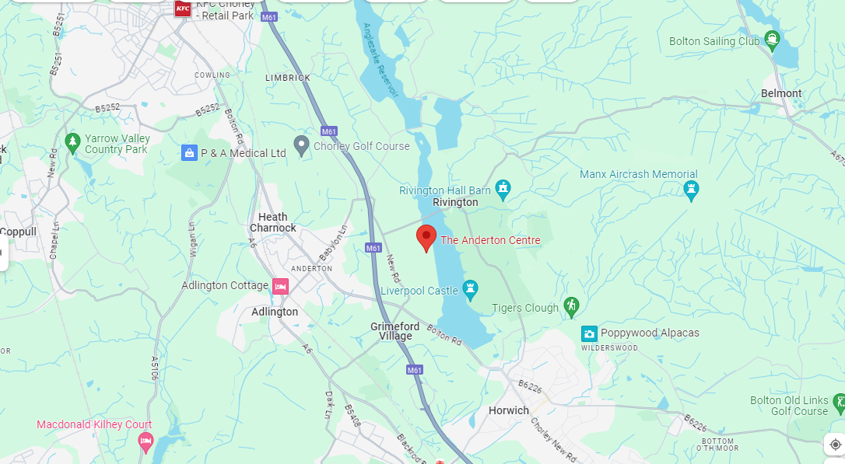
Where is the Anderton centre?

Slide 3
Monday 14th July
Please drop the children at school at 9 am with their luggage and packed lunch for the Mon. We will leave school at 12 to arrive at the centre by 1 pm.
They will come into the hall- be given a luggage label to tie onto their bag, hand in any named medication and money (named envelope).
Once they have dropped their luggage in the hall they will go to their Year 6 classroom for the morning.

Slide 4
Who is going?
Mrs Cooper
Mrs Edward/ Mrs Klaassen
Mr Highton
Children are in 3 groups for activities.

Slide 5
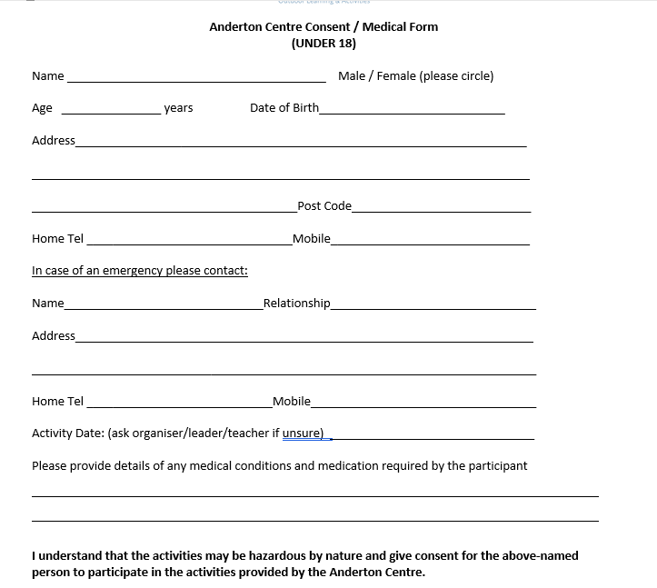
Medical forms
We must have medical forms (Parts 1 and 2) for every child- these have been sent home already.
Medicines include travel tablets.

Slide 6
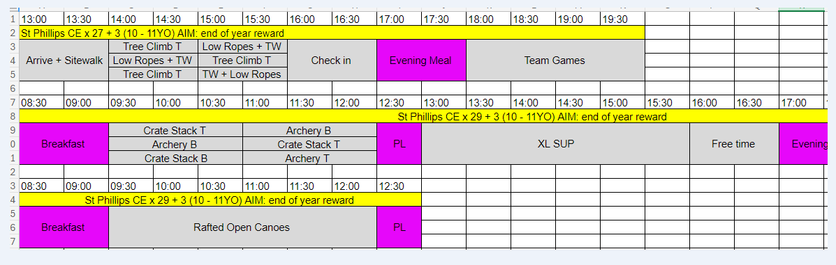
Activities- example

Slide 7
Money
There is a small tuck shop on site- the children can bring up to £10 to spend. Please send in a named envelope and give in on the Monday morning .
This will be kept safe by staff until it is our turn to use the shop.

Slide 8
Food
There is a choice each day out of two/three options
Please do not pack any extra snacks in their bags.
The only food they need is their packed lunch for the first day- please ensure they have a named refillable water
bottle with them.

Slide 9
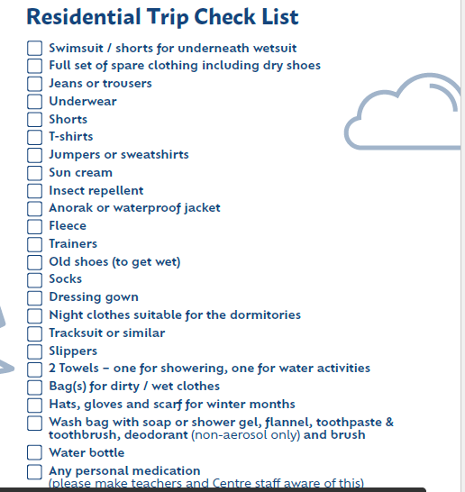
Kit list
Please name everything!
Bin bags! Wet shoes

Slide 10
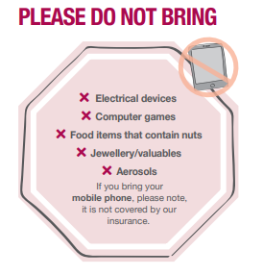
No phones are allowed! Any problems we will contact you.
We will try and upload photos daily to the class website so please check here.

Slide 11
Rooms and groups
Children will be picking two children to be in room/group with- they will definitely be with one of them. They will not know groups or rooms until we get there.
The majority of the bedrooms sleep between 4 to 6 in bunk beds in each room. Sheets, duvets and pillows are provided. All rooms are en-suite

Slide 12

Weds 16th July
The coach will leave the Anderton centre at approximately 1.15 pm to travel back to school.
Any delays we will send a message out- we aim to be back by 2.30 pm. You can collect your child then or leave them in school til the end of the normal school day.

Slide 13


